Slide 1
DOE/EM Waste Management Update
Low Level Radioactive Waste Forum
Amie Robinson
Office of Waste Disposal
APRIL 2025

Slide 2
EM Organization Chart

Slide 3
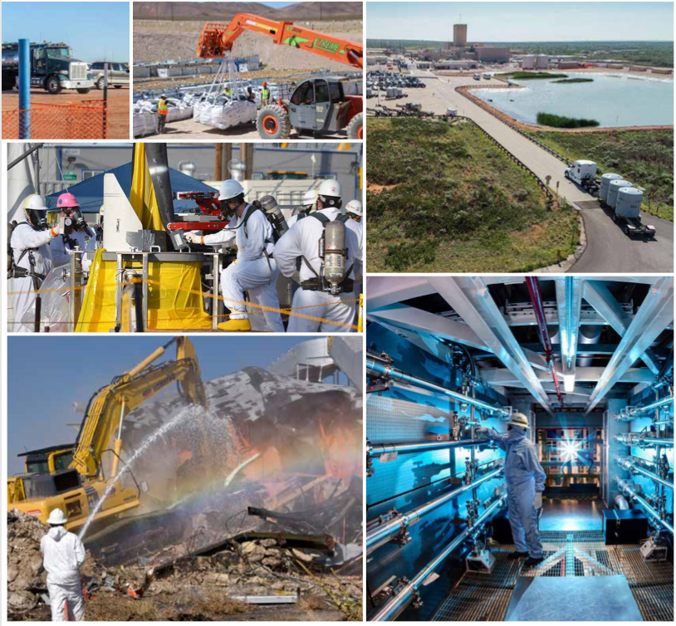
EM MISSION
To complete the safe cleanup of the environmental legacy brought about from decades of nuclear weapons development and government-sponsored nuclear energy research.
EM's priority is to ensure the safety and health of the public and drive down environmental risks while supporting U.S. jobs, U.S. energy and U.S. security.
Notes:
The United States has entrusted EM with the largest environmental cleanup effort in the world – addressing the substantial environmental liability from decades of nuclear weapons production and nuclear energy research.
EM is transforming environmental liabilities into opportunities for new jobs and innovation, strong economies, affordable reliable American energy and national security.
EM utilizes the best of American industry to address the environmental legacy stemming from past national security and nuclear research programs.
EM delivers results in an efficient manner by driving innovation in environmental cleanup, focusing on priorities and reining in costs/schedules all without sacrificing safety or effectiveness.
The continuous success of the mission is dependent upon the people of EM. To that end, EM consists of a highly skilled workforce on the ground today and fosters a pipeline of talent to fill the good paying American jobs of tomorrow.
The following pictures show. Photo Captions:
Moving waste that has been retried from burial grounds and placed in new drums for transport to above ground storage until it is disposed of at a compliant landfill or WIPP.
Tank waste at ORP
Hanford Plutonium Finishing Plant – a worker holds a plutonium button, which the size of a hockey puck during Cold War operations
K- area at the Savannah River Site where plutonium is now stored
A chemical separation facility at Hanford
Hanford U plant – historical photo

Slide 4
DOE Radioactive Waste
Low-Level Radioactive Waste: is waste that is not high-level radioactive waste, spent fuel, transuranic waste, by-product material , or naturally occurring radioactive material.
Mixed Waste: is waste that contains both source, special nuclear, or by-product material subject to the Atomic Energy Act of 1954, and a hazardous component subject to the Resource Conservation and Recovery Act.
Transuranic Waste: is waste containing more than 100 nanocuries (3700 becquerels) of alpha-emitting transuranic isotopes per gram of waste, with half-lives greater than 20 years, except for: (1) high-level radioactive waste; (2) waste that the Secretary of Energy has determined, with the concurrence of the Administrator of EPA, does not need the degree of isolation required by 40 CFR Part 191 disposal regulations; or (3) waste that the NRC has approved for disposal on a case-by-case basis in accordance with 10 CFR Part 61.
Notes:
EM follows refined directives specific to DOE radioactive wastes which includes LLW, MW, TRU, and HLW (which will be discussed further later.) The directive system relies on a tiered approach to treatment, storage and disposal.
Some central concepts include:
the case of low-level waste, disposed of at or near the site where the waste is generated, if practical, or at another DOE facility. Only if DOE capabilities are not practical or cost effective, then will DOE go outside of existing DOE facilities or resources. In essence, a core value of DOE is
Waste disposal is always fully protective of worker and public health and the environment and in compliance with applicable Federal, state, and local requirements, with necessary permit(s), license(s), and approval(s) for the specific waste.

Slide 5
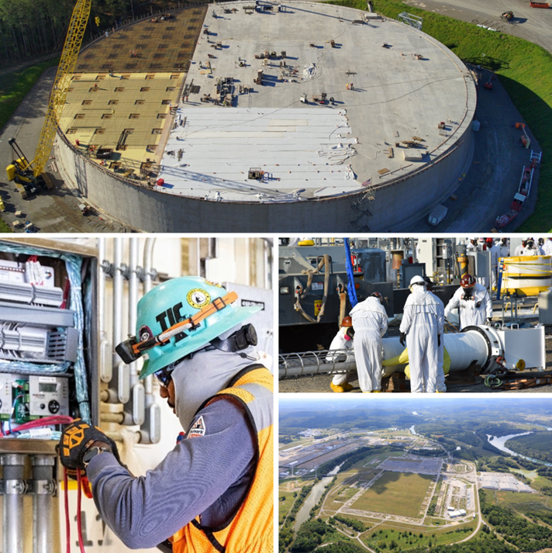
EM Key Mission Elements
Tank Waste
Special Nuclear Material and Spent Fuel
Radioactive Waste Disposal
Soil and Groundwater Remediation
Facility Deactivation and Decommissioning
Notes:
The EM Mission has the following Five (5) elements shown in the above graphic with the following recent impressive numbers behind our clean up activities:
more than 90 million gallons of radioactive waste primarily resulting from the reprocessing of SNF stored in underground tanks at Hanford, and SRS and in above ground bin-sets at INL
More than 700,000 metric tons of depleted uranium
Remediating millions of cubic meters of contaminated soil
Treating billions of gallons of contaminated groundwater
Dispositioning more than 5,000 contaminated facilities

Slide 6
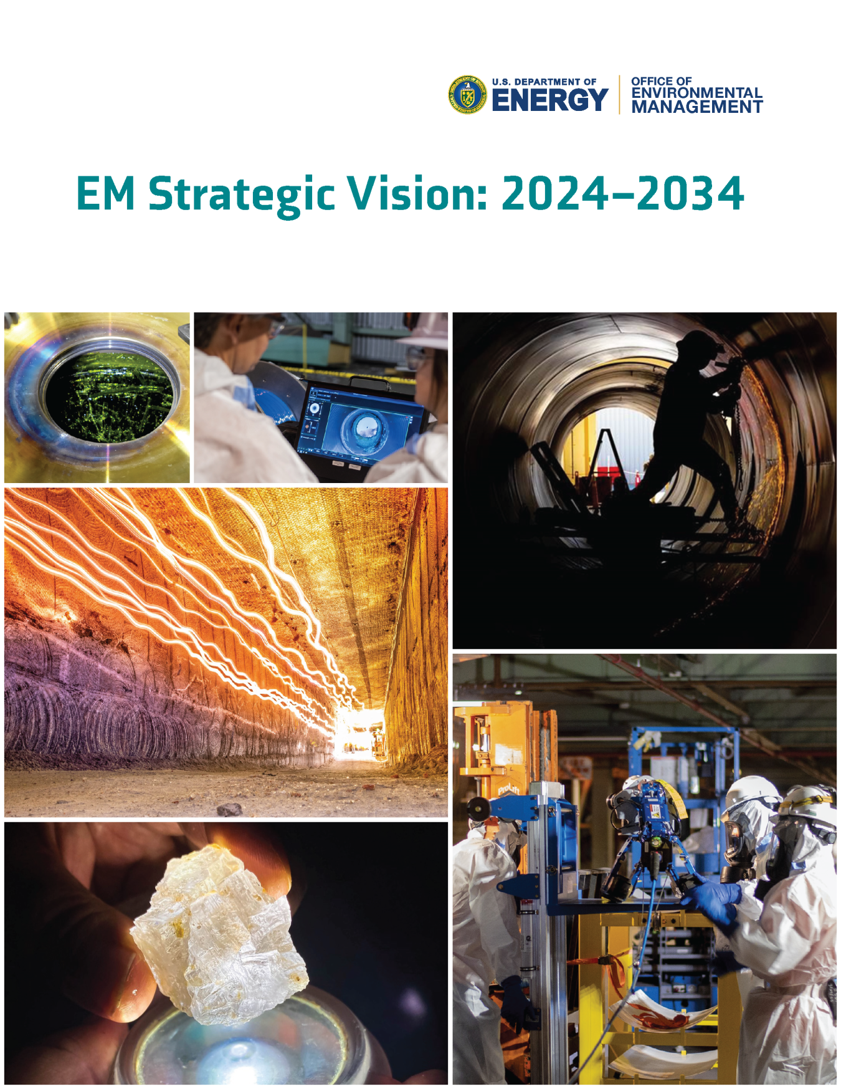
EM Strategic Vision 2024-2034
EM’s Strategic Vision for 2024-2034 provides a clear and concise roadmap to guide our planning and priorities.
In 2020 EM issued our first Strategic Vision, chartering a path for the coming decade
The 2020 vision discussed planned accomplishments, including major skyline changes and game changing tank waste treatment capabilities, as well as strategic initiatives to best position EM for the future.
Find it at: https://www.energy.gov/em/em-strategic-vision
Notes:
One key area of good performance is our watchful eye on and upkeep on our strategic vision for environmental cleanup. This strategic vision keeps the entire of EM on a clear path to guide our planning and priorities for the next 10 years. It is now a fixture since 2020.
Along with the Annual Priorities and associated score card and the EM Program Plan, the EM strategic vision rounds out a trio of planning tools to guide EM in safely executing the mission, fulfilling cleanup obligations and making steady progress across the EM enterprise
Based on years of successful performance and progress, the strategic vision outline has been integral to EM’s significant achievements by centering and honing the entire organization’s tangible risk reduction, thereby reducing environmental liability.

Slide 7
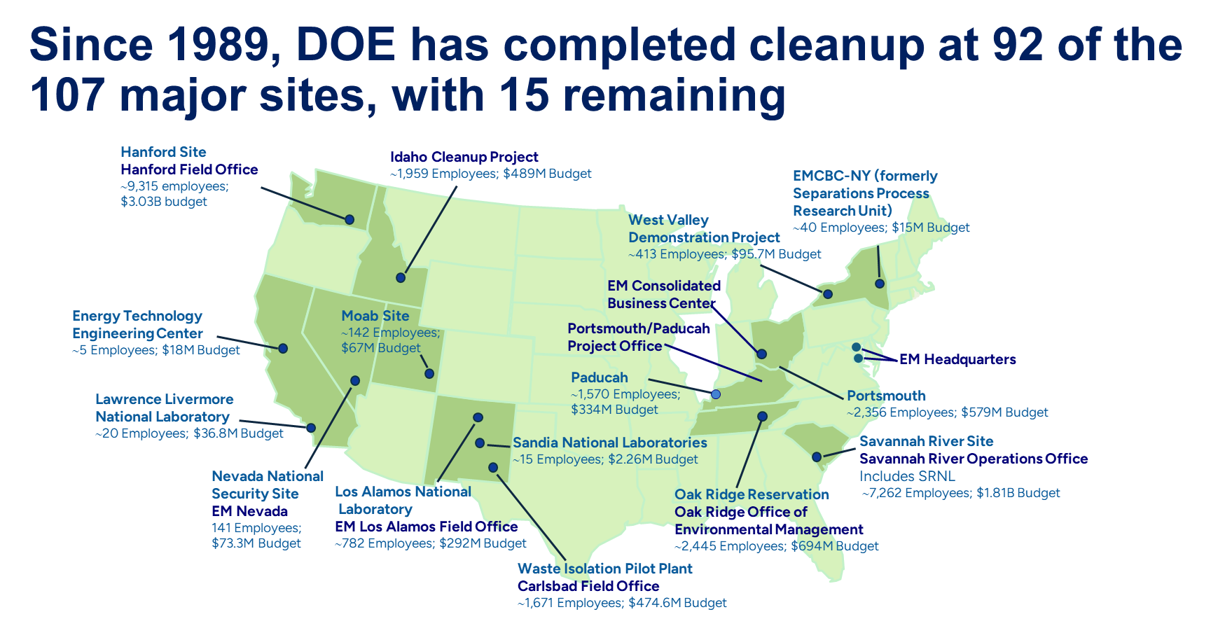
A Proven Record of Cleanup
Since 1989, DOE has completed its cleanup mission at 92 of the 107 major nuclear weapons and nuclear research sites.
Notes:
Thus, in the last 35 years, since 1989, EM brims with pride that only 15 remain of the original 107 clean up sites remain. Specifically, 92 major nuclear weapons and nuclear research sites have been cleaned up. This accomplishment is unmatched and exceeds expectations.

Slide 8
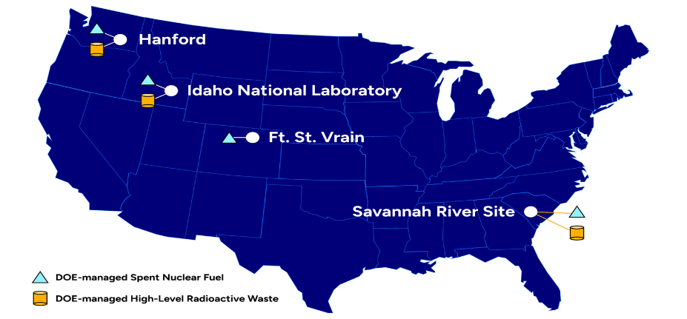
EM-Managed SF & HLW Inventory
SF ~ 2,130 MTHM*
HLW ~ 5,200 MTHM*
OTHER DOMESTIC SITES SF ~ 7 MTHM*
SF~ 271 MTHM*
HLW ~ 3750 MTHM*
SF ~ 15 MTHM*
SF ~ 27 MTHM*
HLW ~ 4,057 MTHM*
TOTAL DOE-managed SF
~ 2,450 MTHM*
Notes:
Another map for perspective is the EM Managed Spent Fuel and High Level Waste Inventor. This is a map showing locations of DOE-managed Spent Fuel (SF) and High-Level Waste (HLW) about which we will spend a moment on.
DOE Spent Fuel From an EM perspective is different than presented by NE a moment ago.
As seen on this map, DOE managed SF is stored in various configurations at four primary sites: at the Savannah River Site, Hanford, the INL, and the Ft. St. Vrain nuclear power station in Colorado also managed by INL.
Unlike the Spent Fuel discussed in other sessions or by the DOE NE office, DOE–managed SF is stored or processed in DOE facilities and for which the office of EM has some responsibility. It excludes the majority of commercial SF.
The total inventory of DOE-managed spent fuel (SF) is approximately 2450 Metric Tons. Just to provide a comparison, the United States has approximately 90,000 metric tones of SF from commercial nuclear power generation.
DOE-managed SF is proportionally smaller yet still significantly more complex and challenging than its larger commercial counter part.
High Level Waste
HLW was generated and is currently stored at three Department of Energy sites, Hanford, INL, and the SRS.
HLW is primarily stored in underground tanks. HLW that has been vitrified (solidified by mixing it with a combination of silica sand and other glass-forming chemicals, heating the mixture to very high temperatures until it melts, and pouring the molten material into stainless steel canisters where it cools to form a glass) is stored in canisters.
The HLW generated at the Idaho National Laboratory was calcined, or converted from liquid to granular solids by evaporation and thermal decomposition at high temperatures .

Slide 9
EM-Managed SF & HLW Inventory
SF ~ 2,130 MTHM*
HLW ~ 5,200 MTHM*
OTHER DOMESTIC SITES SF ~ 7 MTHM*
SF~ 271 MTHM*
HLW ~ 3750 MTHM*
SF ~ 15 MTHM*
SF ~ 27 MTHM*
HLW ~ 4,057 MTHM*
TOTAL DOE-managed SF
~ 2,450 MTHM*
Notes:
Another map for perspective is the EM Managed Spent Fuel and High Level Waste Inventor. This is a map showing locations of DOE-managed Spent Fuel (SF) and High-Level Waste (HLW) about which we will spend a moment on.
DOE Spent Fuel From an EM perspective is different than presented by NE a moment ago.
As seen on this map, DOE managed SF is stored in various configurations at four primary sites: at the Savannah River Site, Hanford, the INL, and the Ft. St. Vrain nuclear power station in Colorado also managed by INL.
Unlike the Spent Fuel discussed in other sessions or by the DOE NE office, DOE–managed SF is stored or processed in DOE facilities and for which the office of EM has some responsibility. It excludes the majority of commercial SF.
The total inventory of DOE-managed spent fuel (SF) is approximately 2450 Metric Tons. Just to provide a comparison, the United States has approximately 90,000 metric tones of SF from commercial nuclear power generation.
DOE-managed SF is proportionally smaller yet still significantly more complex and challenging than its larger commercial counter part.
High Level Waste
HLW was generated and is currently stored at three Department of Energy sites, Hanford, INL, and the SRS.
HLW is primarily stored in underground tanks. HLW that has been vitrified (solidified by mixing it with a combination of silica sand and other glass-forming chemicals, heating the mixture to very high temperatures until it melts, and pouring the molten material into stainless steel canisters where it cools to form a glass) is stored in canisters.
The HLW generated at the Idaho National Laboratory was calcined, or converted from liquid to granular solids by evaporation and thermal decomposition at high temperatures .

Slide 10
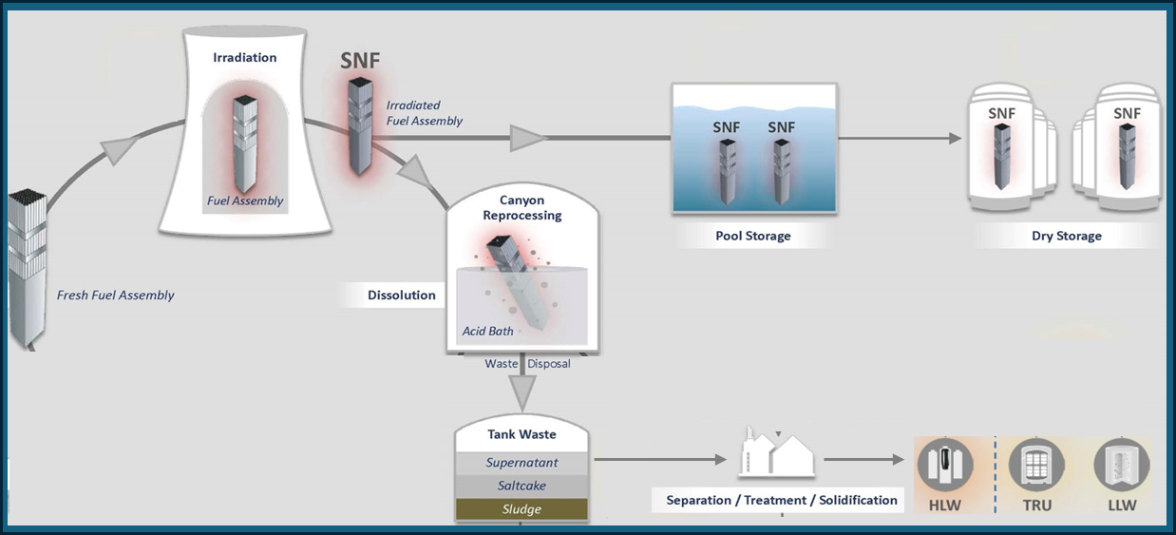
Spent Fuel and High-Level Radioactive Waste
Notes:
I want to take a moment to drill down on EM’s focus on Spent Fuel and High Level Waste as it is a primary focus of this 8th Review Meeting.
When fresh nuclear fuel is inserted into a nuclear reactor and undergoes irradiation, it becomes spent fuel. This is true for al nuclear reactors regardless of design or type.
When the SF is withdrawn from the nuclear reactor, it needs a period of cooling and that tales place in a storage pool.
For EM-managed SF, which is the focus of this slide, there are two main routes after the SF is cooled down.
The SF can be stored in dry storage or could remain in pool storage for a prolonged time with the intent that it will eventually be packaged pending a geologic repository, or
It could be reprocessed, as you see in the diagram, which generates the high-level radioactive waste.
In the past, the United States had reprocessed SF. Reprocessing, within this context, refers to the chemical process required to separate constituent elements from SF. After the extraction of uranium, as an example, or other nuclear material of interest, the resulting waste is considered high-level radioactive waste.
The HLW that was generated due to the reprocessing of SF in this limited context, is sent to the tank waste and eventually separated, treated and you see there are fractions of the waste that are separated into HLW, low-level radioactive waste and transuranic waste.
After the HLW is treated, it is solidified and stored pending disposition.
CAUTION ---- I’d like to highlight that there is plenty of HLW in the DOE complex that needs to be disposed of in a future repository. CAUTION

Slide 11
SF and HLW Challenges
Currently, there’s no disposal pathway for SF and HLW. However, all wastes for disposal must meet as-yet-to-be-issued repository acceptance criteria.
  EM works closely with the Office of Nuclear Energy, National Laboratories, and other stakeholders to ensure the SF inventory will be accepted for disposal.
EM continues to safely and securely store and manage the SF inventory in wet/dry storage facilities on-site until a geologic repository is available.
EM must safely manage aging waste tanks, retrieve waste from tanks/binsets, and permanently close the tanks.
Most EM sites use internationally-recognized high-temperature vitrification technologies to treat HLW.
Notes:
In line with the 8th Review Meeting, EM would like to address a current challenge. EM plays a critical role in ensuring that SF and HLW, is safely and securely managed. Although, currently, there is no disposal pathway for SF and HLW, all wastes for disposal must meet as-yet-to-be-issued repository acceptance criteria. Thus, EM works closely with the National Laboratories, various stakeholders, and other partners to ensure that the inventory of SF and HLW will ultimately be accepted for disposal in a geologic repository. But achieving this goal requires coordinated effort, ongoing innovation, and strict adherence to regulatory guidelines.
One of the most significant actions we have made to resolve this challenge is the Road-Ready Demonstration Project. This project is a part of EM’s commitment to develop and refine the conditioning and packaging technologies needed for the safe transport, storage, and disposal of SF. By improving these technologies, we are not just ensuring that SF can be stored securely, but that it meets all regulatory requirements for transportation packaging and repository safety.
Currently, SF is stored at various EM sites in both wet and dry storage facilities while awaiting a permanent solution, such as a geologic repository. Until that repository becomes available, EM continues to prioritize the safety and security of this material. We are actively working on storing EM’s SF in dry storage facilities, which offer a more long-term solution. Additionally, we are studying the effects of long-term dry storage to ensure that the storage methods we employ today will remain effective for the future.
Addressing the overarching of safe and responsible management of aging waste tanks. EM has prioritized waste retrieval and treatment from these tanks. The expectation is to permanently close them in a way that poses minimal risk to human health or the environment. This requires careful planning, the latest technology, and oversight.
Accepting the monumental challenge of managing high-level waste and spent fuel, EM faces the task using the tools of collaboration, innovation, and strict adherence to regulatory standards. CAUTION Top of mind for EM is protecting both our environment and the public first, and preparing the waste for ultimate disposal at a future geological repository second. CAUTION

Slide 12
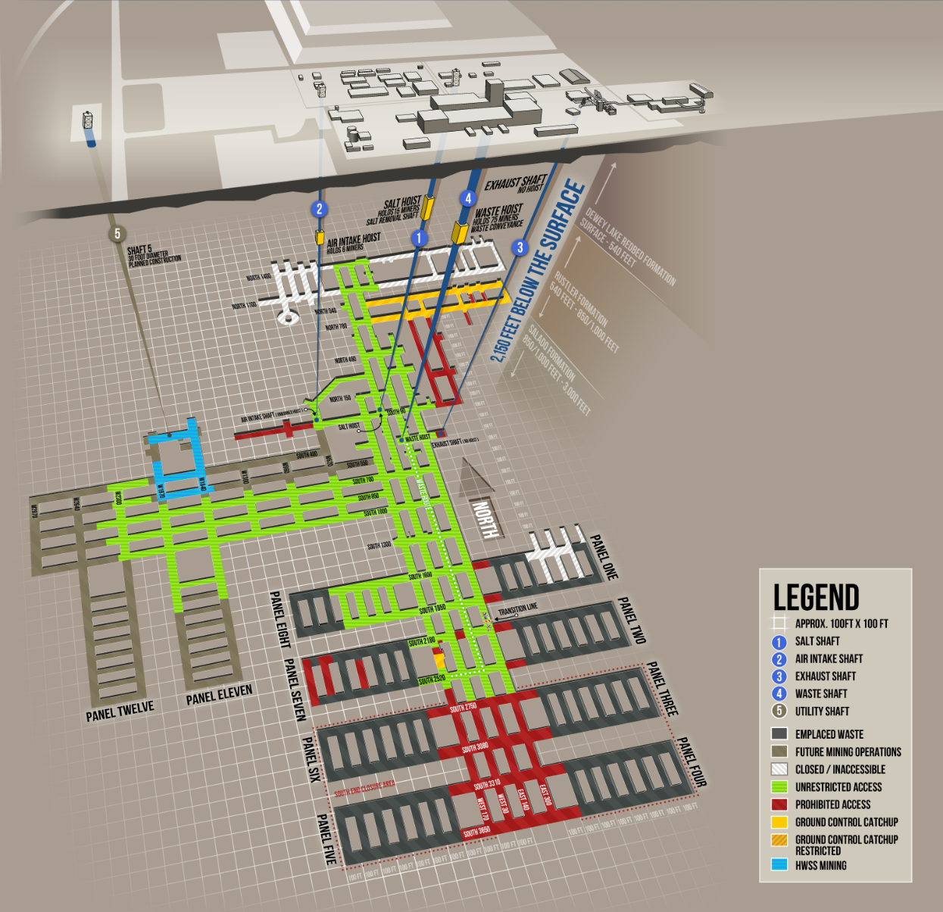
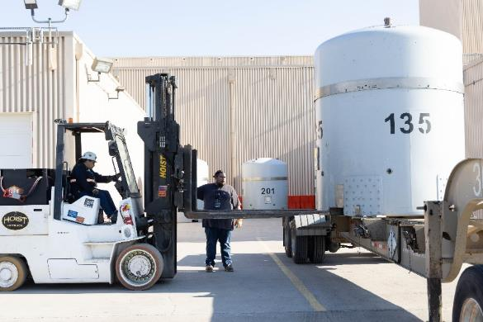
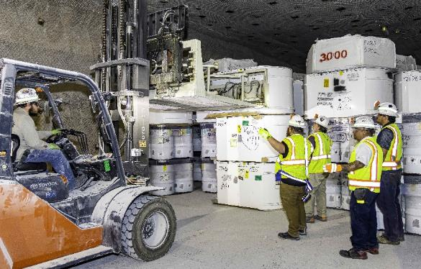
Waste Isolation Pilot Plant
Above: On the surface, workers safely unload incoming TRUPACT shipments
Below: In the underground, workers emplace waste drums in mined rooms
Notes:
And finally, another site worth noting with a unique role in the EM mission is the Waste Isolation Pilot Plant (WIPP). WIPP is the United States’ only repository for the disposal of transuranic waste generated by atomic energy defense activities. WIPP is located 33 miles southeast of Carlsbad, New Mexico, in the Chihuahuan Desert, far from major population centers. Waste is disposed of in a set of panels located nearly one-half mile below the surface in a deep geologic salt bed formed 250 million years ago. The facility began operation in 1999.

Slide 13
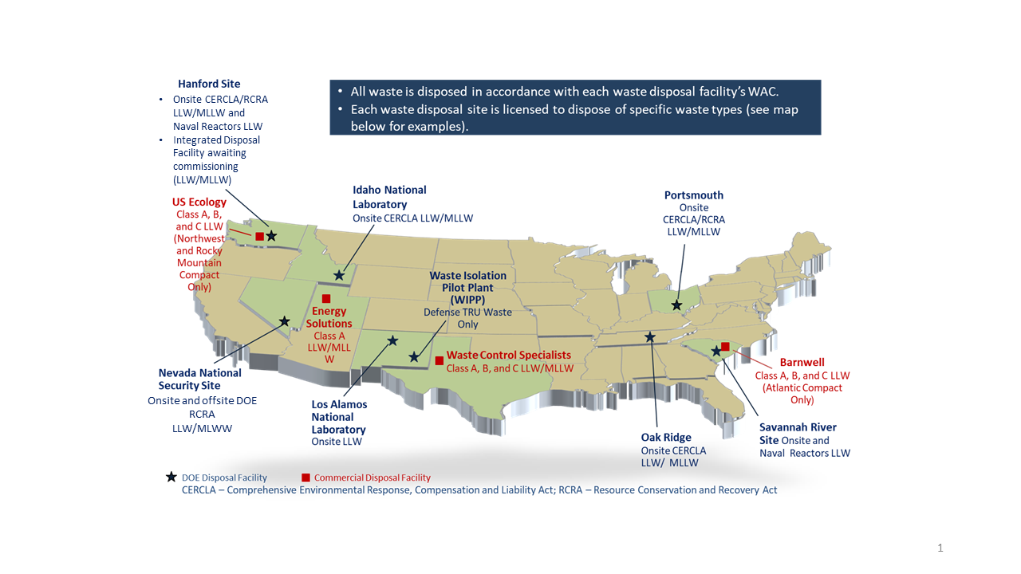
Operating DOE & Commercial Disposal Facilities
Notes:
In conclusion, when looking at the United States, EM is mindful that disposal is the final stage of waste. Clean up is not final without disposal. DOE EM provides numerous pathways, options, and resources for disposal. EM specifically assists the United States with finding a path for DOE cleanup sites to this final stage of cleanup. Some of these sites are owned or operated by private companies, which are called Commercial Disposal. DOE sends some waste streams to these sites. DOE EM reviews its designated waste disposal facilities for permitting, licensing and for transportation and surveillance. If the disposal facility should close or be subject to a complication DOE EM will be involved and respond. EM stands ready to continue this mission until the final site is clean and moves at the speed of safety.

Slide 14
Low-Level Waste Disposal Facility
Federal Review Group (LFRG) as of 2025
LFRG Membership includes:
DOE panel that reviews LLW disposal facility performance at DOE Sites as per DOE O 435.1. Radioactive Waste Management
Program Secretarial Offices
Office of Environmental Management (EM)
Office of Environment, Health, Safety, and Security (EHSS)
Office of Nuclear Energy (NE) Office of Science (SC)
Office of Legacy Management (LM)
National Nuclear Security Administration (NNSA)
Comprised of Federal employees led by EM.
Ensures compliance and consistency of facility design, construction, operation, and closure.
DOE Sites with LLW Radioactive Waste Sites
Hanford, Richland, WA
Idaho National Laboratory, ID
Los Alamos National Laboratory, New Mexico
Nevada National Security Site, NV
Oak Ridge National Laboratory, Oak Ridge, TN
Paducah, Kentucky and Portsmouth, OH, PPPO Office
Savannah River Site, SC
Qualified, experienced, and independent review teams that includes Federal staff and Contracting support as needed.
www.energy.gov/EM

Slide 15
High-Level Radioactive Waste (HLW) Interpretation
The HLW interpretation is a tool in the “waste management policy toolbox” that, where implemented, allows DOE to dispose of defense reprocessing waste in accordance with its radiological characteristics and not by source or where it came from, i.e., some reprocessing wastes may be classified as not HLW (non-HLW)
Since adopting the policy, DOE has implemented the application of the HLW interpretation
    The first waste stream analyzed was a small volume of SRS Defense Waste Processing Facility (DWPF) recycled wastewater treated and disposed in September 2020.
    The second waste stream decision was announced on July 18, 2023, to dispose of SRS contaminated process equipment at WCS. The waste includes a drill string, glass pumps, and replacement glass bubblers related to DWPF operations until facility’s end of life. Environmental analysis shows that the proposed action would have no significant impact to human health and the environment and does not constitute a major federal action in the context of NEPA.
    The drill string is planned to be shipped late in CY2023.
EM-HQ continues to actively search for candidate waste streams to apply the HLW Interpretation to advance DOE clean-up mission.
For more information, please see the website at https://www.energy.gov/em/high-level-radioactive-waste-hlw-interpretation

Slide 16
Greater than Class C (GTCC) LLW Disposal Status
GTCC LLW remains in storage at generators’ facilities.
DOE continues to monitor the Nuclear Regulatory Commission (NRC) regulatory developments, and the Energy Policy Act of 2005 requirement to “await action by Congress.”
DOE staff have taken advantage of NRC’s latest 2023 informative presentations on potential changes to Part 61 low-level waste disposal regulations to integrate criteria for licensing the near-surface disposal of GTCC LLW and depleted uranium.
We are continuing to discuss with NRC staff our views on the information presented and look forward to an opportunity to review the draft rule and guidance.
Notes:
External Interest:
National Security Council interest in GTCC disposal in response to POTUS National Security Memorandum 19 to Counter Weapons of Mass Destruction Terrorism and Advance Nuclear and Radioactive Material Security
In April 2022 – NRC Commission approved the staff’s recommendation to:
issue new proposed rule that consolidates/integrates criteria for licensing the disposal of GTCC waste and 10 CFR Part 61, “Low-Level Radioactive Waste Disposal,” rulemaking activities, and
provide for Agreement State licensing of those GTCC waste streams that meet the regulatory requirements for near-surface disposal and do not present a hazard such that the NRC should retain disposal authority.
NRC Draft Regulatory Basis (July 2019):
“…the NRC staff found that a majority of GTCC waste are both potentially suitable for near-surface disposal and could be regulated by an Agreement state.”

Slide 17
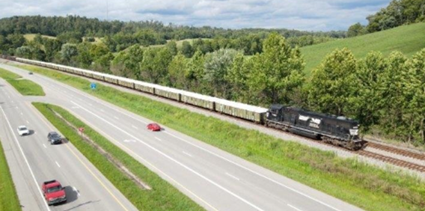
Depleted Uranium (DU)
A 2020 DOE Record of Decision based upon the Final DU Oxide Supplemental Environmental Impact Statement regarding disposition at one or more of the disposal sites evaluated
DOE can ship to selected commercial site(s) if the facility is authorized/licensed to receive DU oxide in addition to DOE’s Nevada National Security Site:
  EnergySolutions near Clive, Utah (licensing application in process)
  Waste Control Specialists LLC (WCS) Federal Waste Facility (licensed)
Multiple shipments by rail in 2023 with first shipment from Portsmouth site and additional shipments from Paducah site

Slide 18
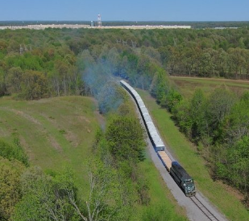
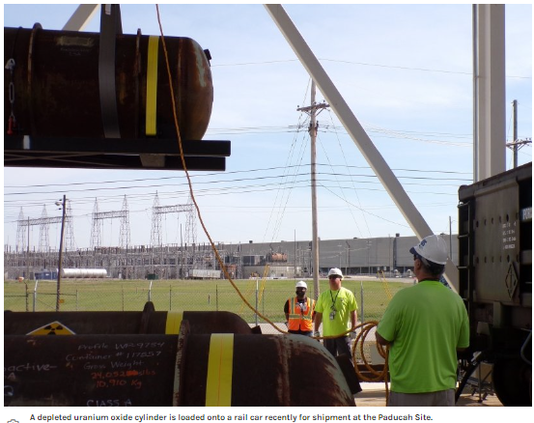
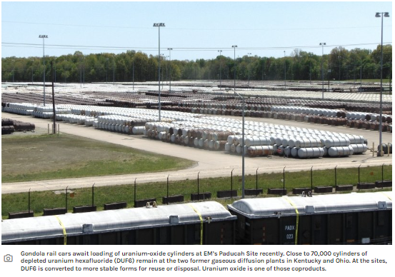
Portsmouth & Paducah – Uranium Oxide Shipments for Disposal

Slide 19
Waste Disposal Considerations
DOE’s Radioactive Waste Management Manual found in 435.1-1 has a “tiered” policy on treatment, storage, and disposal:
  DOE waste shall be treated, stored, and in the case of low-level waste, disposed of at the site where the waste is generated, if practical, or at another DOE facility. If DOE capabilities are not practical or cost effective, exemptions may be approved to allow use of non-DOE facilities for the storage, treatment, or disposal of DOE radioactive waste …
Waste disposal is always fully protective of worker and public health and the environment and in compliance with applicable Federal, state, and local requirements, with necessary permit(s), license(s), and approval(s) for the specific waste.
Sufficient LLW/MLLW disposal capacity exists at DOE and commercial facilities to support the EM cleanup mission.

Slide 20
DOE LLW/MLLW Data
  Waste Information Management System (WIMS)
WIMS is developed to provide stakeholders with the tools necessary to easily visualize, and understand current and future waste volumes, categories, and problems of forecasted waste streams.
WIMS meets this need by providing a user-friendly online system to organize, and present waste forecast data from DOE sites. This system provides a method for identification of waste forecast disposal volumes, waste. classification, disposition pathways, and potential barriers to final disposition.
  Includes LLW/MLLW treatment/disposal forecast from all DOE sites, not just EM sites.
  Annually updated and website maintained by Florida International University
  Out-year data reflects uncertainty due to site funding adjustments, federal budget process, DOE priorities.
  Visit WIMS at: Waste Information Management System (emwims.org)

Slide 21
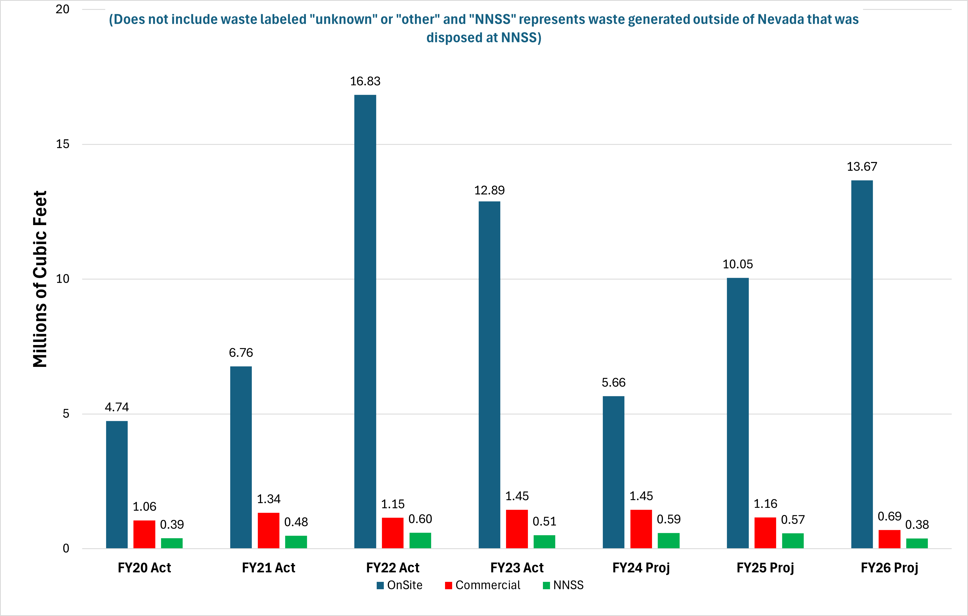
DOE Complex-wide LLW/MLLW Disposal Volume by Disposal Location
Notes:
Jonathan Kang notes:
As discussed earlier, DOE relies on use of strategic partnership between onsite capabilities, NNSS, and commercial facilities to manage its waste.
Historically speaking, most of DOE generated wastes are disposed on-site (80-90%) and remaining wastes at NNSS and commercial facilities (usually combined 10-20%).
We believe this trend will continue in coming years. We don’t necessarily believe this was due to current 435.1 policy and we also don’t expect “leveling the playing field” policy when and if implemented, will significantly change that.
In order to present the consistent methodology with prior year bar charts, NNSS generated waste disposed at NNSS is included in “Onsite” bar (vs. NNSS bar);
Large onsite volume in FY22 is Ports D&D waste (combination of X-326 demo and DUF6 related waste);

Slide 22
Commercial LLW Disposal Manifest Data
  Manifest Information Management System (MIMS)
  MIMS is the public source for manifest data of non-DOE LLW shipped to commercial disposal facilities to meet the provisions in 42 U.S.C. 2021g(a)
  States/compacts are the primary stakeholders
  Data is available for currently operating commercial LLW disposal facilities
    Barnwell, EnergySolutions, US Ecology, and Waste Control Specialists
  Currently updated with CY 2023 data. Next update will be January of 2025 (update with CY 2024 data)
  Visit MIMS at: mims.doe.gov

Slide 23
Thank you for your Attention
Questions?

