Slide 1
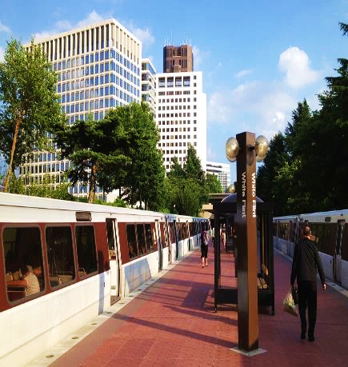
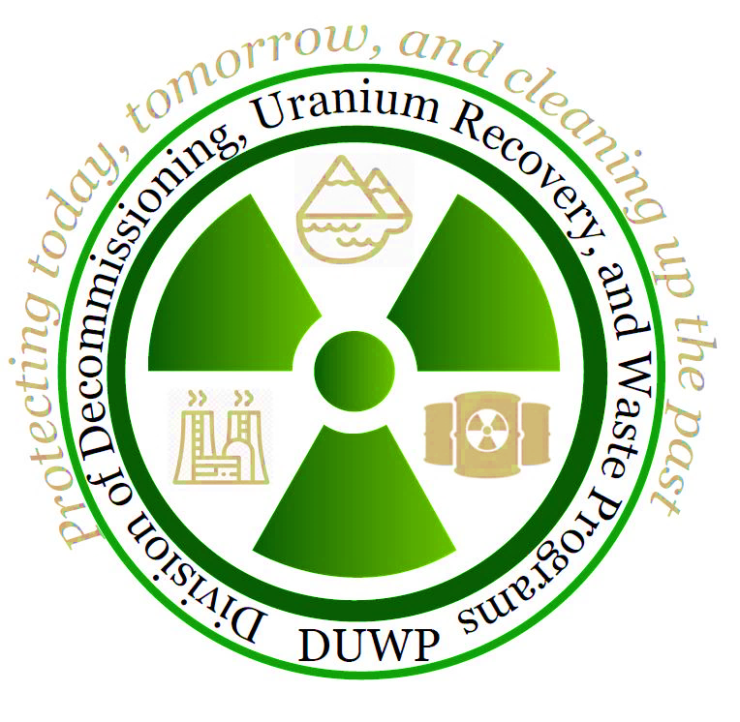
NRC UPDATE
Protecting today, tomorrow, and
cleaning up the past
SPRING LLW FORUM MEETING
April 9-10, 2025
Duane White, Chief
Low-Level Waste and Projects Branch
Division of Decommissioning, Uranium
Recovery, and Waste Programs (DUWP)
Office of Nuclear Material Safety and Safeguards (NMSS)

Slide 2

Agenda
Agreement State Collaboration
Radium Sites​
ADVANCE Act
Proactive Research
Abandoned Uranium Mine Remediation
Rulemakings Update
Low-Level Waste (LLW) Programmatic Assessment

Slide 3
Integrated LLWD (Part 61) Rulemaking
Proposed rule package submitted to the Commission
May 29, 2024 (SECY-24-0045; ML23242A249)
We currently do not have a timeframe for when the Commission will vote on the proposed rule
We are here
Develop Proposed Rule that Integrates GTCC and 10 CFR Part 61 Rulemaking
Submit to Commission for Approval
Publish Proposed Rule
Hold Public Meetings and Comment Period
Revise NUREG-2175 and Develop GTCC Guidance
Hold for Commission Approval of Proposed Rule
Publish Draft Guidance

Slide 4
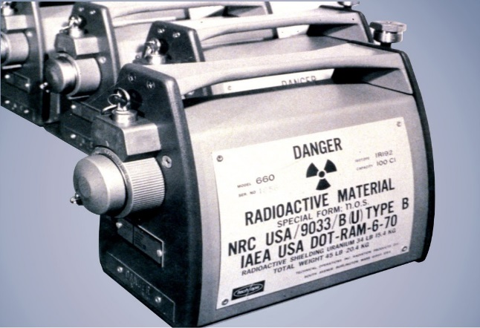
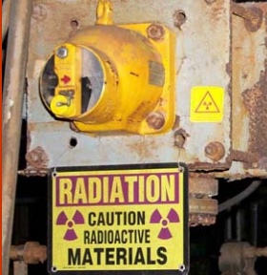
Financial Assurance for Disposition of Category 1-3 Sources Rulemaking
NRC staff preparing Regulatory Basis to expand decommissioning financial assurance (DFA) requirements for Category 1 & 2 (and possibly Category 3) byproduct material sealed sources
Current regulations in 10 CFR 30.35 do not require DFA for many licensees who possess these sources
Regulatory Basis document evaluates several potential regulatory options
Next step: issue Regulatory Basis for public comment and have a public meeting
Staff rulemaking plan (SECY-16-0115) submitted October 7, 2016
Commission SRM issued December 8, 2021

Slide 5
Decommissioning Rulemaking
Would implement specific regulatory requirements for different phases of the decommissioning process consistent with the reduced radiological risk. Topics include:
  Emergency preparedness
  Decommissioning funding assurance
  Environmental considerations
  Spent fuel management planning
  Record retention requirements
Final rule package submitted to the Commission January 2024 (SECY-24-0011; ML23258A200)
We currently do not have a timeframe for when the Commission will vote on the rule
Proposed rule published on March 3, 2022 (87 FR 12254)
Comment period closed on August 30, 2022

Slide 6
Assessing the LLW Program
Completed
#3. Updated Concentration Averaging and Encapsulation Branch Technical Position (https://www.nrc.gov/waste/llw-disposal/llw-pa/llw-btp.html)​
Ongoing High Priority Tasks
#1. and #4. Complete Integrated Low-Level Radioactive Waste Disposal (LLRWD) Rulemaking – SRM SECY-20-0098​
Future Tasks
#2. Update to the Waste Classification Tables​
#5. Finalized guidance on Alternative Disposal Requests (ADRs)-(https://www.nrc.gov/waste/llw-disposal/very-llw.html)​
#6. Published NUREG/BR-0204, Rev 3, Waste Manifest instructions https://www.nrc.gov/waste/llw-disposal/llw-pa/llw-uwm.html​
#7. Performed Very LLW Scoping Study​ SECY-21-0057
#8. Update and consolidate LLW guidance into one NUREG​
#9. Examine the need to define when radioactive material becomes LLW​
#10. Develop and implement the national waste tracking system​
10 Tasks Identified and Ranked
6

Slide 7
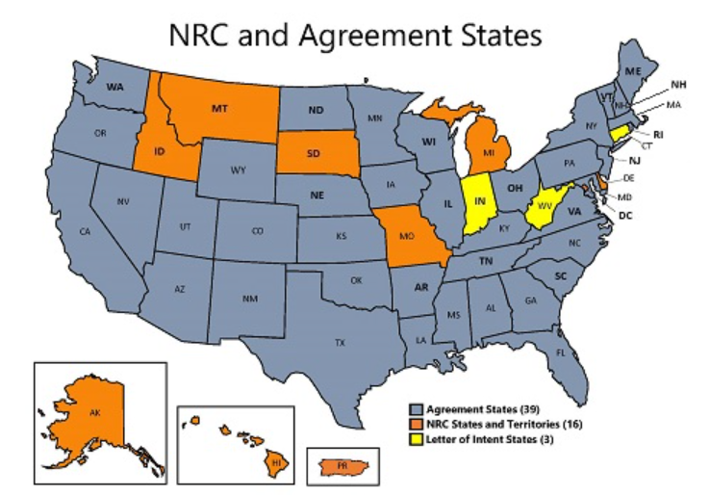
Collaborating with Agreement States
  Integrated Materials Performance Evaluation Program - LLW
    IMPEP Completed in 2024 (Kentucky, New York Follow-up)
    Periodic Reviews in 2025 (South Carolina, Washington, Utah)

Slide 8
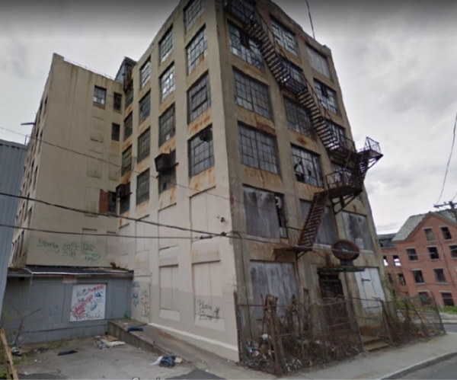
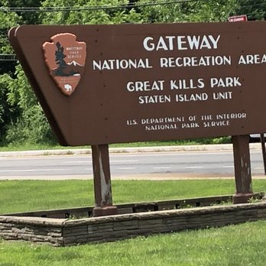
Cleaning Up Radium Sites
  Ensure unlicensed sites with discrete sources of radium or associated contamination do not pose a risk to public health and safety and the environment
  Status
  3 non-military sites remaining with residual radium activity requiring remediation.
  Monitoring or Staying Informed at 3 National Park Service and 17 Department of Defense sites under Comprehensive Environmental Response, Compensation, and Liability Act and Memorandum of Understanding
  Coordinating with other Federal agencies
  Extensive stakeholder communication and coordination – reaching out to Agreement States with radium sites
8

Slide 9

Advance Act - Improving Licensing Processes and Oversight Programs
Licensing Processes
  Incorporate and expand use of Regulatory Audits
  Explore new approaches to full or partial acceptance of License Termination Plans (LTPs)
Oversight Programs
  Completed updates to Uranium Recovery and Byproduct Material Facility Inspection Program
  Assessed previous recommendations
  Public meeting to gather external stakeholder feedback
Ideas Under Consideration
Enforcement Process
Risk Inform Guidance
Organizational Structure
Leverage Technology
Information on ADVANCE Act:
https://www.nrc.gov/about-nrc/governing-laws/advance-act.html
Contact us:
https://www.nrc.gov/about-nrc/governing-laws/advance-act/contactus.html

Slide 10
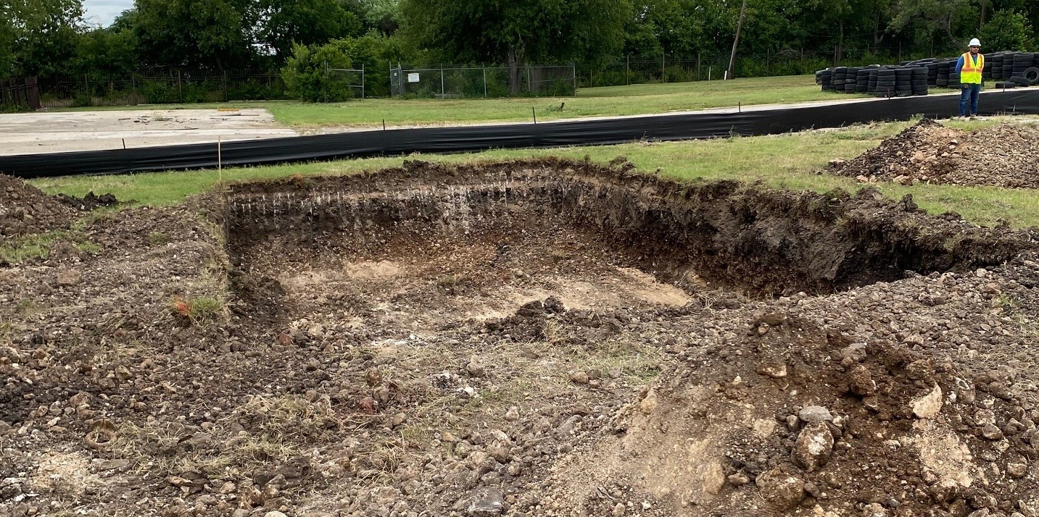
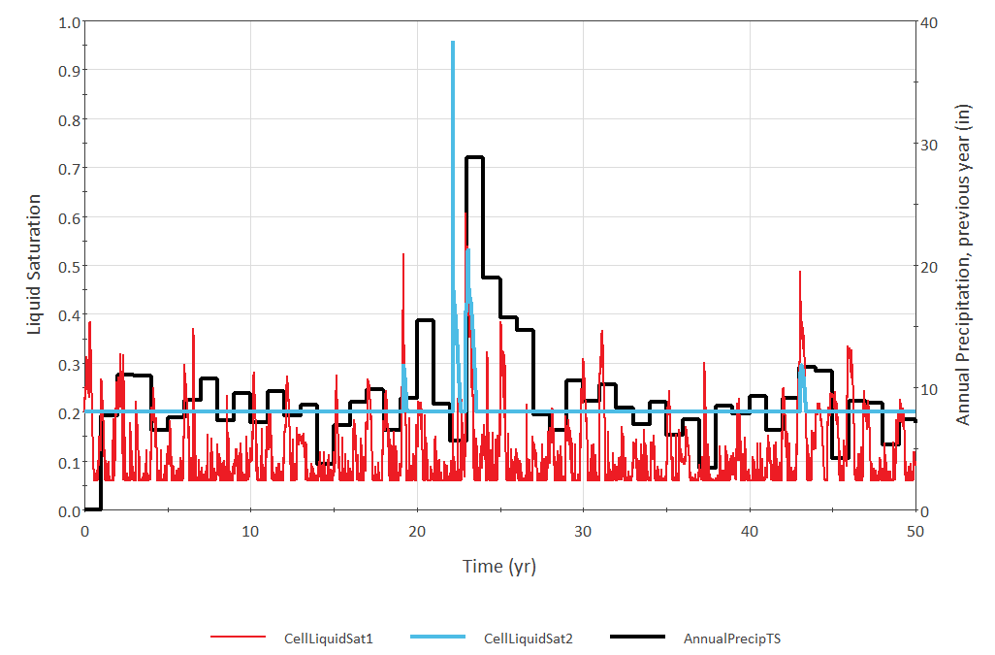
Proactive Research
Intruder Barriers and Evapotranspiration Covers
The Southwest Research Institute (SwRI) is completing experiments to test the efficacy of different engineered barriers to limit or deter disturbance of a closed LLRW disposal facility
Long-term performance of evapotranspiration covers

Slide 11
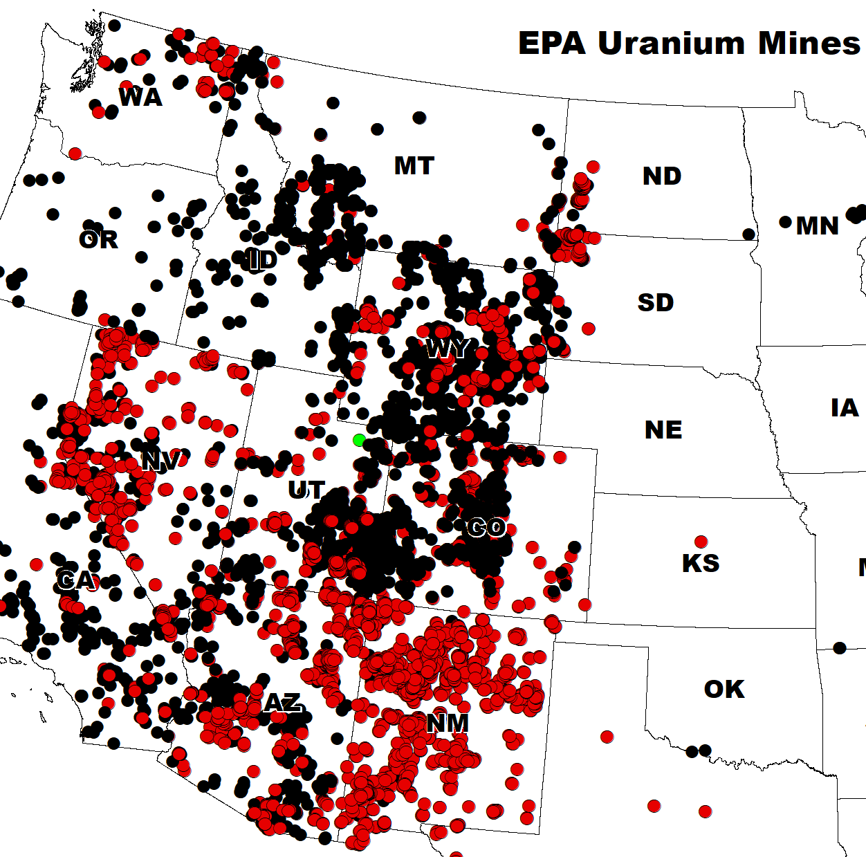
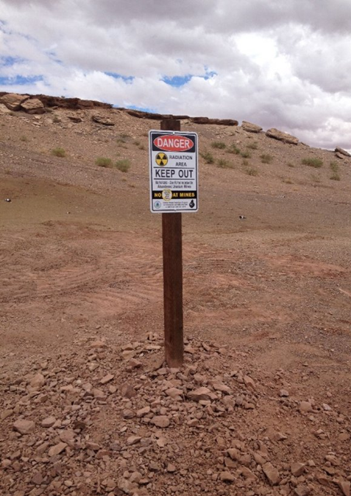
Abandoned Uranium Mine Waste Remediation
Past mining activities created many legacy sites – remediation of waste rock may produce licensable quantities of source material
Implementing SRM-SECY-23-0055 - Options for Licensing Emerging Technologies Used for Remediation of Mine Waste
A&B No. 3 mine
Photo from https://www.epa.gov/navajo-nation-uranium-cleanup/western-abandoned-uranium-mine-region

Slide 12






Questions/Comments
Follow @NRCgov
Information on Radioactive
Waste Program: https://www.nrc.gov/waste.html
To subscribe to e-mail updates: https://www.nrc.gov/public-involve/listserver.html#lyris
12

Slide 13
Backup Slides

Slide 14
Integrated LLRWD Rulemaking
  Consolidate and integrate criteria for Greater-Than-Class C (GTCC) and 10 CFR Part 61 rulemaking
  Conduct site-specific analyses for all waste streams including depleted uranium and GTCC waste
  Include graded approach for compliance period
  Include transuranic (TRU) waste in the definition of LLW
  Address physical protection and
  criticality concerns in GTCC
  waste streams
  Provide for Agreement State licensing of certain GTCC waste streams
Integrated Rulemaking
Depleted Uranium
GTCC Waste
Site-Specific Analyses
TRU Waste

Slide 15
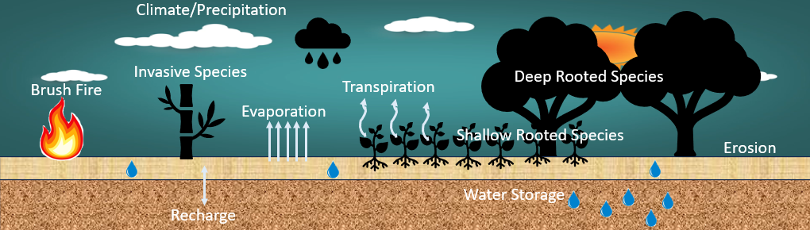
What is an ET Cover?
An ET cover is a highly dynamic system with a very wide range of temporal and spatial scales combining processes and discrete events

