Slide 1
Urenco Update
April 2025
  Steve Magill
  Urenco USA Decommissioning Manager

Slide 2
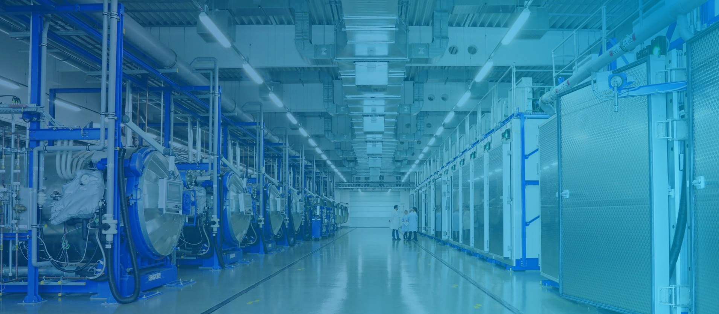

Operations

Slide 3
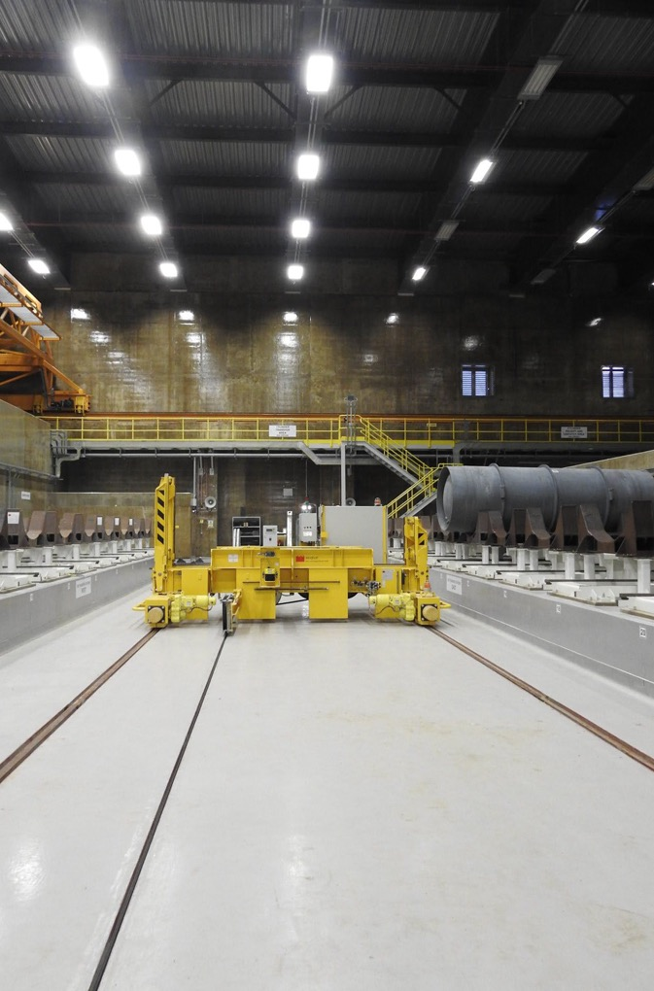


Introduction
    With over 1,600 people in Europe and 350 people in the USA,
    we’re the leading supplier of uranium enrichment services to the world’s nuclear energy industry; providing the uranium enrichment services that our customers need to generate low carbon nuclear energy.
    Established in 1970, as a result of strong political co-operation between Germany, the Netherlands and the United Kingdom following the the enactment of the Treaty of Almelo to promote nuclear enrichment for civil purposes, our industry is regulated and intergovernmental bodies and treaties are aimed at non-proliferation of nuclear technology.
    We have a truly global footprint operating plants in four countries:
    UK, Netherlands, Germany and USA. And we’re supplying 50 customers across 19 countries.

Slide 4
At a glance: global facts
4
Enrichment facilities
50
Customers
19
Customer countries
1,600
Employees
17,600
(tSW/a)
Urenco operations
Urenco USA
Eurice, New Mexico – our American enrichment facility
Urenco UK
Capenhurst, United Kingdom – our UK enrichment facility
Urenco Germany
Gronau, Germany – our German enrichment facility
Urenco Netherland
Almelo, the Netherlands – our Dutch enrichment facility
Urenco customers

Slide 5
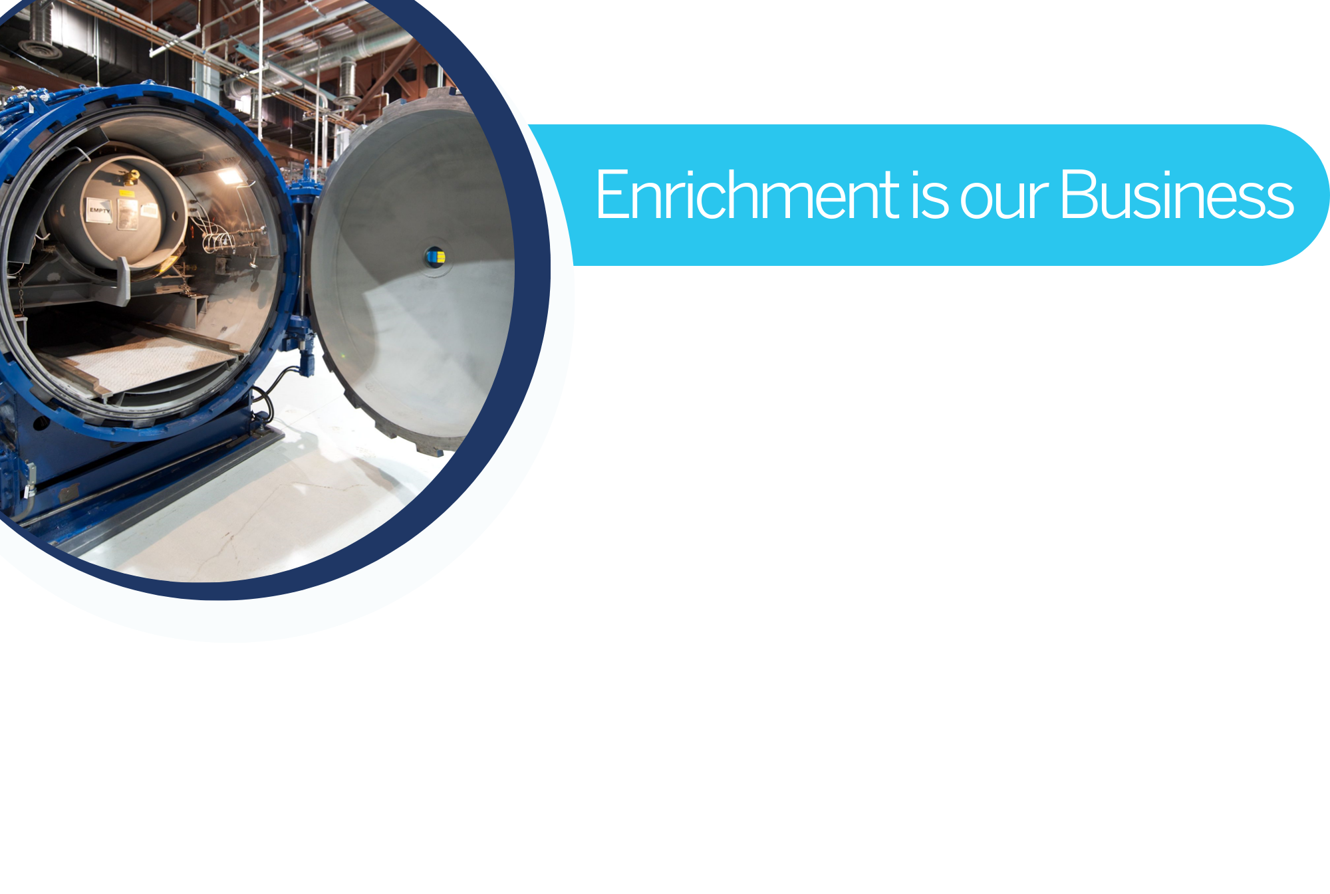

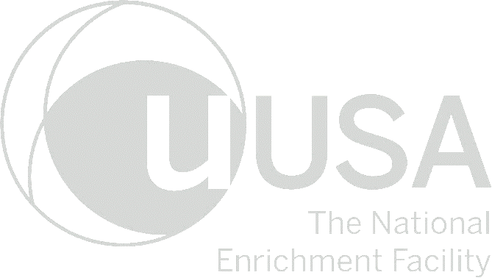
Located in southeast New Mexico
Licensed in 2006 and operating since 2010
Urenco has invested over $5 billion in the plant, one of the largest construction projects in New Mexico
UUSA enriches enough uranium annually to generate over 6% of total U.S. electricity use
American workforce with over 500 full-time employees and long-term contractors

Slide 6

Capacity options near and long-term
Timeline
2021
2022
2023
2024
2025
2026
2027
2028
2029
2030
2031
2032
2033
Refurbishment of existing capacity
Maintains capacity via refurbishment projects underway across sites
Older plant lifetime extensions
Maintains capacity via extensions of expected lifetime of legacy capacity underway across sites
‘Superplant’ extensions
Preparation works underway
New capacity projects underway, with options for additional extension
‘Greenfield-type’ new build
Evaluation underway
New capacity online

Slide 7
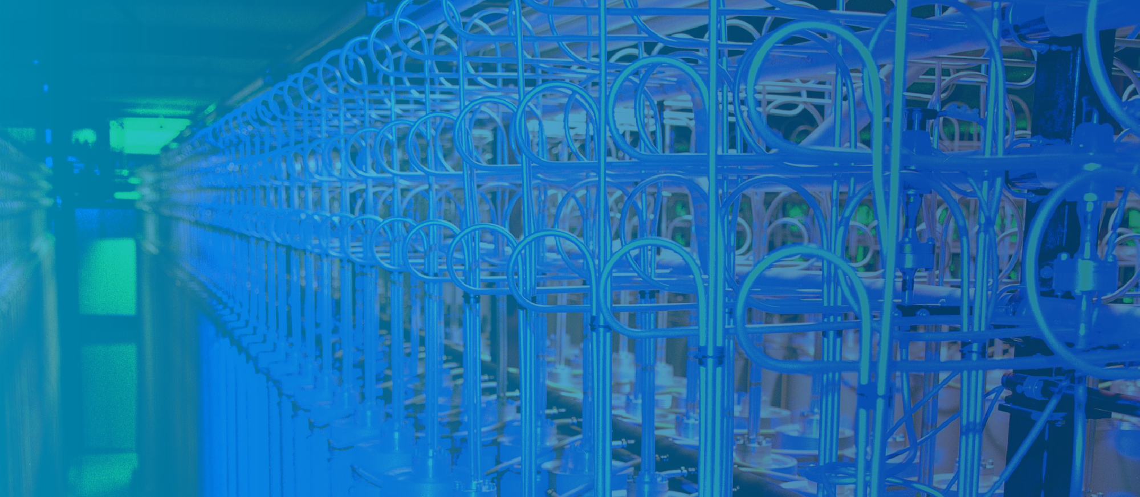
Enrichment Market

Slide 8
Enrichment Price History
Review of Business Highlights
2011: Fukushima nuclear incident
2022: Ukraine conflict
2010 prices today¹
$227/SWU
Market today
Jan 24
Spot:
$163/SWU
Term:
$152/SWU
¹ US Consumer Price Index, Bureau of Labor Statistics

Slide 9
Evolution of enrichment at Urenco
LEU (up to 5-6%)
  Urenco has produced LEU since the 1970s moving from ~2.5% to 5% over a 20 year period.
  LEU serves the fuel needs of traditional light water reactors (LWR) and gas reactors (AGRs) in addition to most molten salt reactors currently under development. Start-up cores of some advanced reactors also require LEU.
1980s
up to 3%
(LEU)
2000s
up to 5%
(LEU)
≥ 2025
up to 7-10%
(LEU)
2030s
up to 20%
(HALEU)
-
-
-

Slide 10
Evolution of enrichment at Urenco
LEU+ (up to 10%)
  LEU+ creates efficiencies for LWR operators by extending the reactor operating cycle from 18 months to 24 months and enable accident tolerant fuels.
  LEU+ will serve LWR customers that require enrichment up to 7-8% and some advanced reactor designs that can operate with enrichments up to 10%.
  In 2025, Urenco will begin producing LEU+ to Commercial customers from both UUSA (up to 10%) and UUK (up to 7%).
1980s
up to 3%
(LEU)
2000s
up to 5%
(LEU)
≥ 2025
up to 7-10%
(LEU)
2030s
up to 20%
(HALEU)
-
-
-

Slide 11
Evolution of enrichment at Urenco
HALEU (up to 20%)
  Advanced reactors operate on longer and more efficient fuel utilisation rates. To achieve this, the reactors require a higher concentration of fissile material than traditional LWRs.
  The leading advanced reactor designs therefore require higher enrichment levels of up to 20%.
  The first advanced reactor needs for HALEU are in 2027/2028.
  The first HALEU production at UUK planned in 2031.
1980s
up to 3%
(LEU)
2000s
up to 5%
(LEU)
≥ 2025
up to 7-10%
(LEU)
2030s
up to 20%
(HALEU)
-
-
-

Slide 12
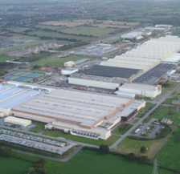

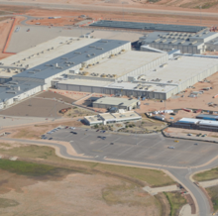

HALEU at Urenco Next Gen Fuels Phase II
Sites designated for first and successive deployment
What’s needed to enrich between 10% and 20%?
    Requires a dedicated category-II facility.
    Uses existing centrifuge technology and hardware.
Project progress
    Logistics under development, including containers
    and transportation packages.
    Project development over 6-7 years.
    Notice of intent filed to NRC regarding HALEU production.
    Responded to DOE’s HALEU RFP.
    Received UK government award under the
    Nuclear Fuel Fund.
Urenco UK
Urenco USA

Slide 13
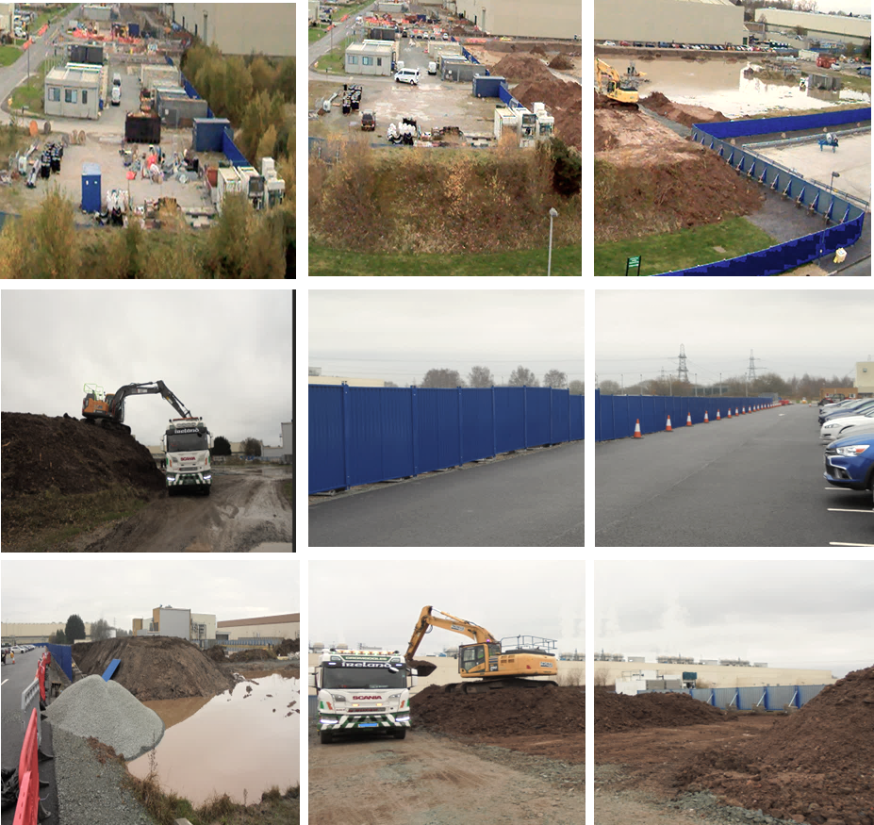

Urenco UK HALEU Program
Project highlights: Enabling works
Project delivery schedule
In numbers…
Project start
2023
Project end
2031
Project delivery targets
Enabling
works complete
2027
Construction commenced
2028
Facility handover
2031
10,000
tons of soil removed
Milestone schedule
2024
User Requirement Specification (URS) approved
2025
Front-End Engineering Design (FEED) contract placed
Concept design MDDRs complete
2026
Cascade basic design complete
2027
Basic design (FEED + core process) complete
2028
Detail design (core process, centrifuge + facility) complete
2031
Cascade online and handover to operations

Slide 14
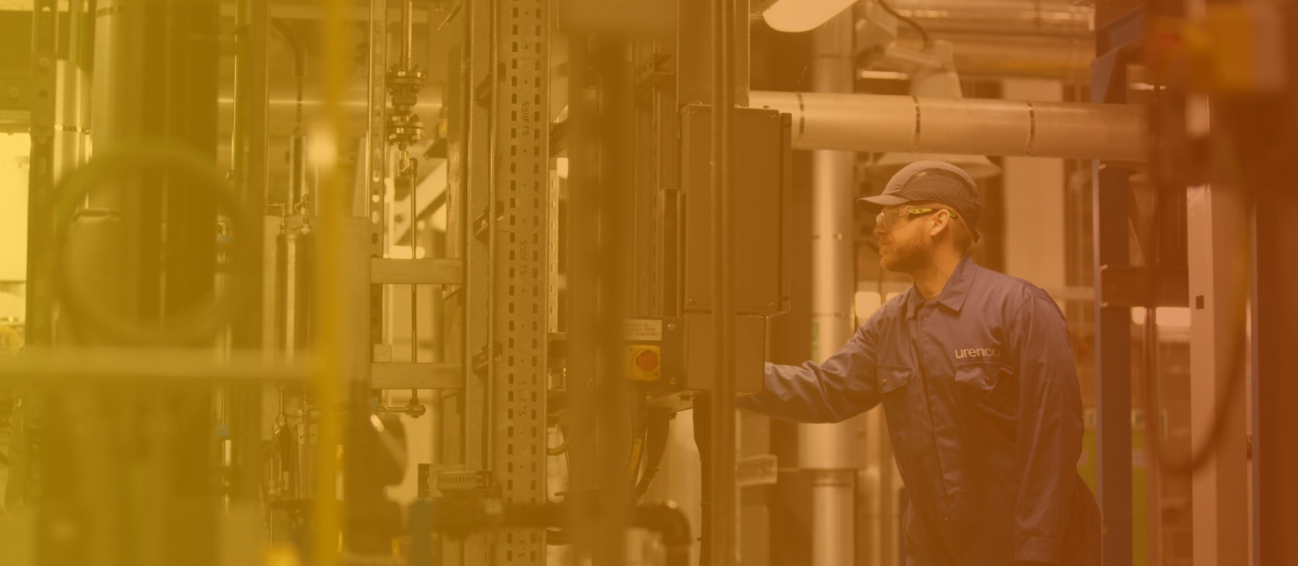
Responsible nuclear stewardship

Slide 15
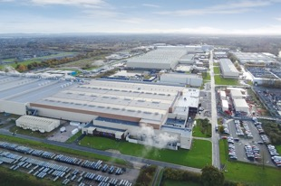
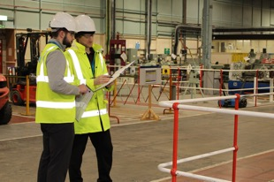



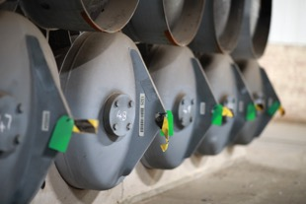
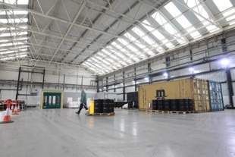

UNS Overview
UNS brings innovation and expertise to nuclear decommissioning
and waste recycling & management, for a safe sustainable and circular nuclear future
UNS is the centralised waste management and decommissioning function for the Urenco group:
  We provide expertise and capacity to decommission and manage nuclear materials both internally and externally.
  We have a presence on each Urenco site and, along with the Urenco Metals Recycling (UMR) programme, form UNS Global.
  UNS is launching a centre of excellence, the Waste Management Facility expansion. Bringing innovative services in the handling and melting of radioactive metals back to the UK.
Our workforce located at Capenhurst have the following specialist management skills:
Decommissioning & land remediation
Engineering support
Storage of nuclear material
Waste management services

Slide 16
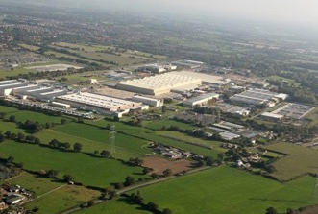
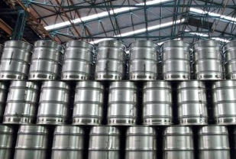
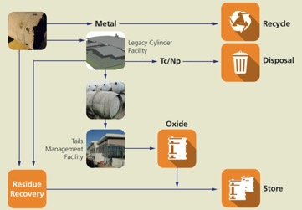

Committed to responsible nuclear stewardship
URENCO Nuclear Stewardship
Decommissioning and Waste Management Centre
Uranic Management
Waste Processing
Nuclear storage
Located at the Capenhurst site
URENCO Nuclear Stewardship has been in operation since 2012 with the NDA as primary customer
95% of NDA’s uranic inventory management
Material repackaging
URENCO Nuclear Stewardship and the NDA are designing the Legacy Cylinder Facility (LCF project) to transfer and treat uranic material stored in ‘legacy cylinders’ (+11,000 cylinders)
In 2016, URENCO Nuclear Stewardship was selected by the Ministry of Defence (MOD) to store and manage the Reactor Pressure Vessels (RPVs) from 27 defueled nuclear submarines

Slide 17
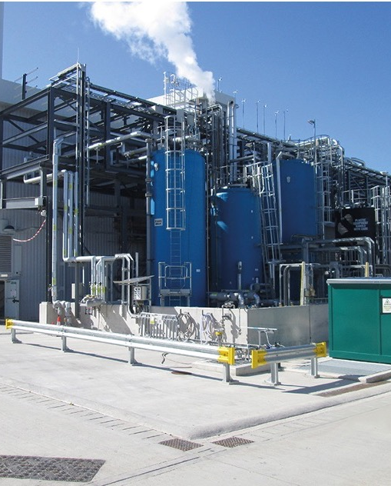
Tails Management Facility
  The TMF, constructed and operated by Urenco ChemPlants manages deconversion of Tails – depleted Uranium Hexafluoride (UF₆) – to stable Uranium Oxide (U₃O₈) and Hydrofluoric Acid (HF).
  The responsible management of the byproduct of our enrichment services is crucial to our commitment to uranium stewardship and sustainability.
  Urenco USA is currently exploring options for US based commercial deconversion plant.

Slide 18
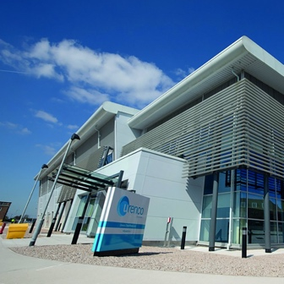
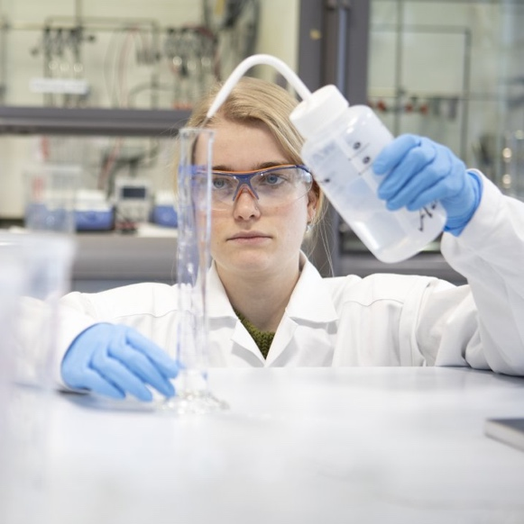
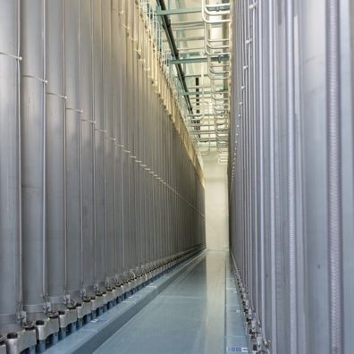
Business Development
.
Decommissioning & Stewardship Support for Enrichment Capacity Refurbishment
R&D efforts are focused on technology development for safely dismantling end-of-life centrifuges
Tails Management Facility doubling in size to support capacity program.

Slide 19

Summary

Slide 20
Summary and Outlook
Urenco is investing in enrichment capability for Advanced Nuclear
Firm commitments are necessary to underpin investments
Increased demand signals for Advanced Nuclear
We continue
to support government initiatives to close the gaps in the supply chain
Now is the time for action to enable current and next generation nuclear reactors

