Slide 1
Waste Control Specialists
Spring 2025 - LLW Forum

Slide 2
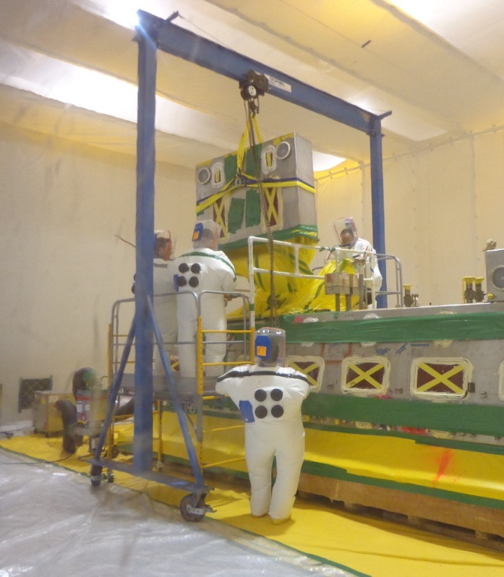
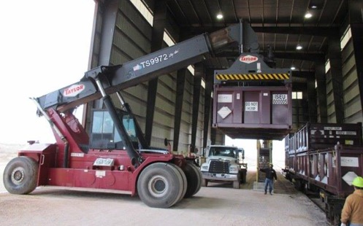
What We Do
Treatment of Hazardous and Mixed Waste
Logistics by Rail and Truck
On-site field services
  Characterization / Waste Planning
  Packaging / Shipping
Safe Disposal of Low-Level Radioactive Waste (LLRW)
  Class A/B/C LLRW and Mixed LLRW
  NORM, Oil & Gas NORM, and Byproduct material

Slide 3
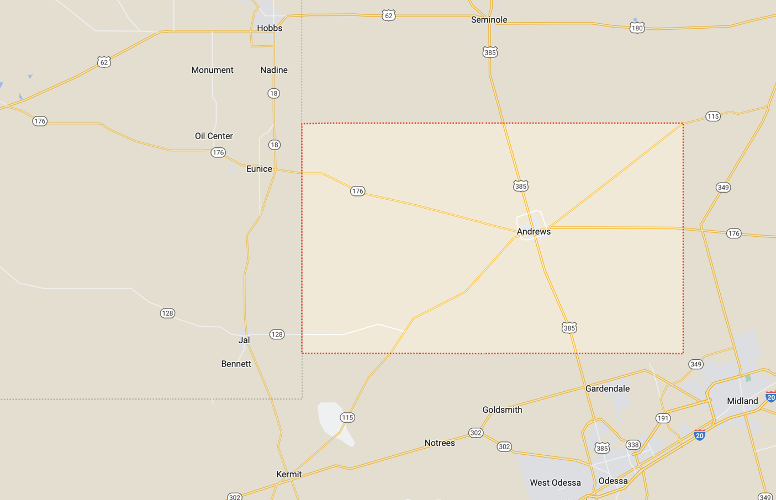
WCS Site – Relative Distances
Direct distance to communities:
Eunice, NM 5 miles
Hobbs, NM 15 miles
Jal, NM 24 miles
Andrews 30 miles
Seminole 30 miles
Odessa 50 miles
Midland 60 miles
WCS
Nearest residence is:
3.5 miles east, in NM @ 176 & 18
Nearest businesses are:
URENCO (uranium facility) - adjacent to site in NM
Lea County Landfill (trash disposal) - across 176 in NM
PB Materials (concrete plant) - NW site boundary in NM
Sundance Disposal (O&G waste) - NW site boundary in NM

Slide 4
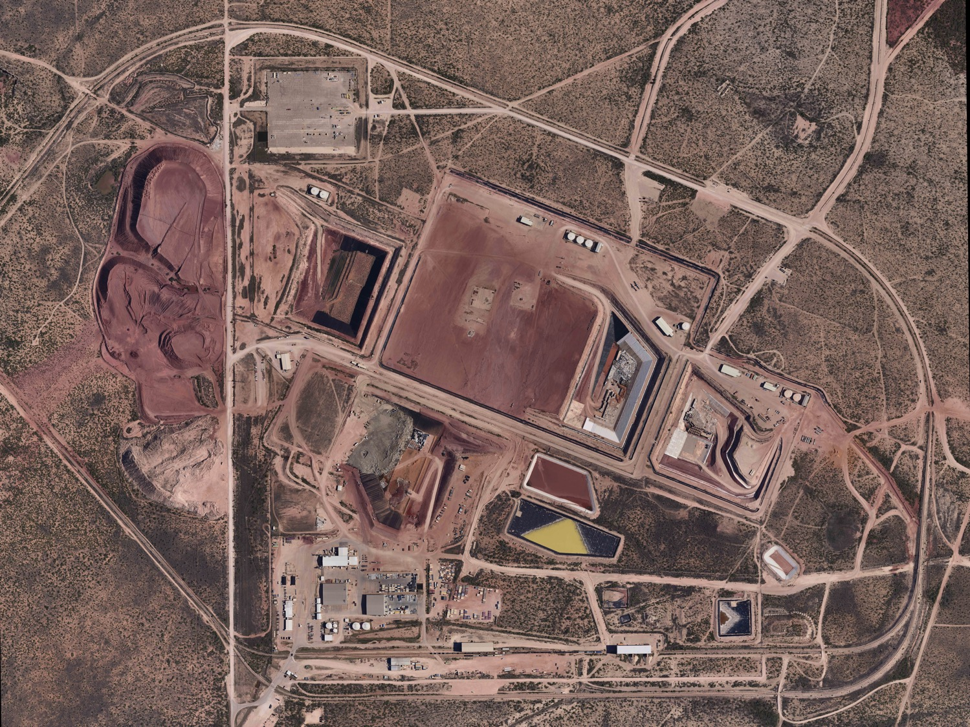
WCS Site – Facilities
14,000 acres (permitted area is 1,400 acres)
4 landfills, treatment facilities, rail access
Located on red-bed ridge
Byproduct
Facility
Federal
Facility
Compact
Facility
Hazardous
Waste
Landfill
Administration
Buildings
Treatment
Facilities
Rail
Offload

Slide 5
WCS Environmental Protection (vs. Generic Facility)
WCS Disposal
Other Facilities
  Key Attributes of WCS site:
  Sub-Grade Design
  Natural Claystone Barrier
  Thick Cover Design
  No viable pathway to groundwater
WCS is the Newest and Most Robust LLRW facility in the US

Slide 6
Extensive Subsurface Characterization
Over 640 wells/soil borings, numerous geologic/hydrologic investigations: 15 major geologic studies;
18 major hydrogeologic studies; 10 geophysical investigations.

Slide 7
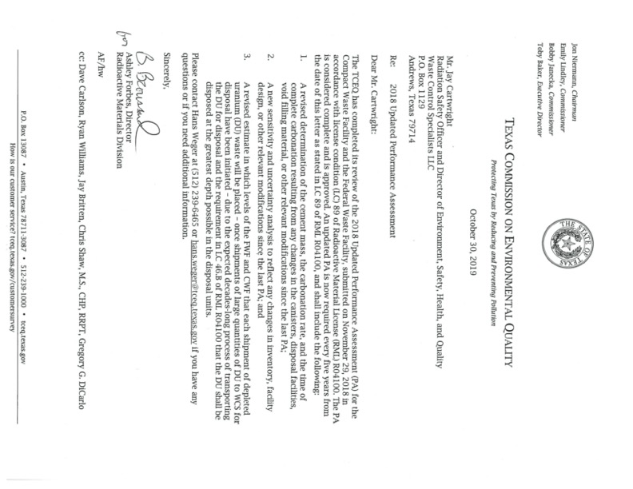
Performance Assessment
GoldSim-based modeling
Integrated PA for entire site examines:
  site geology
  surface water and groundwater
  potential future weather changes
  residential and intrusion scenarios
  possible future uses of the land
10,000-year compliance period, evaluated to one million (1,000,000) years
Majority of radionuclides have short half-life (Co-60, Fe-55, etc)
Some have longer half-life (C-14, N-63, U-238, Tc-99)
Current disposed inventory has a peak dose of 0.5 millirem per year - after >10,000 years

Slide 8
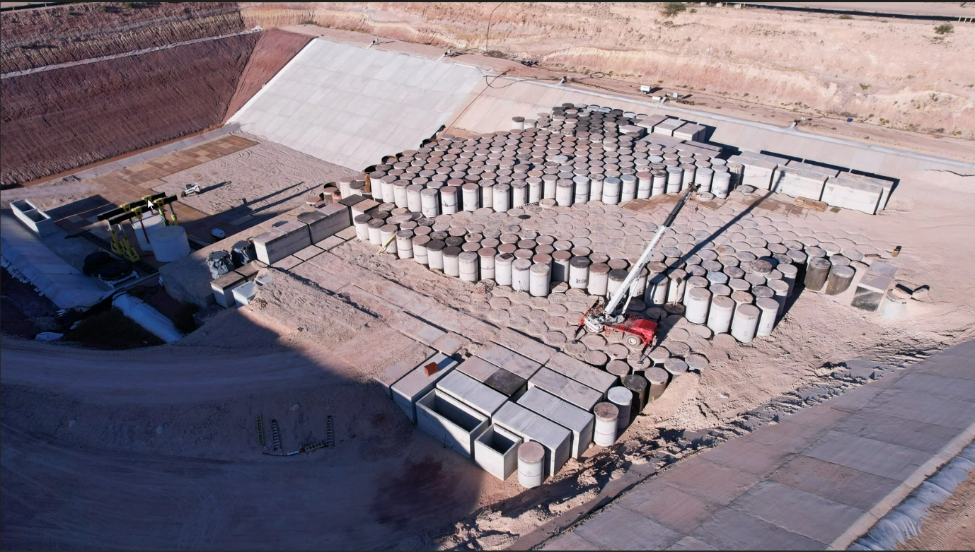
Compact Waste Facility
Texas owned
Privately-developed and operated
Regulated by TCEQ (2 on-site inspectors)
Opened in 2012

Slide 9
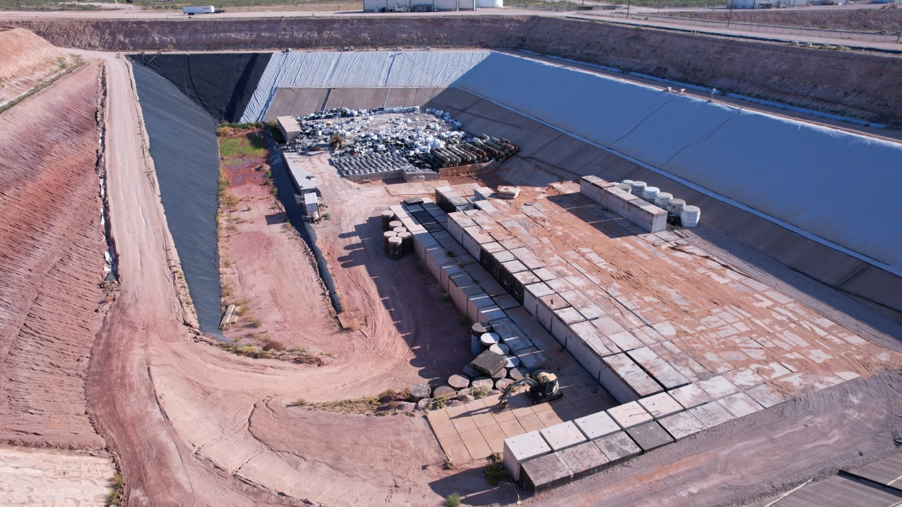
Federal Waste Facility
Federal government takes ownership post-closure
Privately-developed and operated
Regulated by TCEQ
Opened in 2013

Slide 10
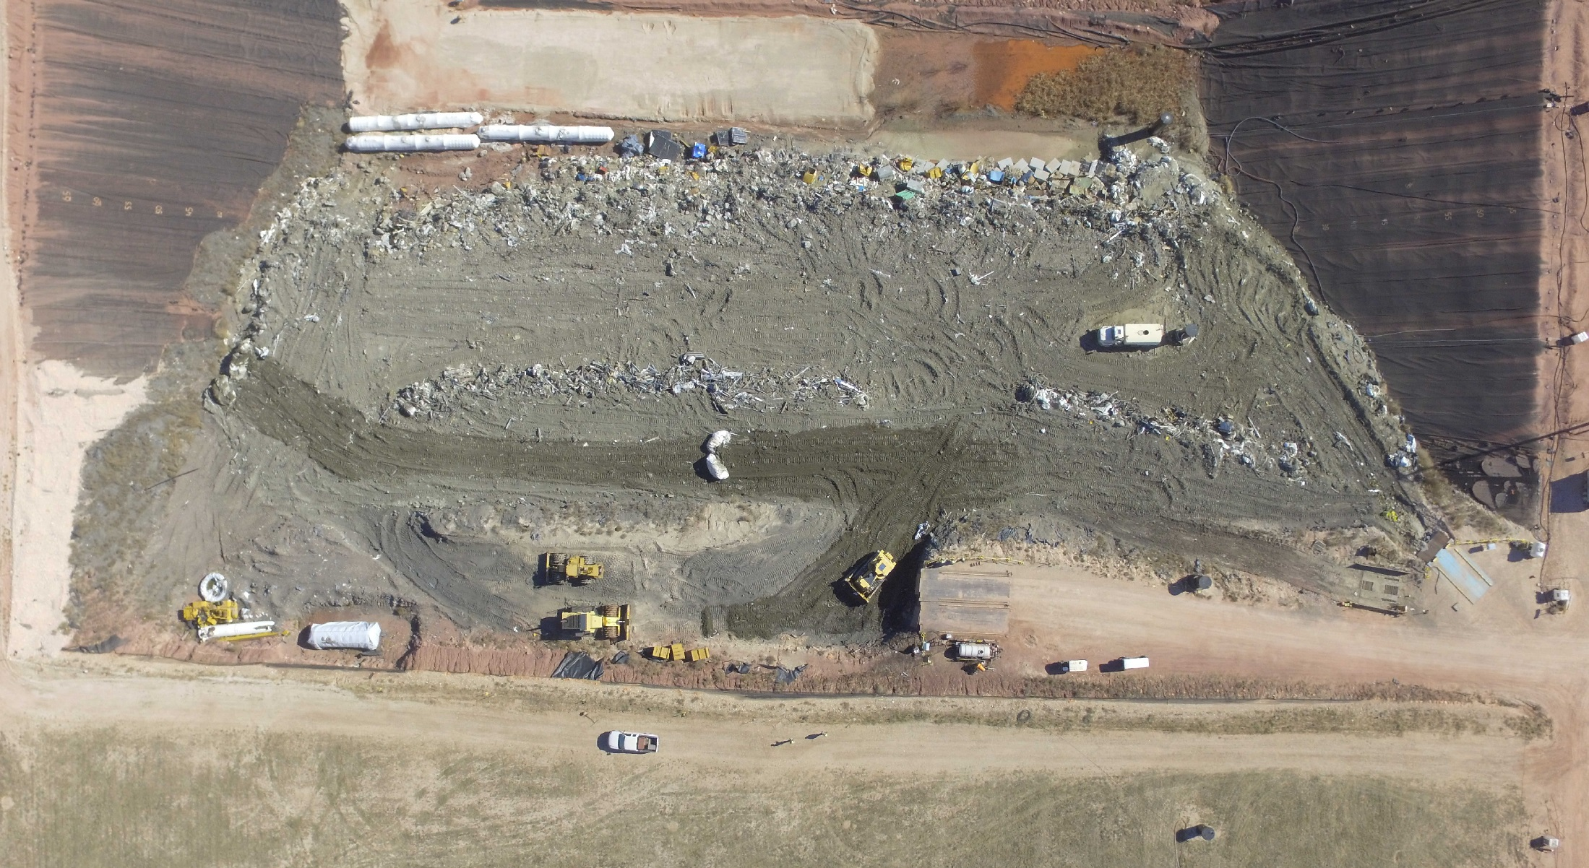
RCRA Subtitle C Landfill (Low Activity Waste)
Regulated by TCEQ
Privately-developed and operated
Opened in 1994
Accepts Exempt waste up to about
10% of the Class A limit

Slide 11
WCS Transportation / Logistics

Slide 12
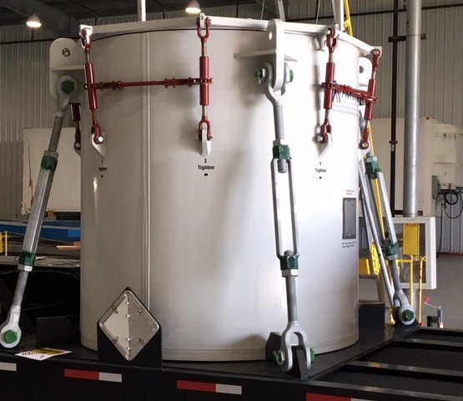
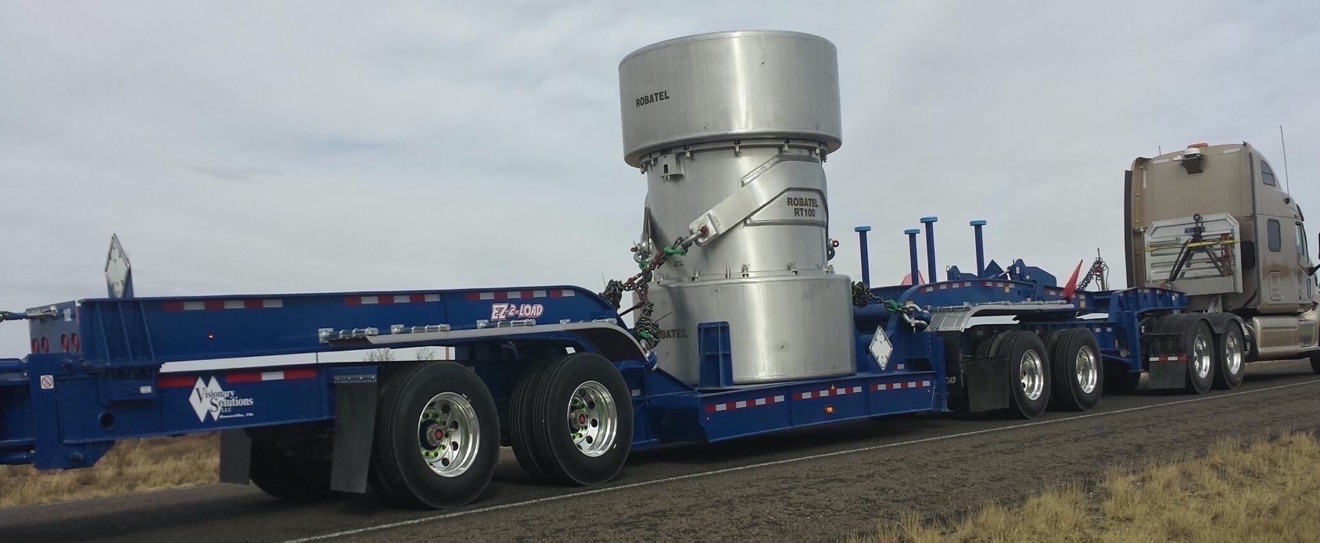
Transportation Casks
The most modern and state-of-the-art casks in service
Provides protection of the public and the environment in the event of the most severe accident scenarios
Regulated by the Nuclear Regulatory Commission and the Department of Transportation
WCS-160 Type B casks – 3 units
WCS-215 Type A casks – 3 units (plus leases as needed)
WCS-215 Type A Cask
WCS-160 Type B Cask

Slide 13
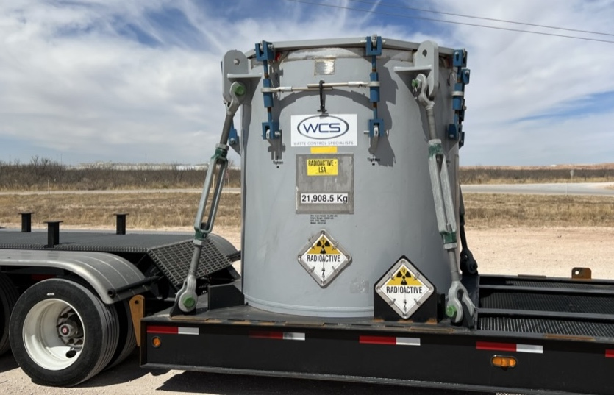
Cask Receipt

Slide 14
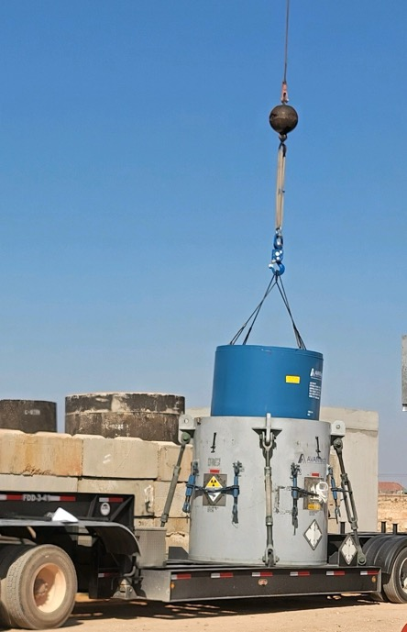
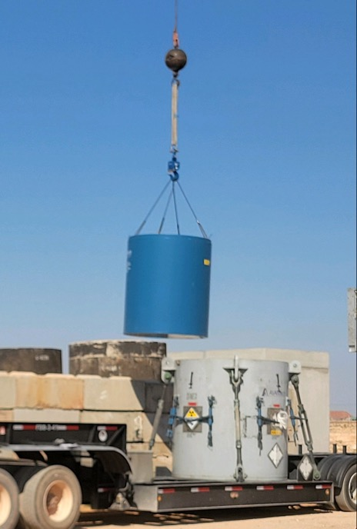
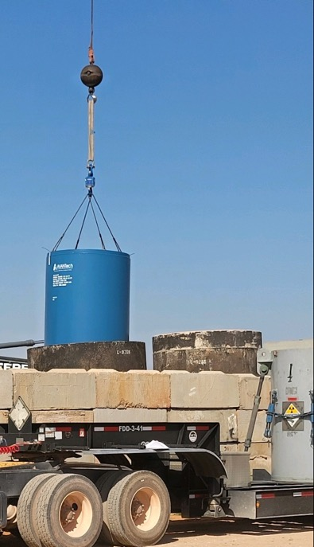
Offloading a Liner from a Transportation Cask
Liner (blue) is fabricated of steel and is bolted shut
Liner is removed from the transportation cask (grey)
Liner is loaded into a reinforced concrete Modular Concrete Container (MCC)
Lift from cask
Transfer
Lower into MCC

Slide 15
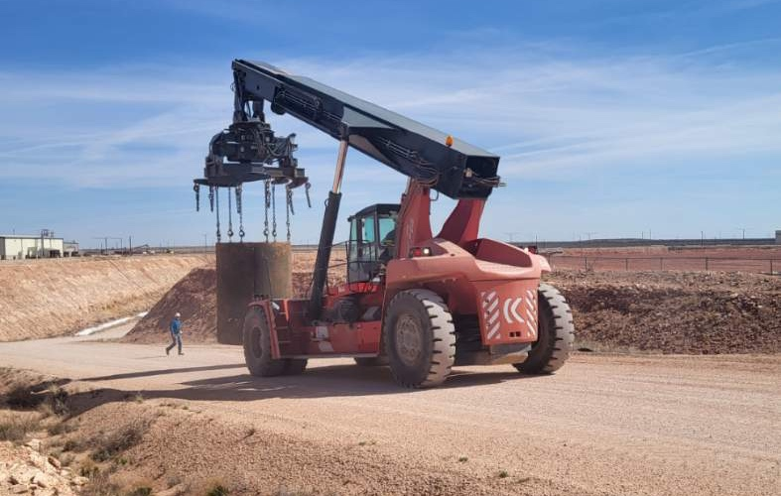
Transfer MCC to Disposal

Slide 16
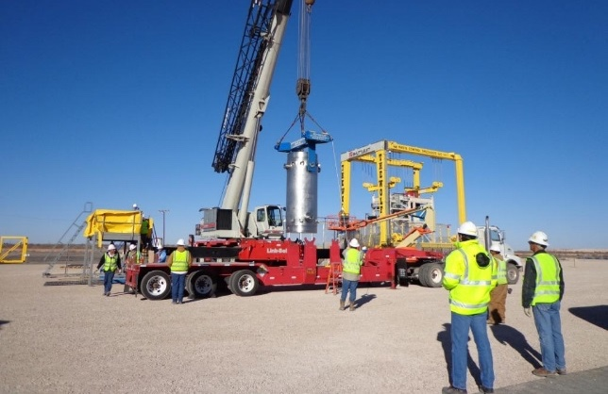
Irradiated Hardware Casks
WCS offloads TN-RAM, MP-197, 3-60B, WCS-160B
WCS routinely disposes of IH with dose rates >20,000 R/hr. on contact
Collective team dose is typically less than 0.02 person-rem
State-of-the-Art transfer system with complete remote handling
IH casks are routinely offloaded, reassembled and shipped back the same day

Slide 17
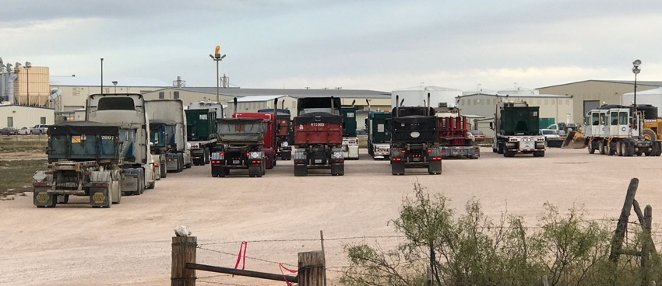
Highway Transportation
2024 Highway Volume
  750 shipments
  4,000 containers
  600,000 cubic feet (25% of volume)

Slide 18
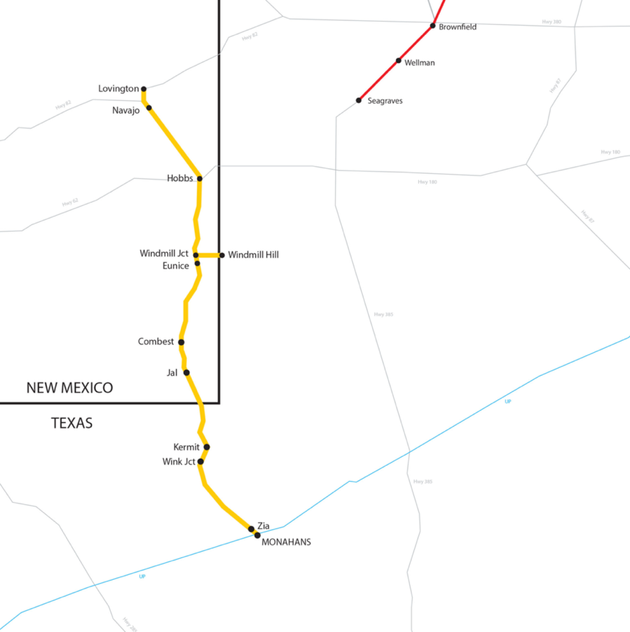
Rail Access
Direct Rail:
Texas and New Mexico Railway (TXN) interchange to Union Pacific (UP) at Monahans
Transload to Truck:
Lubbock and Western Railway (LBWR) interchange to BNSF at Lubbock and transload
WCS has the infrastructure to support transportation of heavy loads
Rail lines upgraded to support shipments over 450,000 lbs
WCS

Slide 19
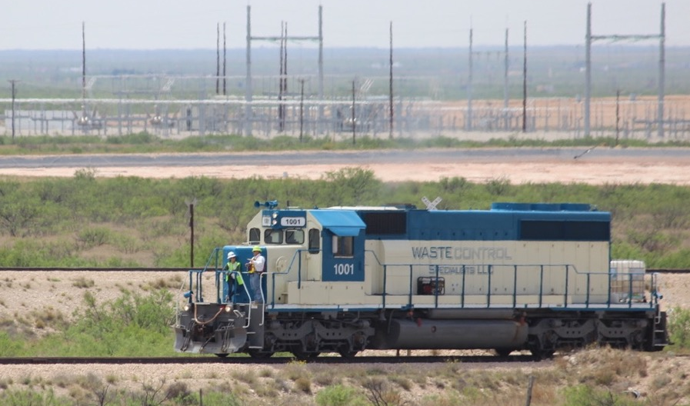
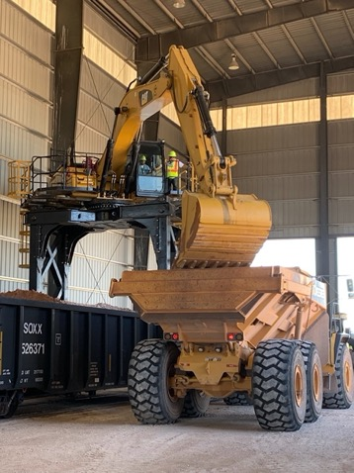
Rail Transportation
WCS has has the only rail line in Andrews County
  Operates 3 locomotives
  4-mile rail loop encircles the licensed site
  5 miles of owned rail line from site to Eunice, NM
  Served by two Class 1 railroads (UP and BNSF)
2024 Rail Volume
  600 shipments
  5,000 containers
  3,000,000 cubic feet (75% of volume)

Slide 20
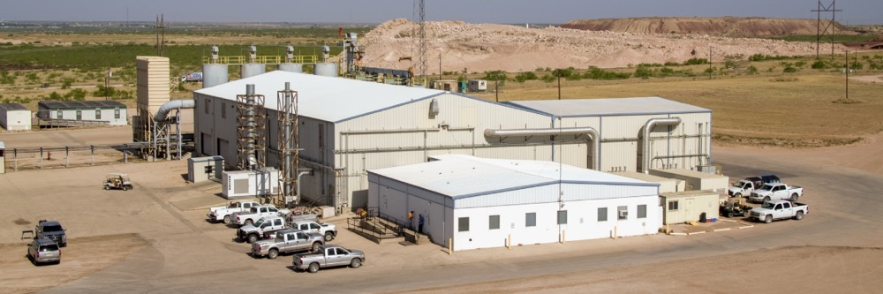
WCS Waste Treatment/Processing
LLRW, Mixed Waste, and Hazardous Waste

Slide 21
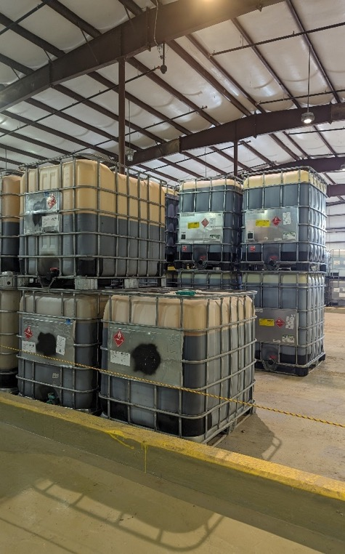
Waste Storage
RCRA/TSCA, Radioactive, and Mixed Waste
Waste Storage
Covered storage (over 60,000 cubic feet):
  Container Storage Building - 36,750 cubic feet (5,000 - 55-gallon drum equivalents)
  Bin Storage Area - 17,118 cubic feet
  Stabilization Building - 8,000 cubic feet
Outdoor Storage:
  Bin Storage Units (BSU) - 87,480 cubic feet
  LSA Storage Pad – 1,500,000 cubic feet, 10-acres of area (radioactive only)

Slide 22
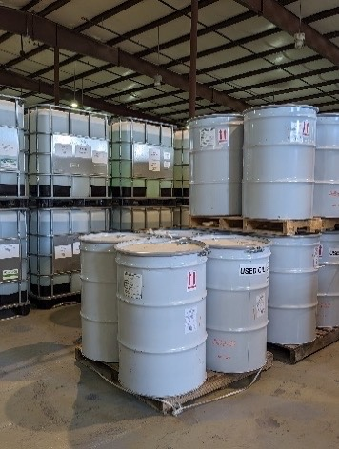
Waste Treatment – Waste Types
Authorized Types of Waste
Container Storage Building
Liquids, sludges, solids, lab packs in approved containers, and liquids in bulk tankers
Inorganic waste streams including acids, bases, and wastes contaminated with metals
Organic waste streams (with some concentration limitations)
High VOCs can be treated on a case-by-case basis
Water-reactive inorganic materials such as elemental lithium, sodium, etc.
Hazardous and non-hazardous wastes mixed with LLRW

Slide 23
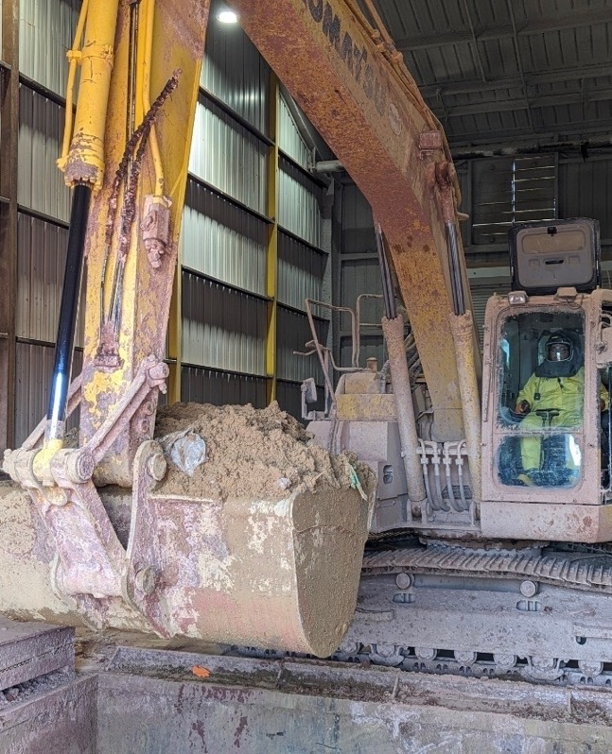
Waste Treatment – Processes
Bulk Pan Treatment
Treatment Processes
Sorting and Segregation
Characterization (parent and daughter waste streams)
Decontamination
Repackaging
Volume Reduction
Chemical oxidation
Chemical reduction
Deactivation
Micro- and macro-encapsulation
Neutralization
Stabilization
Controlled reaction
Dewatering

Slide 24
Treatment Facilities – MWTF
Mixed Waste Treatment Facility
Glove Box processing
  Negative pressure, processing and treatment facility
  20,000 square feet of treatment space
  85-cubic-yard capacity mixing pan
  Isolated treatment room with a dedicated ventilation system within the MWTF and double containment (as necessary)

Slide 25
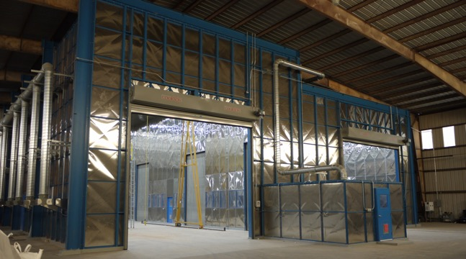
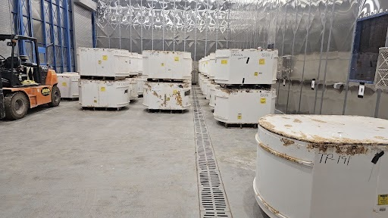
Treatment Facilities – Perma-Con
Perma-Con
In 2023 WCS installed the largest Perma-Con in the U.S.
Supports preparation and shipment of LANL TRU waste
6500 sq. ft. floor space
HVAC/HEPA System
Remotely operated five (5) ton mobile gantry crane
Backup generator

Slide 26
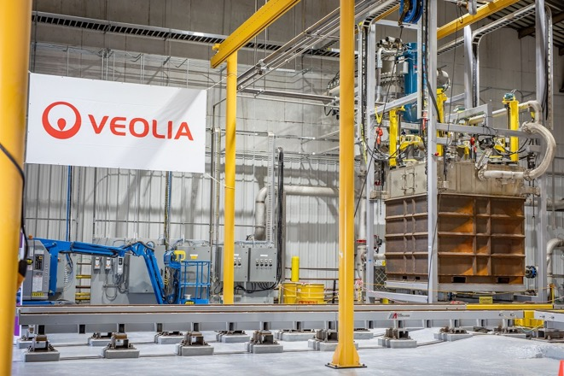
Other Treatment and Storage Capabilities
Veolia GeoMelt
Bulk Vitrification
Currently processing LLRW contaminated reactive metals
Plans in development for further complex and orphaned waste streams

Slide 27
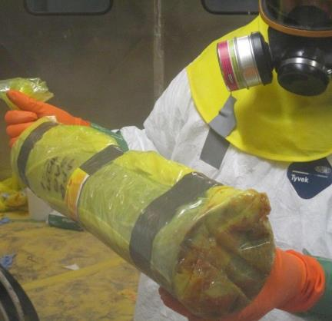
DOE Problematic Waste Example
WCS Services
  Receipt and storage of waste
  Sorting and Segregation by:
    Physical Form
    Radiological Character
    RCRA and TSCA hazard profiles
Re-Packaged waste for most appropriate
  Treatment (as required)
  Disposal (according to radiological character of daughter waste streams)
Result
  Quicker removal from generating site
  Lower cost
  Burial according to actual radiological character
Waste Profile Included:
Class C debris and non-debris mixed waste requiring RCRA treatment.
Potentially included solidified and non-solid sludge, wood, metal, PPE, miscellaneous plastic and cellulosic material, drum bags, plastic bottles (with or without liquid), cardboard, paper, rags, batteries, absorbents, soil/sweepings,
Potential PCB contamination

Slide 28
Depleted Uranium Disposal

Slide 29
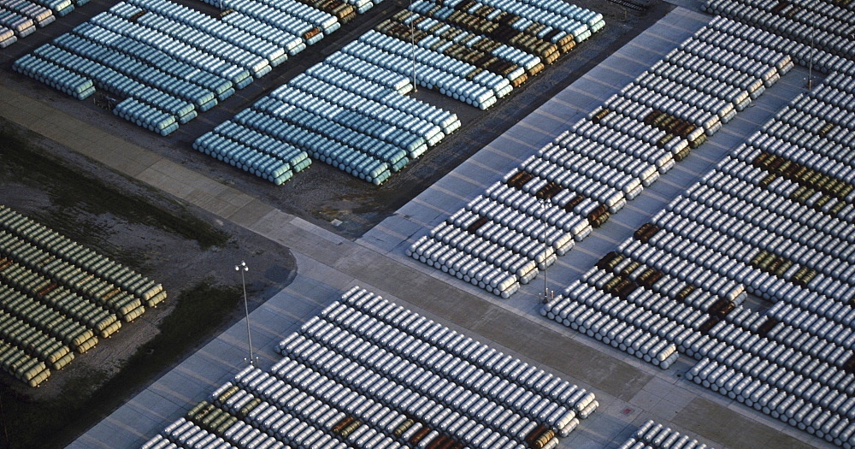
DOE Depleted Uranium (DU) Cylinders in Storage

Slide 30
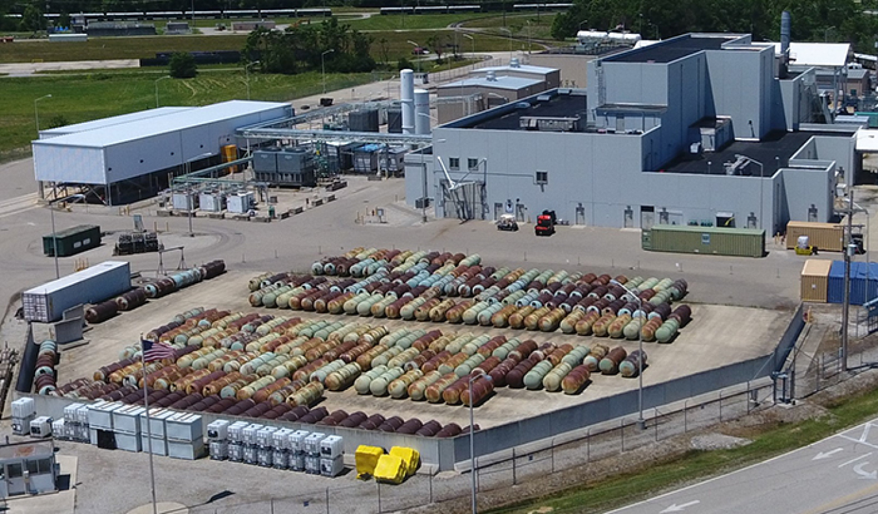
DOE DUF₆ Conversion Plants – Portsmouth and Paducah
DOE DUF₆ Facilities Convert DUF₆ Tails to stable DUO₂ for disposal
  DUF₆ – depleted uranium hexafluoride (a gas when heated)
  Tails – the depleted and discarded portion after enrichment
  DUO₂ – depleted uranium oxide (stable for disposal)
  Uranium Enrichment (increases fissionable U-235 percentage)
  Natural Uranium – 0.7% U-235 (99.3% U-238)
  Low Enriched Uranium (LEU) – 3% to 5% U-235
  Depleted Uranium (DU) – 0.2% to 0.3% U-235
April 2025 Status | Paducah | Portsmouth | TOTAL
Total DU Cylinder Inventory | 43,000 | 19,000 | 62,000
DUF₆ Facility Size | 4 lines | 3 lines | 7 lines
DUF₆ Facility Startup | 2011 | 2010
Conversion/year (capacity) | 800 | 600 | 1,400 | 2%
Converted to date | ~5,500 | ~3,500 | ~9,000 | 15%

Slide 31
DUO₂ Cylinder Disposal at WCS in Andrews, TX
DU Cylinders
4 feet diameter
12 feet long
28,000 lbs.

Slide 32
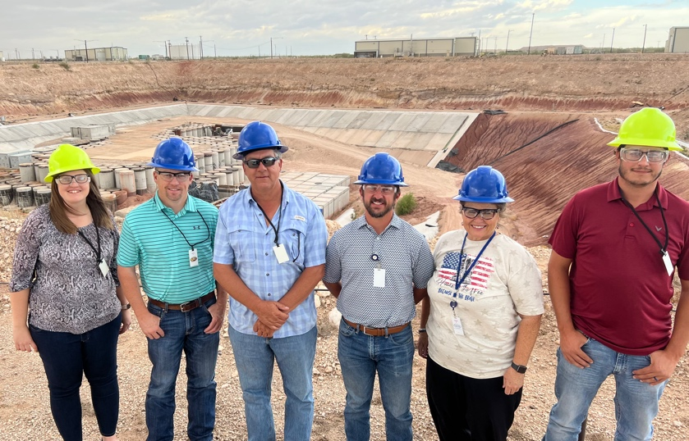
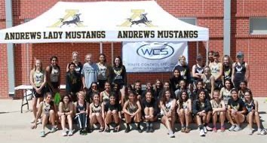
WCS - Local Activities
Our Staff Lives in the Community
  Largest private employer in Andrews county
  Over 125 site employees, >$15 million payroll
  Employees are involved in the community
    (schools, chambers of commerce, churches, sports, etc.)
Local Engagement
  High School credit course and internships
  Outreach to Andrews and regional communities
  WCS office and staff presence in center of town
Financial Support
  Over $300 million invested in site and facilities
  Purchase of supplies and services from local companies
  Financial contributions to Community Activities
    Education Foundation
    Scholarships, Public Safety, Sports Teams, etc.
  Special Surcharges (5% of LLRW disposal revenue)
    Paid in addition to all normal taxes and fees
    Supports quality-of-life community improvements
    $20.4 million provided to Andrews County so far

