Slide 1
Texas Update Low-Level Waste Forum, April 9, 2025
Ashley Forbes, Deputy Director
Office of Waste, Radioactive Materials Division

Slide 2
TCEQ Radioactive Materials Division
Radioactive Materials Licensing
low-level radioactive wastes
naturally occurring radioactive materials (NORM)
Uranium Licensing & Permitting
in situ uranium recovery
decommissioning and reclamation (UMTRCA Title II sites)
Notes:
12 active licenses, several pending applications (uranium). Not including new production areas for Class III UIC.

Slide 4
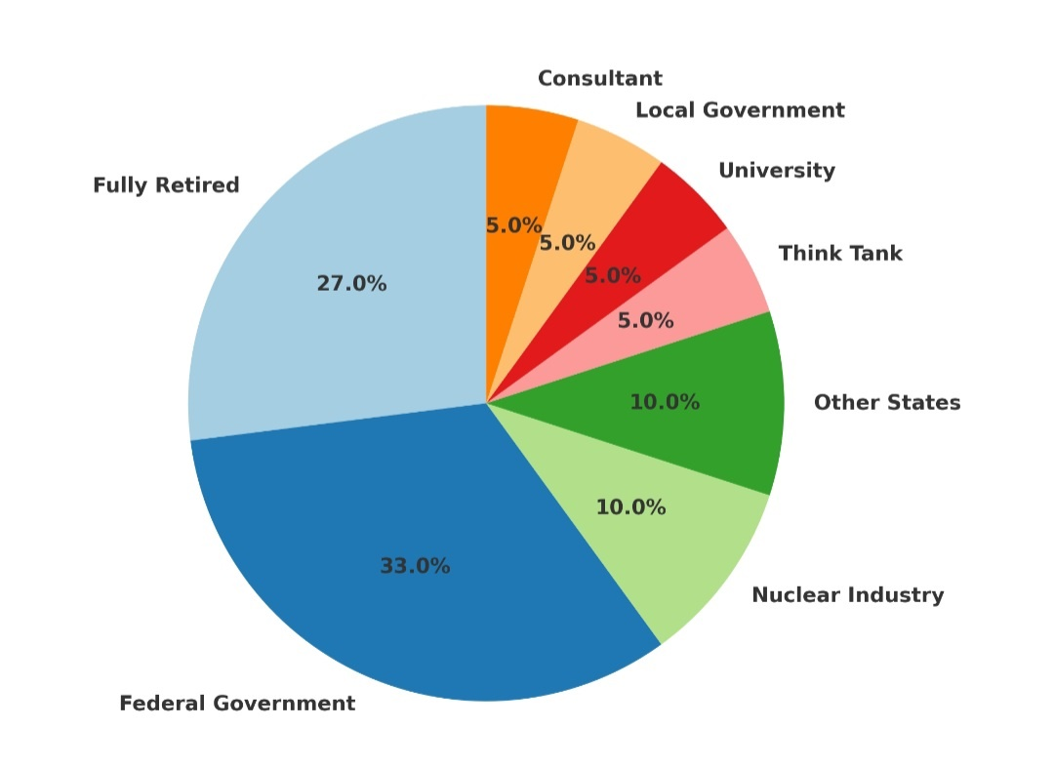
Workforce Challenges – Where Did They Go?
January 2020 to February 2025

Slide 5
Other programs in the TCEQ Radioactive Materials Division

Slide 6
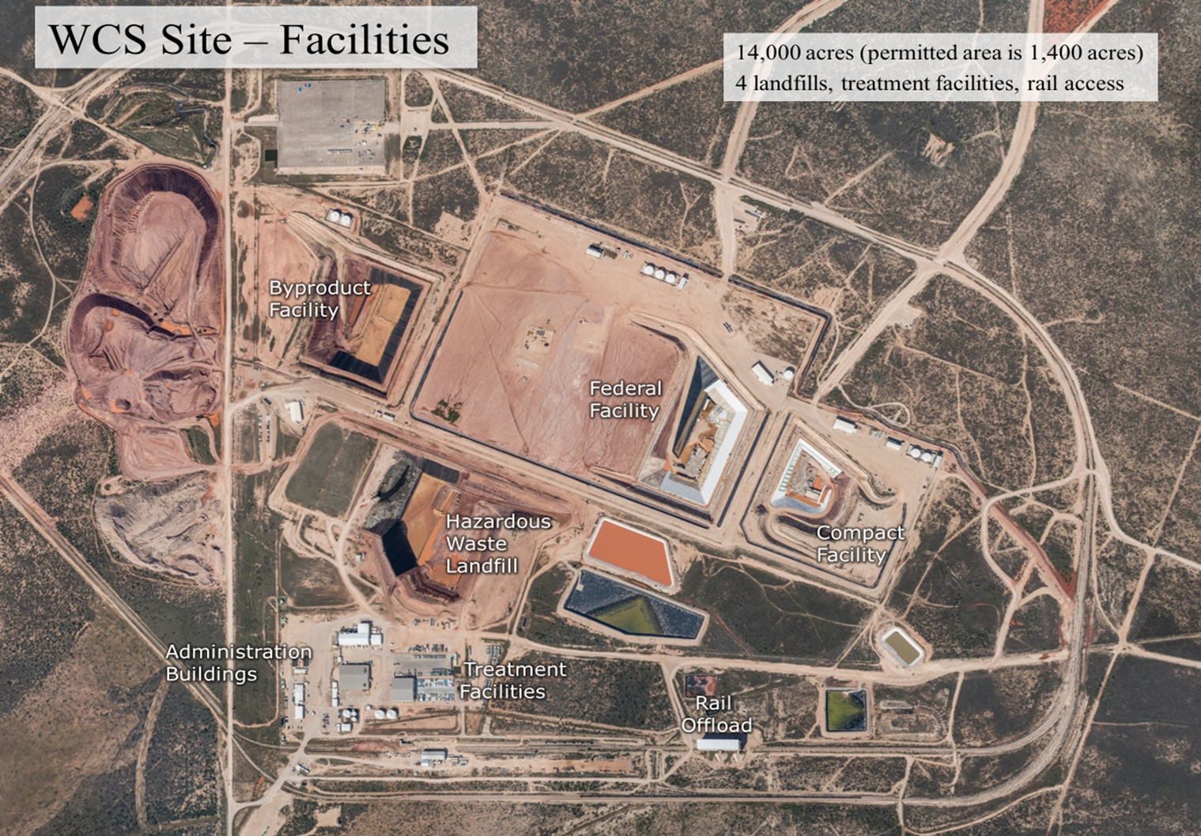

Slide 7
Waste Control Specialists site, Andrews, Texas
Compact Waste Facility (CWF):
9,000,000 cubic feet of licensed volume
Texas Low-Level Radioactive Waste Disposal Compact Commission (TLLRWDCC) makes import/export determinations
State of Texas takes ownership post-closure
Federal Waste Facility (FWF):
26,000,000 cubic feet of licensed volume
Department of Energy (DOE) takes ownership post-closure
Notes:
The rules for licensing of a LLRW disposal facility include detailed technical and performance requirements. The Texas Department of State Health Services' (DSHS) Radiation Control regulates the processing and storage of LLRW generated by DSHS licensees while the LLRW is at the site authorized under the DSHS license. Once the LLRW is received by another licensee for storage, processing, or disposal, it is regulated by the TCEQ.
Texas is a member of the Texas Low-Level Radioactive Waste Disposal Compact with the state of Vermont. The compact allows exclusive disposal of the LLRW generated within the member states to be disposed of in a LLRW disposal facility constructed within any of those states. Texas is the host state for the compact disposal facility.
Federal Waste = DOE. Includes mixed waste (RCRA) permit.

Slide 8
Waste Control Specialists site, Andrews, Texas
License Renewal
Application in timely renewal
Received August 25, 2023
Administrative Review was completed on January 12, 2024
Currently under Technical Review
When complete, will be publicly noticed
No Major amendments are included with the renewal application
License renewal will authorize operation for ten years

Slide 9
Waste Control Specialists site, Andrews, Texas
LANL Transuranic Waste
U.S. Department of Energy’s Waste Isolation Pilot Plant (WIPP) in New Mexico
Incident in 2014
Transuranic Waste from Los Alamos National Laboratory (LANL TRU) waste diverted to WCS FWF for temporary storage
LANL TRU waste moved from FWF to on-site storage facility
Waste prepared for offsite transport and disposal at the WIPP
Completion projected for December 31, 2026

Slide 10
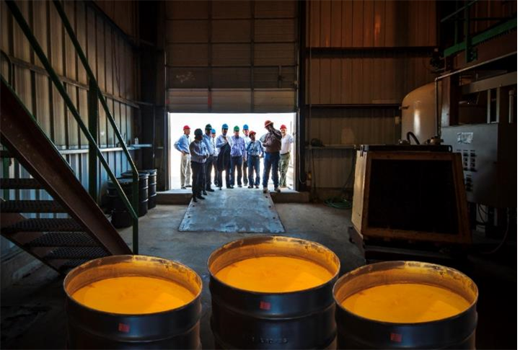

Slide 11
Uranium Mining in Texas
In Texas, the uranium industry is regulated primarily by the Railroad Commission of Texas and the Texas Commission on Environmental Quality​.
​Texas has 10 active exploration permits through the Railroad Commission of Texas​
8 Fully licensed and permitted ISR projects which includes satellite plants, wellfields, and/or processing facilities​
Uranium Energy Corporation - Hobson, Palangana, Goliad, Burke Hollow​
enCore - Rosita, Alta Mesa, Kingsville Dome and Vasquez​
Rosita and Alta Mesa​ are currently in production

Slide 12
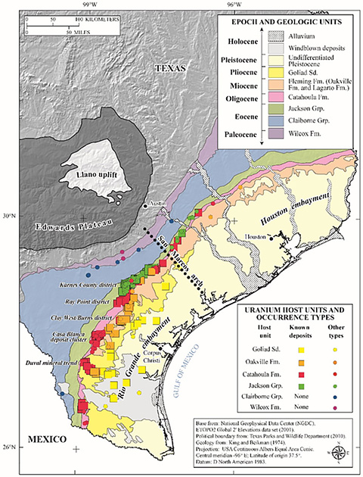
Uranium Mining Outlook for the State of Texas
Texas A&M Kingsville, led by Dr. Matthew Alexander, produced a comprehensive report on the uranium deposits in Texas. The report:
Evaluates existing and potential future sources of uranium in the state
Evaluates the economic potential for utilizing those deposits to lessen the United States’ reliance on foreign sources of uranium
Provides recommendations for strategies, legislative or regulatory changes, potential economic incentive programs, and public health and safety best practices to support the state’s uranium mining industry

Slide 14
89th Texas Legislature
Dates and deadlines for the 89th Texas Legislature
January 14, 2025: The 89th Texas Legislature convened at noon.
March 14, 2025: Deadline for the unrestricted filing of bills and joint resolutions.
June 2, 2025: Sine Die, the final day of the regular session.
June 22, 2025: Governor's signature deadline
September 1, 2025: Effective date for most new laws

Slide 15
89th Texas Legislature
8,898 bills and joint resolutions were filed in the 89th Texas Legislature by the 60-day bill filing deadline on March 14th.
TCEQ Radioactive Materials Division has analyzed or is otherwise monitoring 44 bills.
If passed, these 44 bills will affect the programs and/or resources of the Radioactive Materials Division.

Slide 16
89th Texas Legislature – Key Bills
​House Bills
​Bill Number | ​Author | ​Caption
​HB 14 | ​Harris | ​Relating to funding mechanisms within the Office of the Governor and Texas Public Utility Commission to support the deployment of advanced nuclear reactors in this state.
​HB 279 | ​Guillen | ​Relating to procedural requirements for uranium mining production area authorizations.
​HB 2678 | ​Darby | ​Relating to the establishment of the Texas Advanced Nuclear Energy Authority and a Texas nuclear permitting officer.
​HB 4112 | ​Landgraf | ​Relating to the storage or disposal of high-level radioactive waste.
​HB 4692 | ​Lalani | ​Relating to the storage or disposal of high-level radioactive waste.

Slide 17
89th Texas Legislature – Key Bills
​Senate Bills​
​Bill Number | ​Author | ​Caption
​SB 713 | ​Sparks | ​Relating to the surcharge for the disposal, and the remittance for the storage, of certain waste at the Texas Low-Level Radioactive Waste Disposal Compact waste disposal facility; decreasing the amount of the surcharge and changing how the surcharge and remittance are distributed.
​SB 1061 | ​Parker | Relating to procedural requirements for uranium mining production area authorizations.
​SB 1105 | ​Parker | ​Relating to the establishment of the Texas Advanced Nuclear Energy Authority and a Texas nuclear permitting officer.

Slide 18
89th Texas Legislature – Key Bills
Senate Bills​ cont’d
​SB 1534 | Zaffirini | Parker | ​Relating to a study and report by the Texas Higher Education Coordinating Board regarding health physics education in this state.
SB 1535 | ​Zaffirini | Parker | ​Relating to the establishment by the Texas Workforce Commission of an advanced nuclear energy workforce development program.
​SB 1631 | ​Campbell | ​Relating to the establishment by the Texas Workforce Commission of an advanced nuclear energy workforce development program.
​SB 2060 | ​Parker | ​Relating to funding mechanisms within the Office of the Governor and Texas Public Utility Commission to support the deployment of advanced nuclear reactors in this state.

Slide 19
Contact Information
Ashley.Forbes@tceq.texas.gov
512-239-0493
Notes:
And finally, here is my contact information if you have any questions

Slide 20
Notes:
Thank you all for your time and attention. Does anyone have any questions?

