Slide 1
Stakeholders Coming Together for
Transportation Security
Low-Level Waste Forum Spring Meeting
April 10, 2025
Shannon Morgan, Program Manager
Domestic Transportation Security
Oak Ridge National Laboratory

Slide 2

ARE SECURITY MEASURES ADVANCING with perceived threats to protect
RADIOACTIVE MATERIAL as it’s being moved around
NORTH AMERICA?
Notes:
In 2018, ORNL conducted an analysis for DOE/NNSA, the Office of Radioactive Security to understand just how safe and secure the transport radioactive material is within the United States? Each year, about 2,000 shipments of radioisotopes (Category 1 & 2)—are shipped by land, air, and sea all over the United States.
Generally speaking, yes, we were safe. There was a healthy regulatory environment and a good safety and security culture across those who were involved in moving radioactive sources in the United States.
However, it could be better.

Slide 3





Domestic Transportation Security Program
UNIFY STAKEHOLDERS
Raise the bar for protection through cooperation.
EXPLORE INSIDER MITIGATION
Recognize. Mitigate. Reduce.
ENABLE SOURCE CONTAINMENT
Detect. Delay. Respond.
ENHANCED TRAINING CAPABILITY
Assure a knowledgeable and skilled workforce.
  EFFECTIVE ANALYTICAL CAPABILITY
  Identify weaknesses. Design solutions.

Slide 4

Transportation Security UNIFIED Stakeholders Group
SECURE TRANSPORT OF RADIOACTIVE SOURCES
Strengthening the transport security community in the United States to reduce risk to radioactive sources
Notes:
TSUSG

Slide 5

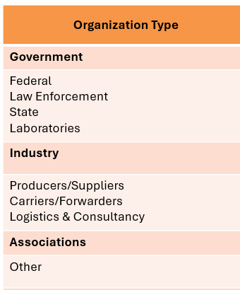
Bring together stakeholders involved in the safety & security of high consequence material while in transit
Collaboration Between Government and Industry
Law Enforcement
Law Enforcement
Industry
Associations
Industry
Government
Government
Notes:
What the TSUSG focuses on is the mutual collaboration between government and industry.
Today, The TSUSG has 167 voluntary members from across government, law enforcement, private industry, and professional associations. Members examine potential transport security issues from all aspects of shipping radioactive material. The goal is to make North America safer by not only delivering needed supplies to medical facilities and research labs, but also in preventing this material from falling into the wrong hands.

Slide 6
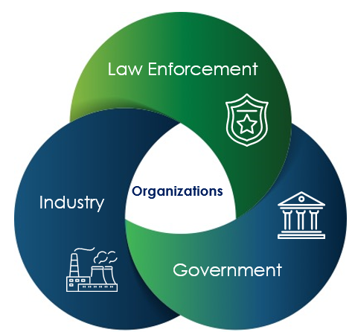

Priority Committees Collaborate to
Mitigate or Resolve Issues
Identify Topics
Priority Committee
Deliverable
Security Planning
Cyber Security
Regulations
Training needs
Escorts
Best practices
Training
Report
Template
Relevant subset of stakeholder's form working group
Notes:
Quarterly Tactical Meeting various topics.

Slide 7
Priority Committees Making Progress
Complete
TSUSG charter
Insider threat assessments
Escort procedures for North America
Create a standardized unified transportation security plan
Artificial Intelligence
Impacts to Security
Create group charter for the Federal Advisory Committee Act
Cybersecurity Mitigation Options
Ongoing
Training
Cyber Security
Artificial Intelligence
Managing security regulations
Insider threat training
Review procedures for escorts and incident response across the U.S. and Canada
New!
Interstate escorting strategy
Harmonization and collaboration of shipping requirements
Managing Security Regulations
Continue to recruit TSUSG members
Notes:
TSUSG Key Activities
Priority Committees (cross functional groups investigating, evaluating, and identifying processes, procedures or measure that mitigate or resolve identified security issues)
Blue are the completed activities
Green are the current active Priority Committees.
Managing Security Regulations with TSA, NRC, DOT, CNSC, and Transport Canada

Slide 8

HOW
TSUSG
WORKS
IMPROVE
security practices
UNDERSTAND challenges
across organizations
Notes:
There are two ways to think about how TSUSG works.
Members share challenges and best practices for their organizations. This creates a shared awareness of the state of transportation security. In some cases, there needs to be a better relationship between government, law enforcement, and industry, and gaining understanding can bridge many issues.
If an organization has a challenge that is hindered, the TSUSG can try to solve it. This may mean asking governments to review policy, helping an organization create a new program to bring more structure to solving a problem, or providing training to create standards of practice across the country.

Slide 9


Slide 10

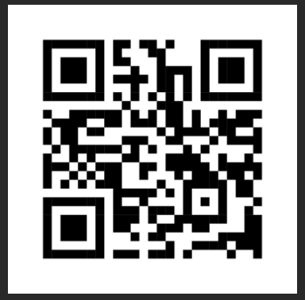
JOIN TSUSG
tsusg.ornl.gov
Shannon Morgan, TSUSG
Domestic Transportation Security
tsusg@ornl.gov
865/603-5681
Notes:
Consider joining the TSUSG and have your voice heard

