Slide 1
Overview of the LLW Forum’s Disused Sources Working Group Michael Klebe April 11, 2025

Slide 2
DSWG Current Membership
Members:
Rich Janati, PA Earl Fordham, WA
Larry Kellum, UT John Williamson, FL
Dane Blakinger, WA Michael Kurth, US Army
Tom Hansen, SECC
Organizational Liaisons
Craig Little, HPS Mike Snee, CRCPD
Staff
Dan Shrum Michael Klebe Cecilia Snyder

Slide 3
Disused Sources Working Group Origin
DSWG formed in 2011 at the request of the NNSA/GTRI to address the problem of disused radioactive sealed sources
Approximately 2 million sealed sources in use
Tens of thousands disused sources with no exact knowledge of number, activity, and storage security

Slide 4
Disused Source Problem Contributing Factors
Life-cycle costs for managing and disposing of sources not internalized
Inconsistent view of which sources pose a security threat
Regulatory system inadequacies for a post-9/11 threat environment
No financial incentive for reuse, recycle, or disposal
Opportunities for recycling and reusing sources are underutilized
Type B shipping container availability and cost

Slide 5
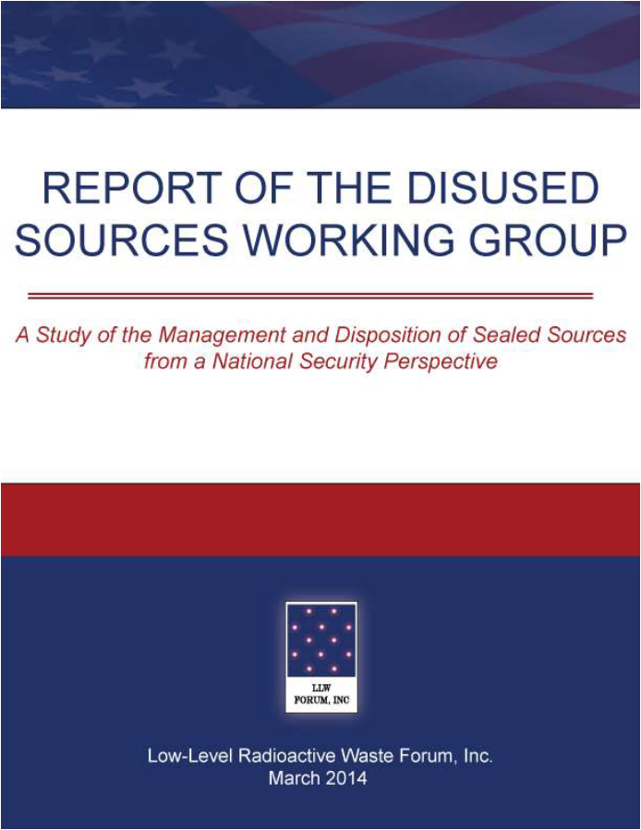
DSWG Report
Report published – March 2014
24 recommendations for improving the security of sealed sources
Several recommendations have been completed
Currently revising the priority of the remaining recommendations
Notes:
19 meetings
30 months
Stakeholder engagement
Report preparation
Technical Review
Report published – March 2014
24 recommendations for improving the security of sealed sources

Slide 6
National Source Tracking System
The NSTS is a secure user-friendly web-based database designed to track Category 1 and 2 radioactive sources.
Tracking spans the life cycle of the source from manufacture through shipment receipt, decay and burial.
About 1,300 licensees began reporting Cat 1 and 2 sources in January 2009

Slide 7
National Source Tracking System
In 2008, NRC proposed to add Cat 3 sources to NSTS. Failed on a 2-2 Commission vote.
DSWG’s 2014 report recommended adding Cat 3 sources to the NSTS.
#5 –The NRC should expand the NSTS to track Category 3 sources.
Response received from Agreement States has been the effort is not worth the return without any quantification of the effort involved.

Slide 8
Pilot Study for Adding Cat 3 Sources to NSTS
DSWG is seeking an Agreement State program partner to evaluate the level of effort associated with adding Cat 3 sources.
Revised scope of work
Single phase
Clearly articulated deliverables
Funding

Slide 9
Pilot Study Scope of Work
Identify licensees (SL & GL) who possess Cat 3 sources
Develop an informational campaign to educate and inform licensees of reporting requirements
Develop draft regulation to require reporting Cat 3 sources

Slide 10
Pilot Study Deliverables – Task 1
No-name list of entities possessing Cat 3 sources
Industry sector
Whether they already report Cat 1 and/or 2 sources
Document describing the process used
Identification of personnel resources used in identifying persons possessing Cat 3 sources (staff hours)
Managerial
Technical
Administrative support

Slide 11
Pilot Study Deliverables – Task 2
Written document describing how the Agreement State would educate/inform licensees possessing Cat 3 sources
Electronic copy of the educational program that would be used
Printed material
Visual media presentations
Identification of the resources used in creating the educational program (staff hours)
Managerial
Technical
Administrative support

Slide 12
Pilot Study Deliverables – Task 3
Document describing the process used to amend their regulations to report Cat 3 sources to the NSTS
Copy of the draft amendment to the regulations
Identification of personnel resources used in creating the draft amendment (staff hours)
Managerial
Technical
Administrative support

Slide 13
Agreement State Partner
Looking for an Agreement State program participant
Had discussion with a few, but no takers.

Slide 14
NRC Rulemakings
Integrated Low-Level Radioactive Waste Disposal
Decommissioning Financial Assurance for Sealed and Unsealed Radioactive Materials
Financial Assurance Requirements for Category 1 and 2 Byproduct Material Sealed Sources

Slide 15
Integrated Low-Level Radioactive Waste Disposal
This rulemaking would:
require new and revised site-specific technical analyses and permit the development of site-specific criteria for LLRW acceptance based on the results of these analyses (long-lived material)
authorize the near-surface disposal of certain GTCC waste streams and provide for Agreement State licensing of these waste streams
Licensees of currently operating LLRW facilities that do not plan to accept GTCC waste, or significant quantities of long-lived radionuclides would continue to comply with current regulations.
Proposed rule publication date: May 30, 2025

Slide 16
Decommissioning Financial Assurance for Sealed and Unsealed Radioactive Materials
This rulemaking would:
add radionuclides and corresponding possession values not currently listed in Part 30 Appendix B for calculating decommissioning funding requirement
apply a uniform and more risk-informed method for setting possession values for all radionuclides listed in Appendix B
apply to all entities licensed to possess sealed or unsealed byproduct or special nuclear material with a half-life greater than 120 days
Proposed rule publication date: April 22, 2025

Slide 17
Financial Assurance Requirements for Category 1 and 2 Byproduct Material Sealed Sources
This rulemaking would:
require financial assurance for the disposition of Category 1 and 2 byproduct material radioactive sealed sources.
help ensure:
that licensees are financially prepared for the costs of end-of-life disposition of Category 1 and 2 byproduct material radioactive sealed sources,
safe and secure management of these sources by facilitating timely disposition when they are no longer needed or wanted, and
that dispositioning costs are borne by those who receive the economic benefits from the use of these sources.
Regulatory Basis publication date: April 30, 2025

Slide 18
DSWG Resources Webpage
Repository of pertinent documents related to the management of sealed sources
Reorganizing to make it more user friendly
Broad categories with expandable drop-down buttons
Launched last winter

Slide 19
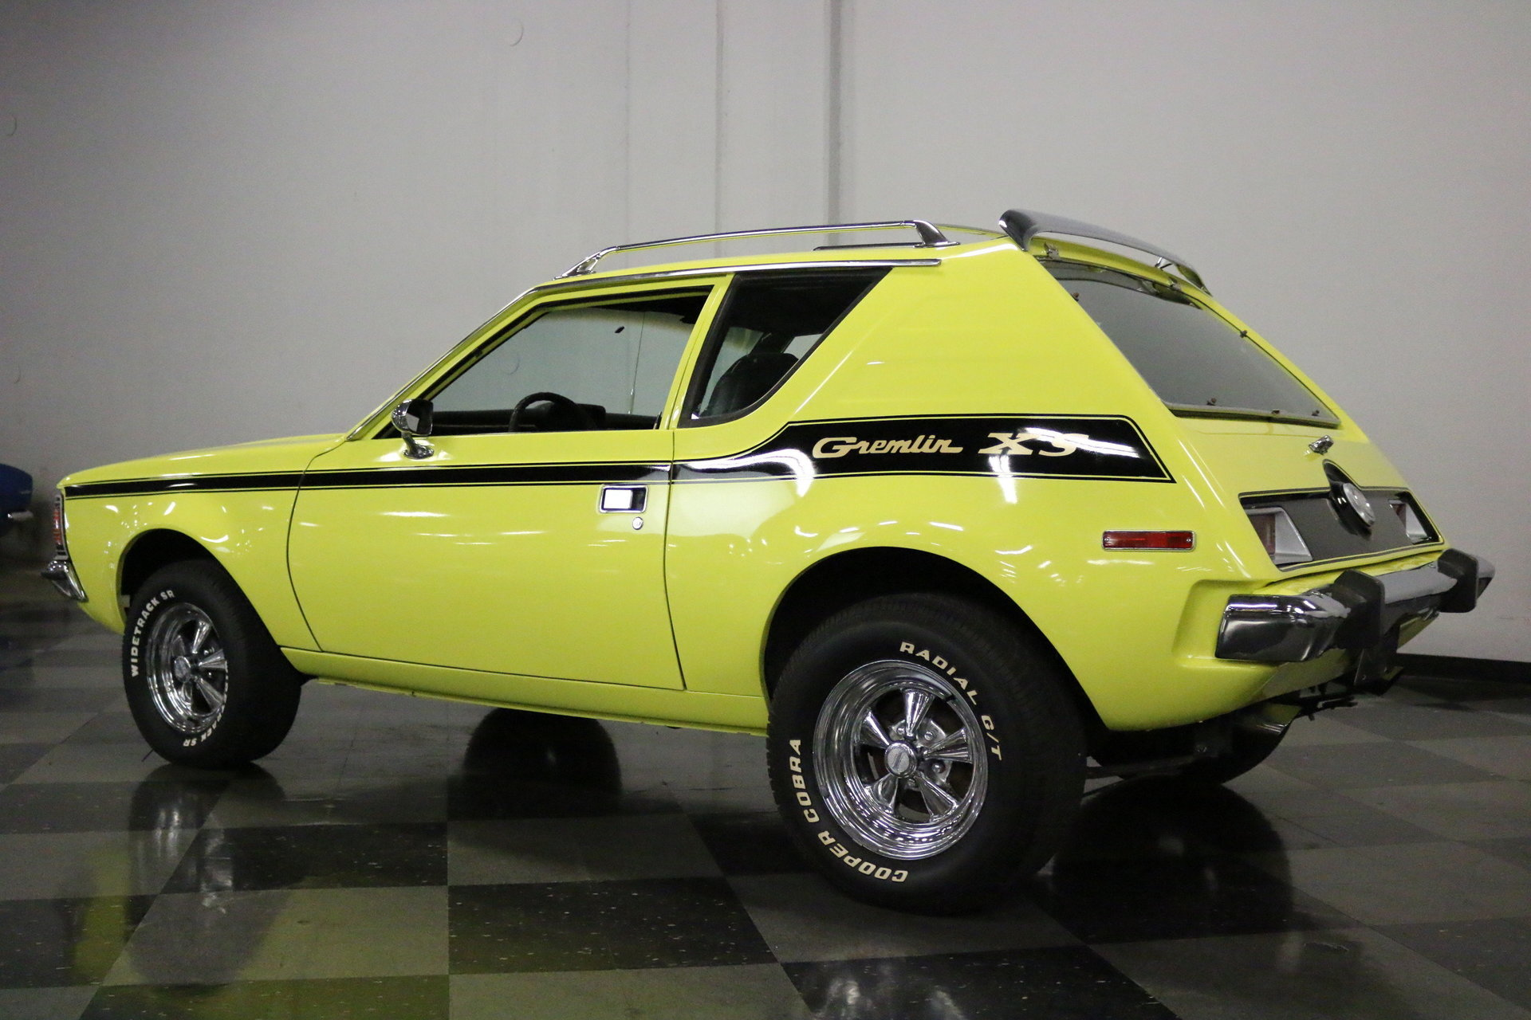
DSWG Resources Webpage
Plagued by gremlins:

Slide 20
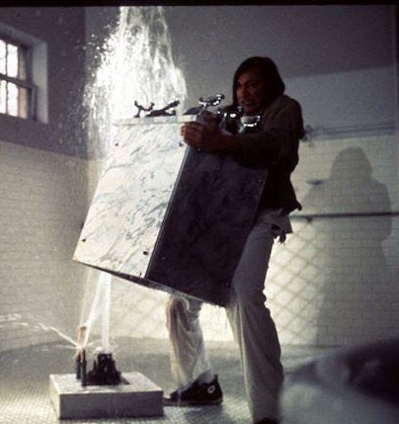
DSWG Resources Webpage
Cecilia working on it:
Michael working on it:

Slide 21
Re-evaluation of DSWG recommendations
#4 – Require a Specific License (SL) for all Category 3 sources.
#7 – Robust financial assurance requirements for Cat 1 – 3 sources
#9 – Annual source fee to encourage disposal
#10 – Storage time limit for unused Cat 1 – 3 sources
#12 – Require manufacturers/suppliers to dispose of sources that have no recycle or reuse value on an annual basis.
#23 – Continue to fund NNSA activities for the collection of orphaned and abandoned sources that don’t have a disposal pathway

Slide 22
Additional Information:

