Slide 1
Richland LLRW Site Update
LLW Forum - Spring 2025 Meeting
Hans Honerlah
Manager of Strategic ES Sales - Republic Services
April 9, 2025
Notes:
Introduction
Thank you for the opportunity to be here and talk a little bit about our Richland LLRW Disposal facility

Slide 2
Republic Services, Inc.
Company Overview
Notes:
USEW is a subsidiary of US Ecology Holdings, Inc, which is a subsidiary of US Ecology, Inc. whose parent company is Republic Services, Inc.
A few slides about the company and how Richland fits into it.

Slide 3

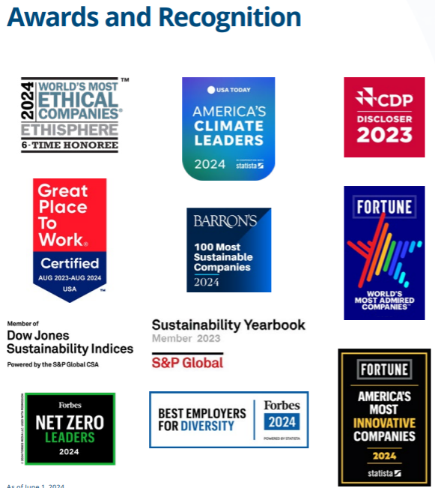

Republic Services
About
Republic Services, Inc. is now the nation’s leading environmental services provider. Through our subsidiaries (US Ecology, ACV & ACT Enviro, Ecoflo), we provide superior service offerings to ensure compliance while partnering with customers to create a more sustainable world.
Company Overview
42K employees
14M customers
1,000+ worldwide locations
$15B in revenue in 2023
95% customer retention
17K Trucks | 5th largest vocational fleet in the nation
Business Solutions
Solid waste collection and disposal
Recycling
Dumpster rental
Construction and demo
Compactor solutions
Environmental solutions
Notes:
RS primary scope before acquiring US Ecology was Solid Waste & Recycling.
RS Purchase of USE in May 2022. Created Environmental Solutions Group.
US Ecology’s main focus was Hazardous Waste (TSD), Field Industrial Services and Emergency Response.
RS added ACT Enviro this year.

Slide 4
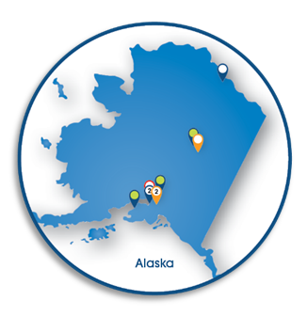
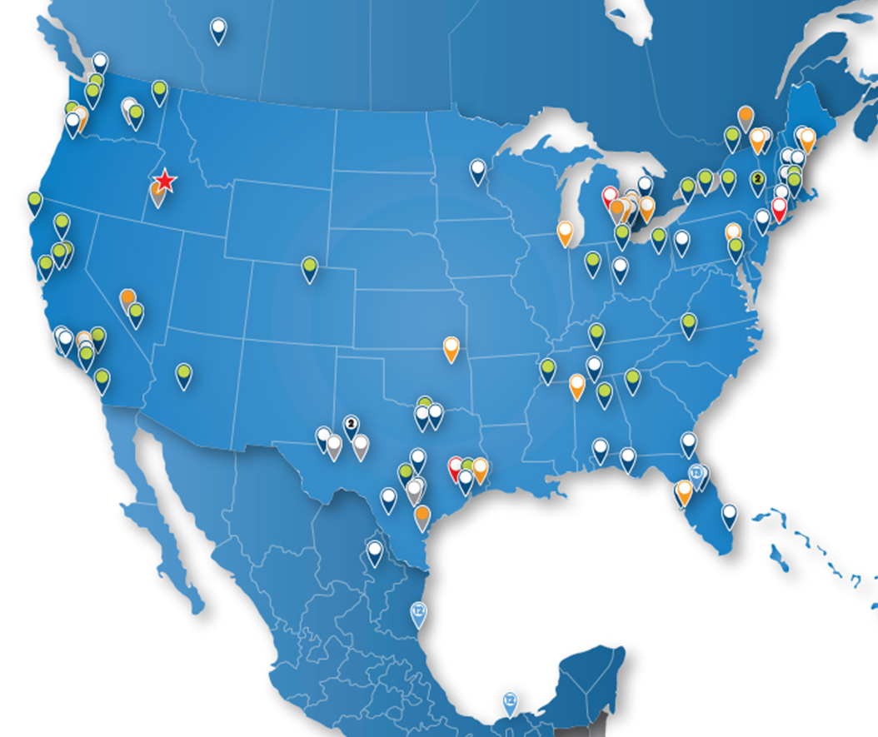
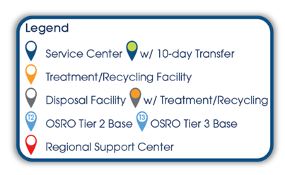
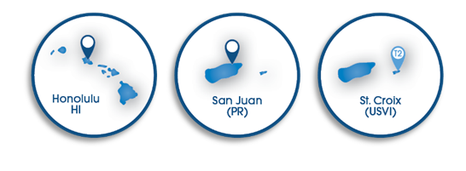
Environmental Solutions
Vision: To be the Premier Provider of Comprehensive Environmental Services
Notes:
Further illustration of the “Environmental Solutions” group.
Additional locations added following the acquisition of ACT Enviro in 2023, another large environmental services company (Environmental, Treatment, Industrial) based on the west coast.
Some of their services include:
Our team of skilled environmental consultants is available to provide on-site support, in a full- or part-time capacity, to supplement existing staff or lead delivery of new environmental initiatives.
Transportation & Disposal
On-site Technical Services
10-Day Distribution
Lab Packing
Bulk Transportation
Consulting
Emergency Response
Investigation Derived Waste (IDW) Management
We offer each customer a broad spectrum of environmentally sound and cost-effective disposal management technologies for both hazardous and non-hazardous wastes.
TSDF
Medical Waste Processing
Universal Waste Processing
Recycling
Solidification Treatment
Our seasoned experts manage a robust fleet of equipment including vacuum trucks ranging from 70bbl bob-tails to 150bbl semi-trailer units, steel 10-40-yard roll-off bins and other specialized units.
Industrial Cleaning
Field Services
Remediation & Demolition
Vacuum Truck Services
Roll-off Bins
Pond-dredging

Slide 5
Environmental Solutions
Republic Services’ extensive Environmental Solutions nationwide footprint allows us to support your recycling and waste needs safely and sustainably. Our team of professionals stand ready to handle your most complex jobs.
15
Environmental Solutions Landfills
7
Injection Wells
8
Environmental Solutions Recycling Sites
20
Treatment, Storage and Disposal Facilities
100+
Service Centers
Notes:
Richland is included in the 20 TSDFs, even though we only do the “D” in TSDF. We are not a traditional landfill as recognized by RS,

Slide 6
Richland, WA
Facility
Low-Level Waste Compacts

Slide 7
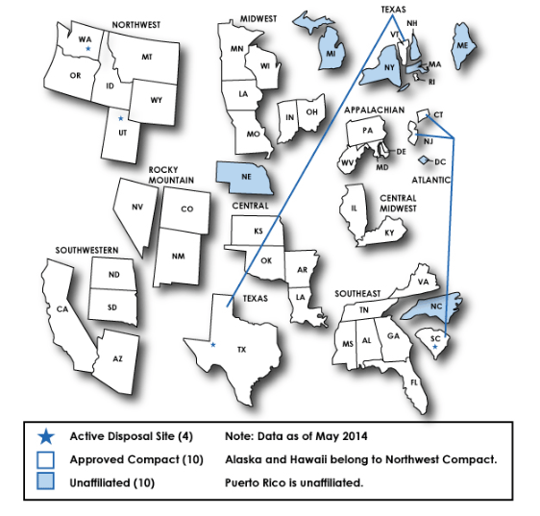
Northwest and Rocky Mountain Compacts
Richland is the designated host LLRW Disposal Facility for the Northwest Compact (8 States)
Richland also serves the Rocky Mountain Compact through agreement (3 States)
Notes:
Should be familiar Compacts – NRC websites visual representation
The NWIC was the first Compact to be formed
The Rocky Mountain was the second Compact

Slide 8
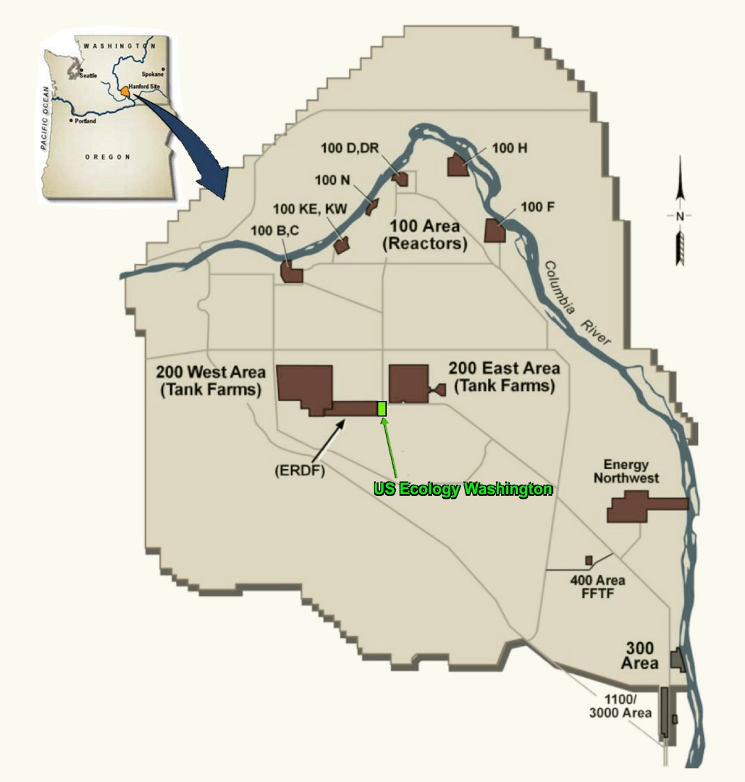
Republic Services Richland
Part 61 LLRW Facility – 1 of 4 in United States
Located on 100 acres within the DOE Hanford Reservation in Richland, WA
Originally Licensed in 1965 by AEC
Serves the NW and Rocky Mountain Compacts
Operates through sublease agreement with State of WA
Rate-regulated by WA Utility & Transportation Commission
Notes:
Other Part 61 facilities - Clive, UT (Energy Solutions), Barnwell, SC (Energy Solutions), Andrews, TX (Waste Control Specialists)
Sublease is being renewed in 2025. Exercising request for another (second) 10-year extension to the 2005 sublease through the Washington Department of Ecology.
Initial sublease offering (2005 – 2015)
First Extension (2015 – 2025)
Second Extension (2025 – 2035)***

Slide 9
Richland Historical – Timeline & Key Dates
1965 – Site Licensed by the Atomic Energy Commission to California Nuclear, Inc. (CNI) begins accepting LLRW
1968 – Nuclear Engineering Company (NECO) acquires CNI, takes over as site operator
1976 – Congress passes RCRA
1980 – Congress passes LLRW Policy Act
1981 – NECO changes name to US Ecology, Inc. US Ecology Washington, Inc (USEW) is a subsidiary.
1981 – USEW disposes of 1,440,000 Cubic Feet of LLRW in a single year, taking almost half of the national volume
1983 – NRC adoption of 10 CFR Part 61 for regulating LLRW sites
1985 – Congress passes LLRW Amendments Act
1986 – WDOH adopts first regulation for NARM disposal
1992 – Started tracking NARM separately from LLRW. Trojan NPP Shutdown (1 of 2 Compact NPPs)
1993 – Northwest Compact restricts disposal of LLRW to NWIC (8 states) and Rocky Mountain Compact (3 states)
1999 – Disposal of Trojan Reactor Vessel.
2019 – Trench 12 opened for disposal of Class A Unstable. (Newest trench – build as we go)
2022 – Republic Services, Inc. acquires US Ecology, Inc. and its subsidiaries. Rebrands USEW site as “Republic Services Richland” but keeps USEW as legal name
Notes:
Interesting Dates to Point Out:
1965 – Opened & originally licensed by the AEC
1980 – LLRW Policy Act
1981 – Disposal volume
1992 – Trojan Nuclear Power Plant (PWR), near Rainier, OR. Shut down in 1992. D&D
1993 – Compacts restrict access for disposal to the Richland Facility

Slide 10
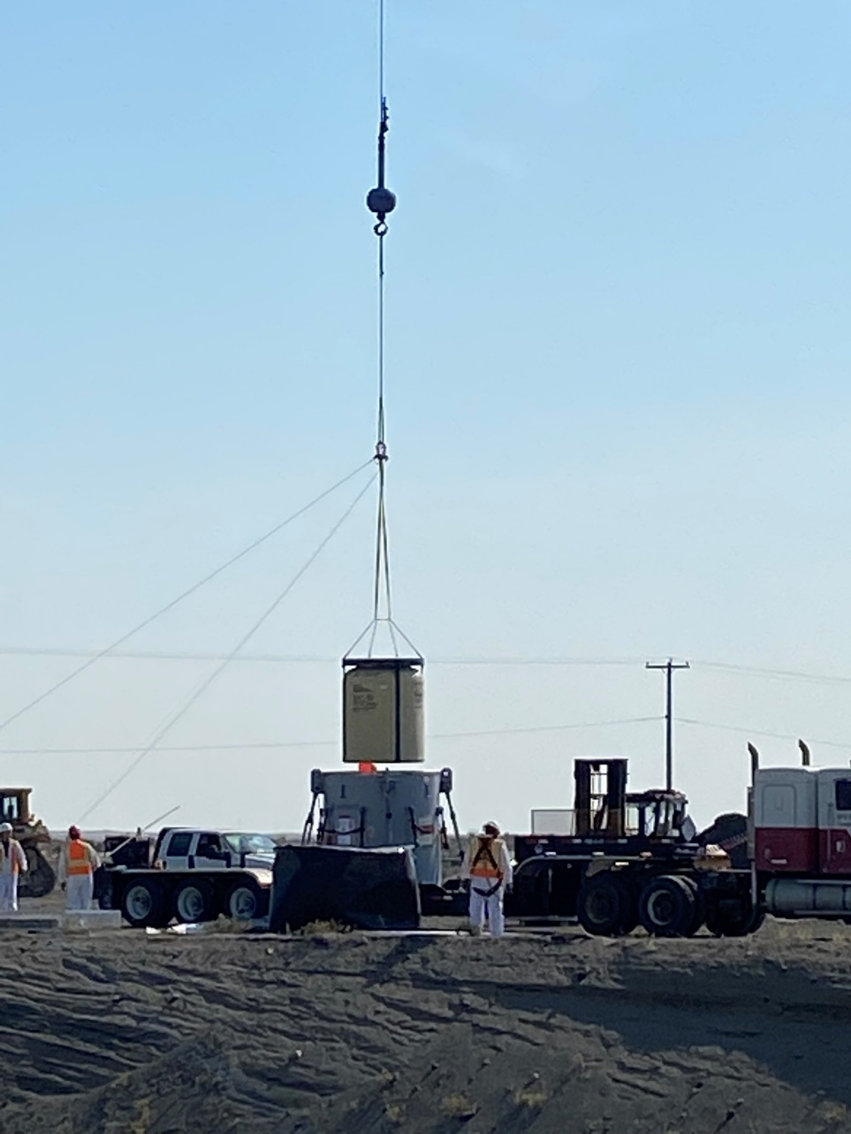
Historical – Volumes and Source Term Update
Total Site Volume Disposed
~14.5M cubic feet
Includes LLRW & NARM
Total Site Source Term
~3.7M Curies
~1.6M Curies from Co-60 alone (~43%)
600+ manifested radionuclides
Not decay corrected
Notes:
Data is thru end of 2023.
Activity was never decay corrected at Richland.
For the 2004 EIS Radiological Risk Assessment, the WDOH went back from 1965 – 1996 and started a decay correction as of 1996 to perform the assessment. Andrew Thatcher (WDOH)

Slide 11
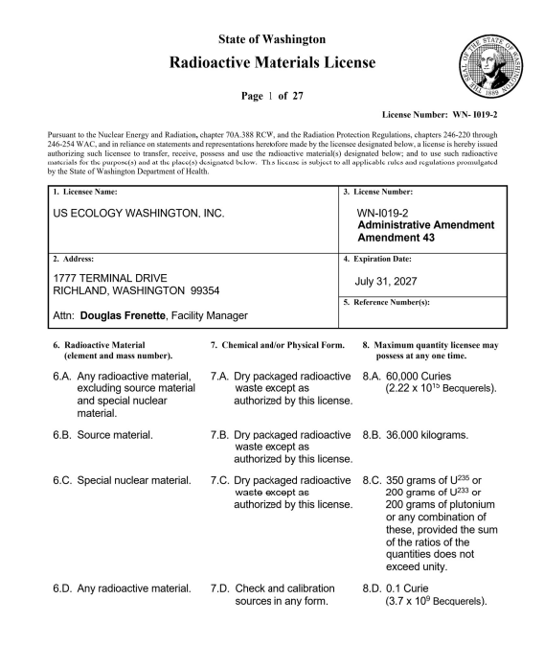
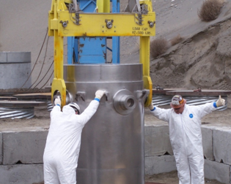
Washington License & Accepted Waste
WDOH License # WN-I019-2, Amendment 44
Expires July 31, 2027
Class A, B and C LLRW in the Northwest and Rocky Mountain Compacts
NORM/TENORM/NARM acceptable from generators nationwide
High-activity sealed source capabilities
All waste arrives by truck
Notes:
Our license contains the waste acceptance criteria for disposal of LLRW at our facility. There isn’t a separate “WAC” Waste Acceptance Criteria document like you may find at other facilities such as WCS or Area 5, RWMC
License was renewed in 2022 (Amendment 42).
WDOH issued an administrative amendment on January 9, 2025. Amendment 44. Only included a revised Facility Standards Manual (incorporated by reference). No impact waste generators or brokers.
Point out no onsite rail capability.

Slide 12
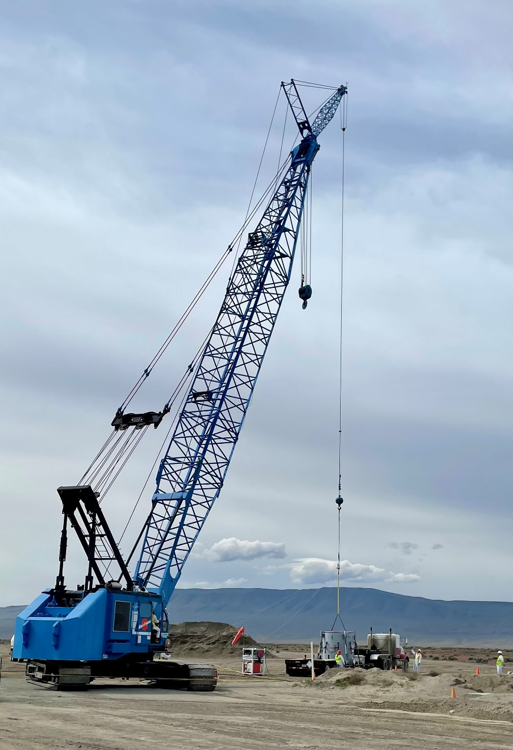
Richland Facility - Overview
Currently employs 24 full time workers
Facility averages ~20,000 ft³ of LLW annually (10-yr average)
Disposal trenches are designated for Stable or Unstable LLW
Disposal trenches are built of various sizes can be up to 50 feet deep, 150 feet wide and 1,000 feet long
Construct trenches on “build-as-you-go” method (150’ sections)
Provides enough disposal capacity for Compact Waste Generators through 2056
Notes:
Seeing a decreasing trend of annual volume (LLRW & NARM):
2022 – 26,681.7 ft3
2023 – 14,439.97 ft3
2024 – 9,122.61 ft3
2025 – 11,402 ft3 (projected)
Estimated volume remining under permit ~

Slide 13
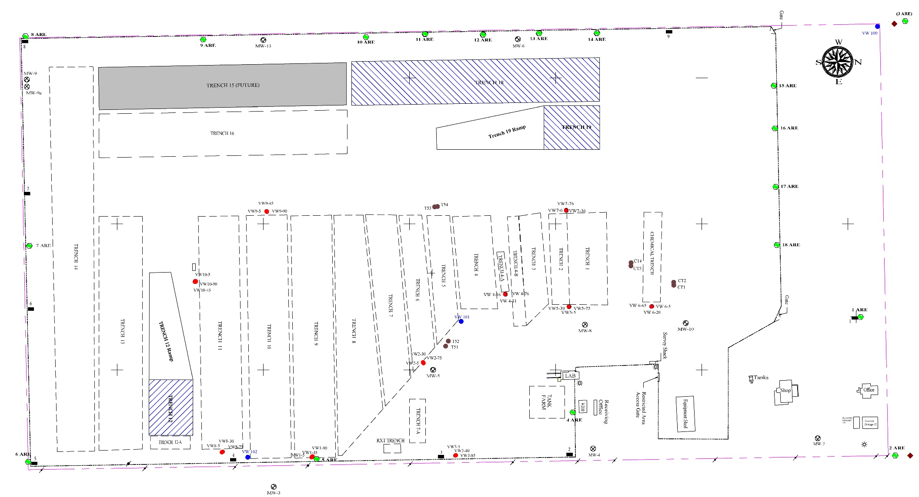
Site Footprint
Trench 18 - AU
Trench 19 A/B/C Stable
Trench 12 - AU
Notes:
3 Active disposal trenches
Stable and Unstable waste is segregated.
Trench 19 is stable waste
Trench 12 & 18 are unstable waste
Trench 12 is the newest of the 2 stable
Trench 18 will have the interim closure cap installed in 2025
Enough disposal capacity to last to 2056 closure date. (Based on existing volumes)

Slide 14
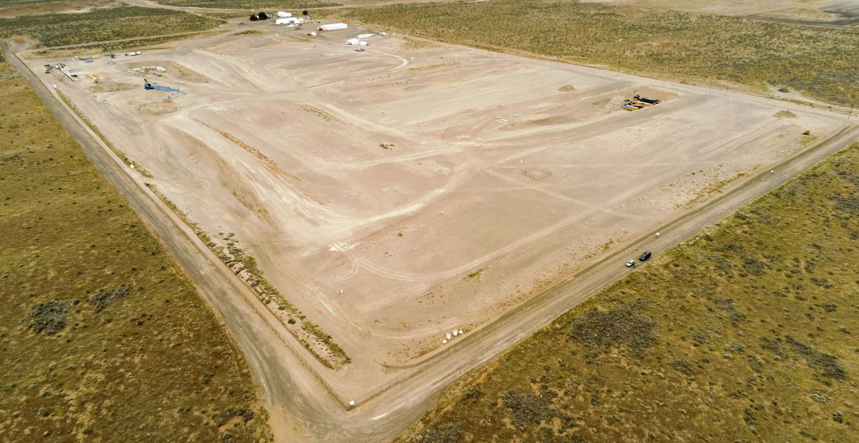
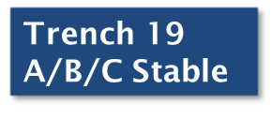




Richland Facility
N
Notes:
2023 aerial view of the site. Three active trenches.
DOE restrictions for the use of drones, must use a specific DOE vetted service contractor

Slide 15
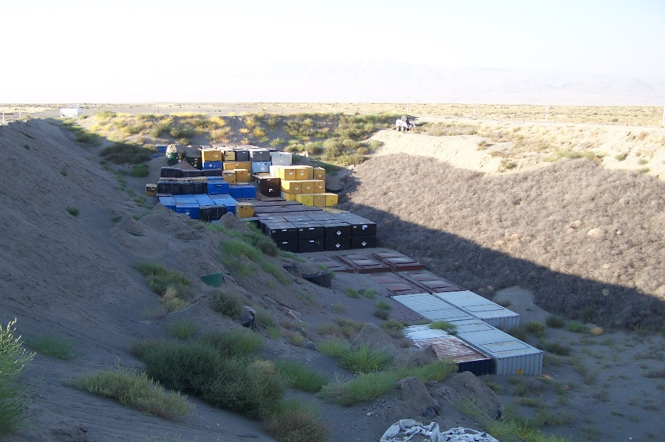
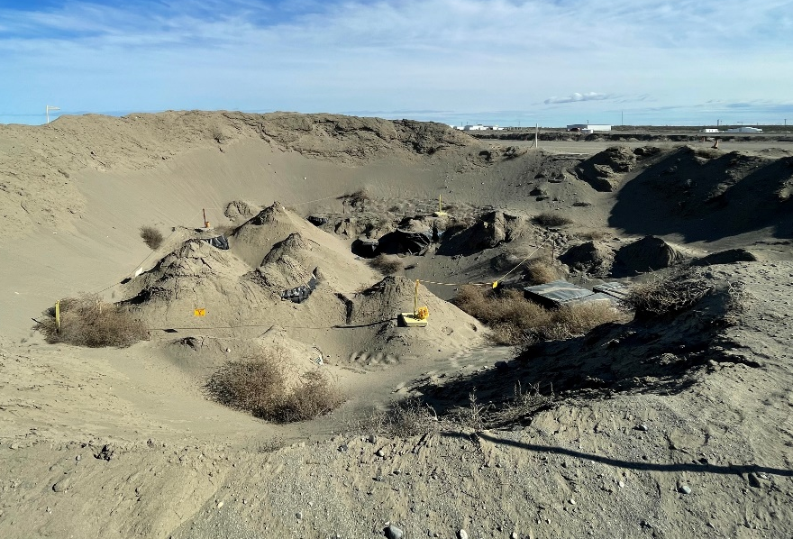
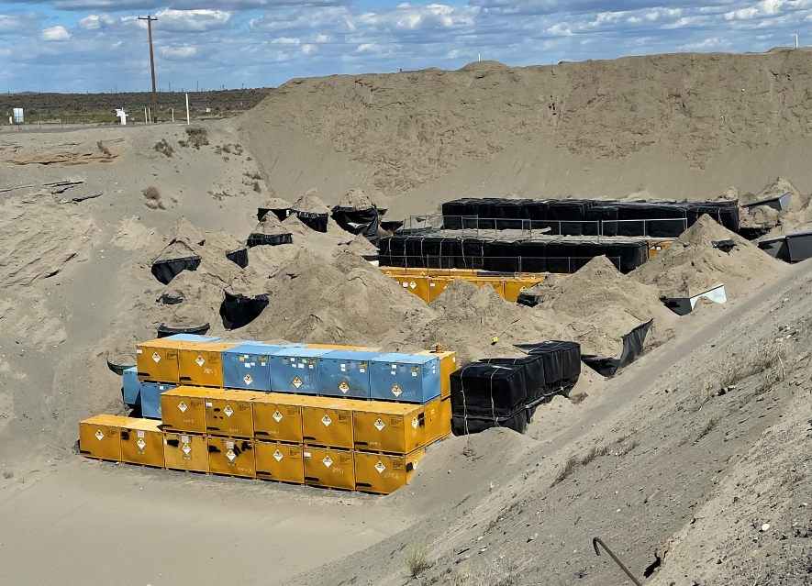
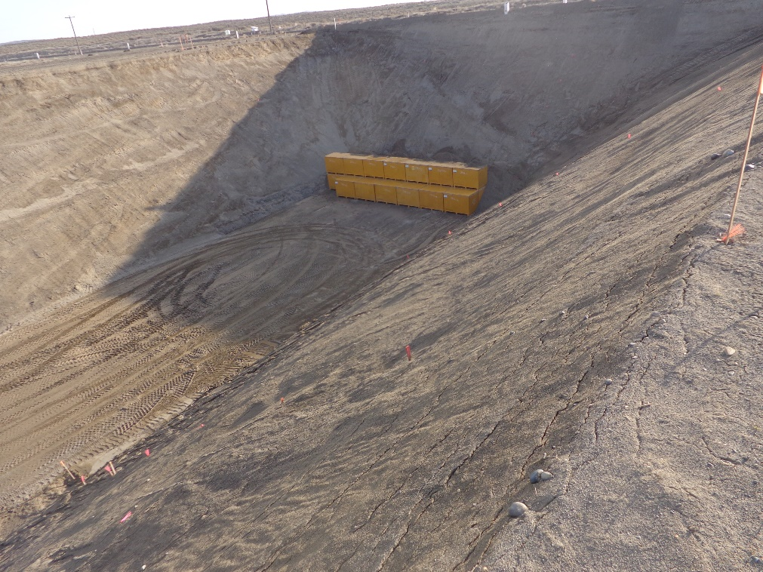
Class A Unstable Waste Trenches
2012
2024
Trench 18
2018
2024
Trench 12
Notes:
Class A Unstable Trenches 18 & 12
Trench 18 was constructed in 1995. Anticipate it will be full early 2025. Place interim cap on it in 2025.
Trench 12 – first phase was constructed in 2019. Build-as-you-go method, adding 150’ of trench at a time. Phase 2 was certified early in 2023. Next phase estimated in 2026.

Slide 16
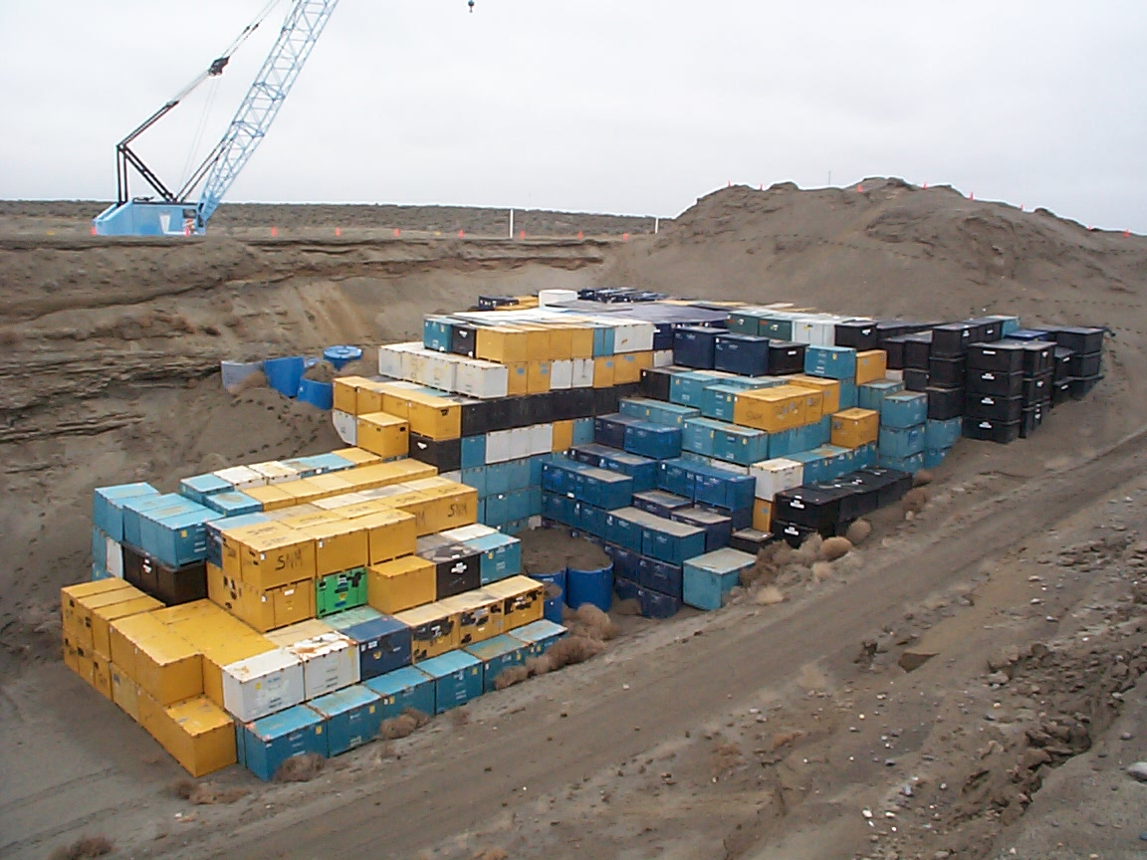
Trench 18 Interim Closure - 2025
Large Trench
Constructed in its entirety in 1995
Opened Nov. 21, 1995
850’ X 45’ X 150’
Class A Unstable Waste
Disposed of:
  >1M cubic feet
  >4.7M mCi
Installation of Interim Cover – planned for 2025
Notes:
Photo from ~2010.
Anticipate being full in 2025.
Interim cover specified in 1991 Consolidated Facility Closure Plan, 1996 SSCP and 2004 EIS. Pit Run Gravel (6” of specified pit run gravel above grade)
Last time trenches were closed: 2006 – Trench 14 & 2007 – Trench 11.
Started the process for closure, but the trench is still open. Planning is ongoing with hope to implement plan starting August.

Slide 17
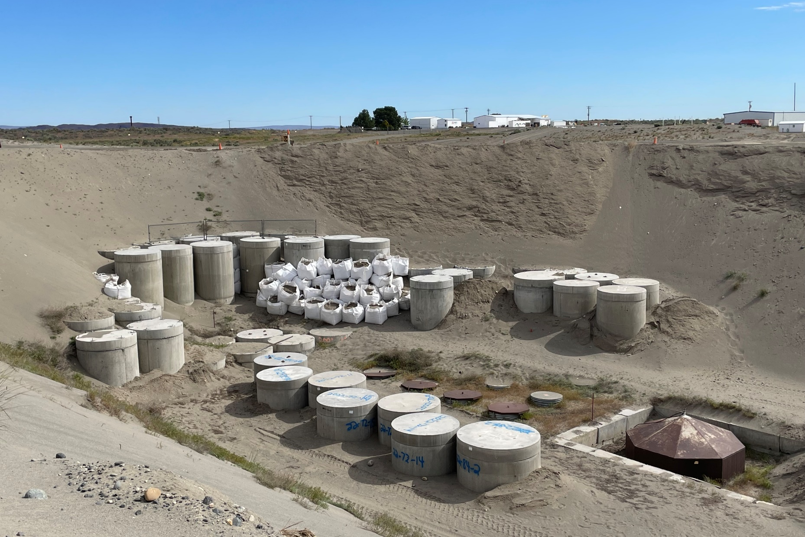
Trench 19 –Class A/B/C Stable Trench
ECBs
Below Grade Caissons
Notes:
Trench 19 was constructed 2006/2007
Trench 19 is where we dispose of our Class A, B & C Stable waste
Small subset of overall waste received; trench is still on the first “phase”
ECB - Engineered Concrete Barriers

Slide 18
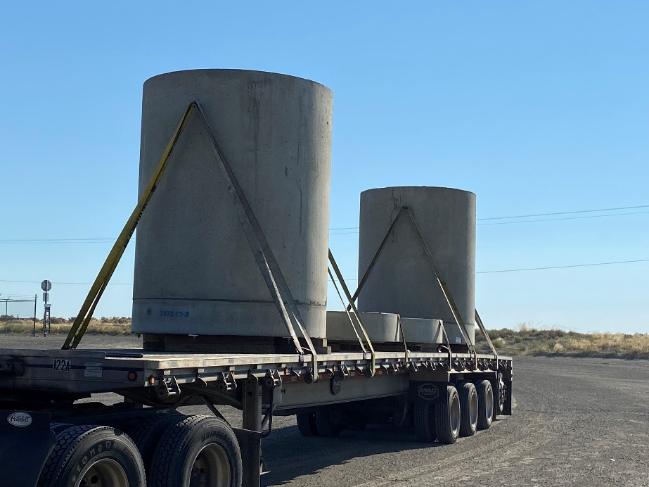
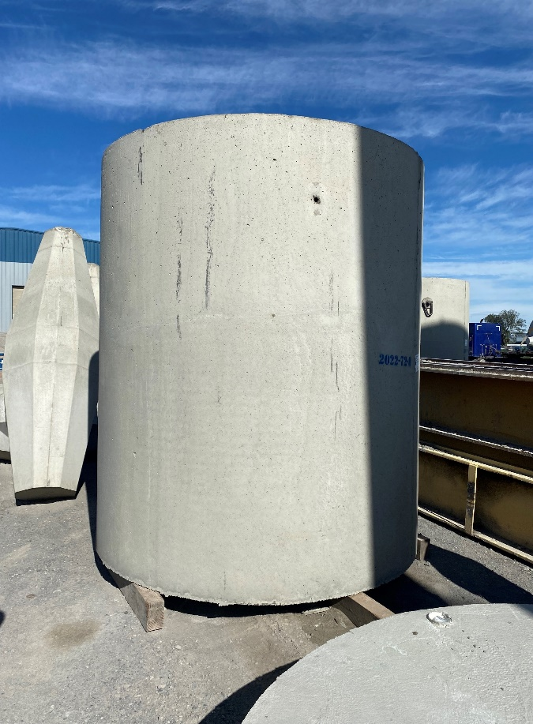
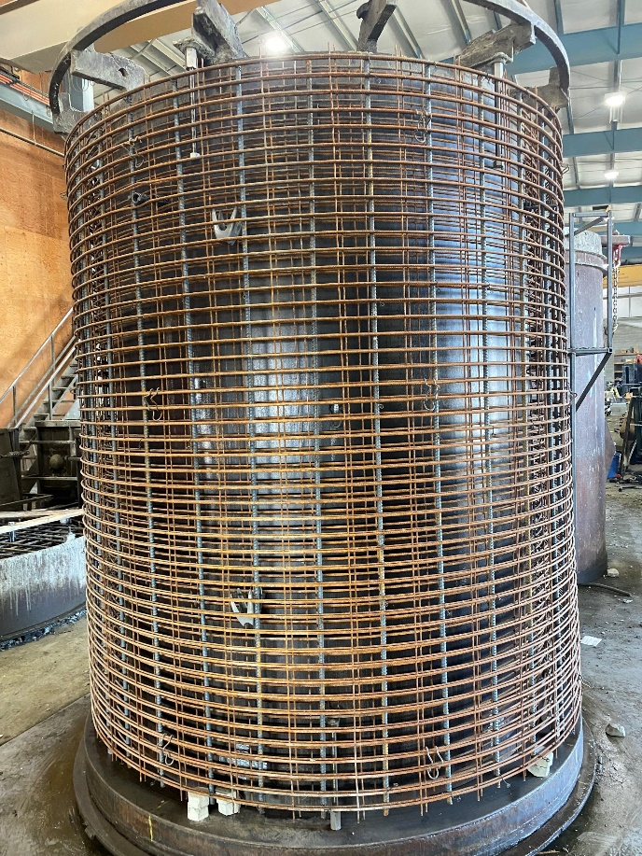
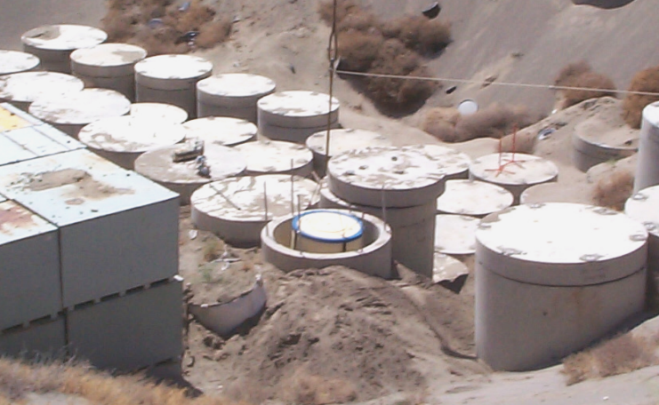
Engineered Concrete Barriers
(ECBs)
Notes:
ECBs are fabricated via outside vendor. Very robust.
Primarily used for Stable Class B & C waste.
Secondary Containment (since we have unlined trenches – against the 7 radionuclides that contribute to the hypothetical post-closure dose)
Preferred over trench liners – increased structural stability, eliminates potential for leachate, requires less maintenance.
2 sizes – 72” diameter and 84” diameter.

Slide 19
Disposal Volumes
&
Rate Regulation

Slide 20
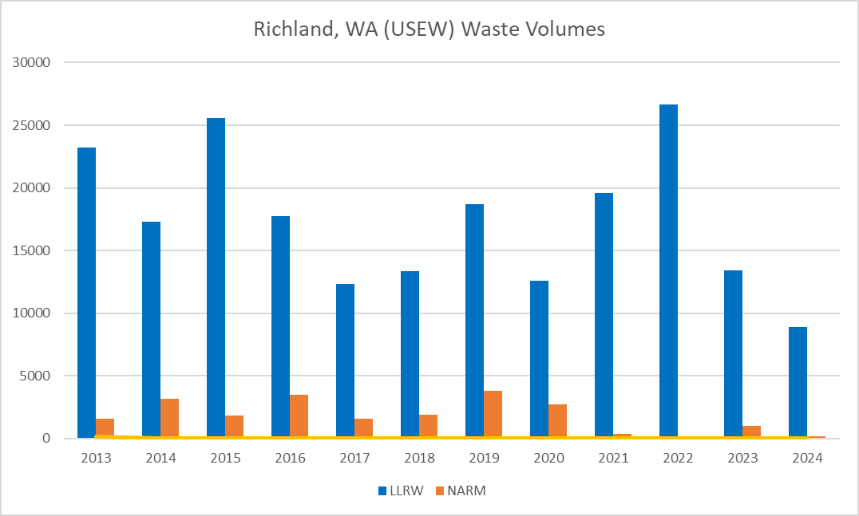
Richland Historical Volumes
Washington Facility has received an annual average volume of ~20,100 ft³ (2013-2024)
Approximately 50% of volume is generated at Energy Northwest Columbia Generating Station
Prior to LLRWPA of 1985, annual average volumes were much larger: ex. 1981, 1,440,000 ft³
Ample capacity remains to support generator needs through 2056 (planned closure)
All values in cubic feet (ft³)
20
Notes:
Over the last several years this graph depicts the variance in volume received at Richland:
2017/2018 – primary WG was temporarily suspended from shipping to USEW
2020 – COVID
2022 – Dawn Mining received waste increased volumes
2023 – a couple customers did not ship what they projected
2024 – 9,122.61 ft3
2025 – projected volume is 11,402 ft3
-In contrast-
Prior to LLRWPA, of 1980 & 1985 and RCRA being passed, Richland site was receiving far greater volumes. Almost half of the nations waste (1.44M ft3 in 1981).
Richland is not authorized to take any Hazardous (Federal) or Dangerous (Washington State). No mixed wastes.

Slide 21

Richland Revenue Requirement
Legal Monopoly – Rate Regulated by WUTC
USEW operates under a base Revenue
Requirement (RR)
Submitted for approval by WUTC every 6 years
Facility Cost of Operation @ 71% operating ratio
Annual adjustments to RR base allowed on core inflation metrics
Five categories – Site Availability, Volume, Shipment, Container, Exposure
Uncollected amounts in a category may be rolled over into next year’s RR
Overcollection results in refunds to all generators that shipped waste that calendar year
Notes:
Richland is legal monopoly, so we are rate regulated by the Washington Utilities Transportation Commission.
Revenue Requirement “Set by WUTC every 6 years”
We are operating under the $5.2 million revenue requirement that was set for the six-year period Jan. 1, 2008 through Dec. 31, 2013.
There are 5 categories – Site Availability, Volume, Shipment, Container, Exposure (Dose Rate).
Under collection in any category – results in a roll over to next year’s rates.
Over collection in any category – results in refunds to generators that shipped that year.
Categories are independent, overcollection in one cannot be used offset under collection in another.
We petitioned to extend the Settlement Agreement continuing with the same revenue requirement as adjusted by annual inflationary adjustments each year for an additional six-year period 2014-2019 and then again for 2020-2025.
The 71% Operating Ratio as agreed to in the Settlement Agreement was used to determine the original revenue requirement and was submitted to the WUTC and generators for approval so to be precise, it’s also not really “set by” the WUTC.

Slide 22
Richland Revenue Requirement
Rates are set using generator supplied volume estimates
  Total Rate = RR / Volume Estimates
Base Rates set in January and adjusted in May of each year
Revenue Requirement is split into 5 categories
  Site Availability (22%)
  Volume (31.6%)
  Shipments (10.7%)
  Containers (21.5%)
  Dose Rate (14.2%)
Notes:
Simplistic explanation shown.
The importance of accurate projections – overestimation results in under collection and roll over (higher rates) for the next year.
The system is designed to “manage” itself.
In general, more waste lowers the cost per unit.
This financial model ensures the viability of the facility and the continued use as a regional asset.

Slide 23
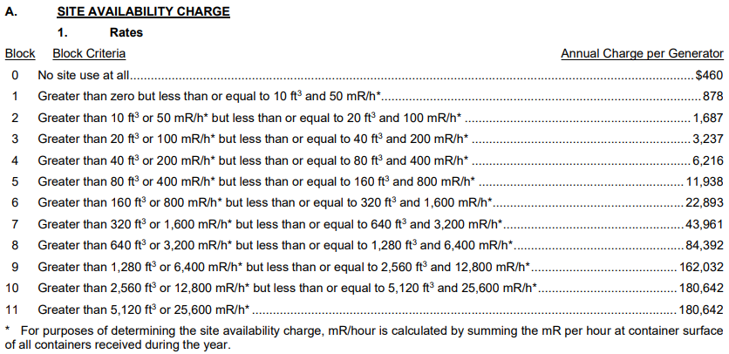
Richland January 2025 Rates
Notes:
Site Availability is based on total volume or exposure (summation of dose rates) a generator projects.
Larger volume/exposure generators pay more to use the site.
Site Availability charge is collected
Allowing a site use permit to expire requires a $1,000 fee to renew it.

Slide 24
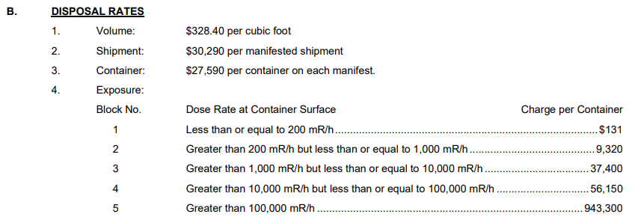
Richland January 2025 Rates
Notes:
Not shown are the taxes and fees.
The Perpetual Care and Maintenance Fee: collected from the facility’s customers, currently set at $1.75/ft3 of waste disposed, is remitted to the Department of Ecology on a quarterly basis. Goes into
Business and Occupation Tax: 3.3% essentially a State income (not sales) tax.
Site Surveillance Fee: $26.00/ft3 WDOH inspectors coverage – management of Permits
Surcharge: $6.50/ft3 – split up - remitted to the county (Benton) $2.00 per RCW 70A.384.120, the other $4.50 deposited in the Hanford Area Economic Investment fund.
Commission Regulatory Fee: 1% of rates and charges, remitted to WUTC to regulate our rates
The closure fund was established in 1982 (per Agreed Order) and set at $0.25 per cubic foot of waste disposed. In 1992, the State ceased requiring contributions to Fund 125.

Slide 25
Sublease

Slide 26
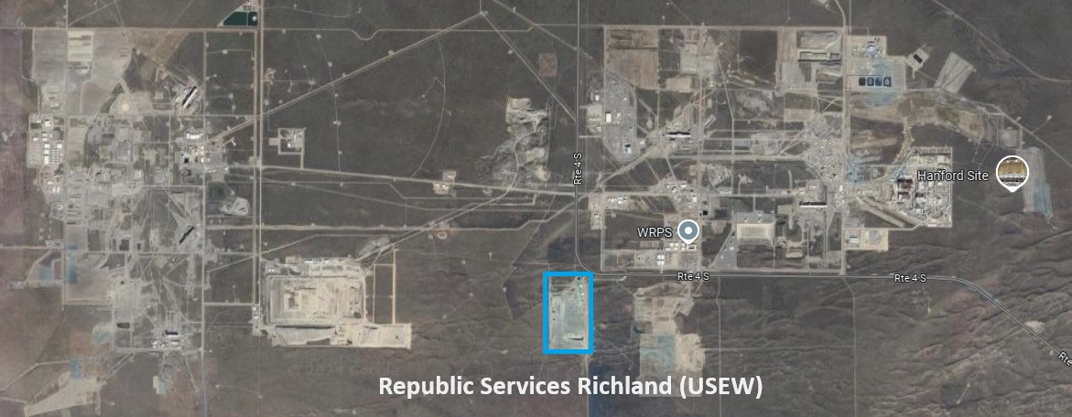
Sublease Extension 2025
The State of Washington (Department of Ecology) leases the 100 acres of land from the US Department of Energy (USDOE) on the Hanford Reservation.
The state subleases the land to USEW to operate.
The 2005 sublease had an original period of 10 years. Options to extend for 10-year increments.
The first option was already exercised in 2015 (2015 -2025).
USEW and Department of Ecology currently working to exercise the second option period (2025 – 2035.)

Slide 27
Richland Updates
Richland Staffing
  Chris Shaw, MS CHP NRRPT appointed as the Corporate Radiation Protection Manager
  Matt Mclellan promoted to Manager Quality Assurance & Regulatory Compliance
  Terry Heiman promoted to Assistance Radiation Protection Manager
New Generator Opportunities
  Tracking small modular reactors progress
    Eielson AFB, AK; TerraPower - Kremmerer, WY; X-Energy, WA
  Rare Earth Minerals Licenses, Upton, WY
  Nusano, West Valley City, UT – Expanding to new processes including Lutetium-177 and Actinium-225

Slide 28

Contact Us!
Doug Frenette General Manager Richland Facility (509) 874-5093 (o) DFrenette@republicservices.com | Sherry Frenette Sr. Mgr, Rad Programs Corporate (702) 912-7925 (m) SFrenette@republicservices.com
Noah Huston Assistant General Manager Richland Facility (509) 392-6848 (o) DHuston@republicservices.com | Hans Honerlah Manager Strategic Services Corporate (512) 202-4928 (m) HHonerlah@republicservices.com
Notes:
If you have questions about anything – questions about some waste you have, need a copy of our license, anything!

Slide 29

Do you
have any
questions?

