Slide 1
Spring 2025 LLW Forum Meeting
Disposal Facility Update
Vern C. Rogers
Director, Regulatory Affairs

Slide 2
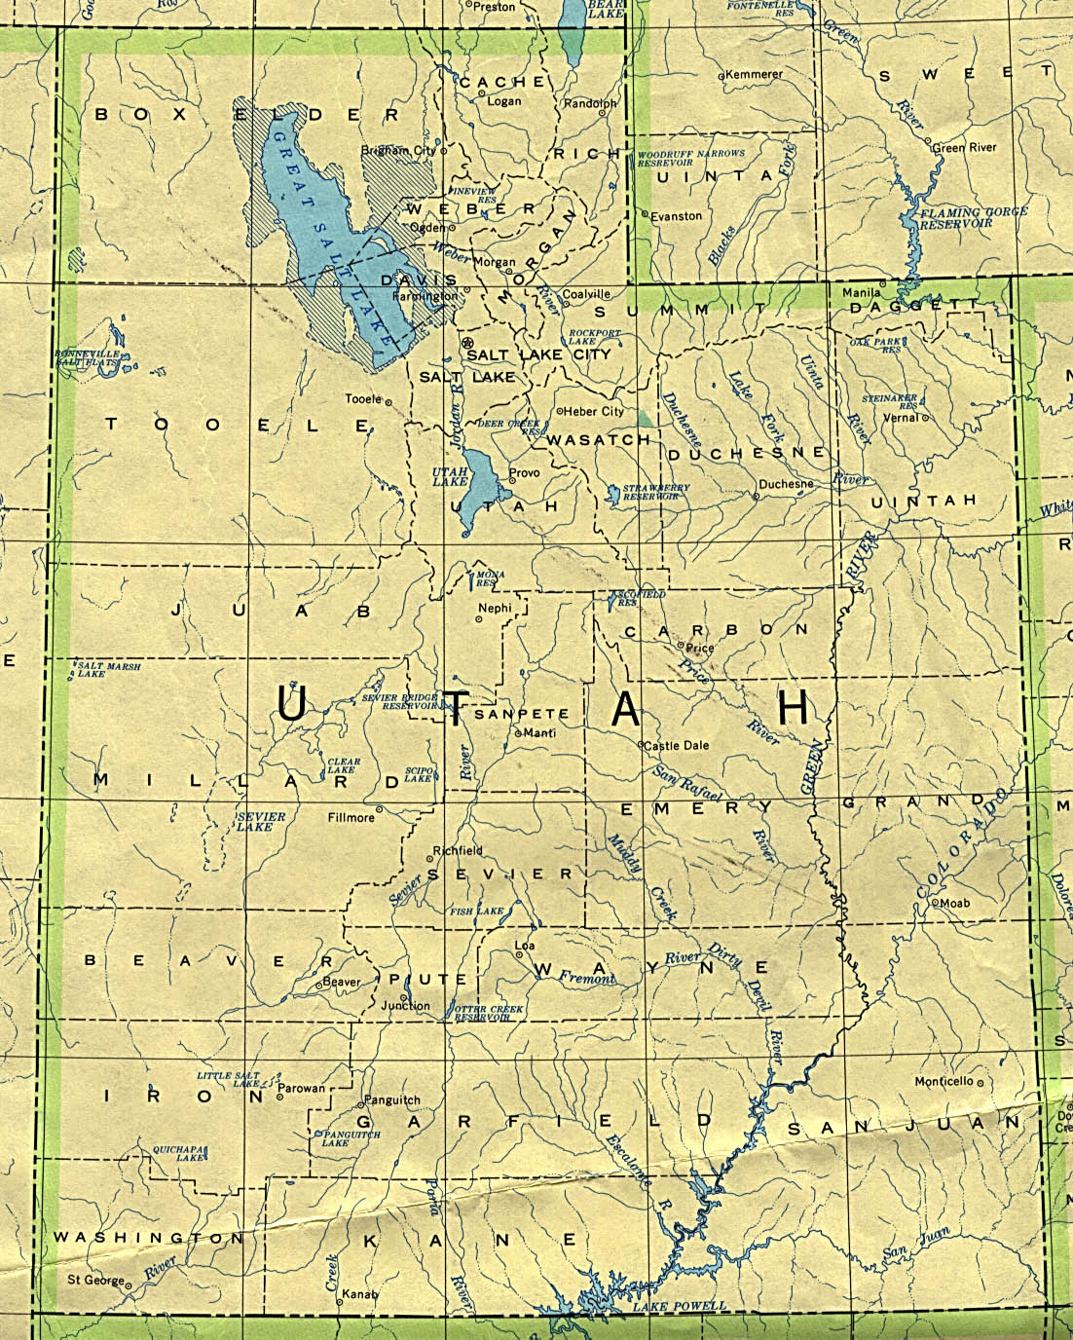
Clive Facility
Very Remote Location

Slide 3
Clive Facility Overview
Over 30 years of proven experience treating and disposing of Class A radioactive waste.
One-of-a-kind bulk waste and containerized waste facilities with unique licenses and permits.
Long-term federal and commercial contracts.

Slide 4
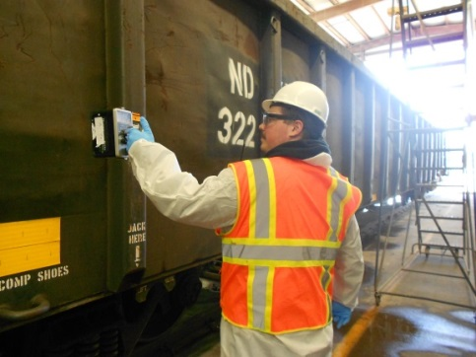
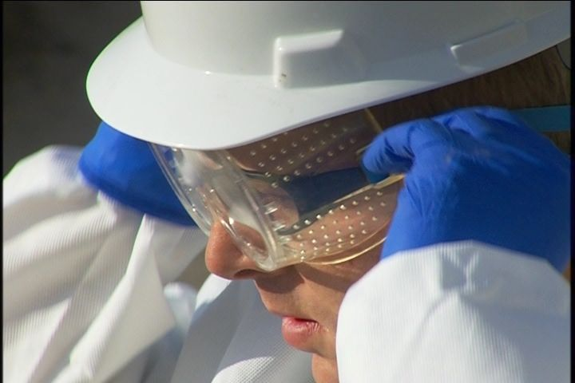
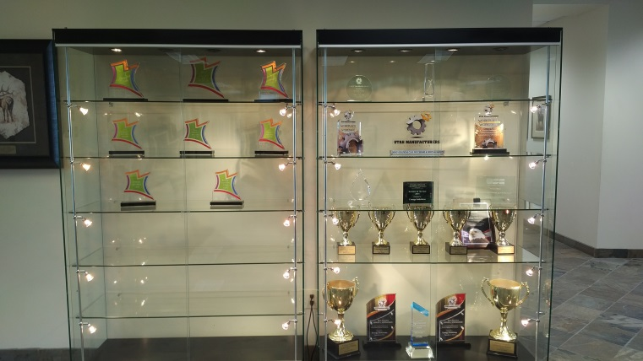
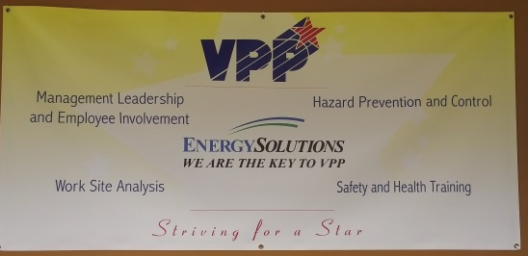
Facility Overview – Clive Operations
Industrial
Behavior Based/HPI
Employee directed / Management Commitment
Between 2004 & 2025, over Seven Million hours worked without a lost-time injury
Utah Safety Council Award of Merit
2006, 2007, 2008, 2009, 2012, 2013, 2015, 2016, 2017, 2018, 2019, 2020, 2021 + + +
Utah Safety Council Perfect Record Award
2011, 2012, 2013, 2015, 2016, 2017
Utah Safety Council 1 Million Man Hour Award
2013, 2016, 2020
Utah Safety Council Award of Honor
2017, 2019
National Safety Council Perfect Record Award
2005, 2006, 2007, 2008, 2010, 2015, 2017
National Safety Council Million Man Hour Award
2006, 2008, 2013, 2017, 2020, 2021
National Safety Council Occupational Excellence Achievement Award
2017
National Safety Council Safety Leadership Award
2017, 2021
VPP Star - 2017
Radiological
ALARA
Personnel exposures very low
34 mRem average annual employee exposure

Slide 5
Clive Permits and Licenses
EnergySolutions is permitted, licensed, and authorized to receive, treat and dispose of the following wastes:
Class A LLRW as defined in Utah Administrative Code R313-15-1009
Class A Mixed LLRW (radioactive and hazardous)
NORM/NARM
11e.(2) Byproduct Material as defined by the AEA
Receipt and storage of RCRA-regulated mixed waste
Treatment of mixed waste for RCRA constituents
Mixed waste disposal
BWF - Receipt, storage, treatment, and disposal of waste containing SNM - concentration-based receipt limits (versus mass-based)
Receipt, treatment, management and disposal of
PCB radioactive and PCB mixed waste
Radioactive Material License
RML UT 2300249, as amended
11e.(2) Byproduct Material License
RML UT 2300478, as amended
State-issued Part B Permit
EPA ID Number UTD982598898
Special Nuclear Material Exemption Order issued by NRC, as amended
Two TSCA Approvals issued by EPA Region 8

Slide 6
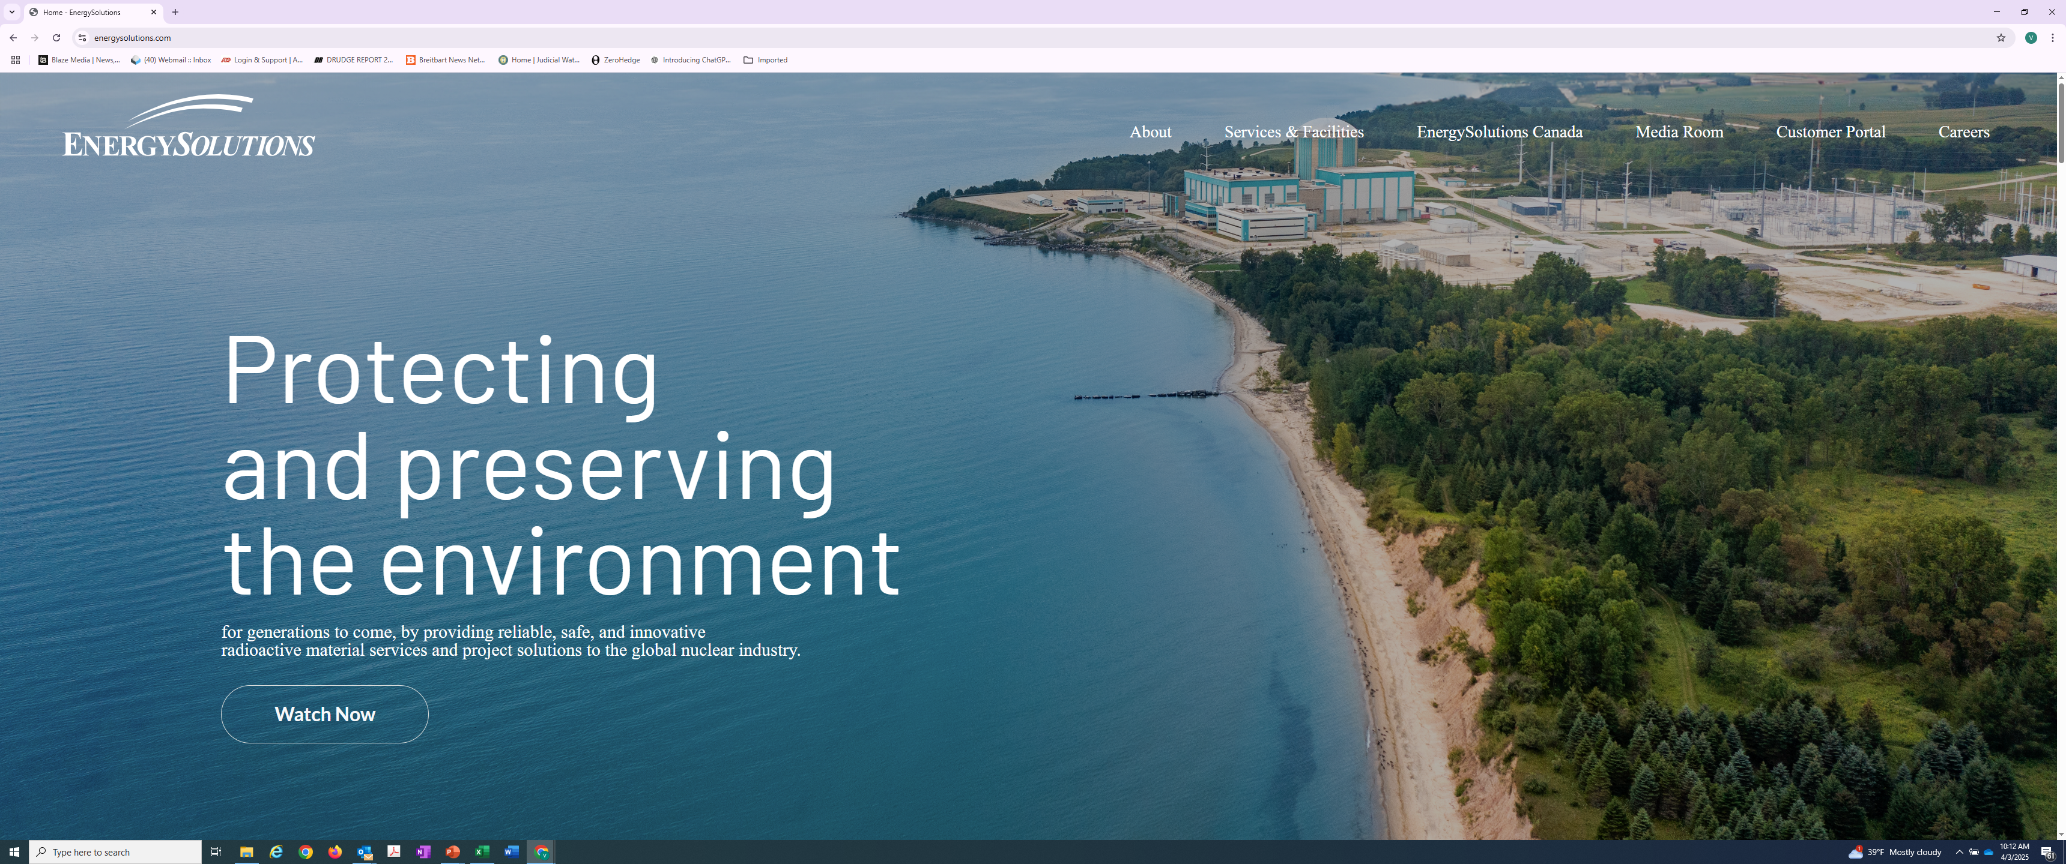
Clive Permits and Licenses
All current Permits, Licenses, WAC, etc. can be accessed from our company website: www.energysolutions.com

Slide 7
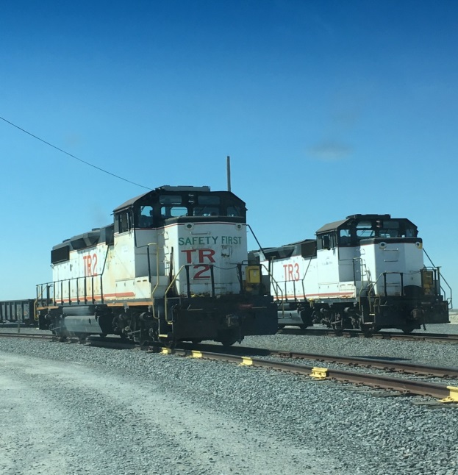
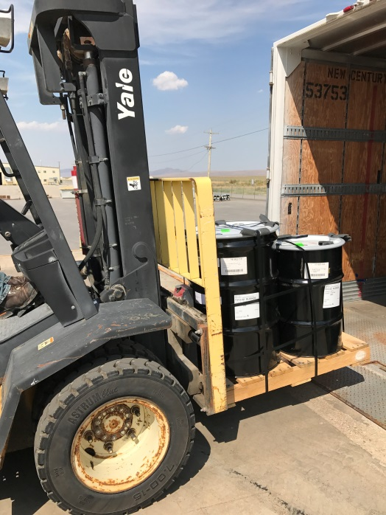
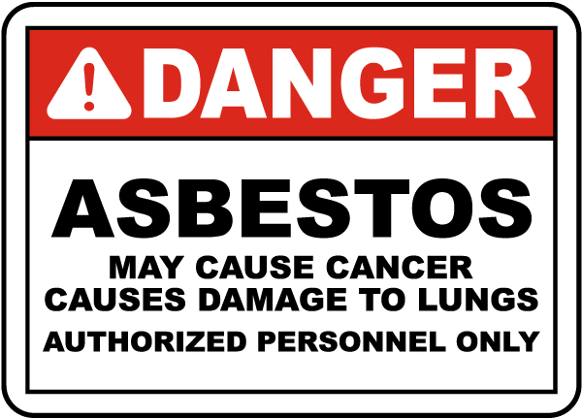
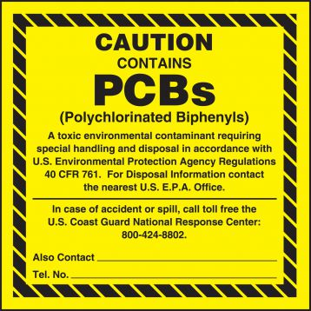
Clive Waste Acceptance Capability
Class A LLRW and NORM
Soil, resin, filters, operational waste, large components
Containerized Waste (CWF) and Bulk Waste (BWF)
Rail or Truck Transport
Radioactive Liquids
Two 10,000-gallon tanks to process real-time
Two+ Portable Eurotainer ISO Tanks (3,000-gallon)
Mixed Waste (Radioactive and RCRA Hazardous)
PCB/Radioactive Waste - TSCA Regulated
Approved to accept CERCLA Waste
Large Component Logistics
UCNI and Export Controlled Waste
Other hazardous substances
Asbestos, beryllium, etc.

Slide 8
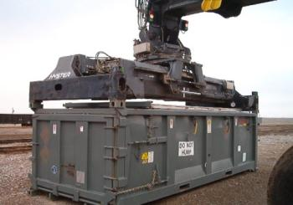
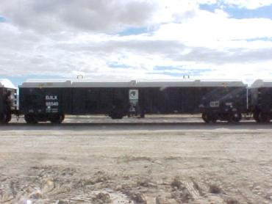
Clive Waste Acceptance
Bulk Waste Facility (BWF)
MW, 11e.(2), & most of Class A LLRW
Receive Bulk and non-Bulk Containers
Soil, Debris and Oversized Debris
Low Dose Resin (< 500 mR/hr, Dewatered)
Liquid Verification for Grossly Dewatered (< 10R)
Receive Highway and Rail shipments
CLSM (Grout) disposal for Higher Contamination / Higher Dose Rate Waste

Slide 9
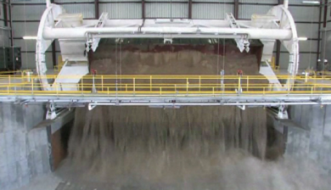
Clive Waste Acceptance
Bulk Waste Facility – (Rail)
Direct Union Pacific rail service to facility
Over 16 Miles of rail lines onsite
Railcar Dumping
Two Rotary Dumpers in Operation
Rail Decon Facility is part of Rotary
Railcar transloading capabilities (Intermodals and Cargo Containers)

Slide 10
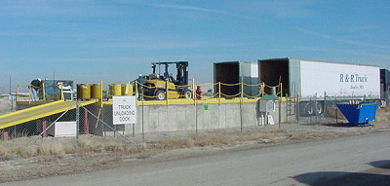
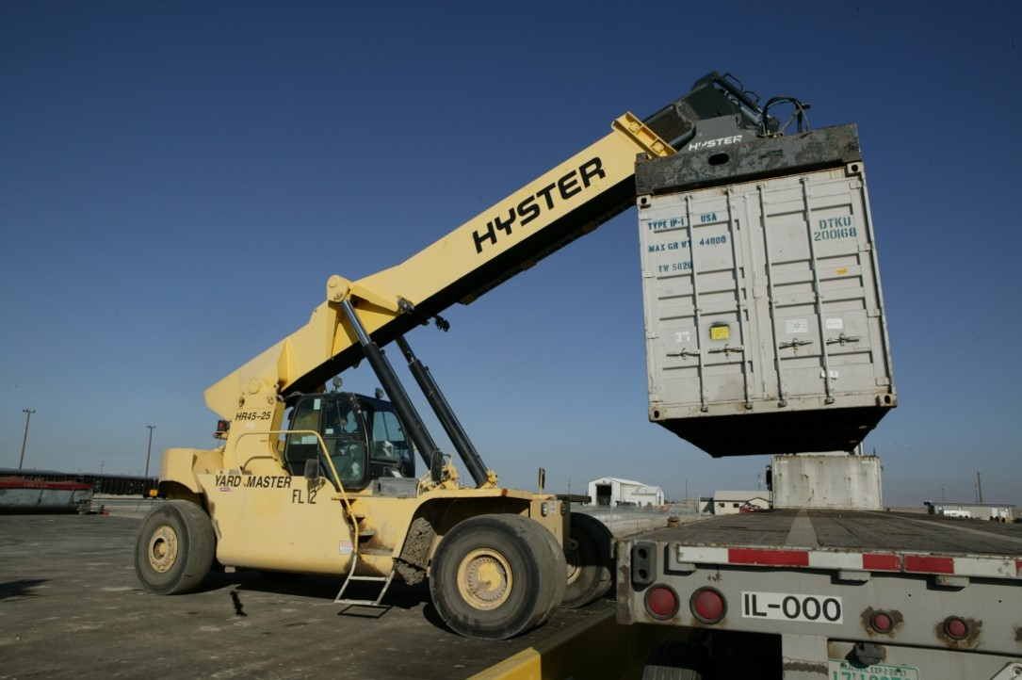
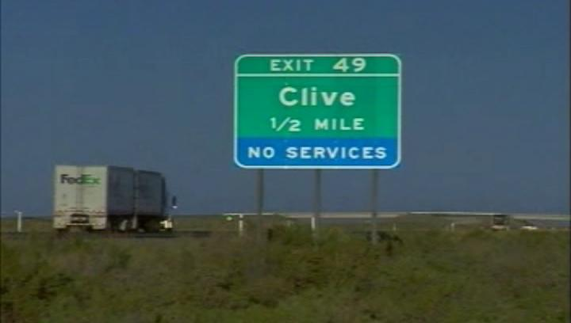
Clive Waste Acceptance
Bulk Waste Facility – (Highway)
Facility is located just 5 miles off I-80
Security Officers onsite 24/7
Parking for over 40 Trucks / Trailers
2 Unloading Docks
Live unloading of all shipments
Driver doesn’t have to enter restricted area
Flatbed, Van, Conestoga Trailers all acceptable
Onsite Truck Scale for weight verification
Showers, Laundry, Lounge for Driver Use

Slide 11
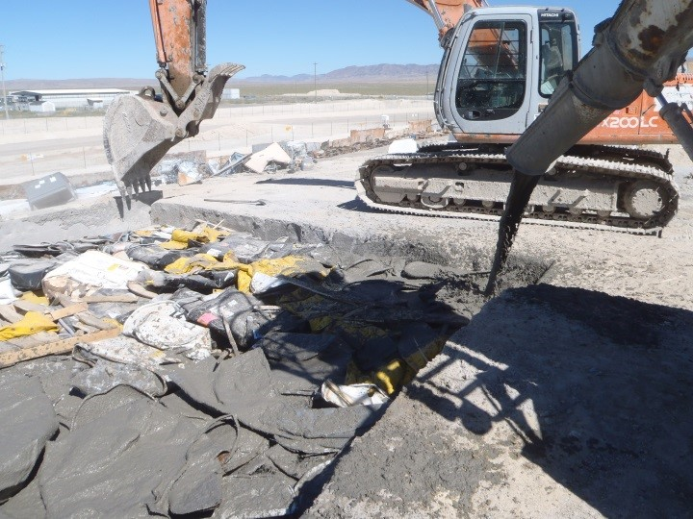
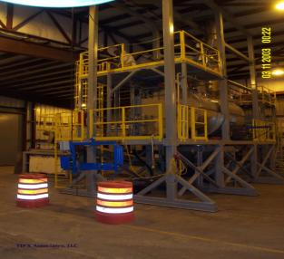
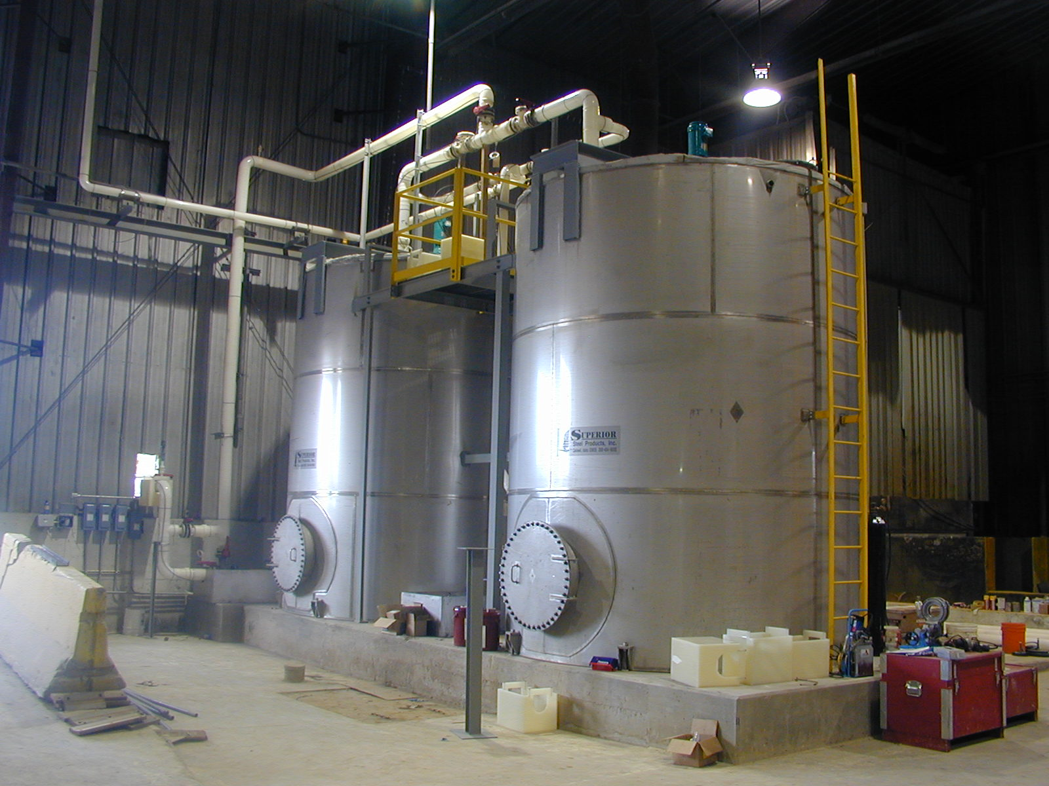
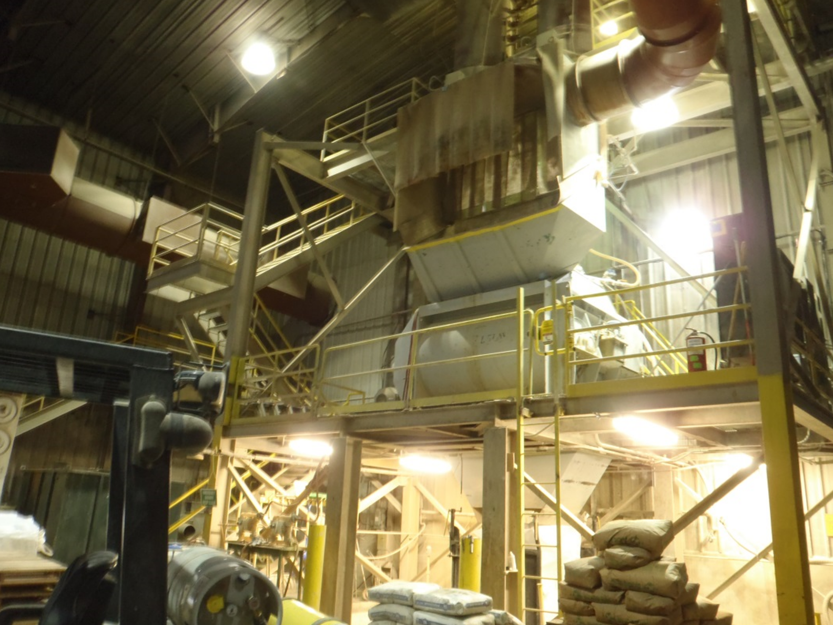
Clive Waste Acceptance
Mixed Waste Treatment Facility
Macroencapsulation
Stabilization
Deactivation / Neutralization / Ox / Red
Mercury Amalgamation
Liquid Solidification
Aqueous and Non-aqueous
Vacuum Thermal Desorption (VTD)
Organics, PCB’s

Slide 12
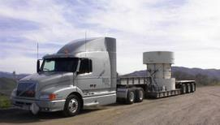
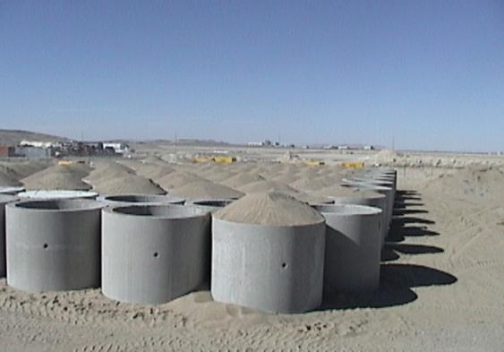
Clive Waste Acceptance
Containerized Waste Facility (CWF)
Higher Dose / Higher Activity liners / packages for disposal
Low contamination “clean area” material handling
Void Remediation on packages that are <85% full (prior approval needed)
Capabilities to handle multiple casks per day (same day turnaround)
Certified Generator Program

Slide 13
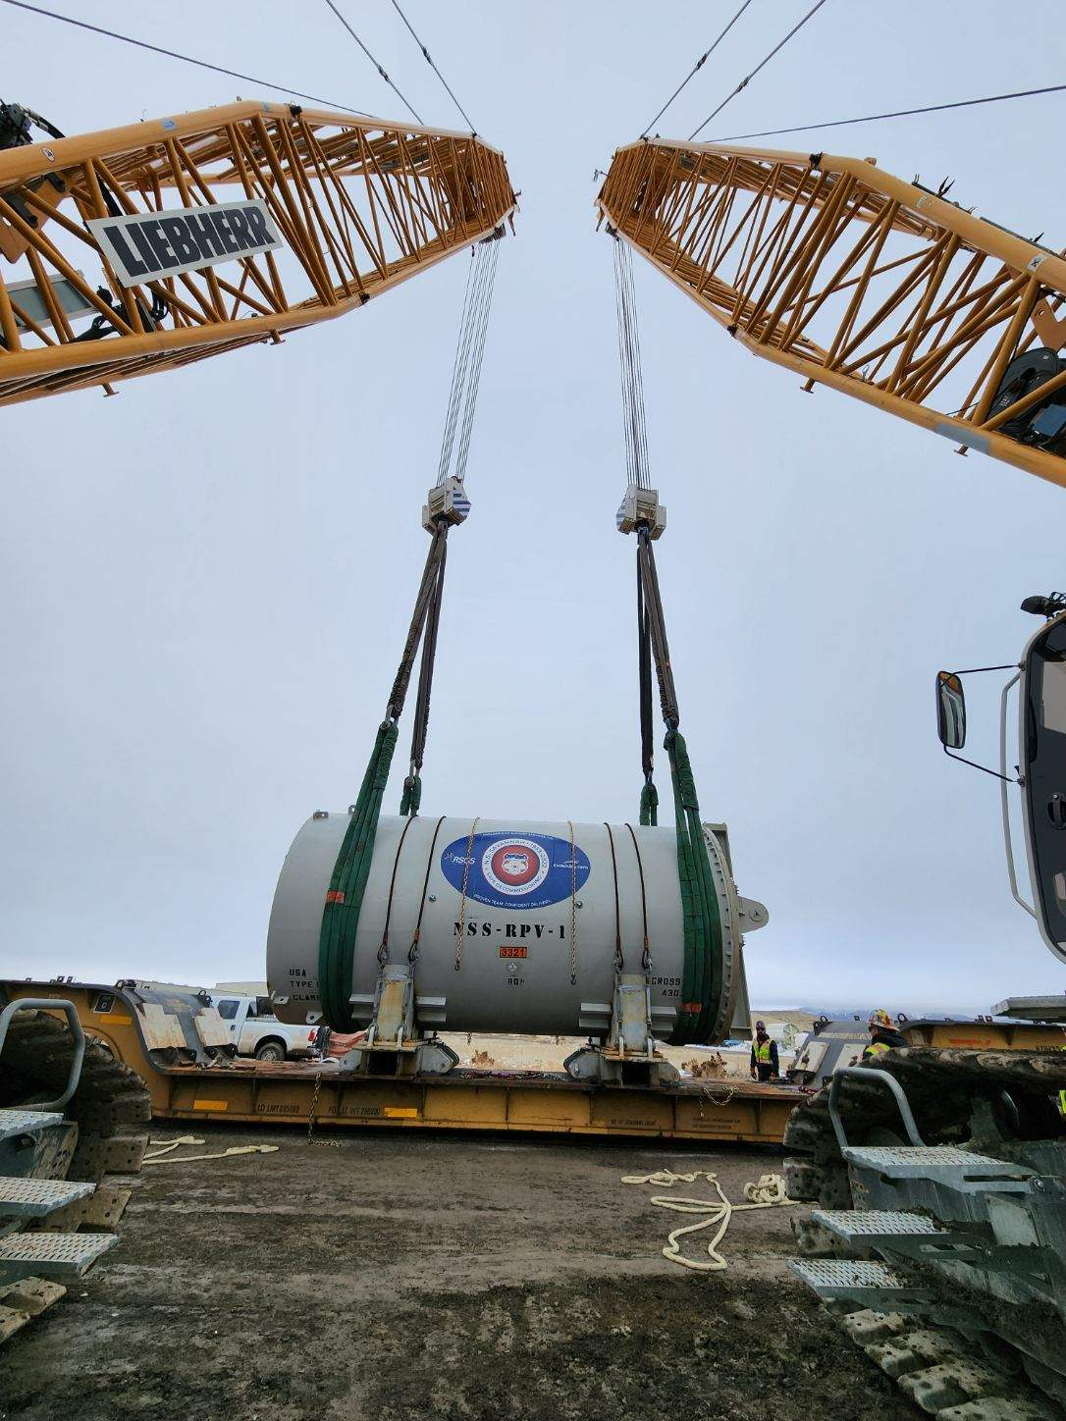
Clive Waste Acceptance
Large Component Disposal
Receive by highway or rail
Typically – Greater than 20,000 lbs
Heaviest component received - 1.52 million pounds
All Large Components undergo an Engineering Review prior to approval
All Large Components are placed for final disposal (will be grouted in place)

Slide 14
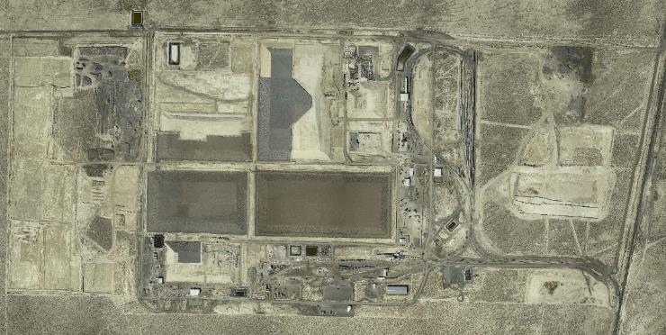
Site Layout
Section 31
Section 30
North
Section 5
Section 32
Section 29
Federal Cell
(under licensing)
Low Activity South
(under licensing)
Class A West
CRF
11e.(2)
VITRO
Dept. of Energy
Radioactive Disposal
from Salt Lake County
(Closed)
LARW
(Closed)
Class A East
(under licensing)
Mixed
Waste
Container
Handling

Slide 15
Facility Overview - Clive Waste Disposal
Rip Rap 18 in (48 cm)
Type A Filter 6 in (15 cm)
Sac. Soil 12 in (30 cm)
Type B Filter 6 in(15 cm)
Install Engineered Cover
Layers of Waste Compacted and Disposed
Install Radon Barrier (Clay Cap)
2 ft (61 cm)
Synthetic Liner with
Leachate Collection System
Install and Approve Clay Liner
Excavate ~ 10 ft.

Slide 16
Environmental Monitoring
Groundwater (78)
Soil (23)
Air (12)

Slide 17
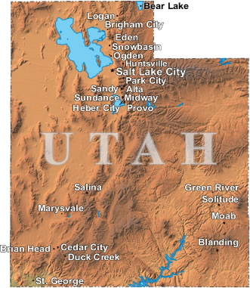
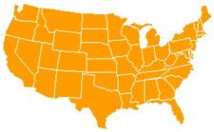
Regulators
Federal
Nuclear Regulatory Commission
Environmental Protection Agency
OSHA
DOT
USDA
Utah
Division of Waste Management and Radiation Control
Air Quality
Water Quality

Slide 18
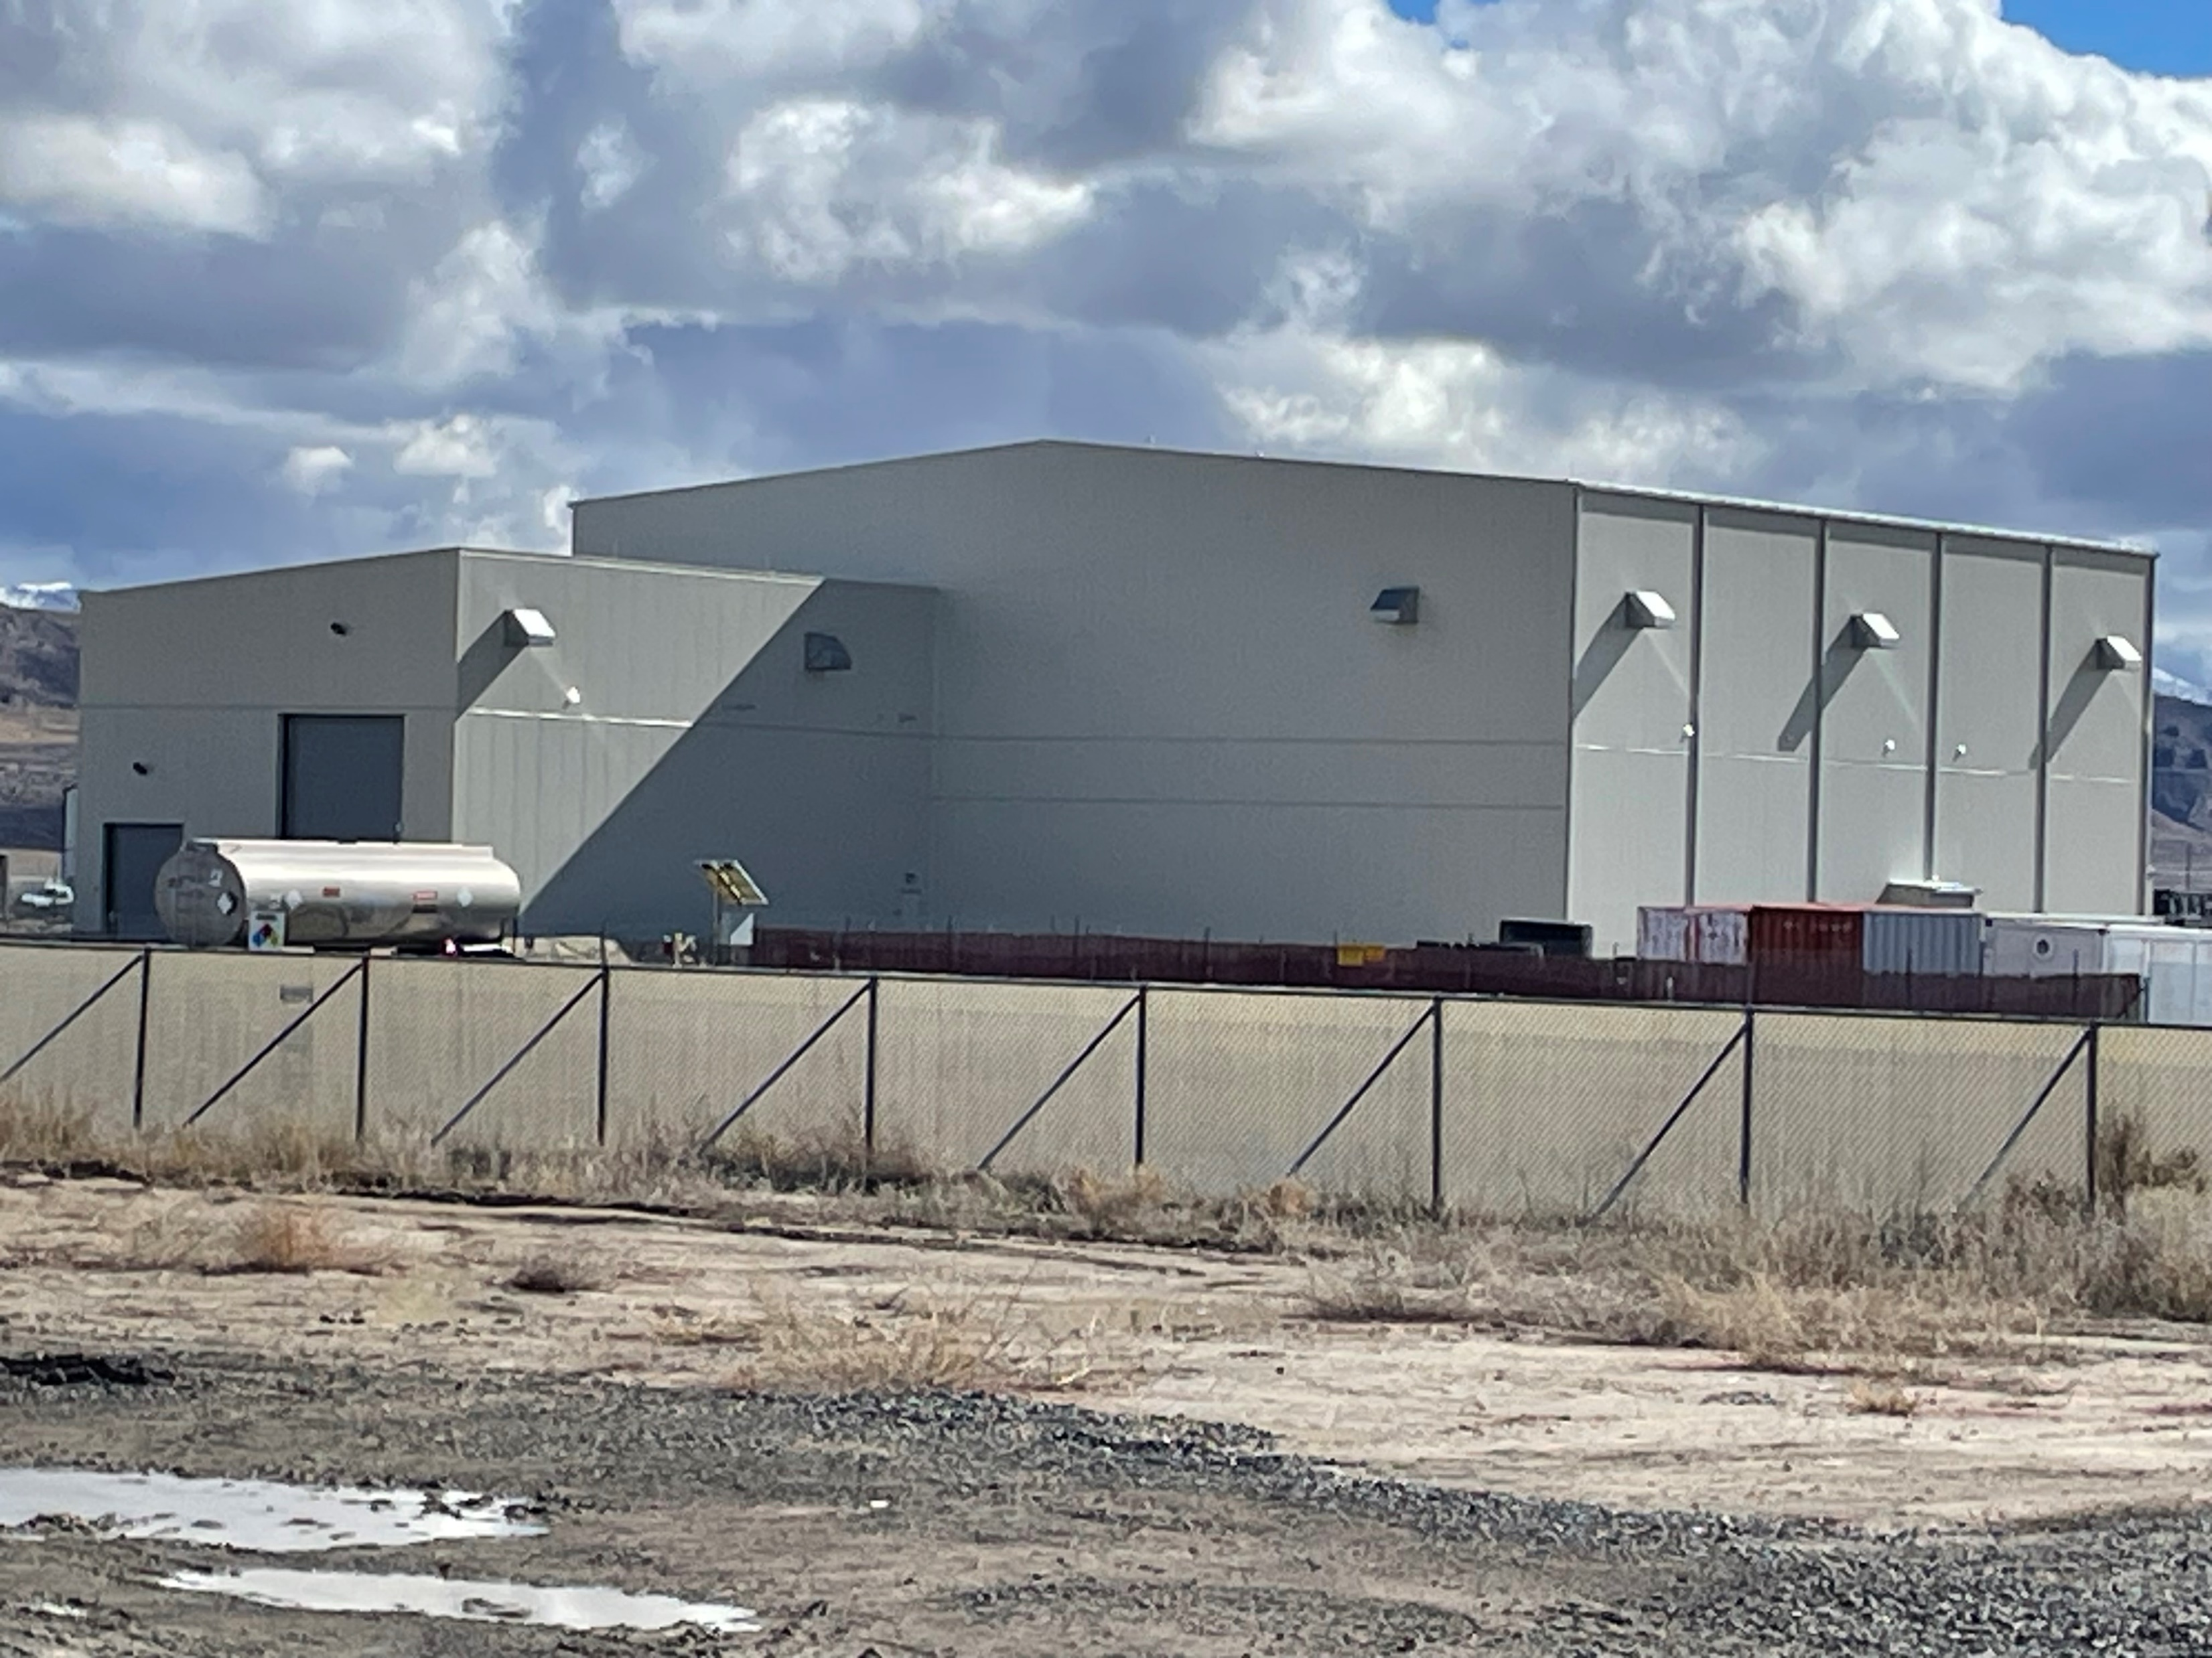
SITE UPDATE
Capital Improvements
East Side Rotary Facility
Liquid Waste Treatment
Evaporative Storage
LLRW Cover Construction
Mobile equipment fleet upgrades
Cranes / Heavy Haul Equipment
Health Physics Instrumentation

Slide 19
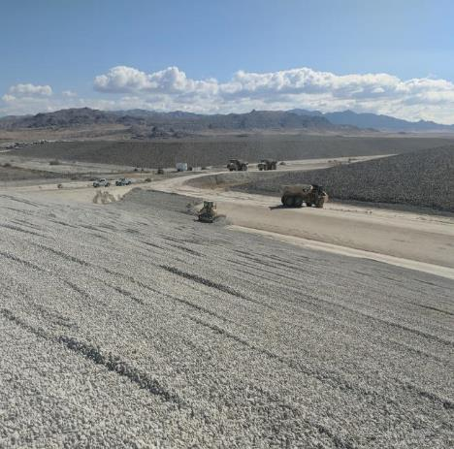
SITE UPDATE
Licensing Update
Federal Cell Facility for depleted uranium and federally-generated low level radioactive waste (license application under review)
License and Permit Renewals
RML UT2300249
GWQDP UGW450005
RCRA Part B Permit
Low Activity Cell Amendment
Class A Expansion Amendment

Slide 20
SITE UPDATE
Changes in Regulators / Inspectors
Jalynn Knudsen
Assistant Director
Larry Kellum
LLRW Section Manager
= new in position

Slide 21
SITE UPDATE
2025 Utah Legislation
Senate Bill 216 – Environmental Quality Amendments
House Bill 254 – Waste Classification Amendments

Slide 22
Questions ?

