Slide 1
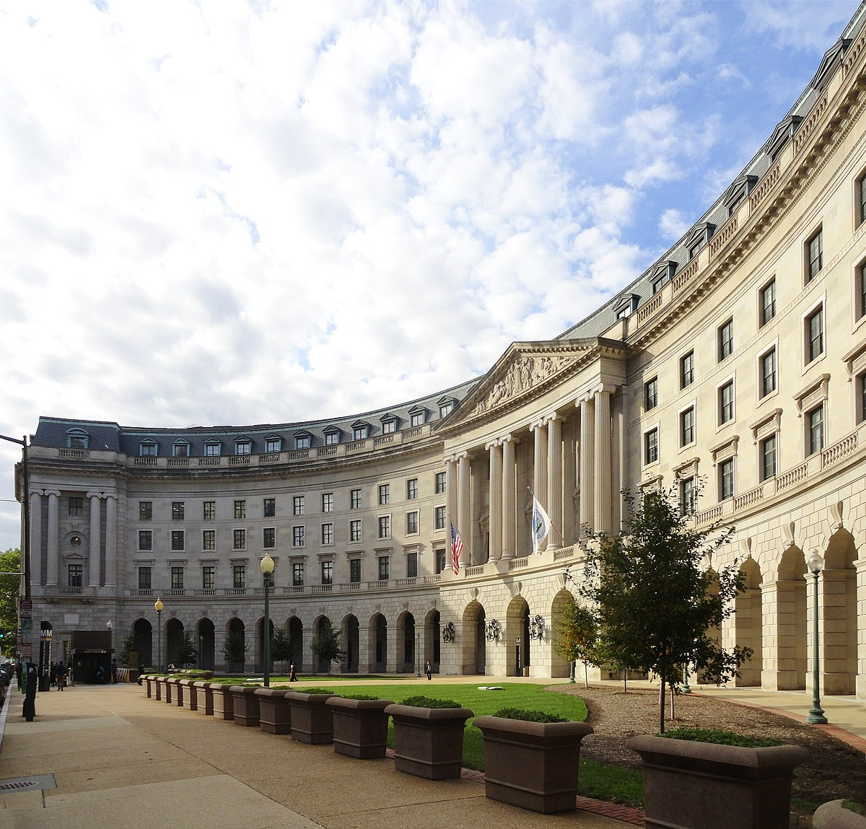
EPA Update
LLW Forum Spring Meeting
Odessa, Texas
Jon Major, EPA Office of Radiation and Indoor Air
April 9-10, 2025

Slide 2
Overview of Presentation
Phosphogypsum
Waste Isolation Pilot Plant (WIPP)
Other EPA activities
  Multi-Agency Radiation Site Survey and Investigation Manual (MARSSIM 2.0)
  Federal Guidance

Slide 3
What is Phosphogypsum?
  Phosphogypsum (PG) is a byproduct of processing phosphate rock into fertilizer.
  Phosphogypsum contains elevated levels of radium-226 and emits radon.
  40 CFR Part 61, Subpart R (1989) requires phosphogypsum to be managed in stacks:
    The motivation of the regulation was to prevent uncontrolled public exposure to radionuclides;
    Stacking was typical practice at the time of the regulation;
    Stacking was identified as the best disposal option, not an ideal solution;
    Stacks have grown in number and size since the regulation was promulgated;
    Populations have increased in the areas of stacks since the regulation was promulgated.
  Industry exploring reuse and further extraction of other resources like REEs (valorization)

Slide 4
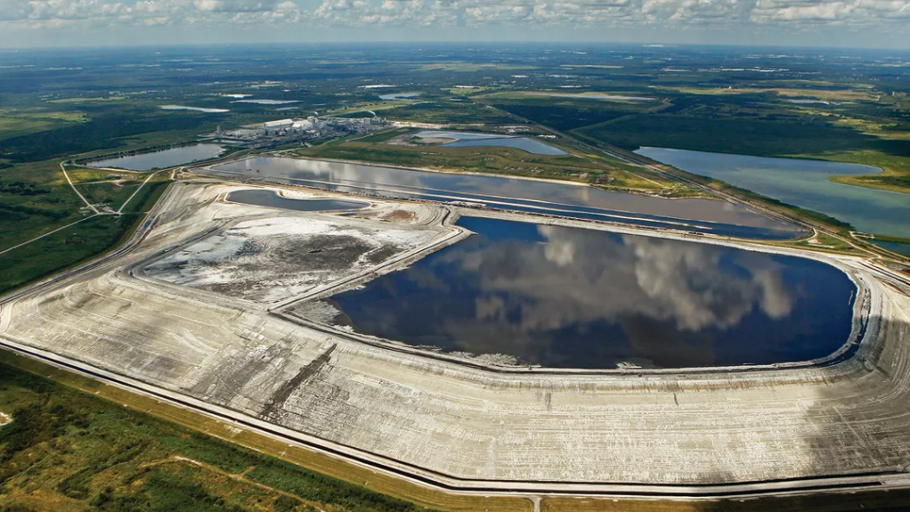
Mosaic New Wales Facility
North
Location of Pilot Road

Slide 5
Phosphogypsum Reuse Request
Mosaic’s PG Road Pilot Project
The Mosaic Company submitted a request to EPA for a pilot project using phosphogypsum in a test road at its New Wales facility in Polk County, Florida
  Segments constructed using different mixtures of phosphogypsum and other materials
  Groundwater monitoring will be conducted
Following construction of the pilot project, Mosaic will collect structural and environmental data for 18 months and report the results to EPA.
  Florida DEP approval also needed for this project
  Florida DOT will use this project to inform its study under 2023 legislation

Slide 6
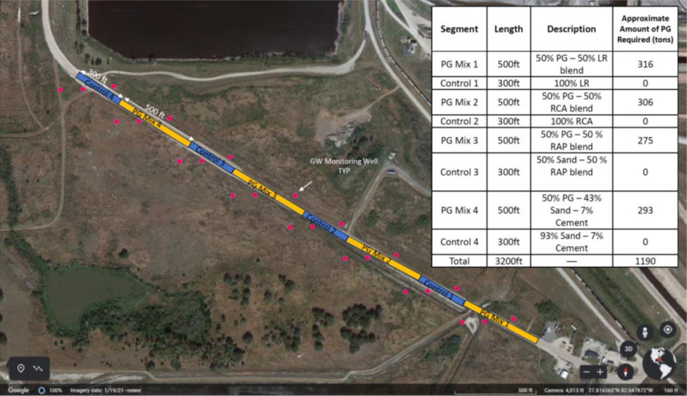
Phosphogypsum
Mosaic pilot road study

Slide 7
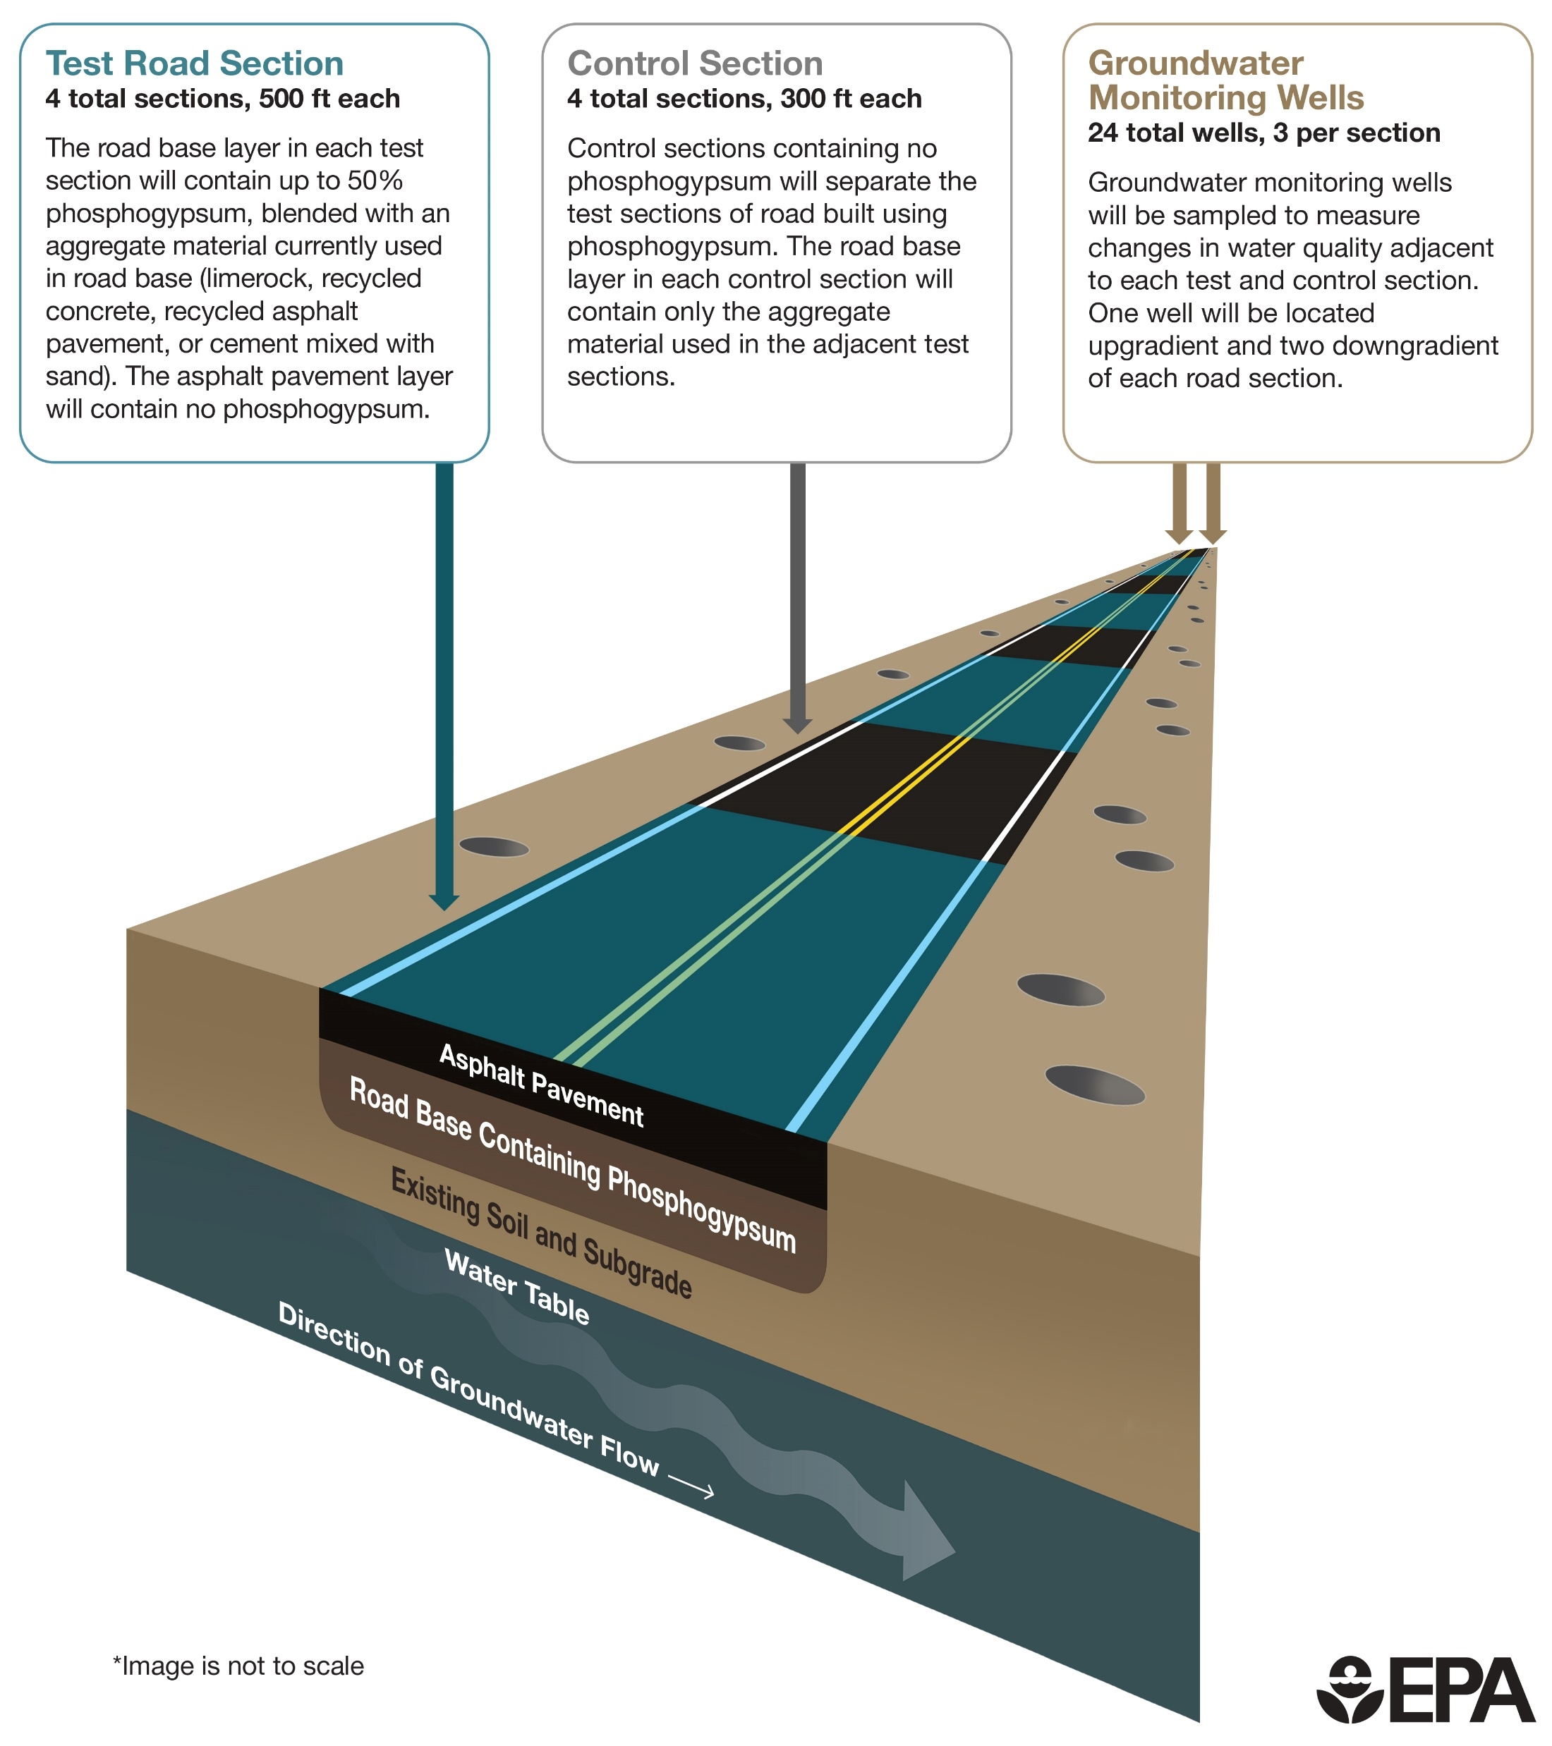
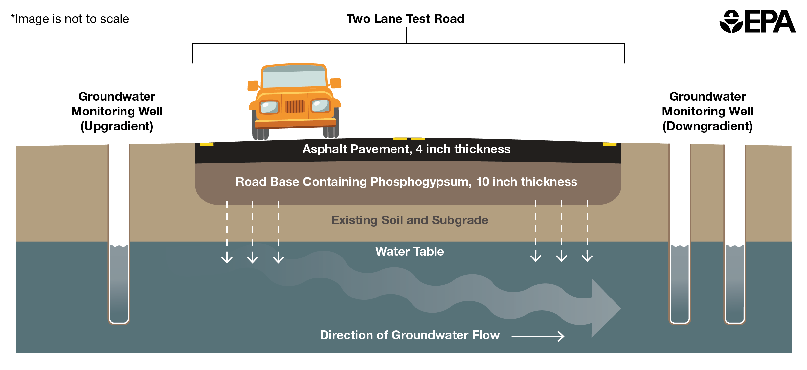
Pilot road cartoon

Slide 8
Phosphogypsum Pilot Project Update
In December 2024, EPA issued final approval of Mosaic’s request
Under the Clean Air Act National Emissions Standards for Hazardous Air Pollutants, EPA may approve uses of phosphogypsum, provided the risks are as low as leaving the material in stacks.
  EPA’s analysis of the request found that projected risks from the proposed project were significantly lower than the threshold for regulatory approval.
EPA published a pending approval in Fall 2024 with supporting technical review of risk assessments and solicited public comment.
  Majority of comments opposed to the use of PG in public roads
EPA published a response to comments along with a Federal Register notice announcing approval
The Center for Biological Diversity (CBD) filed lawsuit against EPA’s decision in February
https://www.epa.gov/radiation/phosphogypsum

Slide 9
WIPP Planned Change Request
Modification of the repository design from 10 to 12 Waste Panels
On March 14th, 2024, DOE submitted to EPA a Planned Change Request (PCR) per 40 CFR 194.4(b)(3) to modify the repository design from 10 to 12 Waste Panels that adds two new waste panels (11 and 12) to the west of the current footprint
  New panels would replace waste volume lost to the 2014 accident and other operational issues
  DOE provided a conceptual 19-panel performance assessment in its submission, indicating DOE’s anticipated state of the repository at final closure after disposal of recently identified volumes
EPA’s review sent technical questions to DOE and requested a separate sensitivity study Performance Assessment (PA) using only 12 Waste Panels instead of a 19-panel repository. This additional technical information package was received in mid-February 2025.
EPA conducted informal public outreach in late August in Carlsbad and Santa Fe
  Public interest groups and individuals, county commissioners, Congressional staff
All documentation received, currently in review, anticipate a decision in coming months

Slide 10
DOE Planned Change Request
DOE proposes adding Panels 11 and 12 to replace space lost from abandoning Panel 9, and losing portions of Panels 1, and 7
  Panels 11 and 12 design are similar to Panels 1 through 8
  DOE is expanding the repository footprint into a new area not covered in the original certification
New Mexico Environment Department has already approved the two new panels in the hazardous waste permit
DOE anticipates the need for up to 7 additional panels in the future
  Will require formal request and EPA review
10
9

Slide 11
MARSSIM Version 2 revisions completed, sending to technical editor this month
  Incorporated comments from EPA’s Science Advisory Board, states, other agencies
  Undergoing final review
  Notice in Federal Register
  Anticipate 2025 publication
Federal Guidance Report (for Radiation Protection)
  FGR-16 (cancer risk coefficients) draft under review
    3-day meeting with SAB held last May
    Additional work needed
  FGR-15 (dose coefficients for external exposures) revision nearly complete
    Expect final publication of updated report in next few months
Other EPA Activities

Slide 12
Questions?
https://www.epa.gov/radiation

Slide 13
Extra slides

Slide 14
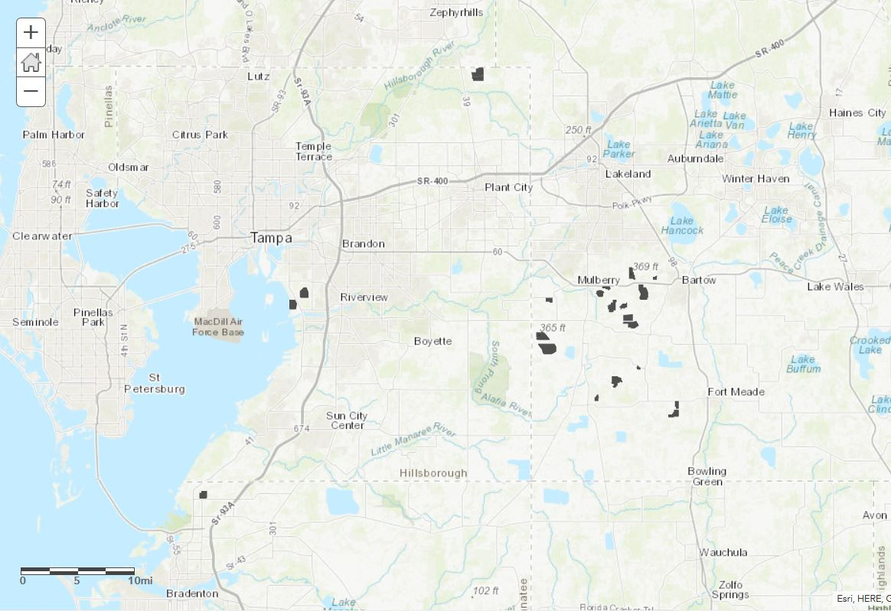
Where is Phosphogypsum?
~50 facilities, 70 individual stacks nationwide.
Located in EPA Regions 4, 5, 6, 7, and 10.
Hundreds of feet high.
Hundreds of acres in extent.
~1.7 billion tons stored.
~30 million tons generated annually.

Slide 15
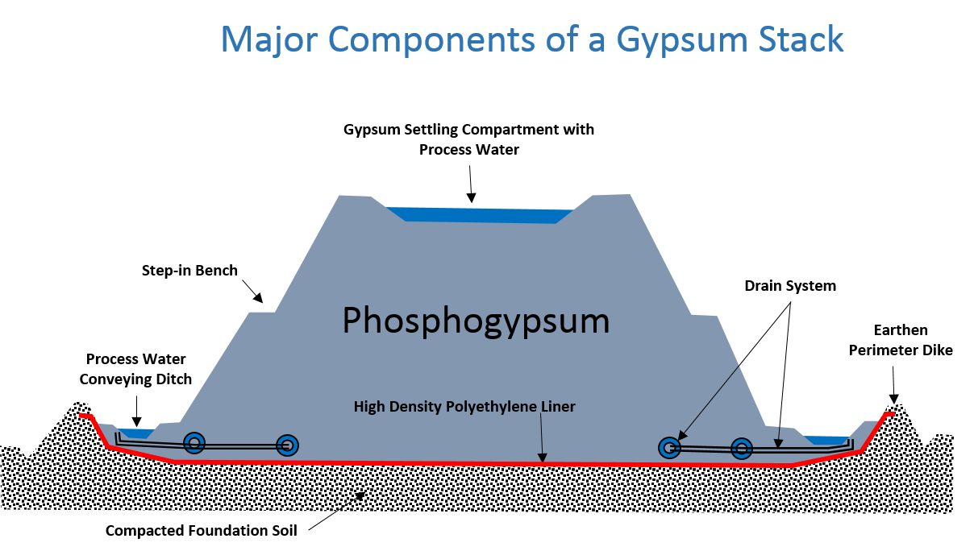
15

