Slide 1
LLW Forum
Spring meeting
Odessa, TX
April 9, 2025

Slide 2
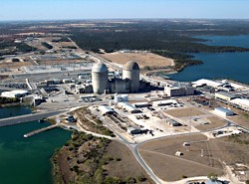
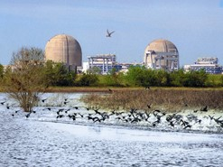
ARDT—Founded 1994
Formed by LLRW generators to promote safe disposal at good rates
Legislative and Regulatory monitoring and advocacy
Helping the deciders make informed decisions

Slide 3
Lone Star State Happenings: A Legislative Update

Slide 4
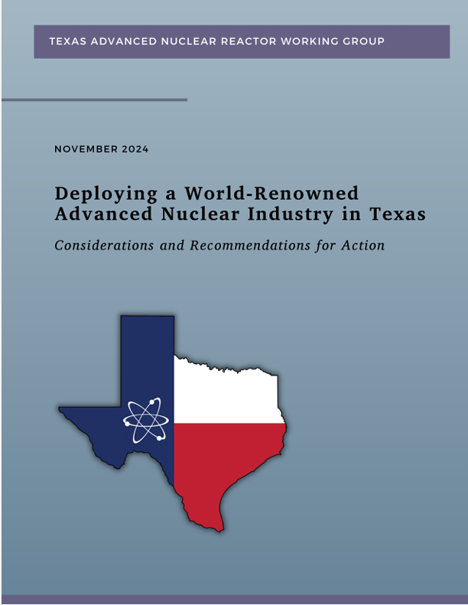
Nuclear Power in Texas
Governor Abbott named the Texas Advanced Nuclear Reactor Working Group to examine policy, regulatory, and workforce issues
Report highlights
Create state-level non-regulatory entities to help companies navigate permitting and oversee financial incentive programs
Establish workforce programs for all levels, from construction to health physics
Establish a Texas Nuclear Fund
The governor also mentioned nuclear power in his state-of-the-state address
Texas Nuclear Caucus in the Texas Legislature
Texas Nuclear Alliance
Uranium mining streamlining

Slide 5
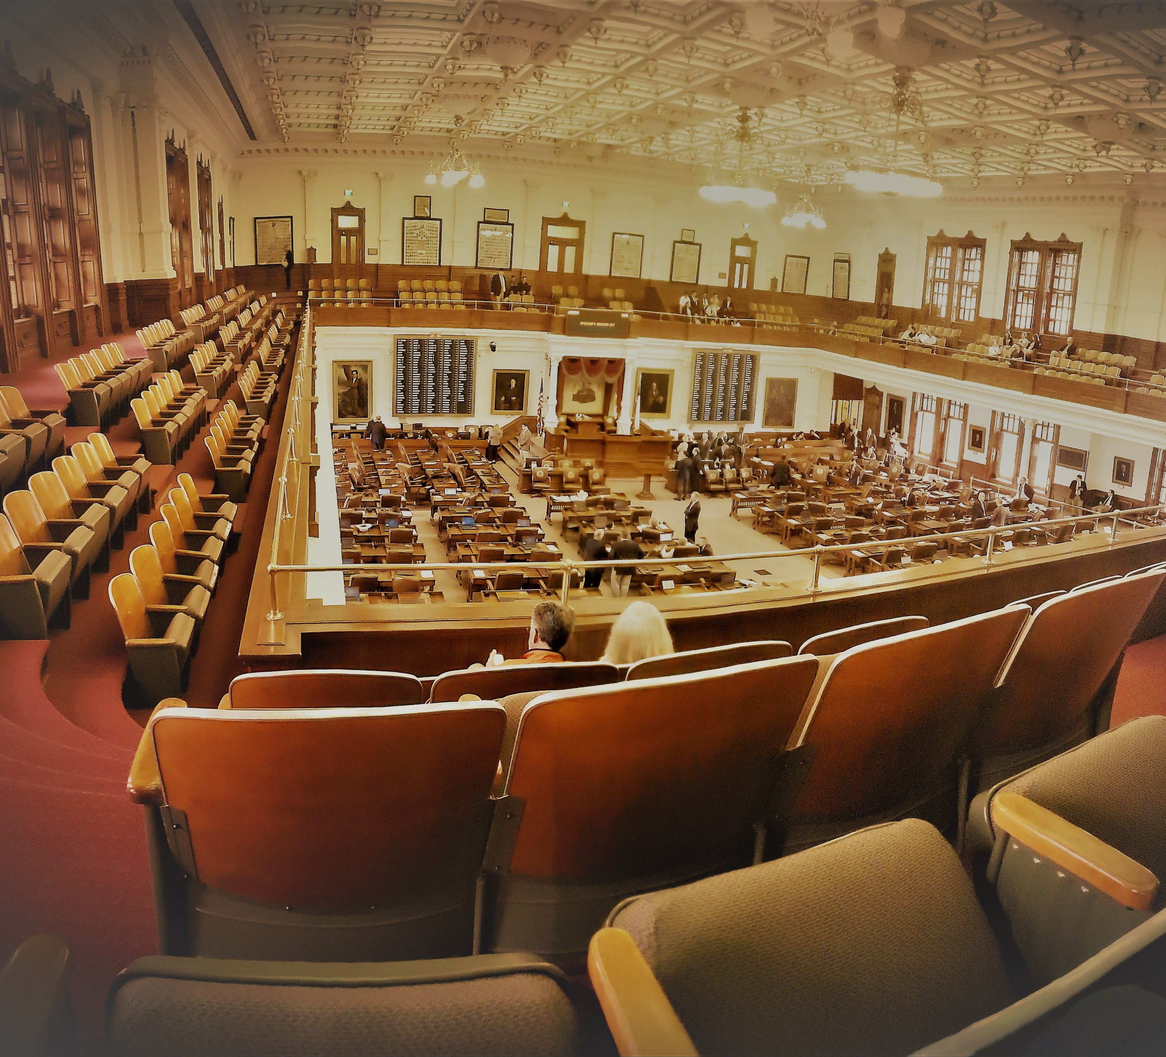
Texas Legislature 101
Meets in odd-numbered years for 140 days
150 Representatives and 31 Senators
Roughly 10,000 bills get filed, but only about 1,300 get passed

Slide 6
House Bill 14
Promotes the development of advanced nuclear reactor projects for dispatchable electric generation while creating high-wage advanced manufacturing jobs
Creates the Texas Advanced Nuclear Energy Office within the Office of the Governor, which would include a Nuclear Permitting Coordinator
Establishes the Texas Advanced Nuclear Development Fund
Creates "reimbursement grant programs” for expenses related to project development and construction
Promotes workforce development through the Advanced Nuclear Energy Workforce Development Program
Makes the completion and operation of advanced nuclear reactors eligible for funding through the Texas Energy Fund

Slide 7
Proposed Constitutional Amendment
The Texas Constitution, would be amended to create the Texas Nuclear Development Fund
The Fund could be used, without further appropriation, to provide grants to entities for financing or incentivizing the development, construction, and operation of advanced nuclear reactor projects, including the appropriate infrastructure necessary to ensure the reliability and adequacy of the state’s power grid
Texas has a budget surplus of $24 billion, plus a “rainy day fund” that will top $27 billion

Slide 8
Nuclear Workforce and Uranium Mining
Senate Bill 1534 mandates a study on health physics education in the State, assessing gaps in education and determining the needs for the nuclear energy and radiological safety sectors
Senate Bill 1535 establishes a Texas Advanced Nuclear Energy Workforce Development Program, requiring curriculum development
House Bill 279, Senate Bill 1061 streamline uranium mining

Slide 9
Tax and Financial Relief
HB 5119 exempts items used to construct a nuclear project from Texas sales and use taxes
HB 5120 allows a tax credit for taxable entities that construct a nuclear project
HB 5588 and SB 2222 exempts property used by a data center to meet its energy needs from State property tax
HB 5590 and SB 2315 incentivize nuclear reactor hook-ins to the grid

Slide 10
And, finally, Waste Issues
Senate Bill 713 reduces the total surcharges paid by WCS from 31.25 percent to 26.25 percent and reallocates some surcharge revenue from the State to Andrews County
House Bills 4112 and 4692 attempt to clarify that future nuclear reactors will be able to store their spent fuel
Still on the look-out for GTCC-related language

Slide 11
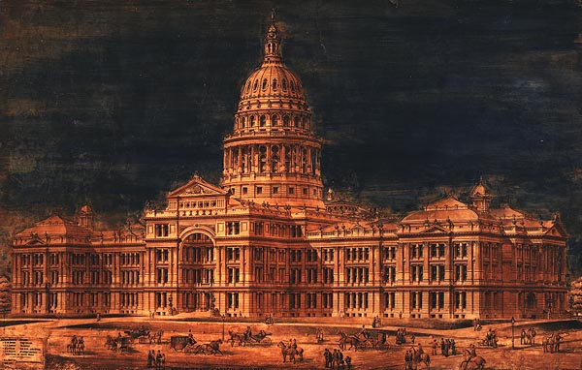
Next Steps
Texas Nuclear Legislative Day is April 10th
If bills are not voted out by committees by early May, they are in serious jeopardy
The Texas Legislature adjourns June 2nd

Slide 12
Connect with ARDT
www.ardt.org
Edward Selig
General Manager
eselig@ardt.org
512.413.0902
Brian Christian
Policy Specialist
bchristian@ardt.org
512.937.2490

