Slide 1
DOE Sealed Source Programs Low-Level Waste Forum, Spring 2025
Sam Meyer, Office of Radiological Security (CONTR)
Justin Griffin, Los Alamos National Laboratory

Slide 2
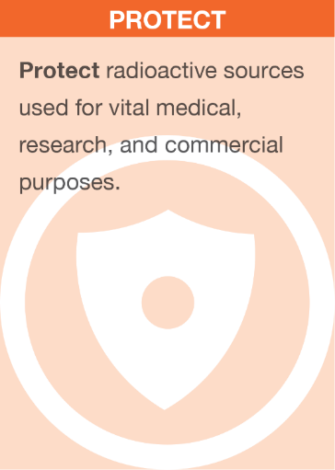
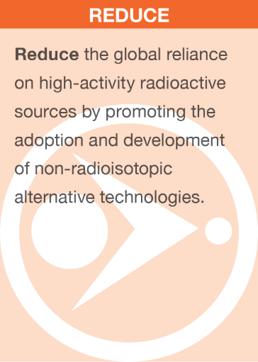
Office of Radiological Security
Enhance global security by preventing high-activity radioactive materials from being used in acts of terrorism.

Slide 3
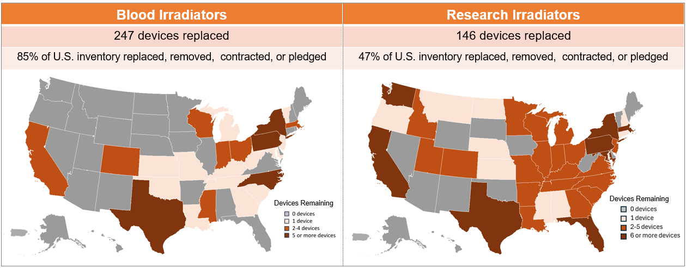
Cesium Irradiator Replacement Project (CIRP)
As of February 28, 2025:
393 cesium-137-based blood and research irradiators replaced through CIRP
69% of the U.S. self-shielded cesium-137 irradiators replaced, removed, contracted, or pledged

Slide 4
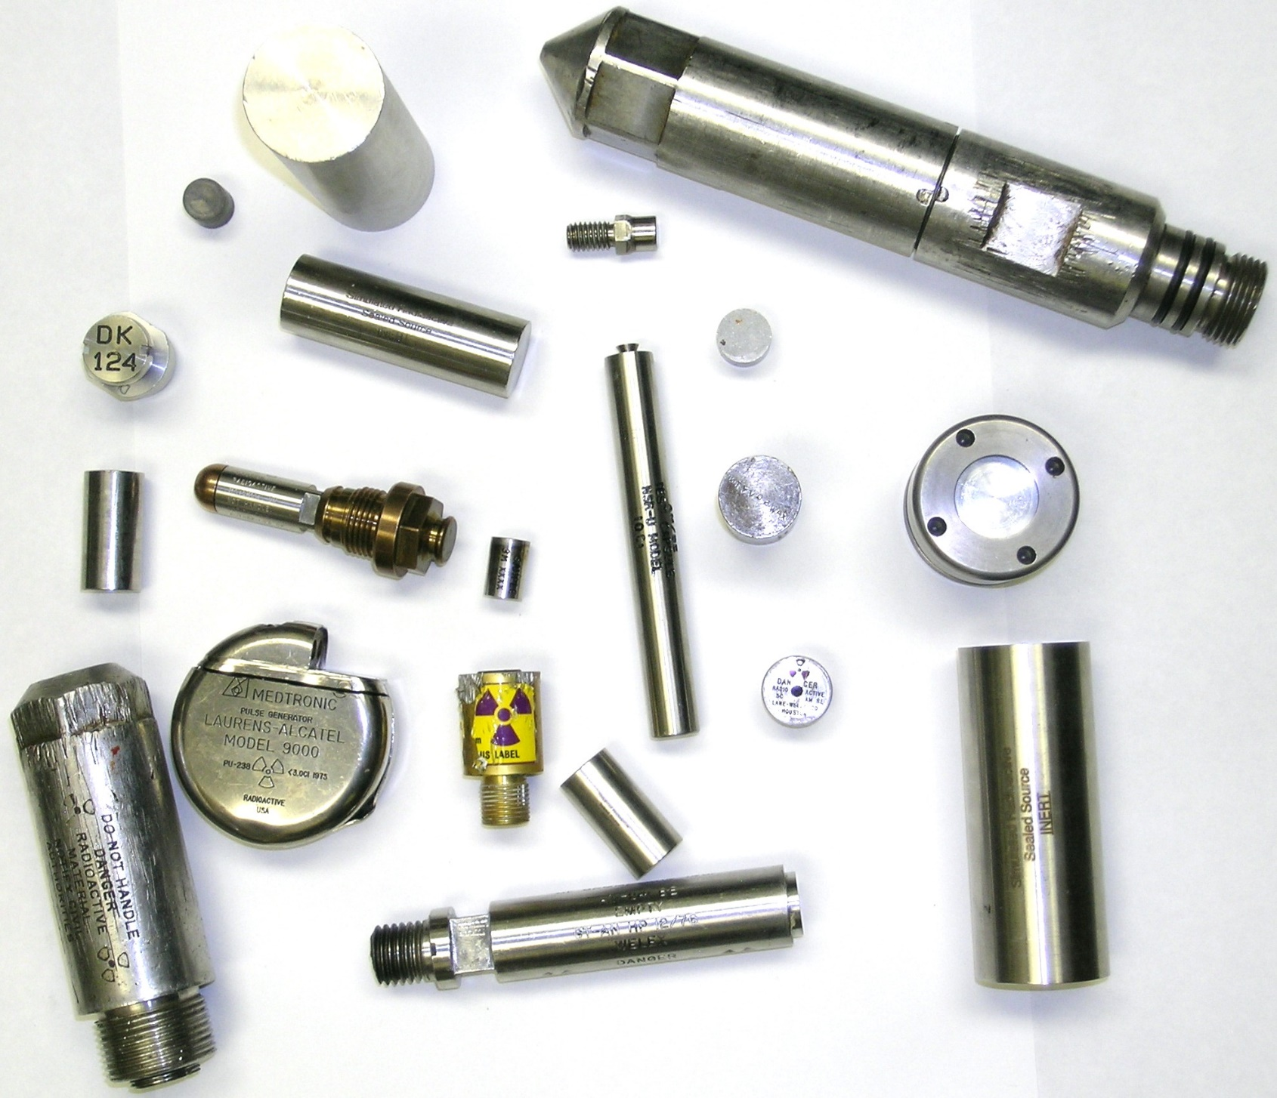
Transuranic Source Removals
LA-UR-25-22561

Slide 5
OSRP Background
Remove disused radioactive sealed sources that pose a potential risk to national security and human health and safety.
Not all sources have a commercial disposal pathway.
Pilot project: 5 Am/Be sources removed in Sept 1997 from OH
Since then, removals from all 50 states, DC, Puerto Rico; and 68 sites in 29 other countries.
OSRP does not recover powders, liquids, trash, or loose/diffuse radioactive material.
The program is limited to discrete sealed sources with rad material in solid form.

Slide 6
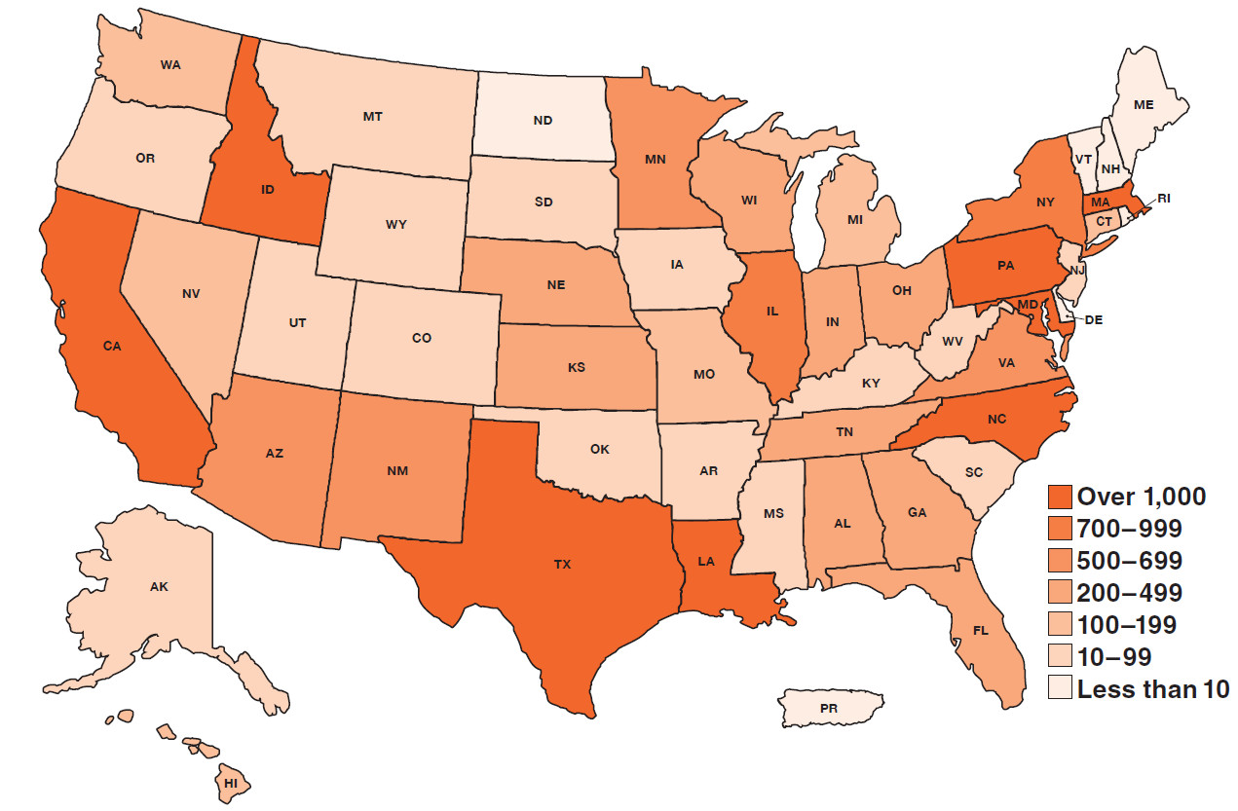
Removal Summary
Since 1997, OSRP work has resulted in reduced threats from disused radioactive sealed sources.
Isotope | Sources Recovered | Curies Recovered*
⁶⁰Co | 6,869 | 353,132
⁹⁰Sr | 314 | 705,559
¹³⁷Cs | 5,750 | 521,502
²³⁸Pu | 2,549 | 16,149
²³⁹Pu | 1,216 | 1,402
²⁴¹Am | 28,264 | 18,457
All Others | 3,080 | 574
TOTALS | 48,042 | 1,616,774
*Activity at time of removal, data as of 3/10/25

Slide 7
What is Transuranic (TRU)?
According to WIPP’s definition, TRU waste means waste containing more than 100 ηCi of alpha-emitting isotopes per gram of waste, with half-lives greater than 20 years:
Mostly Am-241, Pu-238, Pu-239
WIPP criteria only allows materials generated by atomic energy defense activities.
Foreign-origin materials are excluded.

Slide 8
Production of TRU Material
TRU materials produced within the US were sold through the AEC and DOE Isotope Sales Program starting in the 1950s.
DOE stopped producing/selling Am-241, so source manufacturers had to obtain material produced in other countries.
Sealed sources have a finite lifespan, known as Recommended Working Life – RWL is generally 15-20 years.
Since about 2005, almost all americium sources distributed and used in the US contained Russian-origin material.

Slide 9
TRU Removal Success
Isotope | Sources Recovered | Curies Recovered*
²³⁸Pu | 2,549 | 16,149
²³⁹Pu | 1,216 | 1,402
²⁴¹Am | 28,264 | 18,457
TOTALS | 32,029 | 36,008
*Activity at time of removal, data as of 3/10/25
Since 1997, OSRP removed over 32,000 TRU sources from medical, educational, agricultural, research, industrial, and government facilities.
Majority contained Am-241 or AmBe.
Average source activity is ~1Ci.
First OSRP drums were shipped to WIPP in 2003 (1559 drums so far).

Slide 10
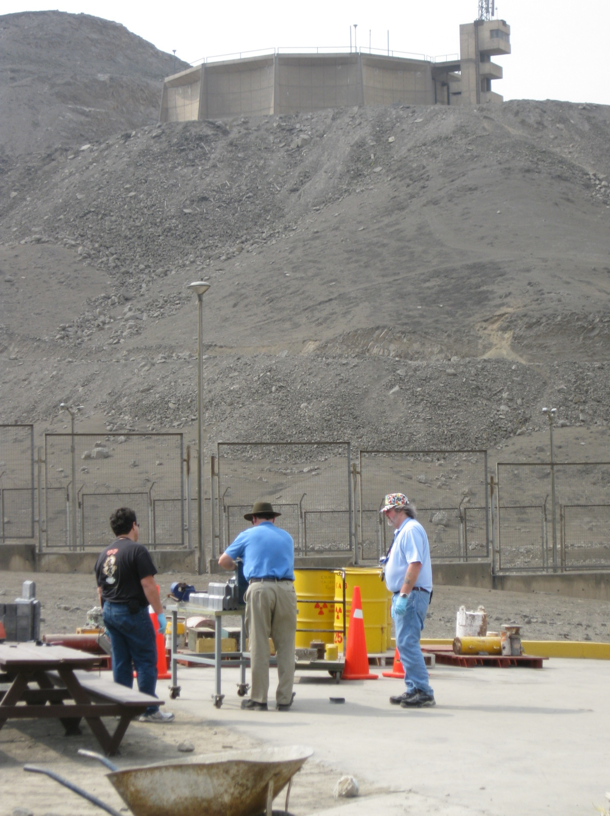
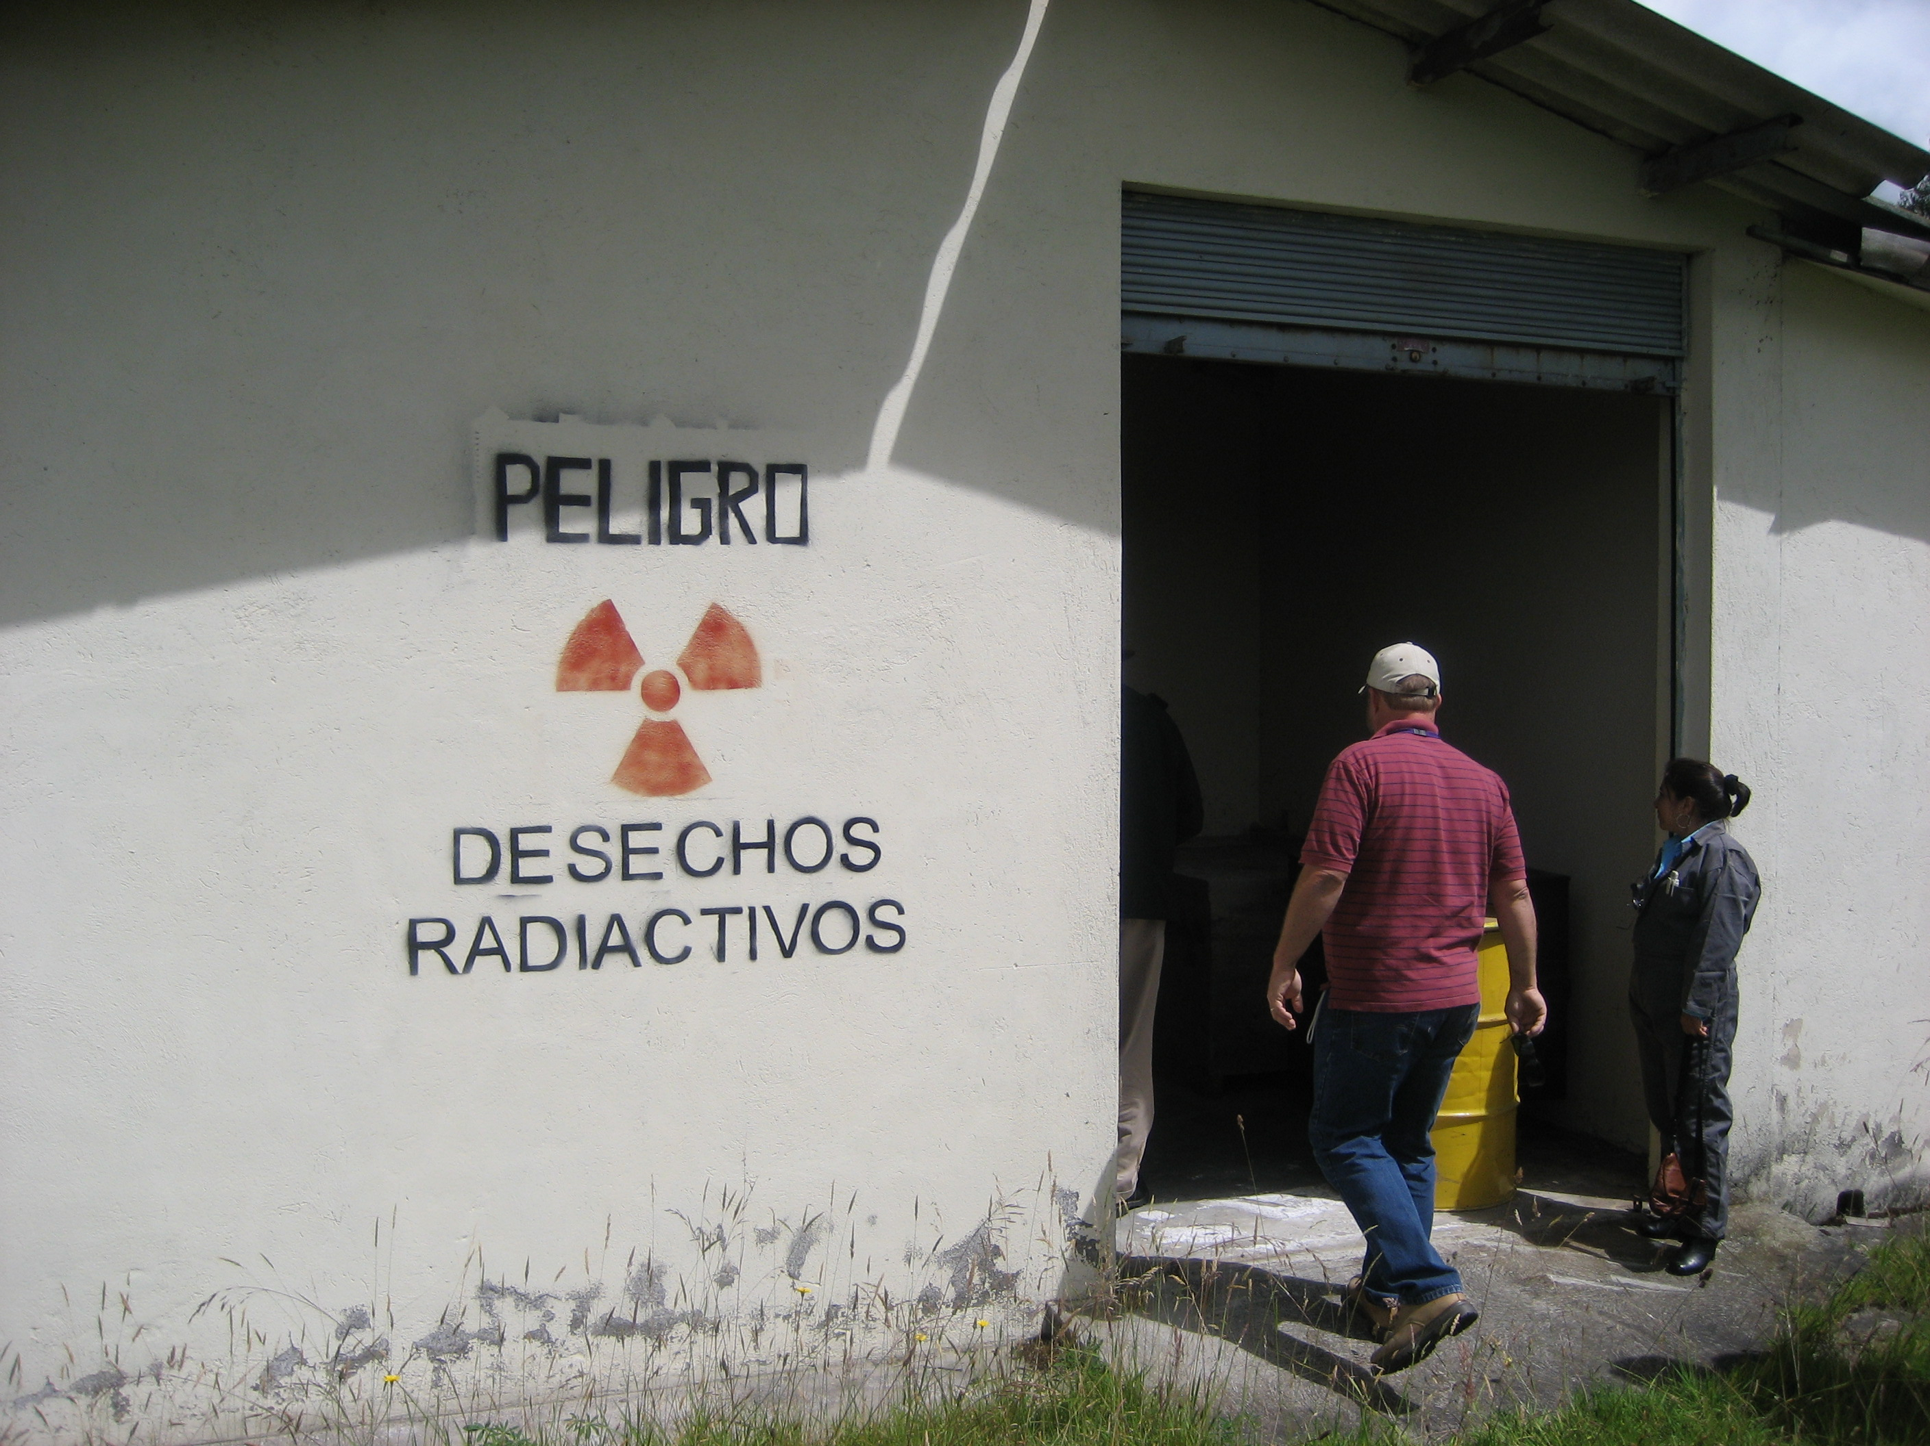
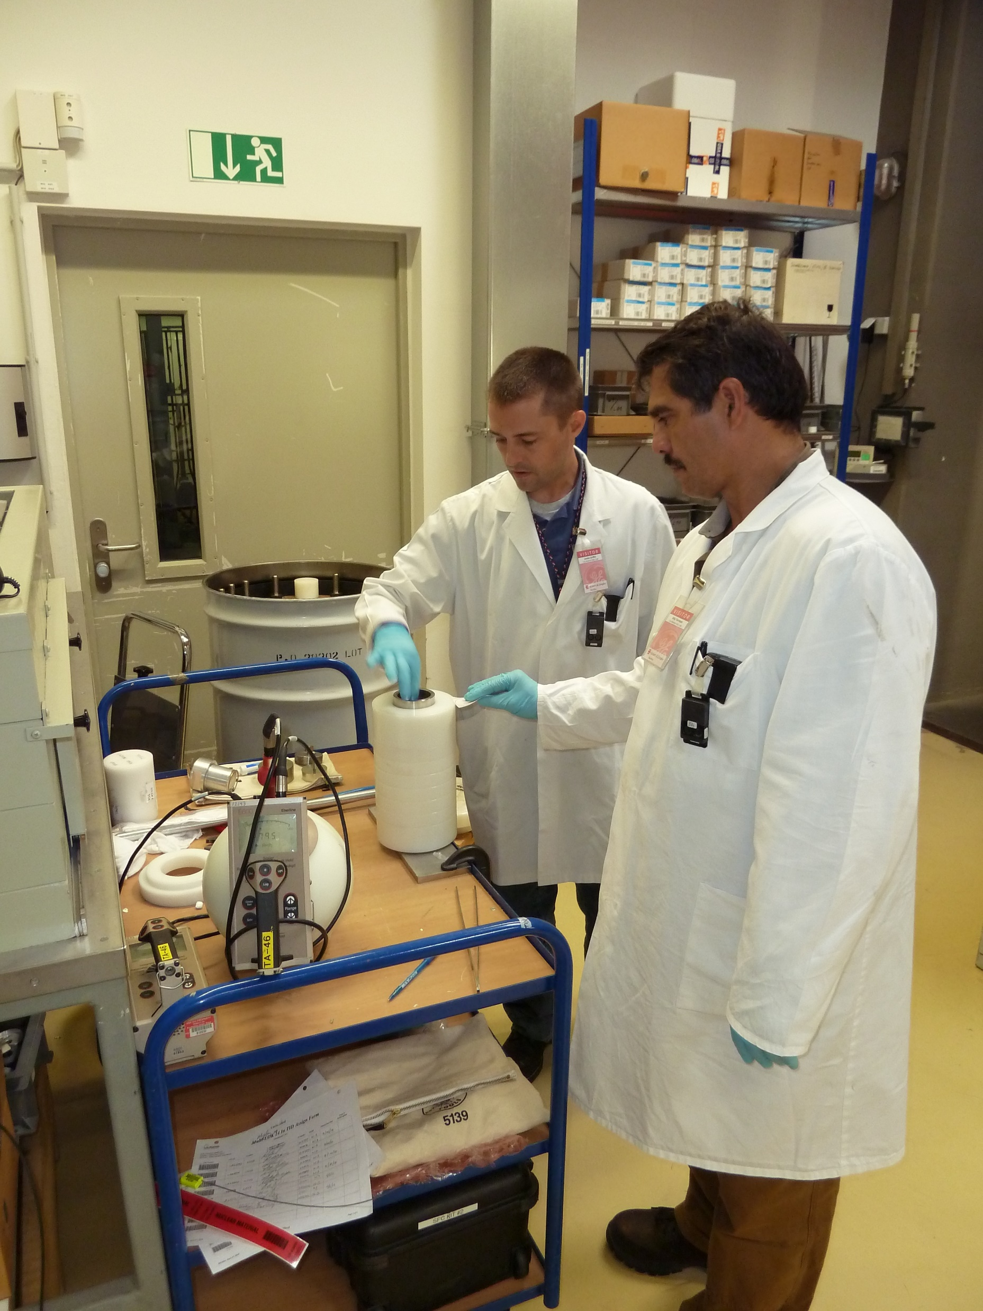
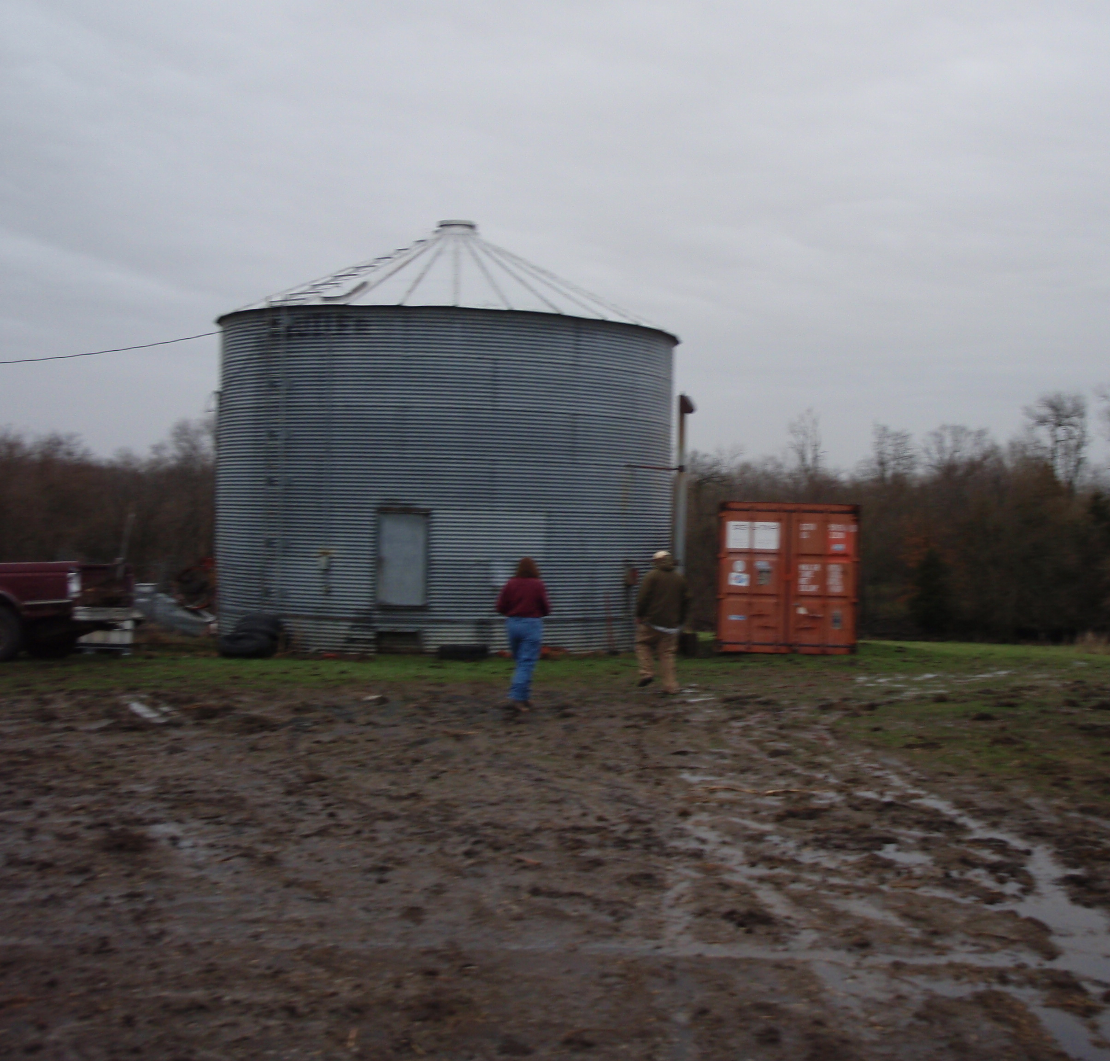
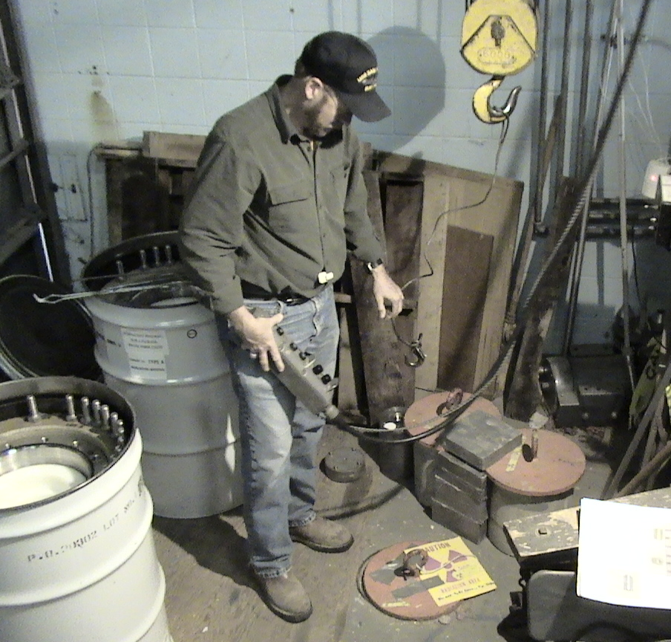
TRU Removals
Oh, The Places You’ll Go!

Slide 11
Next Big Hurdle
Foreign Origin Radioactive Material (FORM)
Extent of the FORM problem is difficult to estimate.
Most are not tracked in NRC’s National Source Tracking System (NSTS).
DOE estimates that there are more than 39,000 foreign-origin Am-241 sources in the US; and more distributed annually.
These sources are currently not acceptable for final disposition at WIPP and do not have commercial disposal outlet.

Slide 12
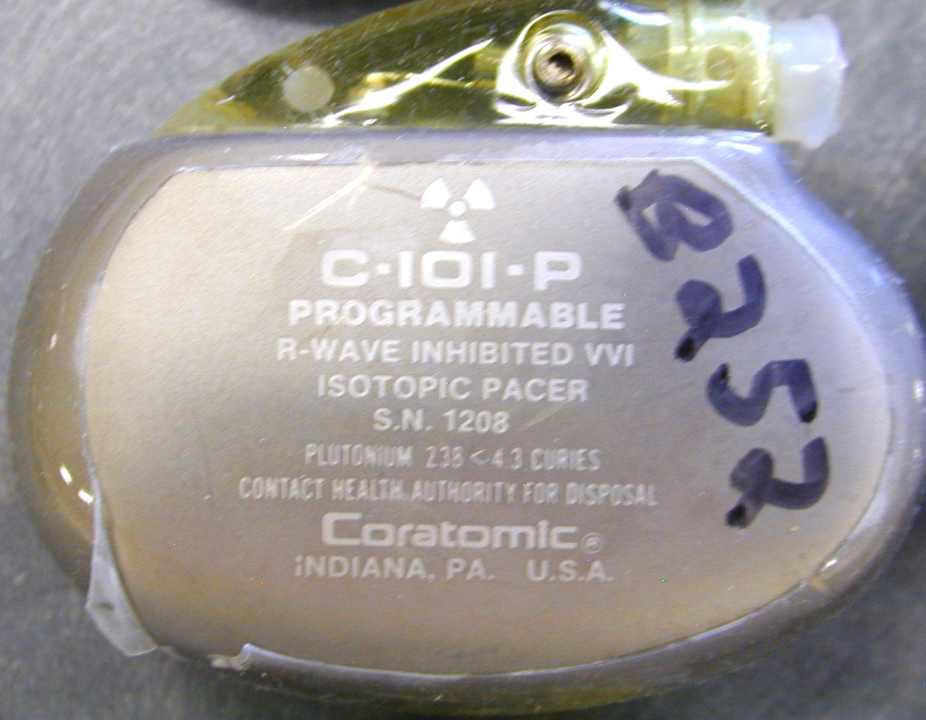
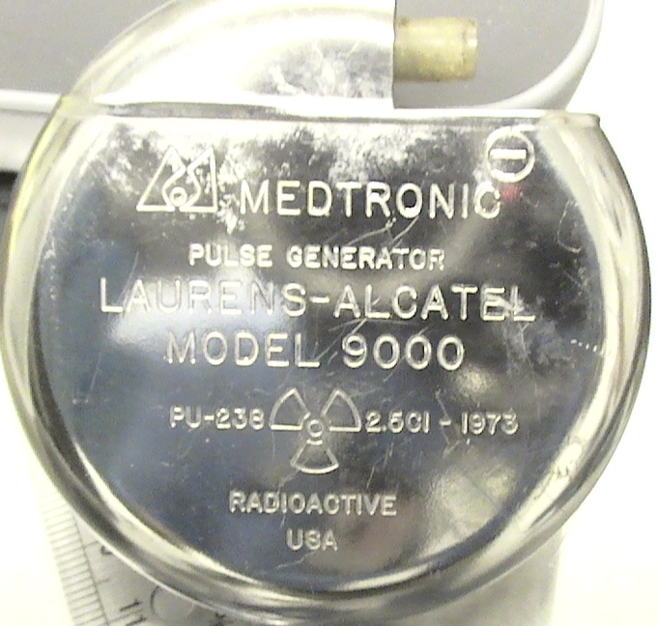
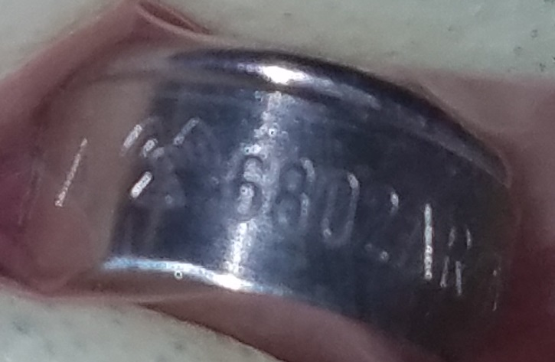
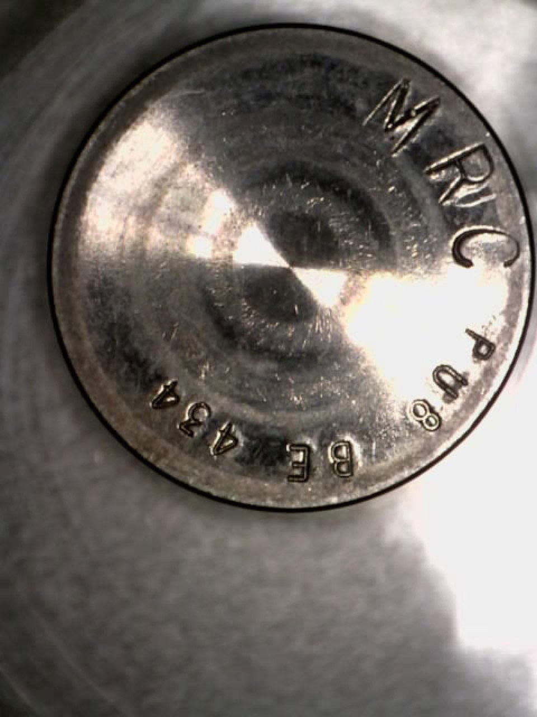
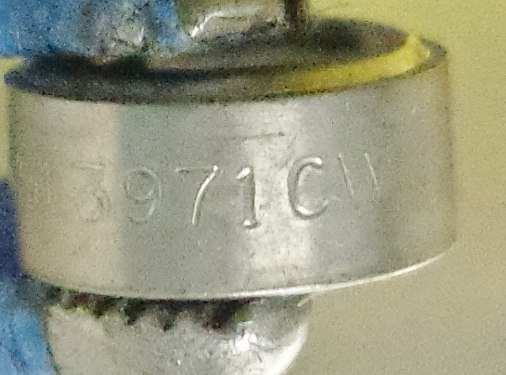
Guess the Origin

Slide 13
Guess the Origin (Answers)

Slide 14
Options for Foreign-Origin Transuranics?
Leave the sources at the licensee site?
Return to the source/device manufacturer, or producer?
Accumulate sources at 3rd party licensed facilities or commercial waste brokerages?
Wait for a new GTCC disposal site?
Revise Land Withdrawal Act?
Allow expanded definition of atomic energy defense activities?
Ongoing efforts

Slide 15
Questions?
Sam Meyer
Project Manager
Office of Radiological Security (Contractor)
National Nuclear Security Administration
samuel.meyer@nnsa.doe.gov
(202) 586-2124
Justin Griffin, PE, PMP
Team Leader
Off-Site Source Recovery Program
Los Alamos National Laboratory
jgriffin@lanl.gov
(505) 606-0362

