Slide 1
Texas Low Level Radioactive Waste Disposal Compact Commission The Beginning Years
Margaret Henderson
Interim Executive Director

Slide 2
Health And Safety Code. Chapter 403. Texas Low-Level Radioactive Waste Disposal Compact. & Vermont Statute: Title 10: Conservation and Development.
Commissioners in Early Years
Michael Ford, CHP, Chair
John C. White, CNMT, Vice Chair
Honorable Richard H. Dolgener, TX
Bobby Gregory, TX
Kenneth L. Peddicord, Ph.D., P.E., TX
Uldis Vanags, VT
Stephen Wark, VT
Robert C. Wilson, TX
Sarah Hofmann, VT, Alternate Commissioner
…legal entity separate and distinct from the party states….
TX: Art. III., Sec. 3.03. The commission is a legal entity separate and distinct from the party states ….

Slide 3
Two recurring issues --- interwoven in the beginning years
Financial
Legal

Slide 4
Concurrent and Some Unknown Timelines
Achieve operational status so the Commission could perform statutory duties
Coincide with opening of the Compact Facility

Slide 5
Where’s the money? $ 12.5 M from VT

Slide 6
Financial Actions
TX interim appropriation $100,000 through a TCEQ appropriations request
Banking Resolution July 21, 2009 to open a bank account
VT contribution per invoice $25,000 two successive fiscal years - Invoiced Vermont for their party state pro-rata share and deposited in the account
Commission sending invoices to TCEQ for reimbursements
MEANWHILE - Awaiting TCEQ’s fee rule for fees to support operations of commission per the statue and for facility to open and collection of fees to commence

Slide 7
Legal Issue
Representation by Attorney General Offices of TX and VT
Contracting with agencies
Opening a bank account and depositing money
Rulemaking
Representation in legal procedures

Slide 8
Rulemaking
Volume Rule – adopted 8/31/2009
By no later than 180 days after all members of the commission are appointed under Section 3.01 of this article, establish by rule the total volume of low-level radioactive waste that the host state will dispose of in the compact facility in the years 1995-2045, including decommissioning waste.
Import – Export Rules – adopted 2/4/2011

Slide 9
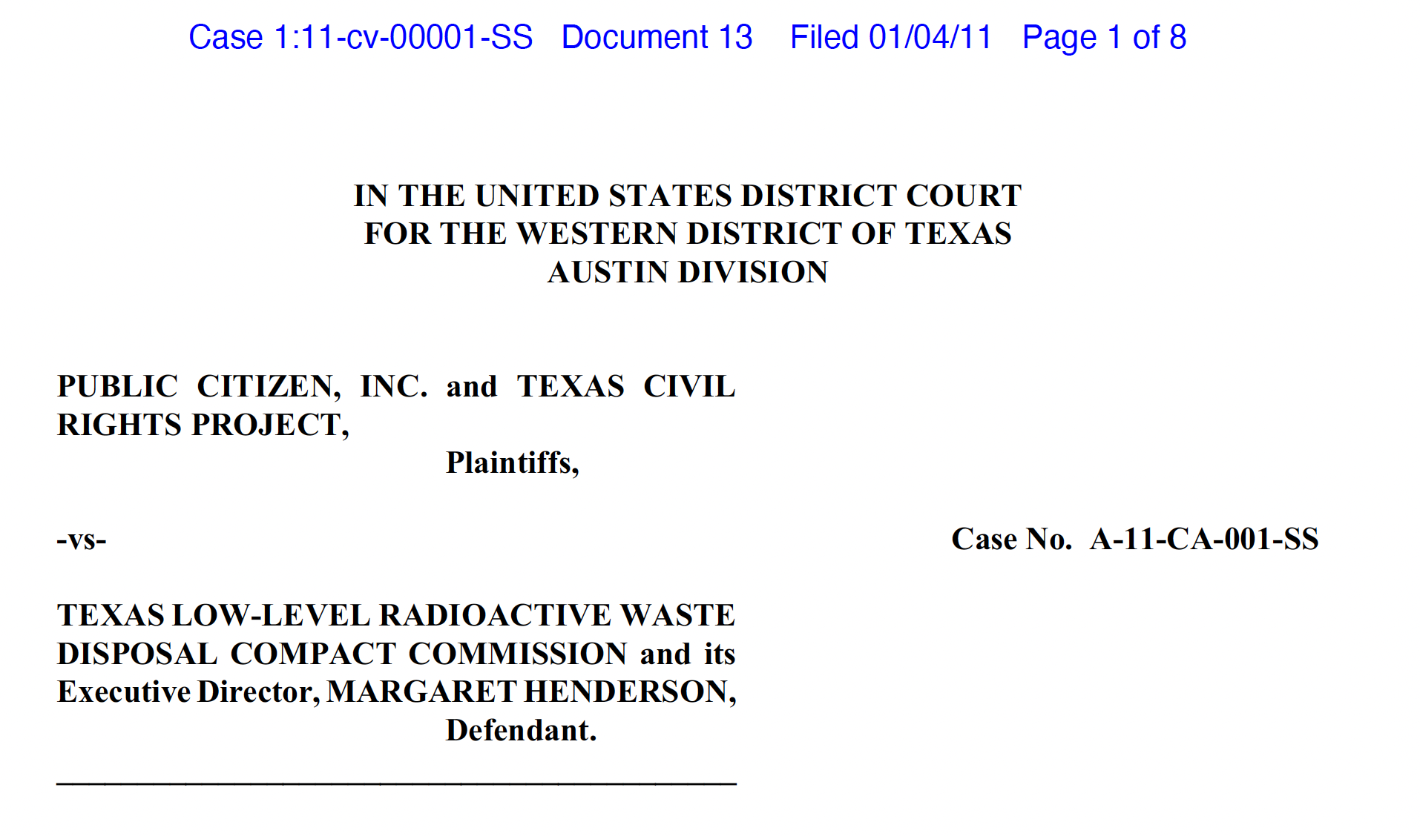
The Litigation – January 2011
Removal of Margaret Henderson
Dismissal of case

Slide 10
Import – Export Rulemaking

Slide 11
When my work concluded --
Commission accessing funds from states
Volume Rule Adopted
Import-Export Rules ready for final adoption
Bills paid
Ready to open office in Austin
Ready to hire full time Executive Director

Slide 12
An Honor and a Privilege: It was important for TX, VT & US
From MY Perspective:
Evaluated radiation safety of medical, academic and associated industries
Liaison for Governor’s TX Radiation Advisory Board to state and federal agencies for all radiation issues for around 15 years
Member of radiological emergency response team
Reviewer of socioeconomic impacts for waste and uranium environmental assessment in TX licensing
Experienced in radiation control agency administration
Participated in rulemaking
Public information experience

Slide 13
Reference Statutes
The U.S. Congress ratified a Compact between Texas, Maine and Vermont for disposal of low-level radioactive waste with the passage of the Compact Consent Act, PL 105-236 in 1998.
The TLLRWDCC was established by the states pursuant to the Low-Level Radioactive Waste Policy Act, PL 96-573 (1980) as amended by the Low-Level Radioactive Waste Policy Amendments Act of 1985 (PL 99-240).
The compact statues of party states are found in:
Health And Safety Code. Chapter 403. Texas Low-Level Radioactive Waste Disposal Compact. Health And Safety Code. Title 5. Sanitation and Environmental Quality. Subtitle D. Nuclear And Radioactive Materials. Chapter 403. Texas Low-Level Radioactive Waste Disposal Compact
Vermont Statute: Title 10: Conservation and Development. Chapter 162: Texas Low-Level Radioactive Waste Disposal Compact

Slide 14
Margaret Henderson, MS in Community & Regional Planning Henderson Planning and Consulting, Specializing in Radiation Issues
Publications Consultant and Editor for Low-Level Waste Forum and for the Conference of Radiation Control Program Directors, Inc.
PO Box 590
Ouray CO 81427
970-519-1588
margaretllwf@gmail.com

