Slide 1
ORS Update and Update on DOE
Source Recovery Efforts
Low Level Waste Forum, Reno NV
October 2024
Sam Meyer
Office of Radiological Security (Contractor)

Slide 2
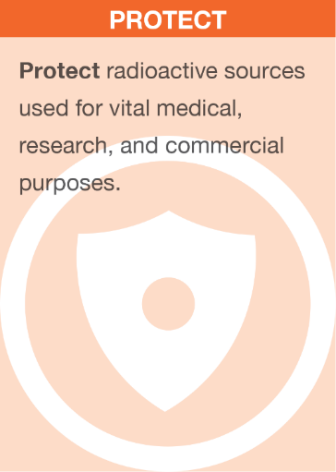

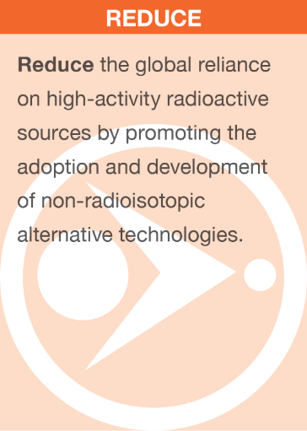
Office of Radiological Security
Enhance global security by preventing high-activity radioactive materials from being used in acts of terrorism.

Slide 3
Support U.S. Government Policy
National Security Memorandum to Counter Weapons of Mass Destruction Terrorism and Advance Nuclear and Radioactive Material Security, March 2023
“Reducing, eliminating, and securing radioactive and nuclear materials are the most effective means to prevent their acquisition and use, and through the implementation of policies and priorities detailed in this NSM, the United States will advance efforts to prevent WMD terrorism.”
U.S. National Security Strategy, October 2022
“We will continue to lead the world in coordinated efforts to lock down nuclear and radiological materials and prevent terrorist acquisition.”
NNSA Strategic Vision, May 2022
“We must detect possible proliferation activities as early as possible and minimize pathways to attaining nuclear or radiological devices.”

Slide 4
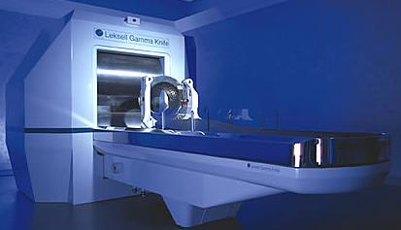
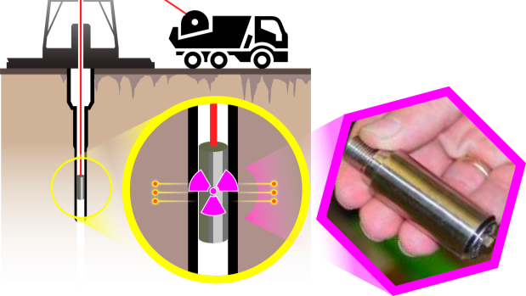
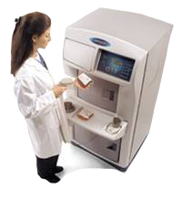
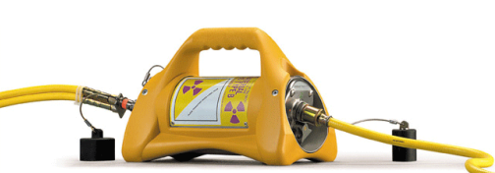
High Activity Sources
Teletherapy and Stereotactic Radiosurgery units (cancer treatment)
Self-shielded and panoramic irradiators (research and sterilization)
Co-60
Normal Device Activity
1,000 – 1,000,000+ Ci
Am-241
Normal Device Activity
8-20 Ci
Oil well logging
(industrial imaging)
Ir-192
Normal Device Activity
10-100 Ci
Cs-137
Normal Device Activity
1,000 – 50,000 Ci
Radiography
(industrial imaging)
Self-shielded irradiators
(e.g., blood and medical research irradiators)
calibrators (dosimeter and detector calibration)
4

Slide 5
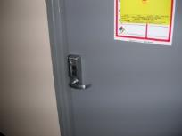
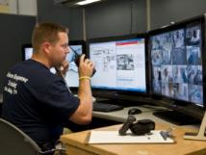
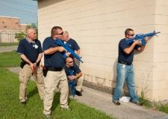
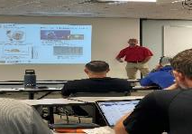
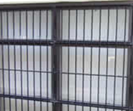


Protect: Security Enhancements
DETECT
DELAY
RESPOND
TRAIN
Prompt Detection and Reliable Notification
Extended Adversary
Task Time
Timely, Aware, Equipped and Trained Response
Security and Response Training
Sentry Remote Monitoring System:
Fully networked, hardened, and encrypted security monitor
Hardened Doors
Centralized Monitoring Stations
Alarm Response Training .
Response Planning
PRD Training, Tabletop Exercises
Multi-Factor Access Control:
Requires combination of card, pin, or biometric scan for entry
Personal Radiation
Detectors (PRDs)
(Domestic only)
Radiological Security
Awareness & Response
Facility Hardening
ORS Containment Strategy

Slide 6
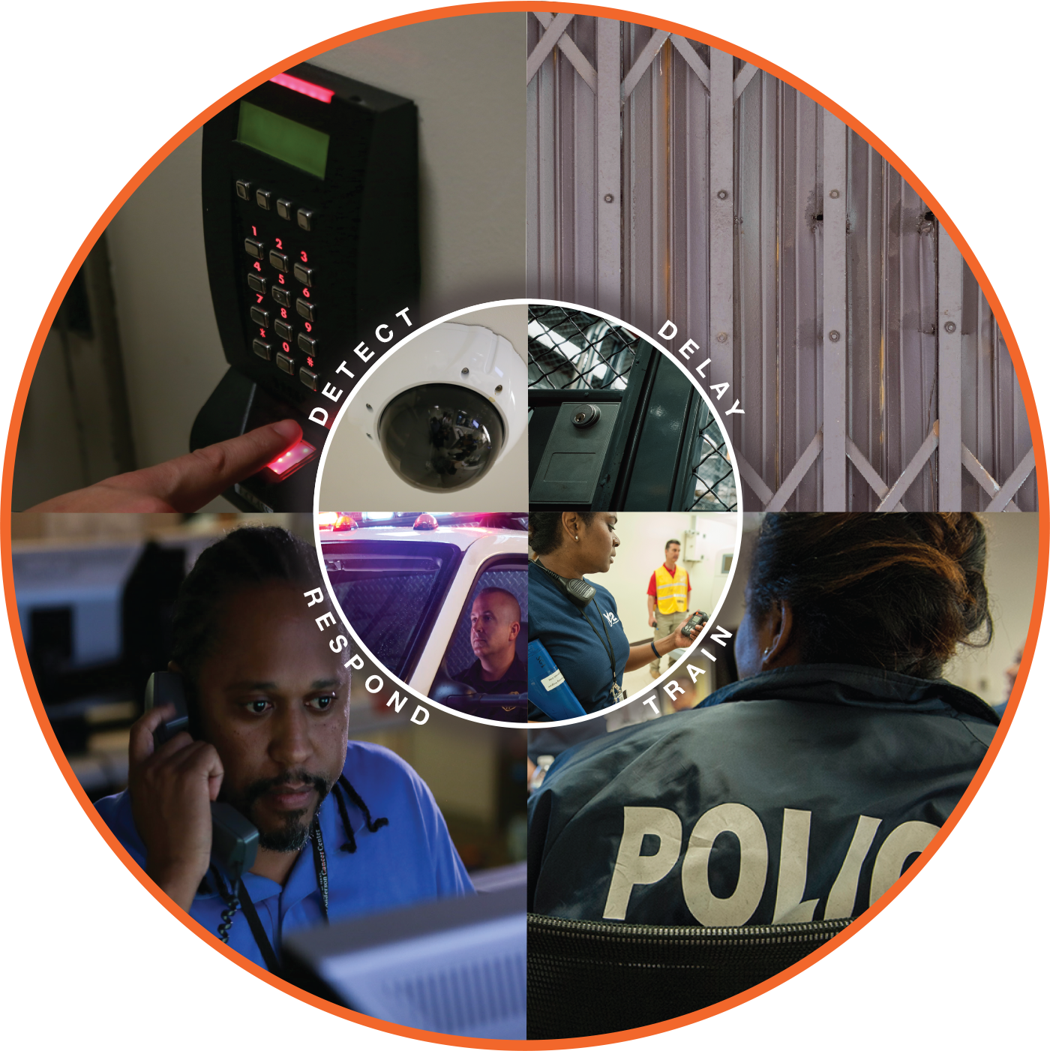
Protect: Security Enhancements
Detect
Prompt Detection, Reliable Notification
Delay
Extended Adversary Task Time
• Sentry Remote Monitoring System
• Multi-Factor Access Control
• Hardened Doors
• Facility Hardening
Respond
Timely, Equipped and Prepared
Train
Security and Response
• Centralized Monitoring Stations
• Personal Radiation Detectors (PRDs)
• Alarm Response Training
• Response Planning
• PRD Training
• Tabletop Exercises
• Radiological Security Awareness and Response
Notes:
ORS offers a full suite of federally funded security enhancements that work to make it harder for an adversary to remove the source from its container or the facility. This containment strategy includes integration with local law enforcement to enable a timely response where officers are fully prepared to respond to a radiological theft event.
At the facility, hardened devices as well as doors, keypads, and security protocols work to make it harder for an outsider, or an insider, to gain access to the source.
All of these security enhancements and training are provided at no cost to businesses, law enforcement, or local governments.

Slide 7
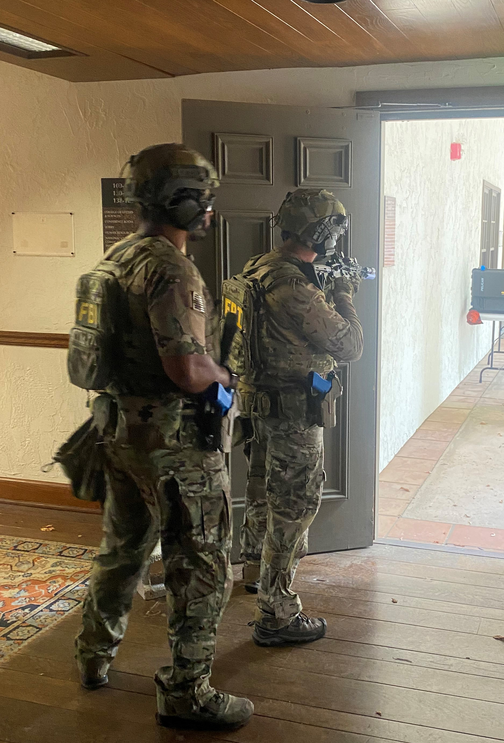
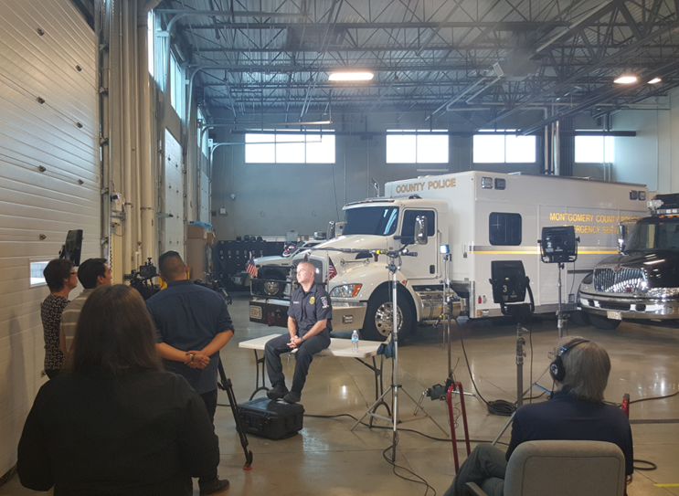
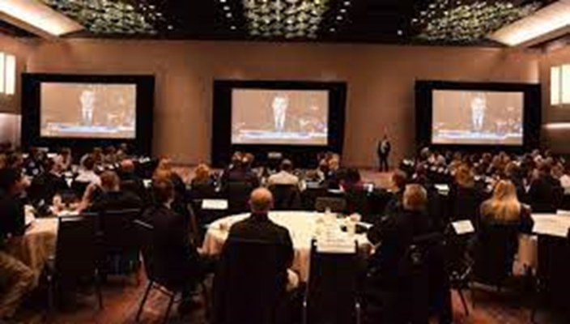
ORS Response Integration
  The ORS Response strategy relies on a timely, well-equipped, and well-trained response from law enforcement
  ORS partners with site security officials and local law enforcement officers for training and exercises
    Alarm Response Training: 3-day course at Y12 for licensees that receive Protect enhancements
  Radiological Security Awareness and Response (RSAR): Customized training support, response policy development, and training for local law enforcement agencies
    Silent Thunder and Isotope Crossroads: 6-hour no fault tabletop exercises involving federal, state, and local organizations using crisis / consequence management skills
  GOAL: Contain the radioactive materials at the facility

Slide 8
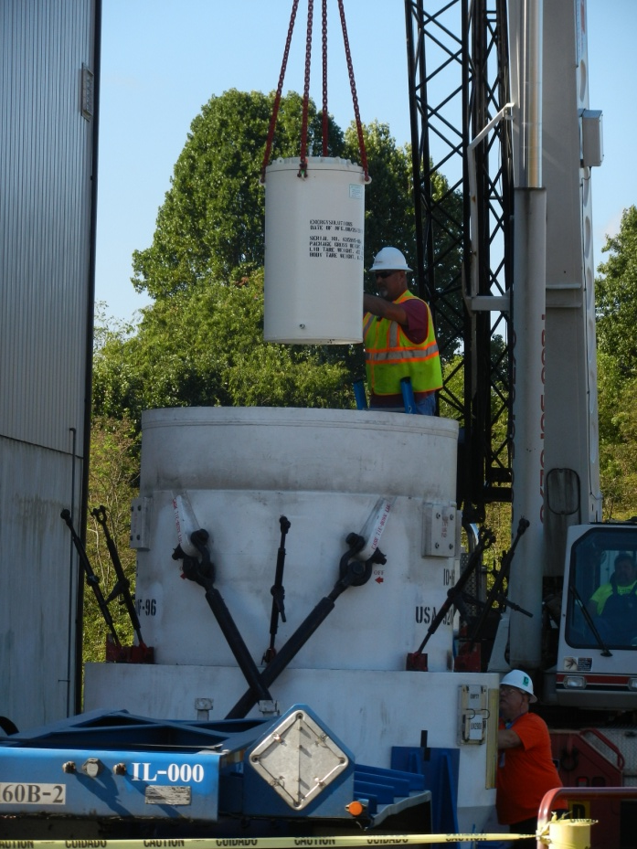
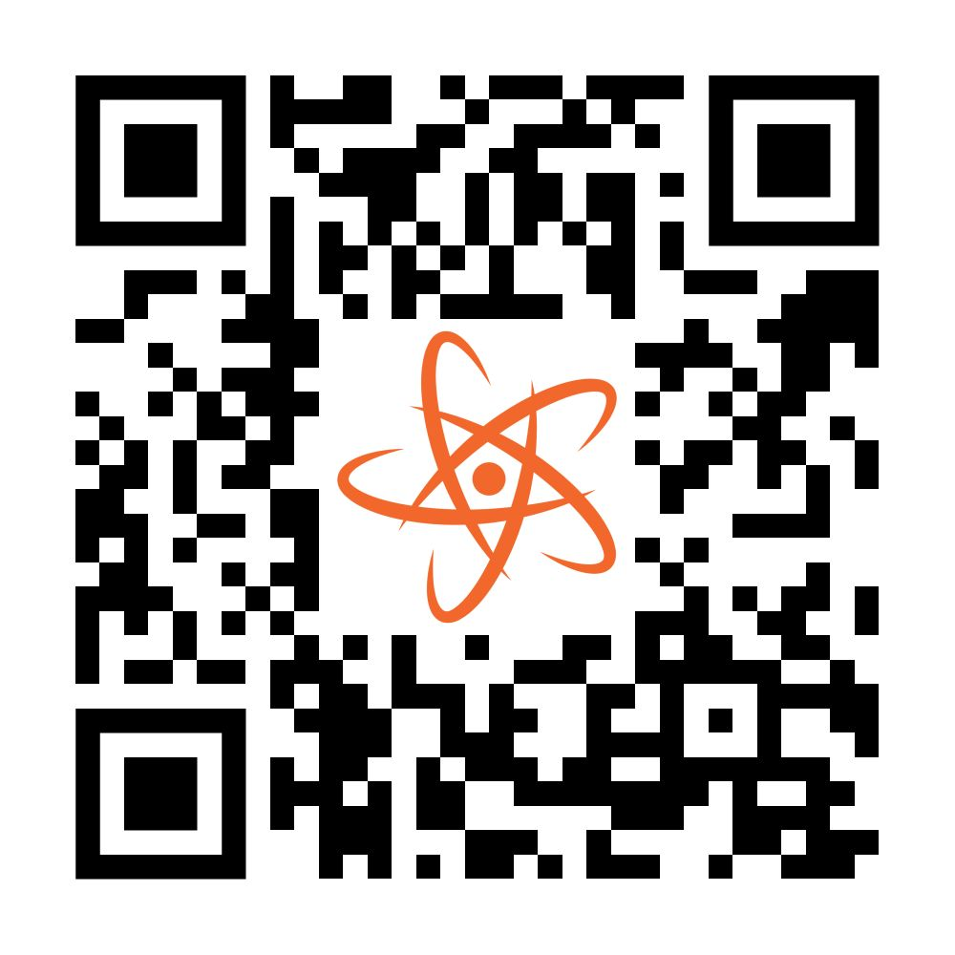
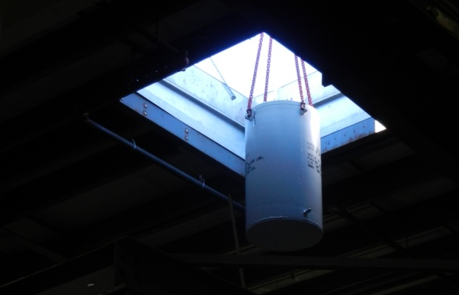
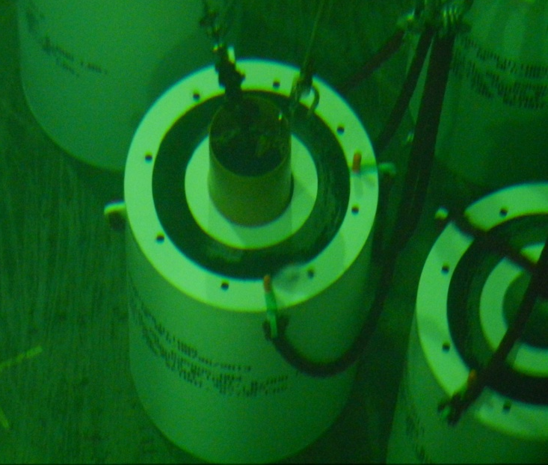
Secure Source Removal
Off-Site Source Recovery Program (OSRP)
ORS recovers disused and unwanted radioactive sealed sources in the interest of national security at no cost to licensees.
Eligible sources should be registered at: http://osrp.lanl.gov/PickUpSources.aspx
  Source Collection & Threat Reduction (SCATR)
  ORS partners with Conference of Radiation Control Program Directors (CRCPD) to work with state regulators and licensees to round up sources with commercial disposal pathways.
Preparing for the Future
Type B transportation containers (435-B and 380-B).
Training service providers to prepare devices for transport
(7 companies trained to date).
End-of-life management options for radioactive sources and devices.
Notes:
For licensees, secure removal and disposal of disused sources and devices can be a challenge. It requires a level of expertise not easily found and can be quite costly.
ORS offers secure, no cost removal and disposal of disused sources, including devices.
Through our Off-Site Radiological Source Removal Program, or OSRP, ORS can pick up and securely dispose of qualified disused and unwanted radioactive sealed sources.
As we are seeing and anticipating an increasing adoption of alternative technologies, or more specifically, X-ray, ORS is preparing for the future by:
Increasing the supply of transportation containers: ORS Developed and manufactured two NNSA-owned Type B transportation containers (435-B and 380-B); also providing the NNSA-owned Type B container design documents to qualified commercial entities to help increase the limited number of Type B containers certified to ship high activity sources and devices
Training service providers to prepare devices for transport
As well as expanding options for end-of-life management of rad sources

Slide 9
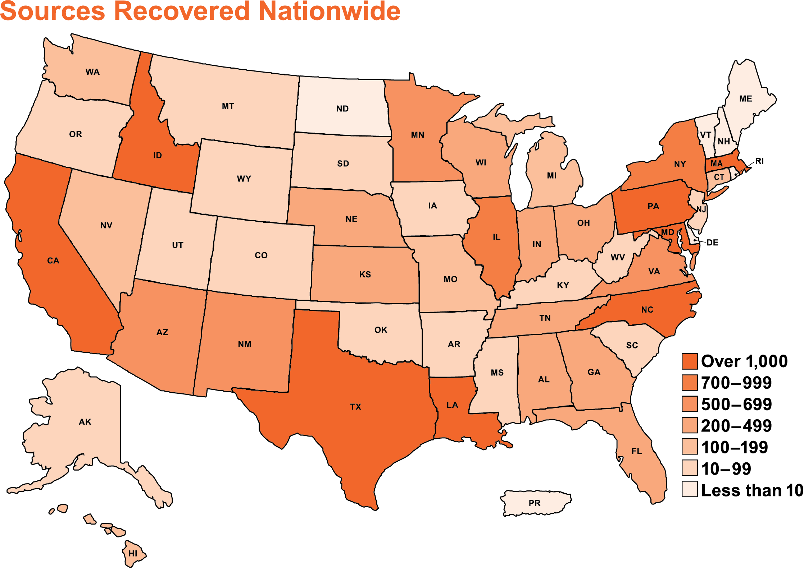
DOE Source Removal Successes
DOE/NNSA Source Recovery Success
As of July 1, 2024, OSRP has recovered 47,458 sealed sources comprising 56,986 TBq of radioactivity
Through the SCATR program, DOE/NNSA has facilitated the disposal of 38,768 sealed sources comprising 53 TBq of radioactivity
Notes:
For licensees, secure removal and disposal of disused sources and devices can be a challenge. It requires a level of expertise not easily found and can be quite costly.
ORS offers secure, no cost removal and disposal of disused sources, including devices.
Through our Off-Site Radiological Source Removal Program, or OSRP, ORS can pick up and securely dispose of disused and unwanted radioactive sealed sources.
As we are seeing and anticipating an increasing adoption of alternative technologies, or more specifically, X-ray, ORS is preparing for the future by:
Developing new and improved transport containers
Training service providers to prepare devices for transport
As well as expanding options for end-of-life management of rad sources
ORS Developed and manufactured two NNSA-owned Type B transportation containers (435-B and 380-B); also providing the NNSA-owned Type B container design documents to qualified commercial entities to help increase the limited number of Type B containers certified to ship high activity sources and devices

Slide 10
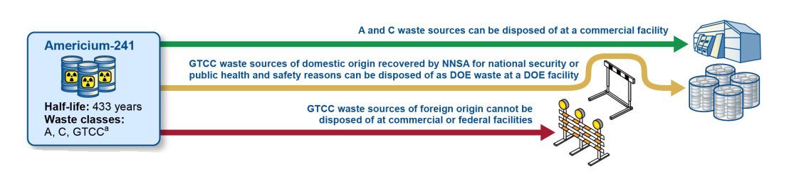
OSRP Disposal Pathways
Transuranic (TRU) Disposal
Consolidation at Gammatron Facility in Houston, TX
Disposal at Waste Isolation Pilot Plant (WIPP), New Mexico
Only U.S.-origin material accepted
Currently, no disposal pathway for Foreign-Origin Americium-241 (FOAM)
High Activity Beta-Gamma (HABG) Disposal
Consolidation at Southwest research Institute (SwRI), San Antonio, TX
Notes:
For licensees, secure removal and disposal of disused sources and devices can be a challenge. It requires a level of expertise not easily found and can be quite costly.
ORS offers secure, no cost removal and disposal of disused sources, including devices.
Through our Off-Site Radiological Source Removal Program, or OSRP, ORS can pick up and securely dispose of disused and unwanted radioactive sealed sources.
As we are seeing and anticipating an increasing adoption of alternative technologies, or more specifically, X-ray, ORS is preparing for the future by:
Developing new and improved transport containers
Training service providers to prepare devices for transport
As well as expanding options for end-of-life management of rad sources
ORS Developed and manufactured two NNSA-owned Type B transportation containers (435-B and 380-B); also providing the NNSA-owned Type B container design documents to qualified commercial entities to help increase the limited number of Type B containers certified to ship high activity sources and devices

Slide 11



Incentive for Source Removal: Cesium Irradiator Replacement Project
DOE/NNSA implements cesium-137-based irradiator replacement, on a voluntary basis, through CIRP
Incentives
Benefits
No cost, priority, safe, and secure removal and disposal of disused sources, valued at $500k per device
Cost-share of a replacement X-ray irradiator, 50% of the cost, reimbursed upon commissioning
No source decay – consistently fast patient treatment and product throughput
Energy can be varied
Simplified workflow and regulation or licensing
No security or radioactive waste management costs

Slide 12
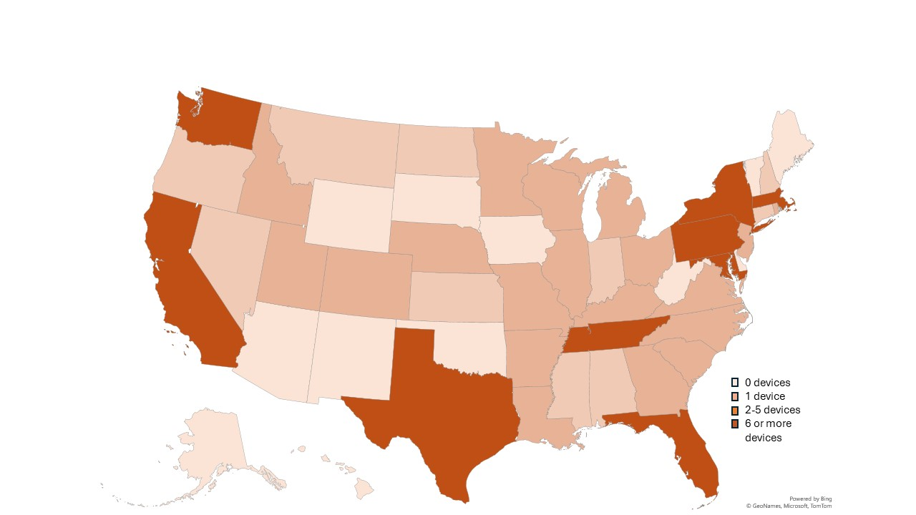
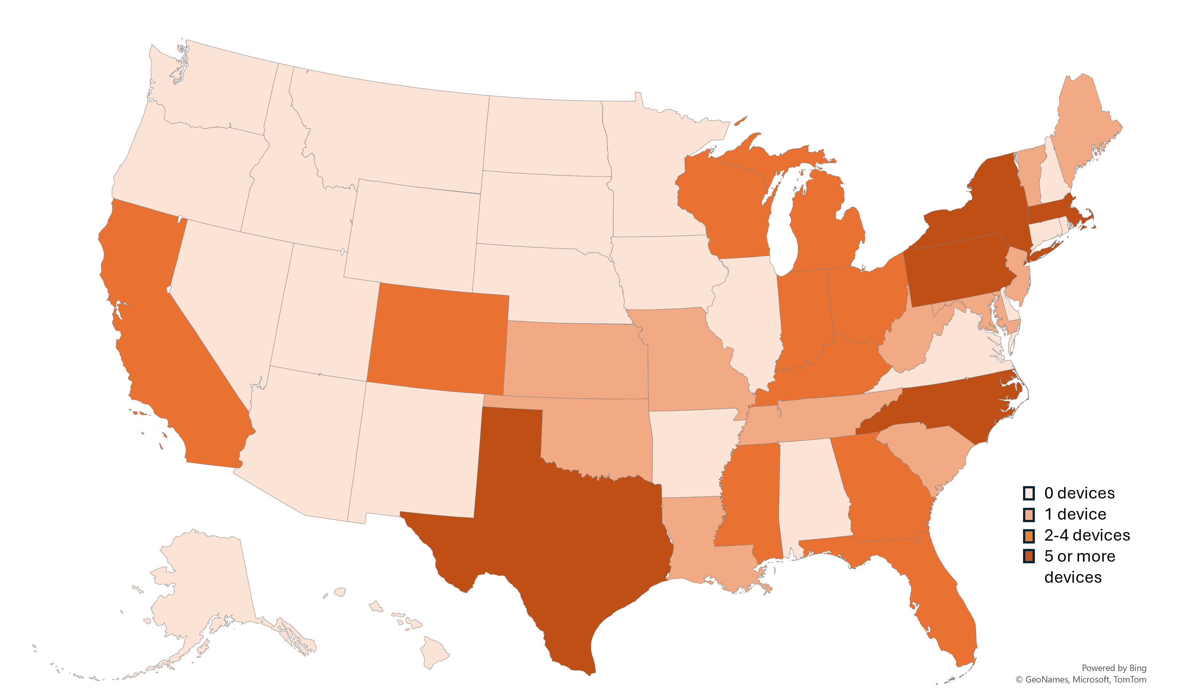
ORS CIRP Progress & Remaining Devices
As of September 5, 2024:
370 cesium-137-based blood and research irradiators replaced through CIRP
65% of the U.S. self-shielded cesium-137 irradiators replaced, removed, contracted, or pledged
Blood Irradiators | Research Irradiators
235 devices replaced | 135 devices replaced
82% of U.S. inventory replaced, removed, contracted, or pledged | 49% of U.S. inventory replaced, removed, contracted, or pledged
Key: Devices Remaining
Key: Devices Remaining

Slide 13








U.S. Partnerships for Irradiator Replacement
Initiative | Irradiator Application | Partners | Irradiators to be Replaced
Vitalant | Blood | Corporate leadership | 100% Completed FY23
American Red Cross | Blood | Corporate leadership | 100% Completed FY22
OneBlood | Blood | Corporate leadership | 100% Completed FY20
University of California | Blood & Research | UC President’s office, Nuclear Threat Initiative | 95%
New York City | Blood & Research | NYC regulator, Nuclear Threat Initiative | 75%
Atlanta | Blood & Research | Emory University, Nuclear Threat Initiative | 66%

Slide 14

Questions

Slide 15
Contact
Sam Meyer
Project Manager, Hunatek Gvt. Solutions
Office of Radiological Security (Contractor)
National Nuclear Security Administration
samuel.meyer@nnsa.doe.gov
(202) 586-2124
Shea Cotton
Foreign Affairs Specialist
Office of Radiological Security
National Nuclear Security Administration
Shea.Cotton@nnsa.doe.gov
(202) 586-3757

