Slide 1
Barnwell LLRW Disposal Facility
Low Level Waste Forum Meeting
October 9-10, 2024

Slide 2
Barnwell Disposal Facility (BDF)
Safety Statistics
Barnwell Compliance
BDF Location and History
Atlantic Compact History and Membership
Regulatory Oversight
Disposal Site Access and Rates
Disposal Facility Capabilities
H3 Plume Migration
H3 Concentration Levels Over Time

Slide 3
Barnwell Disposal Safety Stats
2023
Total Days Away Case = 0
Total Recordable Cases = 0
Total First Aid Cases = 5
  (3 of those were insect bites/stings)
2024 to date
Total Days Away Case = 0
Total Recordable Cases = 0
Total First Aid Cases = 6
  (3 of those were insect bites/stings)

Slide 4
Barnwell Disposal Compliance
2023
Storm Water Inspection
  No issues of concern; no NOVs
Semi Annual DHEC Audits
  No issues of concern; no NOVs
DHEC weekly site inspections
  No issues of concern; no NOVs
2024 YTD; DHEC reorganized to DES
Storm Water Inspection
  No issues of concern; no NOVs
Semi Annual DHEC Audits
  No issues of concern; no NOVs
DHEC weekly site inspections
  No issues of concern; no NOVs

Slide 5
BDF’s Location
235 acres licensed for disposal
123 acres in closed condition
16 acres available for future disposal (900,000 cu ft)
96 acres for other uses
28.4 million cubic feet buried since 1971
14.4 million curies buried
~3.1 million curies remaining (decay correction)
183 groundwater monitoring wells

Slide 6
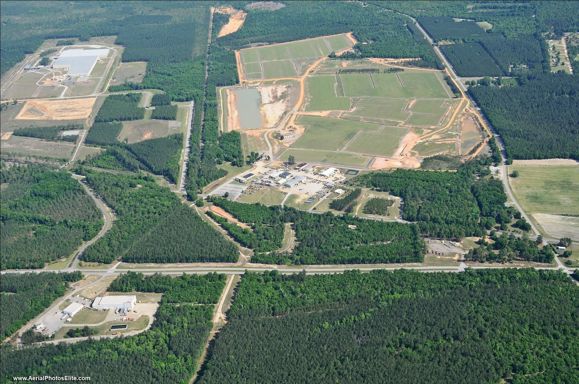
Barnwell Complex

Slide 7
BDF History
Barnwell Disposal Facility has operated uninterrupted from 1971 to present
Received waste from across the US until 2008
Atlantic Compact only operations since 2008

Slide 8
Atlantic Compact History and Membership
2000 Atlantic Compact Act
Atlantic Compact operations started July 1, 2008 after 8 year transition
Membership
  South Carolina
  New Jersey
  Connecticut
Receive about 9,000 cubic feet average yearly volume (excluding large component and IH volume)
Average 60-70 containerized (cask) shipments per year

Slide 9
Barnwell Site Regulatory Agencies
SC Office of Regulatory Staff (ORS)
  Detailed audits of actual costs
  Sets prices for waste disposal
SC Public Service Commission (PSC)
  Determines allowable costs
  Annual hearing process
SC Dept. of Environmental Services (DES)
  (changed from DHEC on July 1, 2024)
  Licenses radioactive materials - disposal

Slide 10
DES Oversight
Licensed by the State of South Carolina Department of Environmental Services (DES) for the receipt and disposal of Class A, B, and C low-level radioactive wastes
DES provides
  On-site Inspector
  Weekly inspections
  License inspections (at lease 2 per year)

Slide 11
Atlantic Compact Disposal Rates
Rate Schedule approved by SC Office of Regulatory Staff every Fiscal Year
Provides 2 Options
  Option A –Maximum Uniform Rate Schedule
  Option B – Access Fee Customer, Volume Allocation

Slide 12
Atlantic Compact Disposal Rates
  3 utilities/customers with 12 reactors in Atlantic Compact use Option B
    Pay quarterly access fee for disposal
    Each reactor allocated equal portion of 7,000 cubic feet
    $110 per cubic foot over allocated volume
  Non-utilities pay calculated rate (Option A) based on several factors including:
    Density and weight
    Dose rate
    Radioactivity
    Biological waste

Slide 13
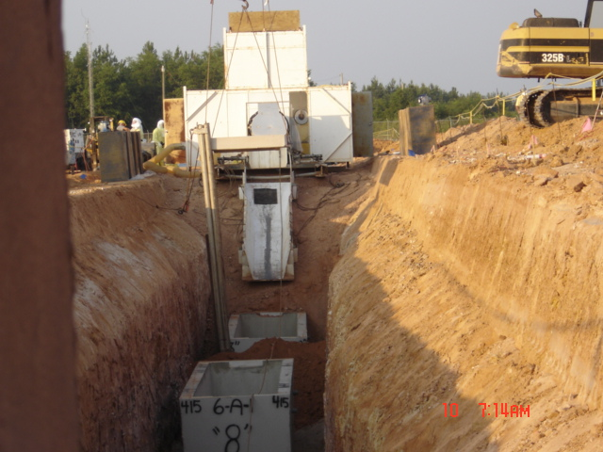
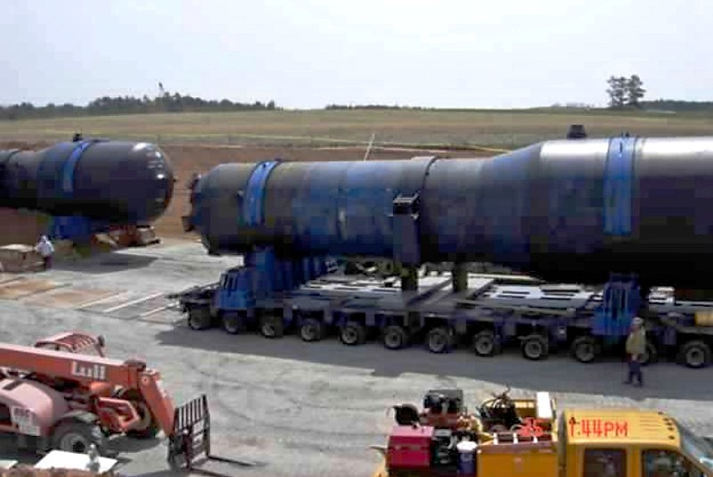
Large Component /
Irradiated Hardware Disposal Rates
Irradiated Hardware and Large Component Shipments

Slide 14
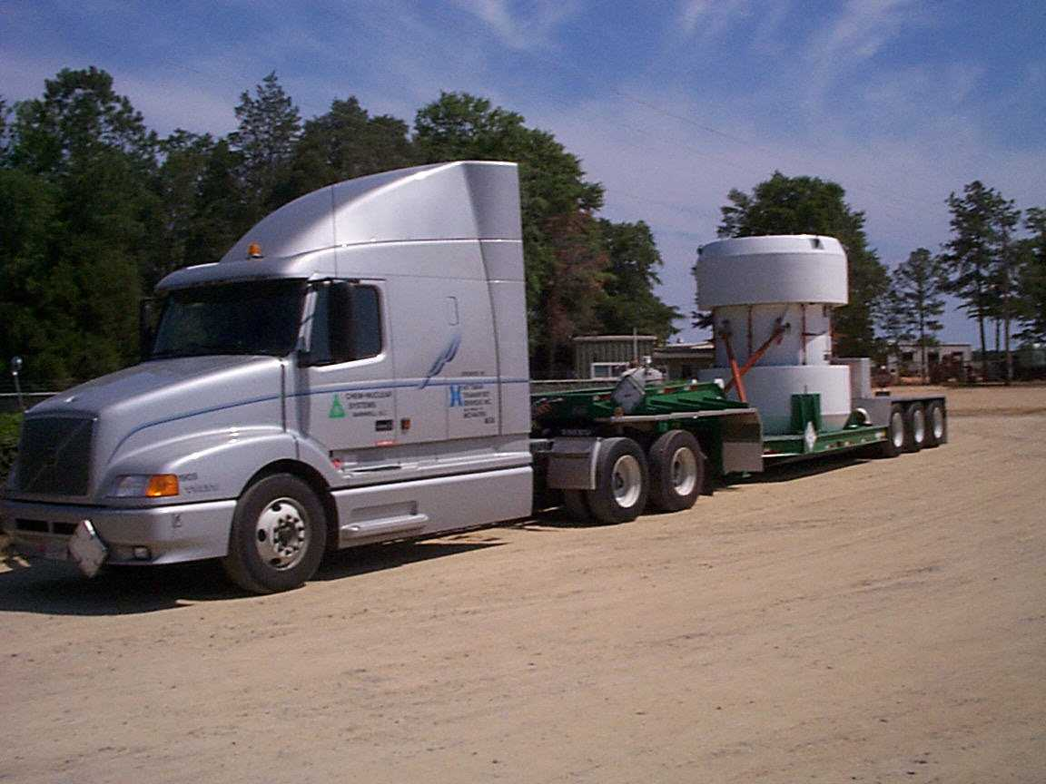
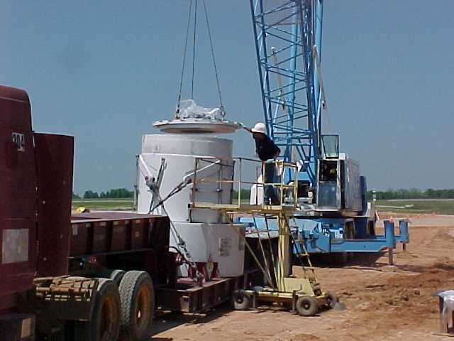
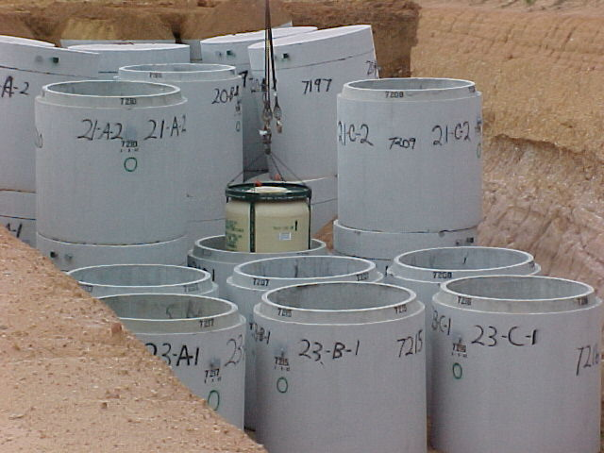
Class A/B/C Waste Disposal
All waste arrives by truck
Most shipments are HIC liners
Vertical crane lift to place liner in prepositioned DES approved vault
All waste classes in same trench - Separate vaults for stable/unstable

Slide 15
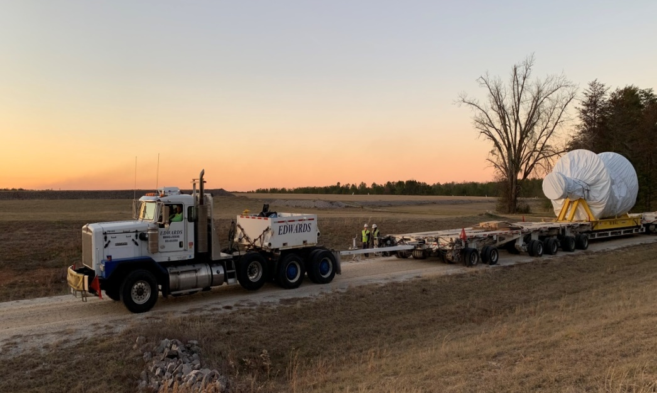
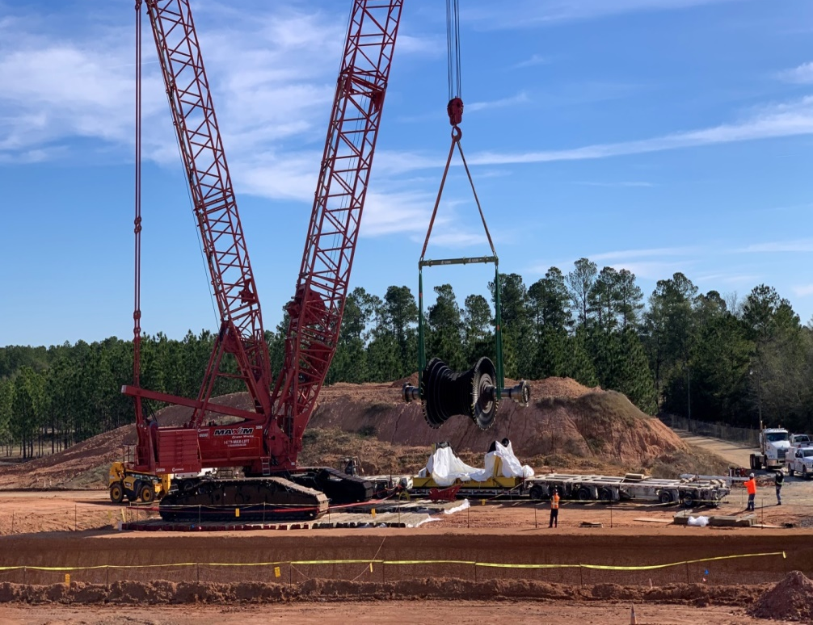
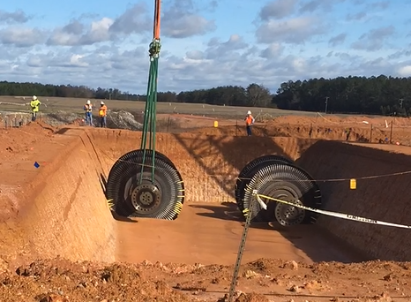
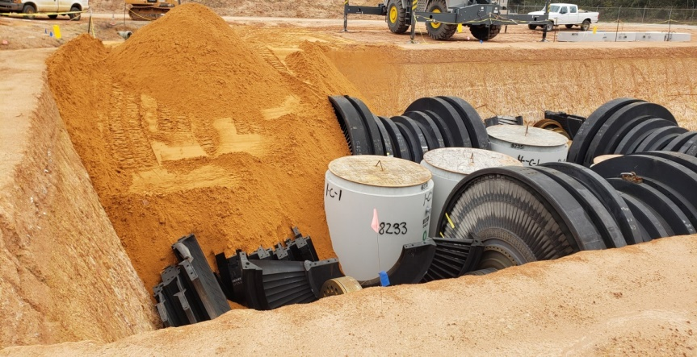
Oconee Rotors & Diaphragms

Slide 16
Institutional Activities
>90% of facility in closed condition and under institutional monitoring and maintenance
Extended Care Fund
  Balance as of June 30, 2024 $158,220,829
Projected Cost of Phase II Decommissioning $8,130,165
  As of July 2022 Closure Plan

Slide 17
Status of BDF Operating License
Renewal license application was submitted Aug 2024; timely renewal letter was received in Sept 2024
We have addressed DES comments
Awaiting Issuance from DES on our 097 Operating License

Slide 18
Tritium Plume Migration
Blue squares = Tritium >Background
Green squares = Tritium <Background

Slide 19
Ground Water Flow Direction
Ground Water Flow Direction moves from the North towards the Southwest

Slide 20
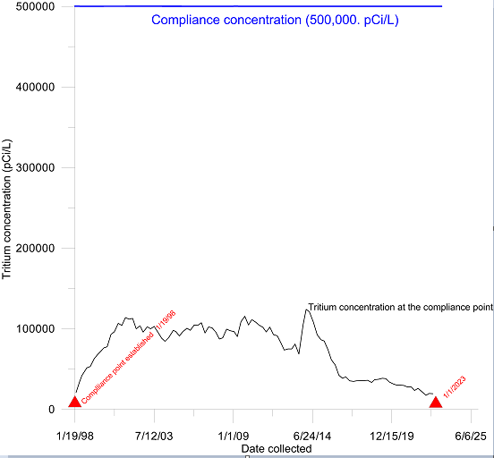
Tritium Plume Concentrations Since Establishment of Compliance Point on Jan. 19th, 1998

Slide 21
Questions?

