Slide 1
Site Overview
October 2024
David Carlson
President
865-201-3191
dcarlson@wcstexas.com

Slide 2

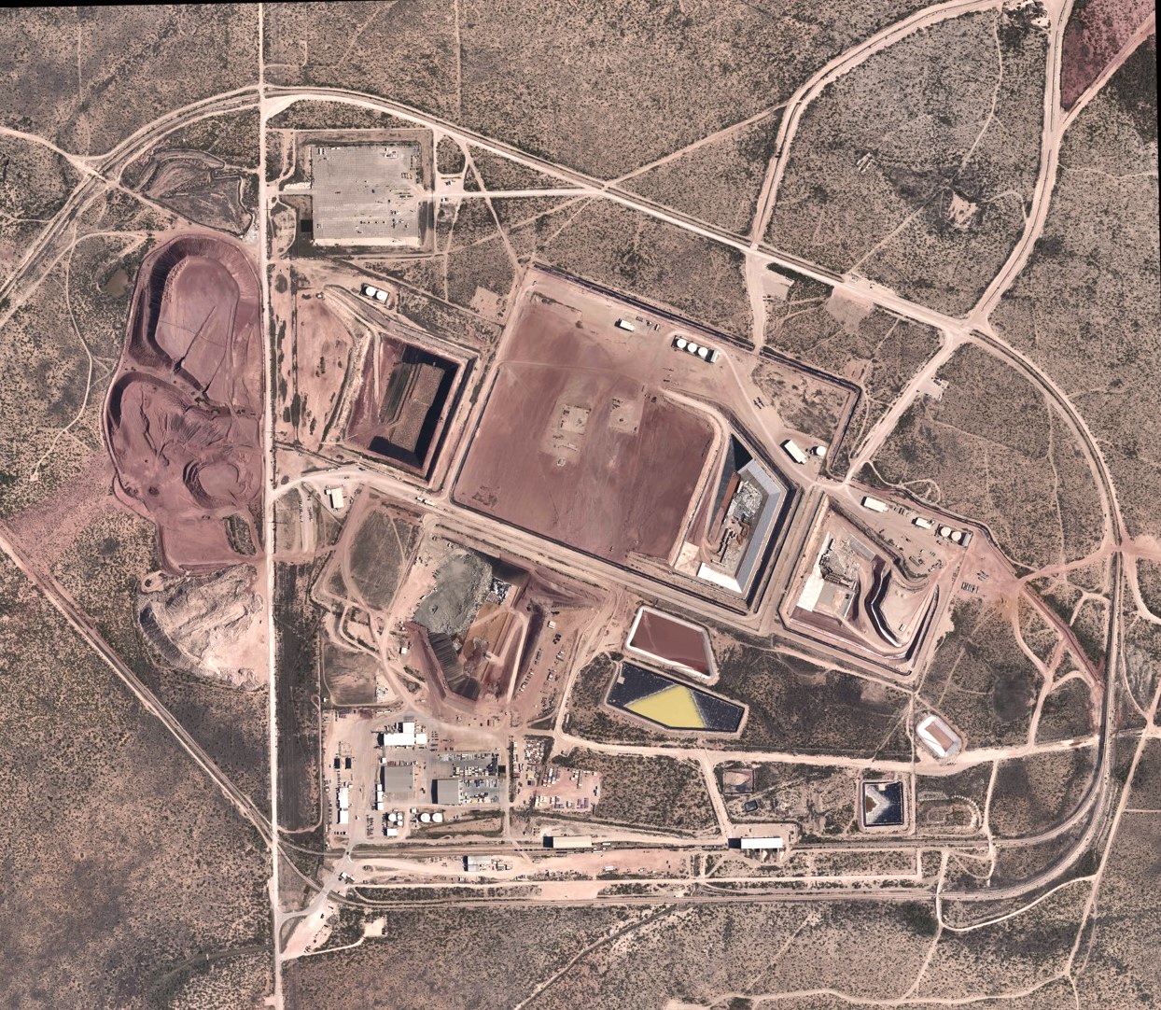
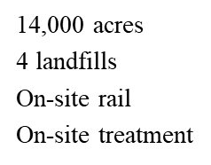

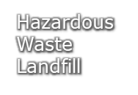


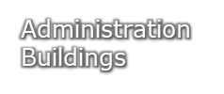


Byproduct Facility

Slide 3
WCS - Disposal Design (vs. Generic Facility)
WCS Disposal
Other Facilities
  Key Attributes of WCS site:
  Sub-Grade Design
  Natural Claystone Barrier
  No viable pathway to groundwater
WCS is the Newest and Most Robust LLRW facility in the US

Slide 4
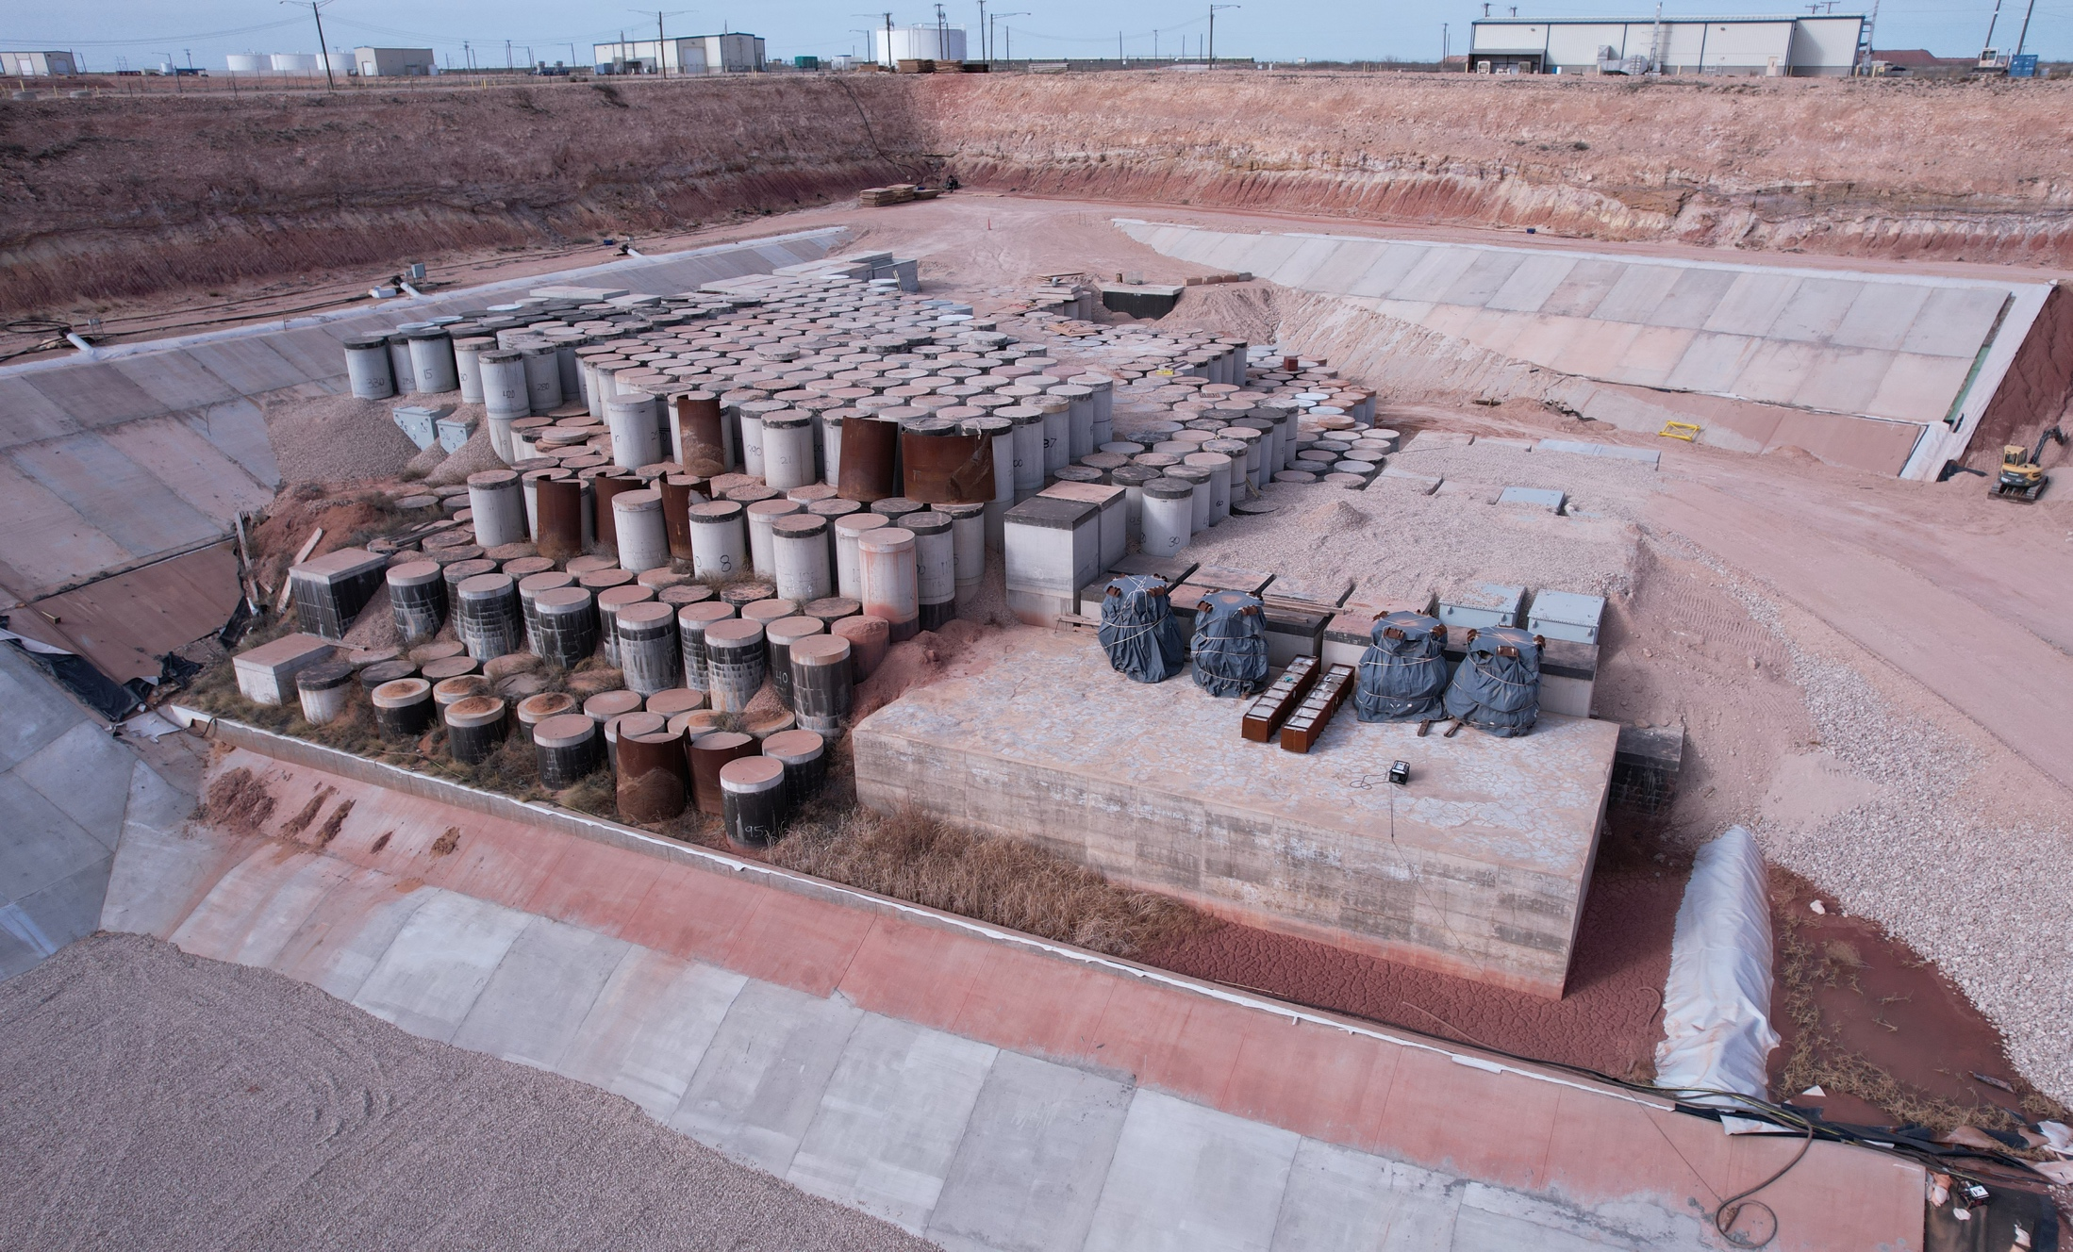
WCS - Compact Waste Facility (CWF)
Regulated by TCEQ (2 on-site inspectors)
Privately-developed and operated
Opened in 2012
Owned by the State of Texas

Slide 5
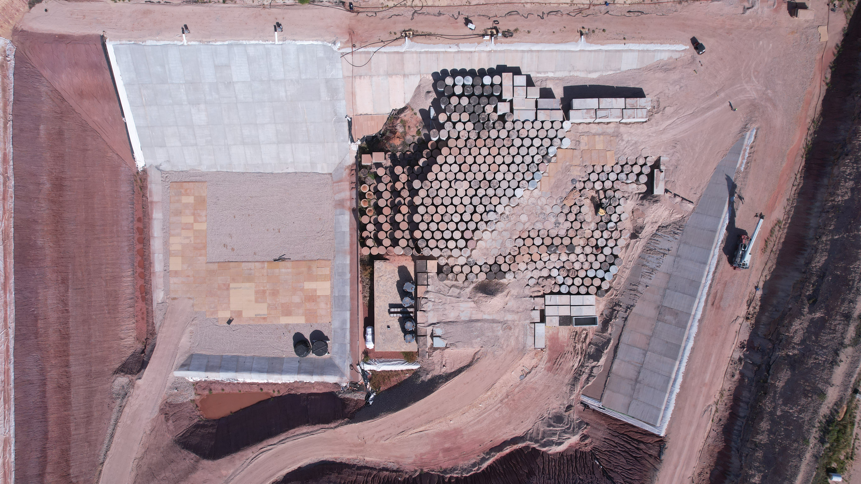
Compact Waste Facility
Licensed – 9,000,000 cubic feet of disposal
Phase 2a – 15,000 cubie feet used
410,000 cubic feet available
Phase 1 - 360,000 cubic feet used
90,000 cubic feet available

Slide 6
CWF Waste Disposal

Slide 7
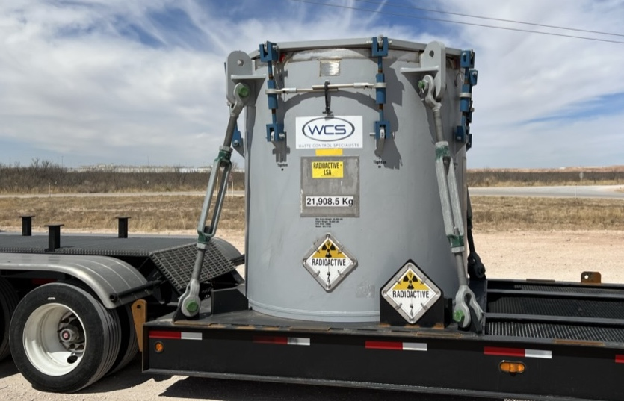
Cask Receipt

Slide 8
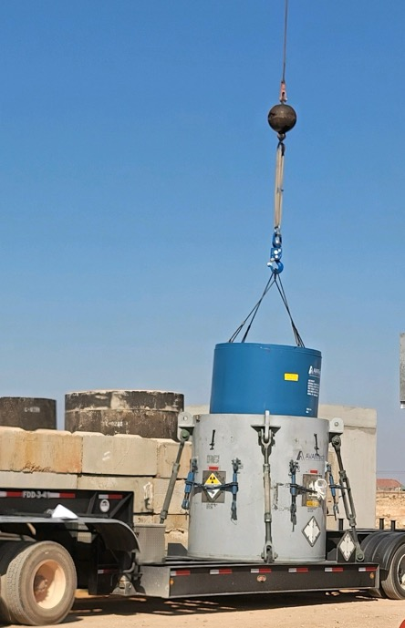
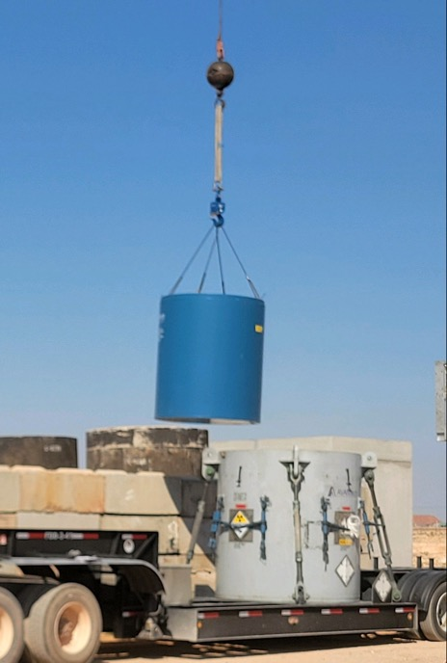
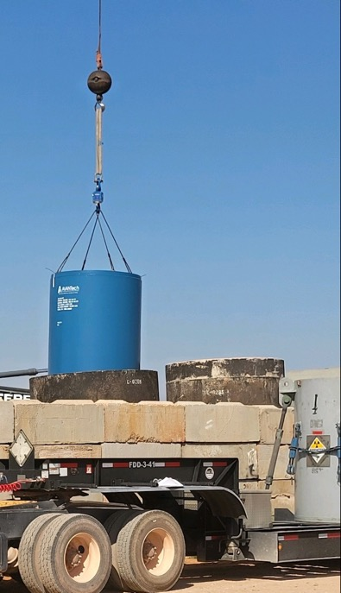
Offloading a Cask
Liner (blue) is transferred from a transportation cask (grey) to a modular concrete container (MCC)
Liner is fabricated of steel and is bolted shut
Modular concrete container (MCC) is thick reinforced concrete
Lift from cask
Transfer
Lower into MCC

Slide 9
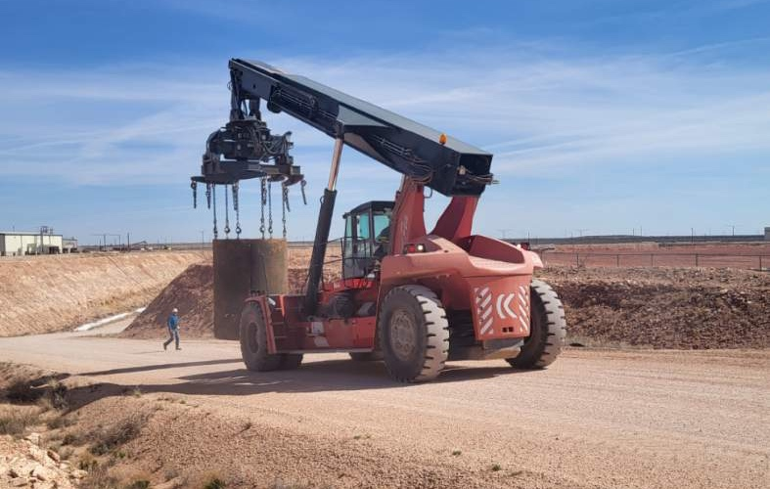
Transfer MCC to Disposal

Slide 10

MCCs in the Compact Waste Facility (CWF)

Slide 11
Crystal River 3 (CR3)
Reactor Vessel Disposal

Slide 12
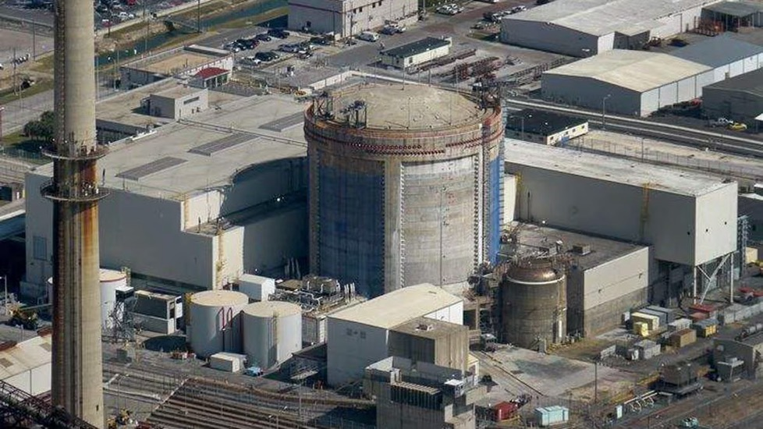
Crystal River Unit 3 Reactor
Pressurized Water Reactor – B&W design
860 MW electrical capacity
Shutdown September 2009
Decommissioning started in October 2020

Slide 13
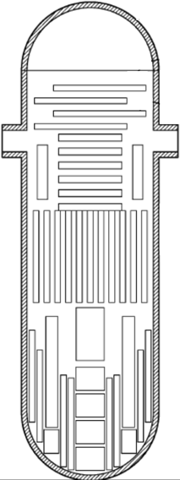
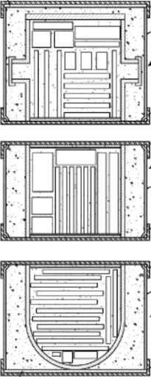
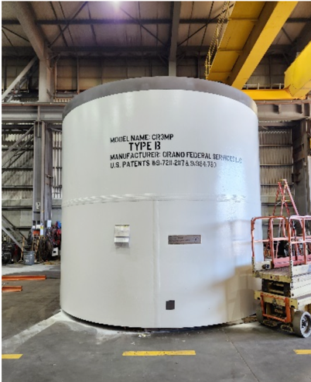
CR3 – Reactor Sections
The reactor vessel was cut into 4 sections and packaged for transport
Mid Section is Class C low-level waste (LLW) and the other 3 sections are Class A LLW
Sections meet all NRC and DOT packaging requirements for transportation
 | Diameter (feet) | Height (feet) | Weight (tons)
Vessel Head | 17 | 8 | 95
Top Section | 19 | 13 | 370
Mid Section | 17 | 15 | 430
Bottom Section | 15 | 7 | 95

Slide 14
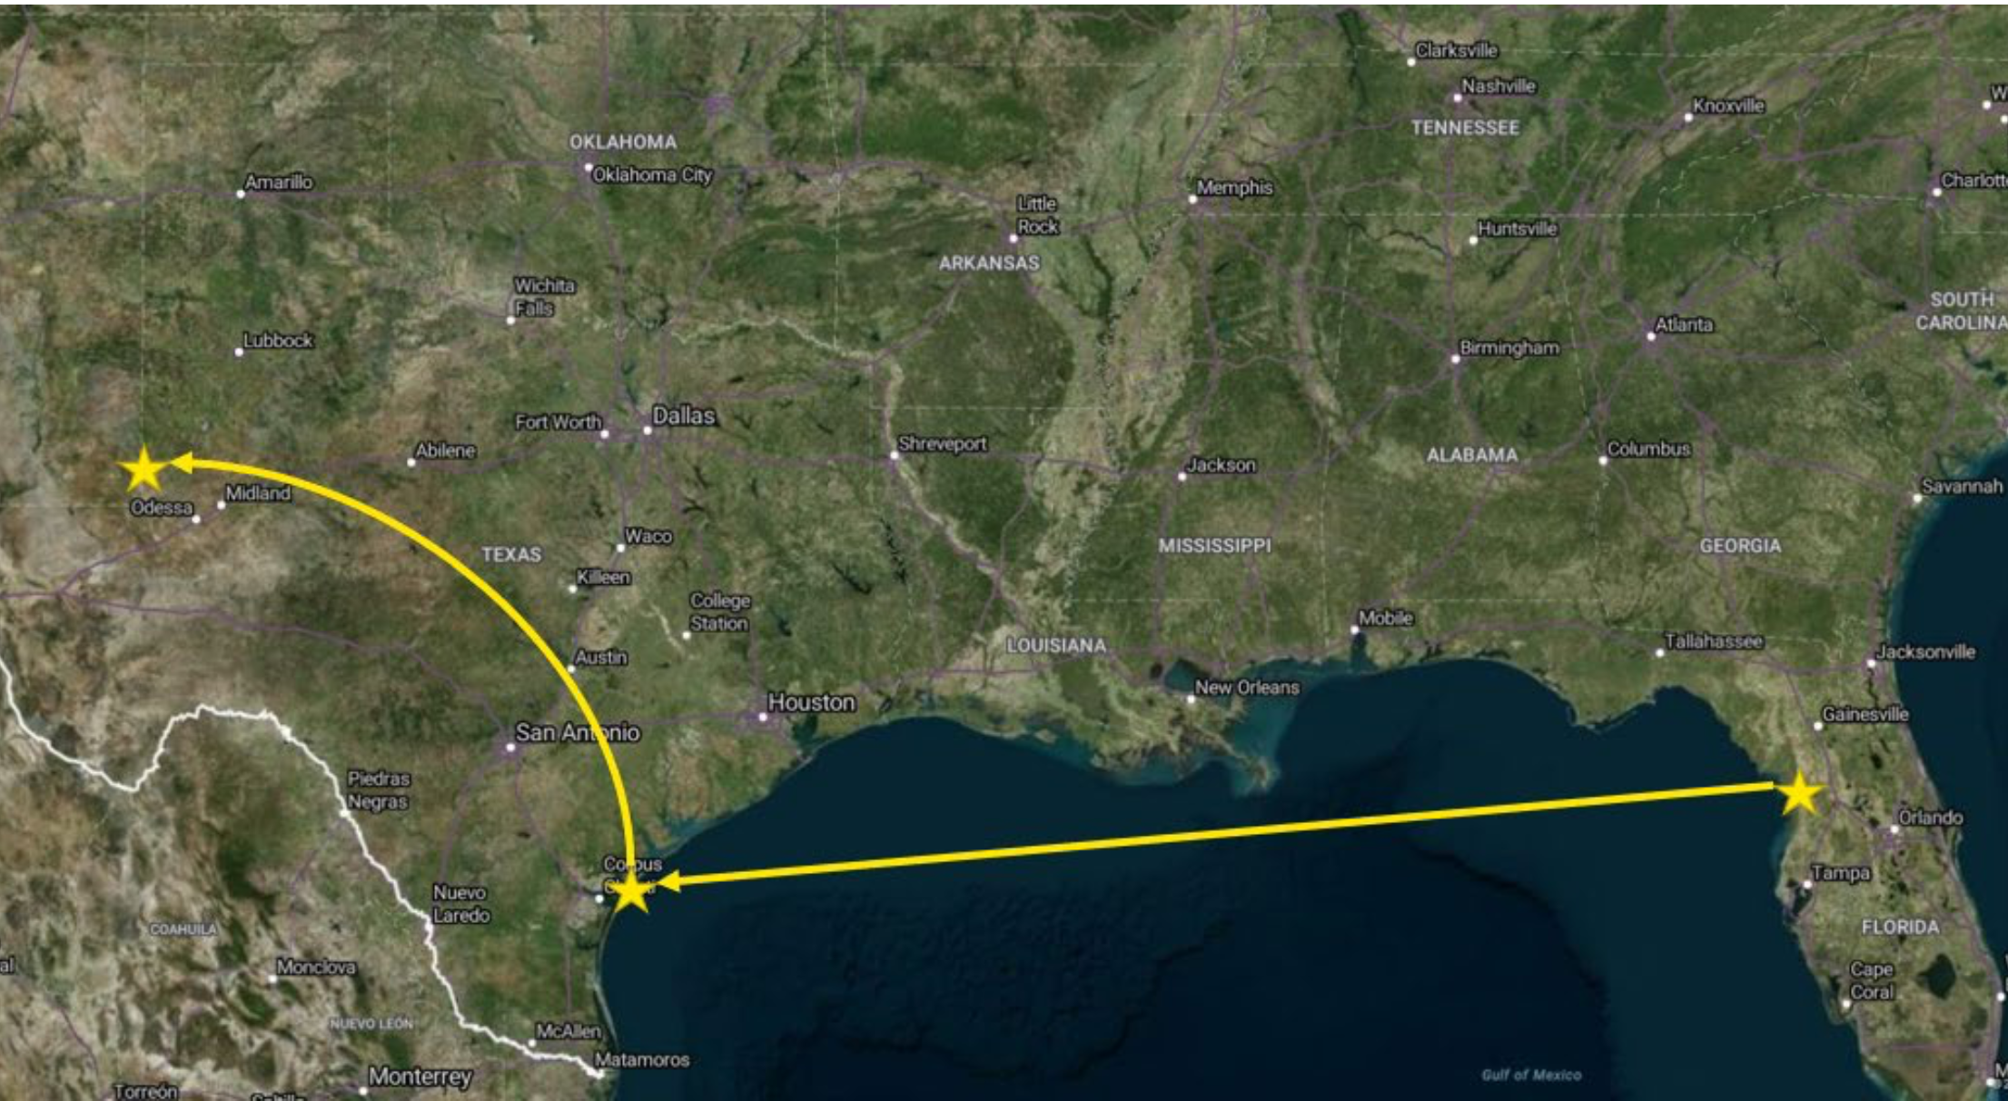
CR3 Reactor Vessel - Transportation
Barge from Crystal River, FL to Aransas Pass, TX
Truck transport to WCS site in Andrews, TX

Slide 15
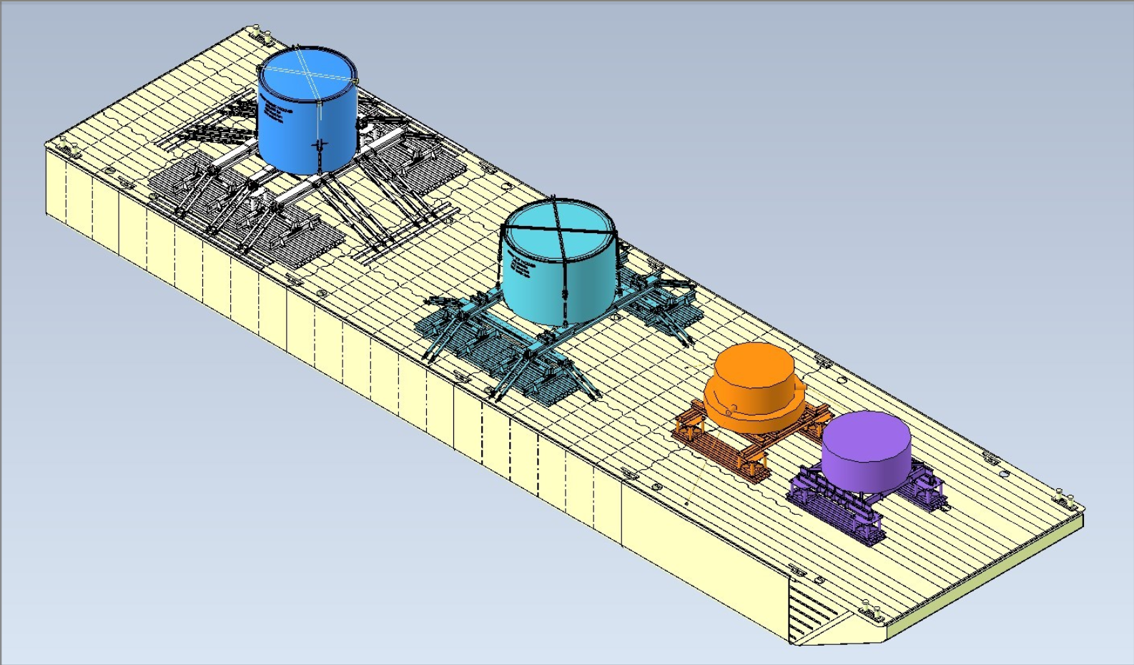
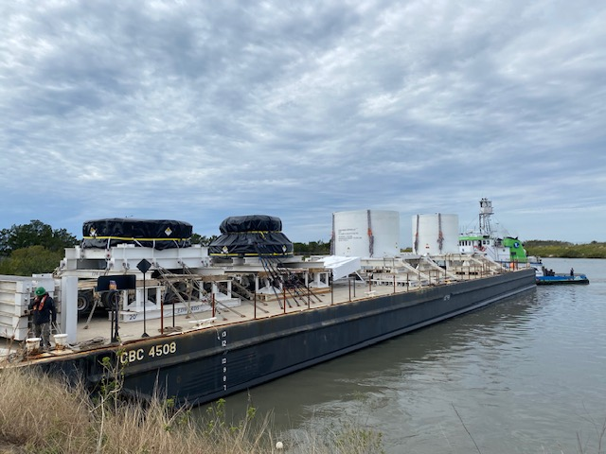
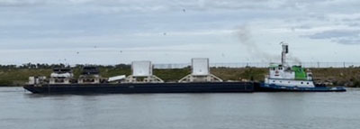
CR3 Reactor Vessel – Barge Transport
Departed Crystal River January 22
Arrived Aransas Pass January 29

Slide 16
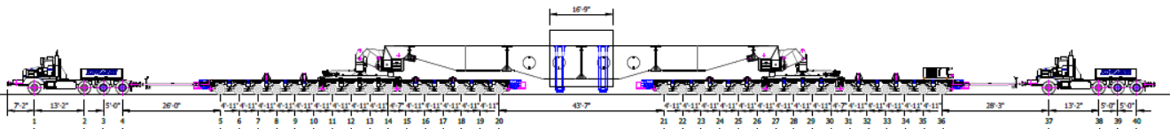
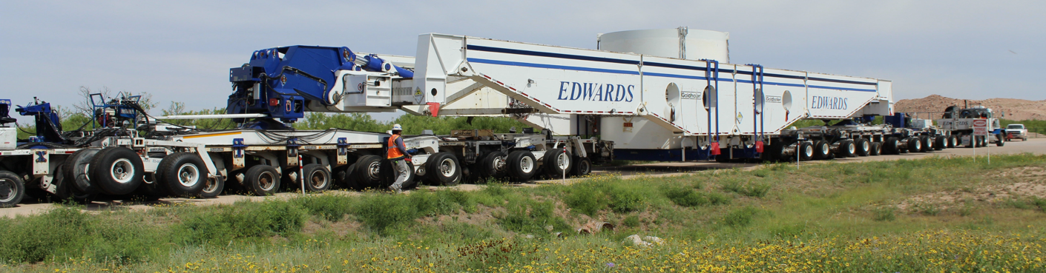
CR3 Reactor Vessel – Road Transport
Shipments were all oversize and overweight
Routes and transportation parameters were predetermined by TXDOT
Avoids major roads and cities
Head and Bottom Section required about 4 days each (~700-mile route)
Top and Mid Sections required over 30 days each (~900-mile route)
Top and Mid Sections configuration – 32 axle trailer (more than 250 wheels)

Slide 17
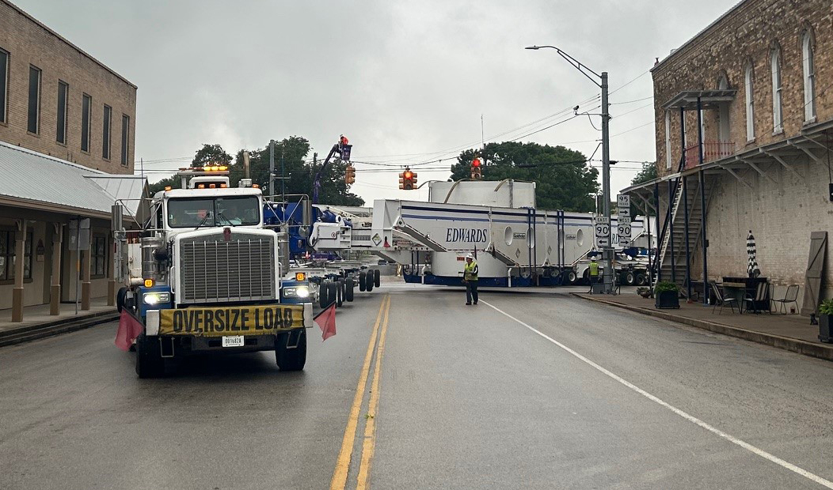
Transportation Challenges

Slide 18
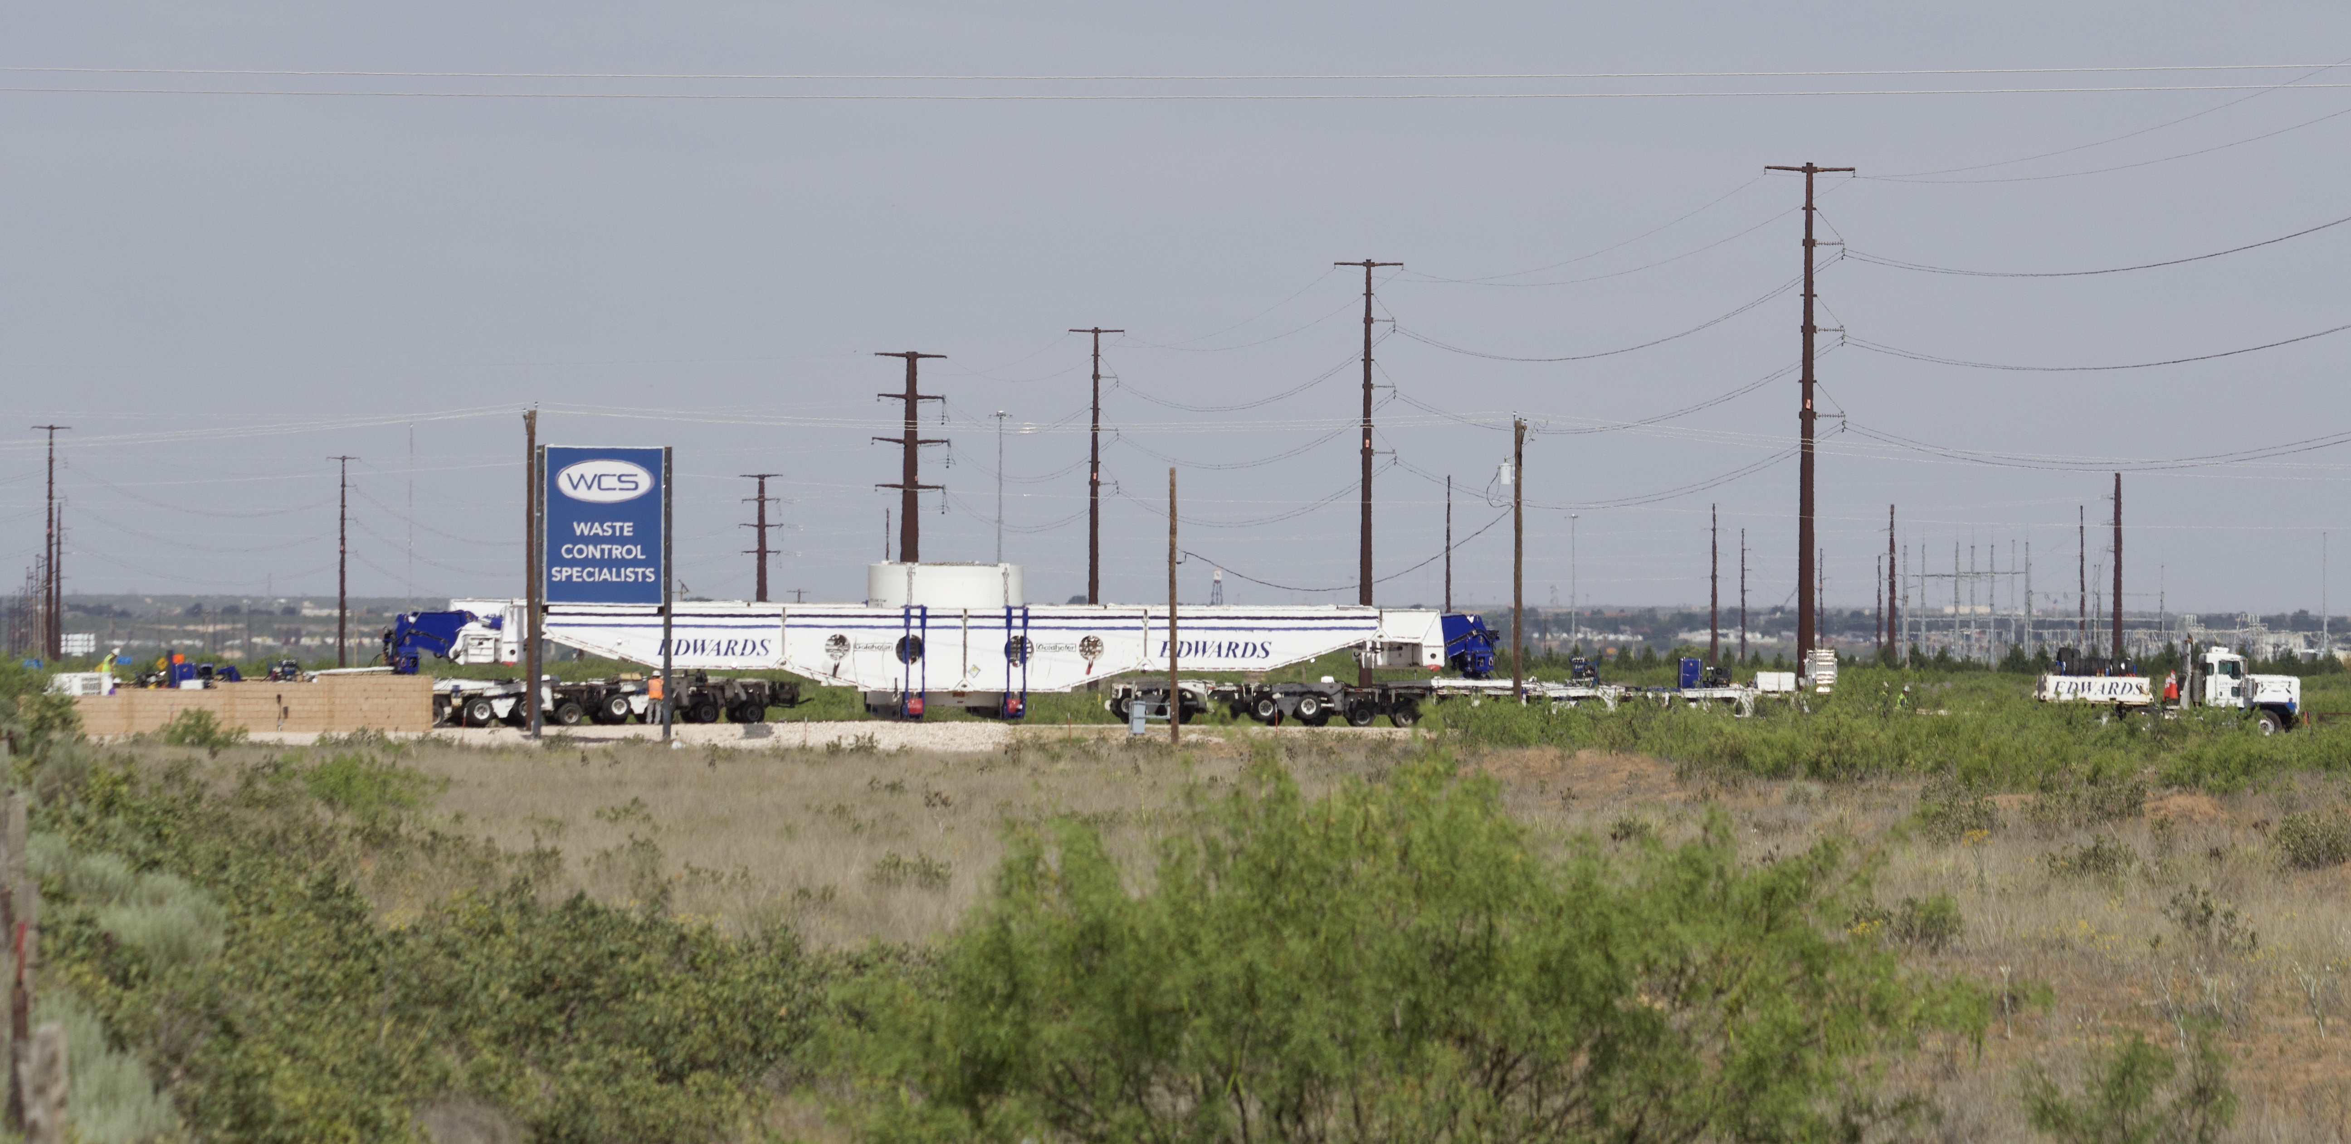
Arrival at WCS

Slide 19
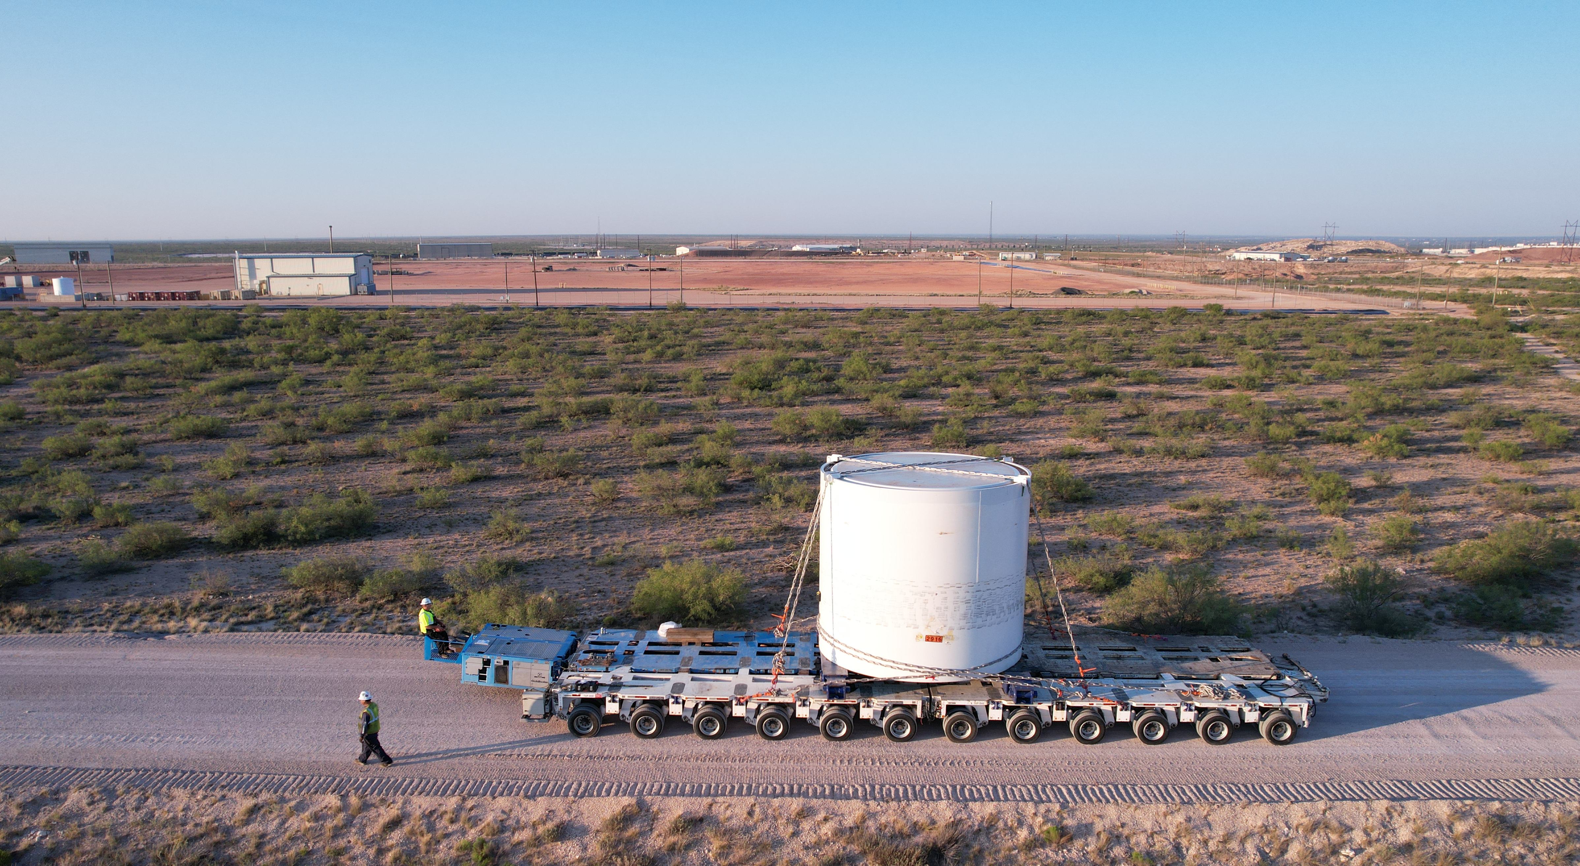
On-Site Transport

Slide 20
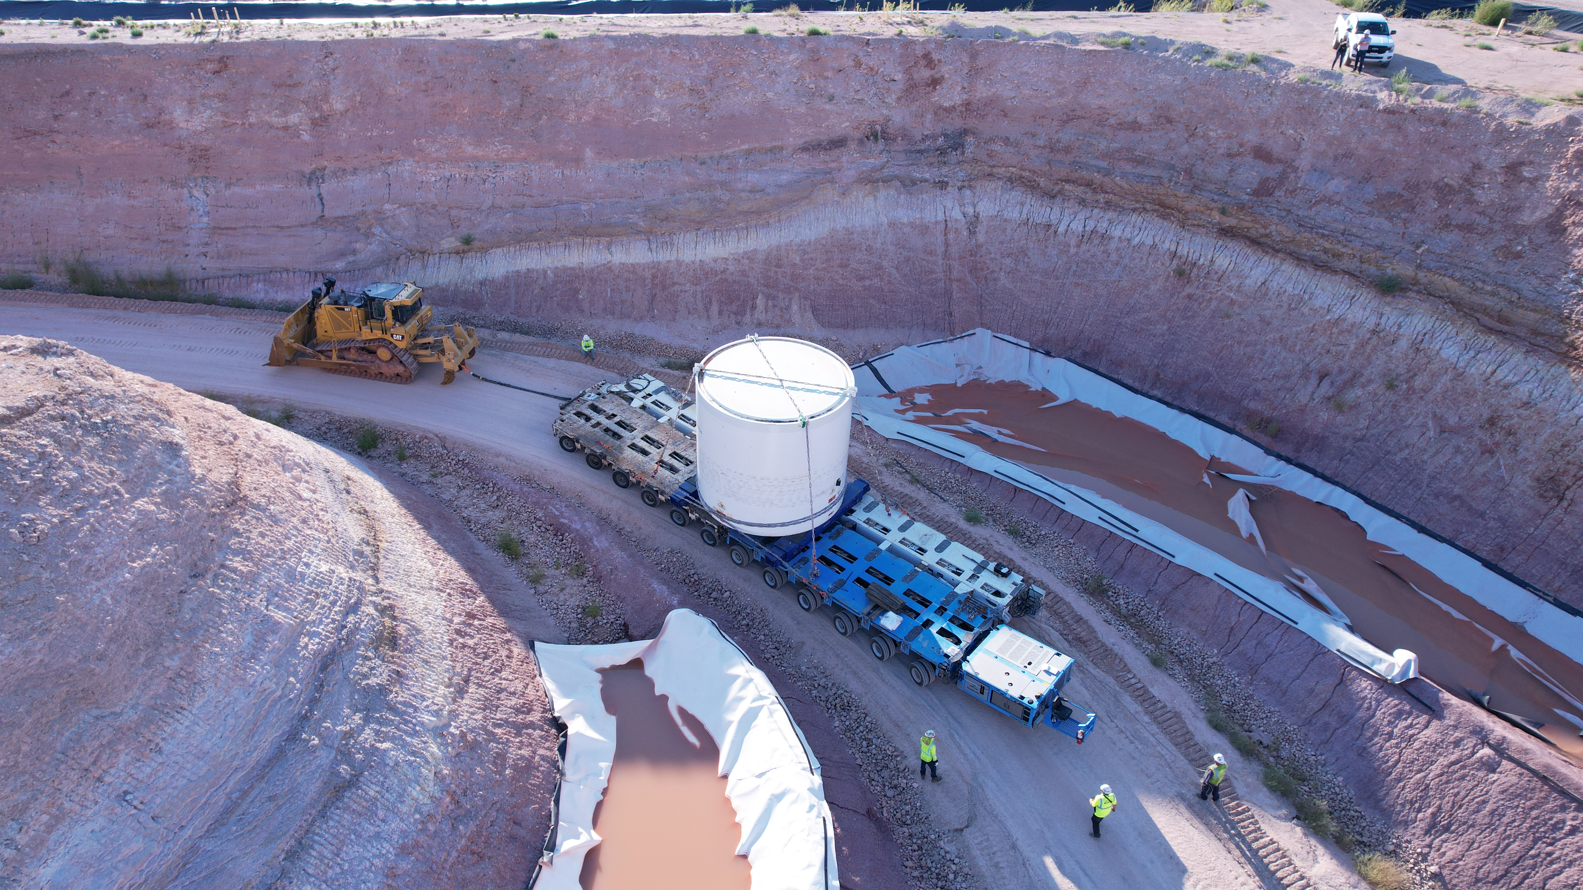
Transport to Disposal

Slide 21
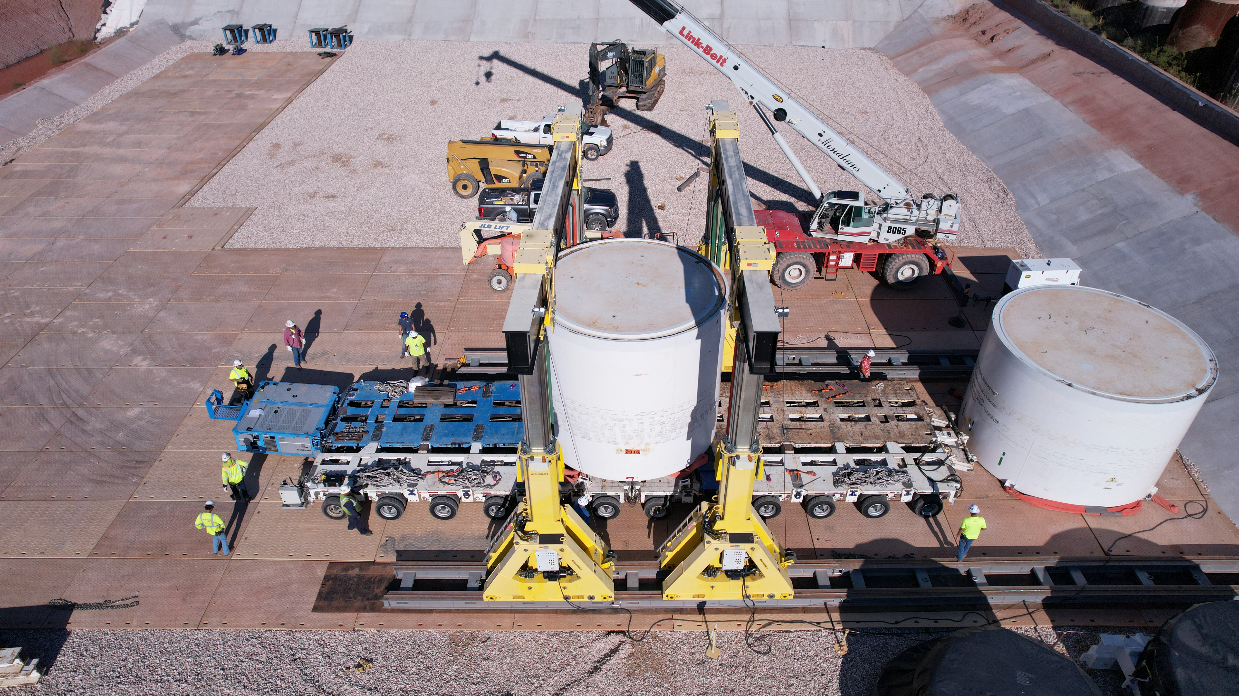
Disposal Placement

Slide 22
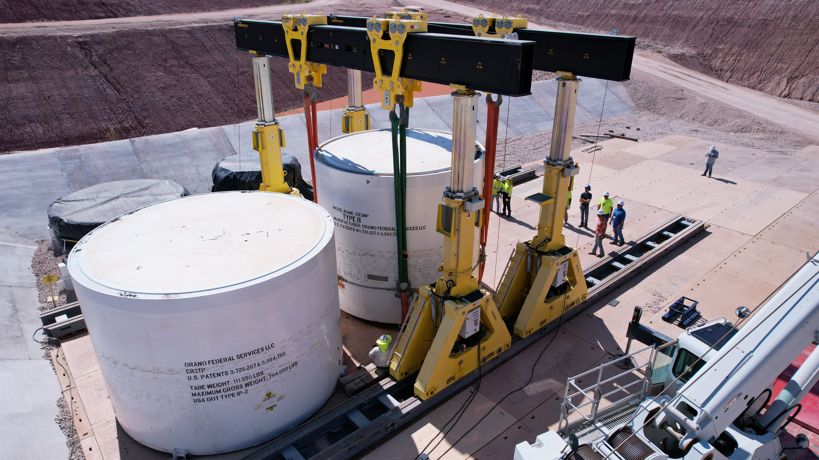
Final Disposal

Slide 23
Thank You

