Slide 1
EnergySolutions’ Clive Facility Update
LLW Forum –2024 Fall Meeting
Vern C. Rogers October 9, 2024
Director, Regulatory Affairs

Slide 2

Corporate Service Enhancements

Slide 3









Nuclear Services
Nuclear Services
Acquisitions / Partners
Transportation& Logistics
Decommissioning & Decontamination
Waste Disposal
Waste Processing
Nuclear Plant Waste Solutions
Onsite Integrated Services
Cask Division

Slide 4
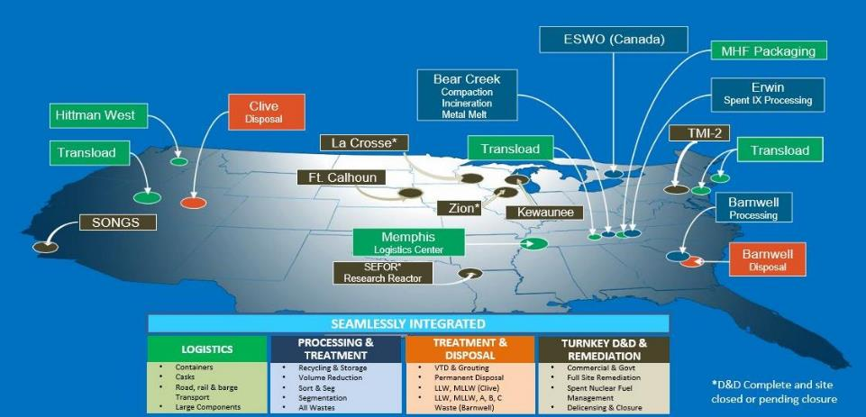
Full Integration of WM and D&D Operations

Slide 5
Services Supplier of the Year by the Utilities Services Alliance
(5 times in 6 years)

Slide 6
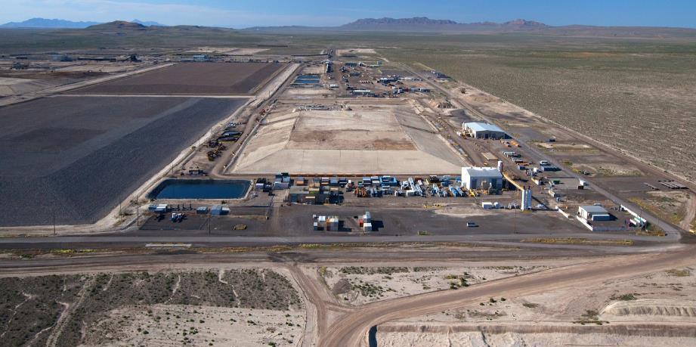
Clive Disposal Facility

Slide 7
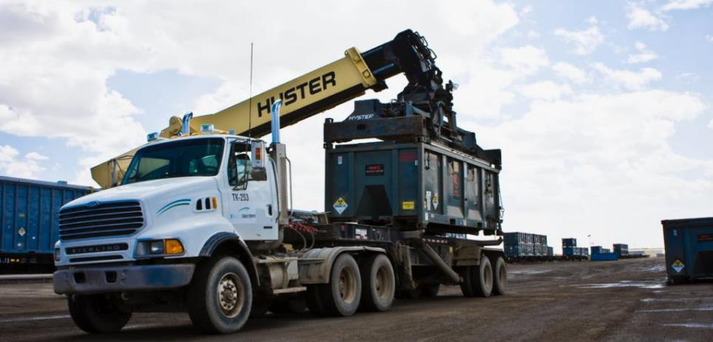

Clive Disposal Facility Reaches Major
Milestone of 7 Million Person-Hours Safely Worked Over 19 Years

Slide 8
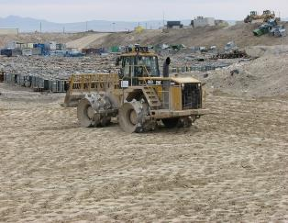
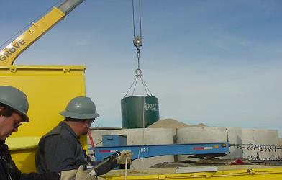
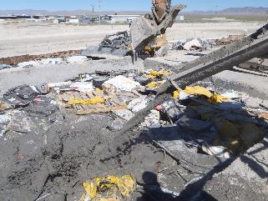
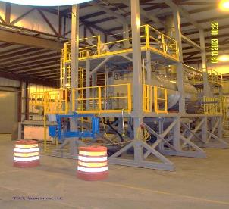
Clive Capabilities
Class A Low-Level Radioactive Waste
  Containerized Waste
  Large Components
  Bulk Waste
Class A Mixed Waste
  Stabilization
  Amalgamation
  Macroencapsulation
  Thermal Desorption (VTD)
Asbestos
PCBs
11e.(2)

Slide 9

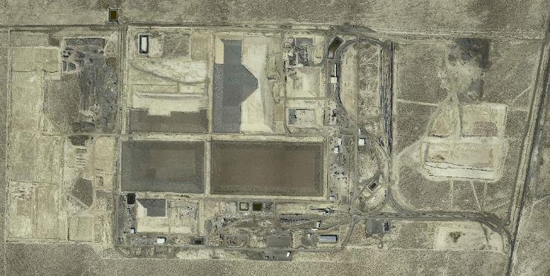
Site Layout
Section 31
Section 30
North
Section 5
Section 32
Section 29
Federal Cell
(under licensing)
Low Activity South
(under licensing)
Class A West
CRF
11e.(2)
VITRO
Dept. of Energy
Radioactive Disposal
from Salt Lake County
(Closed)
LARW
(Closed)
Mixed
Waste
Container
Handling

Slide 10
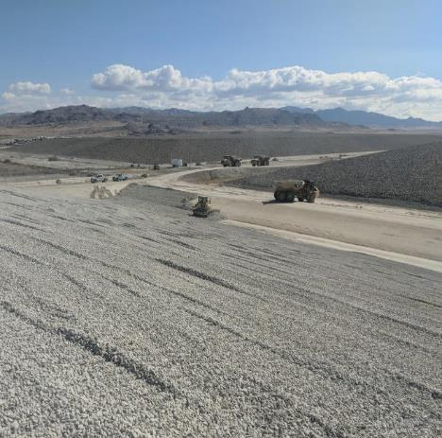
Licensing Update
Capacity Limitation (amendment 26)
Sealed Source disposal (amendment 27)
New Low Activity Waste Cell (amendment under review)
Federal Cell Facility for depleted uranium and federally-generated low level radioactive waste (license application under review)
License and Permit Renewals

Slide 11
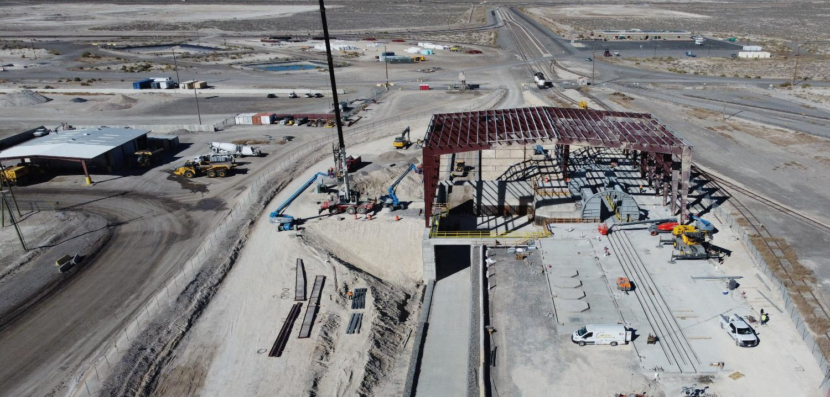
Capital Improvements
East Side Rotary Facility
Evaporative storage
LLRW Cover Construction
Mobile equipment fleet upgrades
Long-term Crane Lease

Slide 12
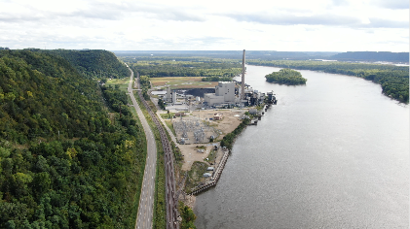
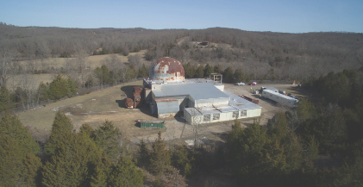
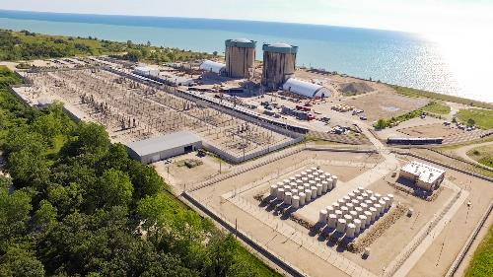
Completed D&D Projects
La Crosse
SEFOR
ZIONS

Slide 13
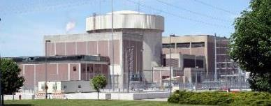
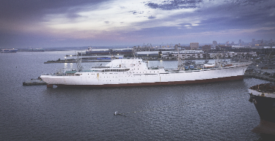
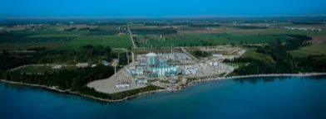
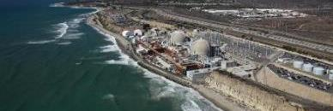
Significant D&D Pipeline
Fort Calhoun Nuclear Generating Station
NS Savannah
Three Mile Island Unit-2 Nuclear Power Plant
Kewaunee Nuclear Power Station
San Onofre Nuclear Generating Station

Slide 14
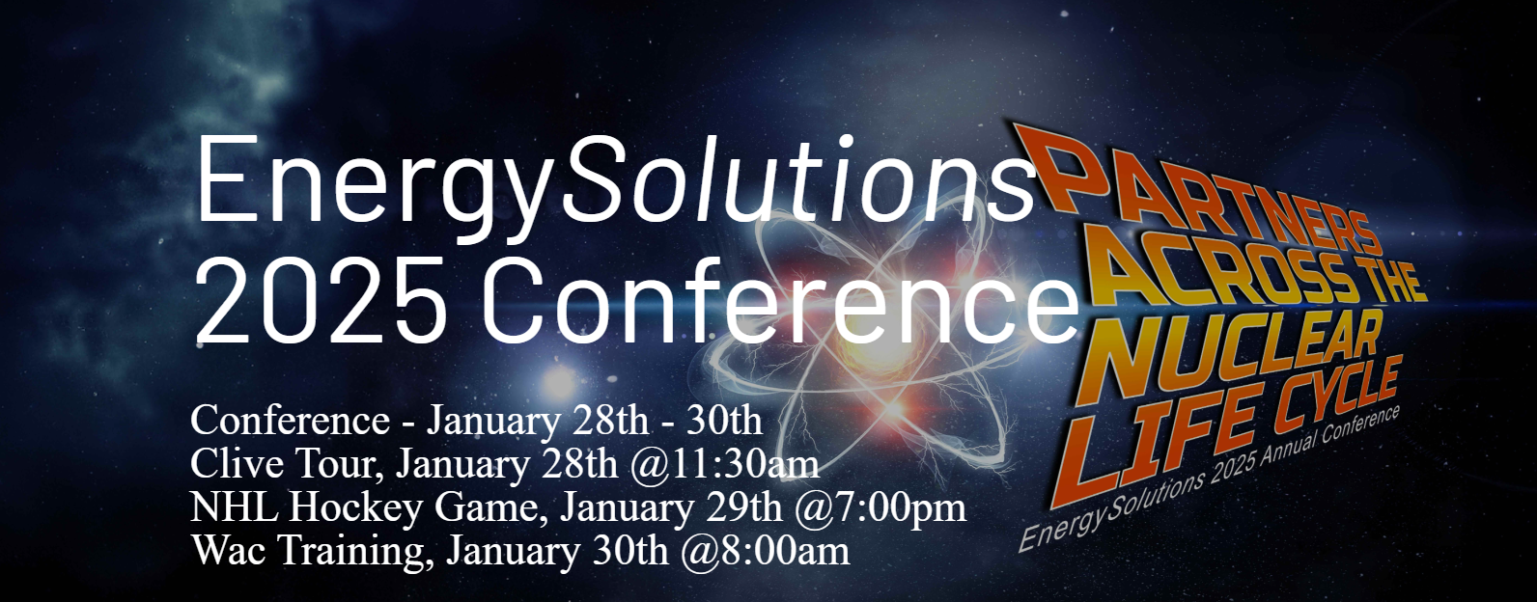
2025 Customer Conference

Slide 15
Thank You

