Slide 1
Low-Level Waste (LLW) Disposal at the Nevada National Security Site (NNSS)
Rob Boehlecke
Program Manager
DOE Environmental Management (EM) Nevada Program
October 9, 2024

Slide 2
EM Nevada Program Mission
Located 65 miles northwest of Las Vegas, Nevada, the Nevada National Security Site (NNSS) is a vast, unique, and diverse research, evaluation, and development complex that has a variety of missions and is managed by the National Nuclear Security Administration (NNSA)
EM Nevada Program’s mission consists of waste management at the NNSS and environmental restoration on the NNSS and federal land impacted by historical DOE activities
EM Nevada Program completed characterization, corrective actions, and closure at more than 2,800 of the nearly 3,000 total legacy sites in Nevada (underground test locations, surface or near-surface soil contamination locations, and industrial-type sites) identified in the Federal Facility Agreement and Consent Order (FFACO)
LLW disposal at the NNSS supports DOE cleanup and activities at sites across the U.S. involved in historical nuclear research, development, and testing, and ongoing national security and science missions

Slide 3
Contractors and Partners
  EM Nevada Program works with several contractors and partners to support the mission work at the NNSS
    Navarro Research and Engineering, Inc. (Navarro – contractor to DOE EM Nevada)
    Mission Support and Test Services, LLC (MSTS – M&O contractor to DOE NNSA)
    National Nuclear Security Administration/Nevada Field Office (NNSA/NFO)
    Nevada Division of Environmental Protection (NDEP)

Slide 4
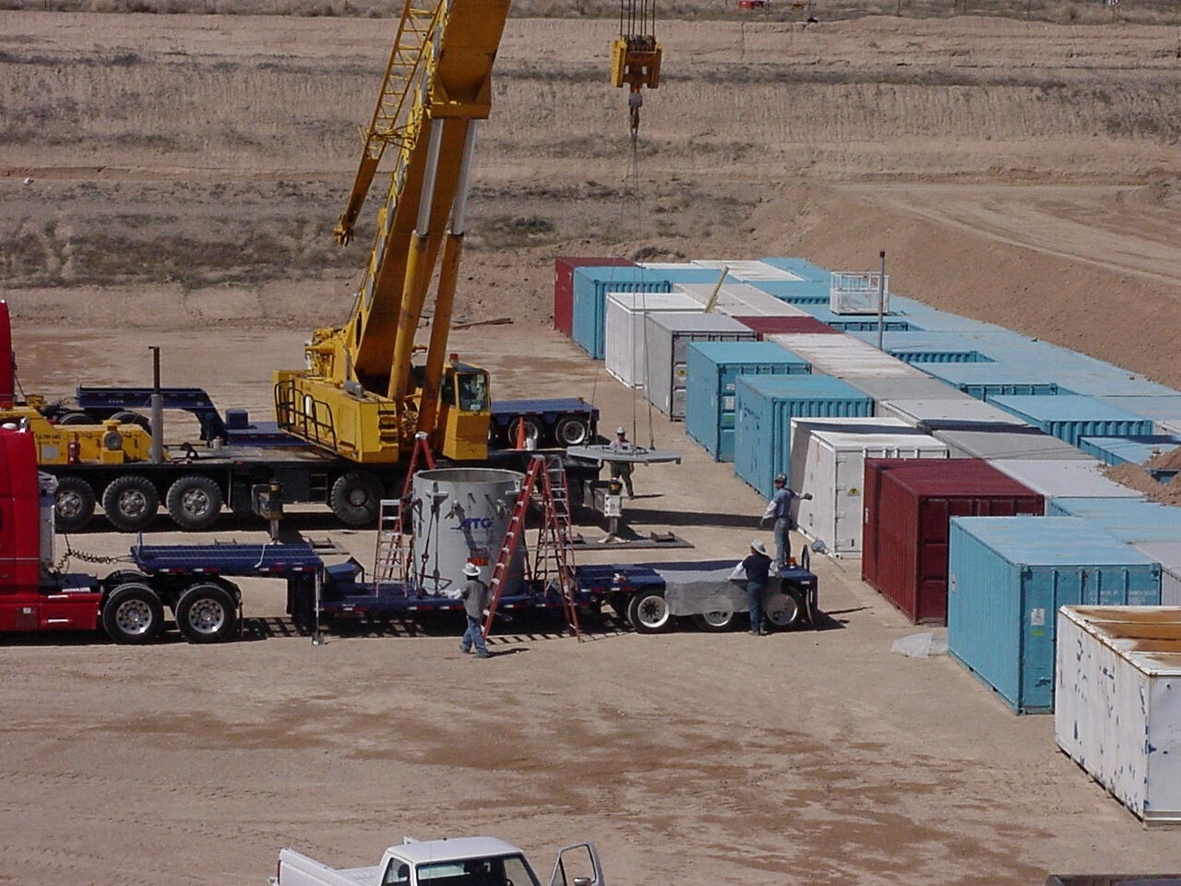
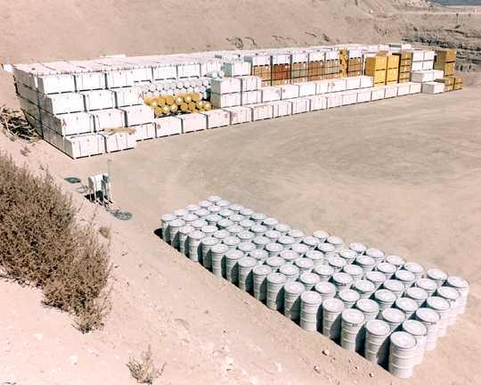
The Waste Mission
  The Waste Disposal Facility – Big Picture
  Radioactive Waste Acceptance Program (RWAP)
  The Waste Disposal Facility – Additional Details
  Waste Transportation
  Stakeholder Involvement
Area 5 Disposal Cell
Area 5 Disposal Cell

Slide 5
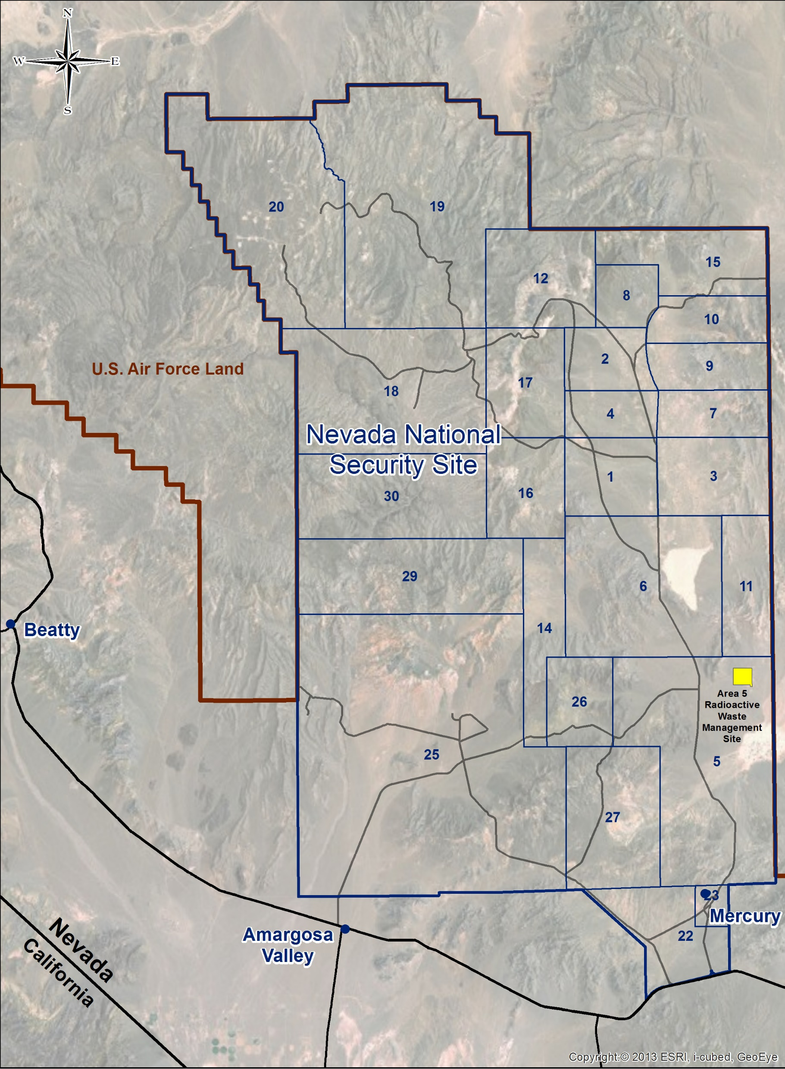
Area 3 Radioactive Waste Management Site (RWMS) and
Area 5 Radioactive Waste Management Complex (RWMC)
Area 3 Radioactive Waste Management Site

Slide 6
Acceptable Waste
NNSS Waste Acceptance Criteria (NNSSWAC) details rigorous requirements; significant structural revision and update in 2022; minor update in 2024
NNSS only accepts waste from generators with a DOE nexus or a Department of Defense mission
Waste types accepted:
  Low-level waste (LLW) is waste that is NOT high-level radioactive waste, transuranic waste, spent fuel, or by-product material
  Mixed low-level waste (MLLW) is a combination of LLW with a hazardous constituent
  Classified non-radioactive (CNR) consists of classified components that have no radioactive or hazardous contamination but must be securely disposed in the interest of national security
  Classified non-radioactive hazardous (CNRH) consists of classified components with no radioactive contamination but that do contain hazardous constituents

Slide 7
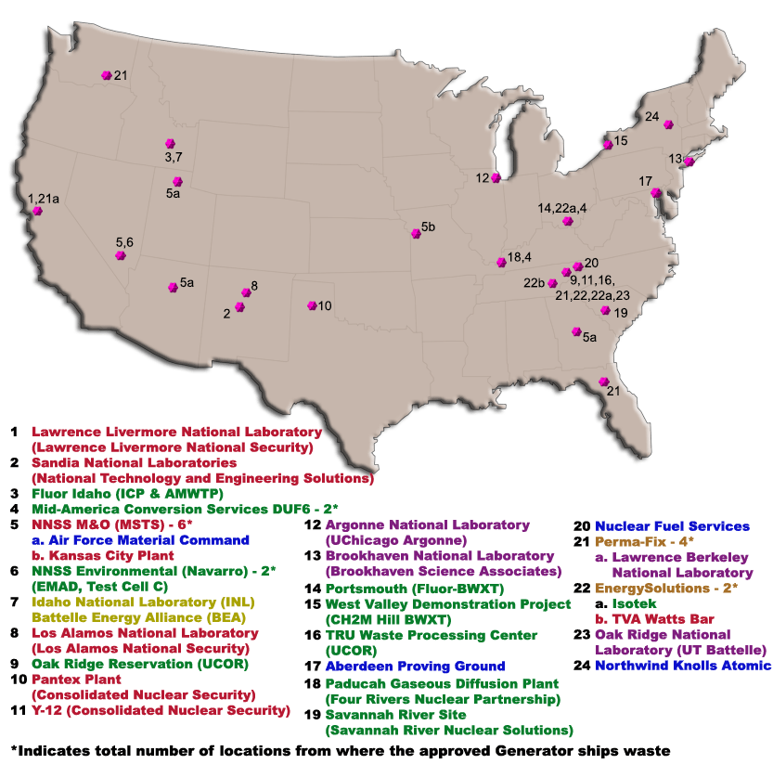
Approved Waste Generators
COLOR CODE identifies the federal program under which the generator reports:
RED – National Nuclear Security Administration
GREEN - EM
YELLOW – Nuclear Energy
PURPLE - DOE Office of Science
BLUE - U.S. Department of Defense
ORANGE - Commercial Generator that processes DOE waste

Slide 8
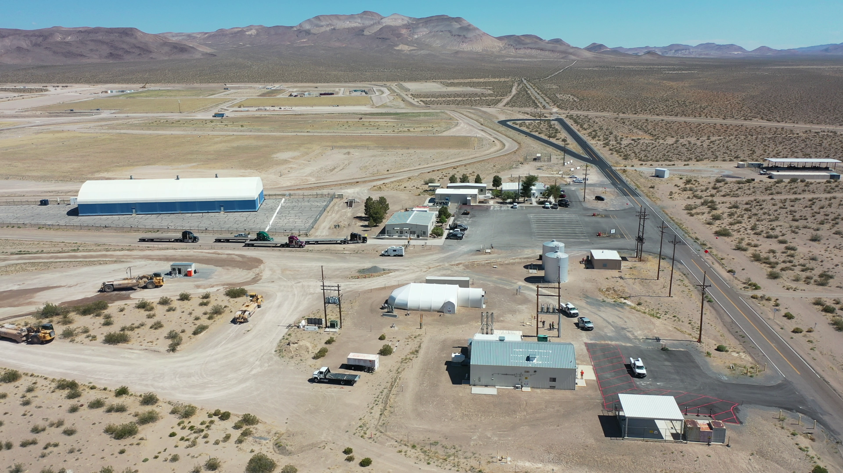
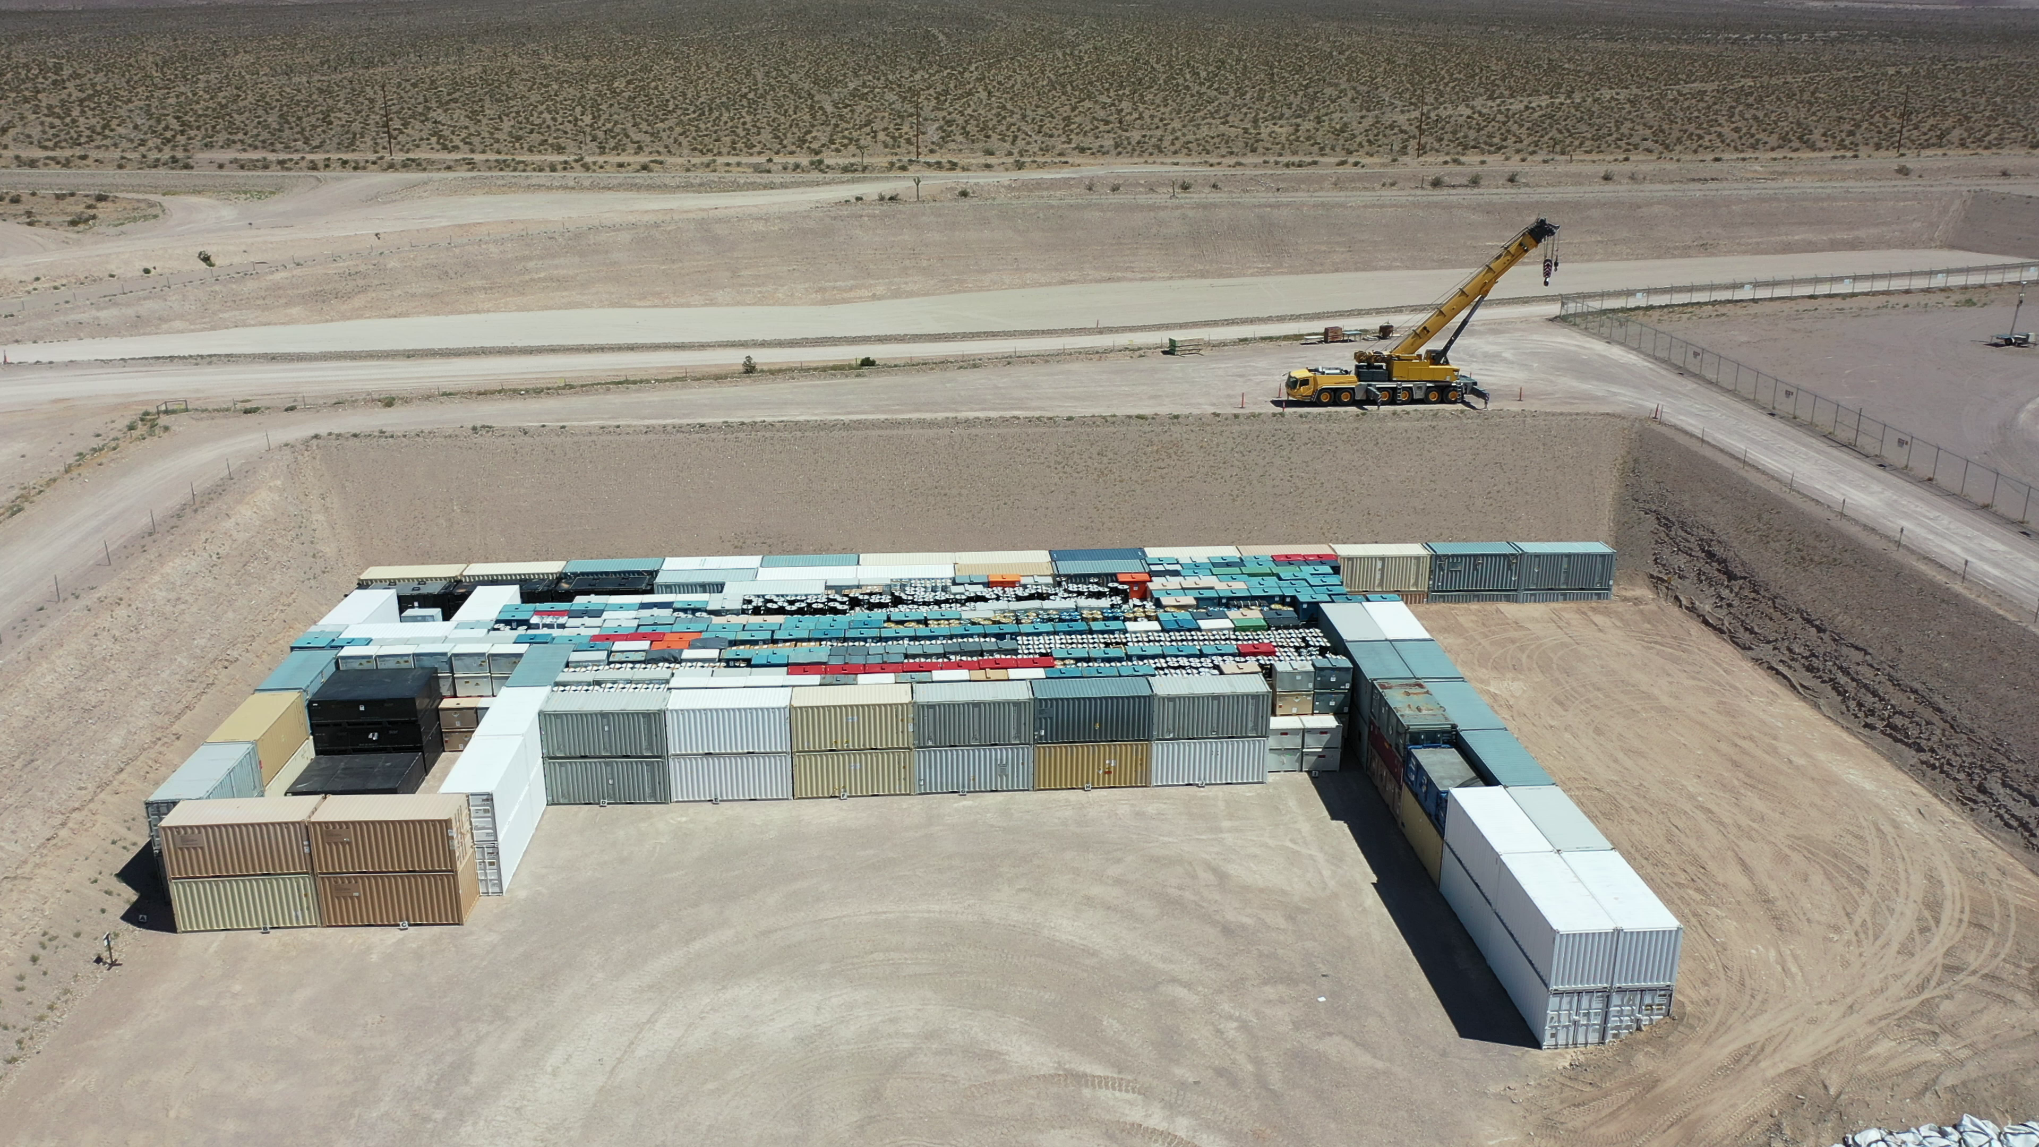
Radioactive Waste Management Complex
Waste Disposal Cell

Slide 9
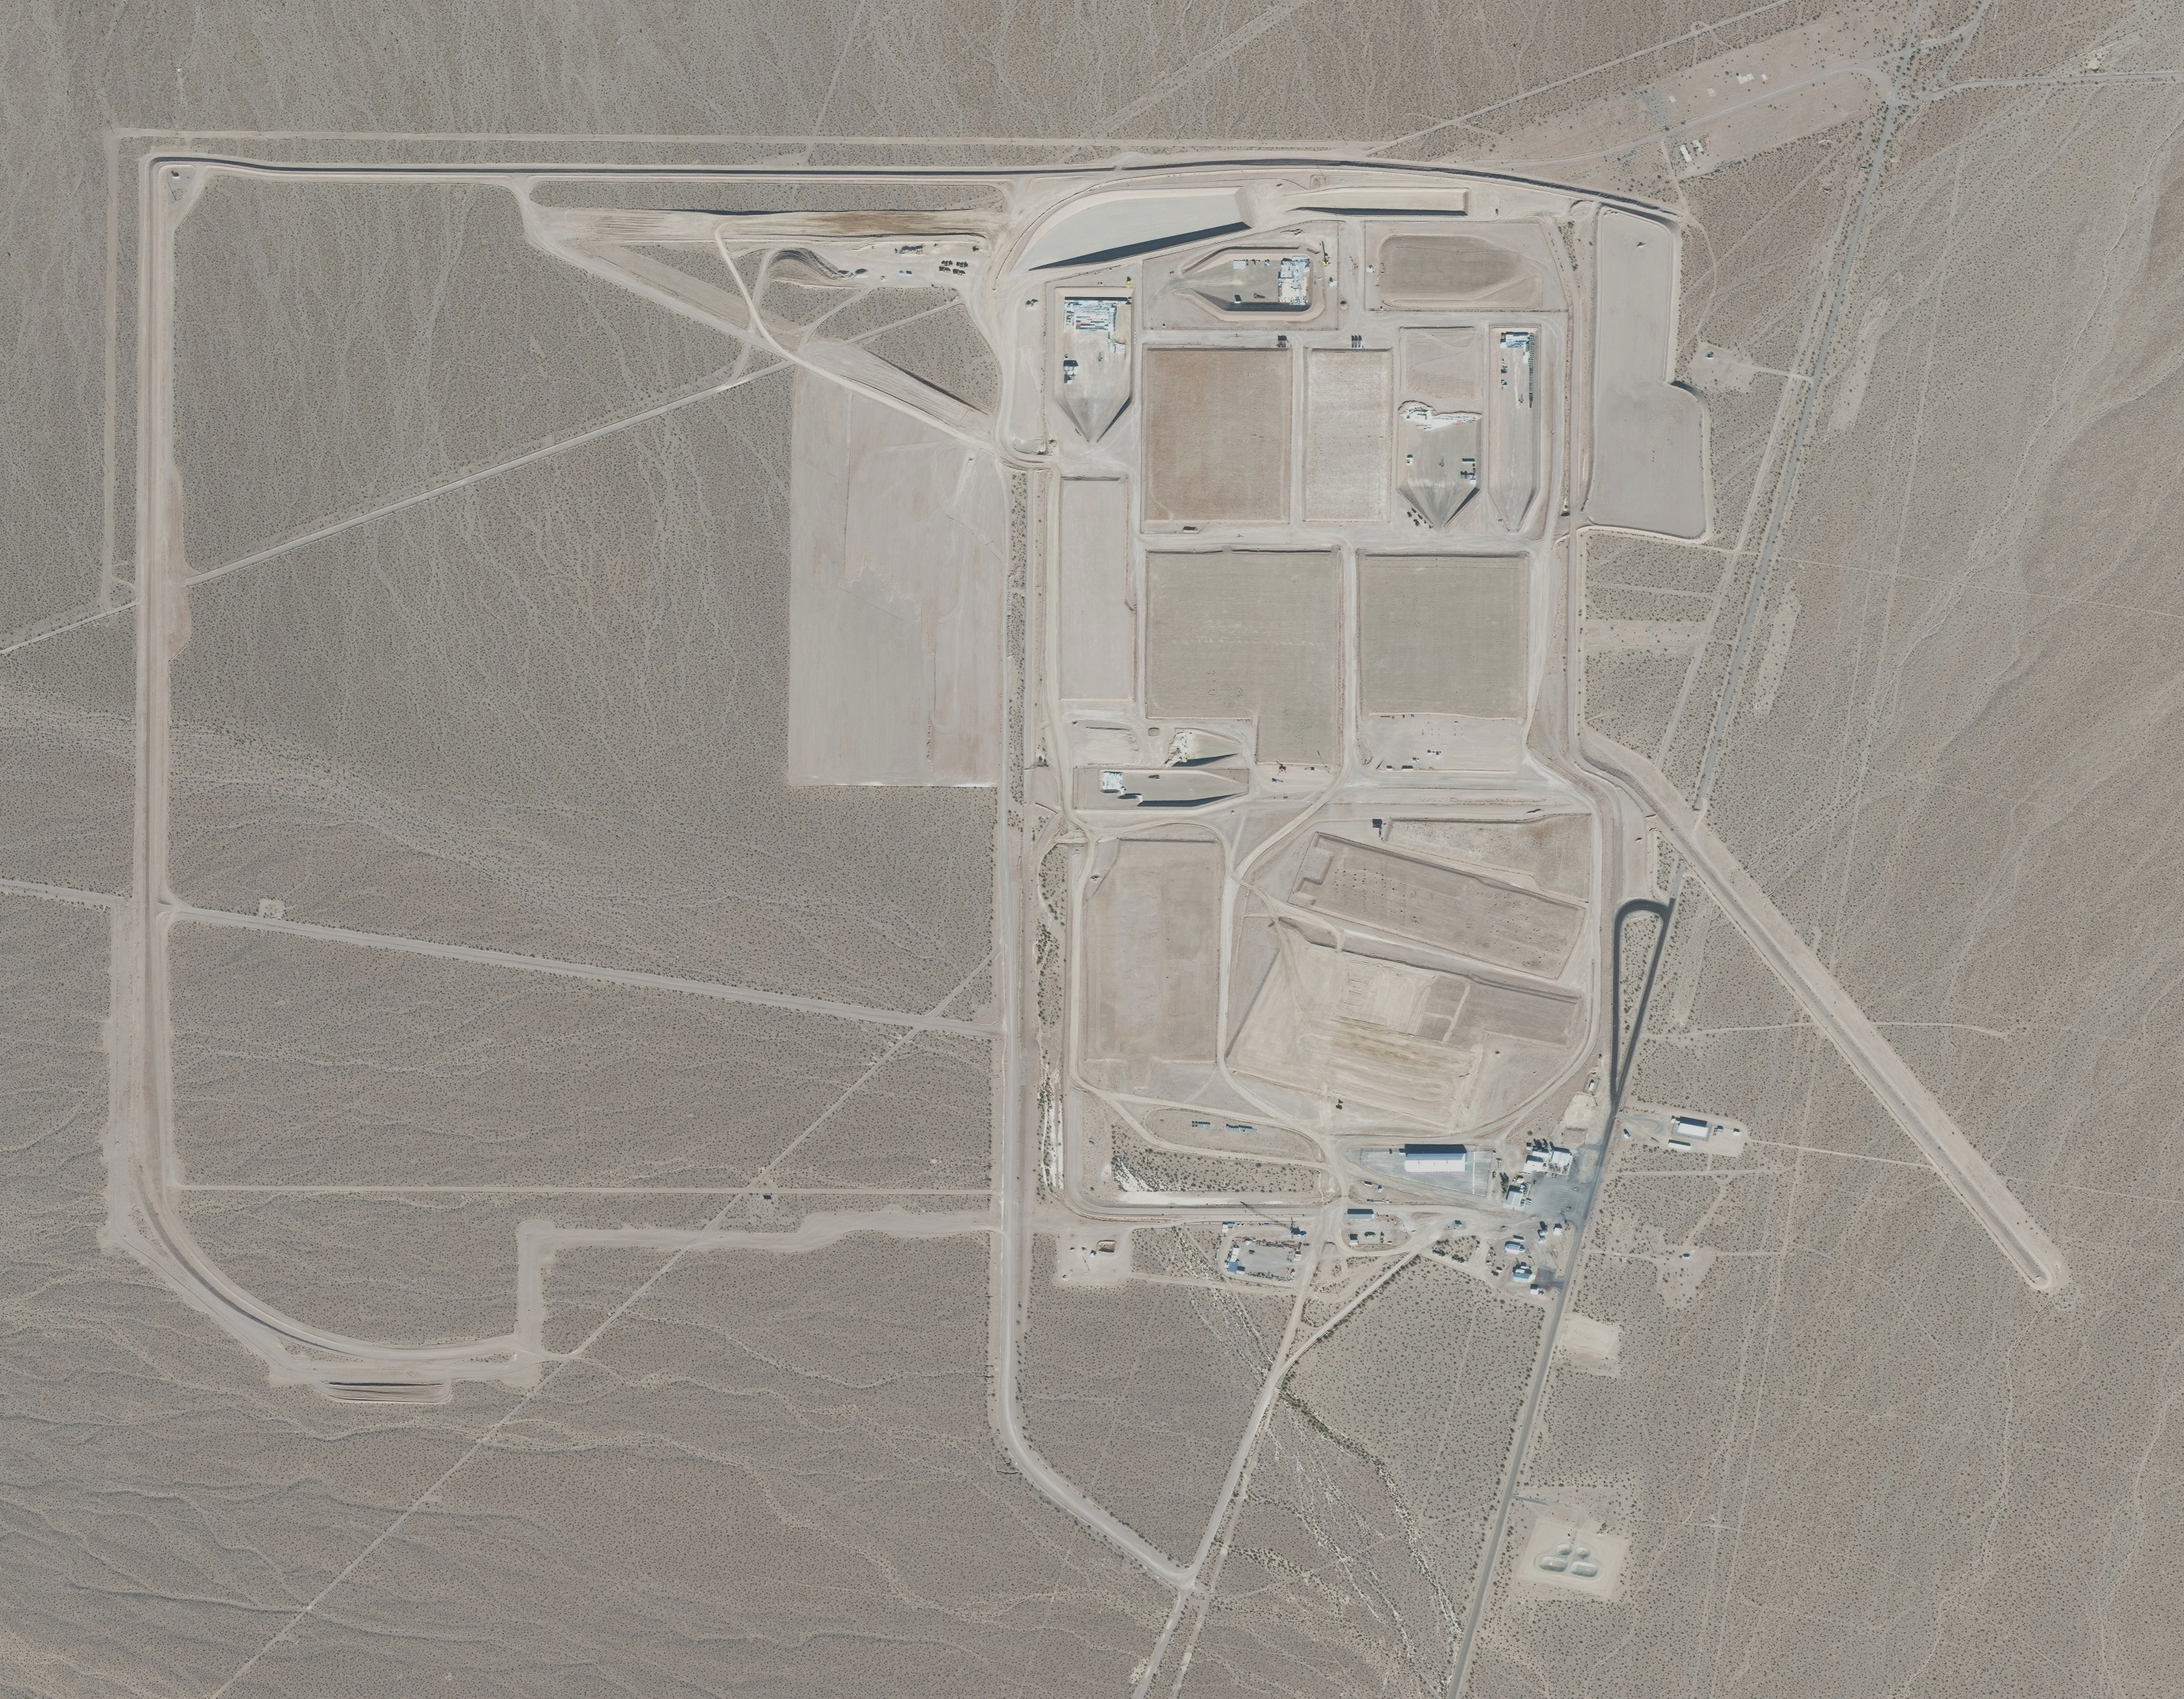
Current Disposal Operations Overview
Eight (8) open disposal units
Available disposal capacity in current cells:
      LLW: 6,000,000 ft³ (1M ft³ available for classified disposal)
      MLLW (Resource Conservation and Recovery Act [RCRA] Permit): 735,000 ft³ (all available for classified disposal)
Western Area Development
    Utilities relocated
    Flood berm completed in 2021
    Construction of first cell in expansion area to start in 2027-2028
    First cell may be for RCRA –
    Drive-through Real-Time Radiography Portal – operational in FY 2025
2028
Drive-through Real-Time Radiography Portal
Radioactive Waste Management Complex

Slide 10
Permits
Active permits for Area 5 RWMC waste disposal with monitoring requirements:
  Resource Conservation and Recovery Act (RCRA) Permit NEV HW0101
    MLLW storage and disposal (Mixed Waste Storage Unit and Mixed Waste Disposal Unit [MWDU])
    Revision issued April 2023
  Class III Solid Waste Disposal Site (SWDS), Permit SW 532
    LLW, primarily with asbestos
    Classified Non-Radioactive Hazardous (CNRH) Waste
    Permit issued May 29, 2024
NNSSWAC implements requirements for waste disposal

Slide 11
Agreement in Principle (AIP)
Signed by Nevada Division of Environmental Protection (NDEP), Nevada Division of Emergency Management (NDEM), and DOE
  Current agreement effective June 2021 through June 2026
Intent is to work cooperatively for the protection of public health and safety and the environment including emergency management initiatives
Provides for transparent coordination of radioactive waste activities including waste profile review, and verification activities
NDEP participates in RWAP activities to provide independent monitoring and oversight

Slide 12
FY 2024 Disposal Volumes
(volumes in ft³)
Waste Type | 1st Quarter Actual | 2nd Quarter Actual | 3rd Quarter Actual | 4th Quarter Actual | Total FY 2024 Volumes
Low-Level Radioactive Waste (LLW) | 162,029.85 | 104,371.94 | 124,632.85 | 288,284.61 | 679,319.25
Mixed Low-Level Radioactive Waste (MLLW) | 16,135.35 | 18,266.90 | 8,751.20 | 9,155.90 | 52,309.35
Classified Non-Rad Waste | 0 | 2,064.00 | 18,771.62 | 5,531.44 | 26,367.06
Classified Non-Rad Hazardous Waste | 815.00 | 326.00 | 820.60 | 591.48 | 2,553.08
TOTALS | 178,980.20 | 125,028.84 | 152,976.27 | 303,563.43 | 760,548.74
FY24 Preliminary Forecast Total was 724,912.00
FY24 Mid-Year Forecast Total is 766,763.04

Slide 13
Past Disposal Volumes
(volumes in ft³)
Fiscal Year | Total Volumes
FY 2023 | 595,656
FY 2022 | 635,417
FY 2021 | 539,422
FY 2020 | 459,644
FY 2019 | 1,079,412
FY 2018 | 1,157,728
FY 2017 | 907,849
FY 2016 | 1,045,899
FY 2015 | 1,324,972
FY 2014 | 1,269,353
FY 2013 | 1,098,898
FY 2012 | 827,109

Slide 14
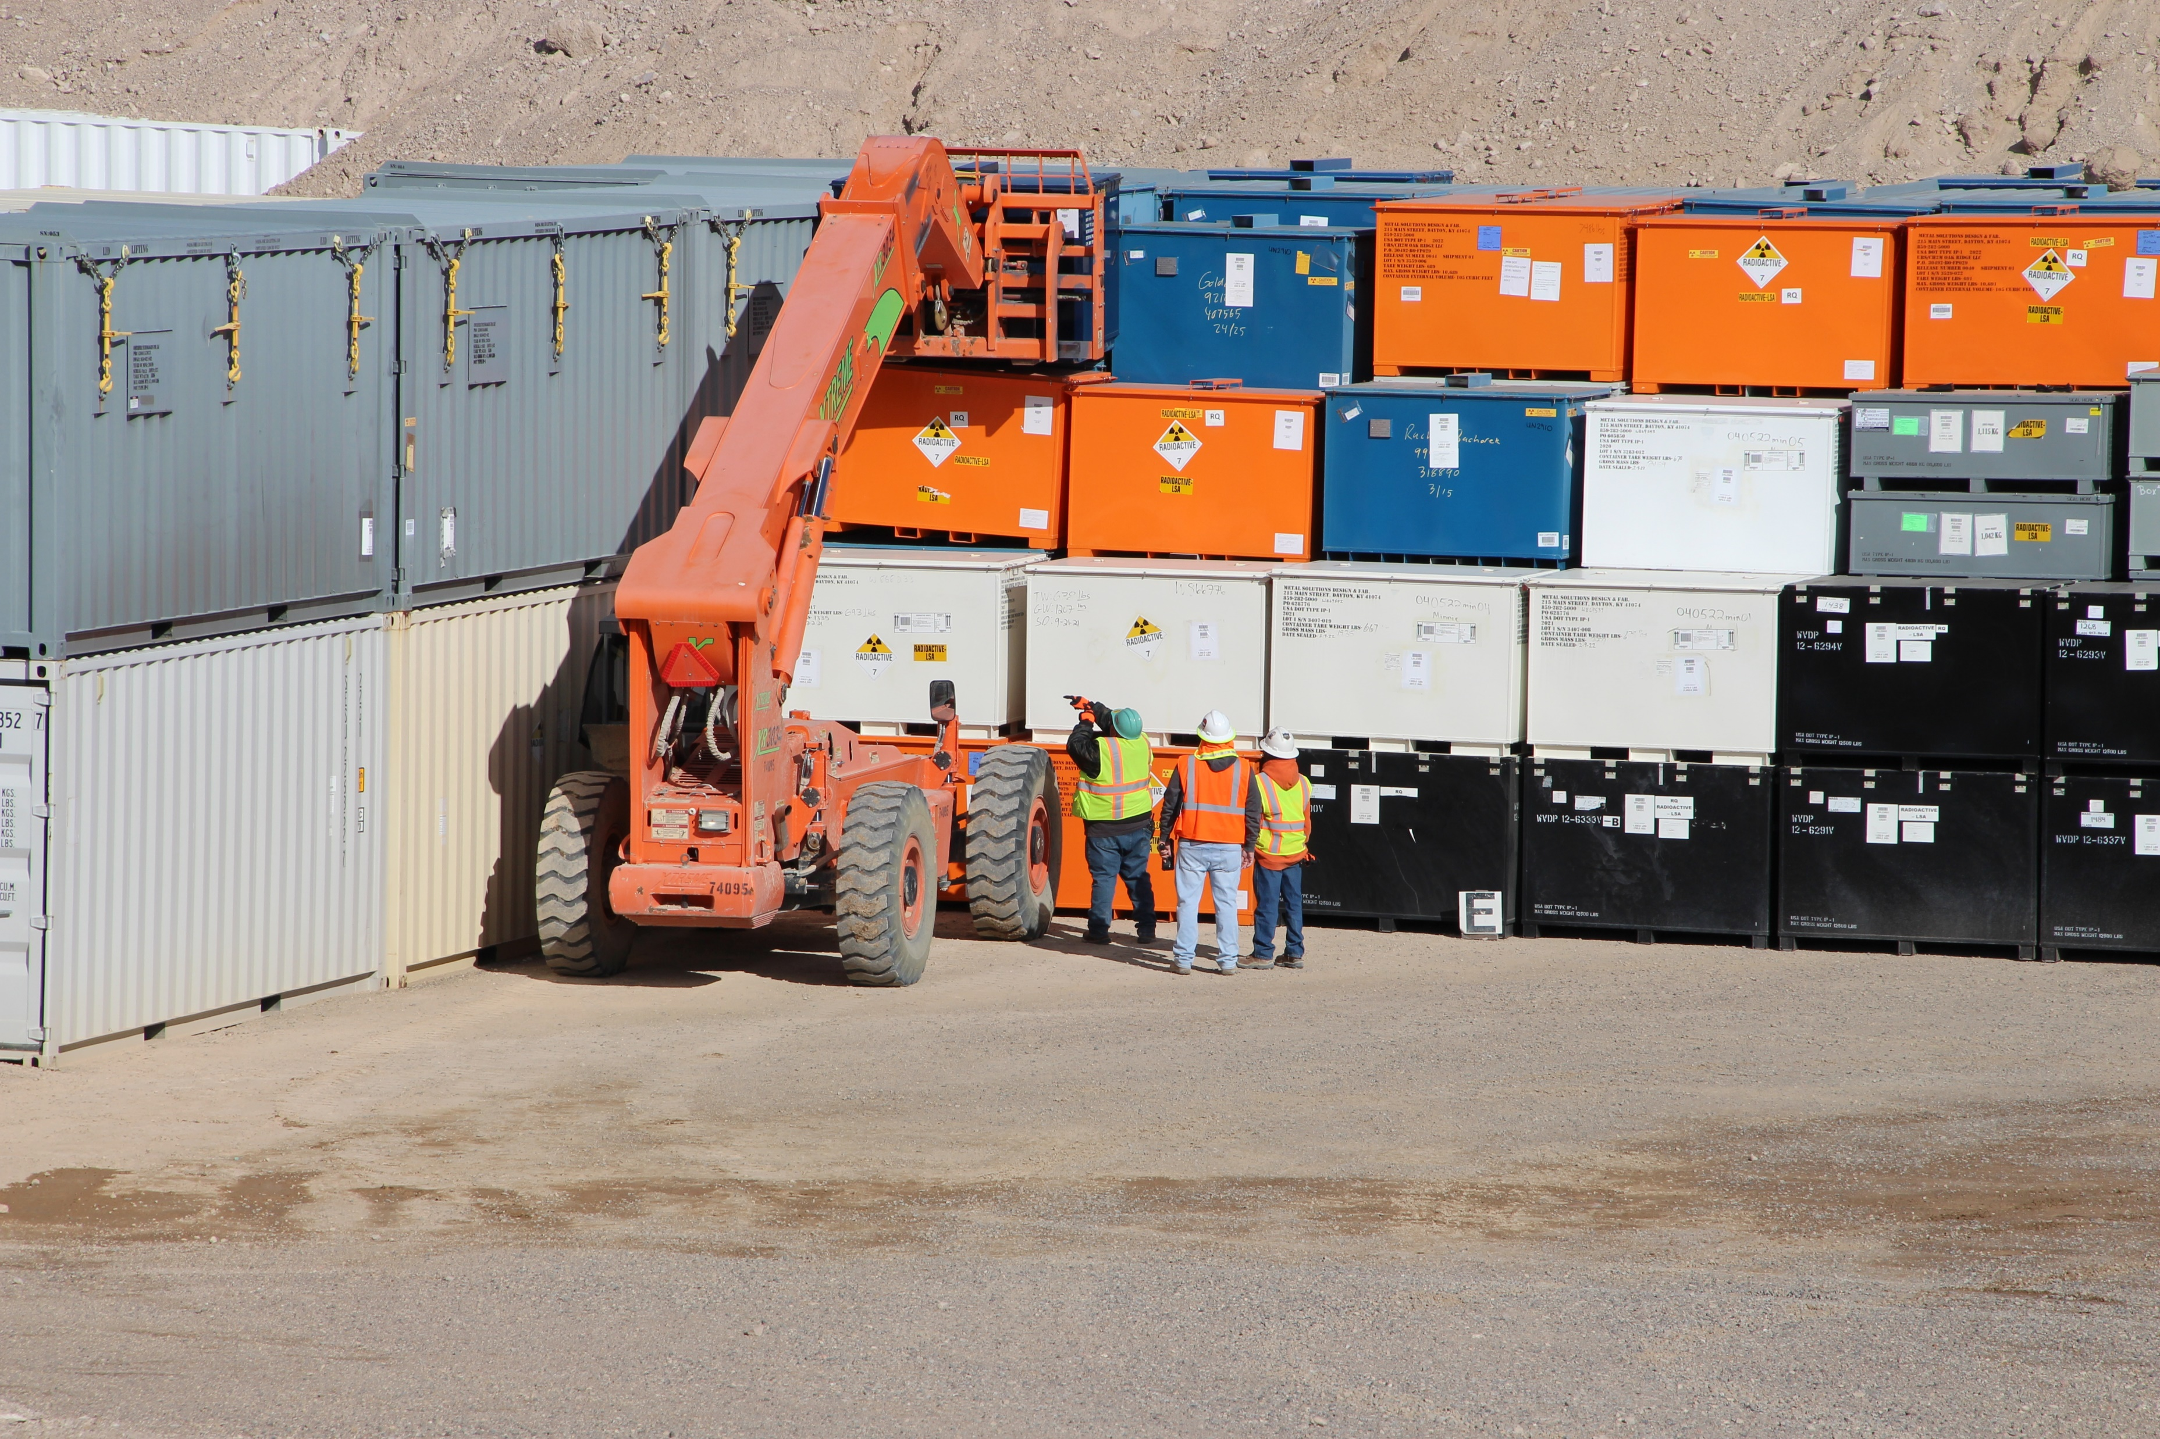
NNSS Radioactive Waste Acceptance Program
RWAP is tasked with monitoring generator compliance with the NNSSWAC
  Update NNSSWAC as necessary
  Facility Evaluations (FEs)
  Waste Acceptance Review Panel (WARP)
  Waste Verifications
Cell 21 Container Stacking

Slide 15
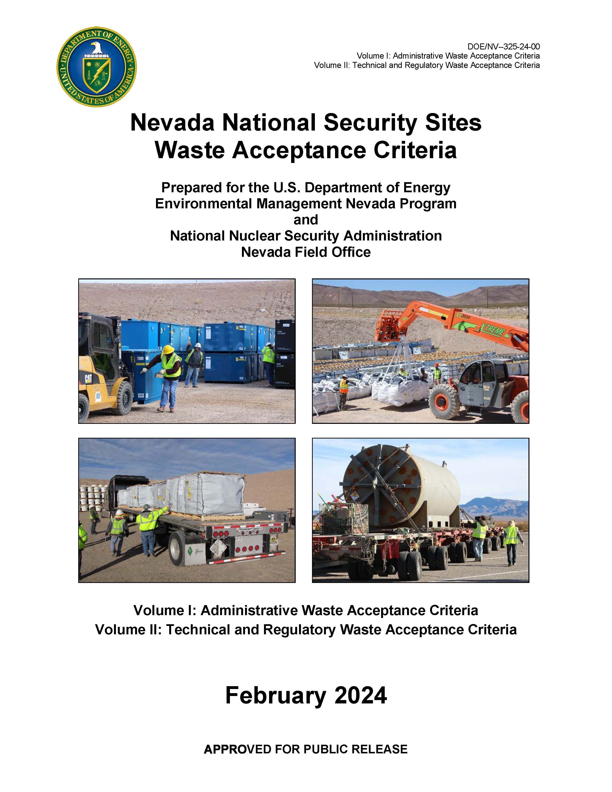
NNSS Waste Acceptance Criteria (NNSSWAC)
Overarching document that details the requirements for generator sites and their proposed waste
  Governs generator waste characterization and quality assurance policies, as well as the practices associated with waste inspection, packaging, shipping, and disposal
  Designed to protect workers, the public, and environment

Slide 16
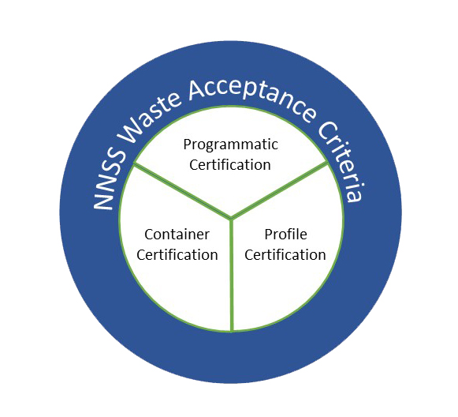
Three Levels of Certification
Programmatic Certification
  Initial and ongoing periodic assessments of generator waste certification program before waste is shipped to the NNSS
Profile Certification
  Profiles, prepared by generators for each waste stream proposed for NNSS disposal, contain pertinent details
  Profiles reviewed by multidisciplinary team and recommended to DOE for approval
Container Certification
  All containers are required to be certified as meeting the NNSSWAC by the generator Waste Certification Official or designee
  WCOs are required to be independent of waste generating operations

Slide 17
Programmatic Certification through NNSS Assessment and Surveillance Program
Periodic assessment of generators to confirm the adequacy of written work procedures conducted primarily as onsite Facility Evaluations (FEs)
The implementation of written procedures is assessed through witnessing work and interviewing generator personnel
NDEP is given the opportunity to attend FEs to observe the assessment process and to obtain first-hand information regarding waste destined for the NNSS
Facility Evaluation Tools
  Audit: Evaluation of all five (5) NNSS Waste Acceptance Criteria (NNSSWAC) elements: Chemical Characterization, Radiological Characterization, Quality Assurance, Waste Traceability, and Packaging/Transportation
  Surveillance: Conducted to review a particular waste stream or operation; May be combined with waste verifications such as a profile verification and collection of split samples.

Slide 18
Profile Certification through NNSS Waste Acceptance Review Panel (WARP)
Waste profiles are prepared by generators for each waste stream proposed for NNSS disposal. Profiles include regulatory classification, identification of radionuclides and concentration amounts, chemical characteristics, generating description and physical form, packaging and shipping specifications, and security considerations.
WARP performs technical and regulatory reviews of waste profiles and makes recommendations regarding the acceptability of wastes; chaired by RWAP with subject matter experts from multiple disciplines.
Each waste profile is provided to NDEP for review. The WARP chair ensures NDEP’s input has been addressed prior to recommendation for approval.
WARP Subject Matter Experts (SMEs) required to recommend approval
  Radiological Characterization
  Performance Assessment
  Nuclear Facility Management
  Permitting Compliance
EM Nevada Program grants final approval

Slide 19
Container Certification and Verification
Certification
  All containers are required to be certified as meeting the NNSSWAC by the generator Waste Certification Official or designee
  WCOs are required to be independent of waste generating operations
Container Verification
  The RCRA and SWDS permits require an agreed to percentage of container verification
  Tools typically used for NNSS verification include:
    Visual
    RTR
    Chemical Verification
    Alternate method as agreed by WARP with NDEP’s participation

Slide 20
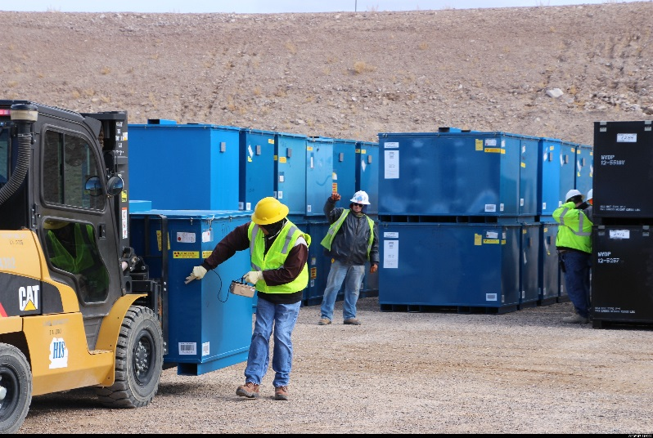
Waste Receipt
Generators transmit a package shipment disposal request (PSDR) to the NNSS
Shipment arrives at the RWMC, paperwork is verified, and entrance radiological survey performed
Perform RTR on containers identified from scheduled shipments
Shipment is escorted to designated disposal cell and offloaded
Delivery truck is surveyed and released from the RWMC
Radiological Scanning

Slide 21
Performance Assessment (PA) Model
Model implemented in the GoldSim probabilistic simulation platform
Integrated system model based on site characterization and results of physics-based process models (e.g., FEHM, CAP-88 PC)
Decision analysis tool used on a routine basis to evaluate proposed changes
Proposed disposal operations changes can be evaluated in hours

Slide 22
Area 5 RWMS Unique Site Characteristics
Extremely arid site
  12 cm precipitation/yr (less than 5 inches)
  Potential evapotranspiration 12x precipitation
Thick unsaturated zone ~240 m (approx. 790 feet) thick composed of porous alluvium
Multiple lines of evidence that percolation below plant root zone ceased greater than 10,000 years ago
Site in operation since 1961 with no evidence of aquifer contamination
No permanent surface water
Very limited potential for agriculture or residential development due to:
  Deep groundwater; aquifer deeper than 99.9% of household water supply wells in Clark, Nye, and Lincoln Counties, NV
  Infertile soil with poor water retention, poor rangeland
  Absence of attractive resources (e.g., minerals or petroleum)
  Government ownership with commitment to institutional controls

Slide 23
Transport Conceptual Model
NLFB – No Liquid Flux Boundary

Slide 24
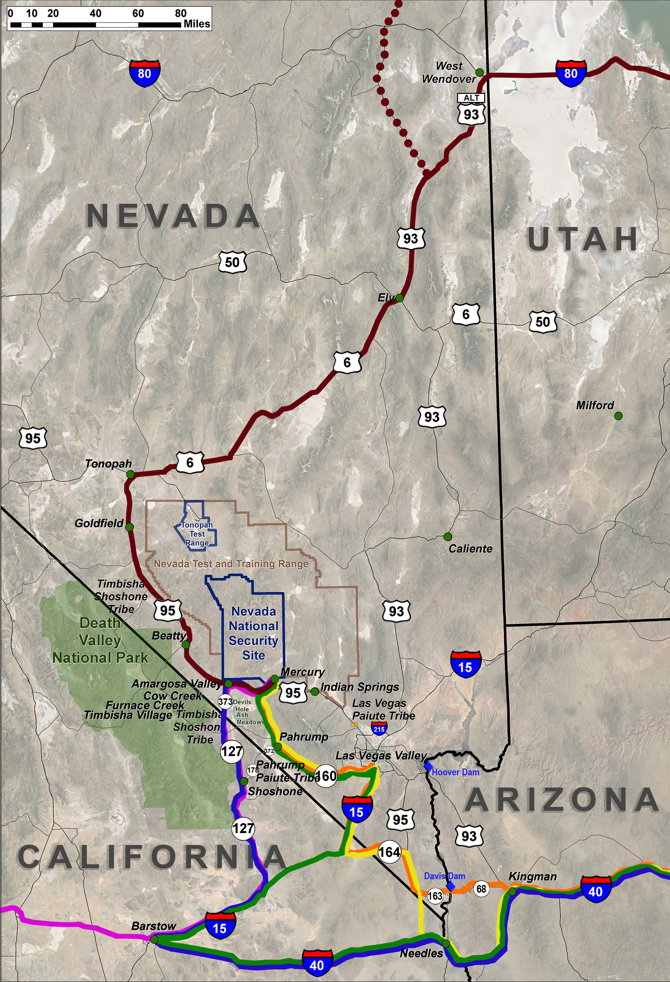
3rd Quarter FY 2024 Shipment Routes
Route Description | Legend | Number of Shipments
I-40, US-93, AZ-68, NV-163, US-95, NV-164, I-15, NV-160, US-95 |  | 103
I-40, US-95, NV-164, I-15, NV-160, US-95 |  | 12
I-40, I-15, NV-160, US-95 |  | 9
I-80, US-93 ALT, US-6, US-95 |  | 16
US-93, US-6, US-95 |  | 12
I-40, I-15, CA-127, NV-373, US-95 |  | 1
I-15, CA-127, NV-373, US-95 |  | 14
NNSS On-Site Shipments | N/A | 6
TOTAL |  | 173

Slide 25
Transportation Safety
Commercial motor carriers transporting waste to the NNSS must be identified on the DOE Motor Carrier Evaluation Program (MCEP) Evaluated Carrier List
NNSS RWAP provides oversight of NNSS waste generators for compliance with DOT regulations and NNSSWAC to include routinely reviewing motor carrier safety and performance
Of the 34,478 radioactive and classified waste shipments transported to the NNSS since January 1, 1999, 21 were involved in a traffic-related event that occurred either on a roadway or in a parking/rest/refueling area
Only 3 of the 21 events involved a breached package - NO release of radioactive contamination occurred during any of the events

Slide 26
Stakeholder Activities
Low-Level Waste Stakeholders Forum (LLWSF)
  Attendees typically include representatives from Las Vegas Fire and Rescue, Nevada State Police, and Clark, Nye, Lincoln, and Elko counties
  Four meetings per year/Quarterly
  Discussions focus on Waste Transportation and Disposal at the NNSS
Nevada Site Specific Advisory Board (NSSAB)
  Volunteer members
  Six meetings per year
  Board meetings open to the public
  Meetings address work plan items and discuss recommendations to DOE
Intergovernmental Stakeholder meetings
  Provides a regular venue for discussions outside a public setting

Slide 27
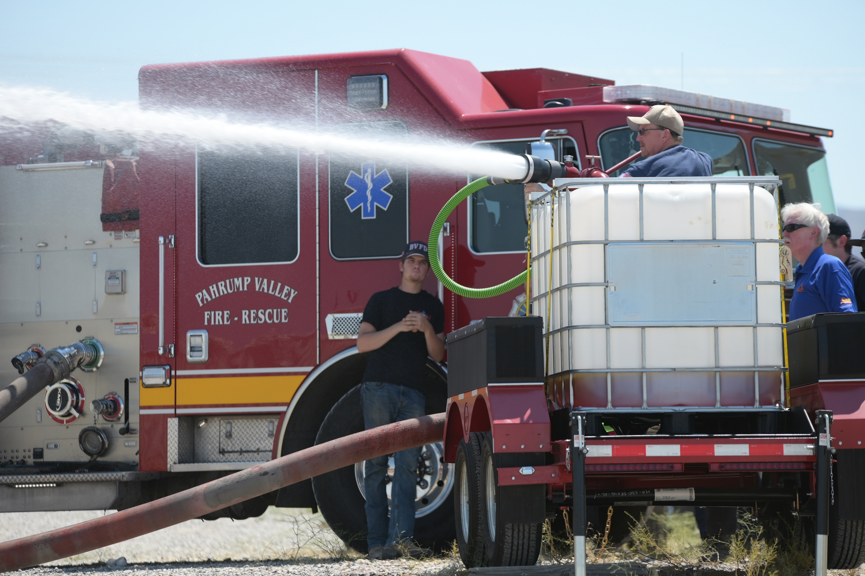
Emergency Preparedness Working Group (EPWG)
EM Nevada Program funds the grant based on $.50 per cubic foot of classified, LLW, and MLLW disposed at the NNSS
More than $16.3 million has been distributed through the State of Nevada Division of Emergency Management to Clark, Elko, Esmeralda, Lincoln, Nye, and White Pine counties
Current Total $16,324,867
  Funding provided in accordance with approved grant application and oversight of funding use
Priorities for grant funding include consideration for the needs of a county and the resource base available in that county
Nye County Department of Emergency Management testing F-500 fire suppression agent. EPWG funded purchase of the F-500 product and additional fire fighting equipment.

Slide 28
Conclusion
EM Nevada Program coordinates with our contractors and partners to support the waste disposal mission
The NNSSWAC details rigorous requirements for waste disposal at the NNSS from approved waste generators
The Radioactive Waste Acceptance Program is tasked with ensuring compliance with the NNSSWAC through Facility Evaluations, the Waste Acceptance Review Panel, and Waste Verifications
The Radioactive Waste Management Complex is an excellent location for LLW disposal due to isolated and secure geological/geographical location, depth to groundwater, low precipitation, and high evapotranspiration potential
EM Nevada Program is committed to maintaining open communications with our regulator, stakeholders, and surrounding communities
Waste has been Safely and Securely disposed at the NNSS since 1961

Slide 29
Questions?

