Slide 1
DOE/EM Waste Management Update
Low Level Radioactive Waste Forum
Amie Robinson
Office of Waste Disposal
October 9-10, 2024

Slide 2
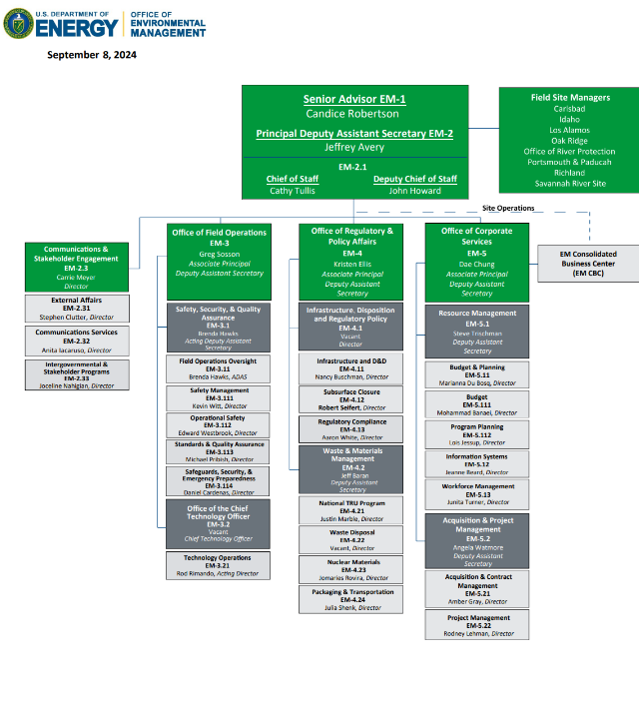
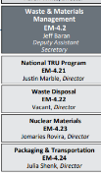
EM Organization Chart (UPDATE!)

Slide 3
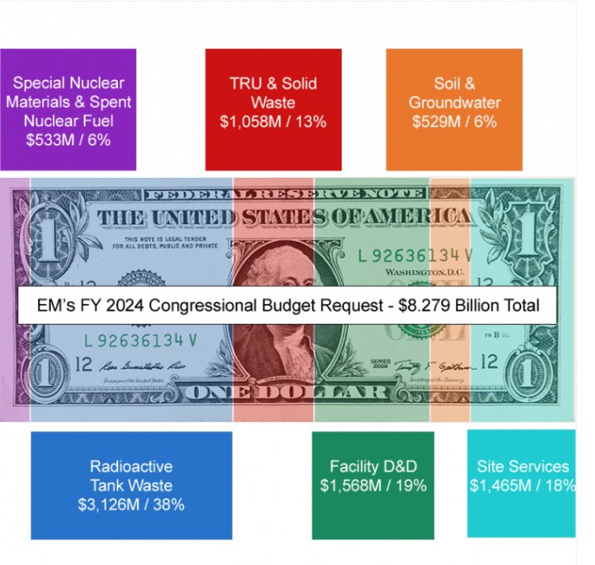
Budget Request FY 2024 ongoing . . . CR to 12/24

Slide 4
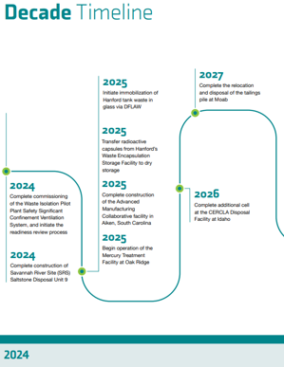
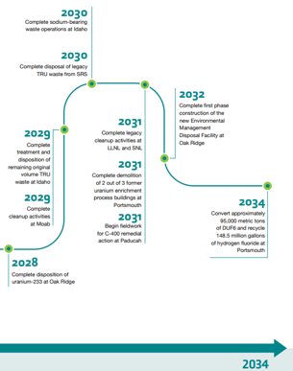
DOE/EM Strategic Planning includes Waste Management Update Currently in Progress
EM Program Plan, outlining a decision roadmap the cleanup program will use as a guide over the next two decades
EM Strategic Vision: 2024-34
CY 2024 Mission Priorities
For more information, visit
Annual Priorities, Strategic Vision, and Program Plan | Department of Energy website at: https://www.energy.gov/em/office-environmental-management

Slide 5
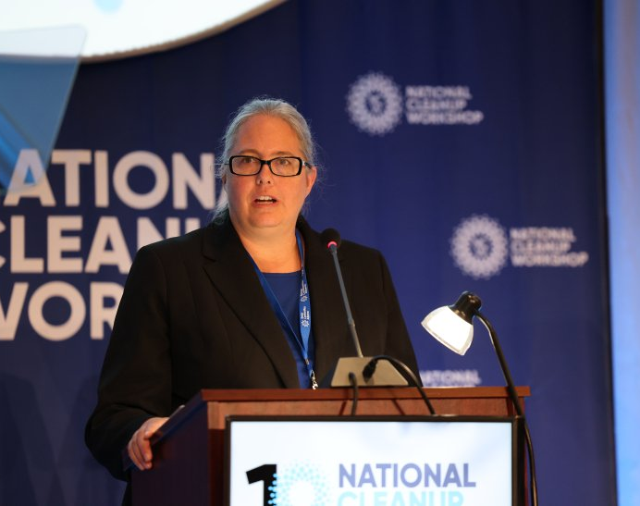
New EM-1 Candice Roberts
“The value of strong partnerships and the work it takes to maintain them is perhaps one of the most important lessons EM has learned over the past 35 years,” Robertson said.
“It’s a prime example of what is possible when EM and our cleanup partners remain focused on the long term goals and achieve alignment on key priorities,” Robertson said.
Robertson emphasized that such achievements all come down to effective partnerships among all people of EM, including the federal and contractor workforce, labor unions, regulators, the best of American industry, congressional cleanup champions, tribal nations, pueblos, states, intergovernmental groups, and local communities near EM sites.
“As a former local elected official myself, I know how important it is to have that kind of local leadership and engagement,” she added.
“I heard firsthand the concerns and priorities of these pueblos, communities, labor unions, workers, which all reinforced the need to foster partnerships built on trust, collaboration and progress as EM maintains cleanup momentum, solves remaining challenges and plans for the future,” Robertson said.
Notes:
U.S. Department of Energy Office of Environmental Management Senior Advisor Candice Robertson speaks at the 2024 National Cleanup Workshop, focusing on partnerships that lead to progress as the cleanup program marks its 35th year. Photo by Matt Roberts

Slide 6
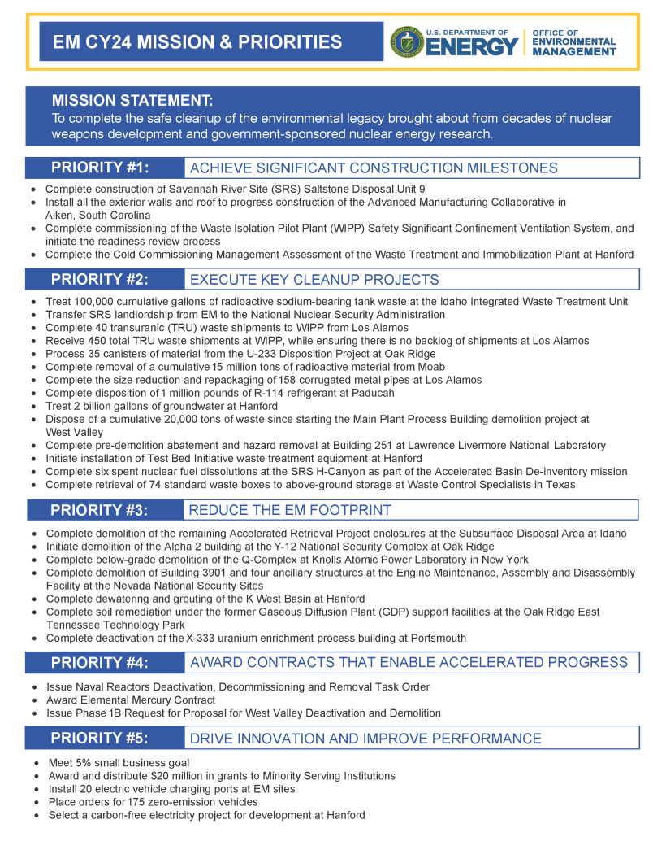
Scorecard: Mission and Priorities 2024

Slide 7
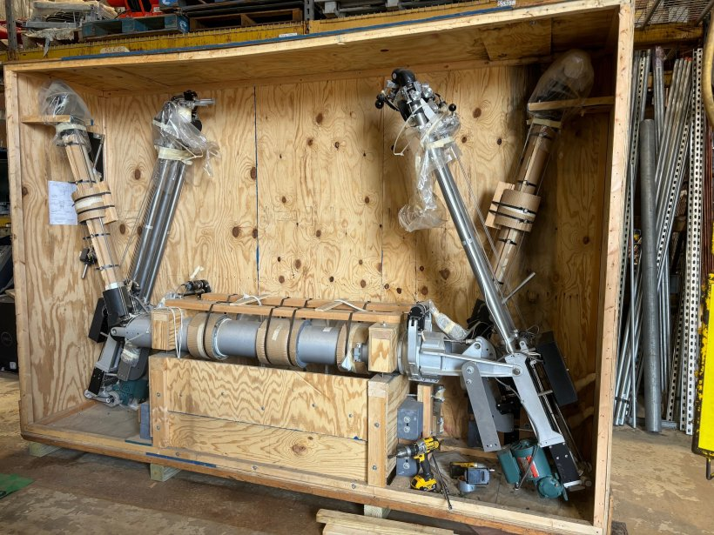
West Valley Sends Equipment to Idaho
For Reuse and
Saves Taxpayers $1Million
EM’s INL Site cleanup contractor, Idaho Environmental Coalition (IEC), will receive major components and spare parts from West Valley for several robotic manipulator arms used alongside telemanipulators to process waste.
Telemanipulators allow an operator to control a hand-like mechanism from outside a working cell — similar to claw crane machine arcade games.
That equipment is among a large inventory of parts used to maintain and replace remote-handling equipment no longer needed at West Valley after crews there decommissioned the Main Plant Processing Building and Vitrification Facility..
West Valley Sends Equipment to Idaho for Reuse, Saving Taxpayers $1 Million | Department of Energy

Slide 8
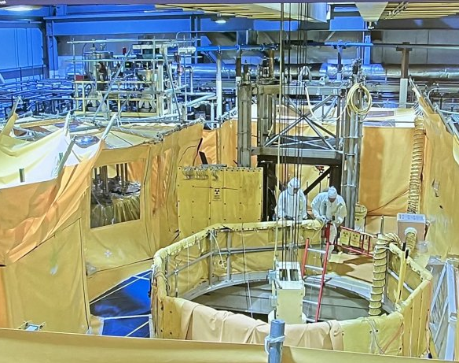
Crews Resume Liquid Waste Treatment in Idaho
IDAHO FALLS, Idaho — U.S. Department of Energy Office of Environmental Management crews have resumed waste processing operations at a radioactive liquid waste treatment facility at the Idaho National Laboratory Site following the completion of two maintenance campaigns.
To date, the facility has treated more than 80,000 gallons of radioactive liquid waste that remains in underground waste tanks at the Idaho Nuclear Technology and Engineering Center.
Sodium-bearing waste is a byproduct of decontamination and rinse campaigns associated with historic spent nuclear fuel reprocessing runs at the center. The waste treatment facility uses a steam-reforming process to convert the liquid waste into a dry, granular solid, which is transferred to stainless steel canisters and placed in concrete vaults for onsite storage.
Sodium-bearing waste treatment is expected to take three to seven years to complete, accounting for outages to conduct regular maintenance on the facility.

Slide 9
Low-Level Waste Disposal Facility
Federal Review Group (LFRG) as of 2024
LFRG Members
DOE panel that reviews LLW disposal facility performance at DOE Sites as per DOE O 435.1. Radioactive Waste Management
^{Program Secretarial Offices}
Office of Environmental Management (EM)
Office of Environment, Health, Safety, and Security (EHSS)
Comprised of Federal employees led by EM.
Office of Nuclear Energy (NE) Office of Science (SC)
Office of Legacy Management (LM)
National Nuclear Security Administration (NNSA)
Ensures compliance and consistency of facility design, construction, operation, and closure.
DOE Sites with LLW Radioactive Waste Sites
Hanford, Richland, WA
Idaho National Laboratory, ID
Los Alamos National Laboratory, New Mexico
Nevada National Security Site, NV
Oak Ridge National Laboratory, Oak Ridge, TN
Paducah, Kentucky and Portsmouth, OH, PPPO Office
Savannah River Site, SC
Qualified, experienced, and independent review teams that includes Federal staff and Contracting support.
www.energy.gov/EM

Slide 10

WIPP
WIPP has been disposing of legacy transuranic (TRU) waste since 1999,
cleaning up 22 generator sites nationwide.
DOE Selects NextEra Energy for a Large-Scale Solar Project at the WIPP
WIPP 14,000 Shipments Marks Milestone
WIPP marks pivotal milestone by completing construction of ventilation system

Slide 11
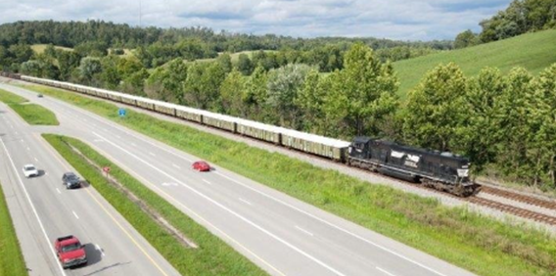
Depleted Uranium (DU)
A 2020 DOE Record of Decision based upon the Final DU Oxide Supplemental Environmental Impact Statement regarding disposition at one or more of the disposal sites evaluated
DOE can ship to selected commercial site(s) if the facility is authorized/licensed to receive DU oxide in addition to DOE’s Nevada National Security Site:
  EnergySolutions near Clive, Utah (licensing application in process meeting regularly with DOE)
  Waste Control Specialists LLC (WCS) Federal Waste Facility (licensed)
Multiple shipments by rail in 2023-24

Slide 12
PPPO DUF6 Recycle/Reuse Efforts
  Hexafluoride (HF)
  HF can be converted safely and routinely over 1,000 cylinders per year (~608 at PAD / ~456 at PORTS FY24 goals), which equates to ~2M gallons of Hexafluoride (HF) annually. PPPO office has recycled over ~15M gallons of HF safely into commerce.
  At Paducah, DOE has entered into a sales agreement with GLE to potentially supply ~25,000 DUF6 cylinders as feed stock for a future laser enrichment facility to be built adjacent to the site.
  Natural Uranium HF from PORTS also presented a unique opportunity for sharing resources with NNSA for the NNSA feedstock. A total of 4,172 DU cylinders between both sites meet criteria for high purity depleted uranium metal needs NNSA feedstock
  Potential Products are circuit board etching and cleaning (Electric Vehicle circuits for example); glass Manufacturing; Analytical Chemistry; and Chemical Synthesis
  Fluorine
  another versatile material and is on the current DOE Critical Materials for Energy list (https://www.energy.gov/cmm/what-are-critical-materials-and-critical-minerals)
  Hydrofluoric Acid (Similar to HF) is A co-product of PPPO’s (Ports and Pad) conversion of 67,000 DUF6 cylinders is Hydrofluoric Acid, which is recycled into industry.
  Approximately 2M gallons per year can and is sold for use in pharmaceuticals, glass etching, and circuit board etching (and other ancillary products)

Slide 13
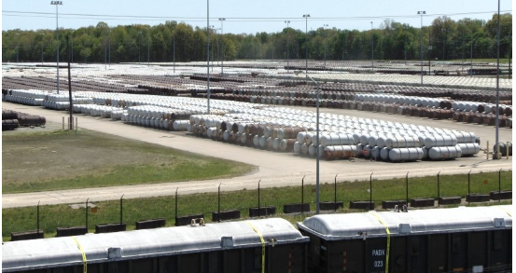
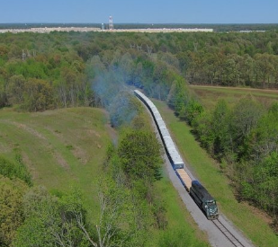
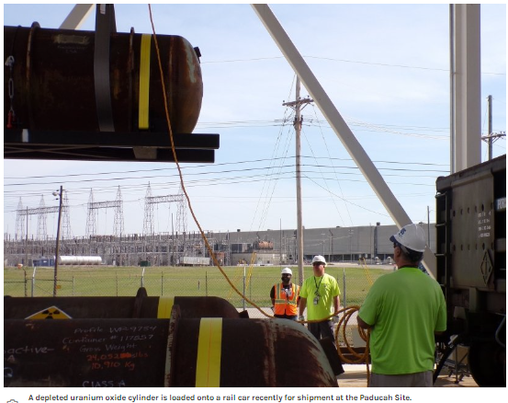
Portsmouth & Paducah – Uranium Oxide Shipments for Disposal

Slide 14
CX-031091: Transport Low Level and Mixed Low Level Rad Waste from the Grand Junction, Colorado Disposal Site to Waste Control Specialists
Office of NEPA Policy and Compliance
CX-031091: Transport Low Level and Mixed Low Level Radioactive Waste from the Grand Junction, Colorado, Disposal Site to Waste Control Specialists
DOE-LM is proposing to dispose of low-level radioactive waste (LLRW) and mixed LLRW (subject waste) stored at the Grand Junction, Colorado, Disposal Site (GJDS) to an offsite non-DOE facility, Waste Control Specialists (WCS), located in Andrews, Texas.
CX-031091: Transport Low Level and Mixed Low Level Radioactive Waste from the Grand Junction, Colorado, Disposal Site to Waste Control Specialists

Slide 15
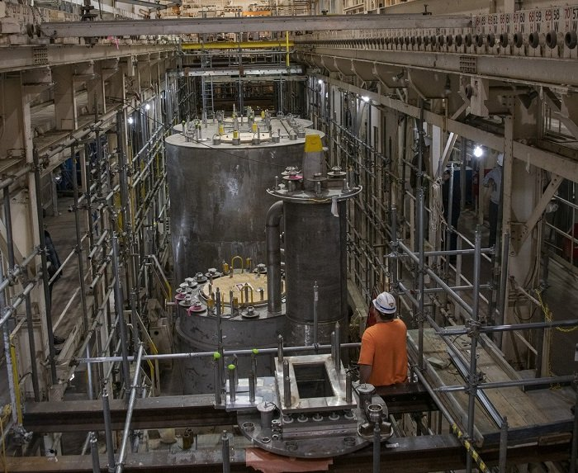
Savannah River Site
Begins Disposition Mission for Japan’s Reactor Fuel
The H Canyon Chemical Separations Facility at Savannah River Site (SRS) recently started dissolving nuclear material from a Japanese research reactor, leading to its safe disposal.
The U.S. Department of Energy Office of Environmental Management achievement follows years of preparation by multiple site contractors and involved replacement of an electrolytic dissolver and its support equipment to process Japan’s Fast Critical Assembly fuel.
Pictured -- Crews installed an electrolytic dissolver in the H Canyon Chemical Separations Facility at the Savannah River Site to dissolve nuclear material and support the U.S. Department of Energy’s nonproliferation mission.
Savannah River Site Begins Disposition Mission for Japan’s Reactor Fuel | Department of Energy

Slide 16
Waste Disposal Considerations
DOE’s Radioactive Waste Management Manual found in 435.1-1 has a “tiered” policy on treatment, storage, and disposal:
  DOE waste shall be treated, stored, and in the case of low-level waste, disposed of at the site where the waste is generated, if practical, or at another DOE facility. If DOE capabilities are not practical or cost effective, exemptions may be approved to allow use of non-DOE facilities for the storage, treatment, or disposal of DOE radioactive waste …
Waste disposal is always fully protective of worker and public health and the environment and in compliance with applicable Federal, state, and local requirements, with necessary permit(s), license(s), and approval(s) for the specific waste.
Sufficient LLW/MLLW disposal capacity exists at DOE and commercial facilities to support the EM cleanup mission.

Slide 17
DOE LLW/MLLW Data
  Waste Information Management System (WIMS)
WIMS is developed to provide stakeholders with the tools necessary to easily visualize, and understand current and future waste volumes, categories, and problems of forecasted waste streams.
WIMS meets this need by providing a user-friendly online system to organize, and present waste forecast data from DOE sites. This system provides a method for identification of waste forecast disposal volumes, waste. classification, disposition pathways, and potential barriers to final disposition.
  Includes LLW/MLLW treatment/disposal forecast from all DOE sites, not just EM sites.
  Annually updated and website maintained by Florida International University
  Out-year data reflects uncertainty due to site funding adjustments, federal budget process, DOE priorities.
  Visit WIMS at: Waste Information Management System (emwims.org)

Slide 18
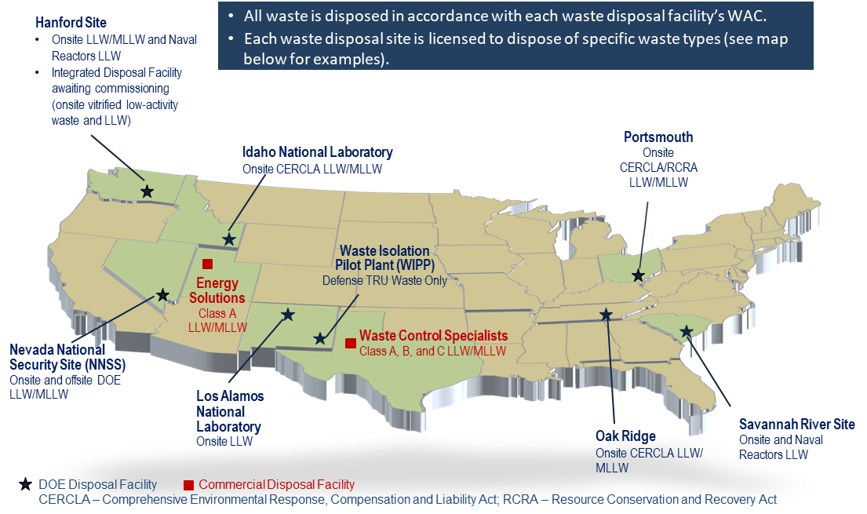
Operating DOE & Commercial LLW Disposal Facilities Used by DOE

Slide 19
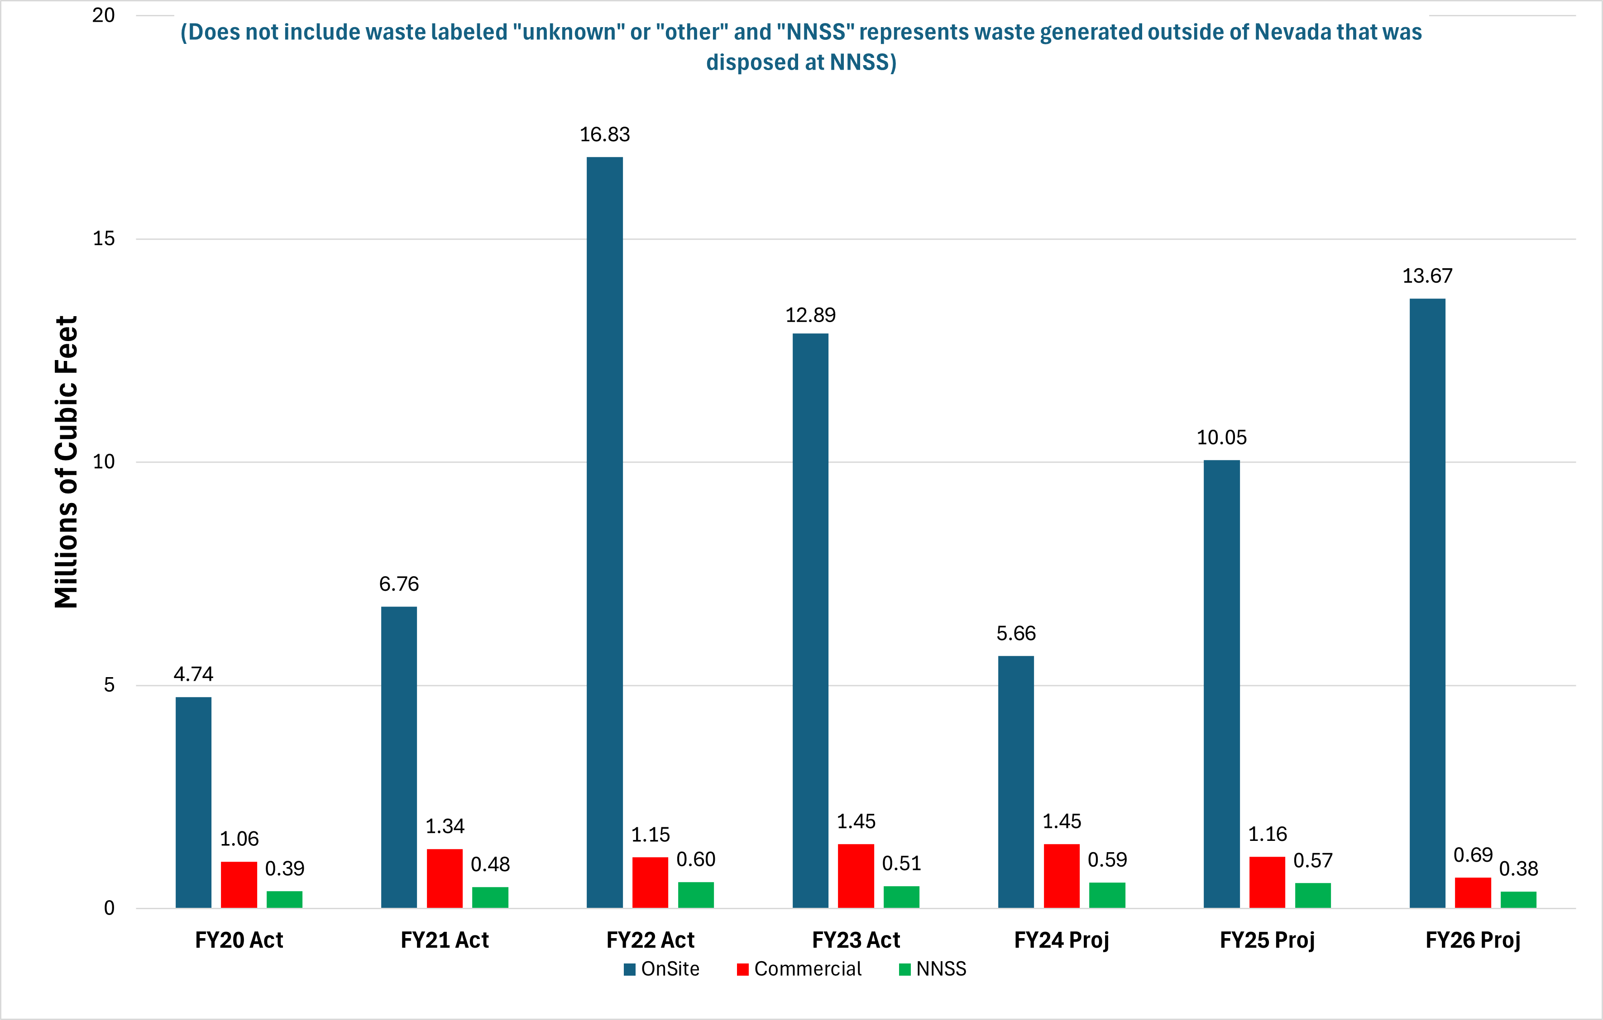
DOE Complex-wide LLW/MLLW Disposal Volume by Disposal Location
)
Notes:
Jonathan Kang notes:
As discussed earlier, DOE relies on use of strategic partnership between onsite capabilities, NNSS, and commercial facilities to manage its waste.
Historically speaking, most of DOE generated wastes are disposed on-site (80-90%) and remaining wastes at NNSS and commercial facilities (usually combined 10-20%).
We believe this trend will continue in coming years. We don’t necessarily believe this was due to current 435.1 policy and we also don’t expect “leveling the playing field” policy when and if implemented, will significantly change that.
In order to present the consistent methodology with prior year bar charts, NNSS generated waste disposed at NNSS is included in “Onsite” bar (vs. NNSS bar);
Large onsite volume in FY22 is Ports D&D waste (combination of X-326 demo and DUF6 related waste);

Slide 20
Commercial LLW Disposal Manifest Data
  Manifest Information Management System (MIMS)
  MIMS is the public source for manifest data of non-DOE LLW shipped to commercial disposal facilities to meet the provisions in 42 U.S.C. 2021g(a)
  States/compacts are the primary stakeholders
  Data is available for currently operating commercial LLW disposal facilities
    Barnwell, EnergySolutions, US Ecology, and Waste Control Specialists
  Currently updated with CY 2023 data. Next update will be January of 2025 (update with CY 2024 data)
  Visit MIMS at: mims.doe.gov

Slide 21
DOE PFAS Update 2024
Recent Updates:
PFAS Sampling Guidance: Published August 2023, presents a framework for investigating PFAS at DOE sites and facilities and describes methods for sampling and analyzing environmental conditions to help identify the nature and extent of contamination, PFAS concentrations in source zones, and the extent and impact of PFAS migration from those zones.
PFAS R&D Program Review: Hosted by Brookhaven National Lab July 2024. Leveraged expertise of DOE National Laboratories to enhance PFAS research, inventory ongoing DOE research efforts, and identify potential research needs. Outcomes will influence an updated report to replace the Initial DOE PFAS Research Plan.
Upcoming:
DOE PFAS Storage & Disposal Guidance: Expected to be published by EOY 2024. Will provide guidance to DOE sites on storage and disposal of materials containing PFAS, whether generated through routine operational processes or from recovery of emergency use discharges or spills of PFAS-containing materials.
Notes:
Past initiatives/actions:
“Addressing PFAS at the Department of Energy”: Memorandum issued by Deputy Secretary guiding DOE efforts to mitigate risk associated with PFAS use, storage/disposal, and reporting of releases at DOE sites.
Initial Assessment of Per- and Polyfluoroalkyl Substances at Department of Energy Sites: Summarizes the results of a preliminary evaluation of known historic or current PFAS uses, PFAS occurrence in the environment, and regulatory and stakeholder interactions at DOE program sites.
PFAS Strategic Roadmap: DOE’s Commitments to Action 2022-2025: Outlines goals, objectives and specific actions DOE is taking to address risk from PFAS.

Slide 22
Thank you for your Attention
Questions?

