Slide 1
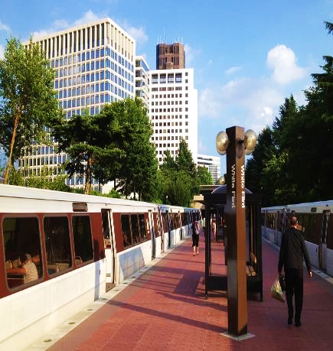

NRC UPDATE
Protecting today, tomorrow, and
cleaning up the past
FALL LLW FORUM MEETING
October 9-10, 2024
Duane White, Chief
Low-Level Waste and Projects Branch
Division of Decommissioning, Uranium
Recovery, and Waste Programs (DUWP)
Office of Nuclear Material Safety and Safeguards (NMSS)

Slide 2


Agenda
Low-Level Waste (LLW) Programmatic Assessment
Agreement State Collaboration
Rulemakings and Guidance
Radium Sites​
ADVANCE Act

Slide 3
Assessing the LLW Program
10 Tasks Identified and Ranked
Completed
#3. Updated Concentration Averaging and Encapsulation Branch Technical Position (https://www.nrc.gov/waste/llw-disposal/llw-pa/llw-btp.html)​
Ongoing High Priority Tasks
#1. and #4. Complete Integrated Low-Level Radioactive Waste Disposal (LLRWD) Rulemaking – SRM SECY-20-0098​
Future Tasks
#2. Update to the Waste Classification Tables​
#5. Finalized guidance on Alternative Disposal Requests (ADRs)-(https://www.nrc.gov/waste/llw-disposal/very-llw.html)​
#6. Published NUREG/BR-0204, Rev 3, Waste Manifest instructions https://www.nrc.gov/waste/llw-disposal/llw-pa/llw-uwm.html​
#7. Performed Very LLW Scoping Study​ SECY-21-0057
#8. Update and consolidate LLW guidance into one NUREG​
#9. Examine the need to define when radioactive material becomes LLW​
#10. Develop and implement the national waste tracking system​
3

Slide 4
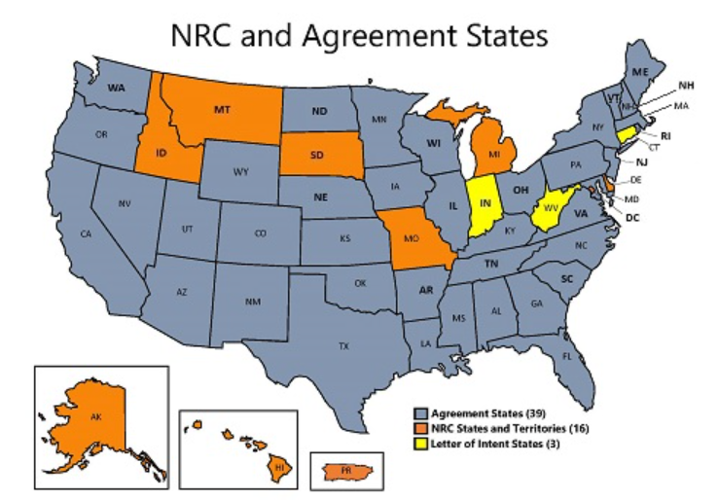
Collaborating with
Agreement States
  Integrated Materials Performance Evaluation Program - LLW
    IMPEP Completed in 2024 (Kentucky, New York Follow-up)
    Periodic Reviews in 2025 (South Carolina, Washington, Utah)

Slide 5
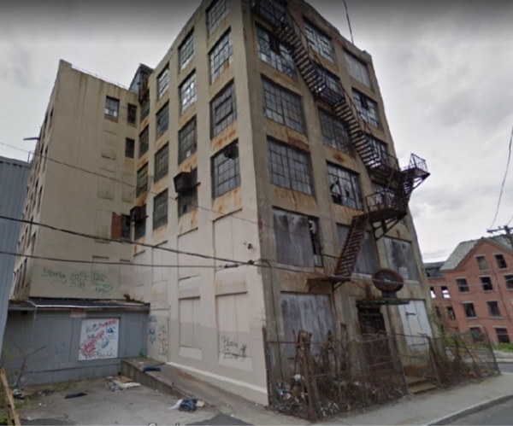
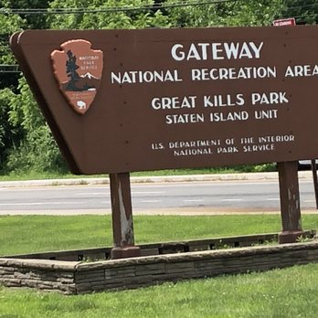
Cleaning Up Radium Sites
  Ensure unlicensed sites with discrete sources of radium or associated contamination do not pose a risk to public health and safety and the environment
  Status
  3 non-military sites remaining with residual radium activity requiring remediation.
  Monitoring or Staying Informed at 3 National Park Service and 15 Department of Defense sites under Comprehensive Environmental Response, Compensation, and Liability Act and Memorandum of Understanding
  Coordinating with other Federal agencies
  Extensive stakeholder communication and coordination – reaching out to Agreement States with radium sites
5

Slide 6
Integrated LLRWD Rulemaking
  Consolidate and integrate criteria for Greater-Than-Class C (GTCC) and 10 CFR Part 61 rulemaking
  Conduct site-specific analyses for all waste streams including depleted uranium and GTCC waste
  Include graded approach for compliance period
  Include transuranic (TRU) waste in the definition of LLW
  Address physical protection and
  criticality concerns in GTCC
  waste streams
  Provide for Agreement State licensing of certain GTCC waste streams
Integrated Rulemaking
Depleted Uranium
GTCC Waste
Site-Specific Analyses
TRU Waste

Slide 7
Integrated LLWD Rulemaking
Proposed rule package submitted to the Commission
May 29, 2024 (SECY-24-0045; ML23242A249)
Next step: Commission review and vote on the proposed rule
We are here
Develop Proposed Rule that Integrates GTCC and 10 CFR Part 61 Rulemaking
Submit to Commission for Approval
Publish Proposed Rule
Hold Public Meetings and Comment Period
Revise NUREG-2175 and Develop GTCC Guidance
Hold for Commission Approval of Proposed Rule
Publish Draft Guidance

Slide 8
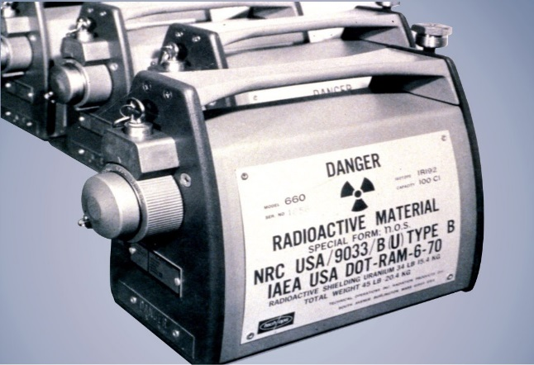
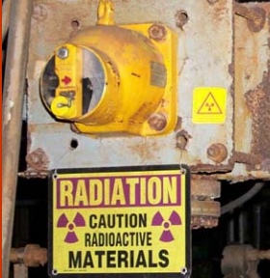
Financial Assurance for Disposition of Category 1-3 Sources Rulemaking
NRC staff preparing Regulatory Basis to expand decommissioning financial assurance (DFA) requirements for Category 1 & 2 (and possibly Category 3) byproduct material sealed sources
Current regulations in 10 CFR 30.35 do not require DFA for many licensees who possess these sources
Regulatory Basis document evaluates several potential regulatory options
Next step: issue Regulatory Basis for public comment in early 2025
Staff rulemaking plan (SECY-16-0115) submitted October 7, 2016
Commission SRM issued December 8, 2021

Slide 9
Decommissioning Rulemaking
Would implement specific regulatory requirements for different phases of the decommissioning process consistent with the reduced radiological risk. Topics include:
  Emergency preparedness
  Decommissioning funding assurance
  Environmental considerations
  Spent fuel management planning
  Record retention requirements
Final rule package submitted to the Commission January 2024 (SECY-24-0011; ML23258A200)
Next step: Commission review and vote on the final rule
Proposed rule published on March 3, 2022 (87 FR 12254)
Comment period closed on August 30, 2022

Slide 10

ADVANCE Act
Information on ADVANCE Act:
https://www.nrc.gov/about-nrc/governing-laws/advance-act.html
Contact us:
https://www.nrc.gov/about-nrc/governing-laws/advance-act/contactus.html

Slide 11






Questions/Comments
Follow @NRCgov
Information on Radioactive
Waste Program: https://www.nrc.gov/waste.html
To subscribe to e-mail updates: https://www.nrc.gov/public-involve/listserver.html#lyris
11

