Slide 1
LLRW Compact System
Low-Level Radioactive Waste Forum Meeting,
October 2024 - Reno, Nevada
Commercial Disposal of Low-Level Radioactive Waste
Daniel B. Shrum
Executive Director
Low-Level Radioactive Waste Forum

Slide 2
Agenda/Objectives
Speaker Introduction
Objective 1 – Explain why the compact system was formed and the role of the Low-Level Radioactive Waste Forum
Objective 2 – Introduce you to the current licensed compact disposal facilities and what is required to access each facility

Slide 3
Copyright Disclaimer Under Section 107 of the Copyright Act 1976
Copyright Disclaimer Under Section 107 of the Copyright Act 1976, allowance is made for “fair use” for purposes such as criticism, comment, news reporting, teaching, scholarship, and research. Fair use is permitted by copyright statute that might otherwise be infringing. Non-profit, education or personal use tips the balance in favor of fair use.

Slide 4
Speaker Introduction
Dan Shrum
BS – Engineering Geology, MS – Hydrogeology, MBA
10+ years at JMM, MWH, and Stantec
20+ years at Envirocare, EnergySolutions
5 years at Low-Level Radioactive Waste Forum
So many years, ”Gone to waste”

Slide 5
Low-Level vs High Level
There are two broad classifications:
High-level or low-level waste.
High-level waste is primarily spent fuel removed from reactors after producing electricity.
Low-level waste comes from reactor operations and from medical, academic, industrial and other commercial uses of radioactive materials.
Both are defined by regulation.
NRC.gov

Slide 6

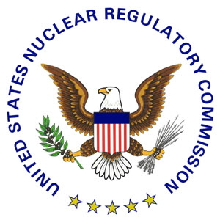

The Need for regulation (AEA)
Law on civilian & military uses of nuclear materials
  Amendment to the Atomic Energy Act of 1946
Established the Atomic Energy Commission (AEC)
  Promote atomic energy for peaceful purposes
U.S. Nuclear Regulatory Commission replaced AEC
AEC's environmental standards transferred to EPA
AEA covers the laws for the development, regulation, & disposal of nuclear materials and facilities

Slide 7
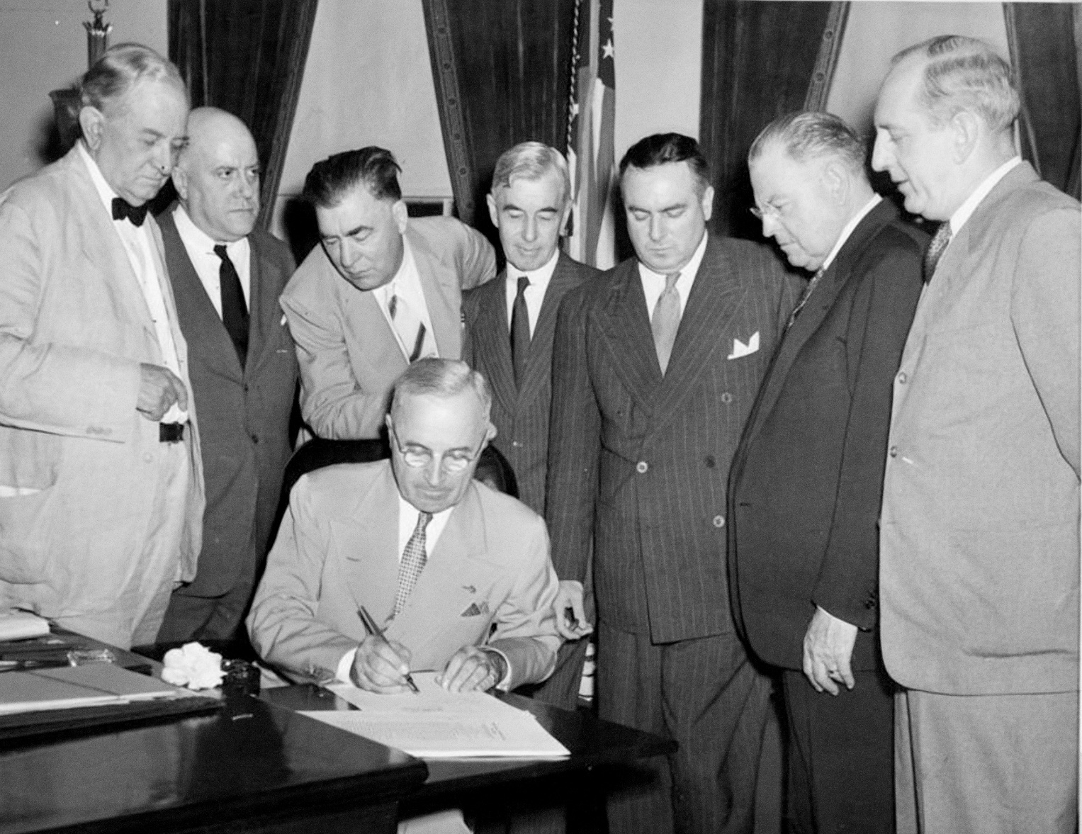
Atomic Energy Act
Public Domain Photo

Slide 8
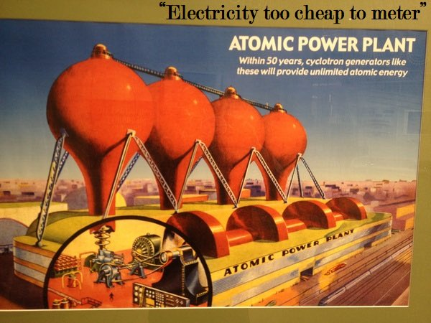
Atomic Energy Age
Public Domain Photo

Slide 10
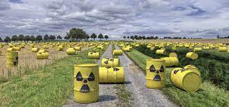
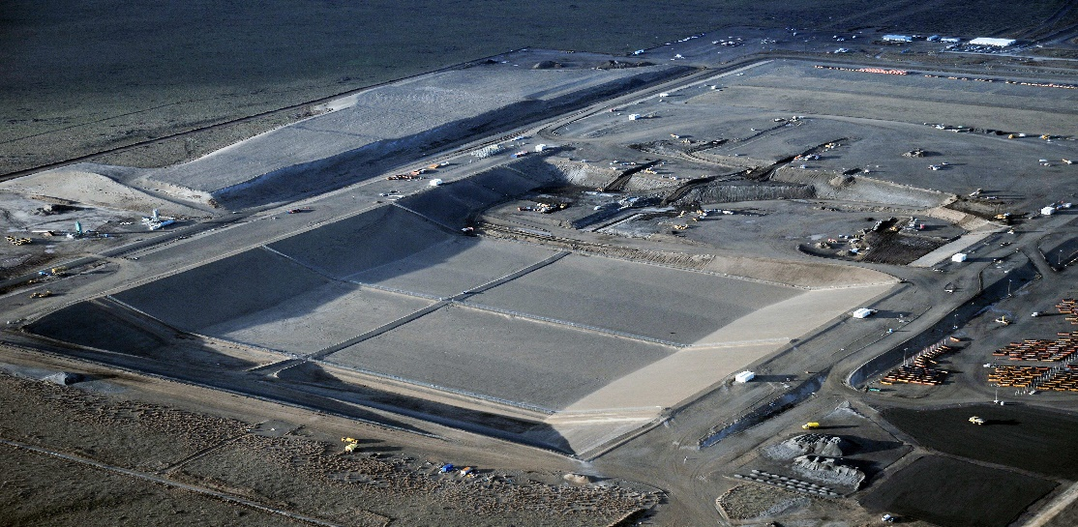
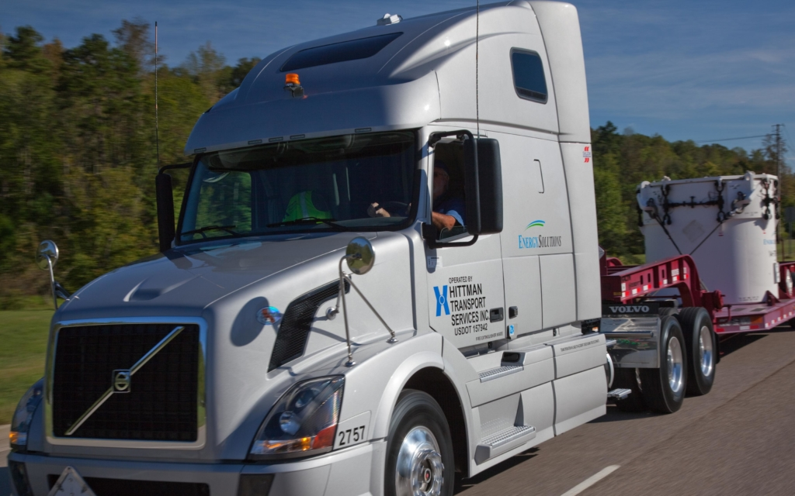
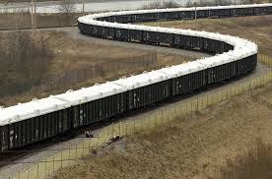
Nuclear Power Produces Waste
Public Domain Photos

Slide 11
You have a package of Low-Level waste – Now What?
Store on Site (decay in storage)
Send to a Broker/Processor
Send directly to a disposal facility
Develop your own on-site disposal facility
These are all regulated activities – some have multiple regulatory bodies and stakeholders
We will focus on sending waste to a disposal facility in the United States. Most other countries have government developed disposal facilities.

Slide 12
Early 1940’s and 1950’s
1940s and 1950s
LLW was buried in shallow landfills without liners or dumped into the ocean
1959
The United States Public Health Service (USPHS) and the US Coast Guard developed a method for burying waste in the deep sea, about 90 miles east of Norfolk, to avoid interfering with fishing and beach access

Slide 13
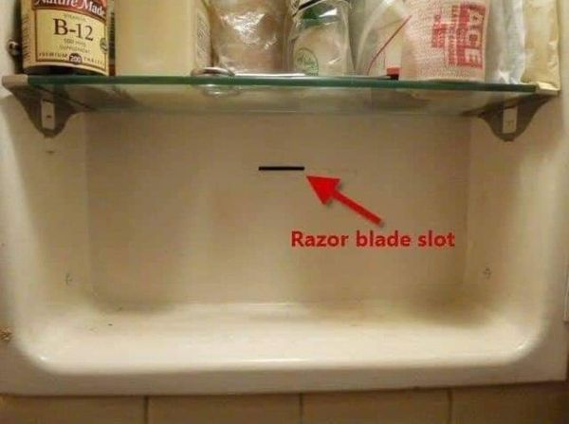
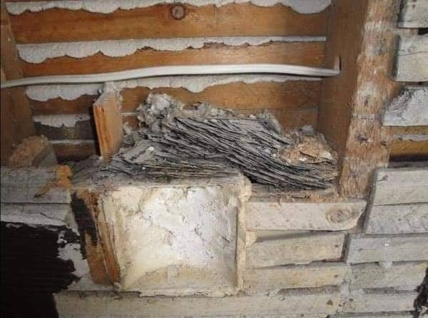
Unrelated (but related)

Slide 14
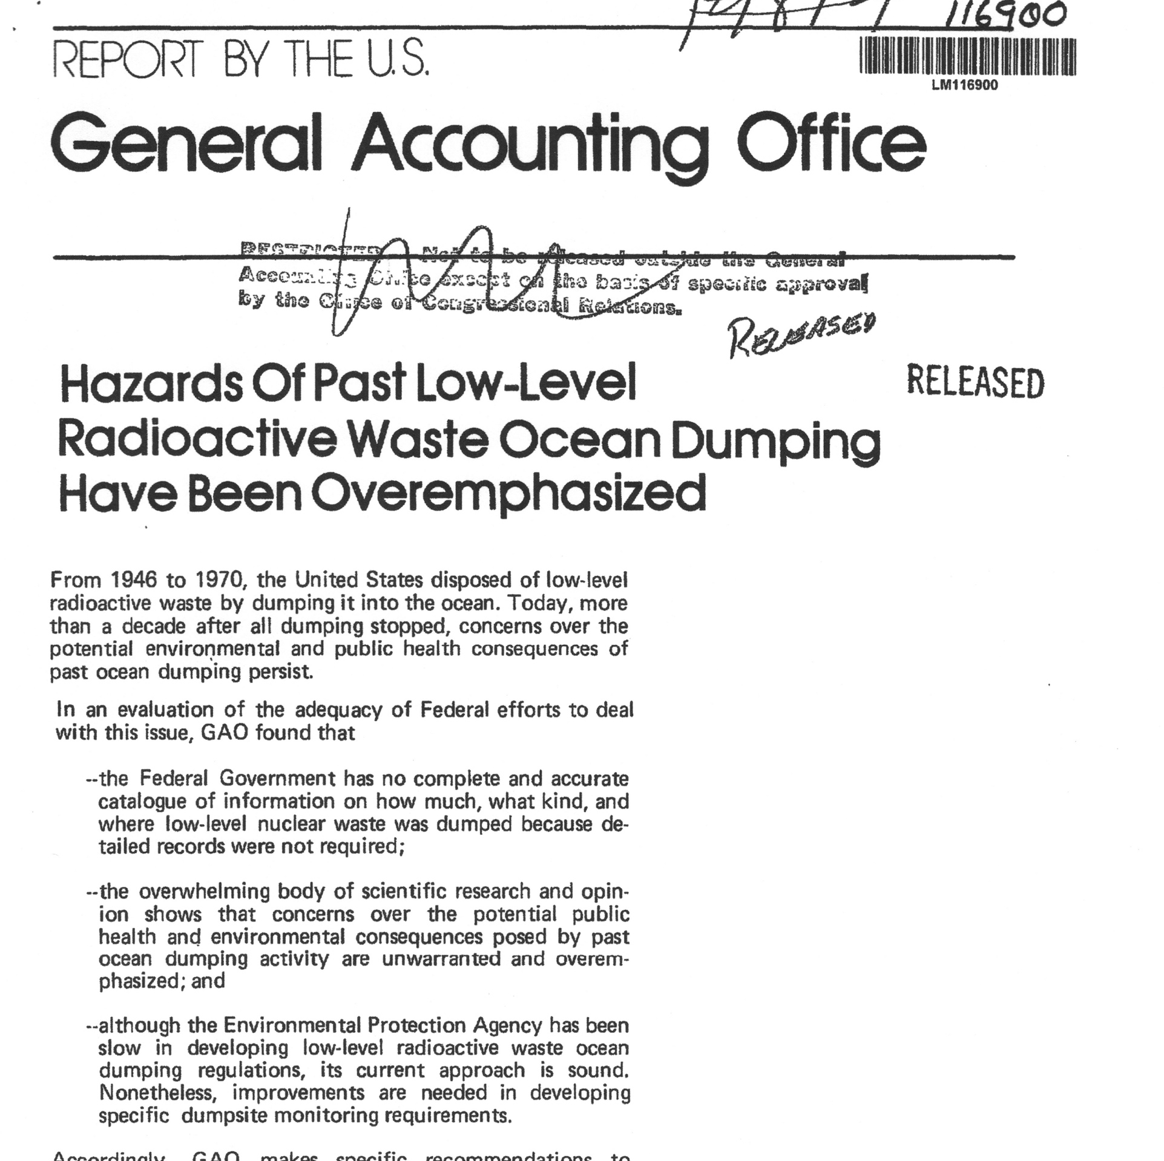
Ocean Disposal (1946-1970)

Slide 15
1960s and 1970s shallow land burial
Five Operating Disposal Sites
Richland (1964 to present)
Barnwell (1971 to present)
Beatty (1962-1992)
Maxey Flats (1963-1977)
Sheffield (1967-1978)

Slide 16
Beatty
Operated from 1962-1992 by US Ecology
7 million cubic feet of material were disposed – closed in 1992 following closure plan
1997 – site turned over to the State of Nevada
October 2015 incident – managed by State of Nevada with US Ecology assistance

Slide 17
Maxey Flats
Operated from 1963-1977 by the Commonwealth of Kentucky
4.7 million cubic feet of material were disposed, 2.4 million curies of byproduct material, and 431 kilograms of special nuclear material (plutonium and enriched uranium)
1987 to 1991 a Remedial Investigation/Feasibility Study was conducted
Record of Decision signed in 1991 - Final Closure Period construction was completed in September 2017 and the permanent surface water controls are functioning as designed

Slide 18
Sheffield
Operated from 1967-1978 by Nuclear Engineering Co. (later became U.S. Ecology)
3.2 million cubic feet of material were disposed – 21 earthen trenches
1975 - NECO proposes three expansion scenarios; studies suggested to study non-radioactive and radioactive disposal sites, ISGS finds trench 18 has water flowing into it and deems trench 18 unsuitable – NECO proposes fill and compact strategy

Slide 19
Sheffield
1976 - NECO applies to NRC to expand from 20-188 acres; monitoring wells shown to have detectable levels of tritium, all space meeting IDPH requirements is full, disposal in Trench 14 and 14A using fill and compact – more wells installed
1977 – 12 more wells installed with detectable tritium – NECO applies for more disposal trenches
1978 – Sheffield LLRWDF closes, USGS studies tritium plume

Slide 20
Sheffield
1979 - NECO attempts to terminate license and abandon site; trench cap collapses,
1988 – Sheffield agreed order signed
1989 – US Ecology constructs new covers
1990 – tritium exits Trout Lake and buffer zone boundary – Signaling event
Sheffield monitoring program continues

Slide 21
Meanwhile, back in the Beltway
1976 - the GAO published a report that reviewed existing private and Federal LLW disposal practices in light of the reported operational and performance irregularities identified at some disposal sites
1977 - In parallel to the GAO review, the NRC had formed a task force to examine Federal and Agreement State programs that regulated commercial LLW disposal. Among other things, the task force recommended that the NRC “accelerate” the development of its LLW regulatory program. Shortly thereafter, the NRC published a program plan that described the elements and schedules for implementing an integrated LLW program. This program plan included the development of an EIS and a yet-tobe-defined LLW regulation

Slide 22
Meanwhile, back in the Beltway
1982 - Following several years of development, the Commission issued a final 10 CFR Part 61 rule in December 1982. The “ umbrella” regulation covered all phases of shallow, near-surface LLW disposal from site selection through facility design, licensing, operations, closure, and postclosure stabilization to the period when active institutional controls end. The regulation requires the use of engineered features in concert with the natural characteristics of the disposal site to contain and isolate the wastes.

Slide 23


Why do we have a Compact System?
There were three operating facilities for disposal Beatty, NV; Barnwell, SC; and Richland, WA. In 1979, the governors of the three existing facilities testified in a subcommittee of Congress that they could not bear all the responsibility of LLRW disposal
OR

Slide 24
Low Level Radioactive Waste Policy Act 1980 (85)
The federal legislation of 1980, and the subsequent Low-Level Radioactive Waste Policy Amendments Act of 1985, were endorsed by the Governors of the 50 states
The purpose of the LLRWPA was to provide for more LLRW disposal capacity and to distribute obligation for disposal on a state or regional basis
This legislation gives states the responsibility to provide for disposal of commercial low-level radioactive waste and encourages states to form interstate agreements, or compacts, to cooperatively implement the law
Regional disposal is safest and most efficient

Slide 25
Low Level Radioactive Waste Policy Act 1980 (85)
State legislatures and US Congress approve of each compact. Each compact is responsible for all the waste generated in their compact and for developing a disposal site. One state volunteers to be the host state for the LLRW disposal facility
The Commerce Clause gives Congress the authority to regulate interstate commerce — the LLRWPA gave compacts authority to exclude waste from a compact’s disposal facility
“To regulate commerce with foreign nations, and among the several states, and with the Indian tribes;”, US Constitution, Article 1, Section 8, Clause 3

Slide 26
Compacts
Commissions manage the compacts. The authority of licensing and regulation of a facility is given by the NRC to the state.
Regulations are found in Code of Federal Regulations under “Energy” in Chapter 1 of Title 10- Parts 61 and 62. This authority comes from Section 274 of the Atomic Energy Act of 1952- where the NRC gives up portions of its regulatory power to agreement states.
The EPA, Department of Transportation, and the Department of Health and Human Services also partly regulate LLRW.

Slide 27
Developing New Sites within Compacts
Texas, Nebraska, California, Pennsylvania and Illinois submitted applications to construct and operate new facilities. Only California was successful (Ward Valley), but ultimately failed. All siting and licensing efforts have failed except Texas who failed (Sierra Blanca) and then reapplied (Andrews). Over $1 Billion was spent trying to develop failed sites
Clive, Utah opened in 1987 to dispose naturally occurring radioactive materials (not discussed under LLRWPA). The facility altered intake over the years to eventually take Class A, Mixed Waste and 11e.(2) mill tailings
Andrews Texas facility took 16 years and $500 million to complete (after an additional 16 years and $55 million were spent by the state of Texas in failed efforts to open a facility
Both the Clive and Andrews Texas facility were developed by private entities who could make disposal economically viable

Slide 28
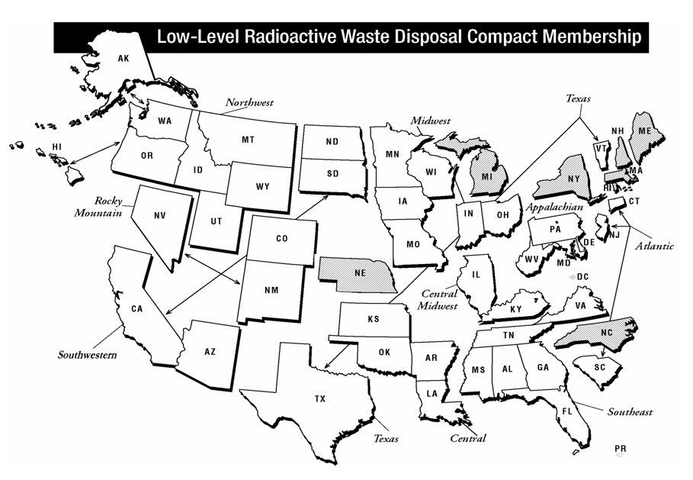
Current Compact Geography
From NRC.gov

Slide 29

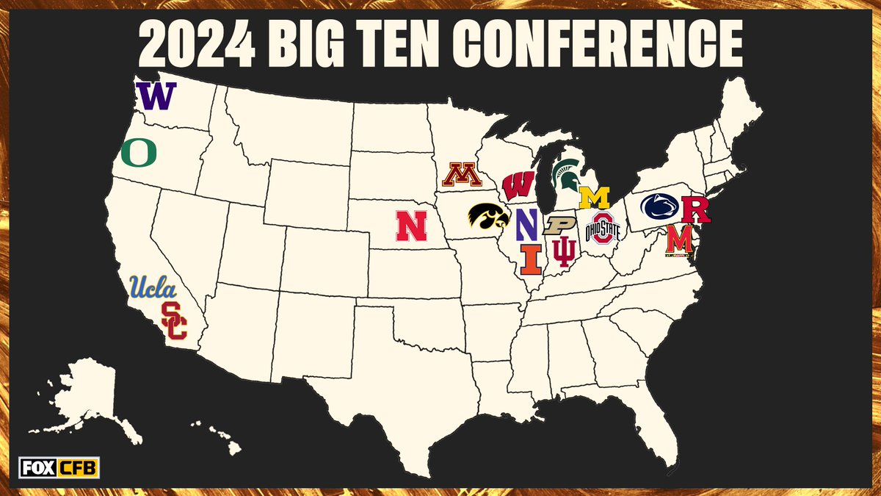
Map of the 18 schools
From Fox website

Slide 30
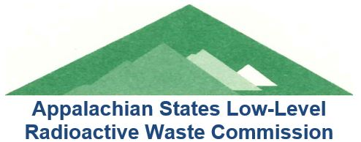
Beaver Valley 1 and 2
Hope Creek 1
Limerick 1 and 2
Peach Bottom 2 and 3
Salem 1 and 2
Susquehanna 1 and 2

Slide 31
Calvert Cliffs 1 and 2
Millstone 2 and 2
Oconee 1, 2, and 2
Robinson 2
Summer

Slide 32
Arkansas Nuclear 1 and 2
Browns Ferry 1, 2 and 3
River Bend 1
Waterford 3
Wolf Creek 1

Slide 33
Braidwood 1 and 2
Byron 1 and 2
Clinton
Dresden 2 and 3
La Salle 1 and 2
Quad Cities 1 and 2

Slide 34
Callaway
Davis-Besse
Fermi 2
Monticello
Perry 1
Point Beach 1 and 2
Prairie Island 1 and 2

Slide 35
Columbia Generating Station

Slide 36
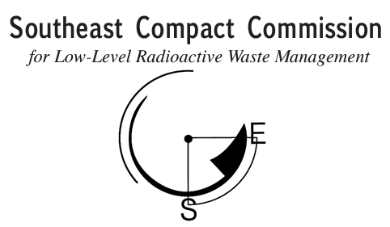
Farley 1 and 2
Grand Gulf 1
Hatch 1 and 2
North Anna 1 and 2
Saint Lucie 1 and 2
Sequoyah 1 and 2
Surry 1 and 2
Turkey Point 3 and 4
Vogtle 1, 2, and 3
Watts Bar 1 and 2

Slide 37
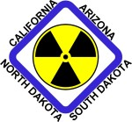
Diablo Canyon 1 and 2
Palo Verde 1, 2, and 3

Slide 38
Comanche Peak 1 and 2
South Texas 1 and 2

Slide 39
Unaffiliated States
Brunswick 1 and 2, North Carolina
Catawba 1 and 2, North Carolina
Cooper, Nebraska
DC Cook 1 and 2, Michigan
FitzPatrick, New York
Ginna, New York
McGuire 1 and 2, North Carolina
Nine Mile Point 1 and 2, New York
Seabrook, New Hampshire
Shearon Harris 1, North Carolina

Slide 40
LLRW Forum
In 2001, the Low-Level Radioactive Waste Forum became an independent nonprofit organization— the Low-Level Radioactive Waste Forum, Inc.
The LLW Forum is committed to fiscal transparency and provides up-to-date documents on its summary of assets and budget projections.

Slide 41
LLRW Forum Mission
To facilitate the implementation of the Low-Level Radioactive Waste Policy Act by serving as the consolidated voice and face for the compacts and states.
As the consolidated voice, we promote the safe and efficient disposal of Low-Level Radioactive Waste by working with a broad spectrum of key stakeholders including regulators, policy makers, the public, and industry to develop national policy that anticipates and resolves problems.

Slide 42


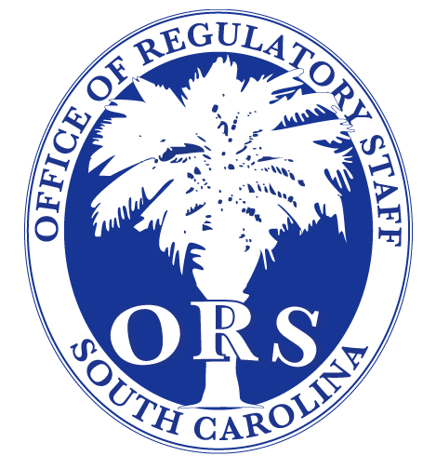
Four States

Slide 43
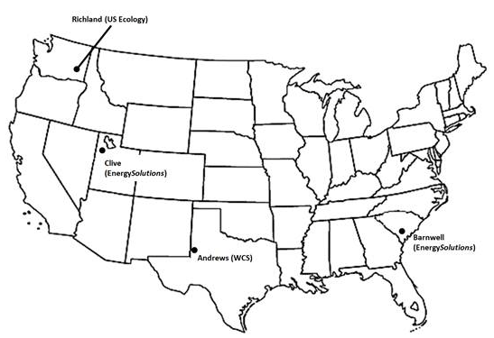
Licensed Commercial LLRW Disposal Facilities
From NRC.gov

Slide 44
Barnwell Disposal Facility
235 acres licensed for disposal
123 acres in closed condition
16 acres available for future disposal (900,000 cu ft)
96 acres for other uses
28.4 million cubic feet buried since 1971
14.4 million curies buried
~3.1 million curies remaining (decay correction)
Slides courtesy of EnergySolutions

Slide 45
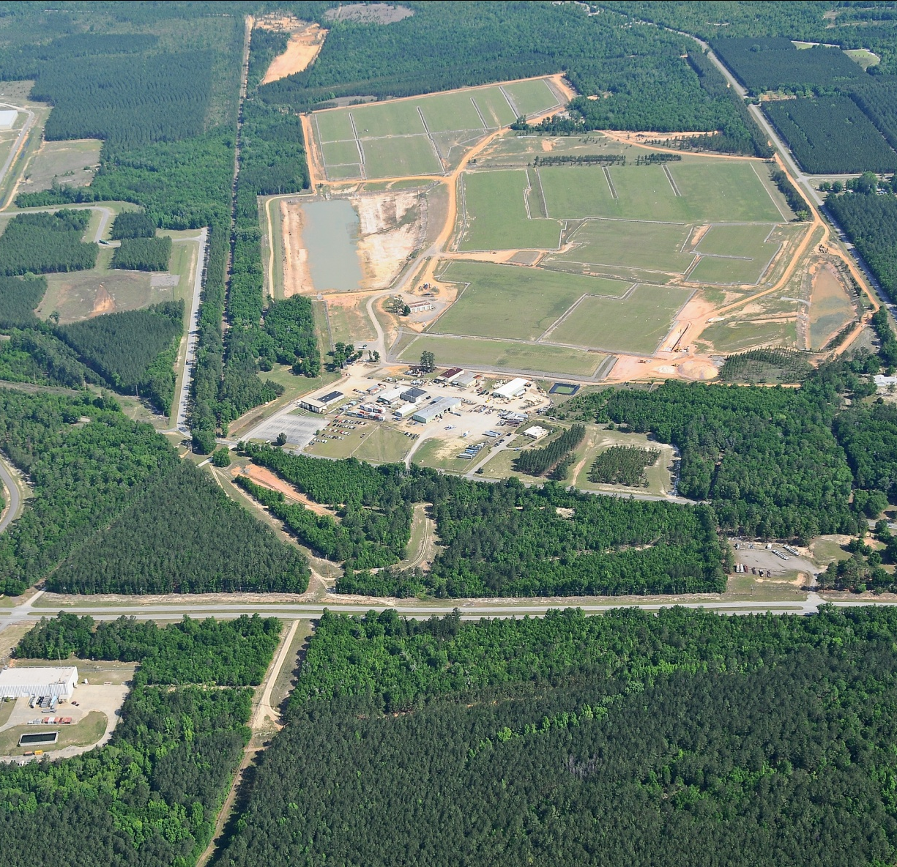
Barnwell Disposal Facility
2000 Atlantic Compact Act
Atlantic Compact only operations started July 1, 2008 after 8 year transition
Receive about 9,000 cubic feet average yearly volume (excluding large component and IH volume)
Average 60-70 containerized (only) shipments per year

Slide 46
Barnwell Disposal Facility
Only waste from Member States permitted
Membership
  South Carolina
  New Jersey
  Connecticut
No restriction on exporting waste from Atlantic Compact

Slide 47
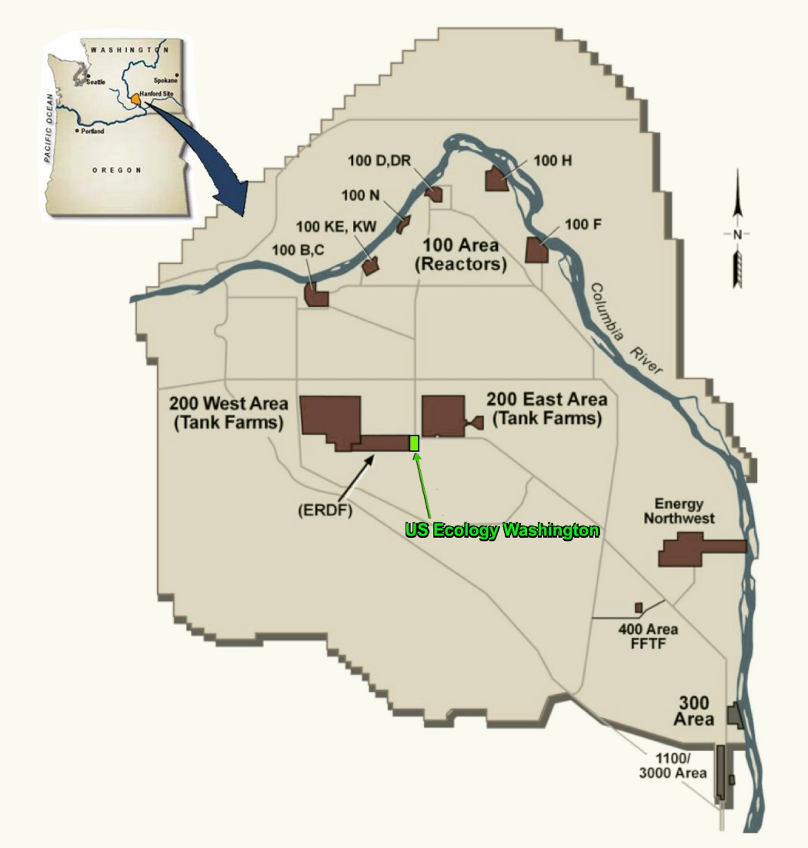
Richland Disposal Facility
Part 61 LLRW Facility
Located on 100 acres within the DOE Hanford Reservation near Richland, WA
Originally Licensed in 1965
Slides courtesy of US Ecology

Slide 48
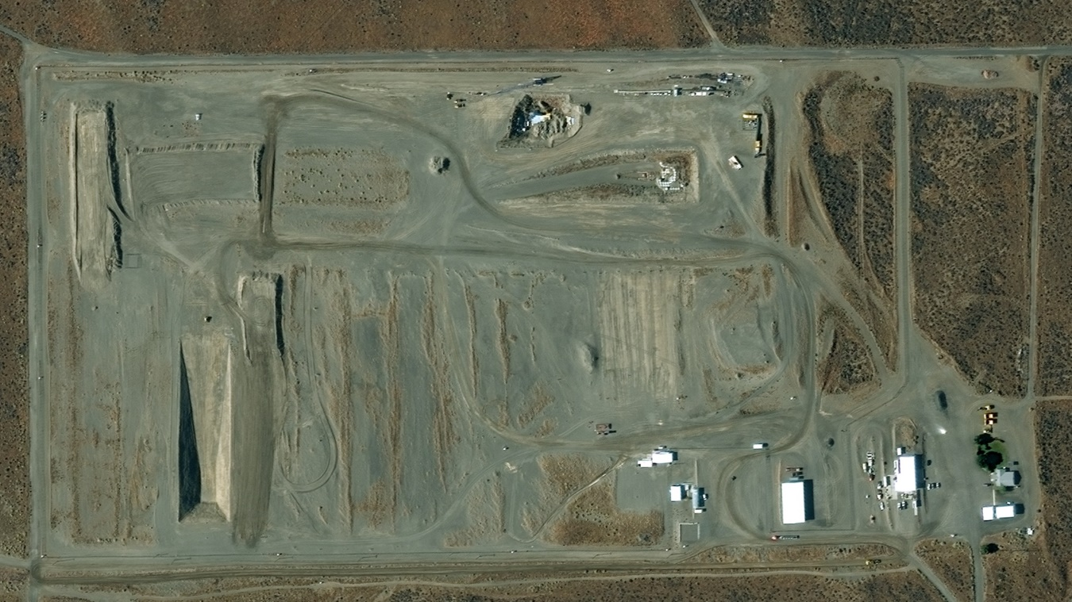
Richland Disposal Facility
Designated NWIC Facility (Accessible to 11 states in NW & RM Compacts - January 1, 1993)
Operates through sublease agreement with State of WA
Rate-regulated by WA Utility & Transportation Commission

Slide 49
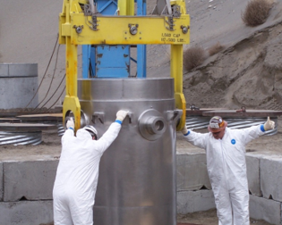
Richland Disposal Facility
Class A, B and C LLRW in the Northwest and Rocky Mountain Compacts
NORM/TENORM/NARM acceptable from generators nationwide
High-activity sealed source capabilities
All waste arrives by truck
5,000 to 7,000 CF disposed per year + Waste to RCRA facility in Idaho

Slide 50
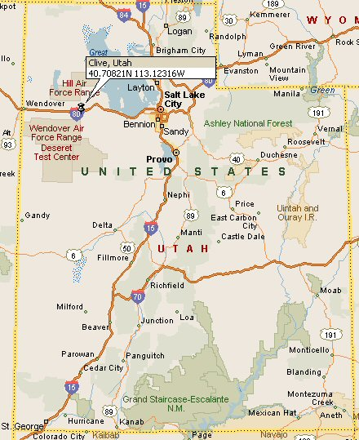
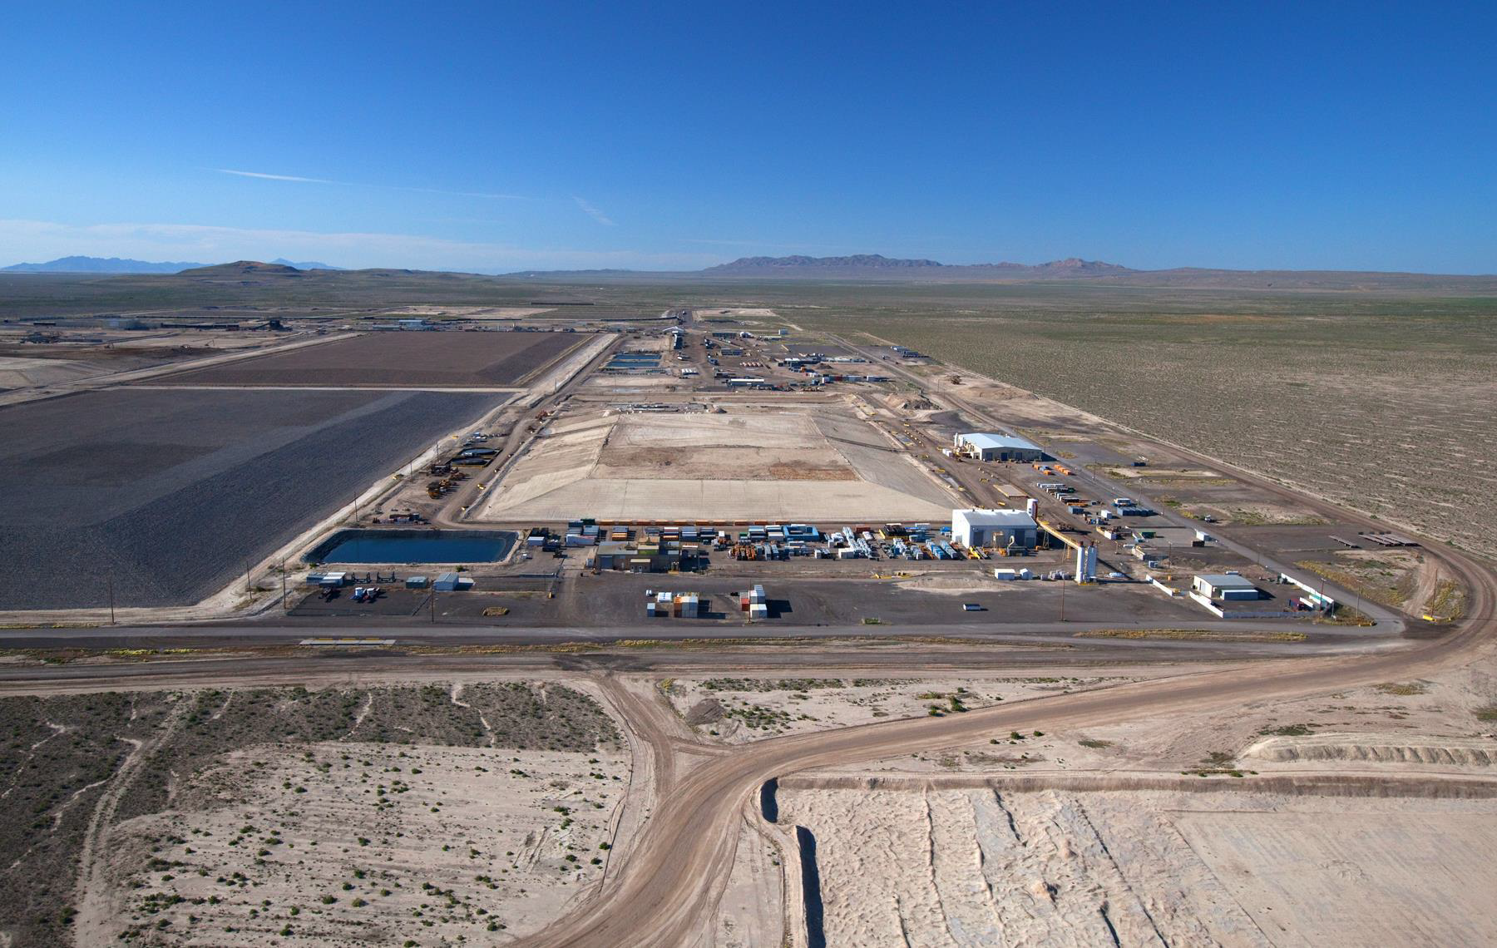
Clive Disposal Facility
Not a compact facility
640 acres of licensed space
Class A waste from all compacts with prior export approval
Mixed waste from all compacts with prior export approval
1 M to 13 M CF per year
Slides courtesy of EnergySolutions

Slide 51
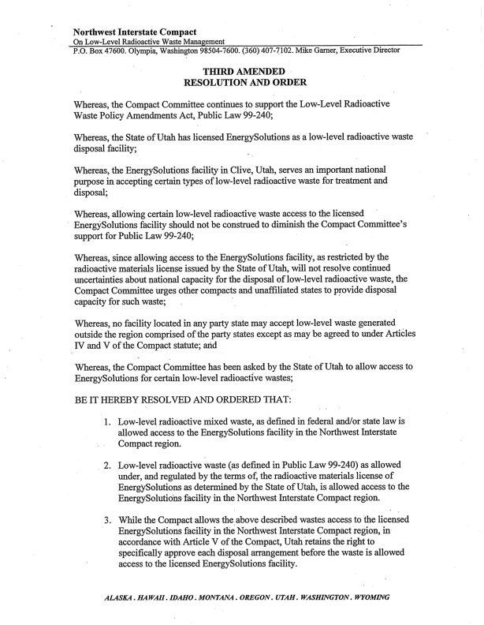
Clive Disposal Facility
Third Amended Resolution and Order

Slide 52

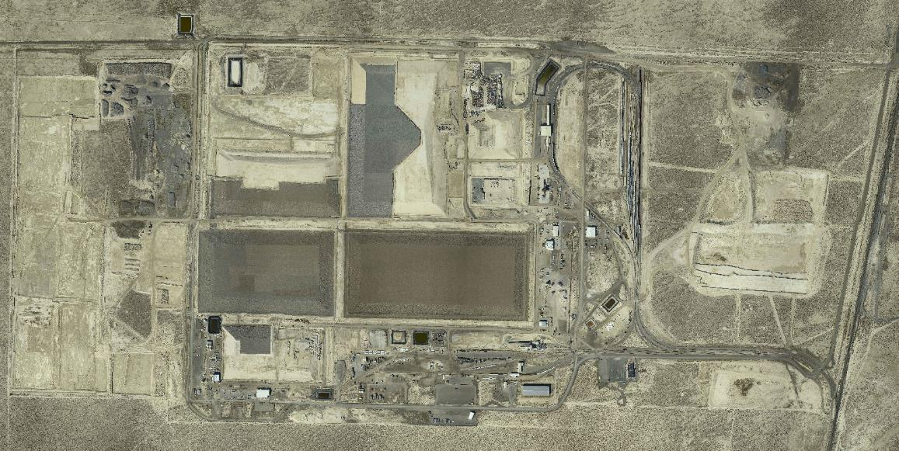
Clive Disposal Facility
Section 31
Section 30
Section 5
Section 32
Section 29
Federal Cell
(under licensing)
Low Activity South
(under licensing)
Class A West
CRF
11e.(2)
VITRO
Dept. of Energy
Radioactive Disposal
from Salt Lake County
(Closed)
LARW
(Closed)
Mixed
Waste
Container
Handling

Slide 53
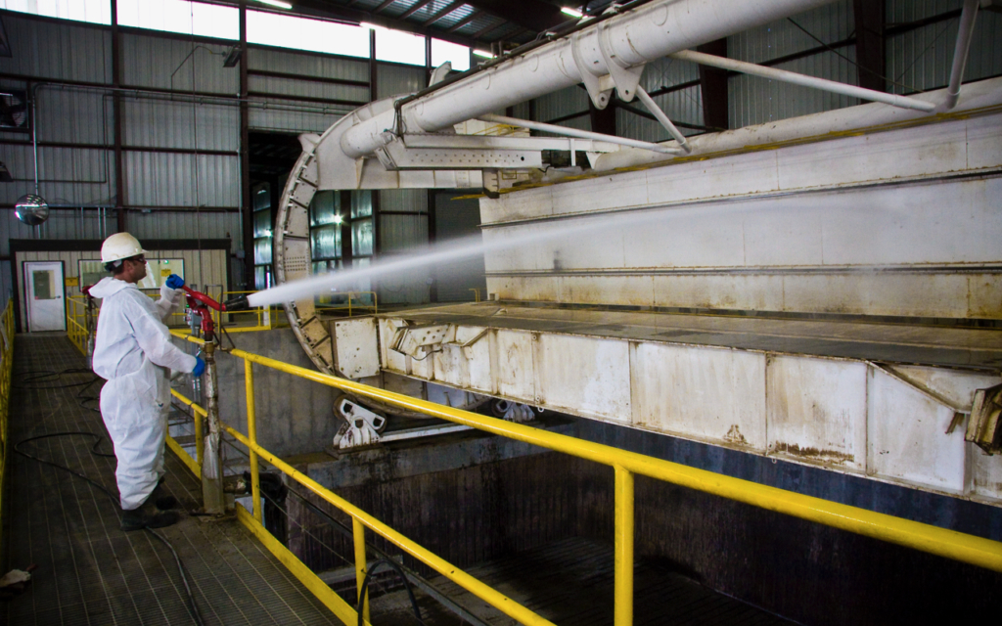
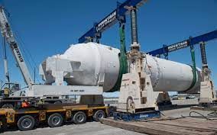
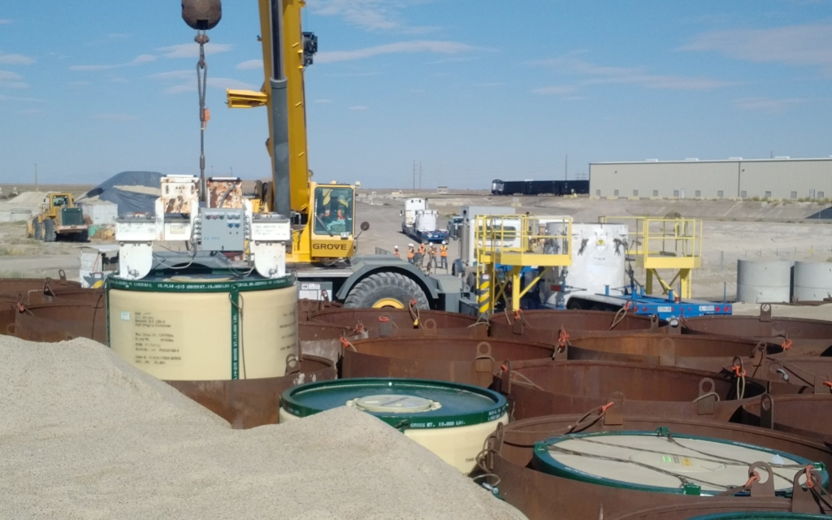
Clive Disposal Facility

Slide 54
Clive Disposal Facility

Slide 55
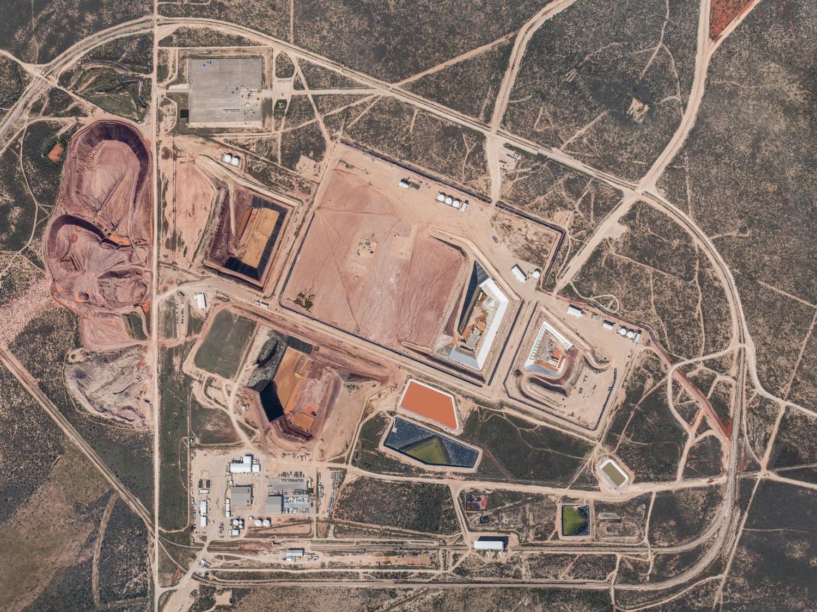
WCS Disposal Facility
14,000 acres (licensed/permitted area is 1,400 acres)
4 landfills, treatment facilities, rail access
Slides courtesy of WCS

Slide 56
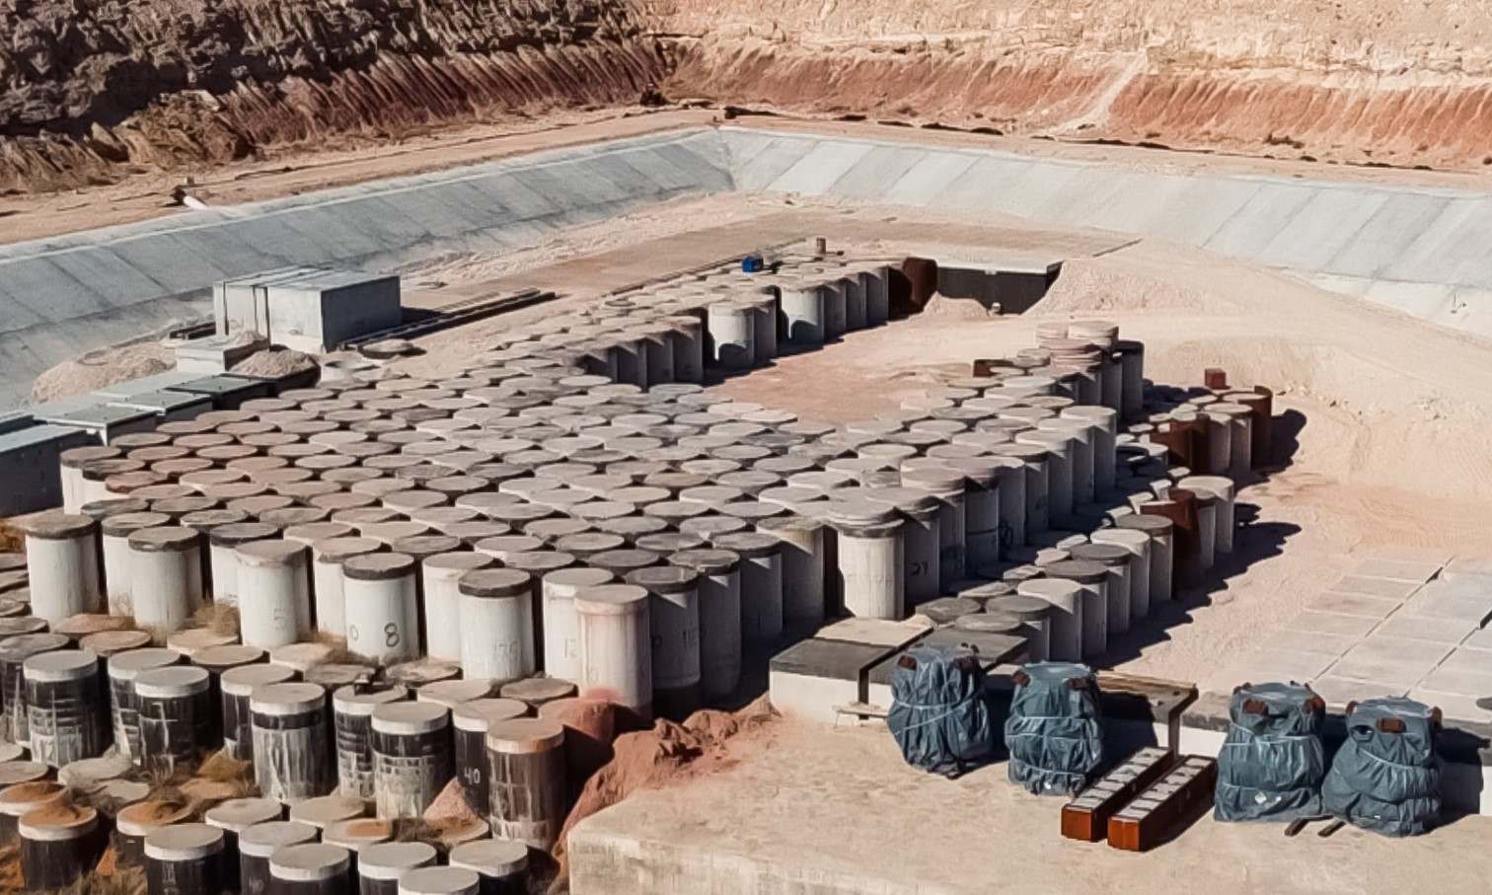
WCS Compact Waste Facility
Texas owned
Privately-developed and operated
Regulated by TCEQ (2 on-site inspectors)
Opened in 2012

Slide 57
WCS Disposal Facility
The WCS facility is licensed for LLRW disposal by Texas
  The Texas regulator is the Texas Commission on Environmental Quality (TCEQ)
  Texas has title to the Compact Waste Facility and will take over long-term monitoring following closure
  DOE will take title to the Byproduct Facility and the Federal Waste Facility following closure
Texas Low-Level Radioactive Waste Disposal Compact
  Texas is part of the Texas Low-Level Radioactive Waste Disposal Compact (TLLRWDC) established under the THSC §403.006 and Texas Low-Level Radioactive Waste Disposal Compact Consent Act, Public Law Number 105-236 (1998)

Slide 58
WCS Disposal Facility
Texas Low-Level Radioactive Waste Disposal Compact Commission
  Issues agreements to import waste into the Texas/Vermont compact
  Small fee to issue an agreement
  Issues agreement to export waste outside of the Texas/Vermont Compact
  Averaging 23,000 CF per year + Waste at RCRA facility

Slide 59
Summary
Compacts exist for a reason – NIMBY is real as is exhaustion
Argument of whether or not they compacts have been successful – South Carolina, Nevada, and Washington believe they are
Four operating sites – all in agreement states
Ten Compacts – all with slightly different requirements
On-going debate on the authority compacts have with regard to waste going to unlicensed facilities

Slide 60
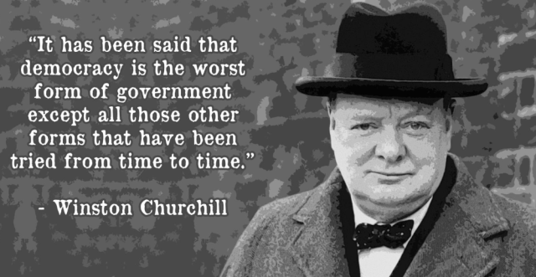
Summary

Slide 61
Thank You
Daniel B. Shrum
Executive Director
Low-Level Radioactive Waste Forum
llwforum.org

