Slide 1
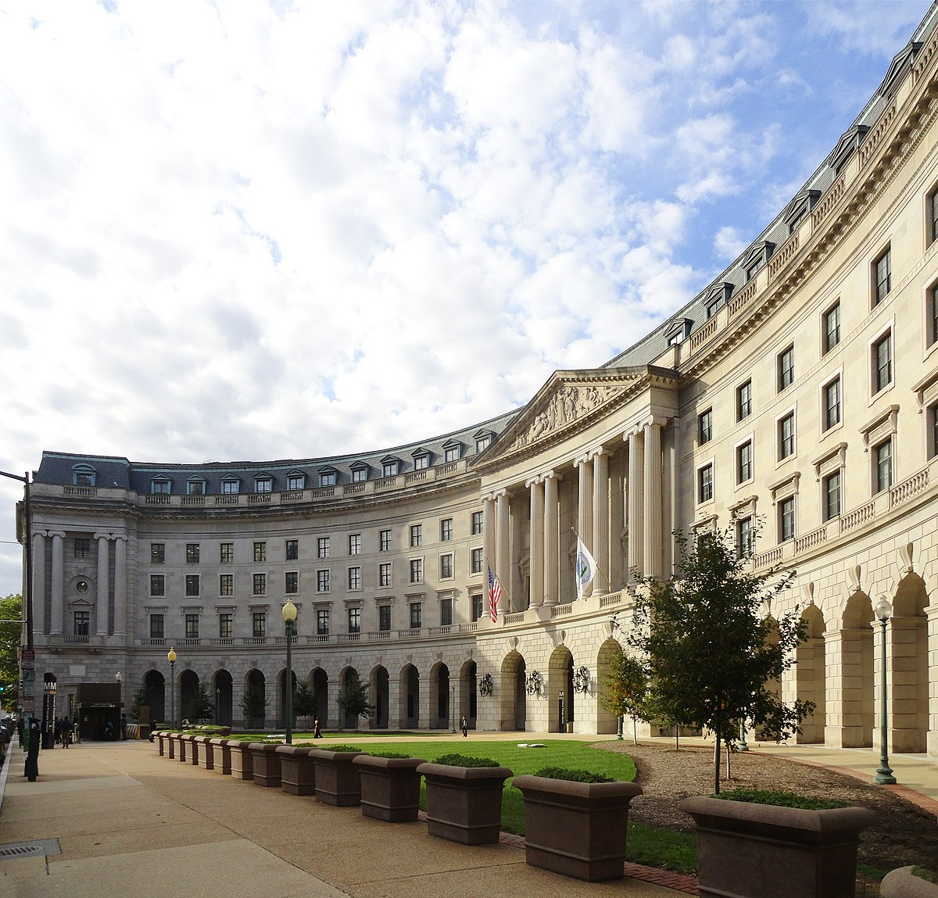
EPA Update
LLW Forum Fall Meeting
Reno, Nevada
Dan Schultheisz, EPA Office of Radiation and Indoor Air
October 10, 2024

Slide 2
Overview of Presentation
Phosphogypsum
Waste Isolation Pilot Plant (WIPP)
INEX-6
Other EPA Activities
  Multi-Agency Radiation Site Survey and Investigation Manual (MARSSIM)
  Federal Guidance
Ukraine

Slide 3
Phosphogypsum Update
On October 1, EPA signed a pending approval to allow Mosaic, LLC to use phosphogypsum in a test road at its New Wales facility in Polk County, Florida
  Segments constructed using different mixtures of phosphogypsum and other materials
  Groundwater monitoring will be conducted
EPA will publish a Federal Register notice opening a 30-day public comment period
Florida DEP approval also needed for this project
Florida DOT will use this project to inform its study under 2023 legislation
All material submitted to EPA to date is available on EPA’s Phosphogypsum webpage

Slide 4
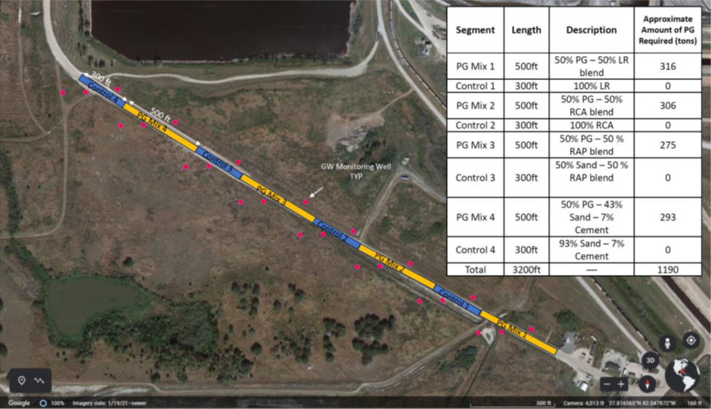
Phosphogypsum
Mosaic pilot road study

Slide 5
WIPP Planned Change Request
Modification of the repository design from 10 to 12 Waste Panels
On March 14th, DOE submitted to EPA a Planned Change Request (PCR) per 40 CFR 194.4(b)(3) to modify the repository design from 10 to 12 Waste Panels
To account for the Land Withdrawal Act waste emplacement volume lost to the radiological event in 2014, DOE has submitted a repository design that adds two new waste panels (11 and 12) to the west of the current footprint
EPA has submitted seven sets of technical questions to DOE
EPA conducted informal public outreach in late August in Carlsbad and Santa Fe
  Public interest groups and individuals, county commissioners, Congressional staff
  Recordings of Zoom meetings will be available on EPA’s WIPP website
  Public comment period ended September 16 but will be extended/reopened

Slide 6
DOE Planned Change Request
DOE proposes adding Panels 11 and 12 to replace space lost from abandoning Panel 9, and losing portions of Panels 1, and 7
  Panels 11 and 12 design are similar to Panels 1 through 8
  DOE is expanding the repository footprint into a new area not covered in the original certification
New Mexico Environment Department has approved the two new panels in the hazardous waste permit
DOE anticipates the need for additional panels in the future
10
9

Slide 7
INEX-6 Exercise (1 of 3)
The week of March 18th, 2024, EPA led a multi-agency national tabletop exercise under the NEA International Nuclear Emergency Exercise (INEX) series. This is the 7th iteration of the exercise, and the first one that the US has participated in recently
The focus of the exercise was on planning and preparedness for the transition and/or the late-stage recovery phases after a nuclear or radiological accident
  Testing the Framework for Recovery Preparedness
  Nature and location of the incident were left to each country to define
27 countries participated in the exercise
  US shared information with the UK and Canada on some aspects of the exercise

Slide 8
INEX-6 (2 of 3)
Modules and Themes
Four modules were conducted over 3 days:
  Health Impacts
  Food Safety
  Remediation and Decontamination
  Radioactive Waste Management
Remediation and Decontamination Themes
  Regulatory/policy framework
  Remediation goals and remedial actions
  Implementation of remedial actions
Waste Management Themes
  Regulatory/Policy Framework
  Transport
  Temporary Storage
  Disposal Routes

Slide 9
INEX-6 (3 of 3)
Participants and Next Steps
Participants in the waste management module covered a broad range of organizations
  Federal agencies (CDC, DHS, DOT, FEMA, USDA)
  States (CA, IL, MD, MN, OH, SC, VT, WA)
  Local (numerous county or municipal)
NEA Working Party on Nuclear Emergency Matters will evaluate results from different countries in late October and plan next steps
Looking farther out, Cobalt Magnet 2025 (CM-25) will take place March 14-21, 2025
  Scenario is a power plant accident in Michigan that impacts Canada
  Indiana and Ohio will also be principal players
  Follow-on recovery tabletop planned for May

Slide 10
Other EPA Activities
MARSSIM Version 2 revisions nearly complete
  Anticipate release early 2025
  Short introductory video in production
  Workshops and training in development
Federal Guidance
  FGR-16 in Science Advisory Board (SAB) review
    3-day meeting with SAB held May 29-31
    Anticipate panel report with comments by end of year
  FGR-15 (external exposures) update nearly complete
    Addressing some calculational and data issues
    Anticipate revised report release by end of year

Slide 11
Ukraine
Situation is generally stable
  All six reactors remain in cold shutdown at Zaporizhzhia NPP
  Continuing threats from shelling and drones to external power, cooling water, cooling towers
  Other Ukraine NPPs in operation save for refueling outages
Initial concerns about Kursk NPP in Russian territory eased
Ukraine letter to IAEA regarding Joint Convention

Slide 12
Questions?
https://www.epa.gov/radiation

