Slide 1

Overview of the LLW Forum’s
Disused Sources Working Group
Michael Klebe
October 10, 2024

Slide 2
DSWG Current Membership
Members:
Joseph Klinger, CMCC – Chair Earl Fordham, WA
Rich Janati, PA John Williamson, FL
Larry Kellum, UT Michael Kurth, US Army
Dane Blakinger, WA Tom Hansen, SECC
Organizational Liaisons
  Craig Little, HPS Augustinus Ong, OAS
  Mike Snee, CRCPD
Staff
Dan Shrum Michael Klebe Cecilia Snyder

Slide 3
Disused Sources Working Group Origin
DSWG formed in 2011 at the request of the NNSA/GTRI to address the problem of disused radioactive sealed sources
  Approximately 2 million sealed sources in use
  Tens of thousands disused sources with no exact knowledge of number, activity, and storage security

Slide 4
Disused Source Problem Contributing Factors
Life-cycle costs for managing and disposing of sources not internalized
Inconsistent view of which sources pose a security threat
Regulatory system inadequacies for a post-9/11 threat environment
No financial incentive for reuse, recycle, or disposal
Opportunities for recycling and reusing sources are underutilized
Type B shipping container availability and cost

Slide 5
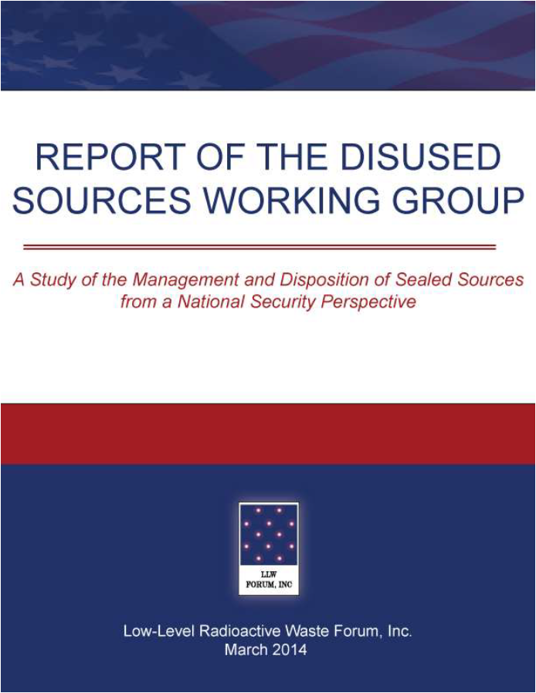
DSWG Report
Report published – March 2014
24 recommendations for improving the security of sealed sources
Several recommendations have been completed
Currently revising the priority of the remaining recommendations
Notes:
19 meetings
30 months
Stakeholder engagement
Report preparation
Technical Review
Report published – March 2014
24 recommendations for improving the security of sealed sources

Slide 6
National Source Tracking System
The NSTS is a secure user-friendly web-based database designed to track Category 1 and 2 radioactive sources.
Tracking spans the life cycle of the source from manufacture through shipment receipt, decay and burial.
About 1,300 licensees began reporting Cat 1 and 2 sources in January 2009

Slide 7
National Source Tracking System
In 2008, NRC proposed to add Cat 3 sources to NSTS. Failed on a 2-2 Commission vote.
DSWG’s 2014 report recommended adding Cat 3 sources to the NSTS.
  #5 –The NRC should expand the NSTS to track Category 3 sources.
Response received from Agreement States has been the effort is not worth the return without any quantification of the effort involved.

Slide 8
Pilot Study for Adding Cat 3 Sources to NSTS
DSWG is seeking an Agreement State program partner to evaluate the level of effort associated with adding Cat 3 sources.
Revised scope of work
  Single phase
  Clearly articulated deliverables
Funding

Slide 9
Pilot Study Scope of Work
Identify licensees (SL & GL) who possess Cat 3 sources
Develop an informational campaign to educate and inform licensees of reporting requirements
Develop draft regulation to require reporting Cat 3 sources

Slide 10
Pilot Study Deliverables – Task 1
No-name list of entities possessing Cat 3 sources
  Industry sector
  Whether they already report Cat 1 and/or 2 sources
Document describing the process used
Identification of personnel resources used in identifying persons possessing Cat 3 sources (staff hours)
  Managerial
  Technical
  Administrative support

Slide 11
Pilot Study Deliverables – Task 2
Written document describing how the Agreement State would educate/inform licensees possessing Cat 3 sources
Electronic copy of the educational program that would be used
  Printed material
  Visual media presentations
Identification of the resources used in creating the educational program (staff hours)
  Managerial
  Technical
  Administrative support

Slide 12
Pilot Study Deliverables – Task 3
Document describing the process used to amend their regulations to report Cat 3 sources to the NSTS
Copy of the draft amendment to the regulations
Identification of personnel resources used in creating the draft amendment (staff hours)
  Managerial
  Technical
  Administrative support

Slide 13
Agreement State Partner
Looking for an Agreement State program participant
Had discussion with a few, but no takers.

Slide 14
DOE Disposal of GTCC
The LLRW Policy Amendments Act makes the Federal Government responsible for the disposal of GTCC waste
DOE chose to co-dispose GTCC waste with used fuel
DOE is not progressing with developing a permanent repository for used fuel/GTCC
GTCC is not suitable for disposal at WIPP
Prohibition on DOE accepting foreign-origin material

Slide 15
DOE Disposal of GTCC
The DSWG will begin discussions on how to engage DOE on fulfilling their responsibility under the LLW Policy Amendments Act

Slide 16
DSWG Resources Webpage
Repository of pertinent documents related to the management of sealed sources
Reorganizing to make it more user friendly
Broad categories with expandable drop-down buttons
Launch later this fall

Slide 17
Re-evaluation of DSWG recommendations
#4 – Require a Specific License (SL) for all Category 3 sources.
#7 – Robust financial assurance requirements for Cat 1 – 3 sources
#9 – Annual source fee to encourage disposal
#10 – Storage time limit for unused Cat 1 – 3 sources
#12 – Require manufacturers/suppliers to dispose of sources that have no recycle or reuse value on an annual basis.
#23 – Continue to fund NNSA activities for the collection of orphaned and abandoned sources that don’t have a disposal pathway

Slide 18


Additional Information:

