Slide 1
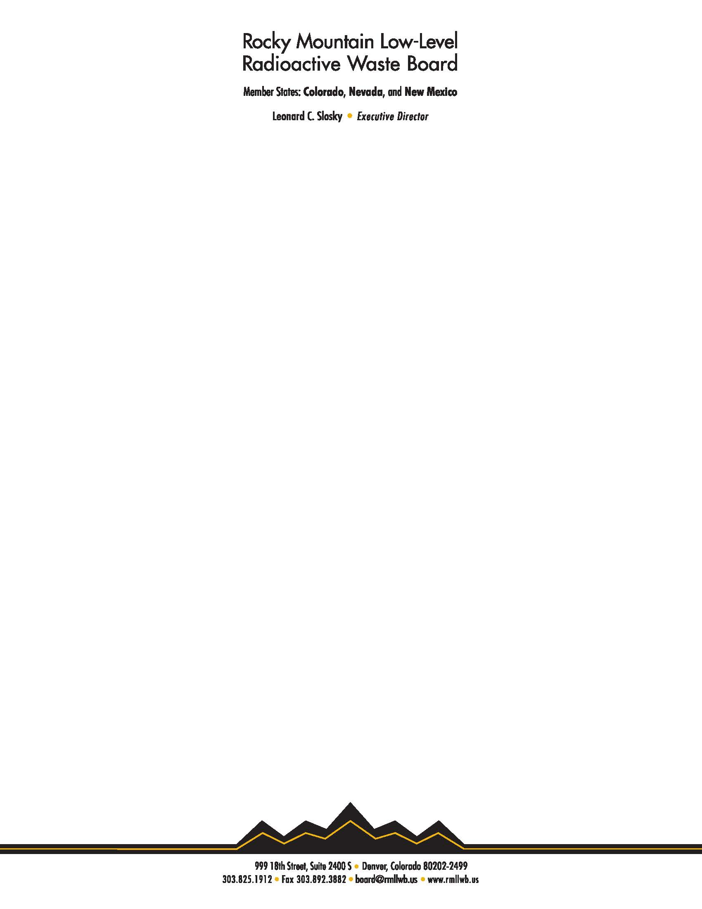
Overview of the Rocky Mountain LLW Compact
Presented by Leonard Slosky
Executive Director
Rocky Mountain Low-Level Radioactive Waste Board

Slide 2


Compacts Recognized in U.S. Constitution
No State shall, without the Consent of Congress,... enter into any Agreement or Compact with another State, or with a foreign Power,... (Article I, Section 10, Clause 3)
Enabling statute such as 1980 or 1985 Policy Act* not necessary
LLW compacts required Consent of Congress because of authority over interstate commerce
Compacts are contracts as well as Federal law, after consent
*Low-Level Radioactive Waste Policy Amendments Act of 1985

Slide 3
State Driven Solution
States did not want another federal program
States did not want feds choosing disposal locations
Compacts were not intended to be uniform

Slide 4
Rocky Mountain Compact (RMC) Beginning
Enacted by member states in 1982 and 1983
Senate Judiciary Committee March 1983 hearing
  Slosky discussed RMC definition of LLW
  NRC advocated uniform definition of LLW and concern with management authority
RMC introduced in Congress (S. 1991) by Senator Alan Simpson (R-WY), member of the Judiciary Committee and Chairman, Subcommittee on Nuclear Regulation in 1983
Judiciary Committee hearing on RMC January 1984
  Discussed RMC LLW definition and civil penalty authority
Judiciary Committee hearing on Southeast, Midwest, RMC March 1985
  Discussed RMC LLW definition, civil penalty authority, authority over management

Slide 5
Congress Carefully Reviewed RMC
House Committee on Energy and Commerce*
  Subcommittee on Energy Conservation and Power
  Slosky testified
House Committee on Interior and Insular Affairs*
  Subcommittee on Energy and Environment
  Slosky testified
Senate Committee on Energy and Natural Resources
Senate Committee on Environment and Public Works
  Subcommittee on Nuclear Regulation
Senate Committee on the Judiciary*
  Slosky testified
*Technical jurisdiction over the compacts

Slide 6
RMC Definition of LLW
Radioactive waste other than:
  DOE nuclear weapons waste
  HLW
  TRU
  Uranium/Thorium mill tailings
  Mining wastes from mineral production primarily other than for radium
    Excludes coal, molybdenum mining waste, etc.
    Oil and gas are not minerals
Does not incorporate NRC definition of LLW or 10 C.F.R. Part 61
Since NORM/TENORM/NARM are not excluded, they are included

Slide 7
RMC LLW Definition Intentionally Broader
NORM/TENORM/NARM inclusion not accidental
When RMC drafted “Denver Radium Waste” (diffuse) issue
  First Colorado NPL site designated by Governor Lamm 1981
RMC definition of LLW broader than NRC two reasons
  Authority provide home for Denver Radium Waste
  Avoid RMC states becoming dumping ground radioactive waste
Rocky Mountain Board (RMB) consistently regulated NORM since 1986
NJ applied to import 202,500 cu ft radium waste in 1986
1988 enforcement against Regional Facility action $9,500 penalty

Slide 8
RMC Authority to Regulate Export and Import
“After January 1, 1986, it shall be unlawful for any person to export low-level waste which was generated within the region outside the region unless authorized to do so by the board.”
“After January 1, 1986, it shall be unlawful for any person to manage any low-level waste within the region unless the waste was generated within the region or unless authorized to do so by the both the board and by the state in which said management takes place.”
Manage defined broadly, including disposal

Slide 9
ALL Waste Export and Import Requires Permit
RMB implemented these authorities through waste-specific permitting system like RCRA cradle-to-grave tracking
Permits required for export to ALL management/treatment and disposal facilities
Export permits authorize specific treatment/management facilities
  Use of facility not authorized in permit is violation
About 100 export permits issued per year
Most waste import to Regional Facility through annual permit to Clean Harbors

Slide 10
RMC Regional Facility
“After January 1, 1986, it shall be unlawful for any person to manage any low-level waste within the region unless the waste was generated within the region or unless authorized to do so both by the board and by the state in which said management takes place.”
Beatty, NV designated initial Regional Facility in Compact statute
January 1, 1993, Beatty no longer authorized to dispose any radioactive waste
2006 RMB designated Clean Harbors Deer Trail Facility as limited, non-exclusive Regional Facility
  Originally permitted by CO for hazardous waste
  Subsequent CO radioactive materials license limited to NORM/TENORM/NARM
  Dispose in-region and out-of-region waste
  RMC generators not required to use

Slide 11
Compact Statute Provides for Civil Penalties
"(e) Any person who violates [import, export, or disposal requirements] shall be liable to the board for a civil penalty not to exceed ten (10) times the charges which would have been charged for disposal of the waste at a regional facility.”
"(g) The civil penalties provided for in . . . . this article may be enforced and collected in any court of general jurisdiction within the region . . .”
"(j) Violations . . . . of this article may be enjoined by any court of general jurisdiction . . . .”
2 to 4 enforcement actions per year
Collected penalties up to $30,000 each

Slide 12
RMC Access to NWIC Washington Facility
1992 contract with NWIC/Washington for access
Throughout life of facility
RMC paid $2.5MM
RMC waste same terms/conditions as NWIC waste
Annual volume limit on RMC waste
RMC no role in WA rate setting process other than public
RMC generators currently not required to use NWIC facility

Slide 13
Legislative History
1985 Policy Act defined wastes which states are responsible
1985 Policy Act not limit wastes which compacts may regulate
Committee Report on H.R. 1083
  “State compact LLW definitions will be incorporated by Congressional ratification as valid for state compact commissions’ activities….”
In ratifying the compacts, Congress found “that each of the Compacts is in furtherance of the Low-Level Radioactive Waste Policy Act.” (P.L. 99-240 SEC. 211)

Slide 14
Compact Authority Upheld by Federal Courts
U.S. Supreme Court
  While the Commerce Clause has long been understood to limit the States' ability to discriminate against interstate commerce, that limit may be lifted, as it has been here, by an expression of the "unambiguous intent" of Congress. Whether or not the States would be permitted to burden the interstate transport of low level radioactive waste in the absence of Congress' approval, the States can clearly do so with Congress' approval, which is what the Act gives them. (New York v. United States, 505 U.S. 144 (1992))
10th Circuit Court of Appeals
  Congressional approval of a radioactive waste compact "transformed it from a mere agreement into federal law." Further, "a compact after receiving Congressional consent is treated and interpreted like any other federal statute." Energy Solutions LLC v. Utah, 625 F.3d 1261, 1267 (10th Cir. 2010).

Slide 15
Compact Authority is Defined by Each Compact NOT 1985 Policy Act
The U.S. Supreme Court decisions and the 10th Circuit decision all concluded that compact authority is defined by each compact's language and not 1985 Policy Act
10th Circuit Court of Appeals citing Alabama v. North Carolina
Like the Supreme Court, we are hesitant to "order relief inconsistent with the express terms of a compact." (130 S.Ct. at 2313) In this case, the Court was faced with the task of interpreting the Southeast Compact, an LLRW compact approved at the same time as the Northwest Compact. Avoiding any linkage to the 1985 Act, the Court based its holding on the language of the compact itself . . . .”
“This indicates the Court viewed the entire LLRW interstate compact system as allowing for great flexibility in determining each compact's specific authority, which is defined by each compact's language. Alabama thus indicates compacts are not limited only to authority found in the 1985 Act.”

