Slide 1
LLW Forum
Lake Buena vista, fl
April 3-4, 2024

Slide 2
30 Years of ARDT
Formed by LLRW generators to support the Texas Low-Level Radioactive Waste Disposal Authority
Remains a stakeholder in the development of LLRW policy and regulations
Interfaces with state and federal agencies
Compact Commission
Export petitions
Monitoring import applications and CWF capacity
TCEQ
Contracts
Monitoring WCS Licensing
Federal Agencies
NRC Rulemaking
DOE, DOD, and EPA policy

Slide 3
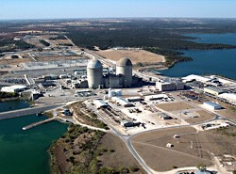
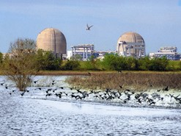
ARDT’s Commitment
Help scientists and engineers share their expertise in radiation issues with legislators, decision-makers, local governments and the public

Slide 4
Lone Star State Happenings—A Legislative and Regulatory Update
Re-cap of the 88th Regular Session of the Texas Legislature
Phase 2a of the Compact Waste Facility and WCS Renewal at TCEQ
Compact Commission Update
Looking Downrange at Emerging Issues and the Next Legislative Session

Slide 5
Texas Sunset Review
Regularly scheduled, periodic review of Texas State regulatory agencies
Designed to make sure an agency is still needed and/or is not duplicating the functions of another agency or entity
Overseen by a 12-member Sunset Commission (10 legislators and two members of the public)

Slide 6
Why We Care
TCEQ and the Texas Low-Level Radioactive Waste Disposal Compact Commission were both up for review
Both agencies elevated LLRW issues for examination
TCEQ’s role in rate-making and disposal contracts
TLLRWDCC’s enforcement authority and contingency plan for the WCS site

Slide 7
Public Comments During the Sunset Process
Transport of nuclear waste, both high-level and low-level, across Texas should be stopped.
Government agencies at all levels should plan for a terrorist attack or other emergencies at the WCS site.
The Compact Commission should develop a contingency plan that applies to the whole site, not just the CWF
The Compact Commission should study the long-term clean-up costs of the WCS facility and recommend fee changes

Slide 8
Sunset Commission Recommendations
Continue TCEQ and, by extension the Compact Commission, to 2035
None related to LLRW

Slide 9
88th Legislative Session
Senate Bill 1397 (TCEQ Sunset Bill)
No proposed amendments related to LLRW
Included enhanced public participation in TCEQ permitting
Increased penalties for most egregious violations
Texas Nuclear Caucus
Uranium Deposit Study by TCEQ and Texas A&M Kingsville
Other environmental issues raised but not enacted
Environmental Justice
Climate change
NO BILLS OR AMENDMENTS RELATED TO LLRW

Slide 10
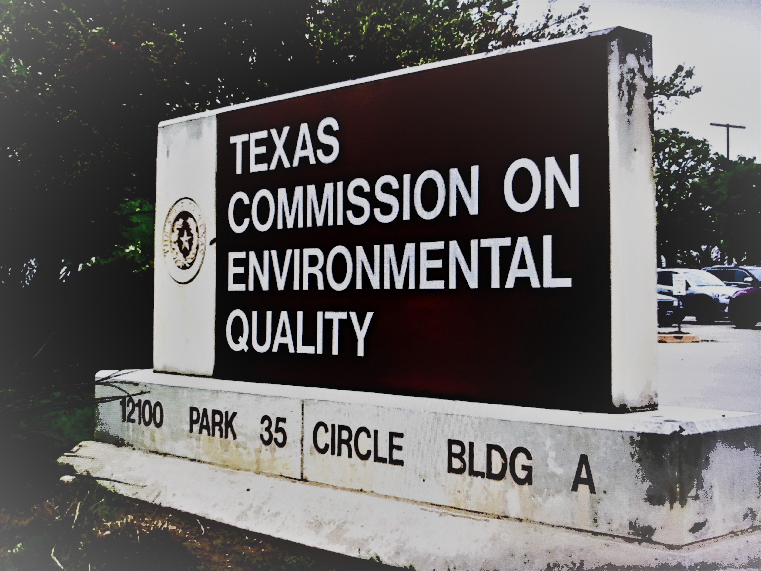
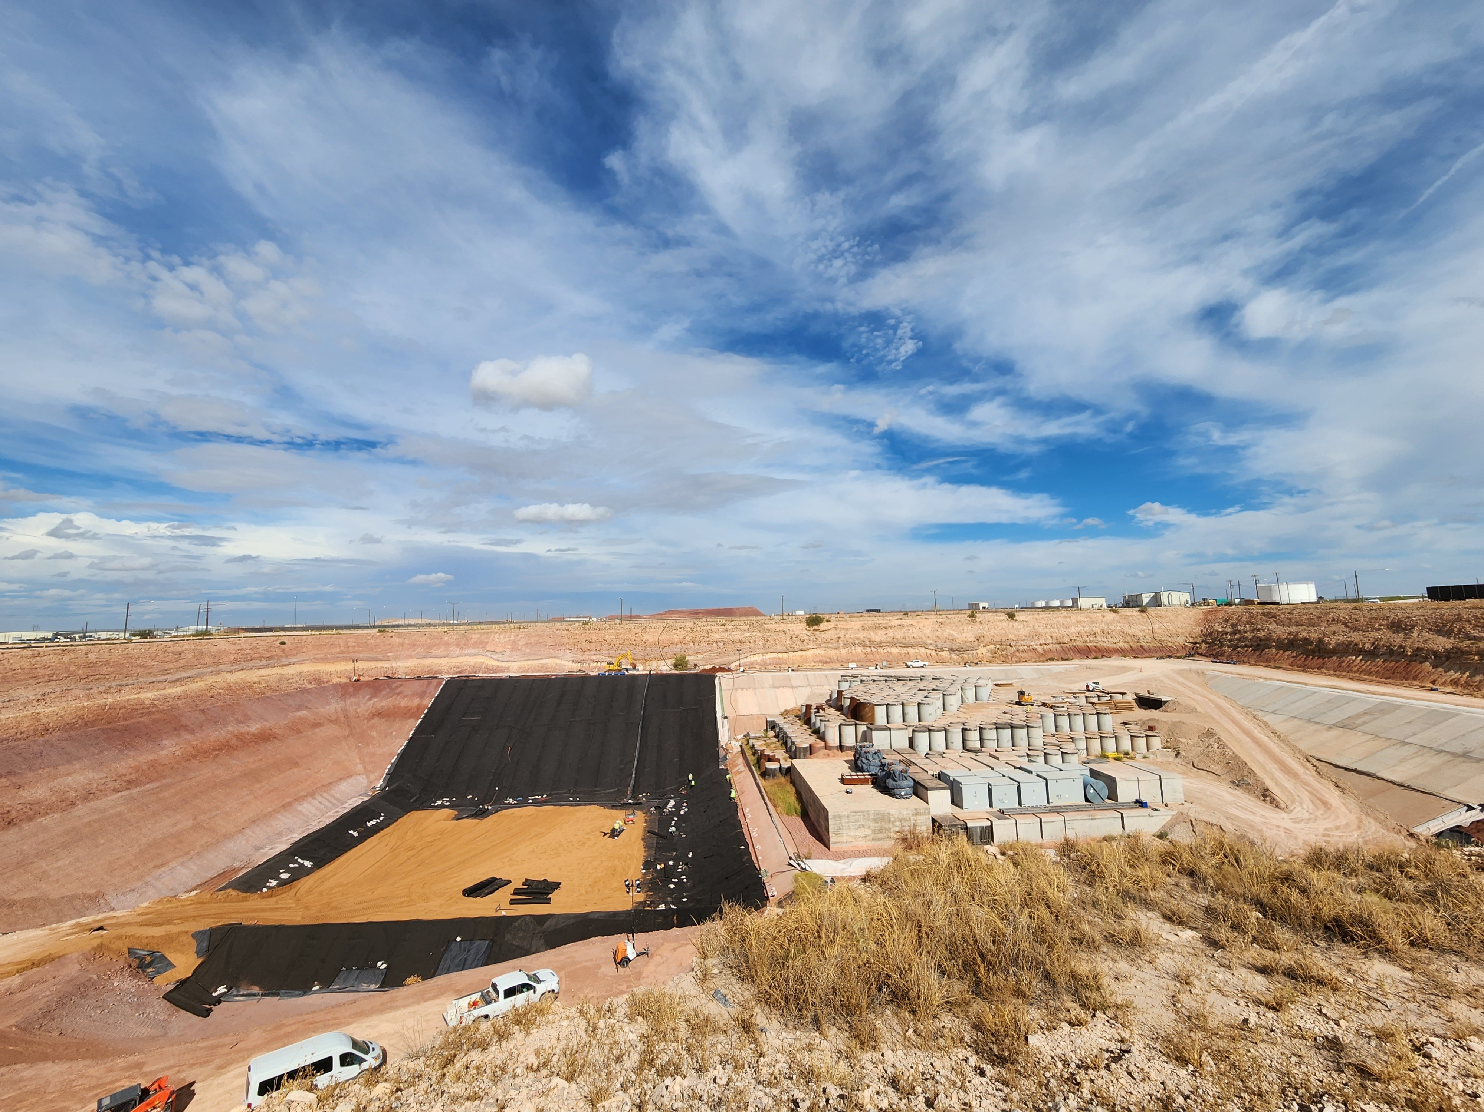
WCS Phase 2a and License Renewal
WCS has opened Phase 2a of the Compact Waste Facility
Open for business
WCS estimates around 10 years as-built capacity
Renewal of Radioactive Material License R04100
No major amendments
Undergoing technical review
Public notice
Possibly a two-year process
Would be renewed for an additional 10 years

Slide 11
TLLRWDCC
Focus on capacity for in-compact generators
Research into whether to set-aside, or reserve, capacity for in-compact generators
Temporary “contingent volume program” (discontinued when Phase 2a opened)
Proposed “management rule” to provide for more frequent accounting of material imported into Texas that is either LLRW or could become LLRW because of treatment and processing
Could be considered for adoption in May
CPNPP and STPNOC file annual export petitions for exigent events
Apply only to Class A

Slide 12
The Future?
ARDT preparing for LLRW issues to appear during the 2025 Legislative Session
Andrews County Resolution on GTCC
Budget requests from both TCEQ and TLLRWDCC
Governor Abbott’s initiative on nuclear technology, particularly for dispatchable power generation
Coal-to-Nuclear electric generating facility conversion
Streamlining uranium mining regulation
Texas Nuclear Caucus

Slide 13
Connect with ARDT
www.ardt.org
Edward Selig
Government Relations Consultant
eselig@ardt.org
512.413.0902
Brian Christian
Environmental Policy Specialist
bchristian@ardt.org
512.937.2490

