Slide 1
Site Overview
March 2024
David Carlson
President
865-201-3191
dcarlson@wcstexas.com

Slide 2
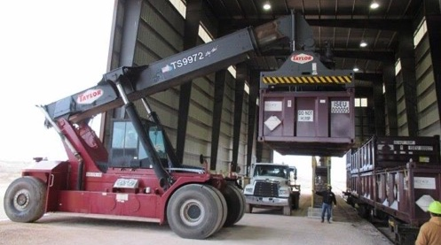
What We Do
Safe Disposal of Low-Level Radioactive Waste (LLRW)
  The most modern and state-of-the-art facility
  One of only 4 facilities in the US
  Two (2) of those facilities are several decades old and only serve a few states
Essential service for:
  Nuclear Power Plants
  Hospitals and Research Laboratories
  Oil and Gas
  Industrial Customers
  US Government (DOE, DOD, etc.)

Slide 3
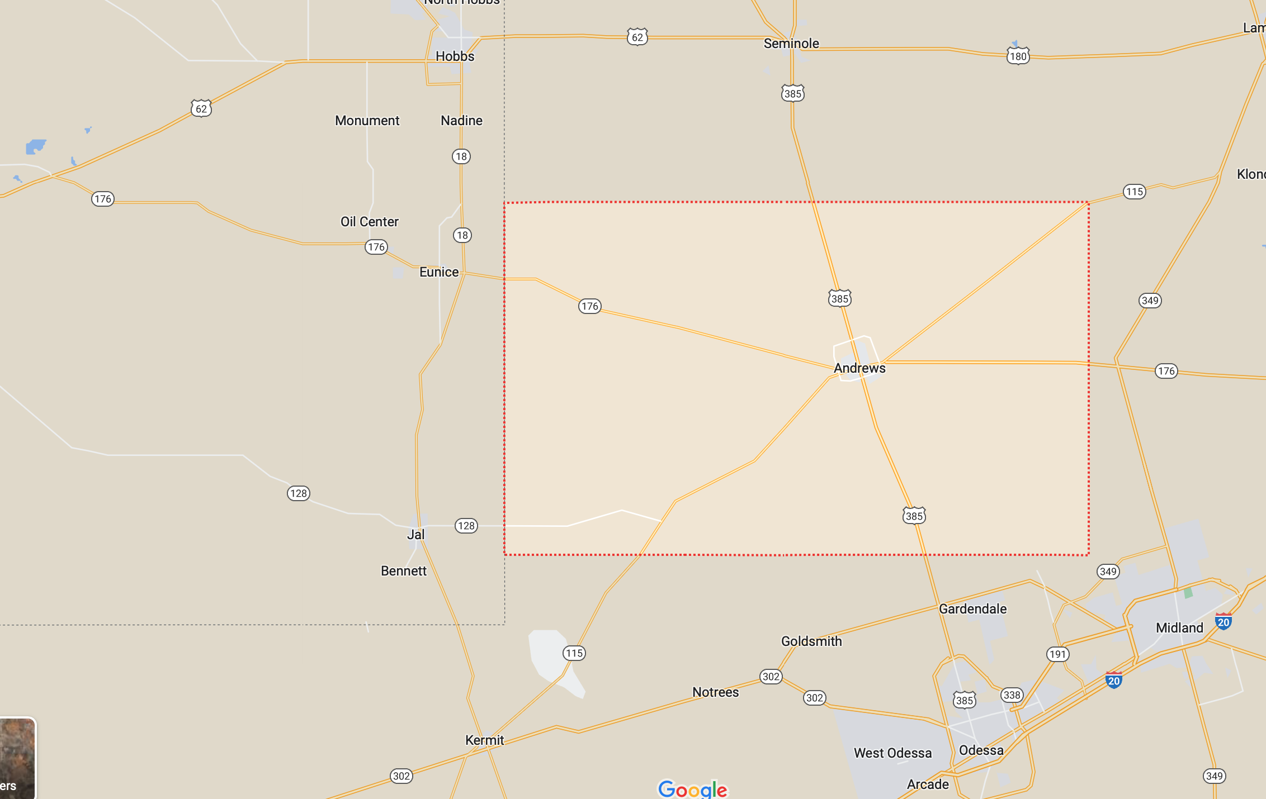
WCS Site - Location
Direct distance to communities:
Eunice, NM 5 miles
Hobbs, NM 15 miles
Jal, NM 24 miles
Andrews 30 miles
Seminole 30 miles
Odessa 50 miles
Midland 60 miles
WCS
Nearest residence is:
3.5 miles east, in NM @ 176 & 18
Nearest businesses are:
URENCO (uranium facility) - adjacent to site in NM
Lea County Landfill (trash disposal) - across 176 in NM
PB Materials (concrete plant) - NW site boundary in NM
Sundance Disposal (O&G waste) - NW site boundary in NM

Slide 4
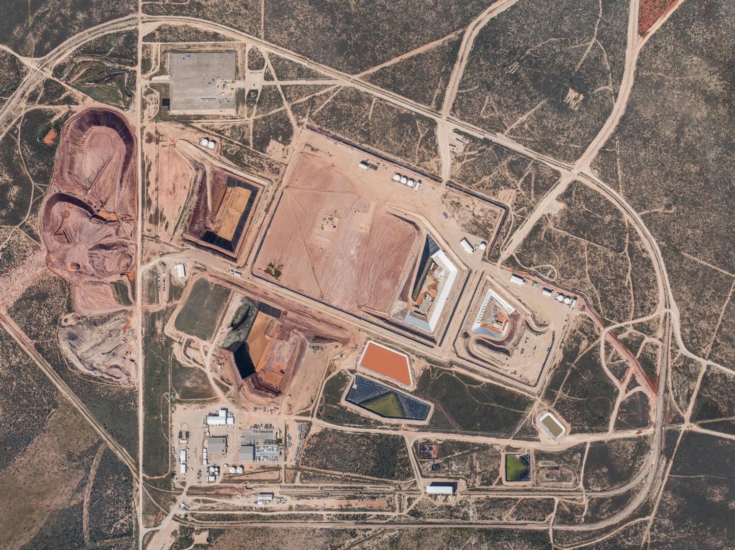
WCS Site – Facilities
14,000 acres (permitted area is 1,400 acres)
4 landfills, treatment facilities, rail access
Located on red-bed ridge
Byproduct
Facility
Federal
Facility
Hazardous
Waste
Landfill
Compact
Facility
Administration
Buildings
Treatment
Facilities
Rail
Offload

Slide 5
WCS - Disposal Design (vs. Generic Facility)
WCS Disposal
Other Facilities
  Key Attributes of WCS site:
  Sub-Grade Design
  Natural Claystone Barrier
  No viable pathway to groundwater
WCS is the Newest and Most Robust LLRW facility in the US

Slide 6
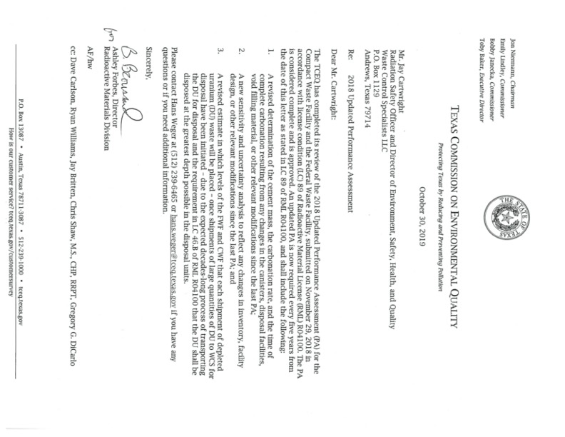
Performance Assessment
Uses sophisticated GoldSim-based modeling
Integrated PA for entire site
PA examines site geology, surface water and groundwater, potential future weather changes, residential and intrusion scenarios, and possible future uses of the land
Evaluated to one million years
Current disposed inventory has a peak dose of 0.5 millirem per year at 170,000 years from closure

Slide 7
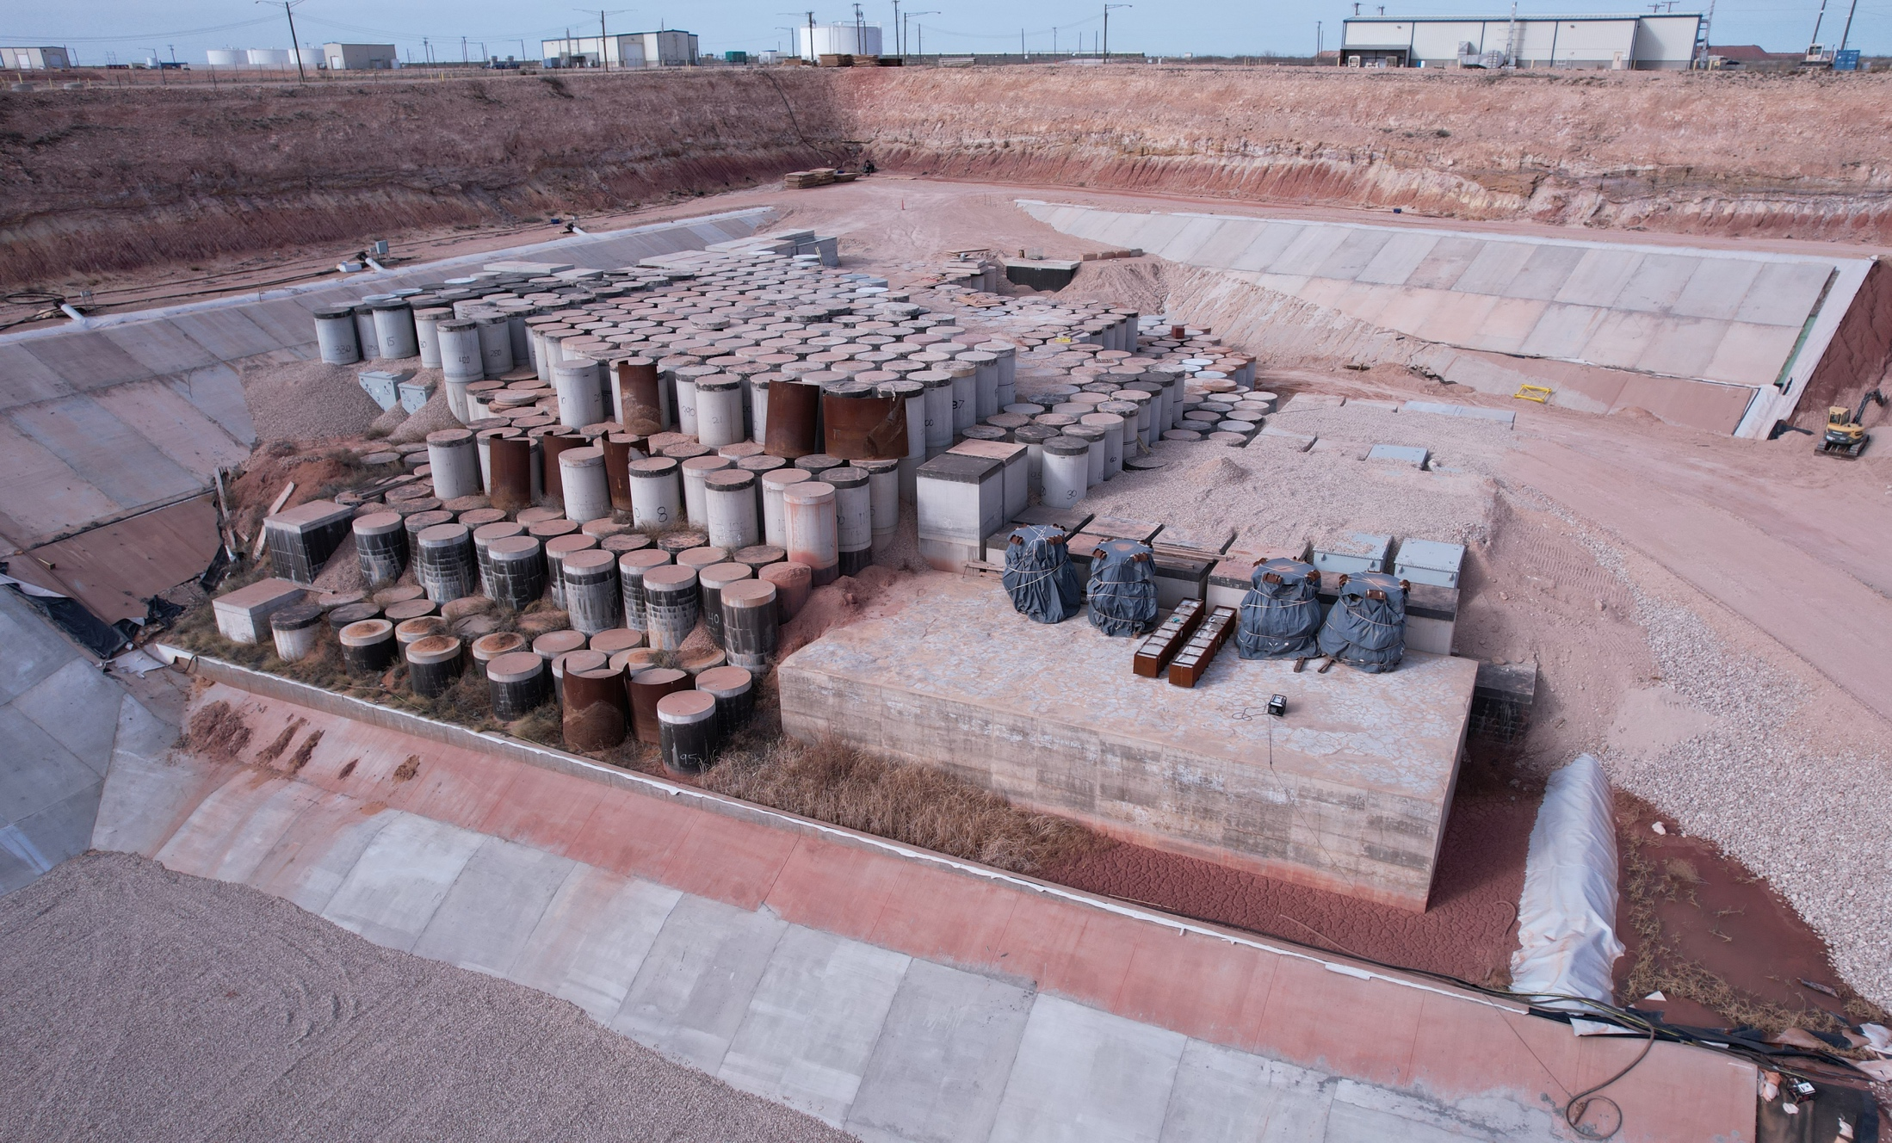
WCS - Compact Waste Facility (CWF)
Regulated by TCEQ (2 on-site inspectors)
Privately-developed and operated
Opened in 2012
Owned by the State of Texas

Slide 8
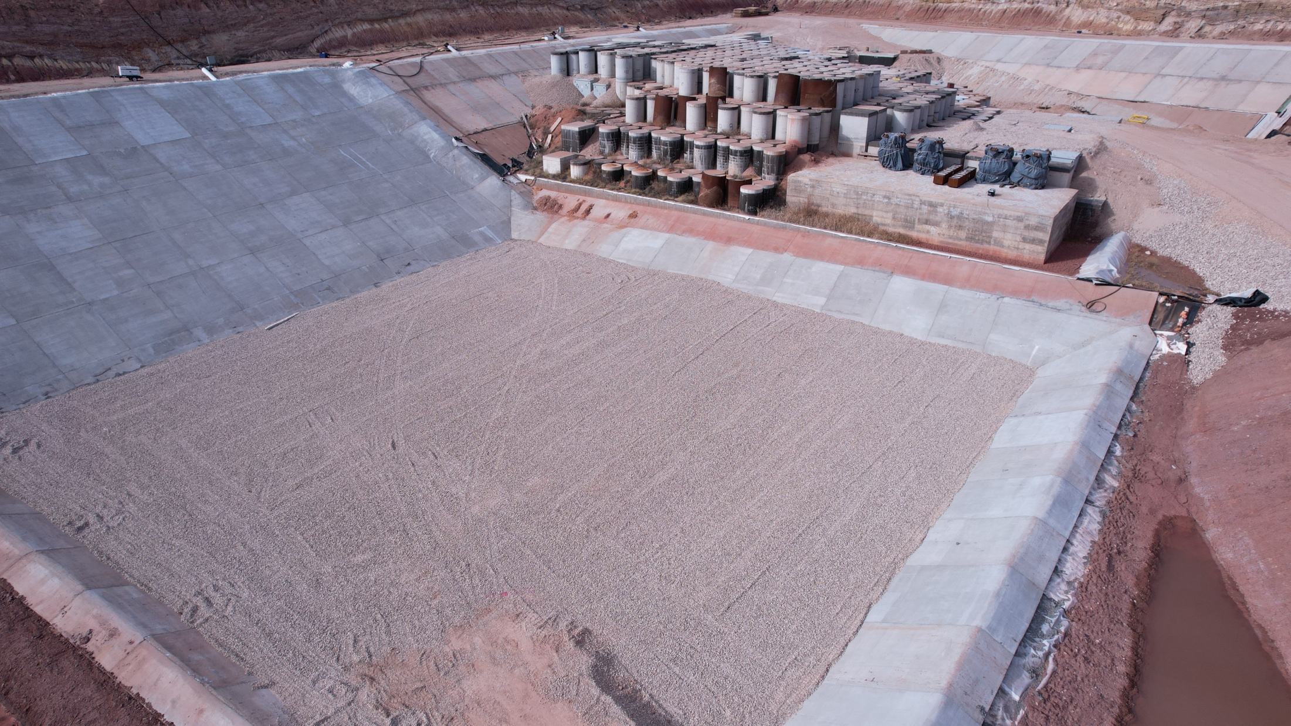
WCS – Compact Waste Facility – Phase 2a
Phase 1 - 330,000 cubic feet used;
120,000 cubic feet available
Phase 2a - completed February 2024
Adds 425,000 cubic feet of disposal

Slide 9
Rates and Fees for CWF Disposal
Disposal rates (prices) for the Compact Waste Disposal Facility (CWF) are in 30 Texas Administrative Code §336.1310
  Maximum rates for in-compact generators
  Minimum rates for out-of-compact generators
  Rate reductions have been limited by the rule
Fees (surcharges) on disposal are established in Texas Health and Safety Code, Section 401
  Applied in addition to the disposal rates (prices)
  Funds to Texas General Revenue, Environmental Perpetual Care, Andrews County, and Compact Commission

Slide 10
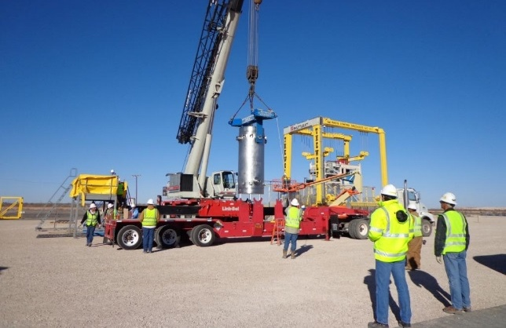
CWF - Irradiated Hardware
WCS routinely disposes of IH with dose rates >20,000 R/hr. on contact
Collective team dose is typically less than 0.02 person-rem
State-of-the-Art transfer system with complete remote handling
IH casks are routinely offloaded, reassembled and shipped back the same day

Slide 11
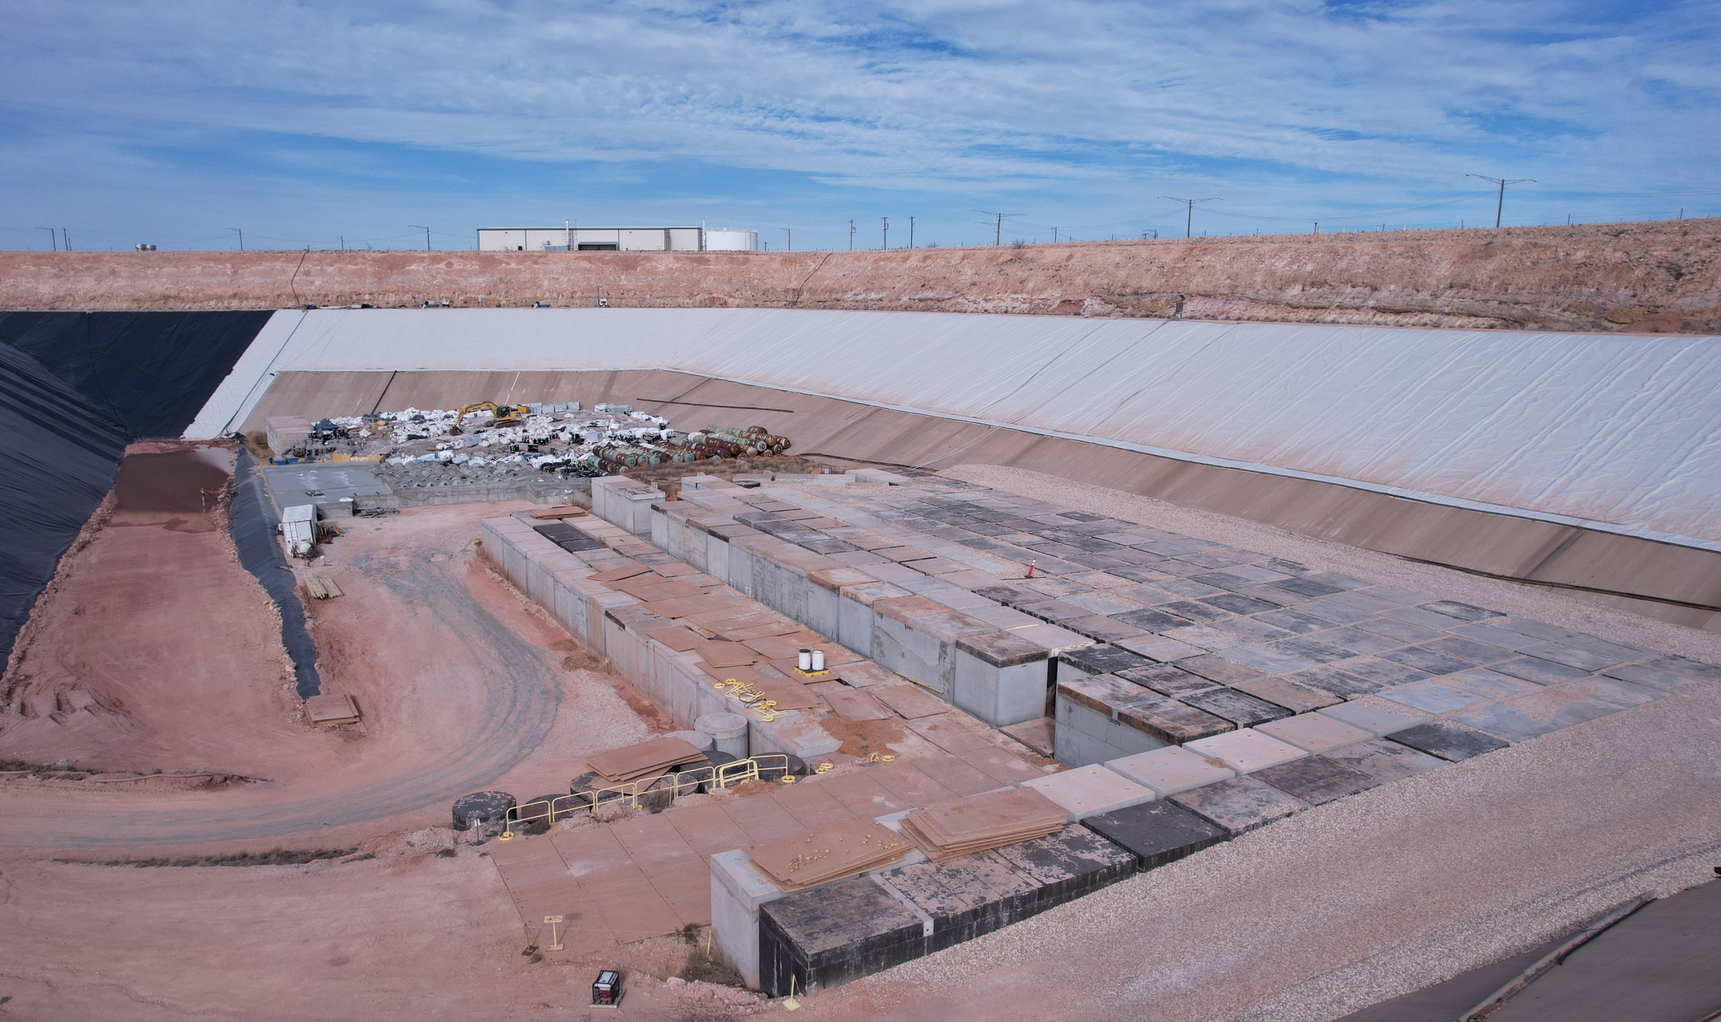
WCS - Federal Waste Facility (FWF)
Regulated by TCEQ
Privately-developed and operated
Opened in 2013
Federal government takes ownership post-closure

Slide 12
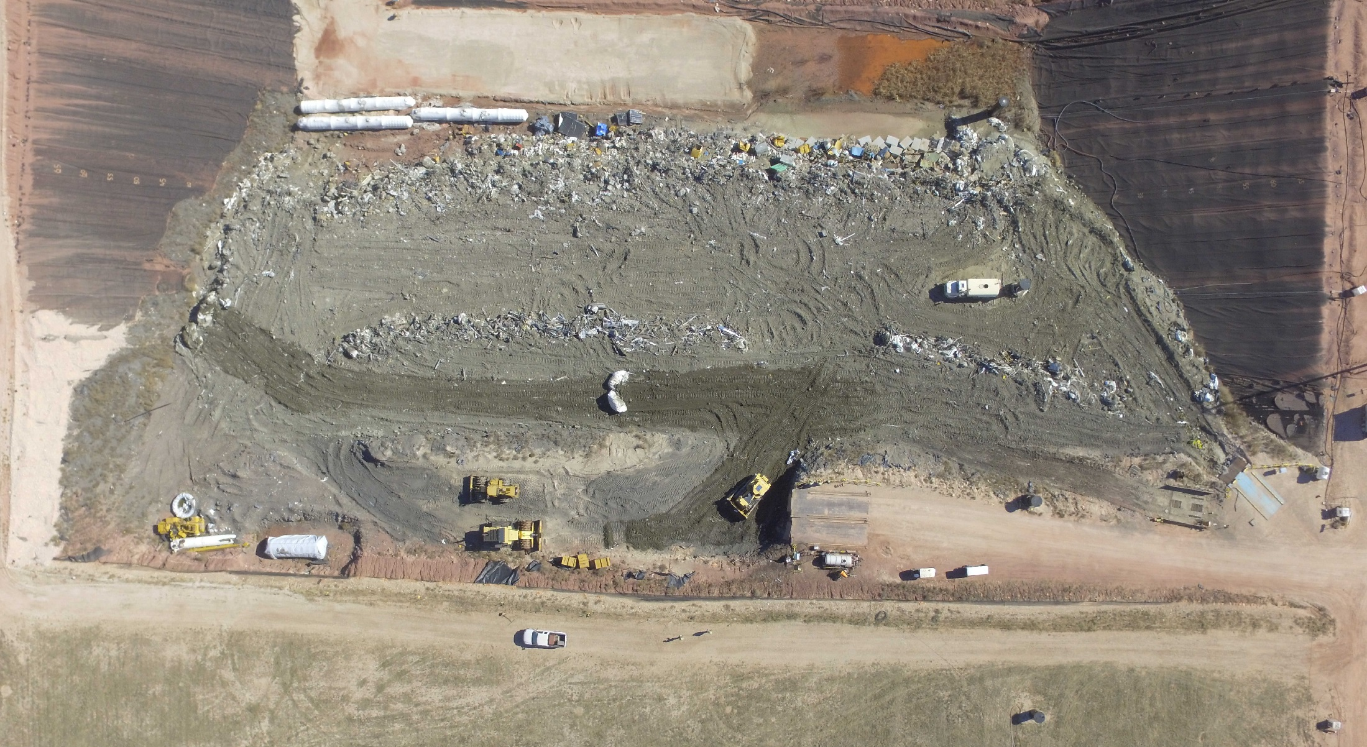
RCRA Subtitle C Landfill for Low Activity Waste
Regulated by TCEQ
Privately-developed and operated
Opened in 1990s

Slide 13
RCRA Landfill - Low Activity Waste
Texas-approved process allows radioactive waste to be exempted and disposed in the Hazardous Waste landfill
No Import Agreement needed for waste shipped to LAW cell
Streamlined process for large-volume waste streams
More than 90% of operational and decommissioning waste qualify for exemption
Reduces risk and future liability compared to disposal in a municipal landfill
    100’ cell depth
    RCRA Subtitle C design/construction/cover
    600’ thick red bed clay geology
    Rad trained and qualified operations staff
    Included in integrated site Performance Assessment

Slide 14
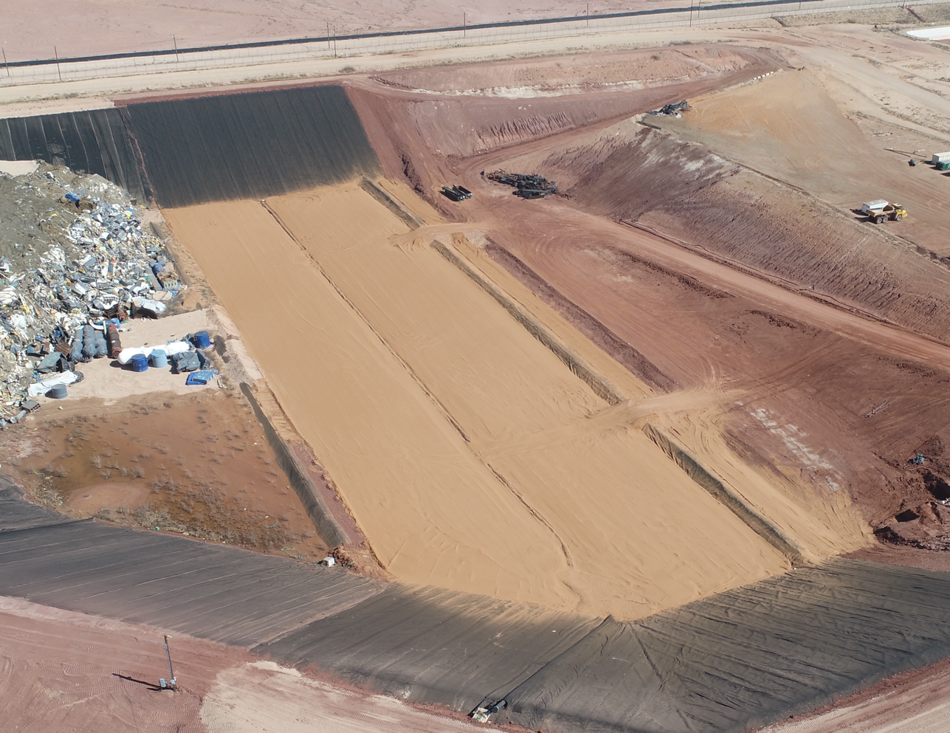
RCRA Landfill - Cell I Construction
  Started 9/5/2022
  Completed 2/11/2023
  Project duration = 6 months
      NorthStar
      Independent QA
      New well installation
    Volume = 10.6 million ft³
  Approved and in use
RCRA Construction Complete – Cell I

Slide 15
Licensed Capacity
CWF Capacity – 9,000,000 ft³
  Currently used = 325,000 ft³ (3.6% of capacity)
  Phase 1 - 450,000 ft³
  Phase 2 – 425,000 ft³
    Started Feb 2023
    Completed Nov 2023
    State authorization Feb 2024
FWF Capacity – 26,000,000 ft³
  Currently used = 520,362 ft³ (2% of capacity)
RCRA (LAW) Capacity – 62,000,000 ft³
  Currently used = 29,300,000 ft³ (48% of capacity)
Site is 14,000 acres with space for additional future expansion
RCRA and FWF volume numbers are as of 6/30/2023
Notes:
For RCRA for the last several years we average approximately two million cuft a year. In last 5 years we have used approximately nine million cuft. Also, this report had it at 62,000,000

Slide 16
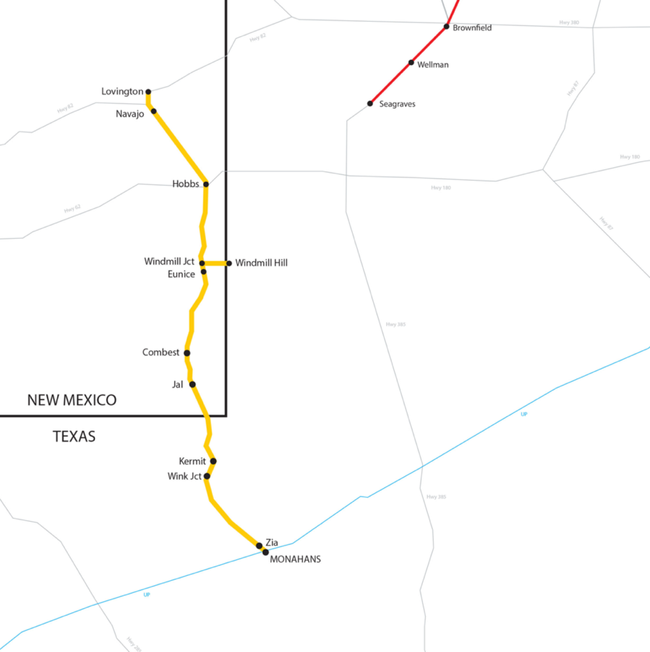
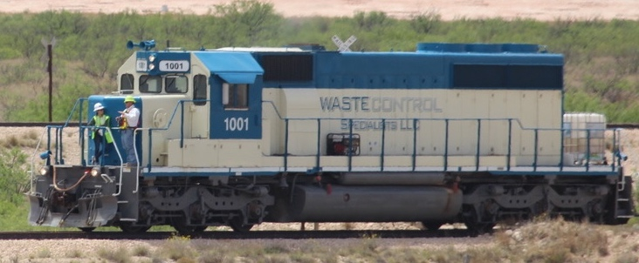
Rail Access
WCS has has the only rail line in Andrews County and operates 2 locomotives
5 miles of owned rail line from site to Eunice, NM
Direct Rail:
Texas and New Mexico Railway (TXN) interchange to Union Pacific (UP) at Monahans
Transload to Truck:
Lubbock and Western Railway (LBWR) interchange to BNSF at Lubbock and transload at Seagraves
WCS has the infrastructure to support transportation of heavy loads
Rail lines upgraded to support shipments over 450,000 lbs
WCS

Slide 17
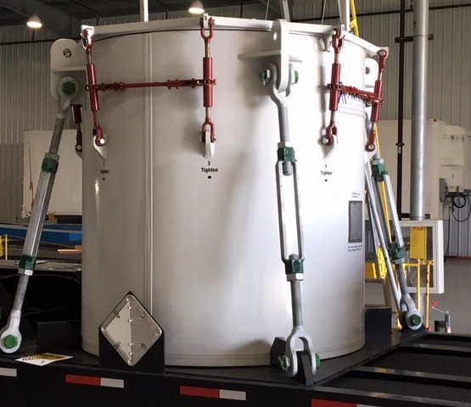
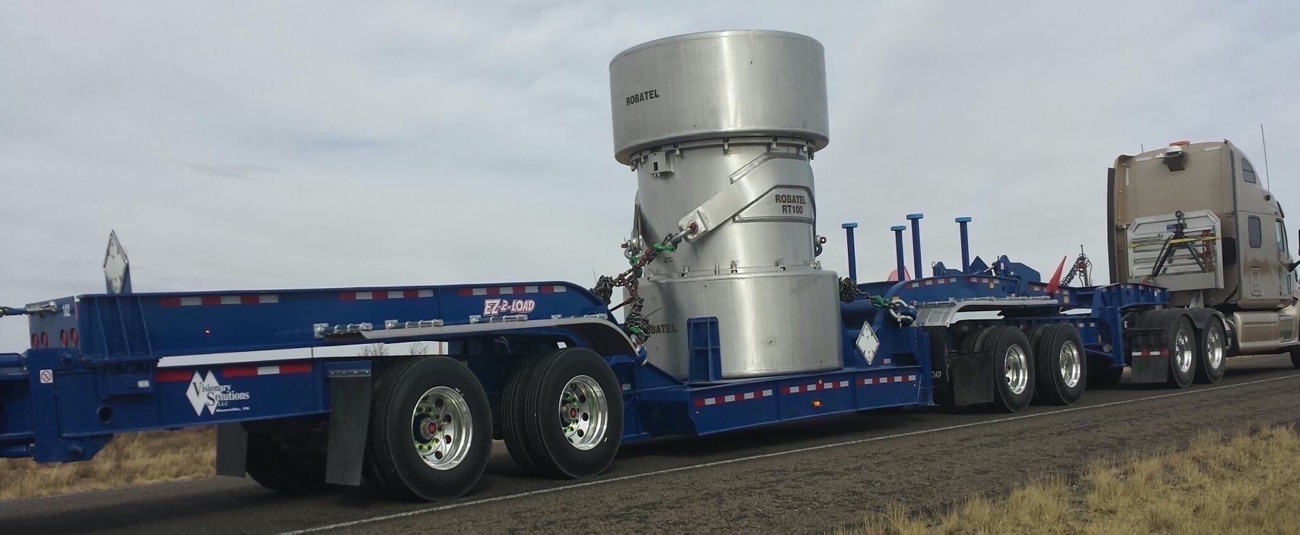
Transportation Casks
The most modern and state-of-the-art casks in service
Provides protection of the public and the environment in the event of the most severe accident scenarios
Regulated by the Nuclear Regulatory Commission and the Department of Transportation
WCS-160 Type B casks – 3 units
WCS-215 Type A casks – 2 units
WCS-215 Type A Cask
WCS-160 Type B Cask

Slide 18
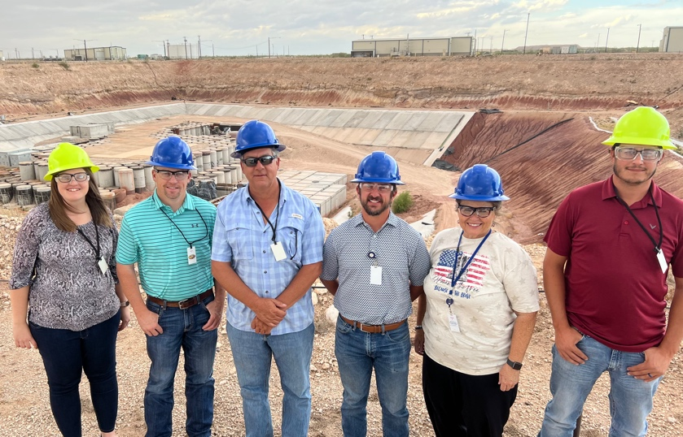
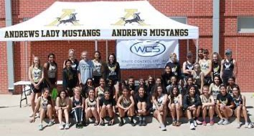
WCS - Local Activities
Our Staff Lives in the Community
  Largest private employer in Andrews county
  Over 120 site employees, $15 million payroll
  Employees are involved in the community
    (schools, chambers of commerce, churches, sports, etc.)
Local Engagement
  WCS office and staff presence in center of town
  Tours and education events available
  High School course and internships
  Outreach to Andrews and regional communities
Financial Support
  Financial contributions to Community Activities
    Education Foundation
    Scholarships, Public Safety, Sports Teams, etc.
  Over $300 million invested in site and facilities
  Purchase of supplies and services from local companies
  Special Surcharges (5% of LLRW disposal revenue)
    $17.8 million to Andrews so far
    Paid in addition to normal taxes and fees
    Quality-of-life community improvements

