Slide 1
DOE/EM Waste Management Update
Low Level Radioactive Waste Forum
Chris Kemp
Office of Waste Disposal
April 3, 2024

Slide 2
EM Organization Chart (March 18, 2024)

Slide 3
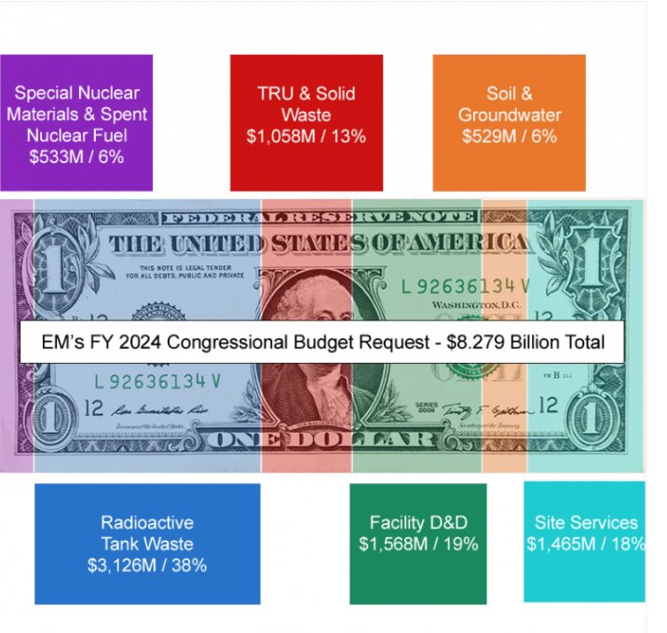
Budget FY 2024

Slide 4
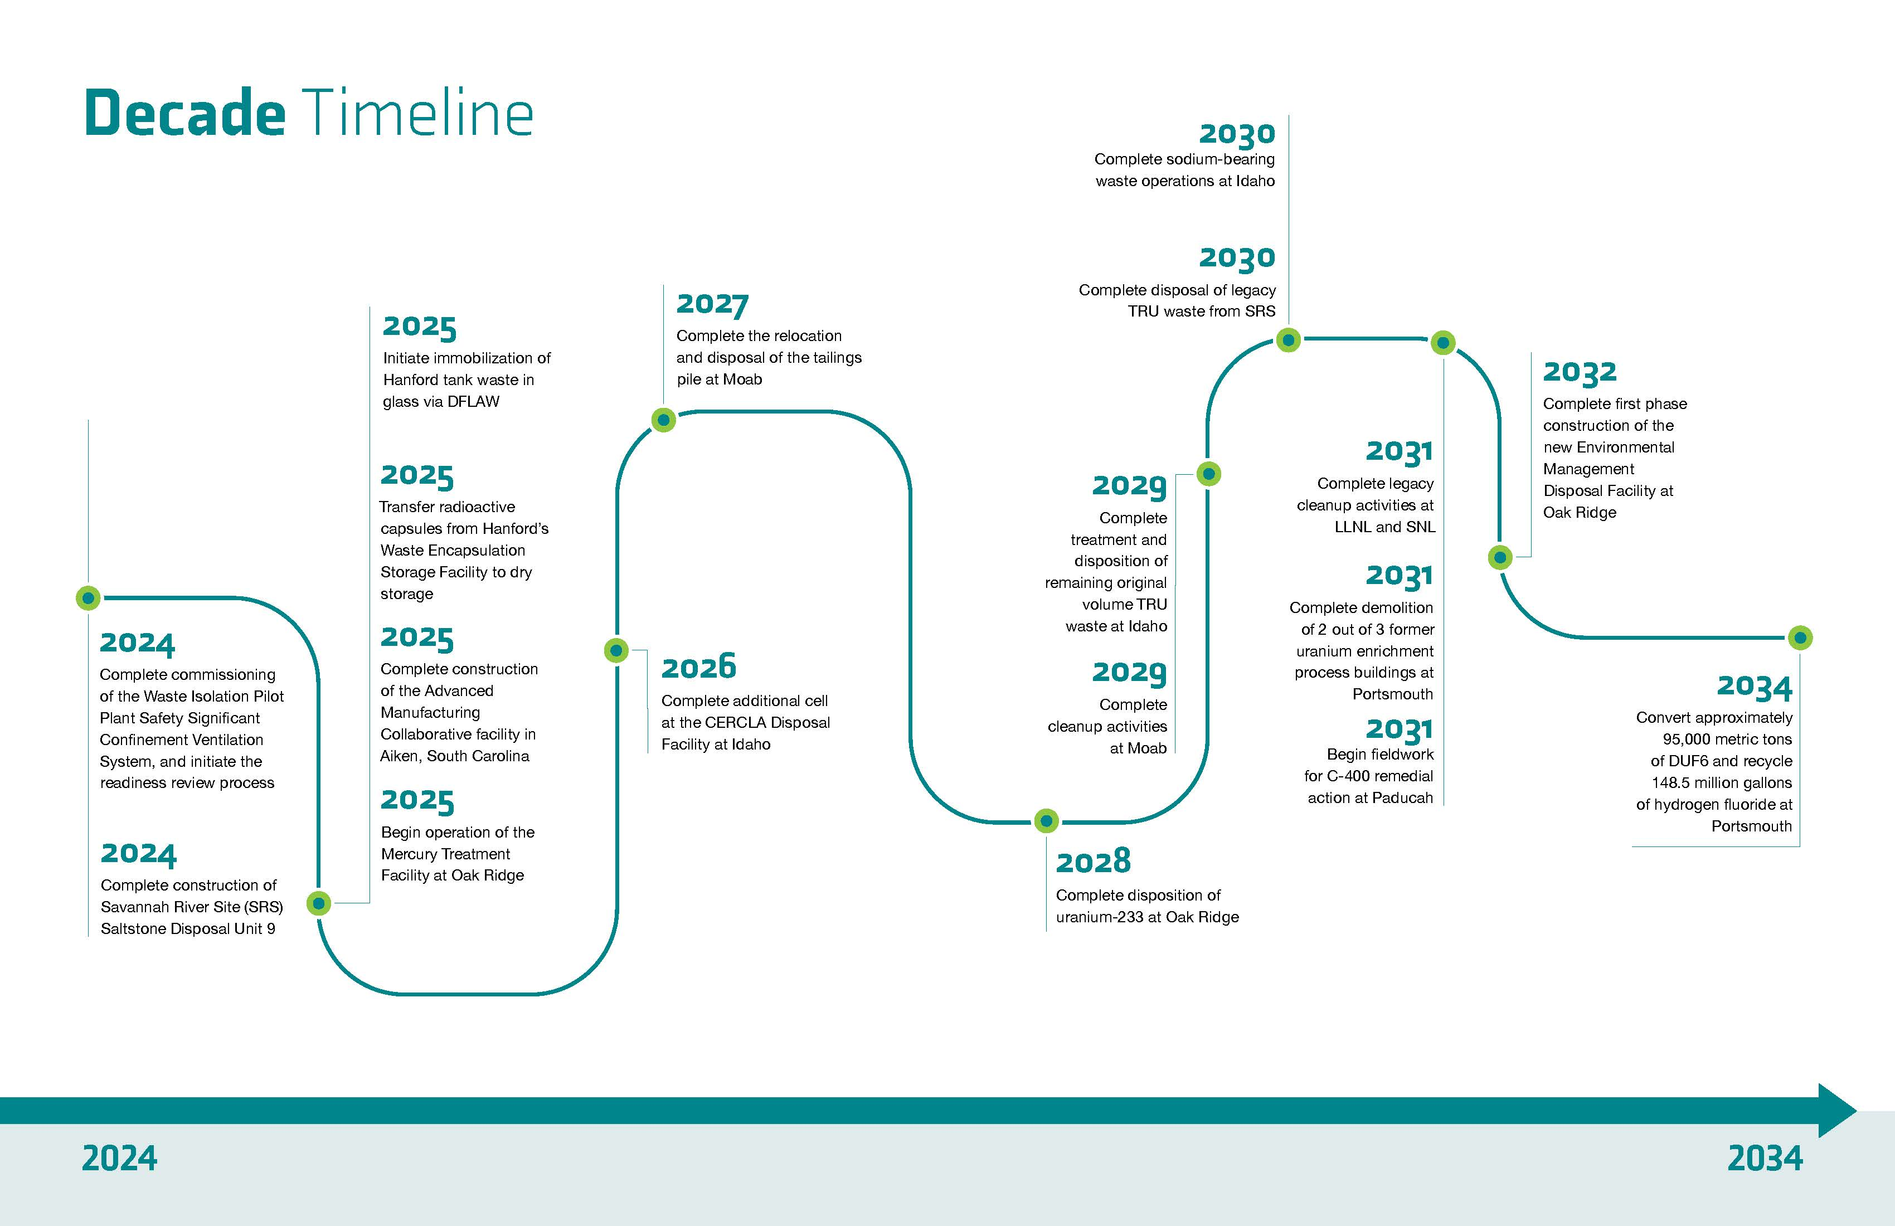
For more information, visit
Annual Priorities, Strategic Vision, and Program Plan | Department of Energy website at: https://www.energy.gov/em/office-environmental-management
DOE/EM Strategic Planning includes Waste Management
EM Program Plan, outlining a decision roadmap the cleanup program will use as a guide over the next two decades
EM Strategic Vision: 2023–2033 (May 2023)
CY 2024 Mission Priorities

Slide 5
Significant Progress Continues
“While our mission is rooted in the environmental legacy of the past, we are also focused on possibilities for the future. We are looking to the future of EM and our communities.”
Ike White, EM Senior Advisor
National Clean Up Workshop September 2023
EM’s successes this year highlight significant construction milestones, key cleanup projects, or activities that reduce the EM Footprint around the DOE Complex.
Safety is our highest priority!

Slide 6
EM CY2024 Mission Priorities

Slide 7
EM CY2024 Mission Priorities

Slide 8
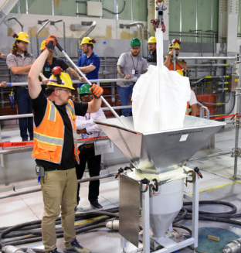
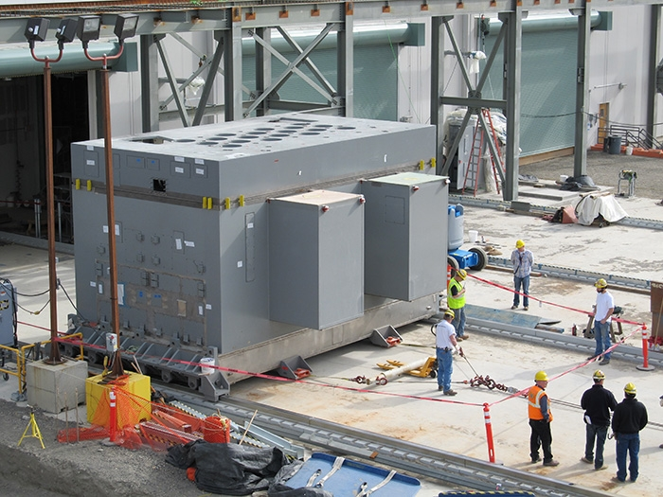
Hanford
Commissioning continues of the Waste Treatment Plant’s heat up the first of two vitrification melters in the Direct-Feed Low-Activity Waste Facility towards hot operations in 2025
  Loss of power test completed
  Water tests completed
  Melter 1 heatup completed (2100⁰ F)
  Melter 2 heatup in progress
Next steps: melter heatup, cold commissioning, hot commissioning, and operations!

Slide 9
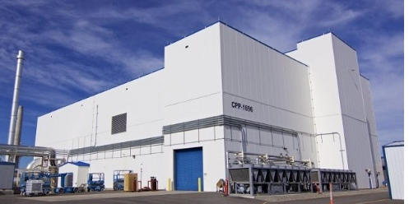
Idaho – Integrated Waste Treatment Unit
Hot operations began in April 2023, treating sodium-bearing radioactive liquid waste. So far more than 68,000 gallons of waste treated (8% complete)

Slide 10
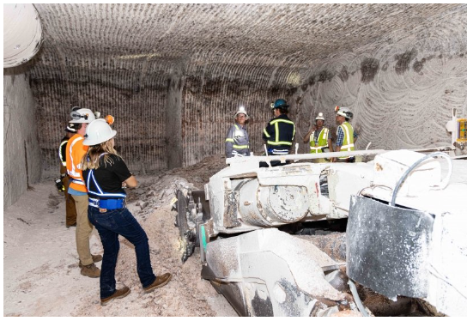
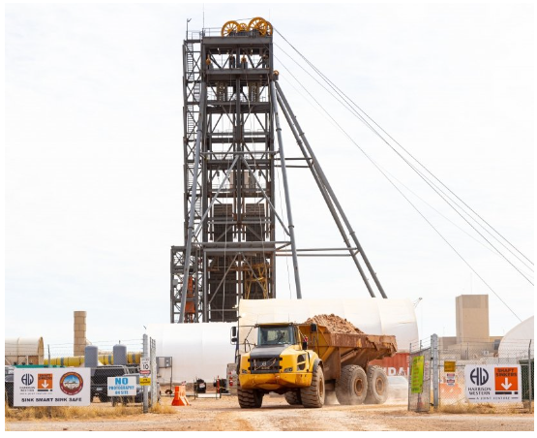
Waste Isolation Pilot Plant – New Shaft
Notes:
Another completed priority#1 milestone: Complete sinking Utility Shaft at WIPP to 2150-foot level.

Slide 11
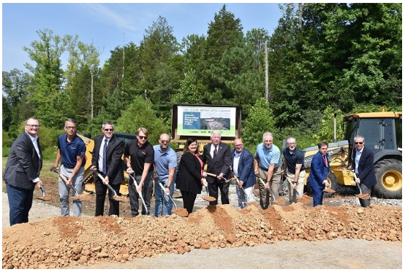
Oak Ridge – EM Disposal Facility Groundbreaking
Notes:
The Oak Ridge Office of Environmental Management (OREM) and contractor UCOR accomplished an EM priority (Priority #2 – Execute Key Cleanup Projects – Begin early site preparation construction start for the Oak Ridge On-site Waste Disposal Facility) four months ahead of schedule when they broke ground on the Environmental Management Disposal Facility (EMDF) this past summer (July 2023). The current onsite disposal facility, the Environmental Management Waste Management Facility, is nearing full capacity, but hundreds of buildings still remain at the Y-12 National Security Complex (Y-12) and Oak Ridge National Laboratory (ORNL) requiring demolition.
The new EMDF will provide the disposal capacity OREM needs to complete cleanup.

Slide 12
High-Level Radioactive Waste (HLW) Interpretation
The HLW interpretation is a tool in the “waste management policy toolbox” that, where implemented, allows DOE to dispose of defense reprocessing waste in accordance with its radiological characteristics and not by source or where it came from, i.e., some reprocessing wastes may be classified as not HLW (non-HLW)
Since adopting the policy, DOE has implemented the application of the HLW interpretation
  The first waste stream analyzed was a small volume of SRS Defense Waste Processing Facility (DWPF) recycled wastewater treated and disposed in September 2020.
  The second waste stream decision was announced on July 18, 2023, to dispose of SRS contaminated process equipment at WCS. The waste includes a drill string, glass pumps, and replacement glass bubblers related to DWPF operations until facility’s end of life. Environmental analysis shows that the proposed action would have no significant impact to human health and the environment and does not constitute a major federal action in the context of NEPA.
  The drill string is planned to be shipped late in CY2023.
EM-HQ continues to actively search for candidate waste streams to apply the HLW Interpretation to advance DOE clean-up mission.
For more information, please see the website at https://www.energy.gov/em/high-level-radioactive-waste-hlw-interpretation

Slide 13
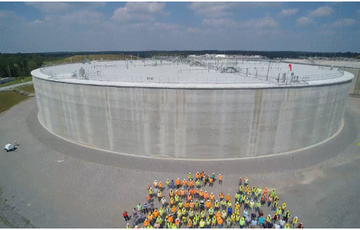
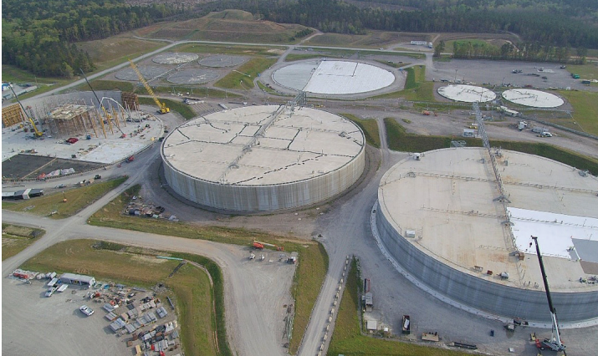
Savannah River Site (SRS) – Completion of Saltstone Disposal Unit 8
Notes:
SDUs are large concrete units used for permanent disposal of saltstone. Left picture is of completed SDU 8. The mega-volume units are 375 feet in diameter, 43 feet high, and can hold approximately 33 million gallons of saltstone. They are designed to receive DSS produced by SWPF. Completing construction of SDU 8 is one of the Priority 1 (achieving significant construction milestones) for CY23 Mission.

Slide 14
Greater than Class C (GTCC) LLW Disposal Status
GTCC LLW remains in storage at generators’ facilities.
DOE continues to monitor the Nuclear Regulatory Commission (NRC) regulatory developments, and the Energy Policy Act of 2005 requirement to “await action by Congress.”
DOE staff have taken advantage of NRC’s latest 2023 informative presentations on potential changes to Part 61 low-level waste disposal regulations to integrate criteria for licensing the near-surface disposal of GTCC LLW and depleted uranium.
We are continuing to discuss with NRC staff our views on the information presented and look forward to an opportunity to review the draft rule and guidance.
Notes:
External Interest:
National Security Council interest in GTCC disposal in response to POTUS National Security Memorandum 19 to Counter Weapons of Mass Destruction Terrorism and Advance Nuclear and Radioactive Material Security
In April 2022 – NRC Commission approved the staff’s recommendation to:
issue new proposed rule that consolidates/integrates criteria for licensing the disposal of GTCC waste and 10 CFR Part 61, “Low-Level Radioactive Waste Disposal,” rulemaking activities, and
provide for Agreement State licensing of those GTCC waste streams that meet the regulatory requirements for near-surface disposal and do not present a hazard such that the NRC should retain disposal authority.
NRC Draft Regulatory Basis (July 2019):
“…the NRC staff found that a majority of GTCC waste are both potentially suitable for near-surface disposal and could be regulated by an Agreement state.”

Slide 15
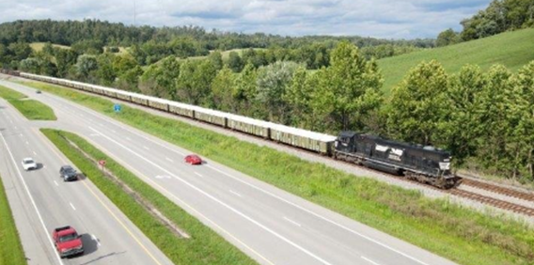
Depleted Uranium (DU)
A 2020 DOE Record of Decision based upon the Final DU Oxide Supplemental Environmental Impact Statement regarding disposition at one or more of the disposal sites evaluated
DOE can ship to selected commercial site(s) if the facility is authorized/licensed to receive DU oxide in addition to DOE’s Nevada National Security Site:
  EnergySolutions near Clive, Utah (licensing application in process)
  Waste Control Specialists LLC (WCS) Federal Waste Facility (licensed)
Multiple shipments by rail in 2023 with first shipment from Portsmouth site and additional shipments from Paducah site

Slide 16
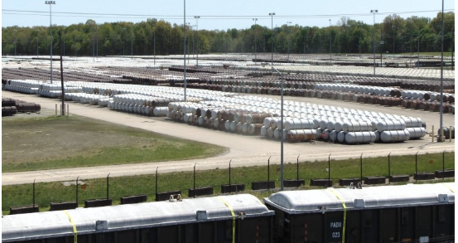
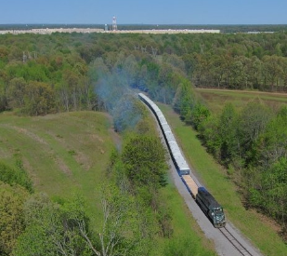
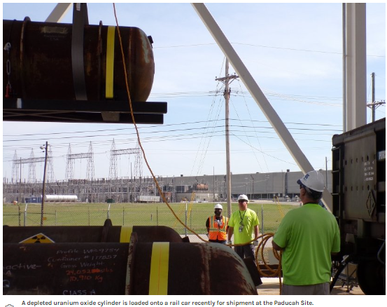
Portsmouth & Paducah – Uranium Oxide Shipments for Disposal

Slide 17
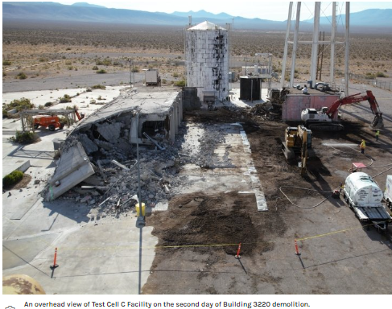
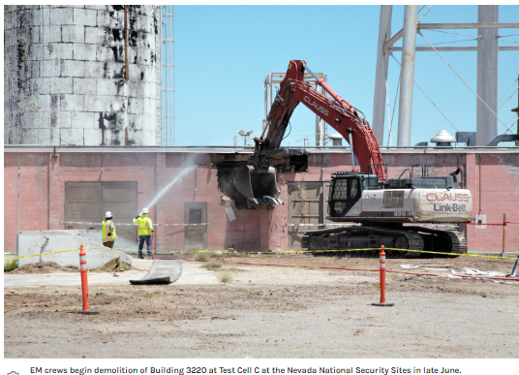
NNSS – D&D of Test Cell C Facility
Notes:
“It was operated decades ago in the ‘60s and ‘70s, so systems, structures and components had been there for a long time and had partially degraded, causing potentially unstable conditions. This activity is one of the CY 23 priorities (priority #3 – reducing the EM footprint). This activity took months of planning, hazard characterization, abatement work and removal of hazardous waste. EM Nevada completed its EM mission and priorities goals for the 2023 calendar year.

Slide 18
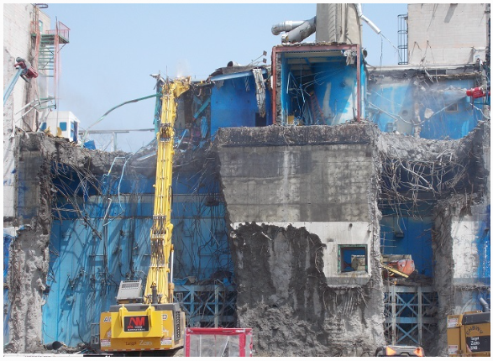
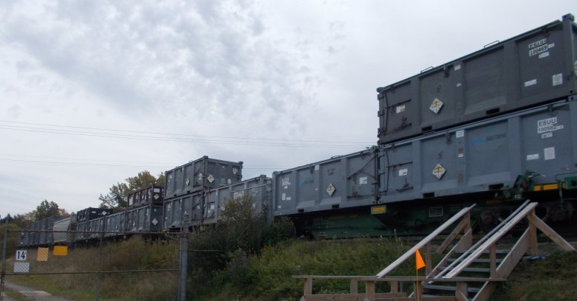
West Valley Demonstration Project D&D Main Plant Process Building
Notes:
An EM 2023 Priority (priority #2) is to dispose of 9,000 tons of Main Plant Demolition Waste. The demolition is expected to take approximately 30 months to complete. An operator uses an excavator with a hydraulic hammer to dismantle the Chemical Process Cell, as part of the deconstruction of the Main Plant Process Building at EM’s West Valley Demonstration Project.
In 2017, EM workers removed 278 high-level waste canisters from that storage facility and safely relocated them to a temporary onsite storage pad until a permanent repository is available for their disposal. The work at the Chemical Process Cell is expected to be completed over several months and will include removal of racks used to store high-level waste canister decades ago. The Main Plant is one of the last remaining major facilities at the West Valley Demonstration Project.
Its successful demolition will further reduce environmental risks and position the site for the next phase in cleanup. The five-story, 35,100-square-foot, reinforced-concrete structure operated as a commercial reprocessing facility to recover reusable plutonium and uranium from spent nuclear reactor fuel. It ceased operations in 1972.

Slide 19
DOE PFAS Update 2023
“Addressing PFAS at the Department of Energy”: Memorandum issued by Deputy Secretary guiding DOE efforts to mitigate risk associated with PFAS use, storage/disposal, and reporting of releases at DOE sites.
PFAS Strategic Roadmap: DOE’s Commitments to Action 2022-2025: Outlines goals, objectives and specific actions DOE is taking to address risk from PFAS.
Initial Assessment of Per- and Polyfluoroalkyl Substances at Department of Energy Sites: Summarizes the results of a preliminary evaluation of known historic or current PFAS uses, PFAS occurrence in the environment, and regulatory and stakeholder interactions at DOE program sites.
Initial DOE PFAS Research Plan: Leverages expertise of DOE National Laboratories and other partnerships to enhance PFAS research, identify 5 research and development topics, inventory ongoing DOE research efforts, and identify potential research needs.
Recent Updates:
PFAS Sampling Guidance: Published August 2023, presents a framework for investigating PFAS at DOE sites and facilities and describes methods for sampling and analyzing environmental conditions to help identify the nature and extent of contamination, PFAS concentrations in source zones, and the extent and impact of PFAS migration from those zones.

Slide 20
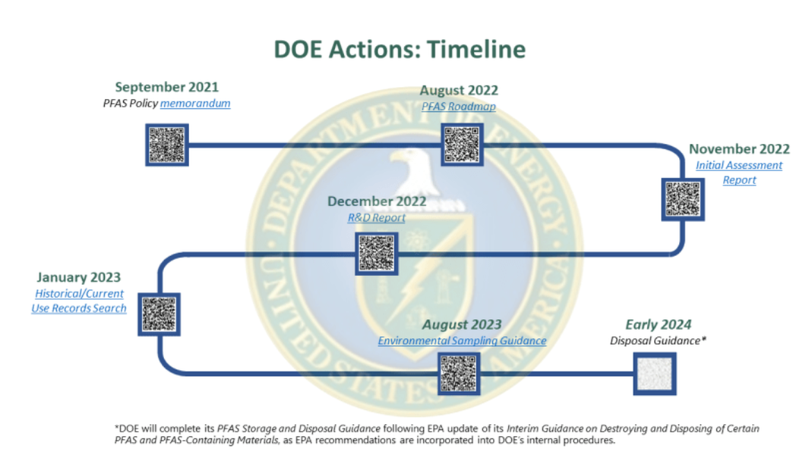
DOE PFAS Updates
Resources can be found at energy.gov/PFAS

Slide 21
Waste Disposal Considerations
DOE’s Radioactive Waste Management Manual found in 435.1-1 has a “tiered” policy on treatment, storage, and disposal:
  DOE waste shall be treated, stored, and in the case of low-level waste, disposed of at the site where the waste is generated, if practical, or at another DOE facility. If DOE capabilities are not practical or cost effective, exemptions may be approved to allow use of non-DOE facilities for the storage, treatment, or disposal of DOE radioactive waste …
Waste disposal is always fully protective of worker and public health and the environment and in compliance with applicable Federal, state, and local requirements, with necessary permit(s), license(s), and approval(s) for the specific waste.
Sufficient LLW/MLLW disposal capacity exists at DOE and commercial facilities to support the EM cleanup mission.

Slide 22
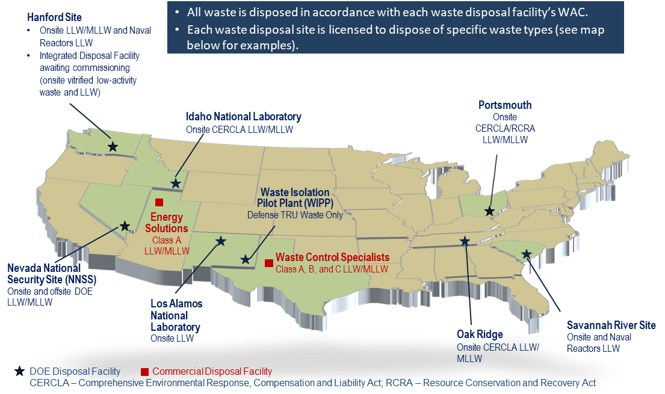
Operating DOE & Commercial LLW Disposal Facilities Used by DOE

Slide 23
DOE LLW/MLLW Data
  Waste Information Management System (WIMS)
WIMS is developed to provide stakeholders with the tools necessary to easily visualize, and understand current and future waste volumes, categories, and problems of forecasted waste streams.
WIMS meets this need by providing a user-friendly online system to organize, and present waste forecast data from DOE sites. This system provides a method for identification of waste forecast disposal volumes, waste. classification, disposition pathways, and potential barriers to final disposition.
  Includes LLW/MLLW treatment/disposal forecast from all DOE sites, not just EM sites.
  Annually updated and website maintained by Florida International University
  Out-year data reflects uncertainty due to site funding adjustments, federal budget process, DOE priorities.
  Visit WIMS at: Waste Information Management System (emwims.org)

Slide 24
DOE Complex-wide LLW/MLLW Disposal Volume by Disposal Location
(Does not include waste labeled “unknown” or “other”, and “NNSS” represents waste generated outside of Nevada that was disposed at NNSS)
Notes:
Jonathan Kang notes:
As discussed earlier, DOE relies on use of strategic partnership between onsite capabilities, NNSS, and commercial facilities to manage its waste.
Historically speaking, most of DOE generated wastes are disposed on-site (80-90%) and remaining wastes at NNSS and commercial facilities (usually combined 10-20%).
We believe this trend will continue in coming years. We don’t necessarily believe this was due to current 435.1 policy and we also don’t expect “leveling the playing field” policy when and if implemented, will significantly change that.
In order to present the consistent methodology with prior year bar charts, NNSS generated waste disposed at NNSS is included in “Onsite” bar (vs. NNSS bar);
Large onsite volume in FY22 is Ports D&D waste (combination of X-326 demo and DUF6 related waste);

Slide 25
Commercial LLW Disposal Manifest Data
  Manifest Information Management System (MIMS)
  MIMS is the public source for manifest data of non-DOE LLW shipped to commercial disposal facilities to meet the provisions in 42 U.S.C. 2021g(a)
  States/compacts are the primary stakeholders
  Data is available for currently operating commercial LLW disposal facilities
    Barnwell, EnergySolutions, US Ecology, and Waste Control Specialists
  Currently updated with CY 2022 data. Next update will be January of 2024 (update with CY 2023 data)
  Visit MIMS at: mims.doe.gov

Slide 26
Thank you for your Attention
Questions?

