Slide 1
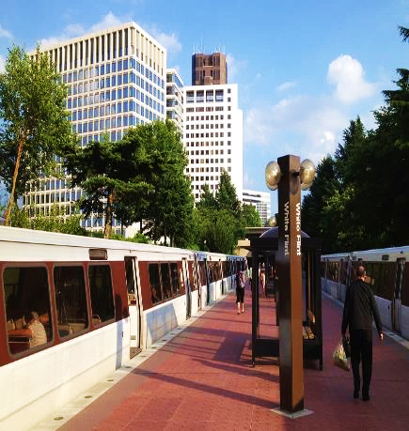

NRC UPDATE
Protecting today, tomorrow, and
cleaning up the past
SPRING LLW FORUM MEETING
April 3-4, 2024
Jane Marshall, Director
Division of Decommissioning, Uranium
Recovery, and Waste Programs (DUWP)
Office of Nuclear Material Safety and Safeguards (NMSS)

Slide 2


Agenda
Low-Level Waste (LLW) Programmatic Assessment
Agreement State Collaboration
Waste Processing
Radium Sites​
Rulemakings and guidance

Slide 3
Assessing the LLW Program
10 Tasks Identified and Ranked
Completed
#3. Updated Concentration Averaging and Encapsulation Branch Technical Position (https://www.nrc.gov/waste/llw-disposal/llw-pa/llw-btp.html)​
Ongoing High Priority Tasks
#1. and #4. Complete Integrated Low-Level Radioactive Waste Disposal (LLRWD) Rulemaking – SRM SECY-20-0098​
Future Tasks
#2. Update to the Waste Classification Tables​
#5. Finalized guidance on Alternative Disposal Requests (ADRs)-(https://www.nrc.gov/waste/llw-disposal/very-llw.html)​
#6. Published NUREG/BR-0204, Rev 3, Waste Manifest instructions https://www.nrc.gov/waste/llw-disposal/llw-pa/llw-uwm.html​
#7. Performed Very LLW Scoping Study​ SECY-21-0057
#8. Update and consolidate LLW guidance into one NUREG​
#9. Examine the need to define when radioactive material becomes LLW​
#10. Develop and implement the national waste tracking system​
3

Slide 4
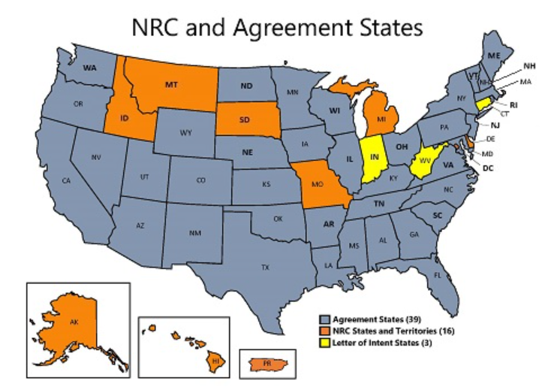
Collaborating with
Agreement States
  Integrated Materials Performance Evaluation Program - LLW
    Completed in 2023 (Illinois and Utah)
    Reviews in 2024 (Kentucky)
  Annual NRC/Agreement States LLW Workshop
    Exchange of operational experience, challenges, and best practices (November 15, 2023)

Slide 5
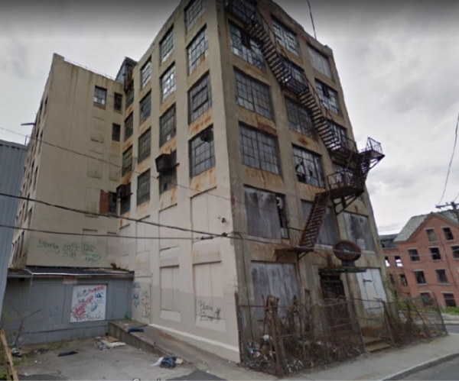
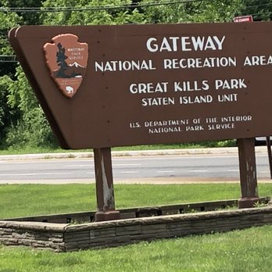
Cleaning Up Radium Sites
  Ensure unlicensed sites with discrete sources of radium or associated contamination do not pose a risk to public health and safety and the environment
  Status
  3 non-military sites remaining with residual radium activity requiring remediation.
  Monitoring or Staying Informed at 3 National Park Service and 17 Department of Defense sites under Comprehensive Environmental Response, Compensation, and Liability Act and Memorandum of Understanding
  Coordinating with other Federal agencies
  Extensive stakeholder communication and coordination – reaching out to Agreement States with radium sites
5

Slide 6
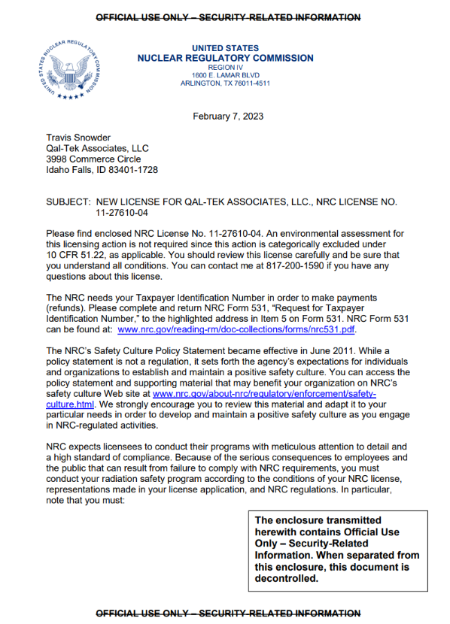
Licensing Waste Processing
In 2023, NRC issued a license to Qal-Tek Associates to perform waste processing at Mayfield Verification Facility
Possible future ADRs associated with the disposal of material
6

Slide 7
Integrated LLRWD Rulemaking
  Consolidate and integrate criteria for Greater-Than-Class C (GTCC) and 10 CFR Part 61 rulemaking
  Conduct site-specific analyses for all waste streams including depleted uranium and GTCC waste
  Include graded approach for compliance period
  Include transuranic (TRU) waste in the definition of LLW
  Address physical protection and
  criticality concerns in GTCC
  waste streams
  Provide for Agreement State licensing of certain GTCC waste streams
Integrated Rulemaking
Depleted Uranium
GTCC Waste
Site-Specific Analyses
TRU Waste

Slide 8

Integrated LLRWD Rulemaking
Key Messages
  Proposed changes will remove the limitation that the requirements were developed for particular waste types (concentrations)​
  Site-specific technical analyses are risk-informed regulation​
  Proposed changes are consistent with domestic and international practice​
  Waste with significant quantities of long-lived radionuclides is more challenging to dispose in the near-surface than “traditional” LLW
  Technical requirements must align with the characteristics of the waste
  An Agreement State will have the option whether to regulate GTCC waste

Slide 9
Integrated LLRWD Rulemaking
Next Steps
We are here
Rulemaking
Develop Proposed Rule that Integrates GTCC and 10 CFR Part 61 Rulemaking
Submit to Commission for Approval
Publish Proposed Rule
Hold Public Meetings and Comment Period
Develop Final Rule
Submit to Commission for Final Approval
Publish Final Rule
      Onsite meetings at “sited” states and virtual meetings
Public Meetings
May 2024
November 2025
Guidance
Revise NUREG-2175 and Develop GTCC Guidance
Hold for Commission Approval of Proposed Rule
Publish Draft Guidance
Hold Public Meetings and Comment Period
Develop Final Guidance
Hold for Commission Approval of Final Rule
Issue Final Guidance

Slide 10

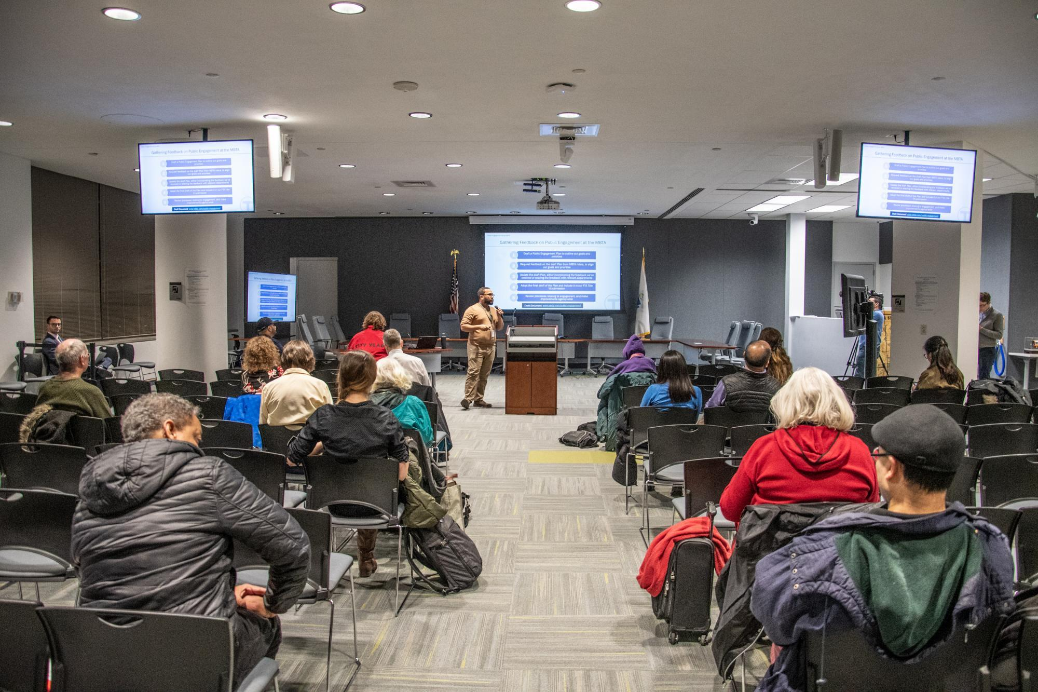
Integrated LLWRD Rulemaking
Outreach Efforts
Public meetings
  May 2023
  January 2024
  https://www.nrc.gov/waste/llw-disposal/decision-support/uw-streams.html
Advisory Committee on Reactor Safeguards (ACRS) meetings
  December 2023
  February 2024
ACRS Recommendation letter
  https://www.nrc.gov/reading-rm/doc-collections/acrs/letters/2024/index.html

Slide 11
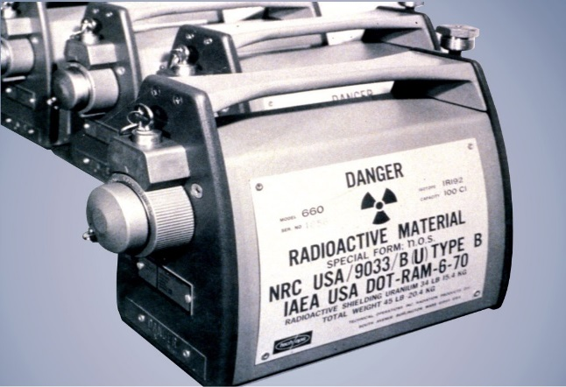
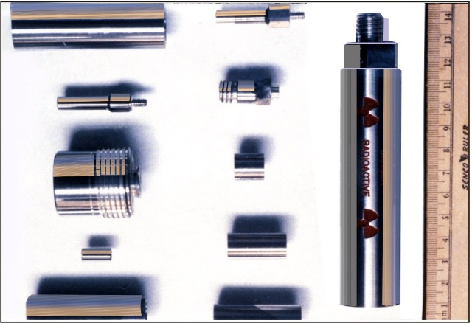
Financial Assurance for Disposition of Category 1-3 Sources Rulemaking
NRC staff preparing Regulatory Basis to expand decommissioning financial assurance (DFA) requirements for Category 1 & 2 (and possibly Category 3) byproduct material sealed sources
Current regulations in 10 CFR 30.35 do not require DFA for many licensees who possess these sources
Staff developing and analyzing several potential regulatory options
Next step: issue Regulatory Basis for public comment in early 2025
Staff rulemaking plan (SECY-16-0115) submitted October 7, 2016
Commission SRM issued December 8, 2021

Slide 12
Decommissioning Rulemaking
Update
Would implement specific regulatory requirements for different phases of the decommissioning process consistent with the reduced radiological risk. Topics include:
  Emergency preparedness
  Decommissioning funding assurance
  Environmental considerations
  Spent fuel management planning
  Record retention requirements
Final rule package submitted to the Commission January 2024 (SECY-24-0011; ML23258A200)
Next step: Commission review and vote on the final rule
Proposed rule published on March 3, 2022 (87 FR 12254)
Comment period closed on August 30, 2022

Slide 13
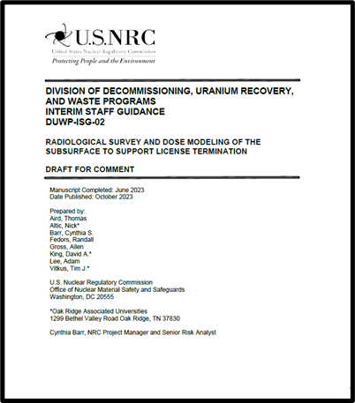
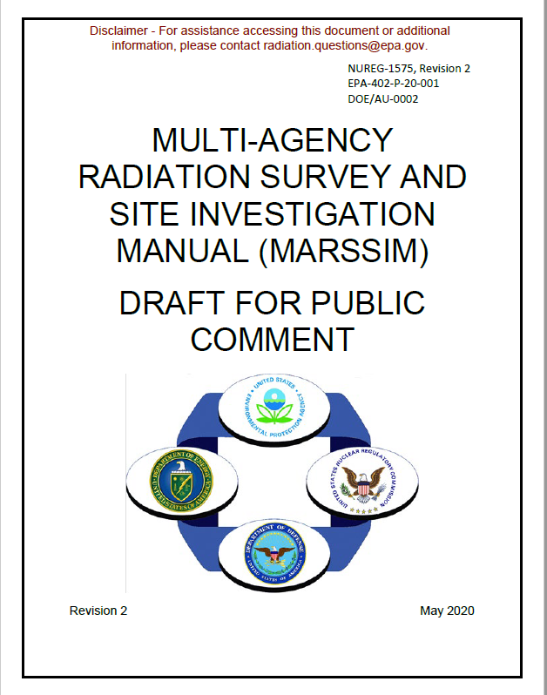
Improving Decommissioning Process Guidance
DUWP-ISG-02, “Draft Interim Staff Guidance: Radiological Survey and Dose Modeling of the Subsurface To Support License Termination”
NUREG-1575, Rev. 2, “Multi-Agency Radiation Survey and Site Investigation Manual (MARSSIM)”
DUWP-ISG-02 addresses surveys and dose modeling for residual radioactivity associated with open excavations, substructures and backfill materials
The draft was published on October 19, 2023 (88 FR 72122, ML23177A008)
Comments are currently being addressed and the final is expected to be issued in summer 2024
DUWP-ISG-02 will be included in next revision to NUREG-1757, Volume 2, Rev. 2
Issued for public comment in July 2021
Over 60 comments in 17 comment letters
Science Advisory Board peer reviewed
MARSSIM working Group is currently addressing comments
Estimated to be finalized in 2024
13

Slide 14

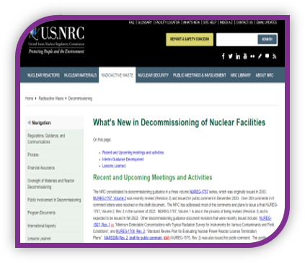
Enhancing Decommissioning Outreach
Webpage on NRC.GOV​
Keep Up-to-Date on Upcoming Workshops and Guidance Release
https://www.nrc.gov/waste/decommissioning/whats-new.html

Slide 15






Questions/Comments
Follow @NRCgov
Information on Radioactive
Waste Program: https://www.nrc.gov/waste.html
To subscribe to e-mail updates: https://www.nrc.gov/public-involve/listserver.html#lyris
15

Slide 16
Back-up Slide

Slide 17
Decommissioning Trust Fund and Major Radioactive Components During Operations
PETITION FOR RULEMAKING - In 2019, NRC received a petition for rulemaking requesting DTF access to pay for disposal of “major radioactive components” (MRCs) during operations. [Steam generators; reactor pressure heads]
In December 2021, the Commission approved publication of the Federal Register notice denying the petition for rulemaking;
Staff is currently finalizing Interim Staff Guidance (ISG) on this topic and has informed licensees that the final ISG will be published in spring/summer of this year.

