Slide 1
Opportunities Exist to Improve the Security of Disused Radioactive Sources
Low Level Waste Forum
April 4, 2024

Slide 2
Government Accountability Office (GAO)
GAO provides Congress, the heads of executive agencies, and the public with timely, fact-based, non-partisan information that can be used to improve government and save taxpayers billions of dollars.
Our work is done at the request of congressional committees or subcommittees or is statutorily required by public laws or committee reports.

Slide 3
Past Work on Security of Radioactive Materials
Socioeconomic of effects of a dirty bomb could be many billions of dollars (2019)
Potential for greater use of alternatives (2021)
Vulnerabilities persist in licensing radioactive materials (2022)

Slide 4
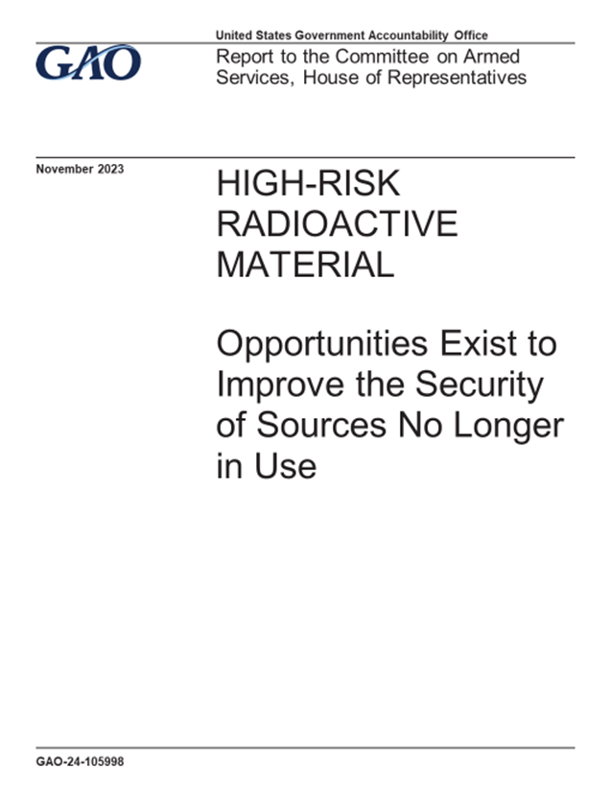
Our Most Recent Report:
GAO-24-105998

Slide 5
Report Background
Work undertaken for House Committee on Armed Services.
Builds off March 2023 national security memorandum establishing a comprehensive policy for securing radioactive sealed sources, including the permanent disposal or recycling of certain disused and unwanted radioactive sources.
Examined the factors that contribute to licensees delaying disposal of disused high-risk radioactive sources, and leading practices that, if implemented, could help address challenges related to the disposal of some disused radioactive sources.

Slide 6
Life Cycle of Sealed Radioactive Sources

Slide 7
Four radionuclides we looked at
Americium-241: Used in the oil and gas industry for well logging.
Cesium-137: Used in the medical industry for blood purification and medical research.
Cobalt-60: Used in the industrial sterilization industry.
Iridium-192: Used in the industrial sector for detecting cracks in welds.

Slide 8
Different disposal pathways for sources

Slide 9
Some factors contributing to delays in disposal of certain disused sources
The NRC does not require licensees to dispose of radioactive sources unless a licensee is terminating all activities under its license at specific locations.
Licensees do not have an option to dispose of GTCC from foreign-origin americium-241 sources.
Licensees may delay disposal of GTCC from cesium-137 sources and may rely on government assistance because of the high cost of disposal and the absence of a commercial GTCC disposal facility in the United States.

Slide 10
Disposal of Americium-241

Slide 11
Leading practices we identified
Tracking category 3 sources may help the NRC and agreement states ensure licensees maintain responsibility for the security and disposal of these sources.
Financial assurances may ensure that licensees plan for disposal of certain sources at the time of purchase.
Possession time limits and fees for disused sources may encourage licensees to promptly dispose of these sources.
Orphan source funds provide resources to properly dispose of lost or abandoned sources.

Slide 12
Recommendations
DOE and NRC, in consultation with other relevant stakeholders, should conduct an analysis to evaluate options and take action to facilitate long-term storage, within agency authorities, to better secure foreign-origin americium-241 until a permanent disposal or viable recycling option is available.
NRC should comprehensively assess leading practices that, if implemented, would minimize the time that disused sources are in a licensee’s possession. These practices include financial assurances for all category 1, 2, and 3 sources; tracking of category 3 sources; possession time limits or fees for disused sources; and orphan source funds.

Slide 13
Agency response to our report
DOE and NNSA agreed to conduct an analysis of options to better secure foreign-origin americium-241 until a permanent disposal or viable recycling option is available, and have initially set April 30, 2024, as the target date for completing their analysis.
NRC generally agreed with our recommendation on securing foreign-origin americium-241, but said that it would need to conduct a regulatory analysis prior to implementing the leading practices identified in our report.

Slide 14
Questions?

