Slide 1
Integrated Low-Level Radioactive Waste Disposal Rulemaking
Waste Management 24’ Session 023. Room 225AB
Daniel B. Shrum
Executive Director
Low-Level Radioactive Waste Forum

Slide 2
Summary
Disclaimer
From Previous episodes – Rule Status as of September 2017
SRM-SECY-20-0098
GTCC – what will the rule encompass?
Compliance Period –
Exception Clause –

Slide 3
Disclaimer
The following slides are my opinion – not the opinion of the Low-Level Radioactive Waste Forum
Nothing but respect for the work NRC staff has done on ensuring safe disposal of LLRW
10 CFR Part 61 has served the industry well – we must be mindful of how it gets modified

Slide 4
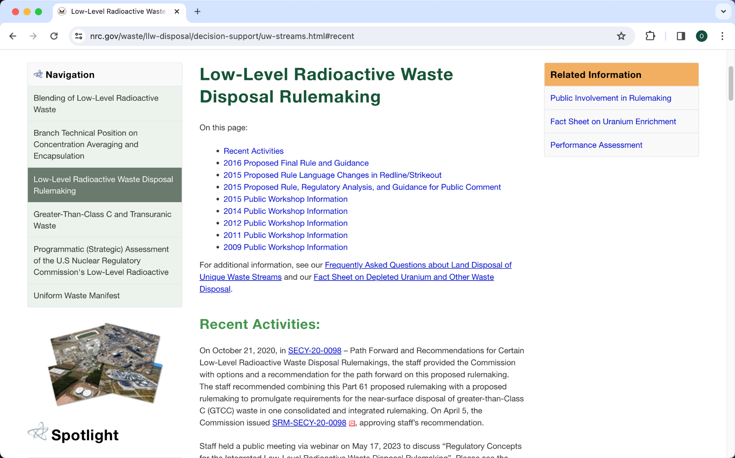
Previously on 10 CFR Part 61

Slide 5
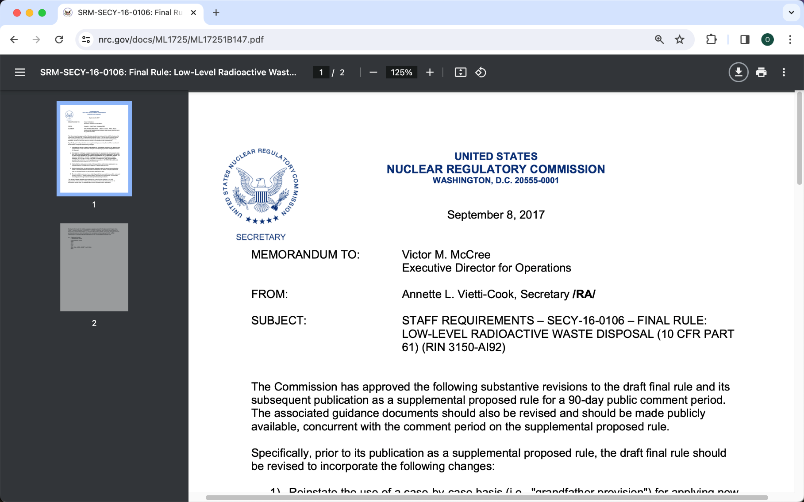
Previously on 10 CFR Part 61 SRM-SECY-16-0106

Slide 6
SRM-SECY-16-0106
Reinstate the use of a case-by-case basis for applying new requirements to only those sites that plan to accept large quantities of depleted uranium for disposal;
Reinstate the 1,000 year compliance period from the proposed rule with a specific dose limit of 25 mrem/year and adopt a longer period of performance assessment (the period of which would be based on site-specific considerations and a “reasonable analysis,” as defined in SRM-SECY-13-0075 ….;

Slide 7
SRM-SECY-16-0106
Clarify that the safety case consists of the quantitative performance assessment, as supplemented by consideration of defense-in-depth measures; and
Modify the draft final rule text addressing defense-in-depth to narrow its consideration solely to providing additional assurance in mitigating the effects of large uncertainties that are identified during the performance assessment; and
Be informed by broader and more fully integrated, but reasonably foreseeable, costs and benefits to the U.S. waste disposal system resulting from the proposed rule changes, including pass-through costs to waste generators and processors.

Slide 8
SRM-SECY-16-0106
Finally, the timing for the staff to prepare a regulatory basis for the disposal of Greater-than-Class C waste as directed in SRM-SECY-15-0094, “Historical and Current Issues Related to Disposal of Greater-Than-Class C Low-Level Radioactive Waste,” should be changed from the previous direction of within 6 months of the completion of the ongoing 10 CFR Part 61 rulemaking to 6 months after the publication of the supplemental proposed rule.

Slide 9
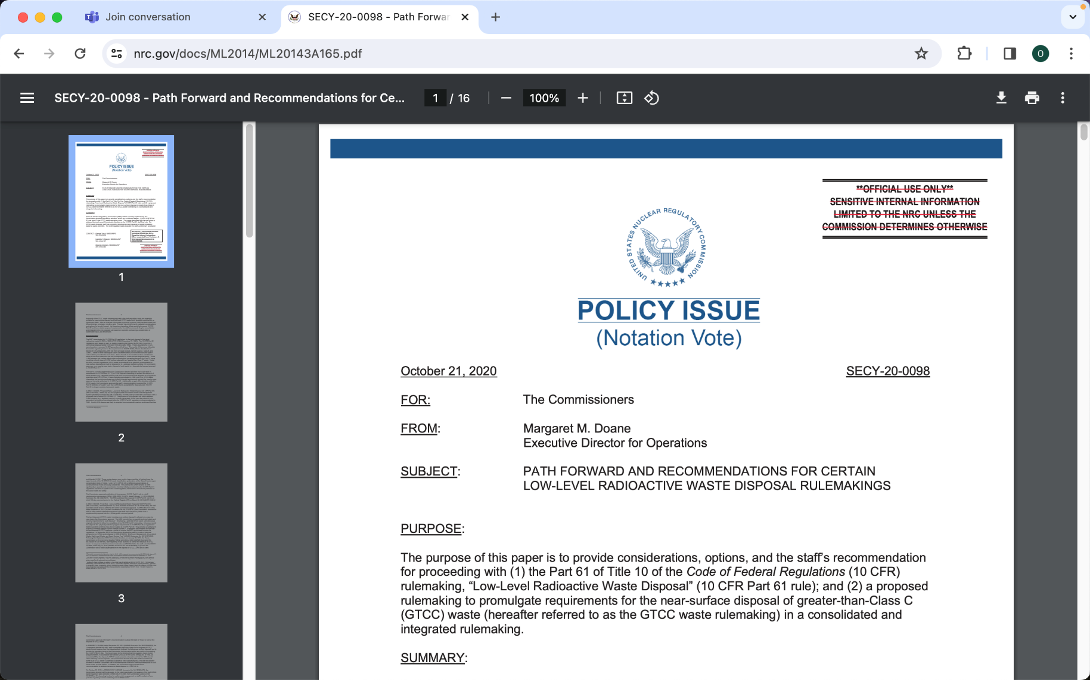
SECY-20-0098
(Option 1)
GTCC in rule

Slide 10
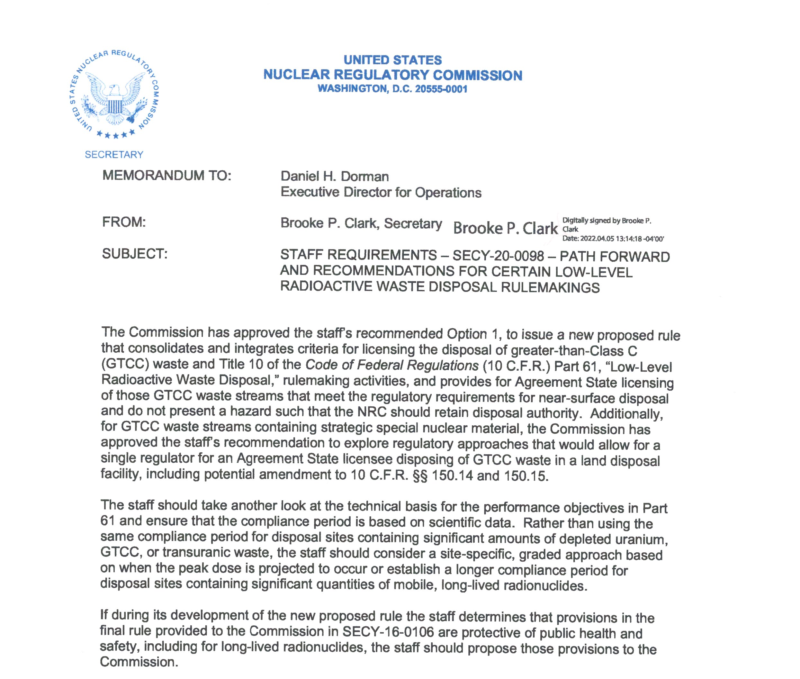
SRM-SECY-20-0098 (Option 1)

Slide 11
SRM-SECY-20-0098
Put GTCC into 10 CFR Part 61
The staff should take another look at the technical basis for the performance objectives in Part 61 and ensure that the compliance period is based on scientific data.
Rather than using the same compliance period for disposal sites containing significant amounts of depleted uranium, GTCC, or transuranic waste, the staff should consider a site-specific, graded approach based on when the peak dose is projected to occur or establish a longer compliance period for disposal sites containing significant quantities of mobile, long-lived radionuclides.

Slide 12
Greater-Than-Class C Waste
Disposal is preferable to Storage

Slide 13
Greater-Than-Class C Waste
The Low-Level Radioactive Waste Policy Amendments Act of 1985 (Amendments Act) states that GTCC waste, "result[ing] from activities licensed by the [NRC] . . . shall be disposed of in a facility licensed by the [NRC]." DOE was assigned responsibility for disposal of GTCC low-level radioactive waste (LLRW). The Act does not address Agreement State regulation of the disposal of GTCC waste generated as a result of [Agreement State] licensed activities. Also, Section 274 of the AEA provides for Agreement State licensing of disposal of byproduct material (i.e., GTCC waste) unless the Commission finds that "because of the hazards" or "potential hazards" it should be licensed by the Commission.

Slide 14
Greater-Than-Class C Waste
§ 61.55.a.2.(iv) Waste that is not generally acceptable for near-surface disposal is waste for which form and disposal methods must be different, and in general more stringent, than those specified for Class C waste. In the absence of specific requirements in this part, such waste must be disposed of in a geologic repository as defined in part 60 or 63 of this chapter unless proposals for disposal of such waste in a disposal site licensed pursuant to this part are approved by the Commission.

Slide 15
Greater-Than-Class C Waste
Will all agreement states assume regulatory authority over GTCC? (dual licensing at ISFSI facilities)
Will Compacts have authority over the movement of GTCC consistent with the LLRWPA?
Will Compacts have authority over the disposal of commercial GTCC if waste is going to an agreement state licensed facility?

Slide 16
Compliance Period
  Commission direction SRM-SECY-16-0106
  Commission direction has two options (SECY-20-0098)
    Peak dose or
    Use different compliance periods depending on the long-lived component of the waste
  Staff is considering the latter option – flexible and site-specific
  Compliance period of 1,000 years without significant quantities of long-lived radionuclides otherwise 10,000 years and performance period

Slide 17
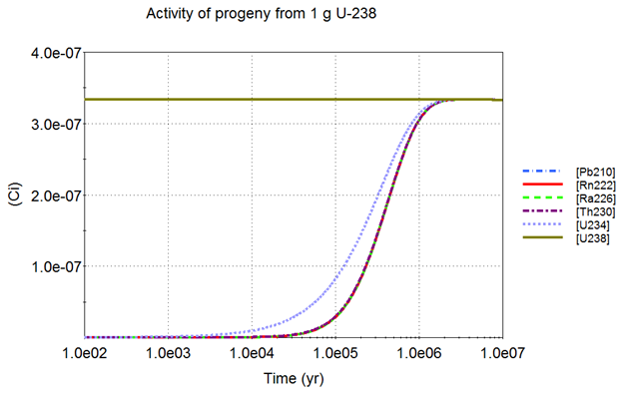
Compliance Period

Slide 18
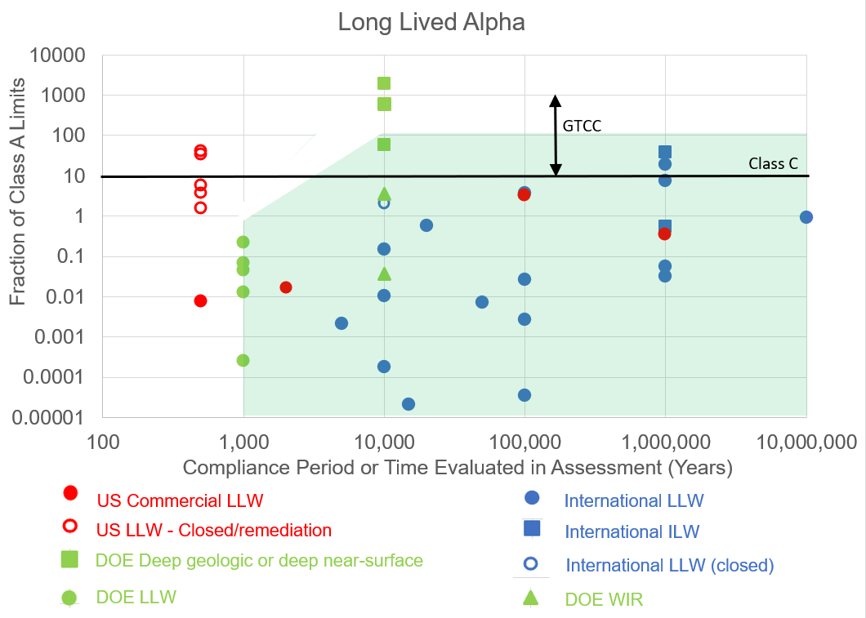
Compliance Period

Slide 19
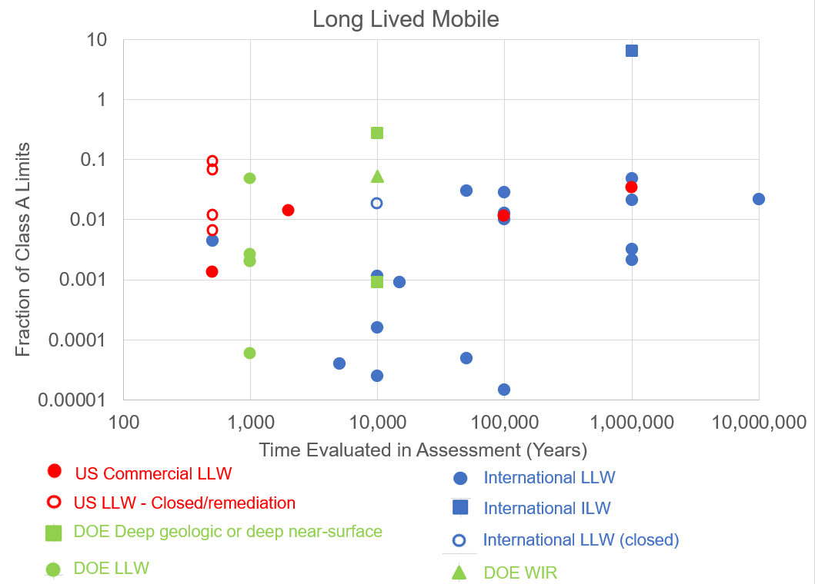
Compliance Period

Slide 20
Compliance Period
  A PA helps inform a licensing decision – based on my last several years – the PA IS the licensing decision. PAs have limits in evaluating uncertainty because of inputs – it doesn’t mean that sites can’t be licensed.
  Don’t stop the analysis but use a qualitative approach to address uncertainty.
  Vesna B. Dimitrijevic, January 7, 2024, ACRS meeting, “there are other ways to analyze uncertainty.”

Slide 21
Compliance Period
  NRC – if a site can’t be analyzed for X years, then maybe you don’t have the right site.
  Response – The uncertainty isn’t with the site, it is with the meaningfulness of the PA. The longer the PA analysis, the less it means.
  Models have limits – they are only as meaningful as the validation of the inputs.
  My goal is to get the next facility licensed - we need to have a reasonable and flexible approach.

Slide 22
Exception Criteria
§ 61.1 (a) The regulations in this part establish, for land disposal of radioactive waste, the procedures, criteria, and terms and conditions upon which the Commission issues licenses for the disposal of radioactive wastes containing byproduct, source and special nuclear material received from other persons. Disposal of waste by an individual licensee is set forth in part 20 of this chapter. Applicability of the requirements in this part to Commission licenses for waste disposal facilities in effect on the effective date of this rule will be determined on a case-by-case basis and implemented through terms and conditions of the license or by orders issued by the Commission.

Slide 23
Exception Criteria
§ 61.1 (a) The regulations in this part establish, for land disposal of radioactive waste, the procedures, criteria, and terms and conditions upon which the Commission issues licenses for the disposal of radioactive wastes containing byproduct, source and special nuclear material received from other persons. Disposal of waste by an individual licensee is set forth in part 20 of this chapter. Applicability of the requirements in this part to Commission licenses for waste disposal facilities in effect on the effective date of this rule will be determined on a case-by-case basis and implemented through terms and conditions of the license or by orders issued by the Commission.

Slide 24
Exception Criteria
§ 61.1 (b) (Purpose and scope)
  Exception criteria
    the land disposal facility license was originally issued before the effective date of this rule; and
    the licensee does not accept GTCC or a significant quantity of long-lived radionuclides after the effective date of this rule
Licensees who meet these exceptions do not need to comply with revised Technical Analyses (§ 61.13), revised Performance Objectives (§ 61.41 and § 61.42), and WAC (§61.58)
Excepted licensees would be required to comply with original Part 61 regulations for these sections above

Slide 25
Exception Criteria
§ 61.1 (a) Applicability of the requirements in this part to Commission licenses for waste disposal facilities in effect on the effective date of this rule will be determined on a case-by-case basis and implemented through terms and conditions of the license or by orders issued by the Commission.

Slide 26
Exception Criteria
If we all promise to not call it the Grandfather clause, which I agree is not an acceptable term, may we just leave the language the way it is? Introducing a new term will become problematic.

Slide 27
Thank You
Daniel B. Shrum
Executive Director
Low-Level Radioactive Waste Forum
llwforum.org

