Slide 1
DoD
Low Level Radioactive Waste
Lead Agent
Mike Kurth
HQ Joint Munitions Command
Rock Island Arsenal
Rock Island, IL

Slide 2
Mission
Safe, compliant, and cost-effective disposition of LLRW and mixed waste for DOD and other Federal agencies
Vision
The provider for DOD LLRW disposition, providing users with a seamless end of life cycle (treatment and disposal) for excessed low-level radioactive materials

Slide 3
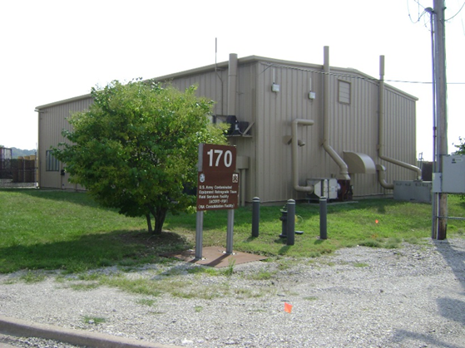
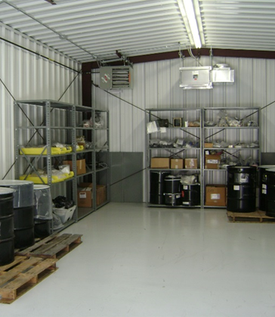
JMC LLRW Program Office
  Government Staff
    Technical Team – 8 Health Physicists (4 are Emergency Essential for Contingency Operations)
Morris Consolidation Facility (MCF)
    Unique Capabilities within all of DoD
    Allows In-House Acceptance of Most Types off Radioactive Material for Reuse, Recycle or Disposal
  Contractors
    Pack, Ship and Disposal Contracts
    Rapid Response

Slide 4
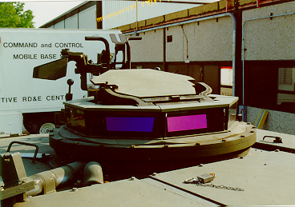
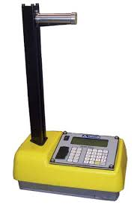
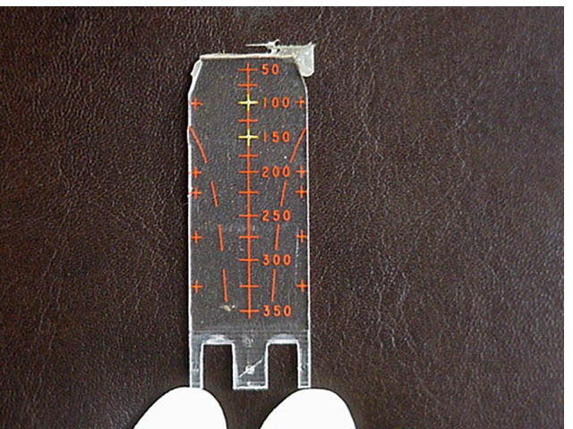
Common Waste Streams
Operations
Research & Development
Testing
Medical
Clean ups
  Ranges
  Base closures
  Reorgs
Depleted Uranium
  Munitions, armor
Radium/Tritium
  Luminescence
Sealed sources
  Chemical detection
Thorium
  Engines, optical lenses

Slide 5
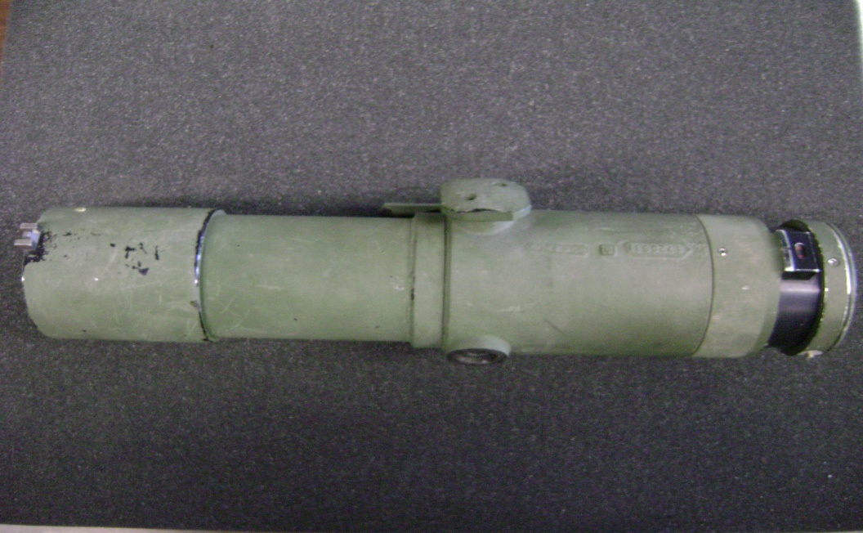
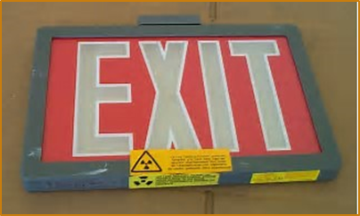
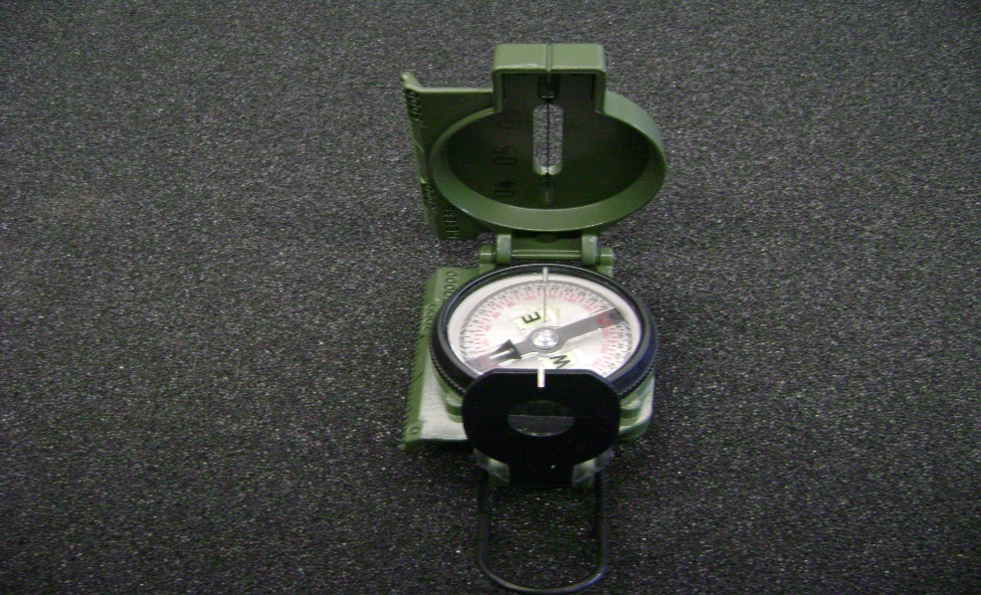
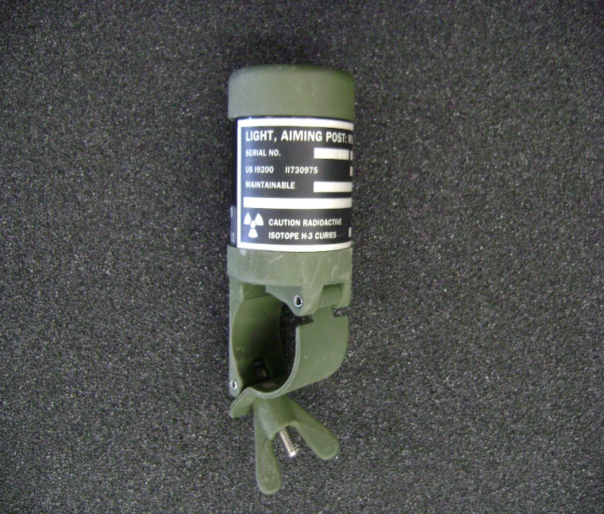
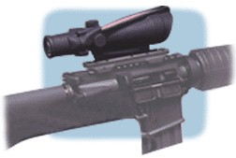

Slide 6
Program Complexities
Customer locations
  Approximately 500 U.S. military bases
    States with the most bases
      California, Texas, Florida, and Virginia
  Numerous U.S. military overseas locations
Military radioactive commodities
  1000’s of military radioactive items
Regulatory licenses
Army – 60 NRC licenses
Air Force and Navy – Master Material Licenses
Permits
  State of Washington – over 200 permits renewed annually

Slide 7
U.S. Military Radioactive Commodities
Recovered from the Public Domain
On occasion, the U.S. Military will be contacted about a military radioactive commodity found in the public domain
  Regulatory Considerations – DoD Instruction 4715.27, Low Level Radioactive Waste Program, guiding document
  Retrieve and safe storage at a military installation

Slide 8
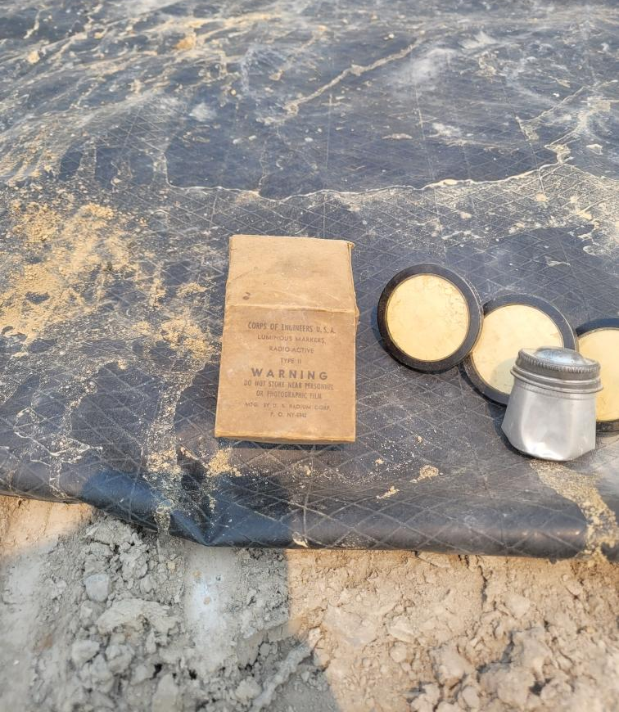
Example – Radium Deck Markers found at a New York Municipal Waste Transfer Station
Items were transferred to the Fort Drum, New York site
Military packed and shipped the items to the Morris Consolidation Facility, Rock Island Arsenal (NRC License Number 12-00722-15) for storage an eventual disposal

Slide 9
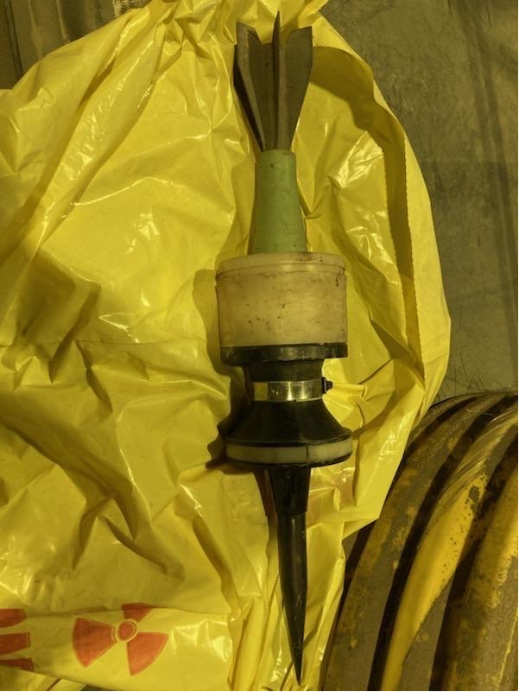
Example – Depleted Uranium (DU) Projectile Assembly Discovered at a Pennsylvania Waste Station
120 mm DU projectile assembly found at the waste station
Site reached out to local law enforcement and emergency responders for help
Military Explosive Ordnance Disposal (EOD) responded
  EOD determined item contained no explosives or propellants
  Took possession and transported the item to a New Jersey military base for safe storage
LLRW staff travelled to New Jersey to pack and ship the item to the Morris Consolidation Facility, Rock Island Arsenal (NRC License Number 12-00722-15) for storage an eventual disposal

Slide 10
Questions?
Mike Kurth
US Army, HQ JMC
Rock Island Arsenal
Rock Island, IL
Michael.f.kurth.civ@army.mil
Cyrus Turner
US Army, HQ JMC
Rock Island Arsenal
Rock Island, IL
Cyrus.e.turner.civ@army.mil
Breezy Coleman
US Army, HQ JMC
Rock Island Arsenal
Rock Island, IL
Breezy.n.coleman.civ@army.mil

