Slide 1
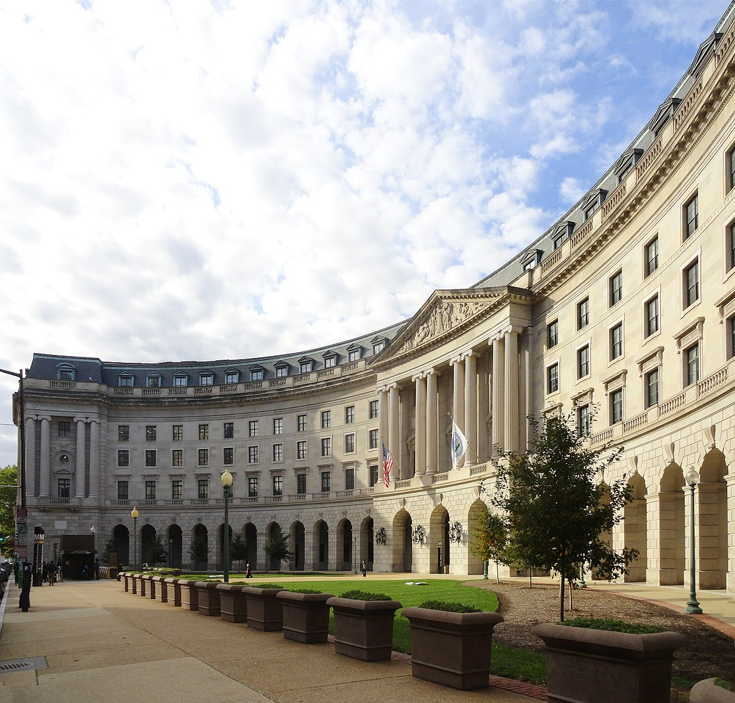
EPA Update
LLW Forum Spring Meeting
Orlando, Florida
Joseph Rustick, EPA Office of Radiation and Indoor Air
April 4, 2024

Slide 2
Overview of Presentation
Ukraine
INEX-6
Waste Isolation Pilot Plant (WIPP) Activities
  Planned Change Request for Additional Panels 11 and 12
NORM/TENORM
  Phosphogypsum
  Phil Egidi Retiring
Multi-Agency Radiation Site Survey and Investigation Manual (MARSSIM)
Federal Guidance
(Re)Examining EPA Standards

Slide 3
Ukraine
Situation at Zaporizhzhia Nuclear Power Plant (ZNPP) as of 22 March 2024
  All six reactors shutdown: 1 in hot shutdown and 5 in cold shutdown – over time shutdown reactors reduce risk of major radiological release
  Only two offsite backup power stations operational – 10 stations provided backup power before war
  IAEA closely monitoring maintenance, staffing, and the availability of spare parts to help prevent the risk of a nuclear accident
Elsewhere in Ukraine, the IAEA experts at the Khmelnytskyi and Rivne NPPs as well as at the Chornobyl site have reported that nuclear safety and security continues to be maintained, despite increased military operations
DOE/NNSA organized its 41st delivery of equipment to Ukraine to include radiation detection and monitoring equipment and related accessories such as portable power supplies and data acquisition systems

Slide 4
INEX-6 Exercise
The week of March 18th, 2024, EPA led a multi-agency national tabletop exercise under the NEA International Nuclear Emergency Exercise (INEX) series. This is the 6th iteration of the exercise, and the first one that the US has participated in recently
The focus of the exercise was on planning and preparedness for the transition and/or the late-stage recovery phases after a nuclear or radiological accident.
Four modules were conducted over 3 days:
  Health Impacts
  Food Safety
  Remediation and Decontamination
  Radioactive Waste Management
Notes:
Prepare some talking points on Module 4
It’s clear that during the Remediation and Deconmoiatnions, need to be thinking about the waste management aspects
One of the issues in the remediation as well as the waste amnagetmnet is the question of temporary and intermin staging; need to be aware of the staging when doing the remediation (too late one you get to the waste management portion)
Mention that Liberty RadEX came up during the exercise

Slide 5
WIPP Planned Change Request
Modification of the repository design from 10 to 12 Waste Panels
On March 14th, DOE submitted to EPA a Planned Change Request (PCR) per 40 CFR 194.4(b)(3) to modify the repository design from 10 to 12 Waste Panels
To account for the Land Withdrawal Act waste emplacement volume lost in Panels 9 and 10 due to the radiological event in 2014, DOE has submitted a repository design that adds two new waste panels (11 and 12) by expanding the repository to the west of the current footprint
The new panels and access drifts will be tied into the new waste shaft (Shaft #5) that is currently being constructed
EPA has begun a review of the PCR
EPA will also be conducting a public outreach program later this year in NM

Slide 6
Phosphogypsum Update
EPA is evaluating a request from The Mosaic Company for a test road on at their New Wales facility in Florida
  Segments constructed using different mixtures of phosphogypsum and other materials
Florida DOT had requested some modifications to the original project design
On August 23, 2023, Mosaic submitted a revised request, lengthening the test sections and adding an additional section to test a fourth road base mixture.
On November 27, 2023, EPA held a technical meeting with Mosaic’s technical team to discuss the study design.
Mosaic submitted additional material to EPA in February 2024 based on the technical meeting with EPA
  EPA is in the process of evaluating this new material
  All material submitted to EPA to date is available on EPA’s Phosphogypsum webpage

Slide 7
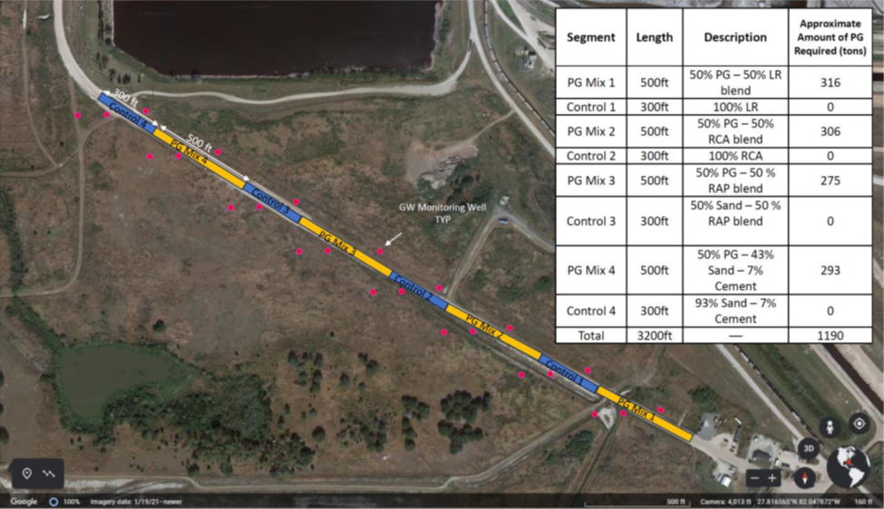
Phosphogypsum
Mosaic pilot road study

Slide 8
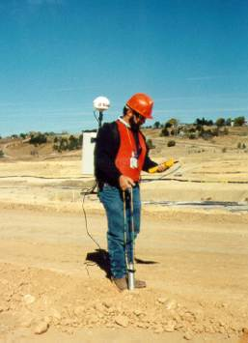
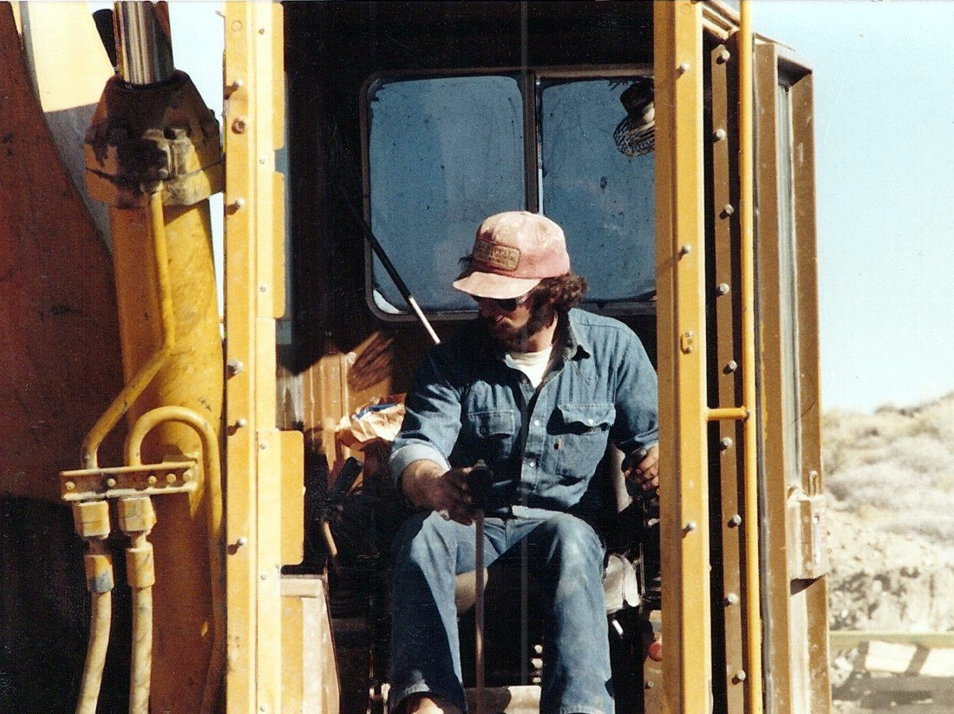

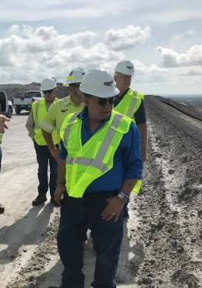
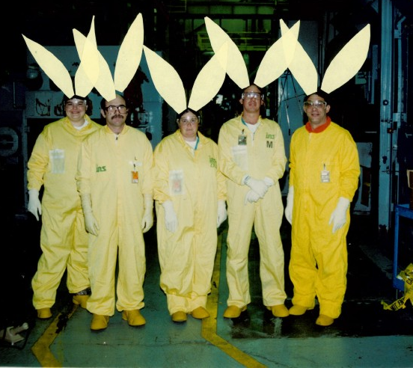
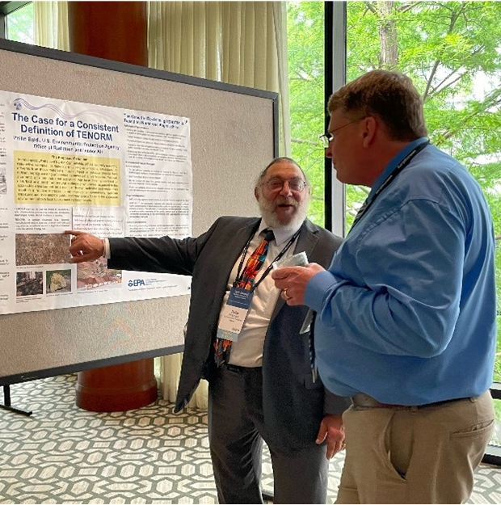
TENORM
Continuing to study certain industrial sectors for TENORM including rare earth minerals
Phil Egidi retired at the end of March
Jon Major will be taking over a number of TENORM duties

Slide 9
Multi-Agency Radiation Site Survey and Investigations Manual (MARSSIM)
Version 2 of MARSSIM
  Follows EPA Science Advisory Board report in 2022 and public comment
  Presentation was done at the Waste Management 2024 Symposium
  Workshops and longer-form training on Version 2 under development
Key issues addressed in Version 2
  Use of Scenario B (assumed to meet criteria until proven otherwise)
  Site-specific scanning surveys
  Measurement Quality Objectives and measurement uncertainty
  Continuously collected data
  Improved discussion on setting the Lower Bound of the Gray Region
  Multiple areas of elevated activity
  Updated instrumentation information and aerial surveys
Right now the document is undergoing technical editing, and then it will have to get approval from four federal agencies, which may take some time. No estimate is reliable at this time, but the hope is to have it issued in 2024.

Slide 10
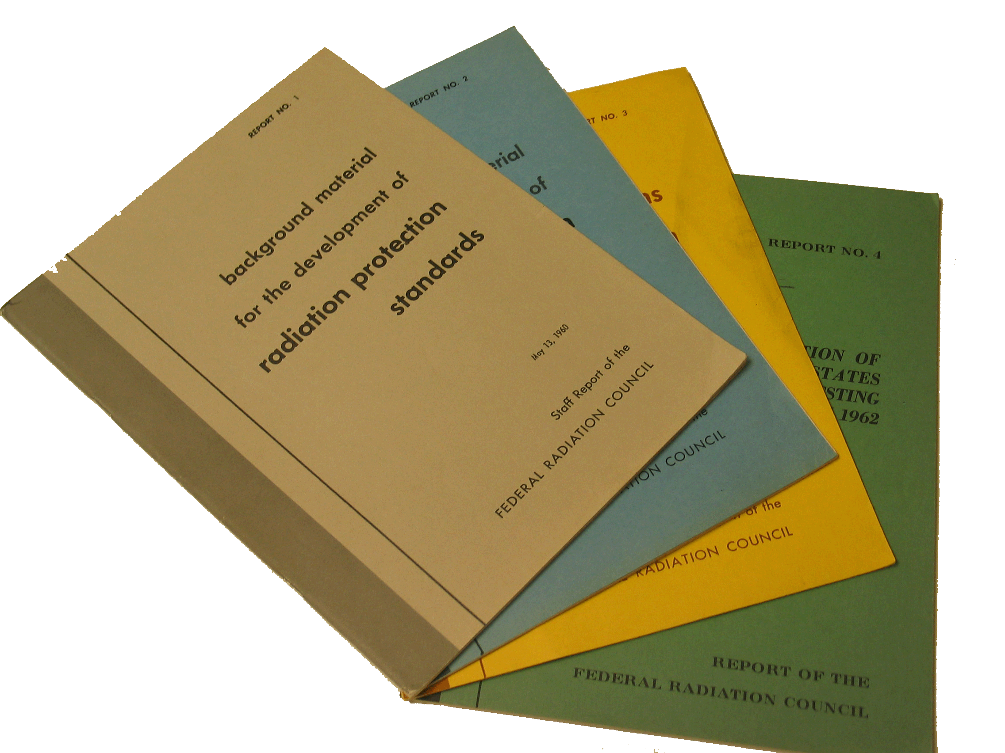
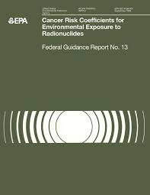

Federal Guidance Report No. 16
Cancer Risk Coefficients for Environmental Exposure to Radionuclides
FGR 16 provides cancer risk coefficients for estimating population radiogenic cancer risks (morbidity and mortality) from environmental exposures to radionuclides.
FGR 16 updates and expands Federal Guidance Report No. 13 (1999).
Risk coefficients are provided for internal exposure from ingestion (water and diet) and inhalation, and external exposure from air and soil.
The report is undergoing peer review by an EPA Science Advisory Board panel of experts.
Publication is expected in 2025.
Examples from the Federal Guidance Report Series
Notes:
Compared to FGR 13, FGR 16 includes:
Increased number of radionuclides considered and updated nuclear decay data
Updated biokinetic models
Updated dosimetric models
Updated U.S. population demographic data
Updated cancer risk models based upon ~20 more years of data.

Slide 11
(Re)Examining EPA Standards
ANS gave its recommendations for new EPA radioactive waste disposal standards in August 2023 (https://www.ans.org/policy/repositorystandard/)
Several recent conferences have focused on advanced reactors and their fuels & wastes (Waste Management Symposia and NCRP annual Meeting)
EPA has identified a potential need to re-examine and update regulations, such as for nuclear fuel cycle operations and for generic disposal standards
40 CFR 190 (from 1977) for electricity related nuclear fuel cycle operations
EPA staff are thinking about how the new SMR uses might affect 190
  For example, the current text within 190 only references electric power generation, and does not mention process heat or hydrogen production
Notes:
We have addressed the ANS report and have talked to ANS in previous meetings; looking at the recommendations seriously
EPA and DOE have entered into an MOU on DOE information sharing with EPA around a whole new program for deep geologic disposal

Slide 12
Questions?
https://www.epa.gov/radiation

