Slide 1
Florida Department of Health
Travails of Historical Low-Level Waste Disposal
Clark Eldredge
Chief, Bureau of Radiation Control
Florida Department of Health
April 4, 2024

Slide 2
Site Use Application
On March 2, 1966, Florida State University submitted a Special Use Application to the State of Florida to use property in the Apalachicola National Forest as a waste burial site for radioactive contaminated wastes generated at the University.

Slide 3
USDA Permit
On June 14, 1966, the University received a Special Use Permit from the USDA to use property in the Apalachicola National Forest as a waste burial site for radioactive contaminated wastes generated at the University.
Notes:
Covered .36 Acres
Conditions included placing 7x8ft 4in thick slab over each waste pit of 8 x 7 ft & 8 ft deep
Burials 6 feet apart
Initially allowing only 2 burials per year, but stating 12 per year max
Three monitoring wells 12 ft west of the chain link fence at north, center and south points of the fence
Liquids to be buried in glass, metal or plastic containers
Other materials in carboard cartons, barrels, wood boxes and some low-level waste without a container.

Slide 4
Burial Site Approval
On March 13, 1967, the Florida State Board of Health granted a Special Use Permit to FSU for that purpose.
Notes:
One year later

Slide 5
Initial Burial Site Plan
Initial site plan allocated as many as 40 separate pits on the site.
FSU RADIOACTIVE WASTE BURIAL SITE #2
Cover
Slab or not
Waste
Notes:
Not all pits were capped at direction of hydrologist/geologist as it would have interfered with the ability to sample the site.

Slide 6
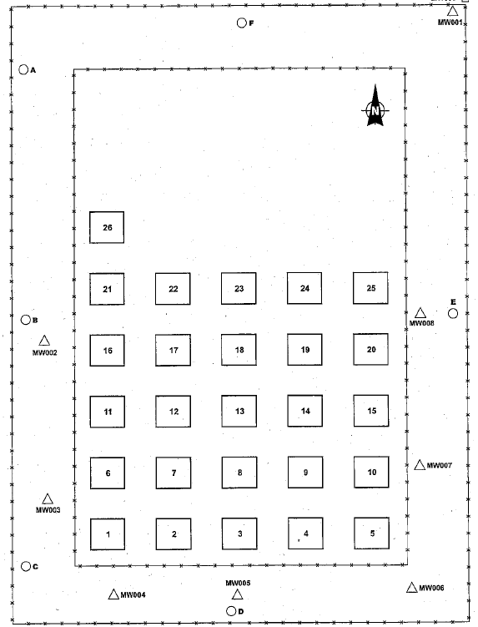
Actual Burial Site
Swapped order of pit identifiers. No longer North to South & West to East, but South to North & West to East.
Six wells, three on West side & one each on North, East, & South.
Notes:
Eventually 6 piezometric monitoring wells were installed
Used 26 pits from 1967 to 1979
While site is rectangular, it wasn’t perfectly N-S.

Slide 7
1988 Preliminary Assessment
In 1988, a preliminary assessment of the burial site completed for the USDA.
Notes:
Environmental Assessment preformed according to CERCLA and SARA
Good news, The soil exposure pathway does not appear to present a substantial risk and no apparent release through surface water pathway, but considered possible pathway
PA (preliminary assessment) score of 38.16 when 28.5 or greater receive further action recommendations

Slide 8
Preliminary Assessment Conclusion
Ground Water Conclusions:
A release of hazardous substances to groundwater is suspected.
Annual analysis of groundwater from monitoring wells has shown that low level radioactivity has reached perimeter of site.
No information is available as to whether this plume has migrated beyond the monitoring wells.
One domestic well 1.5 miles to the south is considered a primary target for contamination, although actual contamination is unlikely.
Notes:
Βασεδ ον:
• Λαχκ οφ σαμπλινγ σιτεσ −> No data are available on how far contamination in the groundwater may have spread.
• No data are available on whether or not local wetlands and the Lost Creek receive water from groundwater filtering through the site.
• Unable to determine mobility factors due to Very little data are available on what specific contaminants, other than radioisotopes, may be present.

Slide 9
Preliminary Assessment Summary
Preliminary assessment recommended additional groundwater and soil sampling be conducted.
Sampling will:
Determine presence of RCRA listed wastes
Determine whether contamination has moved beyond site periphery

Slide 10
Preliminary Assessment Conclusions
Recommendations included:
Testing for Volatile organic compounds, Semi-volatile organic compounds, Pesticide/Poly-chlorinated biphenyls, total metals, radioactive analytes
Groundwater sampling at existing six wells to determine presence of groundwater contamination
Soil (hand auger) sampling with area of pits 1-26 and outside security fence perimeter to determine contamination from leakage
Notes:
While there did not appear to be a high potential for surface water contamination, due to the amount of cover (i.e., concrete slab and soil) over the buried waste. A release through soil or air exposure is expected to be minimal, due to condition of cover at the site, limited access, and lack of reported odors or wind erosion.

Slide 11
2003 Site Investigation
Site Investigation report for the Florida Department of Environmental Protection from 2003 included surface radiation surveys as well as groundwater laboratory analysis.
Notes:
Eight temporary monitoring wells installed around site
(MW001 through MW008)

Slide 12
2003 Site Investigation Results
Surface radiation surveys:
Background radiation approximately 2.5 µR/hr.
Measurements over majority of site less than 2x background.
Highest levels measured along southern boundary
Groundwater VOCs:
Samples GW003 and GW006 exhibited total xylene above FSDWS and GWCTL.
In each site sample, one or more VOCs were detected at level below regulatory limit
Notes:
Safe Drinking Water Standards
Ground water cleanup target levels

Slide 13
2003 Site Investigation Results
Groundwater metals:
Chromium, mercury, aluminum, manganese and vanadium detected above regulatory limits in one or more samples
Groundwater radionuclides detect above regulatory limits:
Gross alpha above 15 pCi/L measured in samples GW003 through GW007
Combined Ra-226/Ra-228 greater than 5 pCi/L in samples GW003 through GW007
Gross Beta on GW003, GW005 and GW007 above 50 pCi/L
Notes:
Based on the measured water levels, shallow groundwater flow on the site was generally southerly. An easterly component of flow also appeared to be present on the southwestern-most portion of the site.

Slide 14
2012 Site Investigation Report
2010-2012, the Florida DEP commissioned a supplemental site investigation examining previous study data.
Notes:
Five (5) new permanent on-site monitoring wells (MW009-MW013) were installed around the perimeter of the FSU-LLRW-2. MW009 id was reused.
Radionuclide groundwater concentrations have decreased below GCTLs (Groundwater and Surface Water Cleanup Target Levels)
Surface radiological data was essentially the same 2.4 uR/hr
Groudwater flow south – southeast across site

Slide 15
2012 Supplemental Recommendations
Surface radiation surveys:
Recommended every five years.
Next recommended survey November 2015
Groundwater surveys:
Based upon 2010 and 2011 groundwater analytical results, recommend delineation of 1,4-dioxane groundwater impacts and installation of downgradient monitoring wells in Apalachicola National Forest.
DEP is unable to obtain site access with USFS for this purpose.
Recommend biennial groundwater monitoring in MW009 through MW013

Slide 16
2017 Expanded Site Inspection
USDA Forest Service commissioned an expanded site inspection report in 2017.
Notes:
They used the 5 of previously installed monitoring wells added 4 off site piezometer wells
1,4-dioxane and select radionuclides were detected in all 4 off-site groundwater at concentrations greater than their respective screening criteria
Gross Alpha and Beta and Radium-226 and -228 were detected in all off-site piezometer wells. Lead-210 was detected in PW01 at a concentration of 1.3 pCi/L. Radionuclide concentrations exceeded EPA drinking water standards in 3 of 4 offsite wells, PW02, PW03 and PW04.

Slide 17
Findings - Recommendations
“Additional Delineation Sampling: Currently the full extent of the 1,4-dioxane plume is unknown east of the site. The plume appears to have been delineated to the south but extends further from the site than was estimated based on 2011 groundwater sampling.”
“Permanent monitoring wells should be considered for installation, downgradient in the proximate locations of PW02 and PW03 to monitor off-site groundwater contaminant concentrations.”

Slide 18
Remedial Action Options
“1. Hydraulic Isolation-installing an impermeable slurry wall to a depth of 30-40 feet around the perimeter of the FSU-LLRW-2 using a single-pass trencher or large capacity excavators.”
“2. Source Removal-the removal of all low-level radiological wastes at the FSU-LLRW-2 for off-site disposal. Buried wastes sit below the water table and dewatering may be required in a source removal operation.”

Slide 19
2018 Phase II Environmental Site Report
Notes:
The presence of groundwater contamination from 1,4-dioxane, radium 226 and 228, and gross alpha activity was confirmed. Contaminants exceeding GCTLs have moved downgradient with groundwater flow to the south and southeast. It is apparent that the source of these contaminants is the radiological burial site

Slide 20
Remedial Considerations
“The primary contaminants of concern at this site are radium 226 and 228, 1,4-dioxane, and gross alpha activity. All of these contaminants were found at elevated concentrations well beyond the established burial site perimeter. Peak concentrations for 1,4-dioxane and gross-alpha activity were detected well downgradient of the burial pits suggesting that releases of chemical and radiological contaminants in groundwater may have occurred in the past.”

Slide 21
Remedial Considerations
“The screening level risk assessment completed in 2017 as part of the initial ESI determined that there are unacceptable risks to human health at the site resulting from concentrations of 1,4-dioxane and radium components. Concentrations of 1,4-dioxane and select radionuclides (gross alpha activity, radium-226 and 228) detected during the Phase II ESI in 2018 are generally comparable to 2017 ESI data. Screening risk conclusions from the 2017 ESI are considered representative of the current data set.”
Notes:
Discussed entombment with concrete surround, cap and dewatering system and source removal operation
For 1,4-dioxane include:
Ex-situ groundwater treatment using advanced oxidation techniques,
Granular activated carbon (GAC), and
Bioremediation performed in-situ or ex-situ (EPA, 2006).
Radionuclides
identified groundwater plume extends over an estimated area of approximately eight (8) acres
Response options for the off-site groundwater contamination include pump and treat systems, and direct injection of remedial amendments

Slide 22
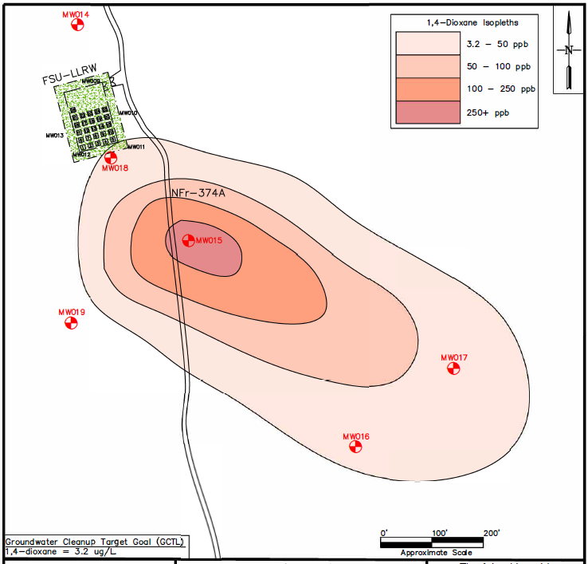
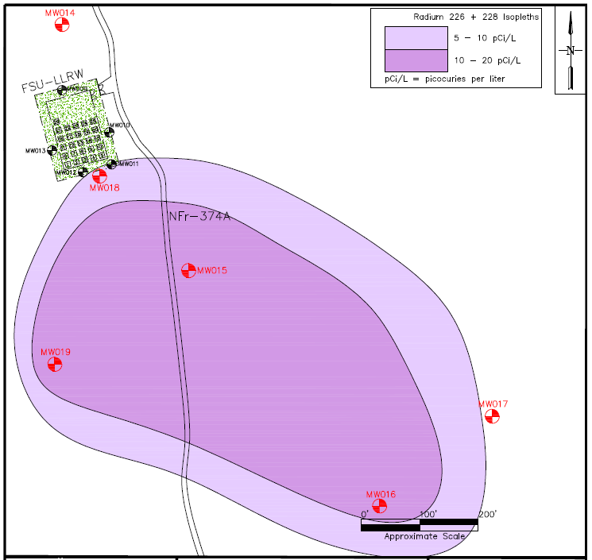
2017 - 2018 Plume Maps

Slide 23
Engineering Evaluation/Cost Analysis

Slide 24
Remediation Alternatives
“The presence of contaminated groundwater several hundred feet downgradient of the site was observed and necessitated the development of both radiological source treatment and contaminated groundwater treatment options. The following removal alternatives were evaluated in this EE/CA:
• Alternative 1 - No Action
• Alternative 2 - Source Treatment: Contaminated waste removal and off-site disposal
• Alternative 3 - Source Treatment, followed by: Monitored Natural Attenuation (MNA) for Groundwater
• Alternative 4 - Source Treatment, followed by: Targeted In-Situ Treatment for 1,4-dioxane and MNA for Groundwater
• Alternative 5 - Source Treatment, followed by: Interceptor Trench and Ex-situ Pump and Treatment Plan for 1,4-dioxane and radionuclides in Groundwater.”

Slide 25
Estimated Remediation Costs
Remediation Costs for Source Removal Range from $0 (no action) to $4.3M depending on extent of the project.

Slide 26
Estimated Remediation Costs
Remediation Costs for Site Groundwater Treatment range from $1M to $19.5M depending on extent of the project.
Notes:
2021: Action Memorandum is to document the decision to proceed with a Non-Time-Critical
Removal Action (NTCRA) for the removal and off-site disposal of buried low-level radiation waste and
remediation of groundwater

Slide 27
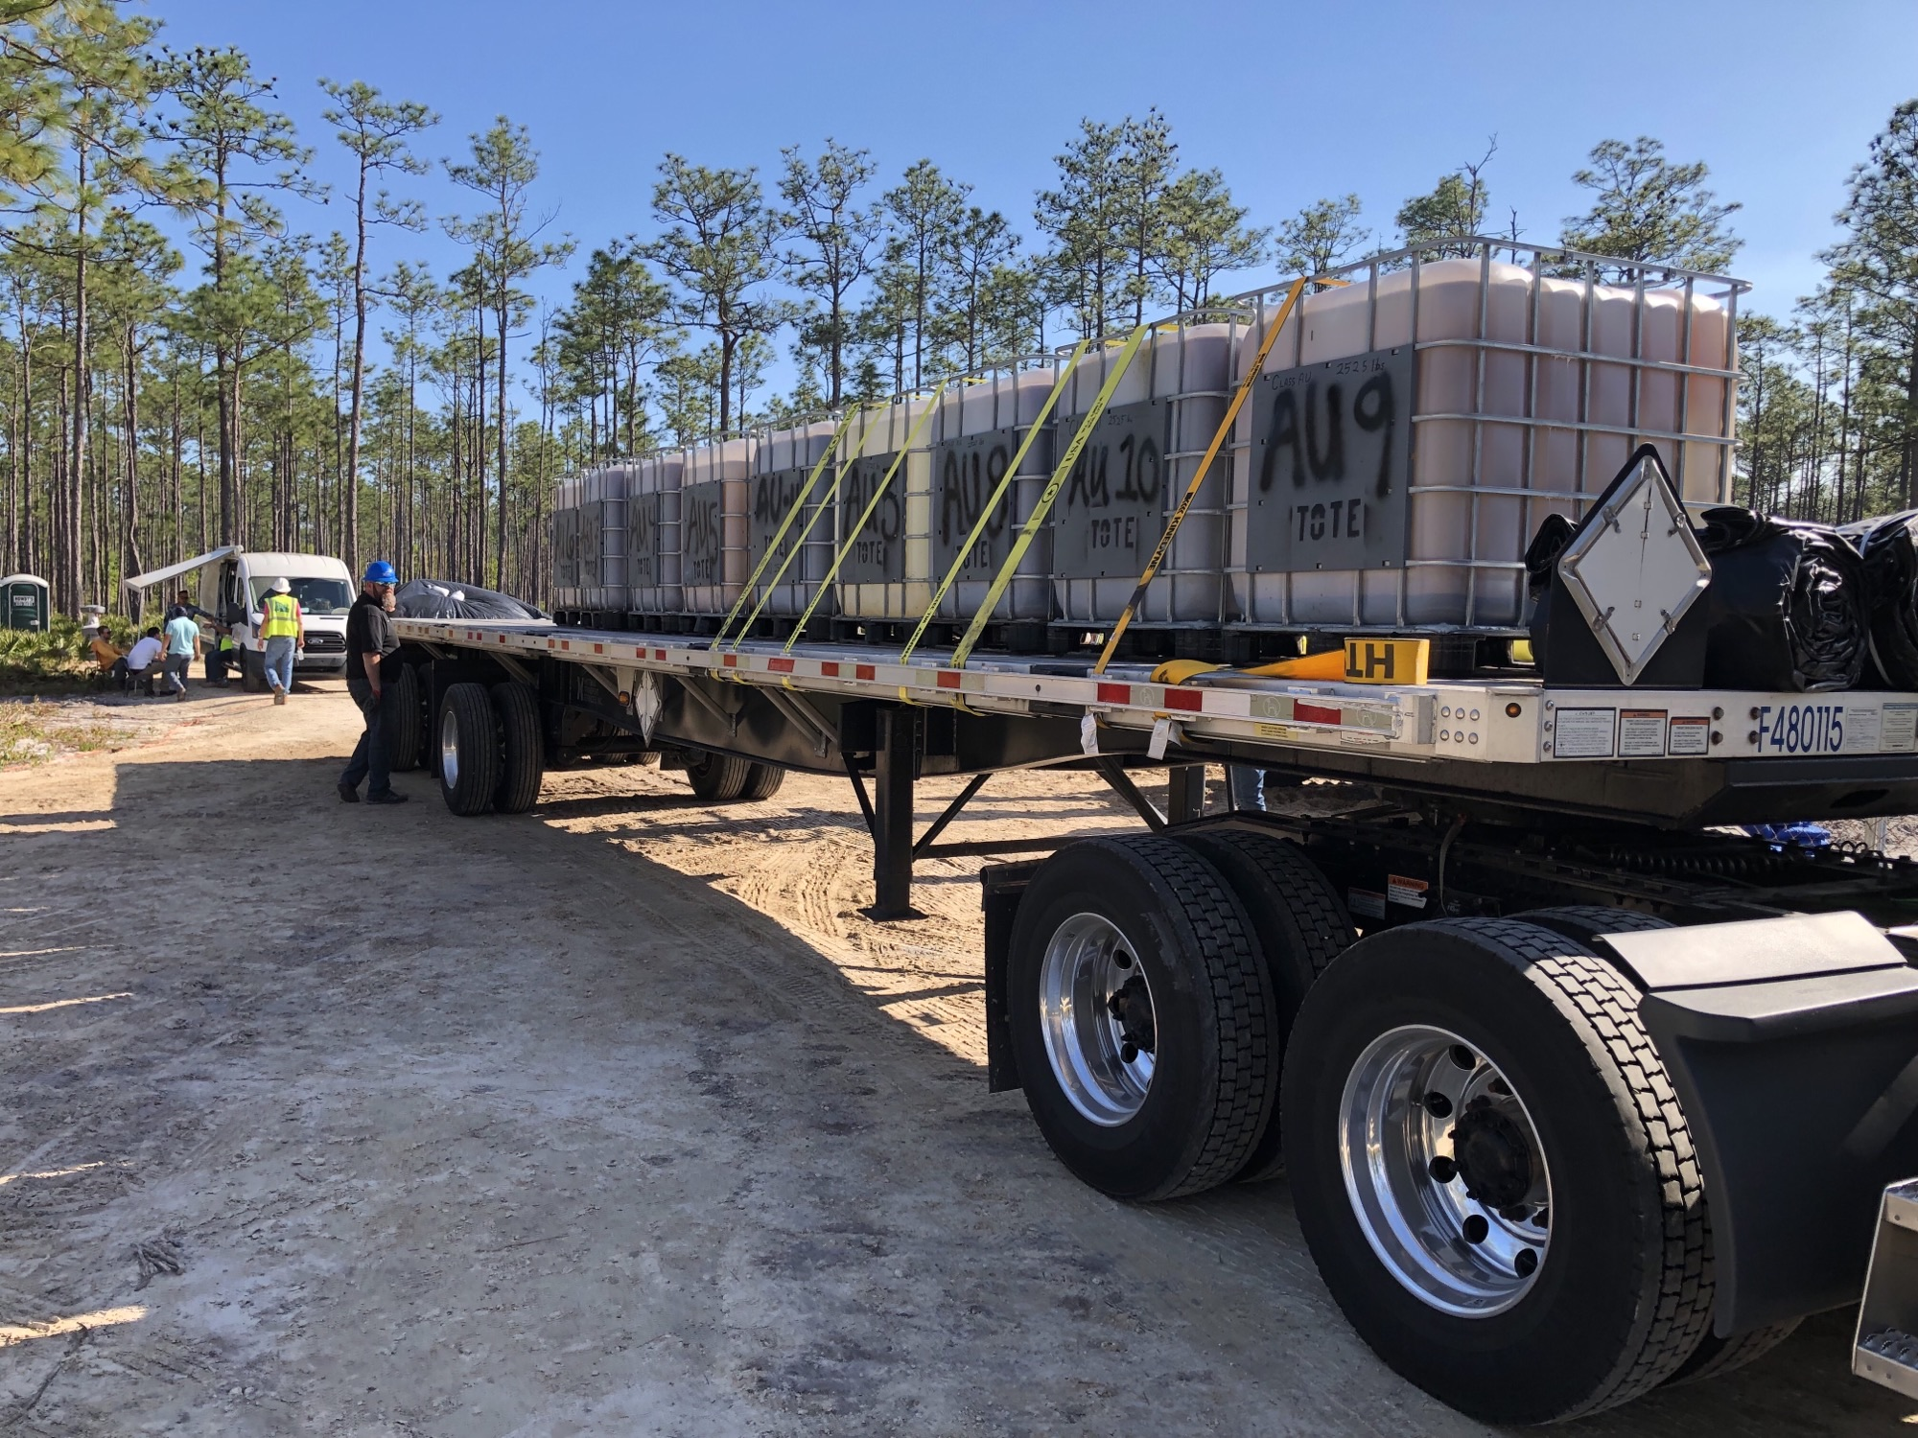
Soil Excavation
Removal of waste involved 23 truck loads and 9315 cubic feet of material.
Waste shipped to Clive, UT for disposal.
Notes:
Staff experiences

Slide 28
Project Status
Source removal and off-site disposal phase is complete.
Beginning to gather subcontractor quotes for the next phase of Targeted In-Situ Treatment.

Slide 29
Contact Information
Clark Eldredge
Chief, Bureau of Radiation Control
Florida Department of Health
850-245-4266
clark.eldredge@flhealth.gov

