Slide 2
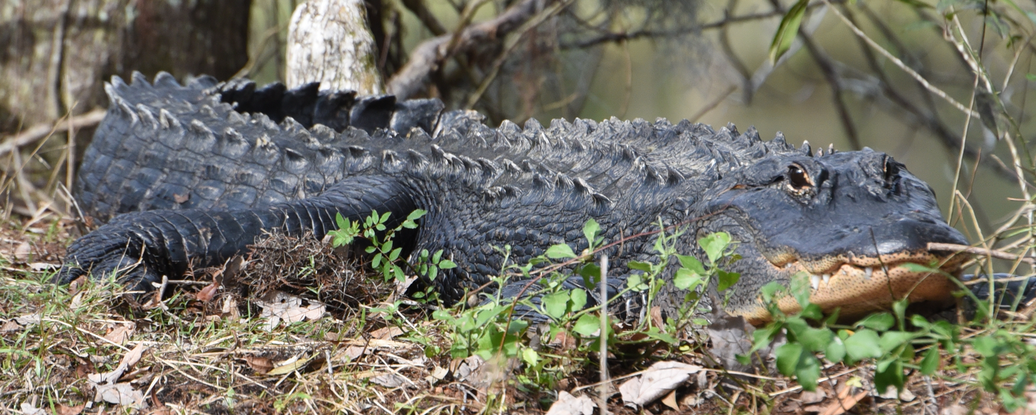
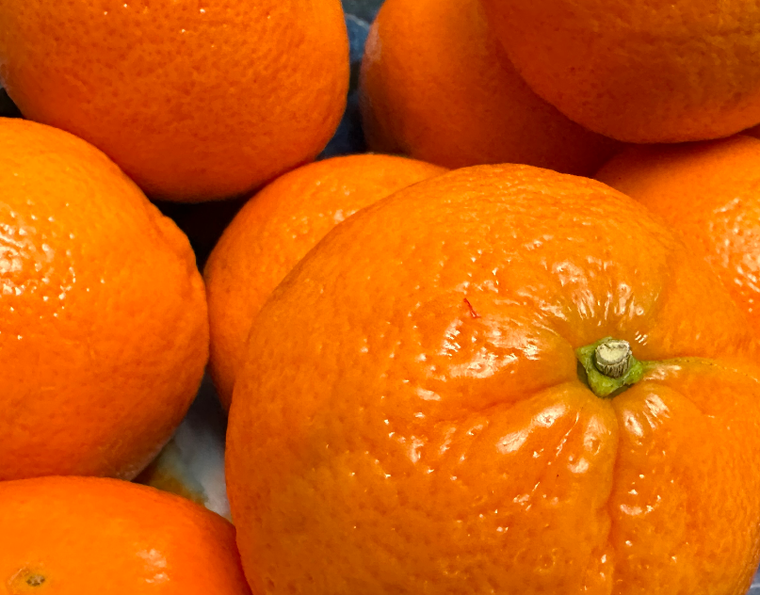
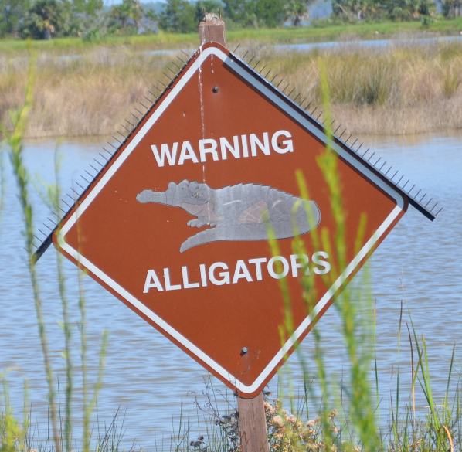
We Have

Slide 3
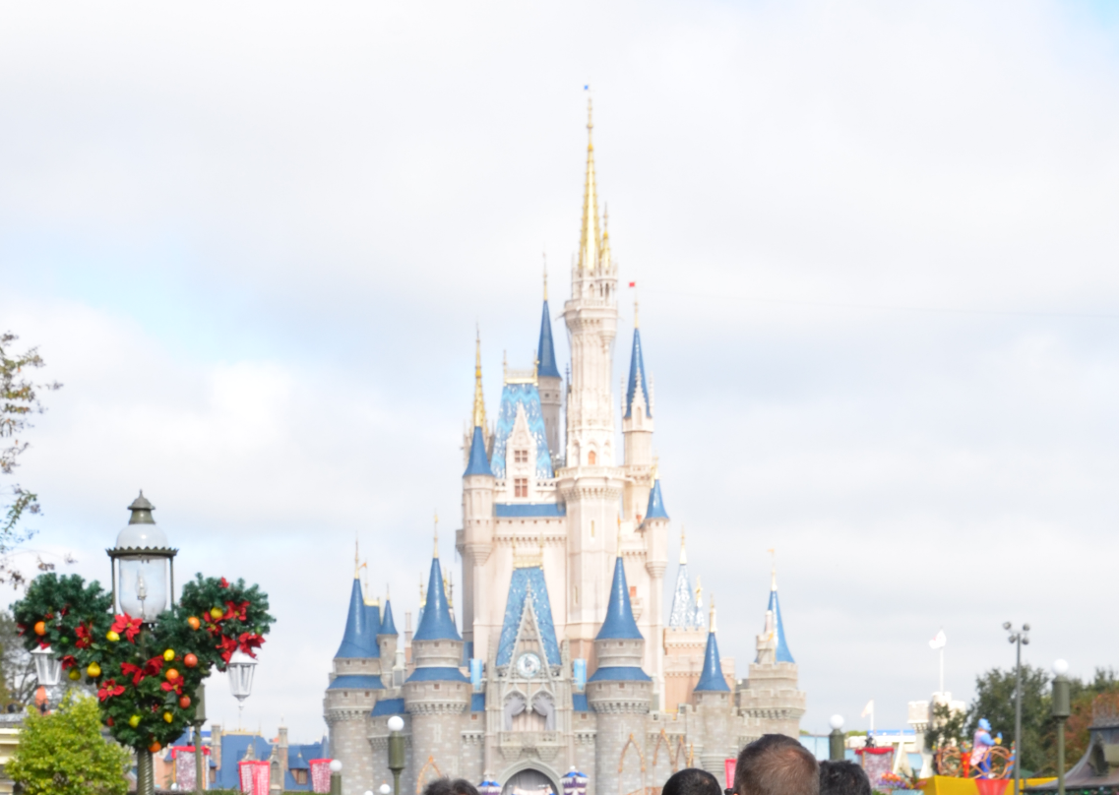
We Have

Slide 4
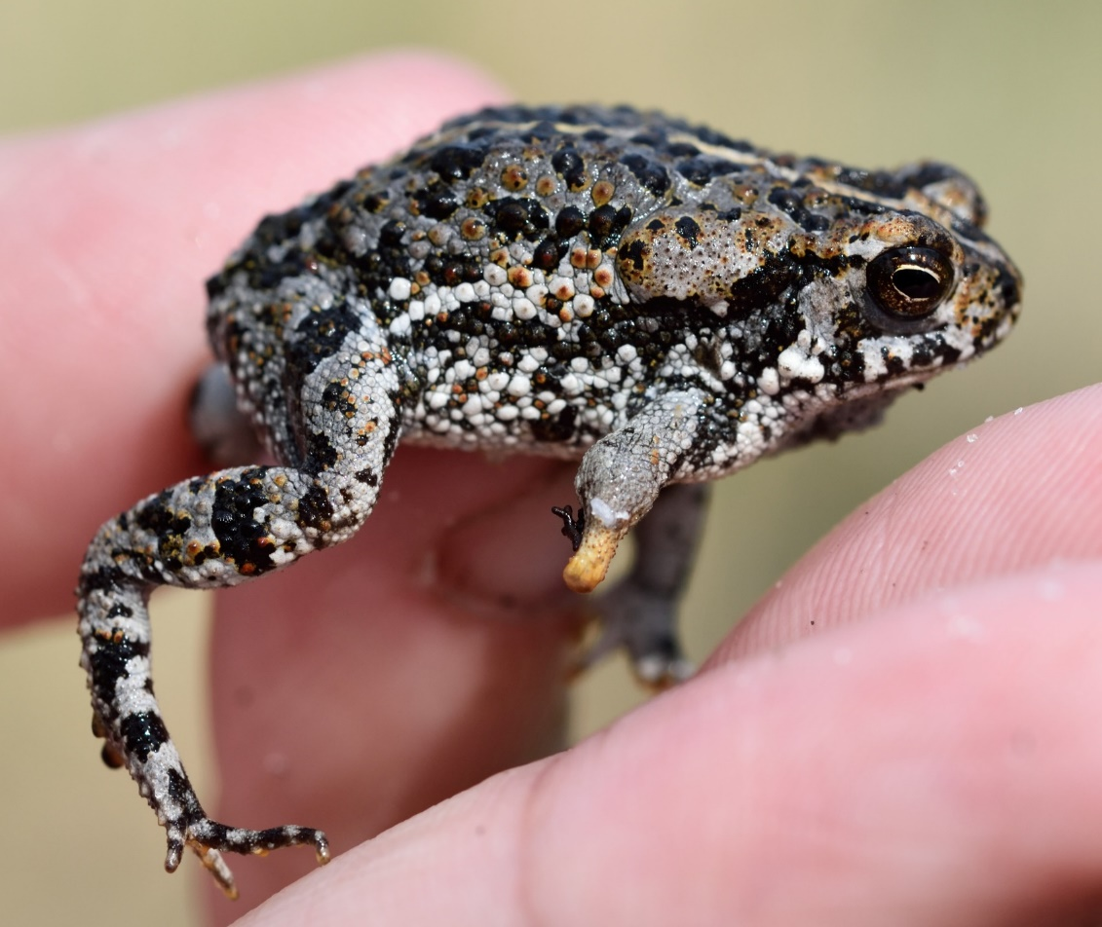
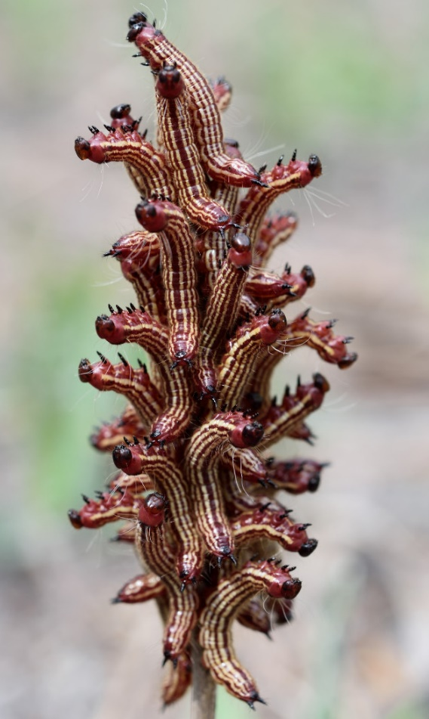
We Have
Florida
Man

Slide 5
We Have
1527 Specific Radioactive Materials Licensees (2nd largest in nation)
401 Industrial Licenses
1030 Medical Licenses
16 Academic Licenses
Two active nuclear power plant sites
Turkey Point (TP), 30 miles S of Miami in Homestead
St. Lucie (SL), on S. Hutchinson Island near Ft. Pierce
Crystal River (CR) Unit 3 nuclear power plant in process of decommissioning

Slide 6
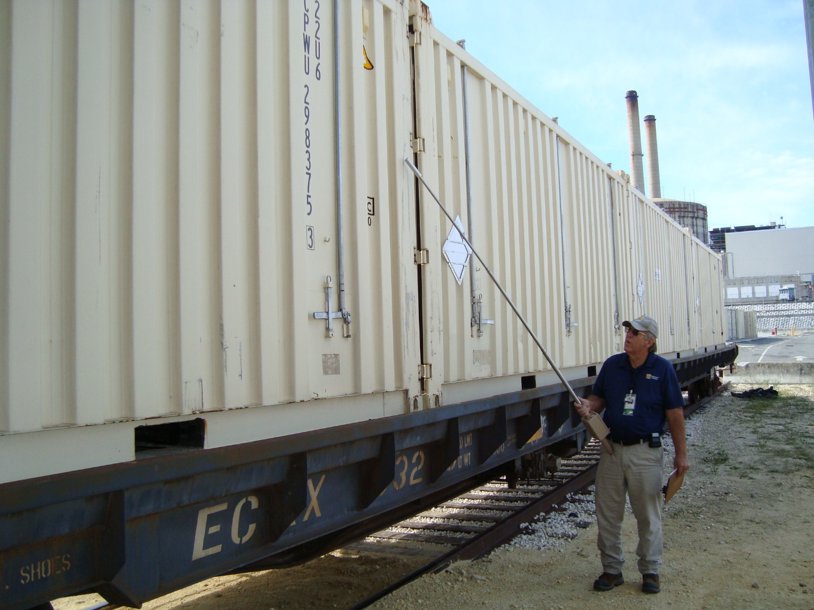
We Have
Low Level Waste Inspection Program
Includes standard shipment transports, packages, drums, B-25 boxes, Intermodal containers and casks
Also includes material from CR Unit 3 decommissioning including
Reactor Head
Steam Generators

Slide 7
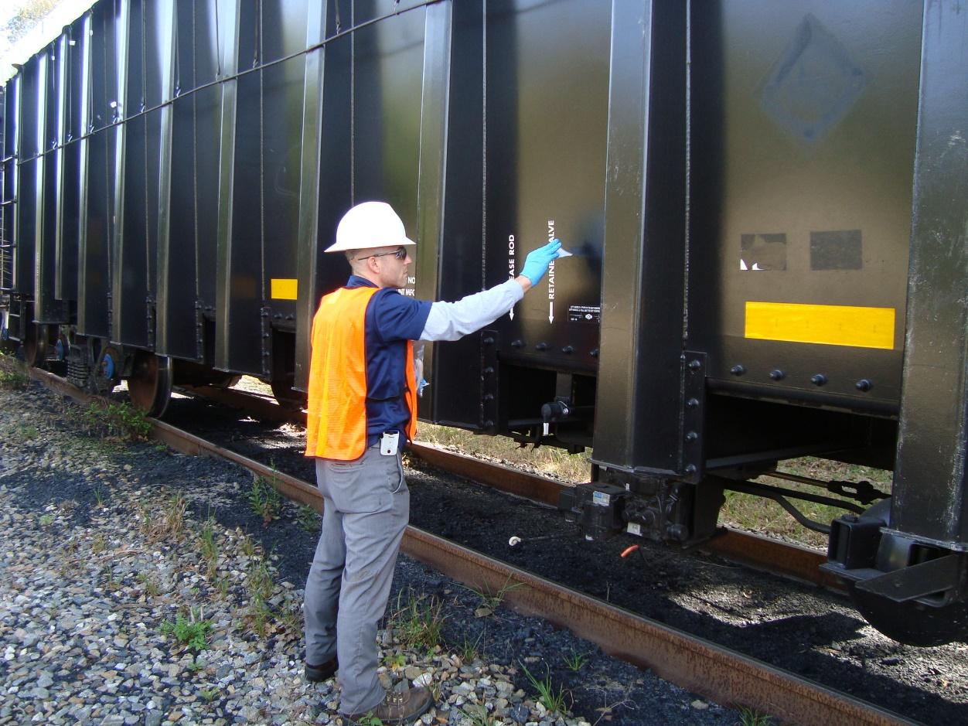
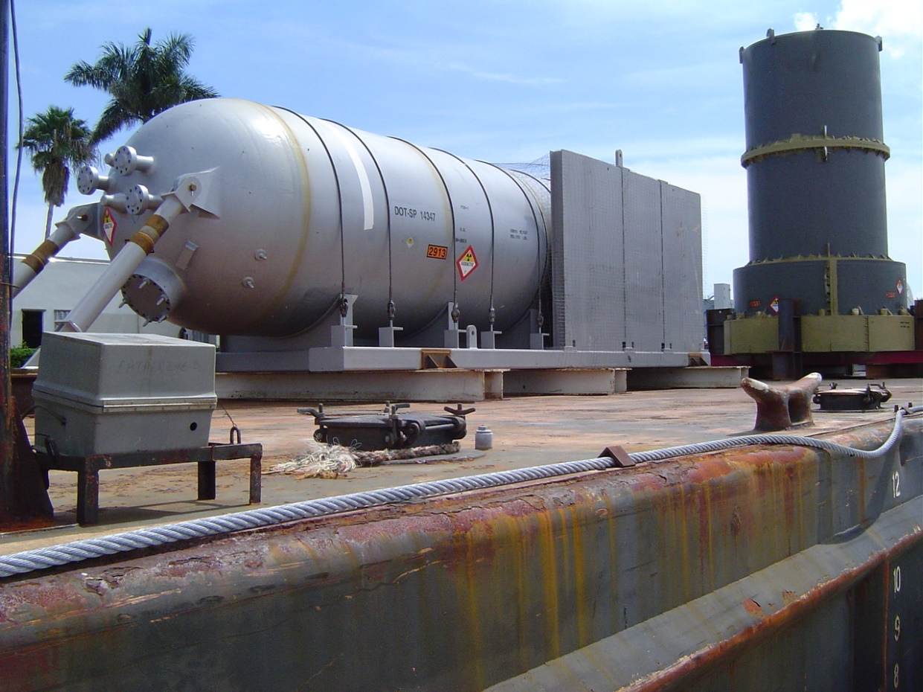
LLRW Shipments
Rail car at CR Unit 3 – Dec 2020
Steam Generator from SL - 2006
Notes:
Sent MS via intercoastal

Slide 8
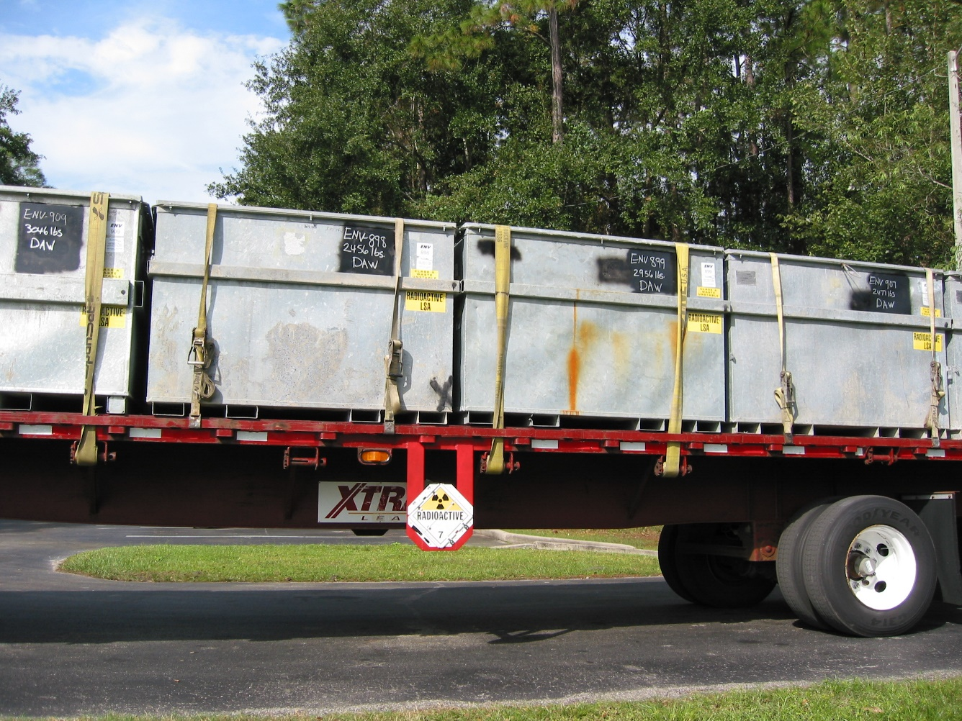
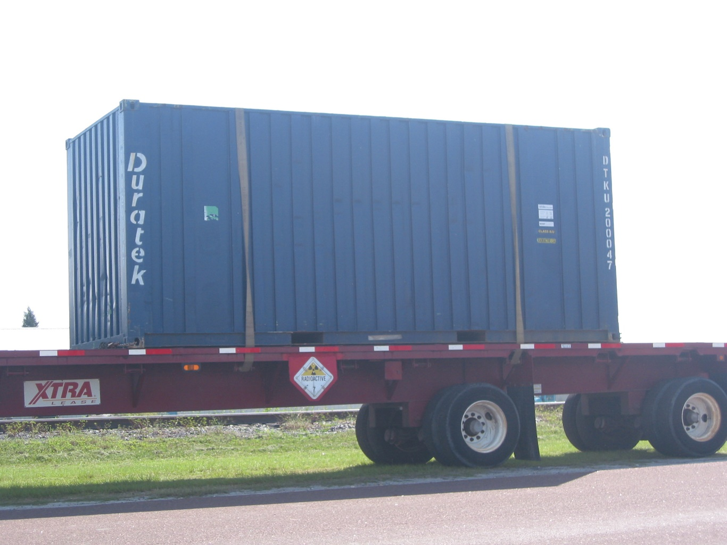
LLRW Shipments
B-25 Boxes of DAW at Permafix - 2003
Intermodal at Crystal River - 2003
Notes:
Dry active waste, Permafix Florida’s sole processing facility

Slide 9
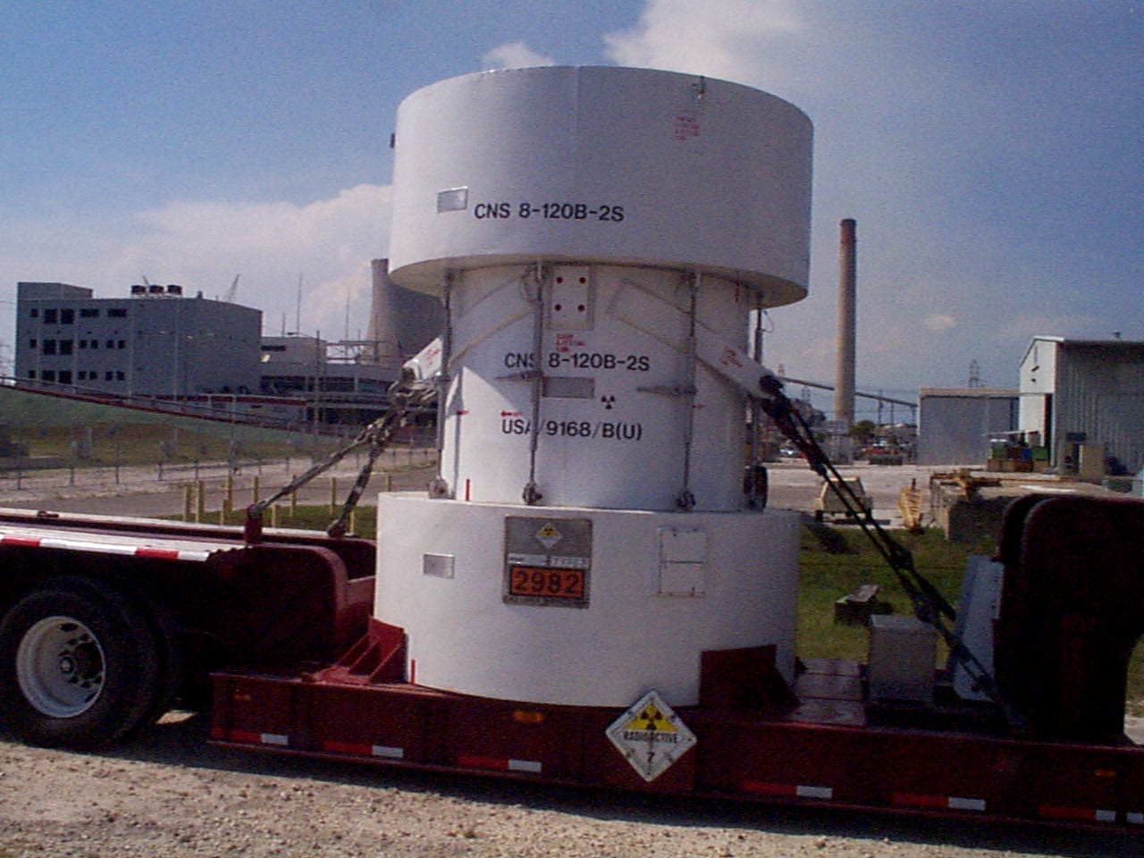
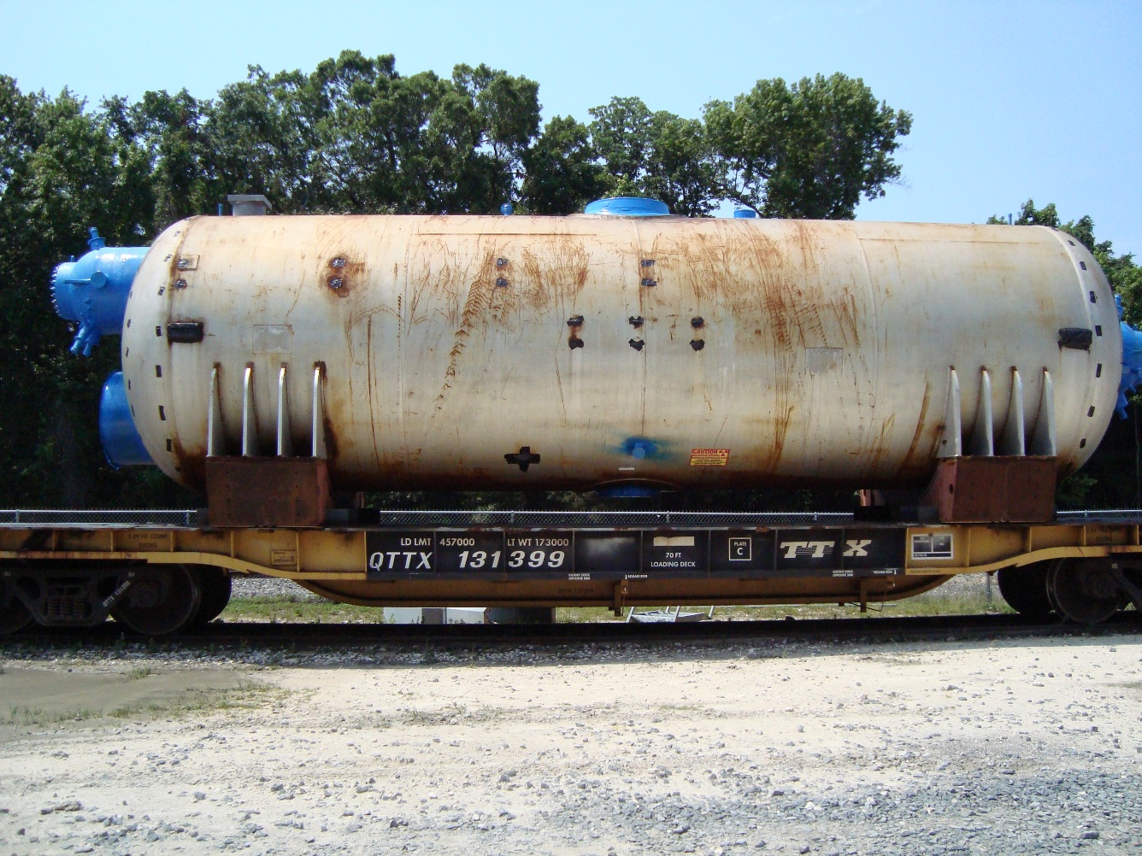
LLRW Shipments
Steam Generator from CR Unit 3 - 2011
Resin Cask at CR Unit 3 - 2002
Notes:
½ of 600 MW Steam generator

Slide 10
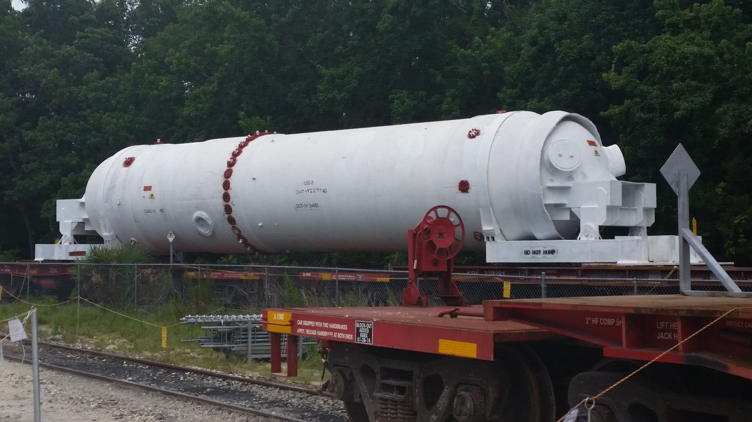
LLRW Shipments
Steam Generator on Rail Car at CR Unit 3 - 2016
Notes:
DOT Special permit 14455
½ of 900 MW Steam generator

Slide 11
We Did
Calendar Year 2023
168 Shipments inspected
37 shipments from CR Unit 3 decommissioning
31 Shipments from TP
23 Shipments from Florida State University
21 Shipments from Permafix
17 Shipments from SL
224,819 Cubic feet of waste shipped
126,979 Cubic Feet from CR Unit 3
39,681 Cubic Feet from TP
21,789 Cubic Feet from Permafix

