Slide 1
Overview of the LLW Forum’s Disused Sources Working Group Michael Klebe October 3, 2023

Slide 2
DSWG Current Membership
Members:
Joseph Klinger, CMCC – Chair Earl Fordham, WA
Rich Janati, PA John Williamson, FL
Larry Kellum, UT Michael Kurth, US Army
Dane Blakinger, WA Tom Hansen, SECC
Organizational Liaisons
Randall Redd, CRCPD Craig Little, HPS
Augustinus Ong, OAS
Staff
Dan Shrum Michael Klebe Cecilia Snyder

Slide 3
Disused Sources Working Group Origin
DSWG formed in 2011 at the request of the NNSA/GTRI to address the problem of disused radioactive sealed sources
Approximately 2 million sealed sources in use
Tens of thousands disused sources with no exact knowledge of number, activity, and storage security

Slide 4
Disused Source Problem Contributing Factors
Life-cycle costs for managing and disposing of sources not internalized
Inconsistent view of which sources pose a security threat
Regulatory system inadequacies for a post-9/11 threat environment
No financial incentive for reuse, recycle, or disposal
Opportunities for recycling and reusing sources are underutilized
Type B shipping container availability and cost

Slide 5
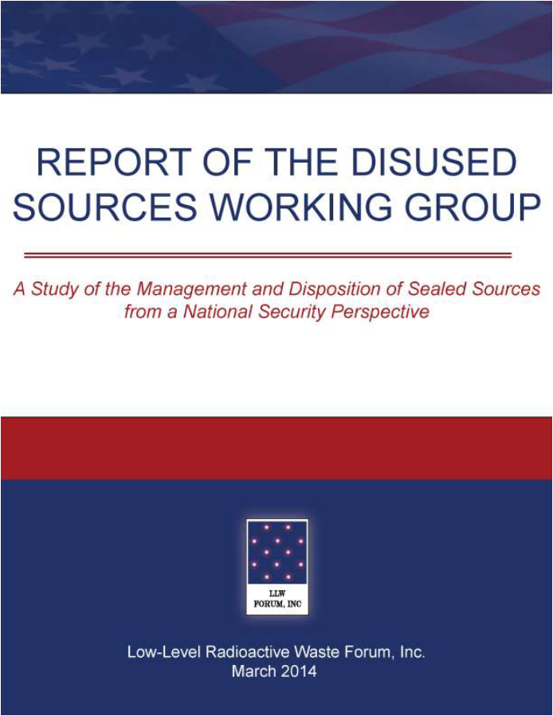
DSWG Report
Report published – March 2014
24 recommendations for improving the security of sealed sources
Several recommendations have been completed
Currently revising the priority of the remaining recommendations
Notes:
19 meetings
30 months
Stakeholder engagement
Report preparation
Technical Review
Report published – March 2014
24 recommendations for improving the security of sealed sources

Slide 6
National Source Tracking System
The NSTS is a secure user-friendly web-based database designed to track Category 1 and 2 radioactive sources.
Tracking spans the life cycle of the source from manufacture through shipment receipt, decay and burial.
About 1,300 licensees began reporting Cat 1 and 2 sources in January 2009

Slide 7
National Source Tracking System
In 2008, NRC proposed to add Cat 3 sources to NSTS. Failed on a 2-2 Commission vote.
DSWG’s 2014 report recommended adding Cat 3 sources to the NSTS.
#5 –The NRC should expand the NSTS to track Category 3 sources.
Response received from Agreement States has been the effort is not worth the return without any quantification of the effort involved.

Slide 8
Pilot Study for Adding Cat 3 Sources to NSTS
DSWG is seeking an Agreement State program partner to evaluate the level of effort associated with adding Cat 3 sources.
Two phases:
Figure out what it will take
Do it
Funding
Phase 1 - flat fee
Phase 2 – based on estimate generated in phase 1

Slide 9
Pilot Study Scope of Work – Phase 1
Determine:
resources to identify licensees possessing Cat 3 sources
resources to collect and assemble information about specific Cat 3 sources
impact to licensees for maintaining their sealed source information in the NSTS
resources needed to create and implement an informational campaign to educate Cat 3 licensees
changes in regulations

Slide 10
Pilot Study Scope of Work – Phase 2
Identify the licensees who possess Cat 3 sources
Collect and assemble information for Cat 3 sources
Develop an informational campaign to educate licensees
Develop a draft amendment to regulations to require the tracking of Cat 3 sources

Slide 11
Pilot Study Funding
Phase 1 – flat fee grant
Phase 2 – based on estimate developed in phase 1

Slide 12
Agreement State Partner
Looking for an Agreement State program participant

Slide 13
Proposed NRC Rulemaking

Slide 14
SECY-23-0062
Proposed rule waiting for Commission approval to publish in the Federal Register
Amend Part 30:
Replace Appendix B with Part 20 Appendix C
Remove radionuclides with half-life of 120 days or less
Set default values for alpha and non-alpha emitting radionuclides
Retitle Part 30 Appendix B
Compatibility Category B (requires essentially identical)

Slide 15
DSWG Comments
Suggested a different alternative – address immediate concern and additional rulemaking
Response – not cost effective and outside the scope of the rulemaking as directed by the Commission
Fixed dollar amounts are outdated
Response – NRC agreed but outside of the scope
Activity threshold for requiring FA is set too high
Response – NRC agreed, SECY-16-0115, proposed rule to Commission 4/2026, Final rule published 12/2027

Slide 16
Re-evaluation of DSWG recommendations
#4 – The NRC should fully address the national security threat posed by sealed sources by amending its regulations to require a Specific License (SL) for all Category 3 sources.
#7 – To encourage timely disposal, the NRC should develop robust financial assurance requirements for all licensees with sources that pose a threat to national security (Categories 1 through 3). The financial assurance requirements should be adequate to cover the entire cost of packaging, transport, and disposal.

Slide 17
Re-evaluation of DSWG recommendations
#9 – To provide a financial incentive for the disposal and increase awareness of sources in inventory and especially in storage, the NRC and Agreement States should require licensees to pay an annual fee for each source in its possession, similar to what Oregon now has in place. The fee should be sufficient to provide licensees with an incentive to promptly dispose of disused sources rather than store them.

Slide 18
Re-evaluation of DSWG recommendations
#10 – Now that disposal access is available for most sources in the US, the NRC and the Agreement States should expand and make enforceable the General License (GL) storage limit regulation to address all Category 1 through 3 sources in storage for more than two years unless the licensee can make a clear demonstration of future use. There should be clear regulatory authority to direct the disposition (reuse, recycle, or disposal) of Category 1 through 3 sources after they have been stored for two years. (This was a 2006 Task force Action item.)

Slide 19
Re-evaluation of DSWG recommendations
#12 – To prevent the accumulation of an excessive number of sources by manufacturers and suppliers, the NRC and Agreement States should require manufacturers and suppliers to dispose of those sources that have no recycle or reuse value on an annual basis.
#23 – Congress should continue to fund NNSA activities for the collection of orphaned and abandoned sources that do not meet the waste acceptance criteria of commercial disposal facilities. In providing these services, NNSA should ensure its actions continue to be in compliance with state and compact requirements.

Slide 20
Additional Information:

