Slide 1
Program Overview and Explanation of Policies for the Turn-In of Defense-Owned Radioactive Items Found in the Public Domain
Mr. Cyrus Turner
U.S. Army - Department of Defense
Lead Agent for Low Level Radioactive Waste
3 October 2023

Slide 2
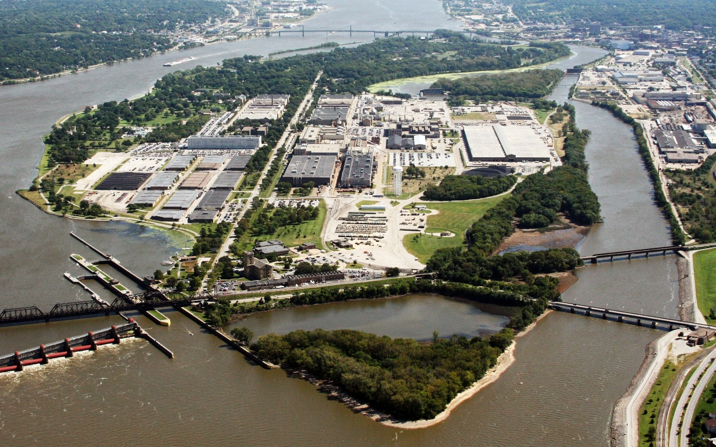
Program and Proponent
Under Department of Defense Instruction (DODI) 4715.27, the United States Army is the Department of Defense Lead Agent (DODLA) for Low-Level Radioactive Waste (LLRW)
Located at Rock Island Arsenal, the U.S. Army Headquarters, Joint Munitions Command (JMC) Environmental, Health and Safety Directorate – Environmental and Health (Physics) Division – executes the responsibilities of the Department of Defense (DoD) LLRW Program

Slide 3
Policy
Support military personnel with life-cycle management of defense-owned commodities that have radioactive material for DoD-entities, world-wide.
Dispose of these unwanted commodities in a manner that is protective to human health and the environment, and that complies with DoD issuances and applicable statutory and regulatory requirements.
Policy for the Program is distinct for defense-owned commodities with radioactive material outside DoD possession (in the public domain).

Slide 4
Scope
Unwanted or excessed commodities (military items) that contain source, special nuclear, or byproduct material.
Includes:
- Mixed waste (hazardous and radioactive)
- Naturally occurring radioactive material waste (NORM)
- Naturally occurring and accelerator-produced radioactive material waste (NARM)

Slide 5
Limitations
Does not include wastes that are:
Generated by the Naval Nuclear Propulsion Program
Related to nuclear weapons programs
Generated from former Army Deactivated Nuclear Power Program facilities
Decay in storage, release in effluents, disposal by release into sanitary sewage treatment or disposal by incineration, and disposal of specific wastes in accordance with Sections 20.2002-20.2005 and 20.2108 of Title 10 Code of Federal Regulations (CFR)

Slide 6
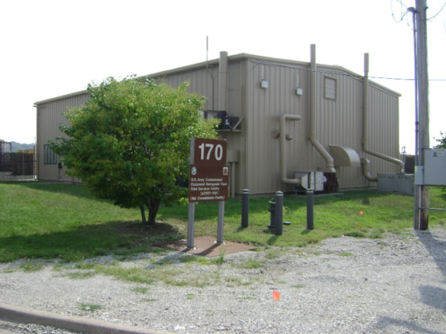
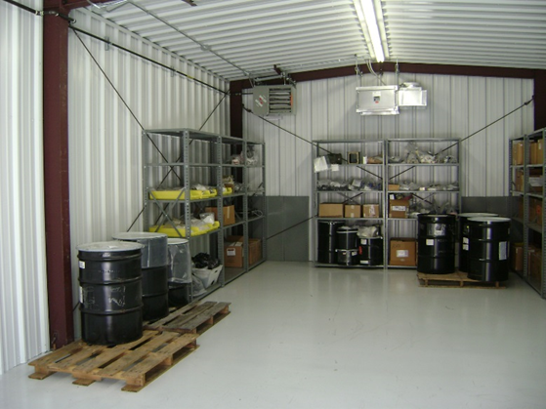
Staff and Capabilities
Government Staff and Facility
Civilian Technical Team – 8 Health Physicists
Facility is Licensed by the USNRC
The Morris Consolidation Facility (MCF)
Unique Capability within the DoD Program
Receive Any Type of Low-Level Radioactive Material and Perform Processing prior to Recycle or Disposal

Slide 7
Mission
Obtain services for customers (safe, compliant, and cost-effective removal, processing, recycle and disposal)
Operate and maintain a consolidation and processing facility (the Morris Consolidation Facility)
Support unit readiness and Soldier/Civilian safety (safe turn-in of non-functioning or unwanted equipment containing radioactive materials to obtain replacements)
Grant disposal waivers (applicant basis)

Slide 8
Military Items Outside of DoD Possession
In general, military items outside of DoD possession and control may not be accepted, handled, removed, or disposed under the DODLA Program when the following conditions apply:
1. The LLRW or material is owned by, or in the possession of, a private citizen, business, State, or non-federal entity, or
2. The LLRW or material is located on property that is not currently and never was owned by, leased to, or otherwise possessed by a DoD Component.
This does not mean that the DoD cannot take back radioactive items clearly marked as DoD (labeled) property from the public.

Slide 9
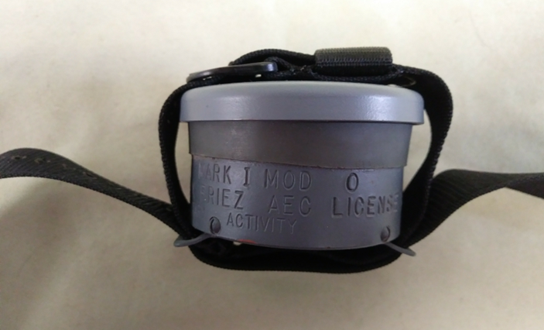
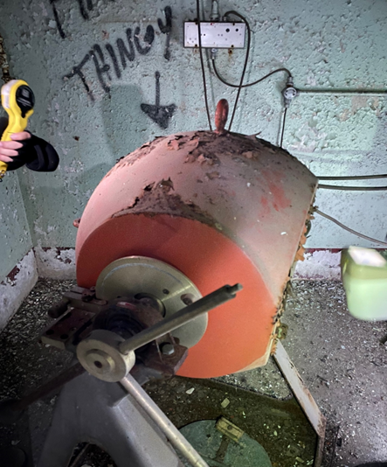
Examples of Items

Slide 10
Accepting the Military Item Back
Requests are reviewed on a case-by-case basis.
Usually supported by clear evidence that the LLRW or material is or was owned by the DoD Component (labels, markings, or serialization)
Priority is determined necessary to avoid:
1. Unsafe Situations or Potential Harm to Human Health
2. Potential Harm to the Environment
3. Current or future DoD liabilities

Slide 11
Questions?
POC: Mr. Cyrus Turner
Email: cyrus.e.turner.civ@army.mil
Phone: 309-782-4233

