Slide 1
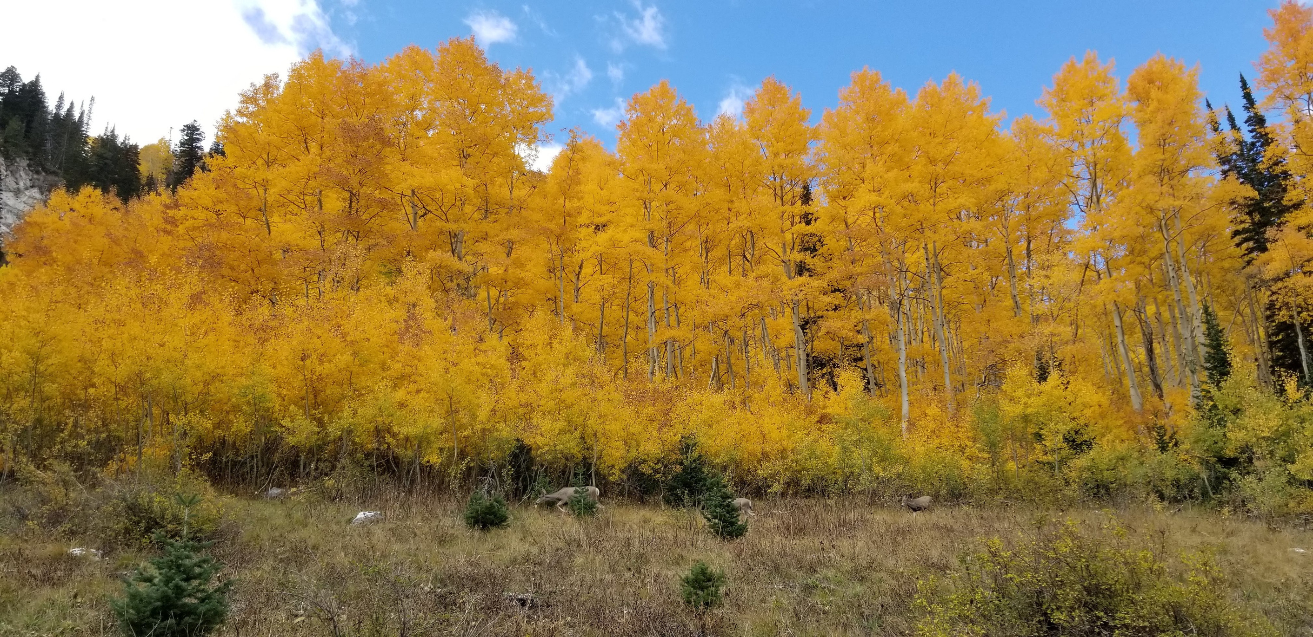

Low-Level Radioactive Waste Forum
October 3, 2023

Slide 2





Low Level Radioactive Waste Program
State of Utah
Governor
Spencer Cox
Assistant Director
Jalynn Knudsen
Program Manager
Otis Willoughby
Department of Environmental Quality
Kim Shelley, Executive Director
Health Physicist
Larry Kellum
Kevin Carney
Tyler Hegburg
Hydrogeologist
Charlie Bishop
Brandon Davis
Bailey Anderson
Engineer
David Esser
Carlo Romano
Transportation
Gage Fausto
Division of Waste Management and Radiation Control
Doug Hansen, Director

Slide 3
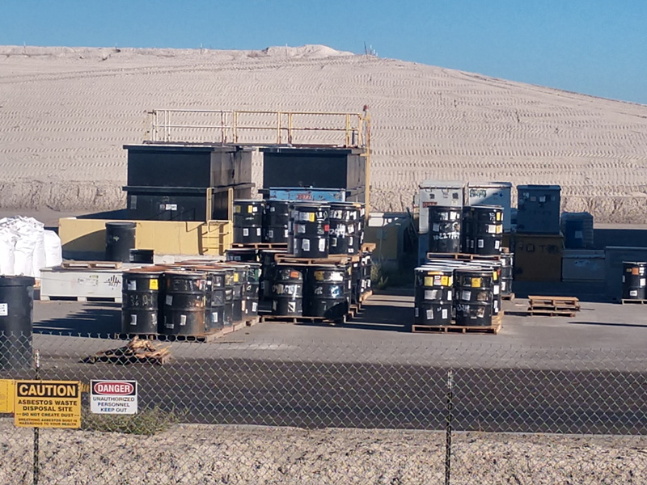
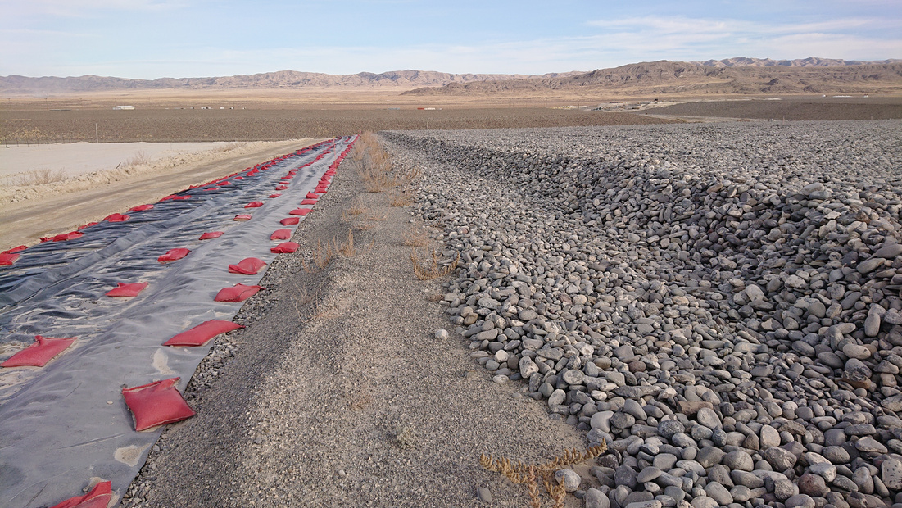
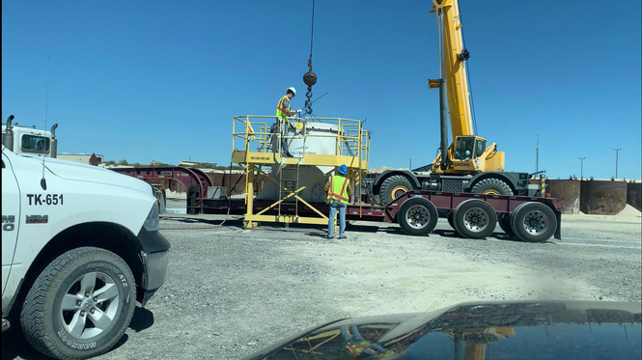
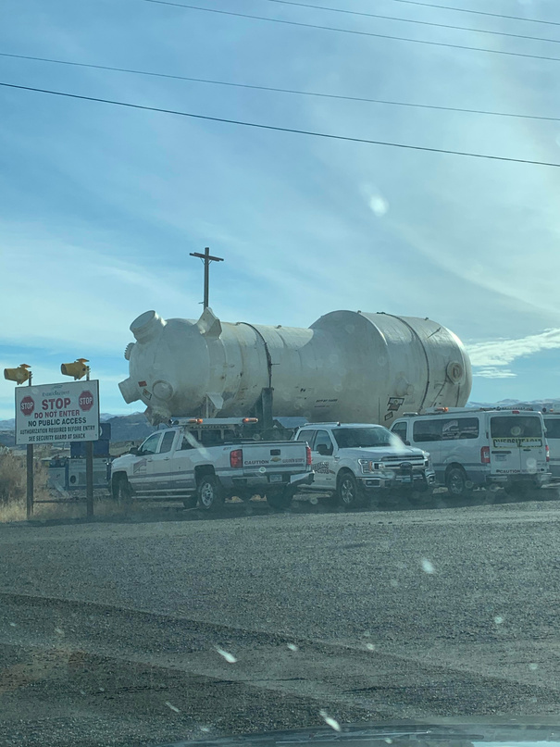
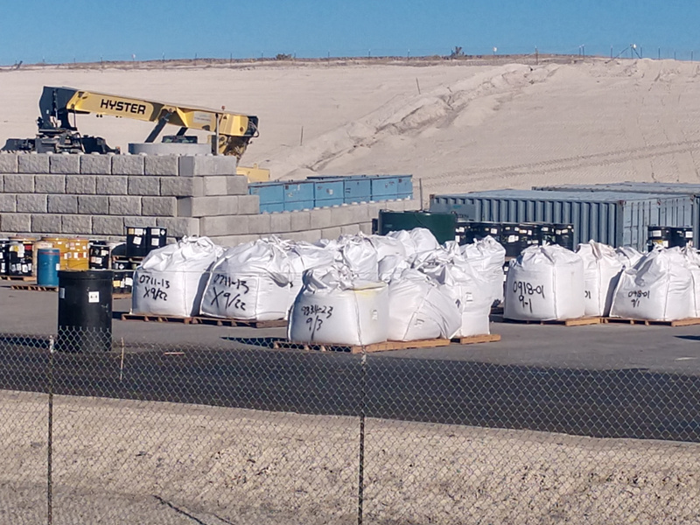

CLIVE Regulatory Oversight
Licensing, Compliance and Operations Activity Monitoring
Facility Operation Oversight
Licensing Requests
Variance Requests
Construction Activity
Alternative Management
Compliance Solutions
16 Health Physics
12 Engineering
16 Groundwater/BAT
6,422 Generator Site Access Shipments
INSPECTIONS
OPERATIONS

Slide 4
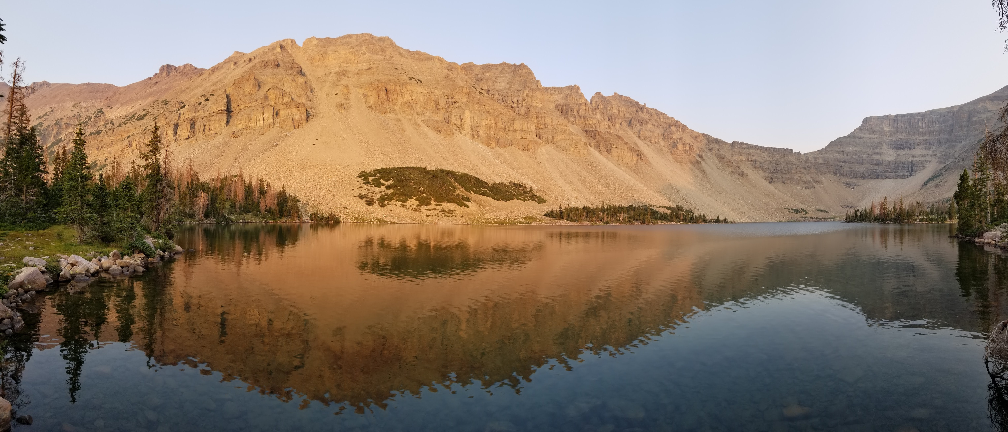






Licensing Actions
ONGOING
COMPLETED
LOW ACTIVITY
CELL
RAM
LICENSE RENEWAL
FEDERAL
CELL
AMEND.
27
AMEND.
26
Application
April 8, 2020
Ongoing Review & Request for Information
Application to Renew UT2300249
October 12, 2012
Timely Renewal
Application
August 4, 2022
Ongoing Review & Request for Information
Clarification of Condition 9.E and Huntsman Agreement
November 16, 2022
Removal of State prohibition for disposal of Class A Sealed Sources and Annual Surety Update
May 31, 2023

Slide 5
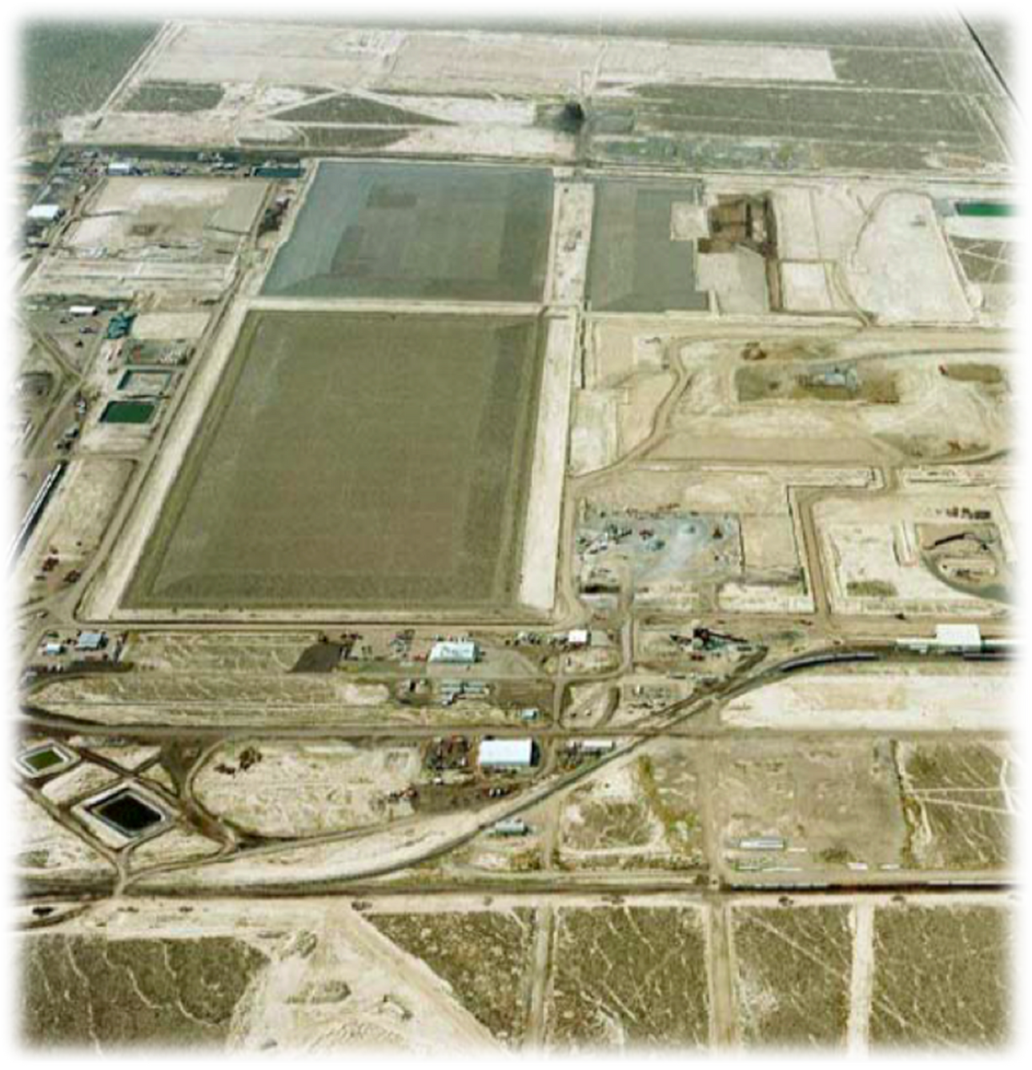





Proposed
Low Activity
Disposal Cell
Mixed Waste
Disposal Cell
(Part B)
Proposed Federal
Disposal Cell (DU)
Low Level Radioactive
Waste Disposal Cell
11e.(2) Byproduct
Disposal Cell
Energy
Solutions
| Clive Facility

Slide 6

Doug Hansen, PE
Director
801-536-0203
djhansen@utah.gov
Otis Willoughby
LLRW Program Manager
385-622-2213
owilloughby@utah.gov
Jalynn Knudsen
Assistant Director
385-622-1874
jknudsen@utah.gov

