Slide 1
Clive Site Operational Overview

Slide 2
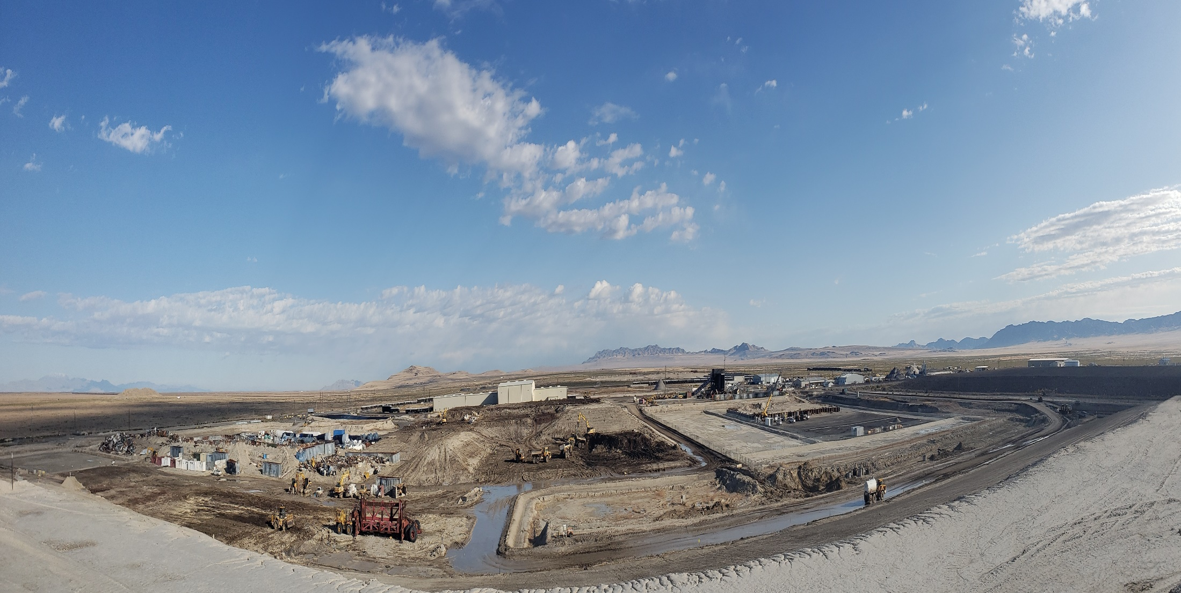
World’s Largest
Commercial Radioactive Waste Disposal Facility

Slide 3
Clive Facility Mission
Protect the Environment by safely disposing of Low Level Radioactive Waste (LLRW) and Mixed LLRW in regulated, engineered disposal embankments (cells)

Slide 4
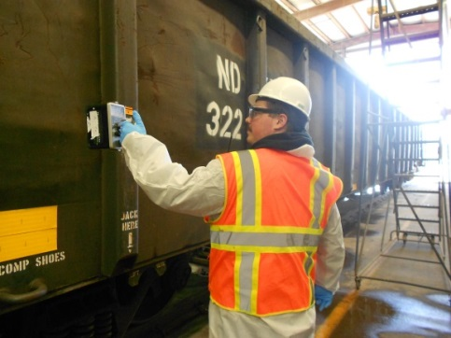
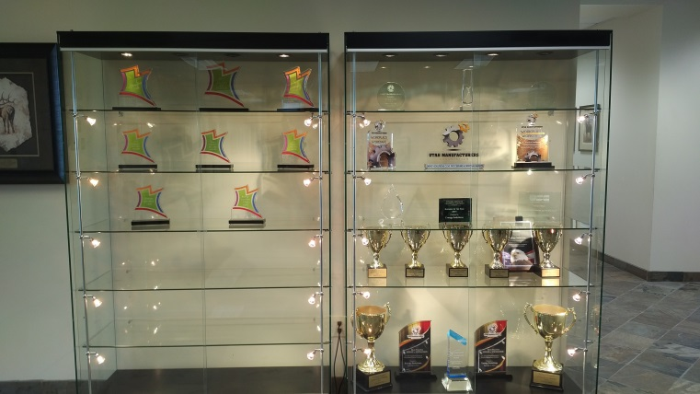
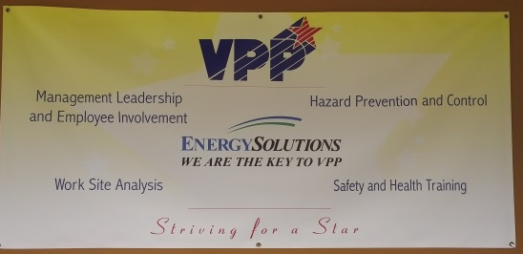
Safety
Industrial
Behavior Based/HPI
Employee directed
Management commitment
Between 2004 & 2009, over 3.5 million hours worked without a lost-time injury
Utah Safety Council Award of Merit
2006, 2007, 2008, 2009, 2012, 2013, 2015, 2016, 2017
Utah Safety Council Perfect Record Award
2011, 2012, 2013, 2015, 2016, 2017
Utah Safety Council 1 Million Man Hour Award
2013, 2016
Utah Safety Council Award of Honor
2017
National Safety Council Perfect Record Award
2005, 2006, 2007, 2008, 2010, 2015, 2017
National Safety Council Million Man Hour Award
2006, 2008, 2013, 2017
National Safety Council Occupational Excellence Achievement Award
2017
National Safety Council Safety Leadership Award
2017
VPP Star – 2017
7 million hours (19 years) without lost-time injury; 2004-2023
Radiological
ALARA
Personnel exposures very low
37 mRem average annual employee exposure

Slide 5
Clive Facts
1988 Envirocare founded
2006 EnergySolutions LLC
Workforce
111 FTE
16% Female
84% Male
Primary Labor Pool – Tooele County
Work Schedule
M, T, Th, Fr 0630 – 1700 hours
Location
Remote location
Raw Materials
Clay, Sand, Rock
Environment
Low precipitation – 8 inches annually
High evaporation – 60 inches annually
Operations shut down - 35 mph wind speed
Air Monitors – Particulate (Gamma Spec) and Radon (Radium 226)
Aquifer
30 – 50 feet below ground surface
Naturally twice the salinity of the ocean
Truck in 30,000 gallons of water per day

Slide 6
Clive Capabilities
Unload 45 Railcars per shift
Unload 30 Truck shipments per shift
Shred 1,500 tons per shift
Place 50,000 CF per day
20 M gallons evaporation pond storage

Slide 7
Clive Rail Facility (CRF)
Railcar Storage & Staging
10 Ladder Tracks (Approximately 3 Miles)
Storage Capacity – Approximately 300 Railcars
Empty Railcar Maintenance and Repair In Accordance for Federal Railroad Administration Regulations
Transloading of Intermodals, SeaLands and Other Bulk Containers
Total Site Track – 16 Miles ( 2 Locomotives)

Slide 8
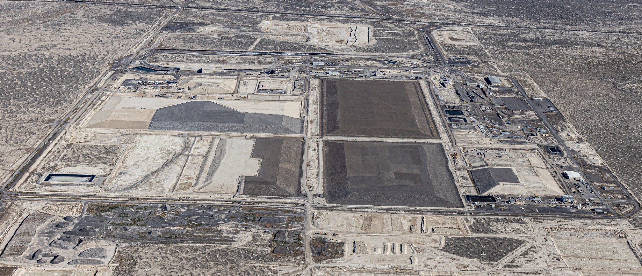
Clive Capacity
~100 million cubic feet of licensed capacity remaining
At average receipts of 3-4 million cubic feet per year, the Clive facility has 30-35 years of capacity remaining
Notes:
Does not account for ~5 million cf MW expansion capacity

Slide 9
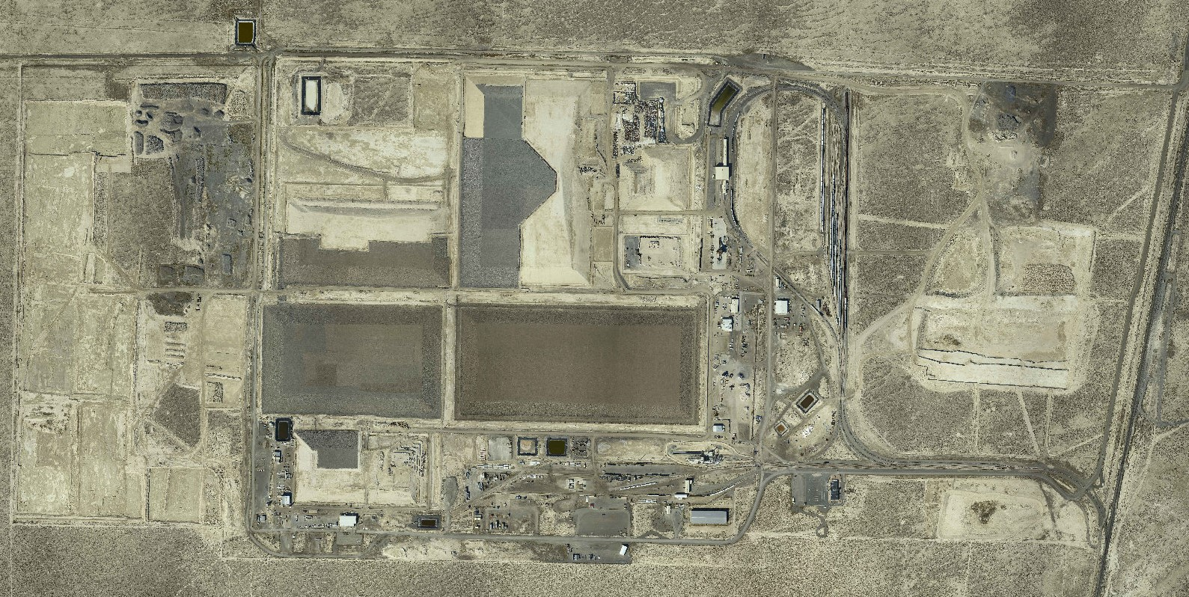
Site Layout
West
Rotary
Shredder
East
Rotary
Administration
Building

Slide 10
Site Layout
Federal Cell
(Future)
Class A West
Low Activity South
(Future)
Section 32
CRF
11e.(2)
LARW
(Closed)
VITRO
Dept. of Energy
Radioactive Disposal
from Salt Lake County
(Closed)
Section 5
Section 29
Mixed
Waste
Container
Handling

Slide 11
Embankment Construction
Rip Rap 18 in (48 cm)
Type A Filter 6 in (15 cm)
Sac. Soil 12 in (30 cm)
Type B Filter 6 in(15 cm)
LLRW
Mixed Waste
Install Engineered Cover
Layers of Waste Compacted and Disposed
Install Radon Barrier (Clay Cap)
2 ft (61 cm)
Synthetic Liner with
Leachate Collection System
Install and Approve Clay Liner
Excavate ~ 10 ft.

Slide 12
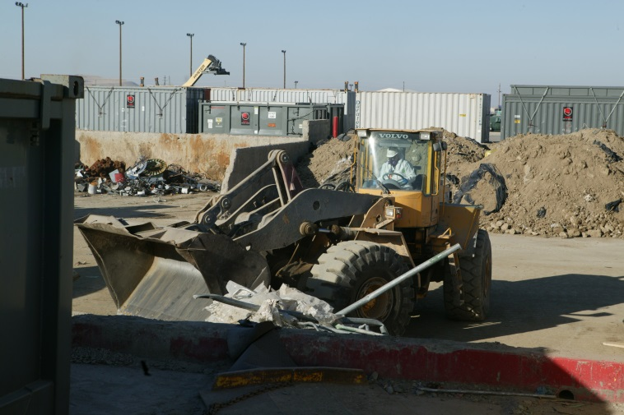
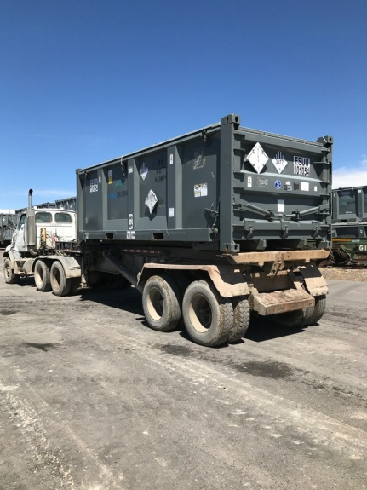
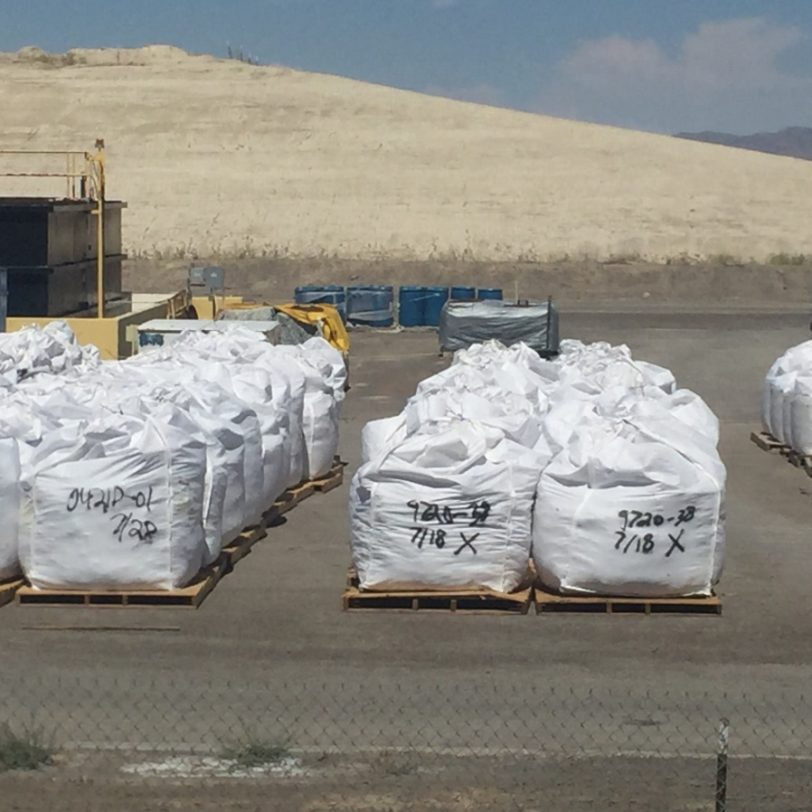
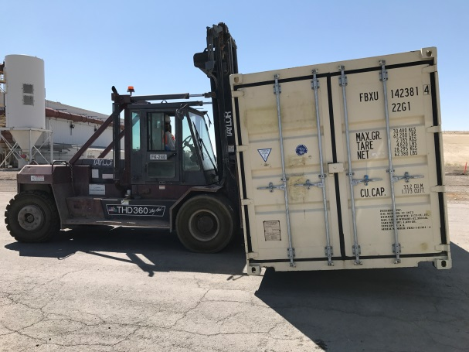
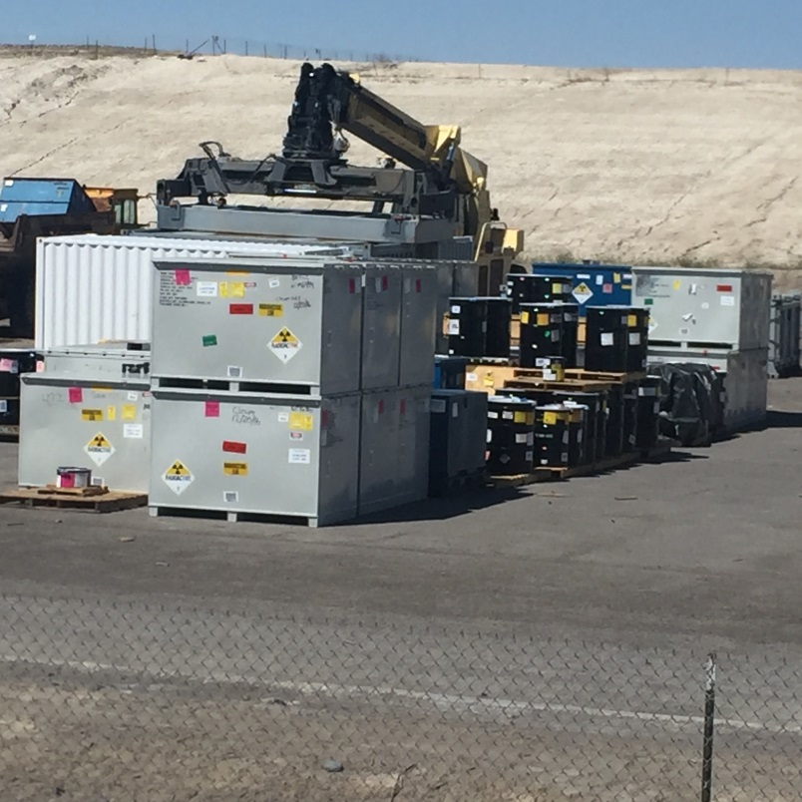
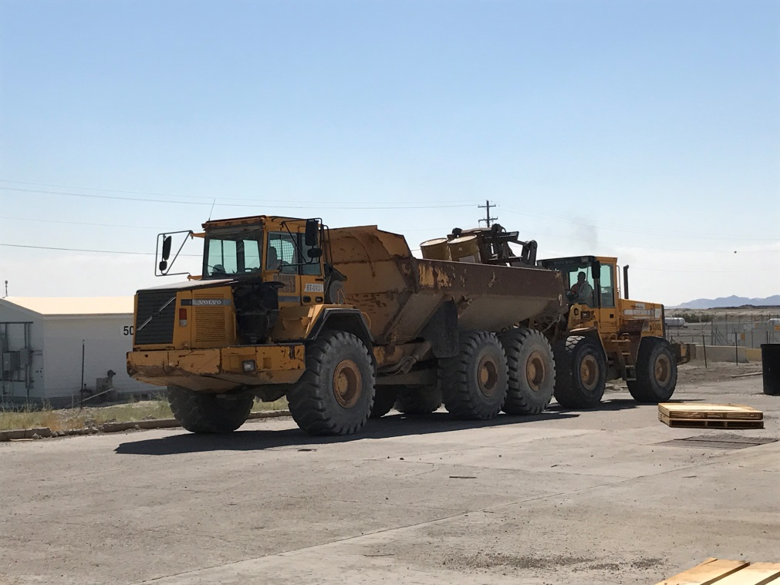
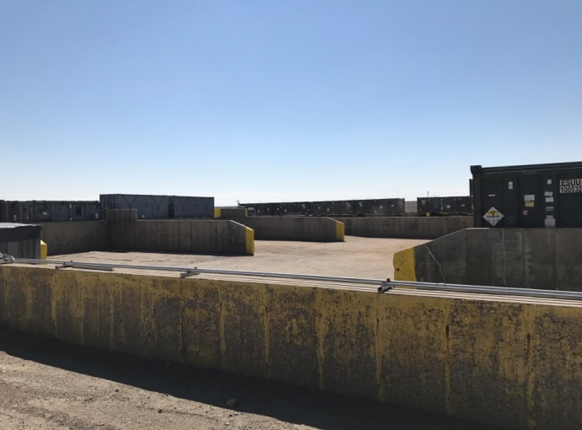
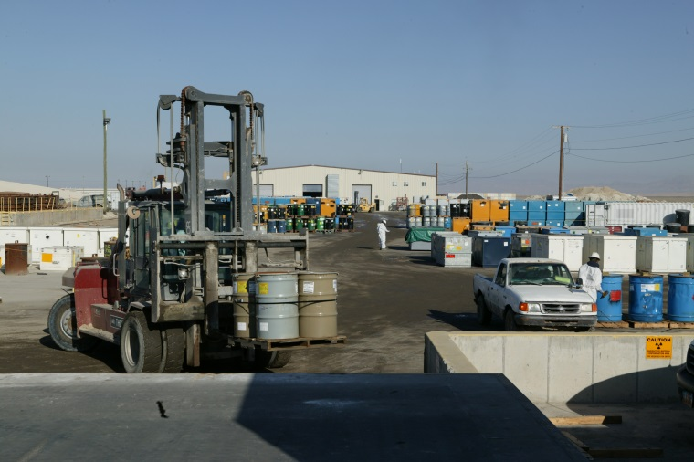
Container Handling
Boxes/Drums
Intermodals/Sealands
Supersacks
Site Transport
Waste Management
Pads, IUF

Slide 13
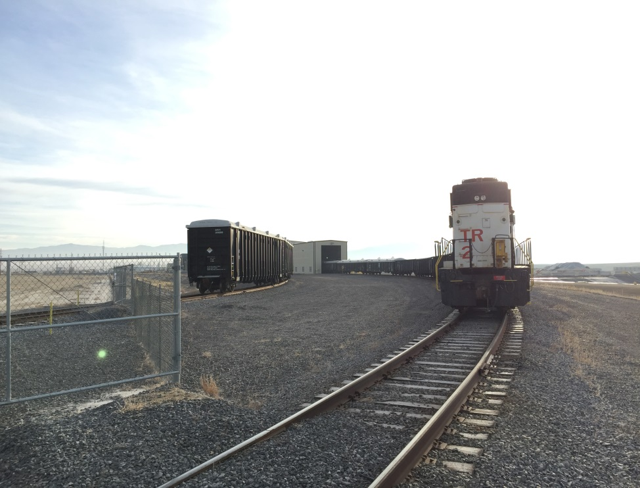
Disposal Operations
Gondola Railcars
Largest Volumes
Most Efficient
Soil, Debris, Bags

Slide 14
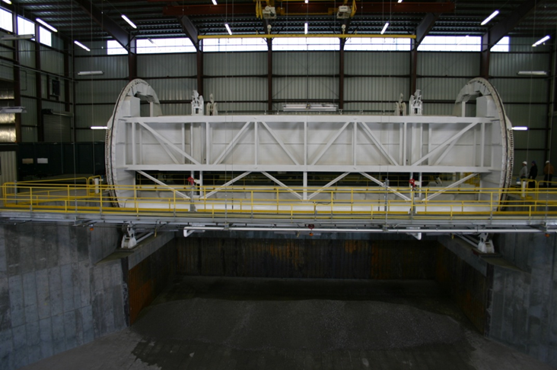
Disposal Operations
Thaw Shed
High heat
Rotary
Audible alarms
Clear equipment from pit
Switchman
Radio Communication
Exclusion Zones
Wash Bay
Catwalk
Railcar access
Decontamination
Rotary

Slide 15
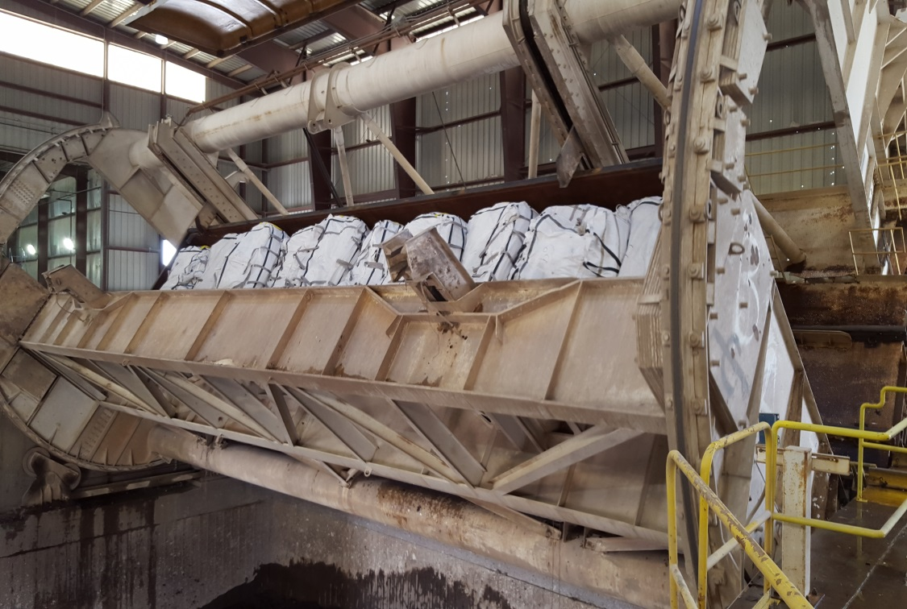
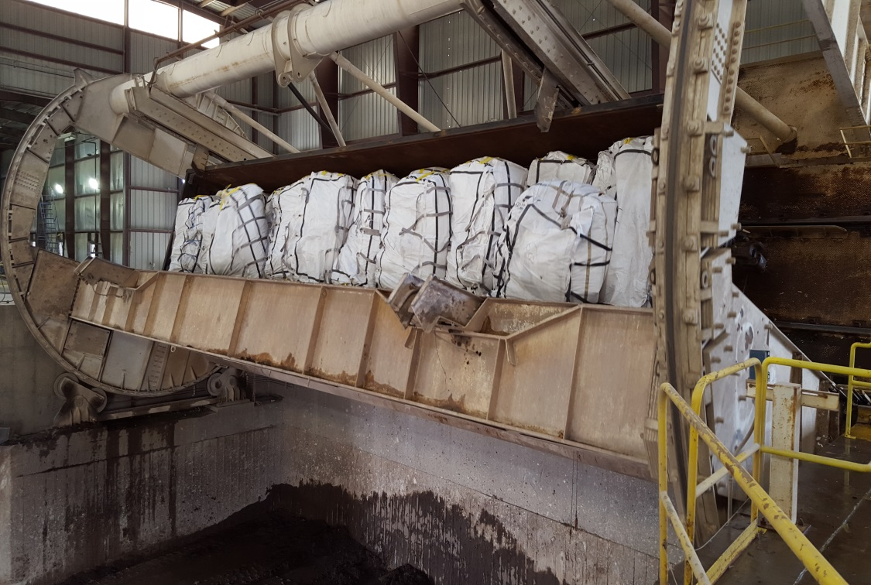
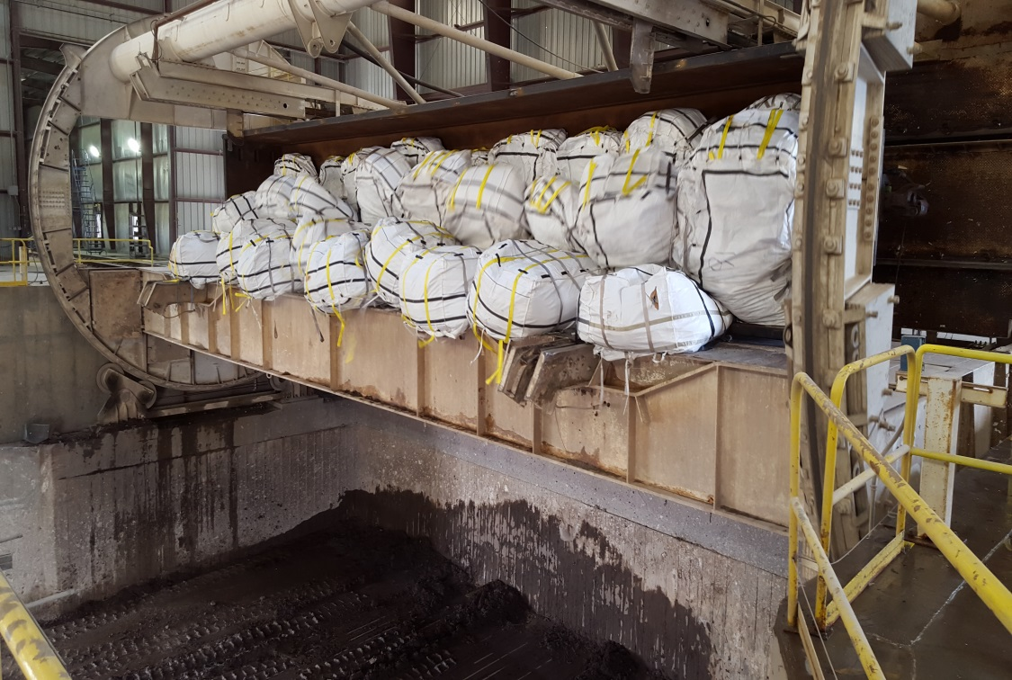
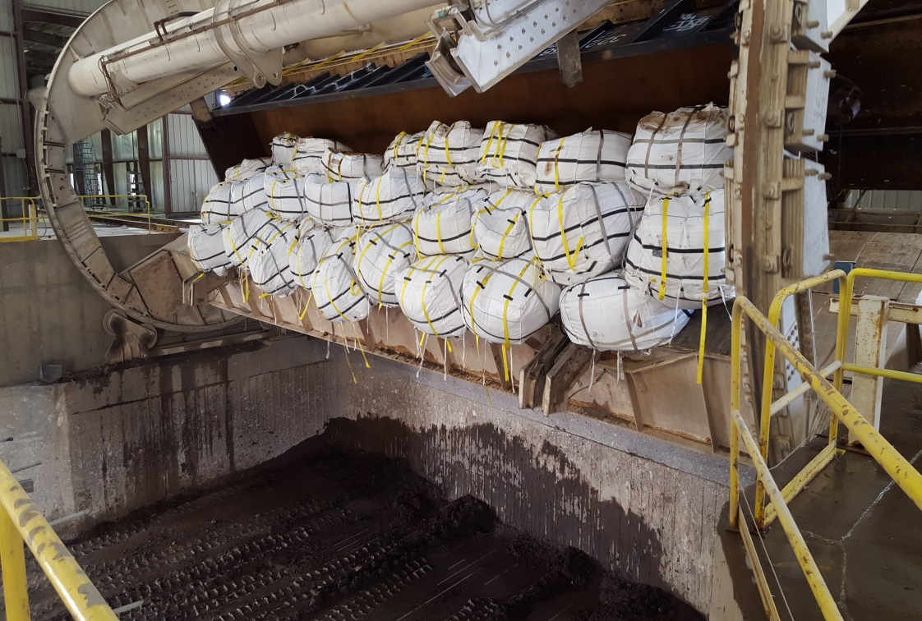
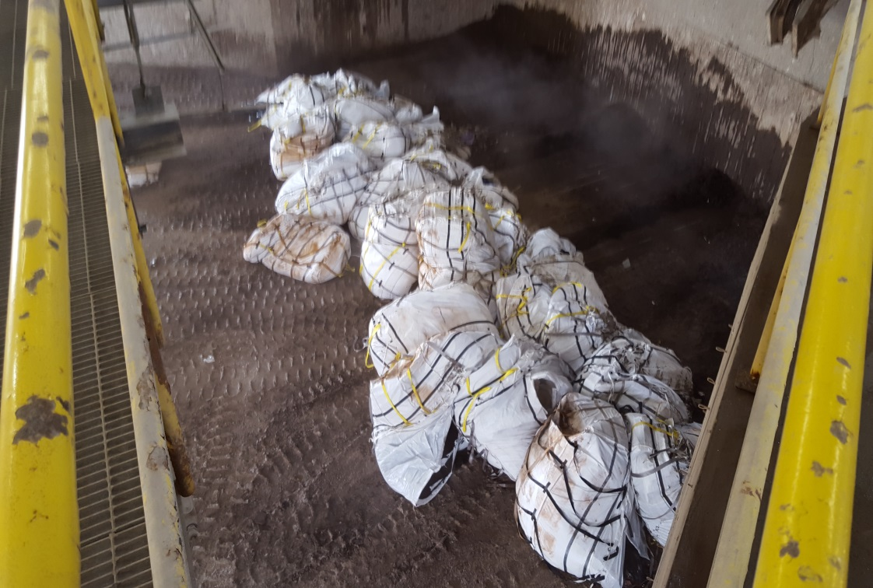
Disposal Operations
Rotary
Video

Slide 16
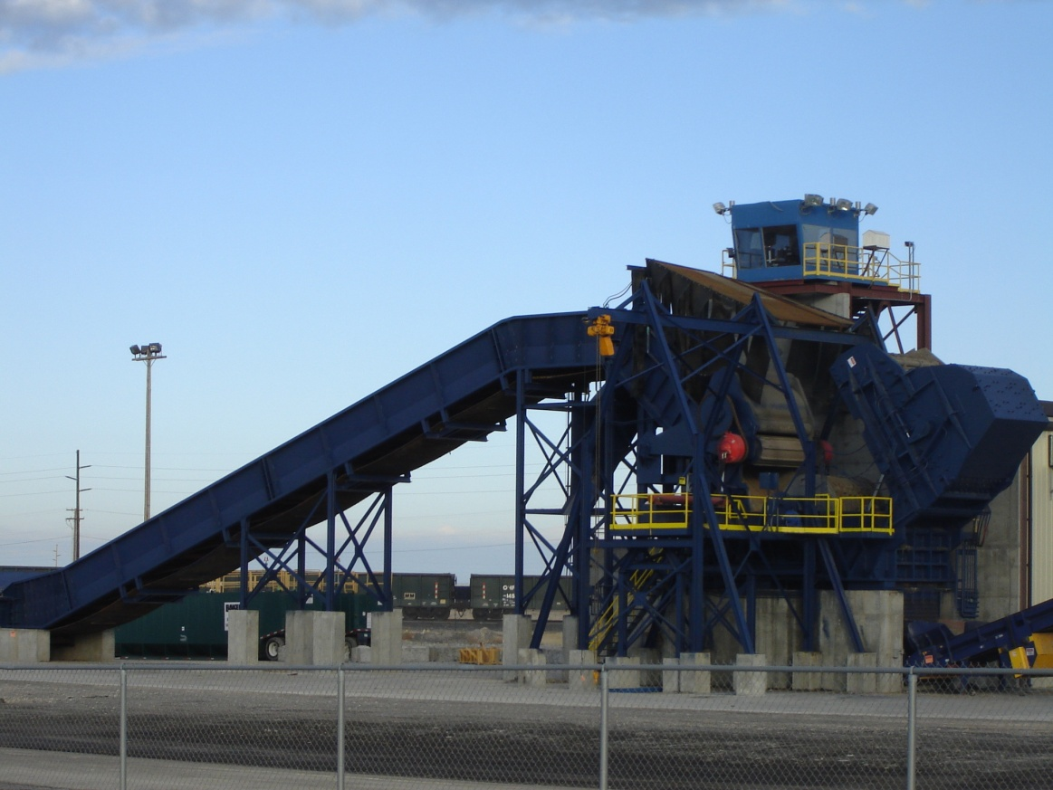
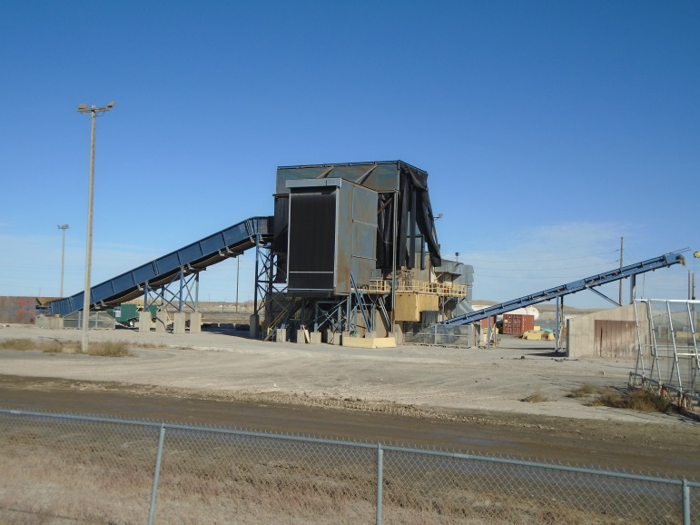
Disposal Operations
Shredder
6,000 HP Electric Motor
Reduce debris to 4 inches or less
Night Operation Only
Cost
Safety
Safety Features
Operator protected by 2 inches of bullet proof glass and 2 inch thick steel plate
Shroud
Suburban

Slide 17
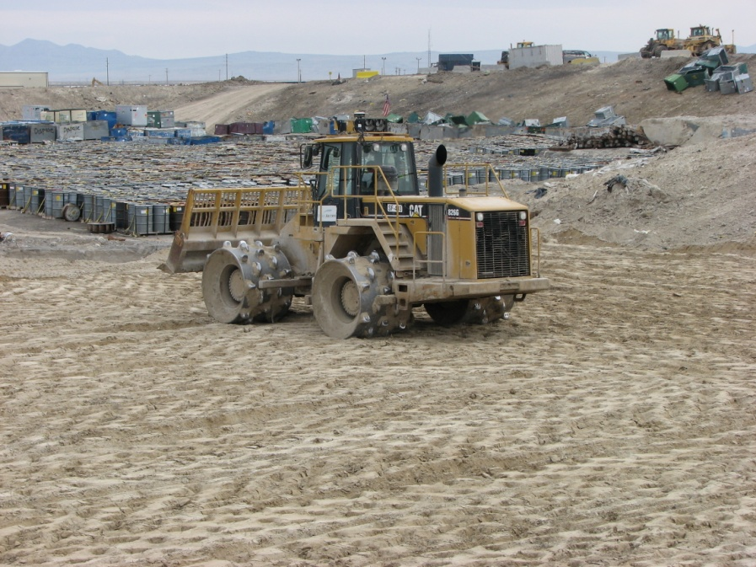
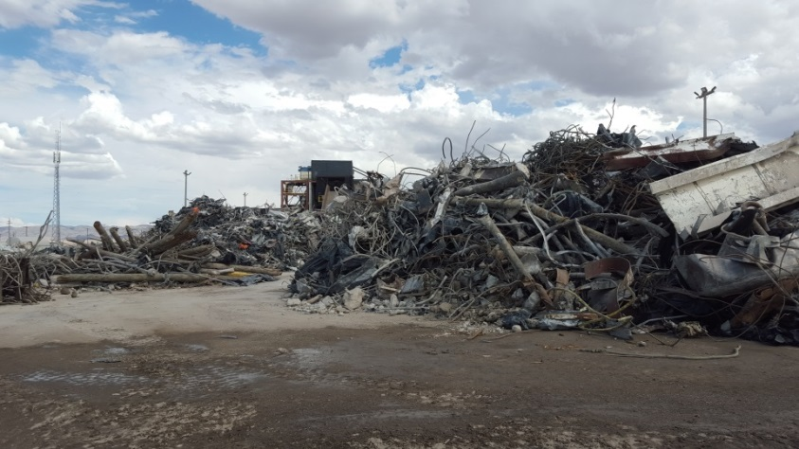
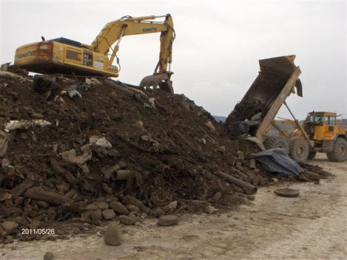
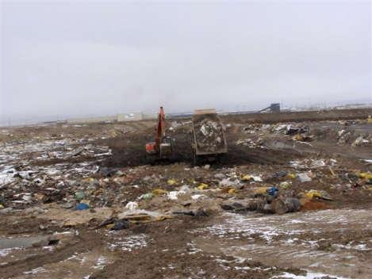
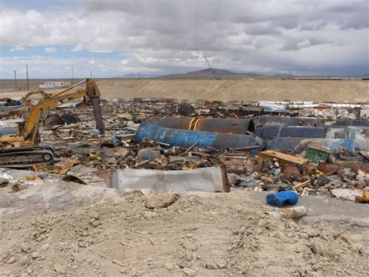
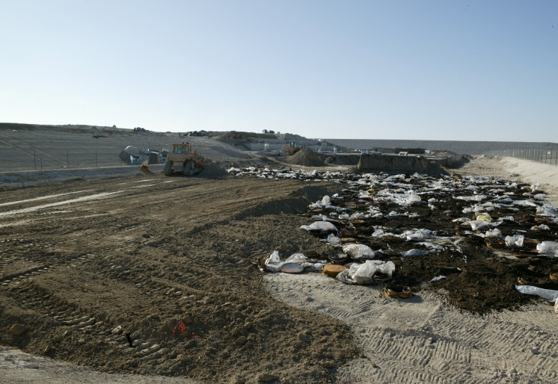
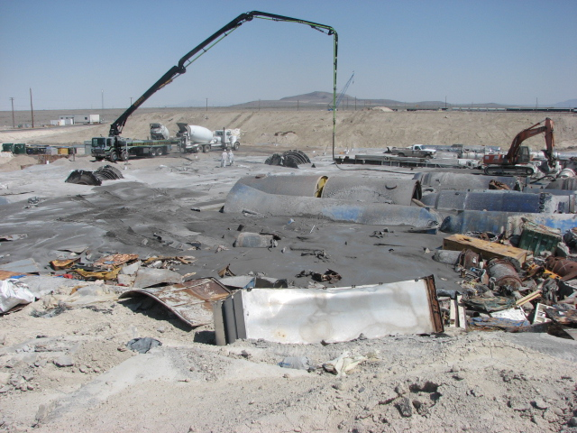
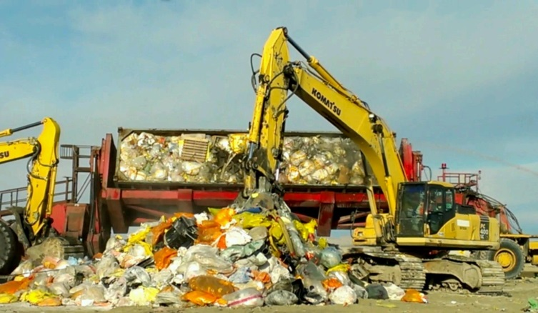
Disposal Operations
Disposal
Soil
Standard Debris
Compactor
Oversized Debris
Least Efficient

Slide 18
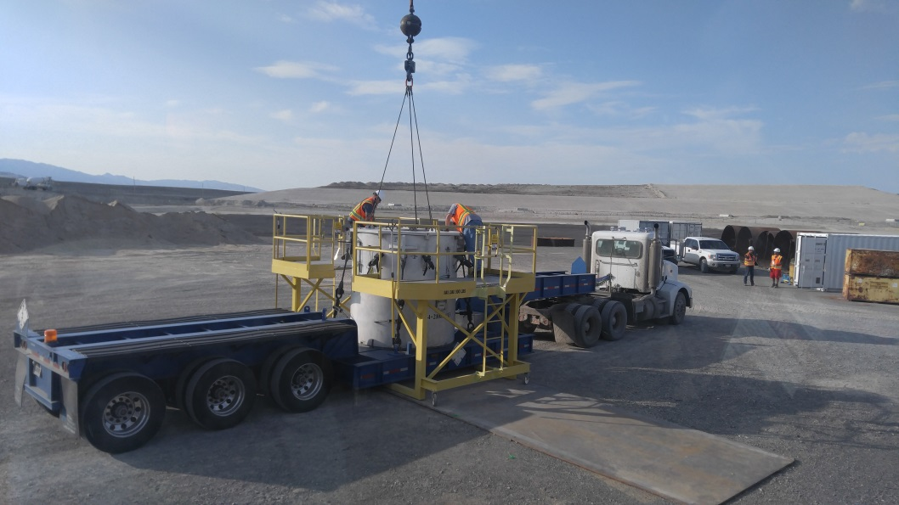
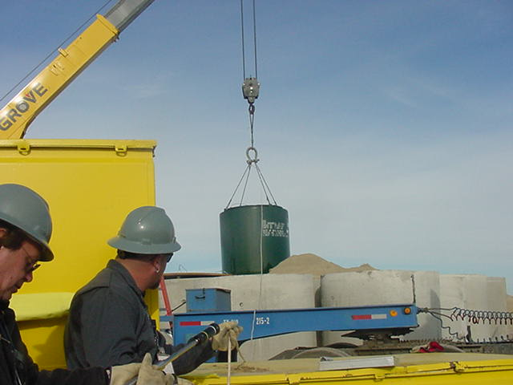
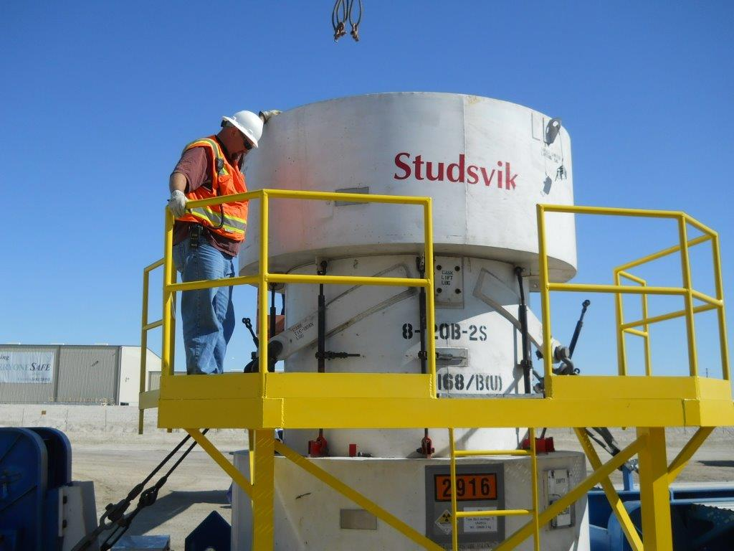
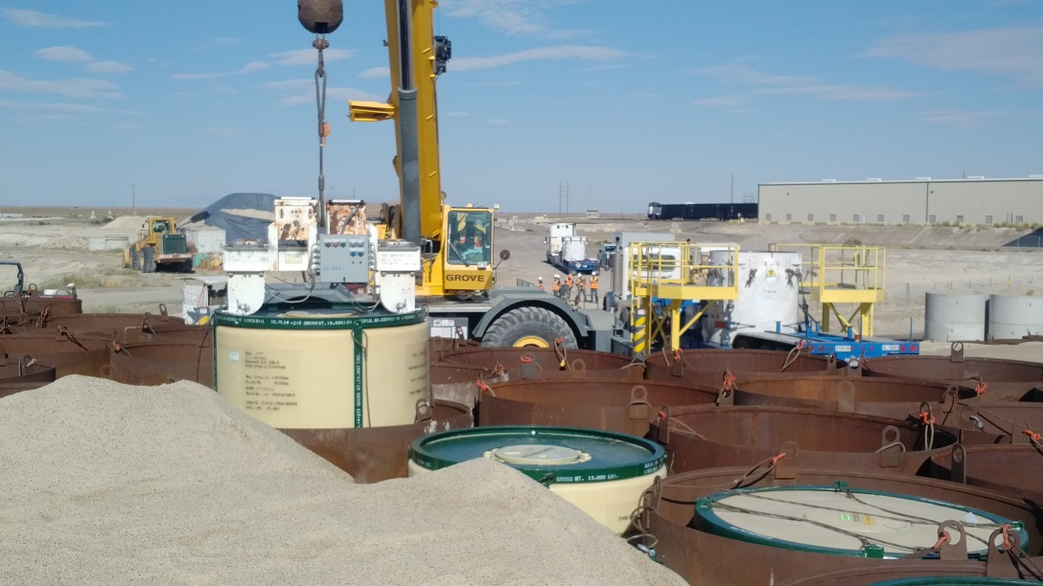
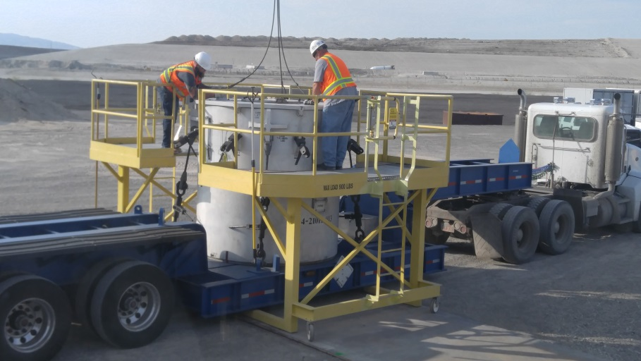
Disposal Operations
Disposal
Containers (CWF)
CWF

Slide 19
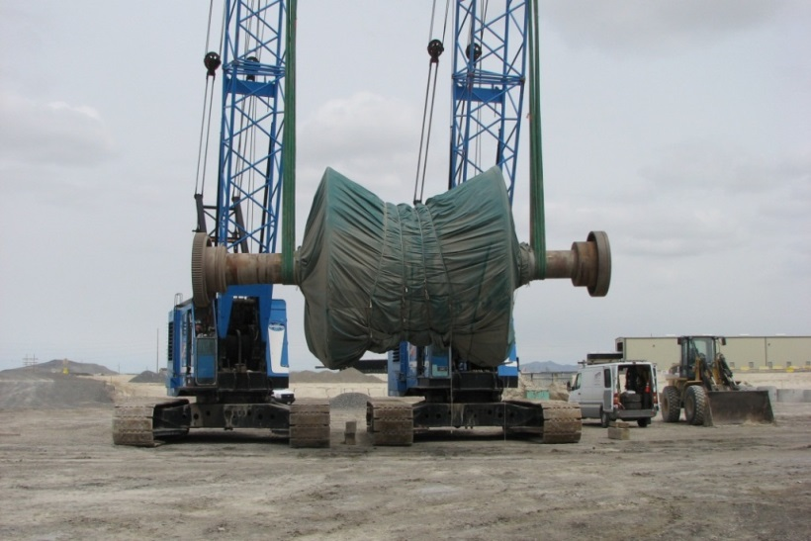
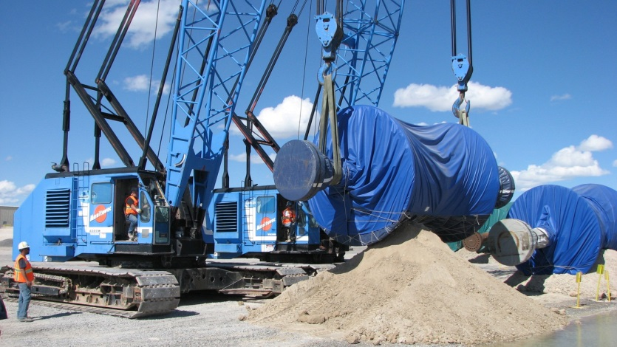
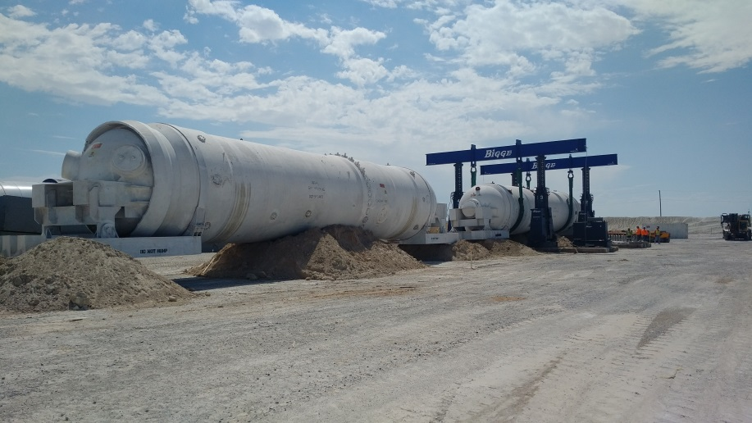
Disposal Operations
Disposal
Large Components
Lift Plan
LOER
Large Components

Slide 20
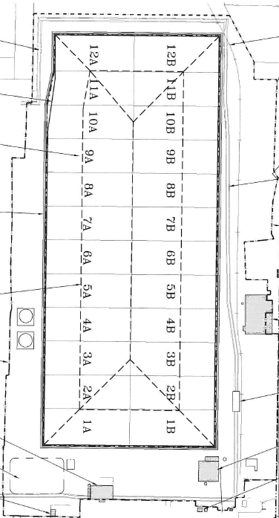
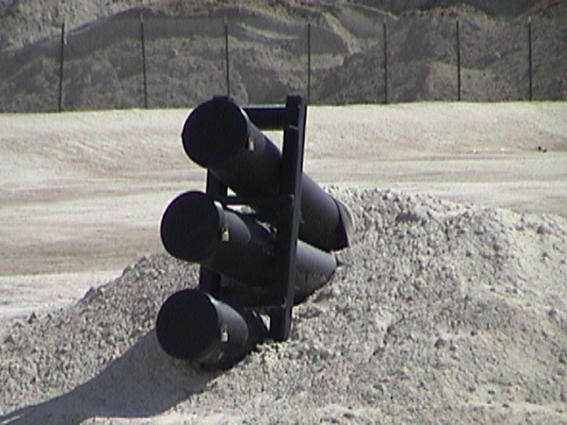
Mixed Waste
Radioactive and Hazardous Waste
RCRA-designed Landfill
24 Sumps
Triple-Lined – Leak Detection

Slide 21
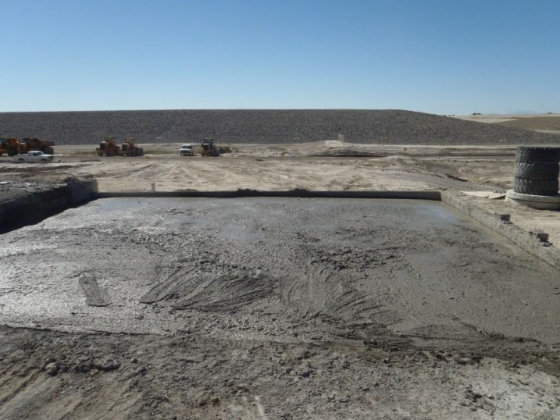
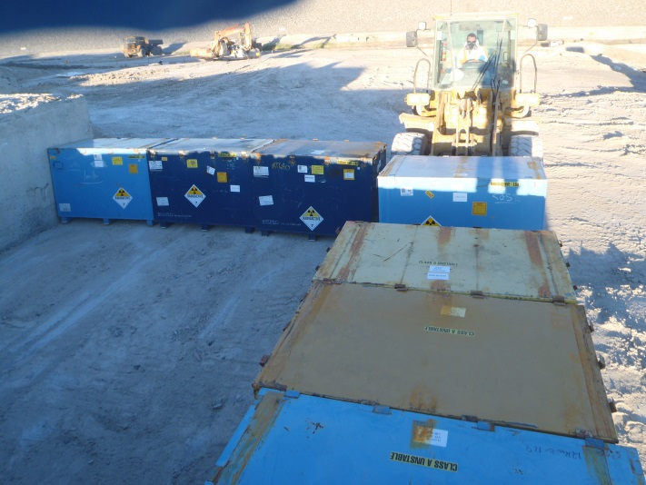
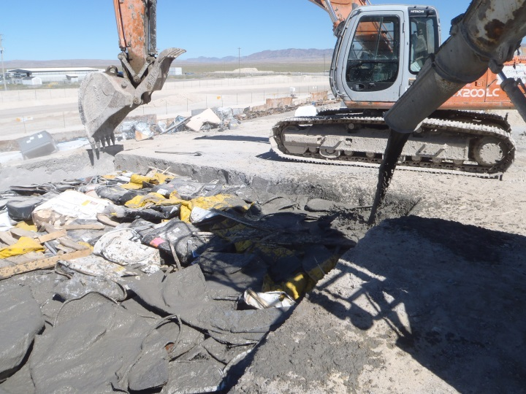
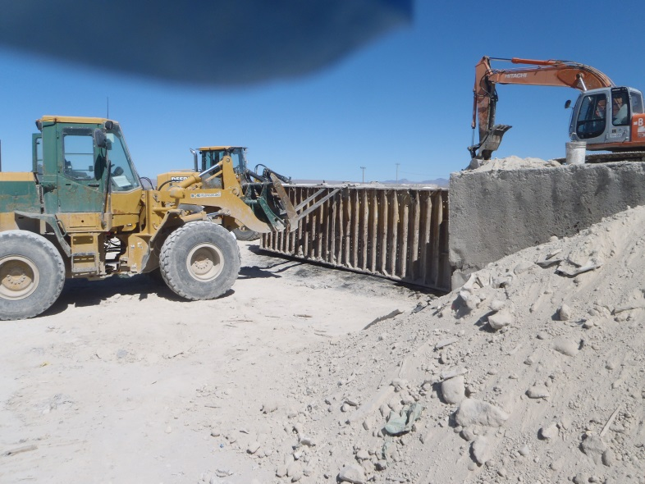
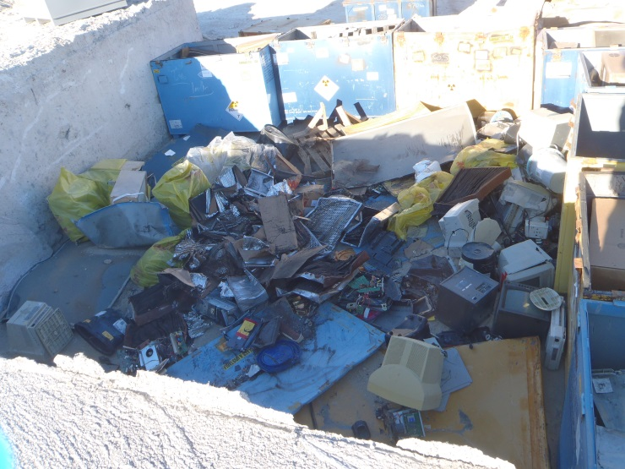
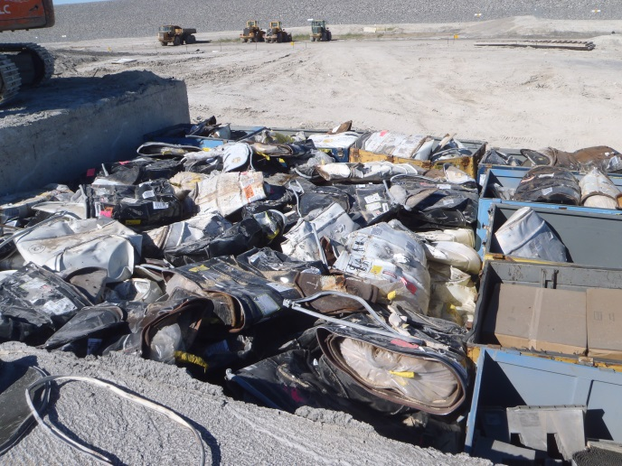
Mixed Waste Treatment
Macroencapsulation

Slide 22
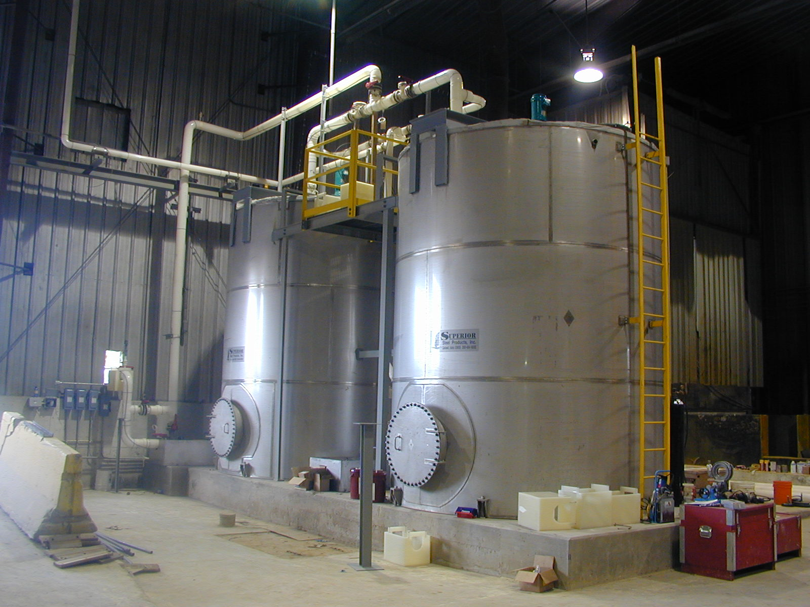
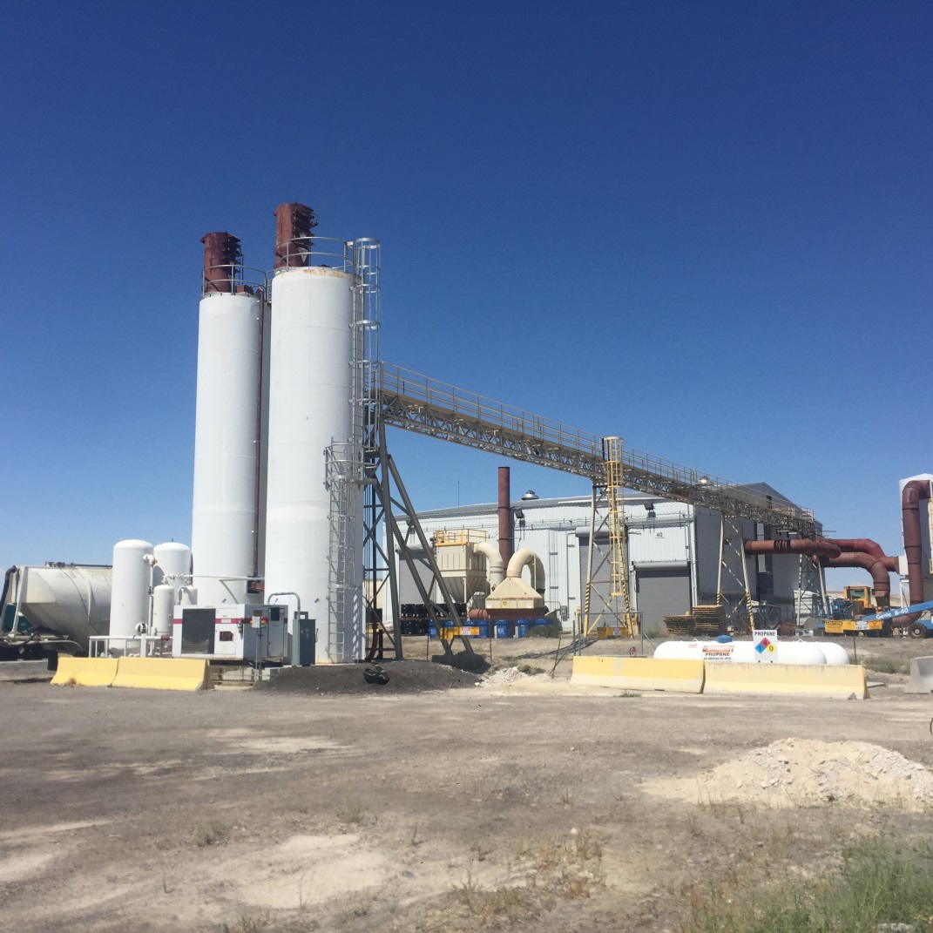
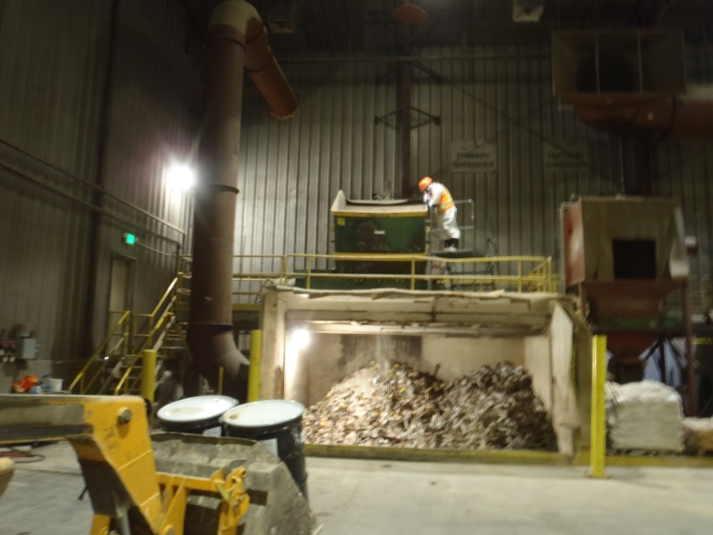
Mixed Waste Treatment
Stabilization/Solidification
Shredding
Solidification
Mixing
Reagent Delivery

Slide 23
Mixed Waste Treatment
Thermal Desorption
Indirect Heating
Batch Process
45 CF per Batch
Products
Dry Solid (land disposable)
Liquid Organic Condensate (non-rad)

Slide 24
Composite View

Slide 25
Environment
Groundwater (75)
Soil (23)
Air (12)

