Slide 1
The Path to Commercial
Fusion Energy

Slide 2
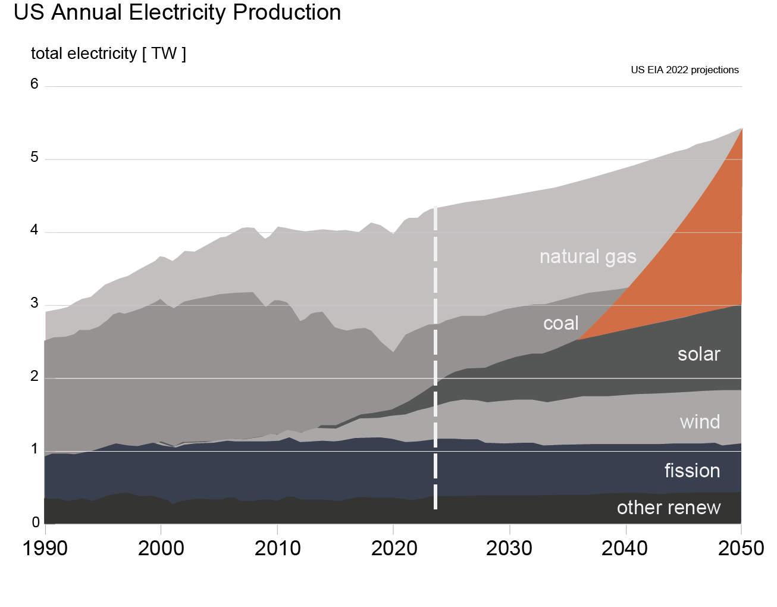
The world needs more clean energy technology
Largest problem and opportunity facing humanity
Largest industrial transformation in history
Innovation at the generation source is highest leverage
Whatever the solution is, it must arrive soon and scale rapidly
The challenge
Notes:
Transformation: needs to happen at an unprecedented rate
Opportunity: Replacement + expansion rates

Slide 3
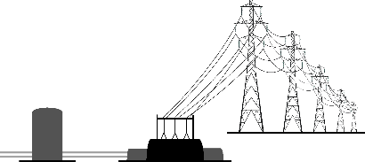
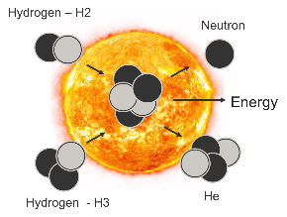
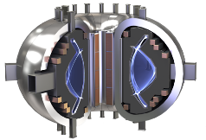
Fusion is a solution at the scale of the problem
Fusion is the process that powers the stars
Inside stars, hydrogen fuses in a plasma to make helium – releasing lots of energy
CFS designs and builds machines capable of harnessing the power of fusion
Clean – No emissions, no long-lived, high-level radioactive waste
Safe – No risk of meltdown, regulated like medical research facilities
Scalable – Affordable, modular, and capable of siting almost anywhere
fuse it
replace it

Slide 4
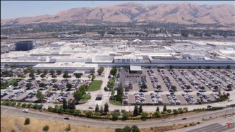
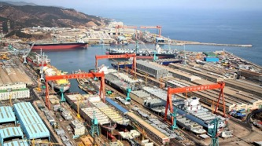
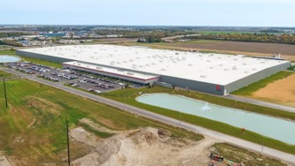
The Industry must be capable of manufacturing at scale
Tesla Factory
This means the energy transition will require making THINGS AT SCALE
These things must be easy to make and use supply chains that exist
They will require new factories or retooling of existing factories
There can’t be specialty equipment or materials involved
There can’t be specialty people involved – needs to employ the existing workforce
Hyundai Heavy Industries Shipyard
First Solar thin-film factory

Slide 5
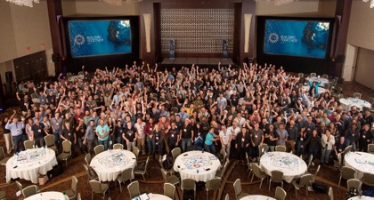
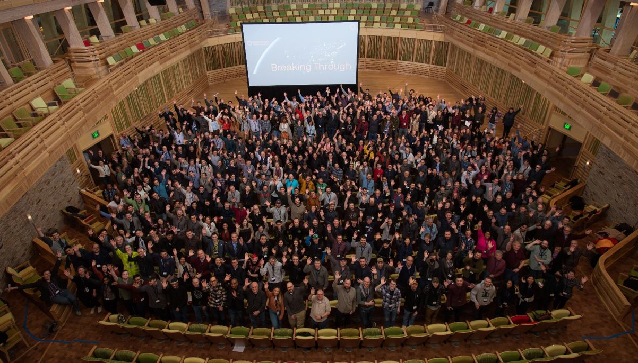
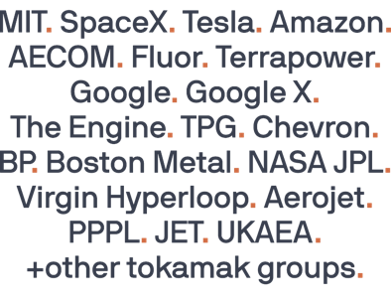
About Commonwealth Fusion Systems
CFS Founded in 2018, spun out of MIT
Raised >$2 Billion in private funding
Investors include Tiger Global Management, Bill Gates, Coatue, DFJ Growth, Emerson Collective, Google, JIMCO Technology Fund, John Doerr, Marc Benioff’s TIME Ventures, Breakthrough Energy Ventures, The Engine, Eni, Equinor Ventures, Khosla Ventures, and Temasek.
Largest fusion company in the world
~600FTE + ~150 collaborators and contractors, 1600+workers
Forbes Best Startup Employer 2021, 2022, 2023
From a large variety of backgrounds
Plasma physics, including leaders from nearly all major tokamaks
Engineering from aerospace, military, manufacturing
Strong partnerships to major Labs and Universities
Execution. Self-critique. Integrity. Impact.
Notes:
Bob

Slide 6
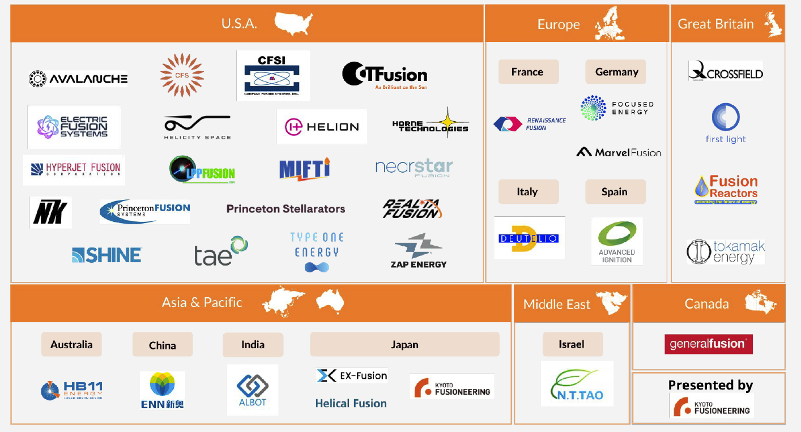
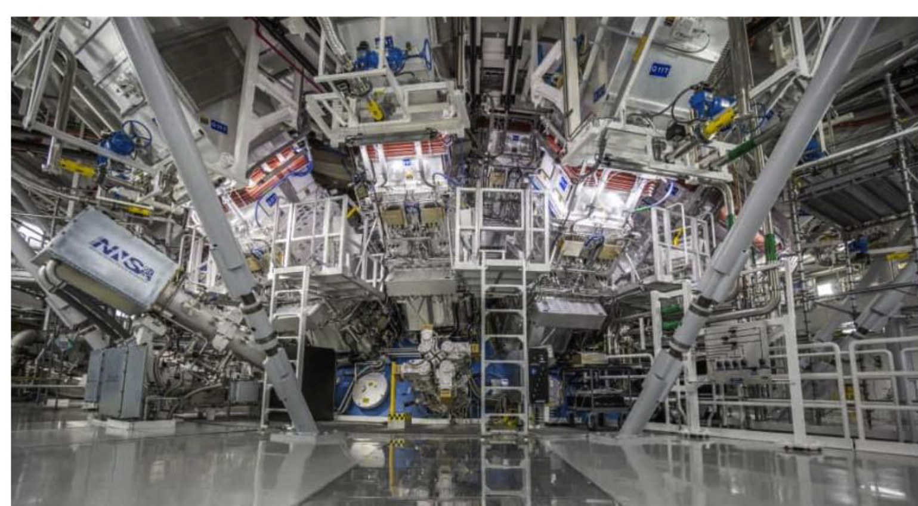
Fusion industry overview
Over 40 private fusion companies, $5.5B raised
In the past 12 months:
NIF laser facility demonstrated scientific fusion energy gain Dec 2022
US NRC votes to regulate fusion energy plants distinct from fission
US DOE launches fusion milestone program - cost-share modeled off of NASA/SpaceX
National governments establishing and funding fusion industry strategies: U.S., U.K., China, Japan, Korea, UAE, Germany, etc.
National Ignition Facility demonstrates net fusion energy gain in world first

Slide 7
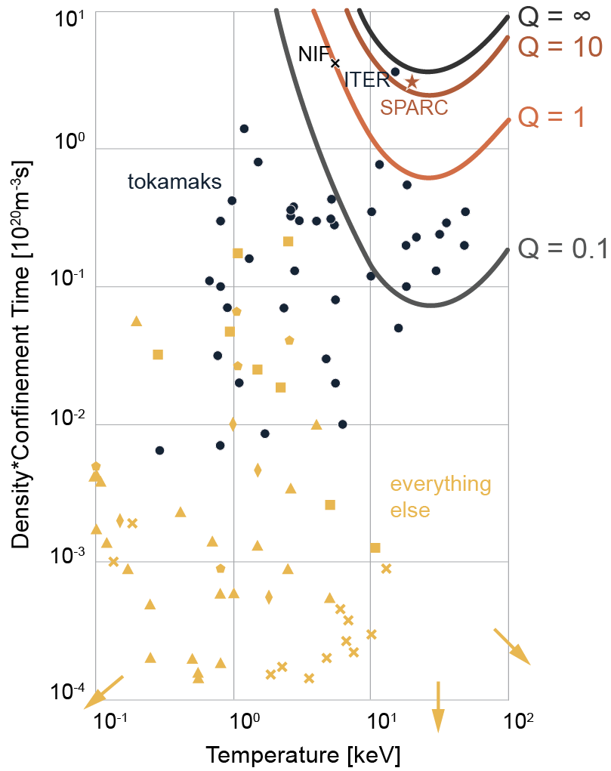
Scientifically feasible but not yet harnessed commercially
Scientists have been working on fusion for more than half a century
Key milestone — net energy — proven to be feasible, but not in any commercial device
Fusion machines called “tokamaks” have always been pursued as commercial technology
>150 built around the world; most proven fusion concept
Notes:
"There are two devices in the world that the scientific community has agreed will create commercially relevant net energy - ITER and SPARC"

Slide 8
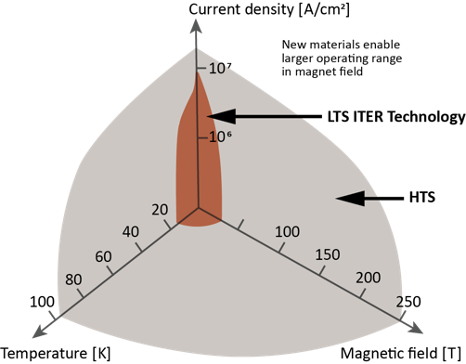
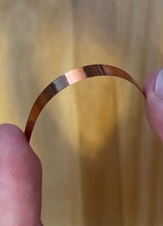
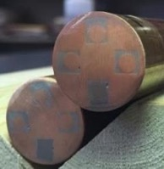
CFS has integrates HTS into new magnets for higher field
High-Temperature Superconductor (HTS) materials expanded possibilities
New material enables re-optimization of magnet design
CFS developed a new generation of superconducting magnets
Doubling the magnetic field in fusion machines
HTS material
CFS magnets
Notes:
Bob

Slide 9
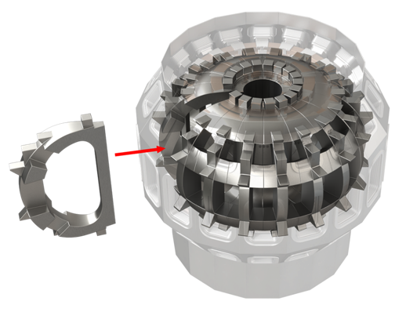
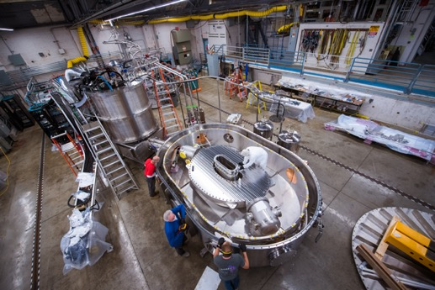
CFS proprietary magnets unlock new fusion path
CFS founded on fastest path to fusion energy – high field tokamaks
In collaboration with MIT invented world’s strongest High Temperature Superconductor (HTS) magnet
Designed and built it in 3 years, demonstrated 20 Tesla in 2021
Power plants can be >40x smaller, faster, and much lower cost
Notes:
Due to limits in magnet technology, the next step in tokamaks was to build them large – but it was known that higher fields could unlock smaller and more economic machines – that is what CFS is doing with HTS magnets

Slide 10
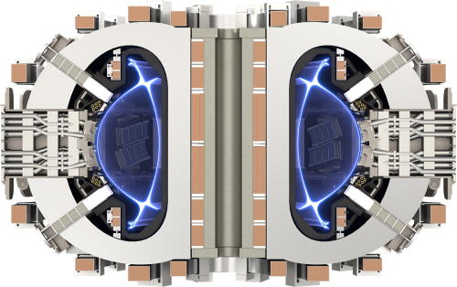
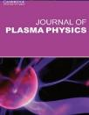
Now building world’s first commercial net energy machine
SPARC, a compact, high field tokamak
Produces industrial scale fusion heat
In package that can be constructed anywhere
At scale machine with most systems required or fusion power plant
Based on existing known science with revolutionary engineering
Broad peer reviewed scientific consensus that SPARC will work
Demonstrates economic pathway for fusion energy
Opens path to a new industry
Seven peer reviewed papers in the Journal of Plasma Physics
Notes:
. SPARC is a half-scale machine with most of the systems required for a power plant, will produce industrial scale fusion heat, in a package that can be constructed anywhere in the world
Demonstrate net energy from confidned plasma in compact, high field tokamak
Open path to a new industry
Learnings of FOAK pilot project
Based on existing known science with revolutionary engineering

Slide 11
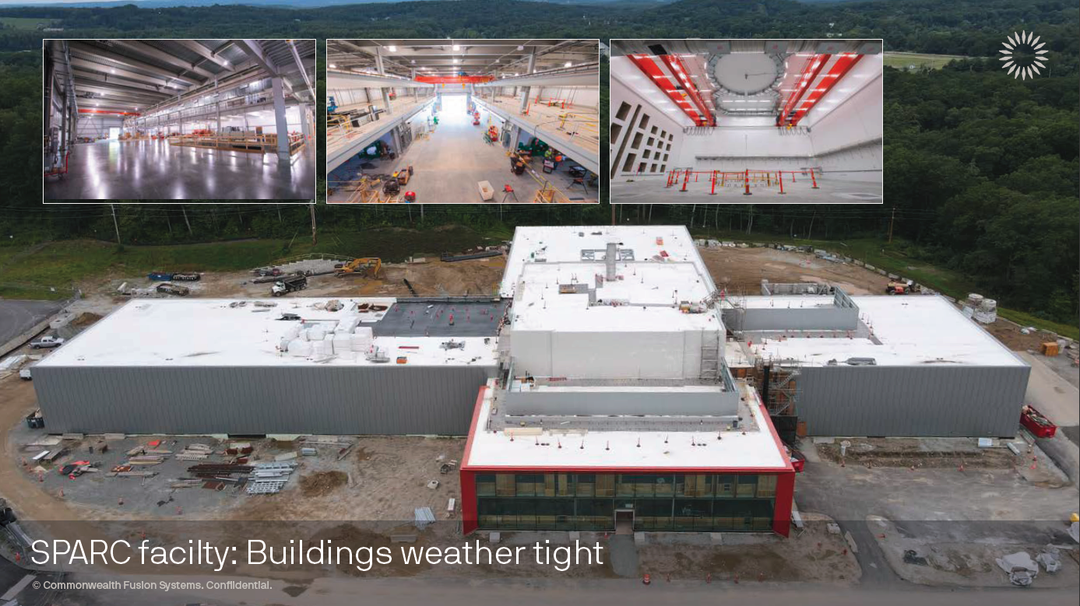

Slide 12
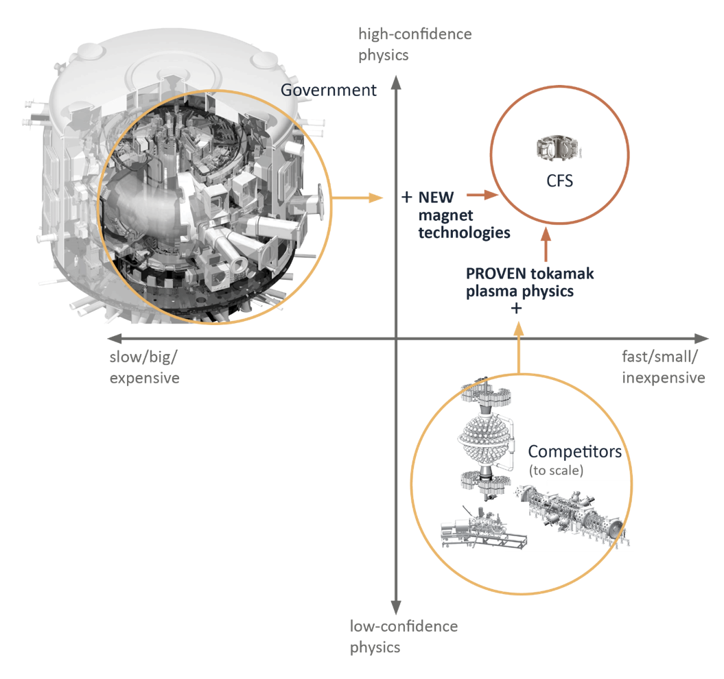
Our path breaks the fusion conundrum
CFS = proven science + CFS proprietary High-Temperature Superconductor (HTS) magnets
Build smallest, fastest, simplest, lowest-cost energy solution
Leader of a new energy industry
CFS combines established science with new magnet technology to reach new scale and eliminate a tradeoff
Notes:
Bob

Slide 13
Positioning to move to ARC ASAP after SPARC
Economics are de-risked using our receipts and BOM from SPARC
Performance de-risked and optimized through SPARC operations
Technologies de-risked and developed through SPARC and other R&D
Business development to find beachhead customers and markets
We’ll have assembled the partners and found the first customer
Manufacturing using our facilities
ARC R&D:
ARC Design:
Demo cost and performance of 4 of 17 subsystems
Preparing to construct upon SPARC success
Facilities adapted from the existing ones and campus expansion
Cost and performance of 13 of 17 subsystems
SPARC:
Manufacturing:
Development
Preparing for scale deployment
Finding the right customer and site
Partner building:
Set up to move to ARC construction immediately after SPARC demonstrated

Slide 14
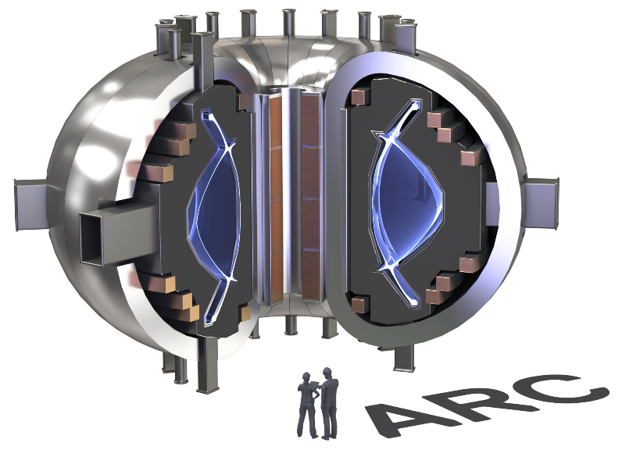
CFS Designs and Builds Fusion Power Plants
ARC Power Station
1 GW thermal
400MW net electric (450MW gross)
Load following or baseload
Quality process heat - 600C
High capacity factors
Flexible siting near loads
No volatility of fuel supply
Appropriate and supportive regulatory framework
Site search currently underway
Notes:
After that we'll put the first electricity on the grid with a tokamak called ARC. And finally, ARCs will be built throughout the world.

Slide 15
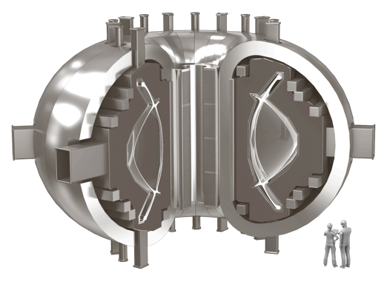
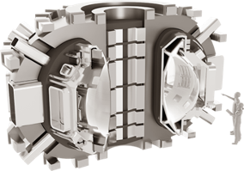
Risk retirement in concrete steps
COMPLETED:
Alcator C-Mod
Record-setting tokamak
COMPLETED:
Demonstrate groundbreaking
HTS magnets
CONSTRUCTION UNDERWAY for 2025 LAUNCH:
SPARC Q>1
Achieve net fusion energy
EARLY 2030s:
ARC deployed
~400 MW
Commercially-relevant net fusion energy for the first time
Carbon-free commercial power on the grid
Notes:
Bob

