Slide 1
Low Level Waste Disposal in an Evolving Electric Industry
Peter A. Bradford
Low Level Radioactive Waste Forum
Fall Meeting, 2023

Slide 2
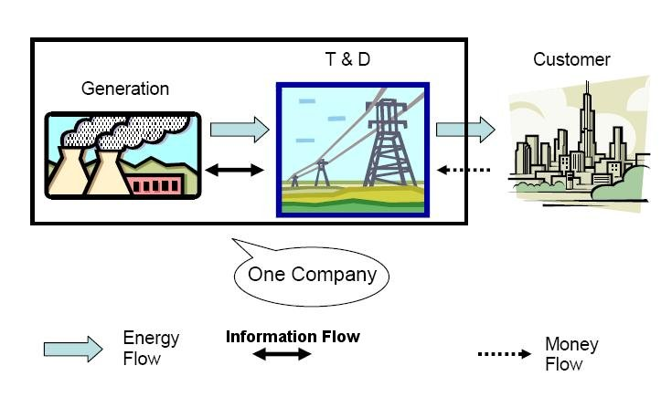
Vertically Integrated Monopoly Utility – U.S. Standard Pre-1985 – All prudent expenses covered
Notes:
Note customers

Slide 3
1990s Competitive Wholesale Electricity Market Structure
NPP
IPP
IPP
NPP
IPP
IPP
Generation
Transmission
Poolco
Transmission
Transmission
Regulated
Distribution
Disco
Disco
Disco
Disco
Disco
Disco
Regulated
Customer
Customer
Customer
Customer
Customer
Customer

Slide 4
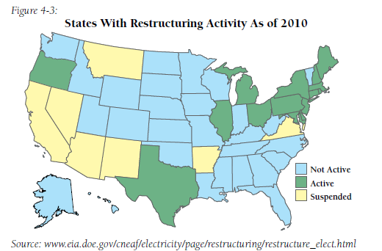

Slide 5
Nuclear Power’s Excess Cost Problem
Cost estimates, including those by reactor builders, have indicated that large new reactors will cost in the range of 12-20 cents/kwh. Vogtle could exceed that.
U.S. power market average 2015-18 cost was 3.5-4.5 cents/kwh, so the SMR or other new units have to cut recent nuclear construction costs by at least 3-400 percent to be competitive. This is implausible even with economies of scale if many units are built. It is impossible for the first units.
Current U.S. gov’t gas price forecasts indicate gas-fueled electricity not rising above 8 cents/kwh for many years.
And large amounts of efficiency remain available at less than 4 cents/kwh.
2018 solar plus storage bids in Colorado of 3.6 cents/kwh, wind at 2.1 cents per kwh.
Six months later Nevada, Arizona and Texas solar (without storage) was at 2.3-2.5 cents/kwh
Los Angeles more recently accepted a bid for 400MW of solar plus storage at under 2 cents per kwh, one of 120 bids

Slide 6
