Slide 1
LLW Disposal Attribution & Volume Reporting
Clint Miller
2023 LLW Forum
Salt Lake City, Ut

Slide 2
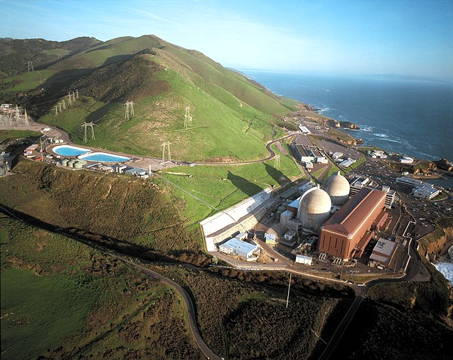
Diablo Canyon Power Plant

Slide 3
Topics
Uniform Manifest
Part 20 App G definitions
Disposal Reporting
DoE MIMS
Generator ID #
Volume issues
Attribution, non use of 542 Form
Comments to NRC
Possible Future Actions

Slide 4
Uniform LLW Manifest
540 Form – Shipping paper
541 Form – Disposal data
542 Form – Attribution data
NUREG BR 0204 guidance on how to complete above forms

Slide 5
Part 20 App G
Generator (1) a waste generator… or (2) the licensee to whom the waste can be attributed…
Residual waste …waste resulting from processing or decontamination activities that cannot be easily separated into distinct batches attributable to specific waste generators.

Slide 6
Internal Disposal Reports
Monthly waste generation reports
Business need
Aid in generation of annual reports
Annual waste reports
Required by our waste minimization program to comply with ANI/MAELU Section 4.2
Corporate Sustainability Report

Slide 7
Compact Export Permit
Southwestern Compact Commission Export Permit fee is based on LLRW disposal volume
Annual export permits with annual fees
$x.xx/ft3 disposed
Need to know the disposal volume
Submit annual report to Compact to document actual disposal volume

Slide 8
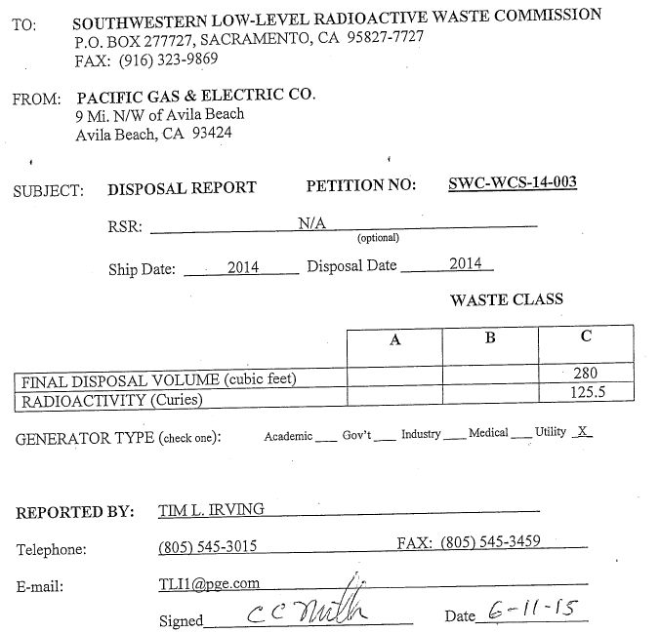
SWCC Export & Texas Import Reports

Slide 9
State LLRW Reporting
California Senate Bill 2065 from 2002 required LLRW reporting to the State
Cal Health & Safety Code 115000.1(h) submit LLRW reports annually to the Radiological Health Branch from 2003 on.
LLRW disposal Volume and Activity by waste class
LLRW volume in storage by waste class

Slide 10
LLRW Reporting to NRC
RG 1.21 Annual Rad Effluent Report
Solid waste volume and activity Table 3
Rev 1 issued prior to advent of off-site waste processing
Table 3 “for Burial or Disposal”
Rev 2, 2009 include bulk volume to processors
Table 3 included Waste Class
Rev 3 deleted Table 3
bulk waste to processor has no Waste Class

Slide 11
2015 Class A Disposal

Slide 12
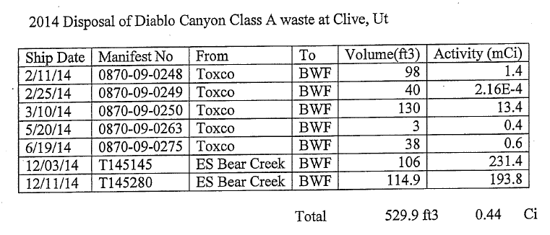
2014 Class A Disposal

Slide 13
2014 Class B/C Disposal

Slide 14
DOE MIMS
Manifest Information Management System (MIMS) is the US national Commercial LLRW disposal data base
All Commercial LLRW disposal sites submit manifested disposal data to DoE
Uniform Manifest data populates MIMS
DoE web site includes waste generator report feature
Need to know your plant’s Gen ID#

Slide 15
Generator ID #
Obtain your plant’s MIMS Gen ID# from the disposal site
Ensure your processors are manifesting your plant’s Gen ID# on the 542 Form
If not, direct them to use the proper Gen ID#

Slide 16
Generator ID #
If shipping direct to Clive unify your Gen ID#s
Revise your BWF # to match your CWF #
Direct waste Processors to use your Clive Gen ID# on their 541/542 Forms to Clive
Bear Creek won’t change the ID# they assigned your plant
Direct Clive to change all Bear Creek manifests to your Clive Gen ID# using their over ride feature

Slide 17
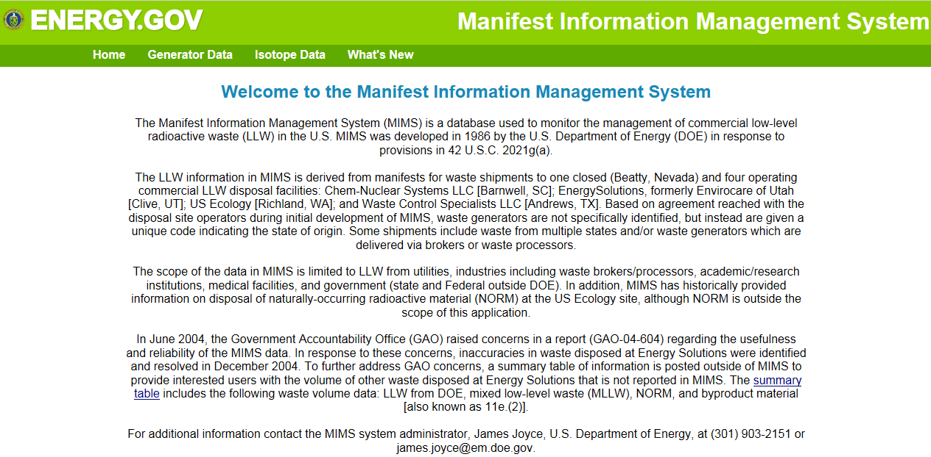
DOE MIMS Home Page

Slide 18
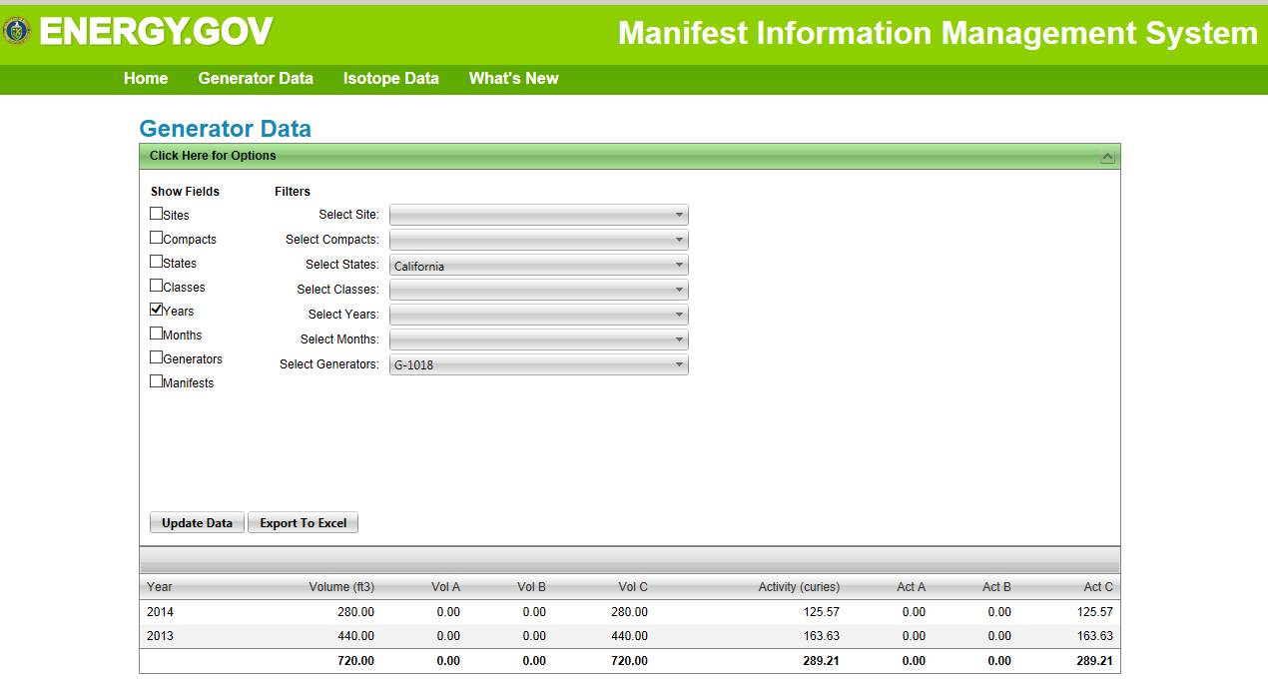
MIMS Texas Data - Year

Slide 19
MIMS Texas Data
Wow, the disposal data requested by the State, the Compacts and submittal to NRC (280 ft3 and 125 Ci for 2014) is in MIMS

Slide 20
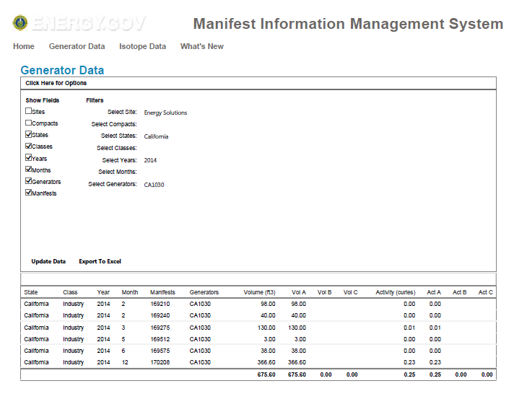
MIMS Clive Data - Manifest

Slide 21
MIMS Clive Data - Manifest
Two alignment issues
MIMS collects data for shipments “received” by a disposal site in a given year while State, Compact and NRC ask for data “shipped” in a given year. (Late December shipments not currently included in MIMS report)
Disposal volume at Clive’s BWF for shipments from Bear Creek are often “bulk” shipping volumes

Slide 22
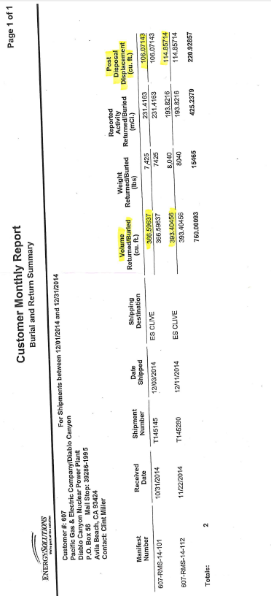
Bear Creek Report

Slide 23
Disposal Volume
Barnwell, Richland and Texas submit container volume as disposal volume
IAEA data lists container volume as disposal volume
Clive, Ut CWF had reported waste volume as disposal volume but, has now aligned to submit container volume as disposal volume

Slide 24
542 Issues
WCS Texas does not send DoE MIMS a breakdown of attribution from 542 forms sent to the Compact facility
Thermal processors not completing 542 Forms. Energy Solutions Erwin provides a separate attribution list but, this impedes transfer of the attribution breakdown to MIMS.

Slide 25
Comments on BR 0204 to NRC
Comments from NEI and others intended to improve guidance without revising Part 20.
E-1 comments to enhance guidance on disposal volumes (bulk on 540, post disposal on 541).
NRC rejected all comments save use of #11 Bulk Unpackaged Waste on 541.
E-2 Generator …should be the facility where the radioactivity originated.
NRC rejected this comment but added a foot note to see Part 20 App G definition.

Slide 26
Part 61 Revision
NRC has indicated Part 20 App G will be revised to implement the revision to Part 61.
NRC Staff indicates no intention to alter the definition of Generator or Residual Waste
Suggest submitting comments to NRC to revise:
Generator definition be revised to be “the facility where the radioactivity originated”.
Residual waste …waste resulting from processing or decontamination activities that cannot be easily separated by calculation or physically into distinct batches attributable to specific waste generators (e.g., grit blast media).

Slide 27
Possible Actions
Encourage DoE to add query start and stop dates option to MIMS generator report (e.g., include December shipments received in January in an “annual” report)
Request that for compactible waste Clive BWF submit post disposal displacement volume versus bulk shipping volume to MIMS

Slide 28
Possible Actions
Advocate to have DoE determine funding WCS Texas needs to provide 542 breakdown to MIMS.
Industry and Compacts encourage Congress to fund DoE to implement the above

Slide 29
Possible Actions
Advocate to have MIMS include LLW disposed of at Alternative RCRA cells
Request DOE determine additional funding to collect data from RCRA cells at WCS Texas and Republic-Idaho
Encourage Congress to fund DOE to include Alternative RCRA cell waste disposal in MIMS

Slide 30
Conclusion
Commercial LLRW disposal manifest data is collected and available in DOE MIMS
NRC, some States and LLRW Compacts have LLRW reporting requirements
Generator data from DOE MIMS can meet these reporting requirements

