Slide 1
EPRI Low and Intermediate Level Waste (LILW) Program Update
Darcy Campbell, CHP
Principal Team Lead, Radiation Safety
Low Level Waste Forum – Fall 2023
October 4, 2023

Slide 2
Vision
To be a world leader in advancing science and technology solutions for a clean energy future
Mission
Advancing safe, reliable, affordable, and clean energy for society through global collaboration, science and technology innovation, and applied research.
Together…Shaping the Future of Energy®

Slide 3
EPRI Radioactive Waste Management Research
Generation & Management
Dry Solid Waste
Wet Solid Waste
Volume Reduction
Concentration Averaging and Encapsulation
Storage & Disposal
Disposal site waste acceptance criteria
Very Low Level Waste
Mixed waste (hazardous and rad waste)
Liquid radwaste processing and effluents
Strategies to optimize generation by waste stream/form and classification
Radwaste Characterization
On-Site Storage

Slide 4
Radioactive Waste Management
Research and Development on methods, strategies, guidance, technologies associated with radwaste management
RadBench Database (https://radbench.epri.com)
Radwaste Hub (https://radwaste.epri.com)
EPRI Low-and-Intermediate Level Waste Technical Strategy Group (LILW TSG)
Site-Specific Assessments
Training
Quarterly webcasts (recordings available for LILW TSG members)
ASME / EPRI Radwaste Workshop & EPRI International Low-and-Intermediate Level Conference
July 2023 – Radwaste Fundamentals Training
July 2024 – Savannah, GA (Tentative)

Slide 5
Accurate Estimation of Tc-99 and I-129 in Nuclear Power Plant Low and Intermediate Level Waste

Slide 6
Background & Purpose
Tc-99 and I-129
Hard-to-detect radionuclides that are required (and important) to characterize for radwaste disposal
Current Methods of Characterization
Lower limit of detection (LLD) of currently commercially available laboratory analysis for Tc-99 and I-129 are several orders of magnitude higher than actual concentrations.
Utilities typically use LLD values for waste classification and waste disposal reporting purposes
Problem
Current, typical characterization methods could:
inaccurately quantify Tc-99 and I-129
limit options for disposal of low and intermediate level waste (LILW) for nuclear power plants
Objective: Develop more accurate estimation methods for Tc-99 and I-129 in Nuclear Power Plant LILW

Slide 7
Background & Purpose
Previous Efforts (cont’d)
1990s: Pacific Northwest National Laboratory (PNNL) measured the Tc-99 and I-129 content in nuclear power plant wastes using mass spectrometric methods (NUREG/CR-6567)
2015: EPRI developed generic scaling factors for Tc-99 and I-129 for LILW using the PNNL dataset (EPRI Report 3002005564)
2018 – NRC Request for Additional Information
Additional justification needed for:
Use of PNNL dataset
Statistical methods employed
Scaling factor relationships
2021
NRC expressed openness to review industry submittals of calculated generic scaling factors
EPRI emerging issue project funded and prioritized due to impact of potential change in U.S. regulations as well as U.S. and international member feedback

Slide 8
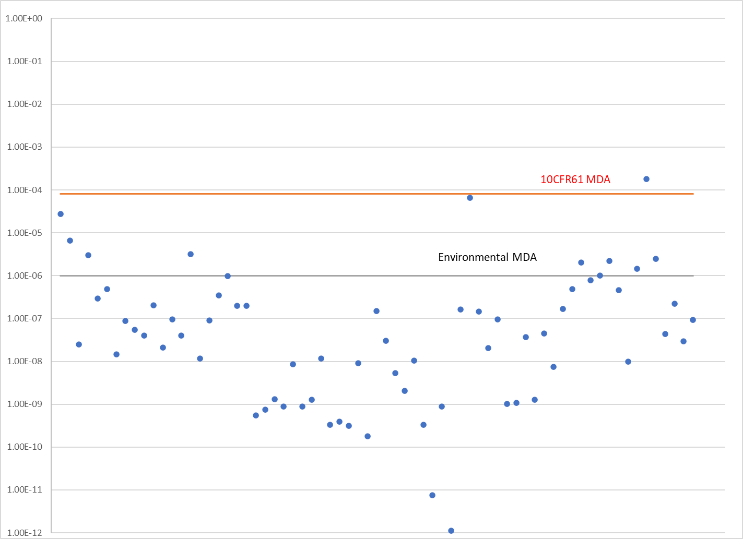
Current Estimation Practices – U.S. Examples
NUREG/CR-6567 I-129 Analysis Results Compared to U.S. Commercial Laboratory Minimum Detectable Activity (MDA)
Radionuclide | NUREG/CR-1759 DCF* Value, Ci/m³ (Bq/m³) | ICRP 60 DCF Value, Ci/m³ (Bq/m³)
Tc-99 | 3.0 (1.1E+11) | 0.14 (5.2E+09)
I-129 | 0.08 (3.0E+09) | 0.024 (8.9E+08)
µCi/gram (resin)
* DCF = Dose Conversion Factor
EPRI Report 3002003121 – Dose Conversion Factor Evaluation and IMPACTS Analysis of Low Level Radioactive Waste

Slide 9
Phase 1 – Completed Tasks
TASK | RESULT
Re-evaluate data from NUREG/CR-6567 to: Address technical questions related to EPRI Report 3002005564 on generic scaling factors for Tc-99 and I-129. Determine an alternative, generic method for more accurately estimating Tc-99 and I-129. | Sampling and analysis methods are not consistent between samples Errors identified in NUREG/CR-6567 dataset EPRI Report 3002005564 removed from epri.com – Generic scaling factor being re-calculated based on new information.
Explore other datasets (including those from non-US organizations), methods, technologies, and strategies that may be available. | Limited data is available due to inadequate sample representativeness, sampling difficulties, and large expense for analysis Difference in U.S. versus international disposal site performance assessment
EPRI Technical Update | In progress – expected completion Fall 2023

Slide 10
Phase 2 – Future Activities (2023 – 2024)
Industry Needs and Changes:
Internationally: New disposal facilities being sited, licensed, and constructed
U.S.:
Disposal facilities may impose site specific limits based on facility specific, rather than generic, performance assessments
Regulatory revisions currently in progress
Availability of “Very Low Level Waste” options
Tasks:
Collect waste sample data to create a new industry dataset to support statistical analysis of Tc-99 and I-129 in typical plant waste streams
Determine if changes can be made to laboratory analytical methods to achieve lower levels of detection for Tc-99 and I-129
Review U.S. and international guidance assumptions
EPRI Technical Report to capture findings (Fall 2024)

