Slide 1
Richland LLRW Site Update and Revenue Requirement LLW Forum Fall 2023 Meeting
Doug Frenette
General Manager, Richland LLRW Disposal Facility
October 4, 2023

Slide 2
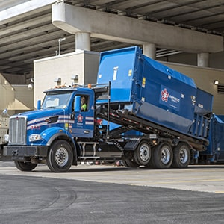
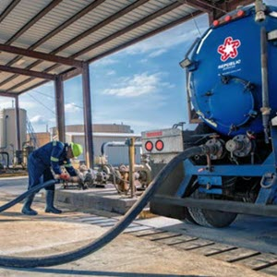
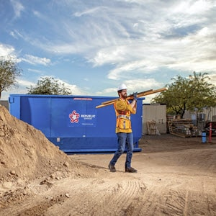
Republic Services
About
Republic Services, Inc. is now the nation’s leading environmental services provider. Through our subsidiaries (US Ecology, ACV Enviro, Ecoflo), we provide superior service offerings to ensure compliance while partnering with customers to create a more sustainable world.
Company Overview
39K employees
14M customers
1,000+ worldwide locations
$11B in revenue in 2021
95% customer retention
16K Trucks | 5th largest vocational fleet in the nation
Business Solutions
Solid waste collection and disposal
Recycling
Dumpster rental
Construction and demo
Compactor solutions
Environmental solutions
Notes:
The 39k employees includes the ~4k added from acquiring US Ecology

Slide 3
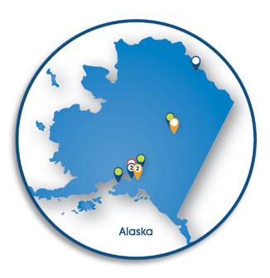
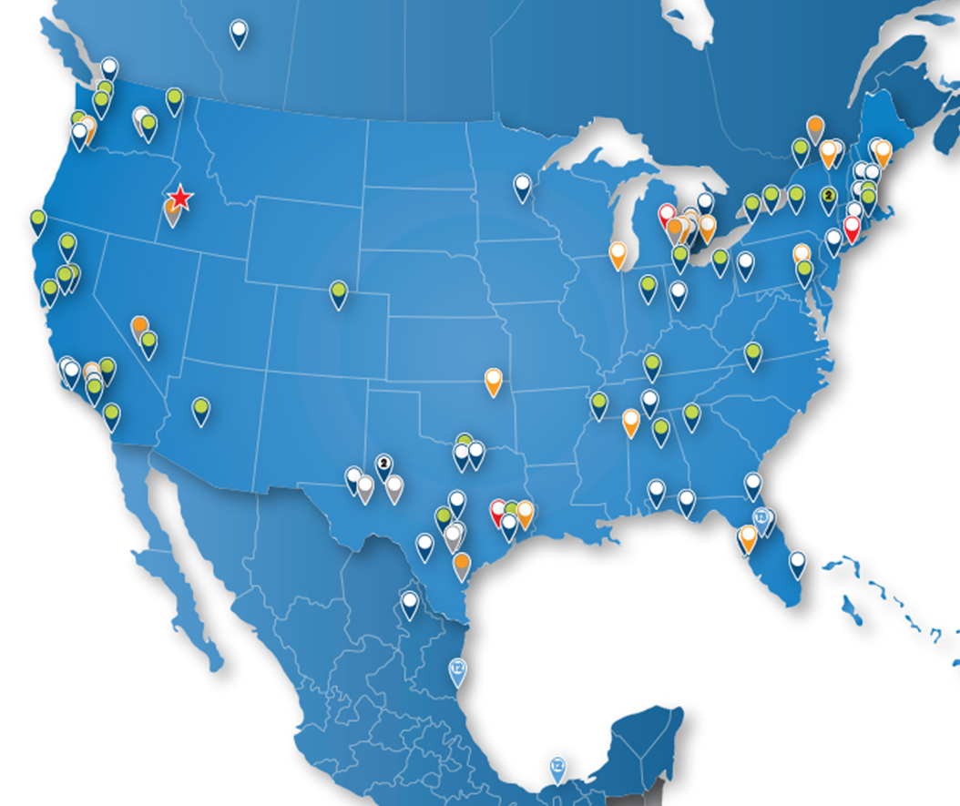
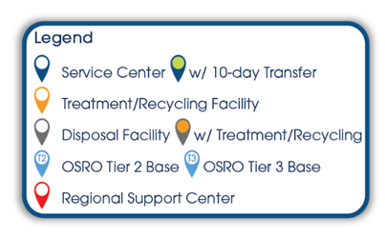
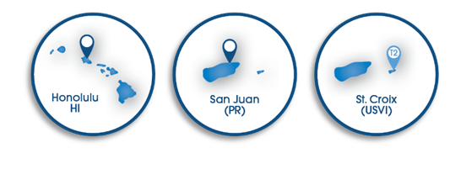
Environmental Solutions
Vision: To be the Premier Provider of Comprehensive Environmental Services
Notes:
Legacy USE is now the Environmental Solutions division of Republic Services. This is the new capabilities and locations RS purchased.

Slide 4
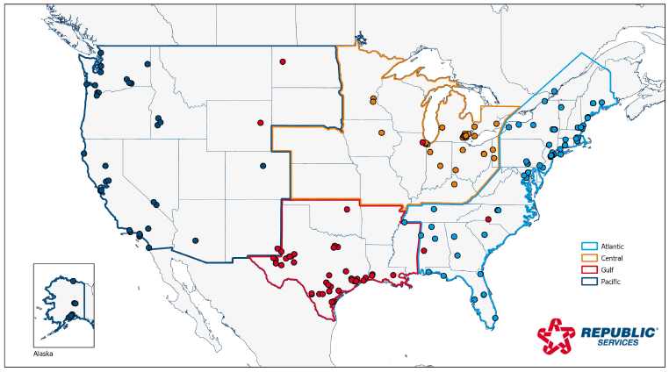
What’s Changing?
No changes to radioactive waste programs or services
Legacy US Ecology is now the “Environmental Solutions” Group within Republic Services
Corporate HQ in Phoenix, AZ with Area offices throughout US
US Ecology continues to be rebranded to Republic Services throughout 2023
Facility name changed to “Republic Services Richland”
Legal name remains the same, “US Ecology Washington, Inc.”
Notes:
Republic Services Richland is part of the Pacific Area of Environmental Solutions.

Slide 5
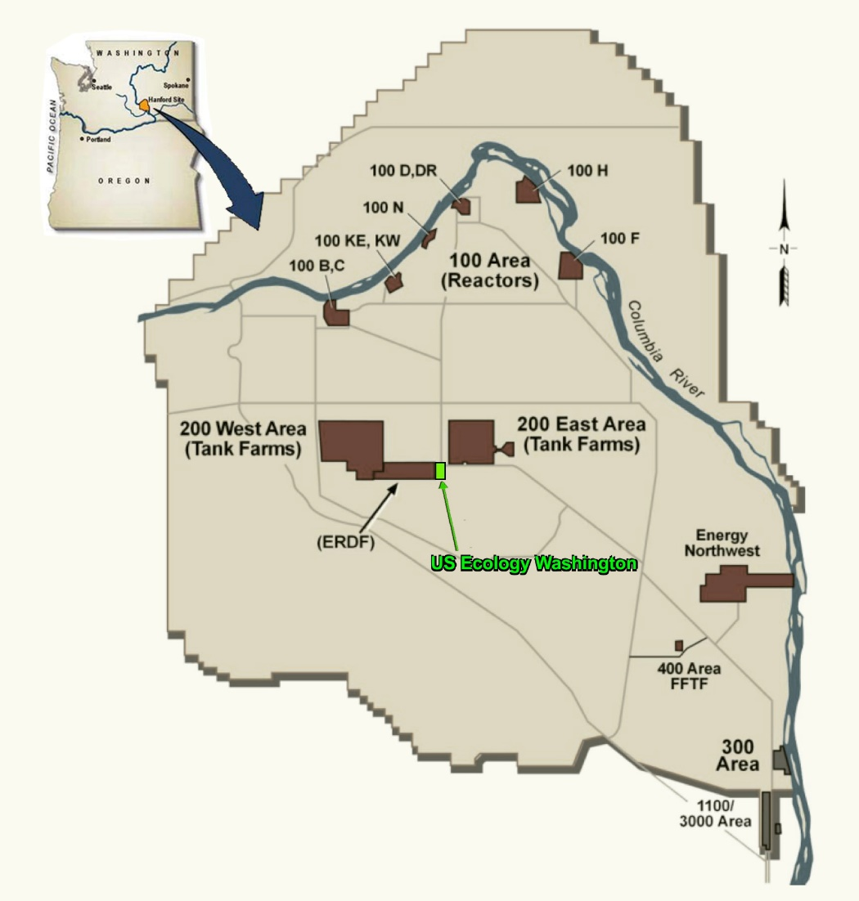
Republic Services Richland
Part 61 LLRW Facility – 1 of 4 in United States
Located on 100 acres within the DOE Hanford Reservation in Richland, WA
Originally Licensed in 1965
Designated NWIC Facility (Accessible to 11 states in NW & RM Compacts - January 1, 1993)
Operates through sublease agreement with State of WA
Rate-regulated by WA Utility & Transportation Commission
Notes:
Other Part 61 facilities - Clive, UT (Energy Solutions), Barnwell, SC (Energy Solutions), Andrews, TX (Waste Control Specialists)

Slide 6
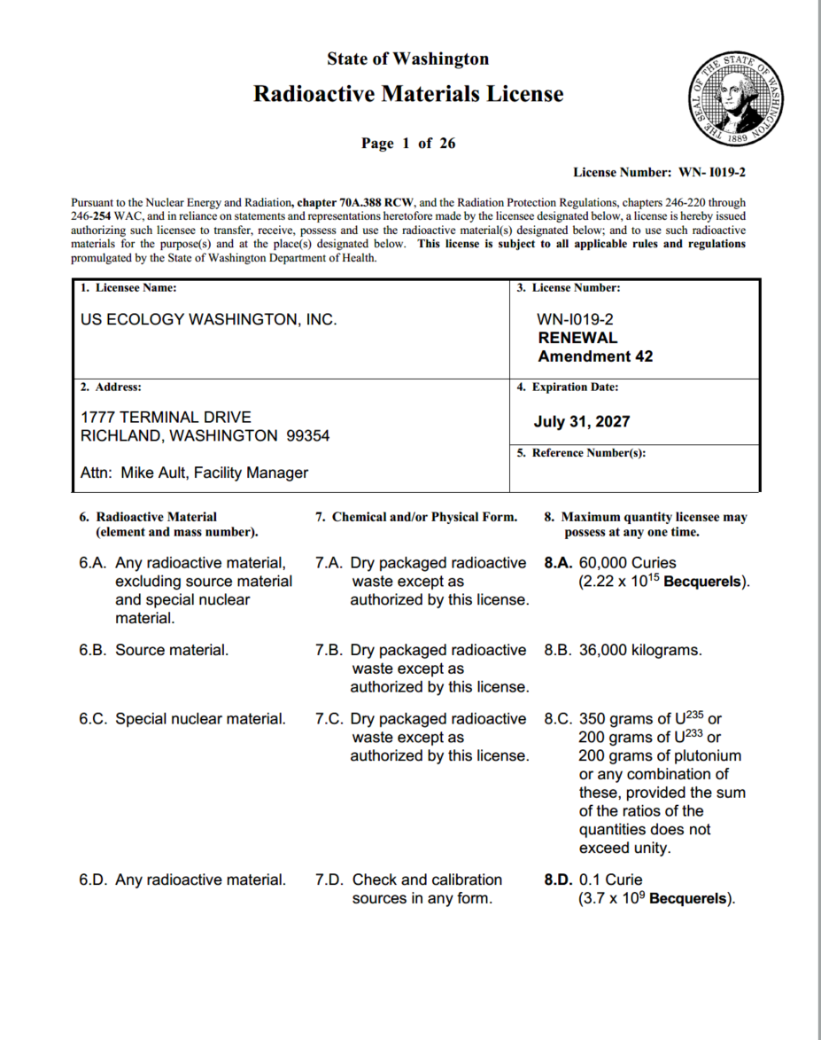
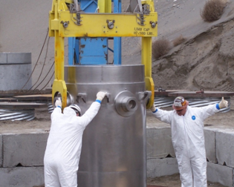
Washington License & Accepted Waste
WDOH License # WN-I019-2, Amendment 42
Expires July 31, 2027
Class A, B and C LLRW in the Northwest and Rocky Mountain Compacts
NORM/TENORM/NARM acceptable from generators nationwide
High-activity sealed source capabilities
All waste arrives by truck
Notes:
Latest revision to the license did not modify Waste Generator requirements.
8 states in NW Compact
3 states in Rocky Mtn Compact

Slide 7
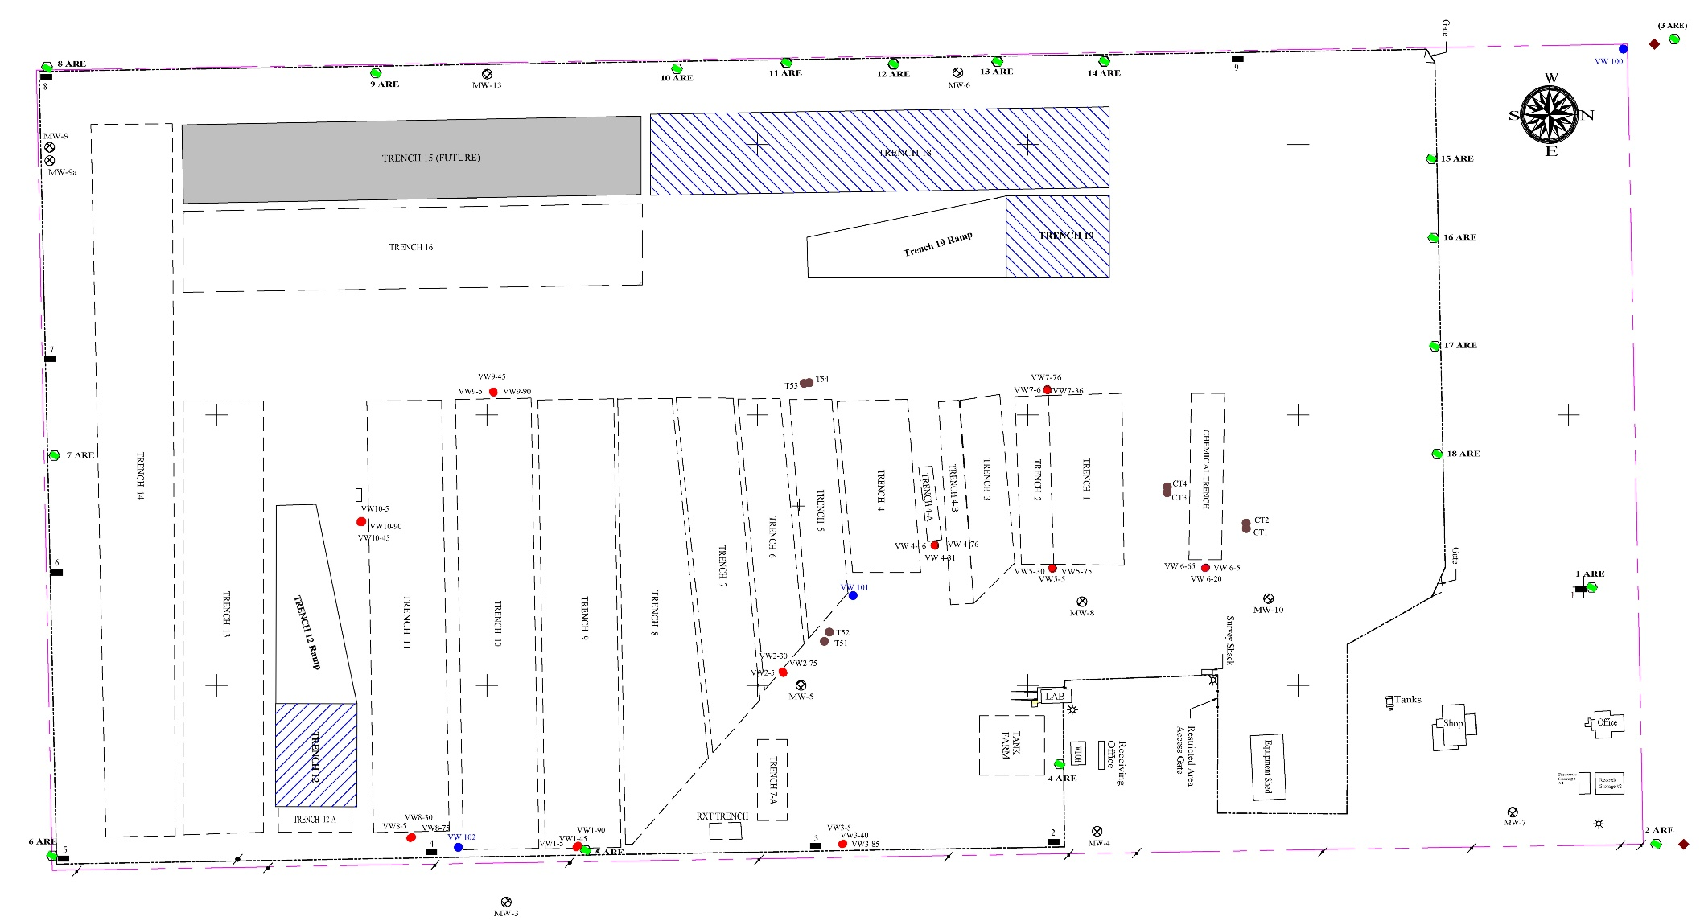
Site Footprint
Trench 18 - AU
Trench 19 A/B/C Stable
Trench 12 - AU
Notes:
Stable and Unstable waste is segregated.
Enough disposal capacity to last well past the 2056 closure date. (Based on existing volumes)
3 Active disposal trenches

Slide 8
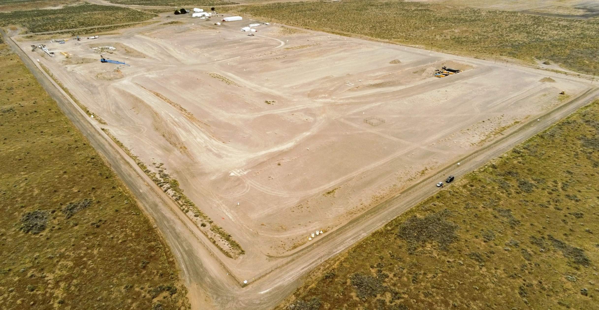
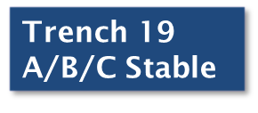
Richland Arial Photograph ~2023
N
Notes:
2023 aerial view of the site

Slide 9
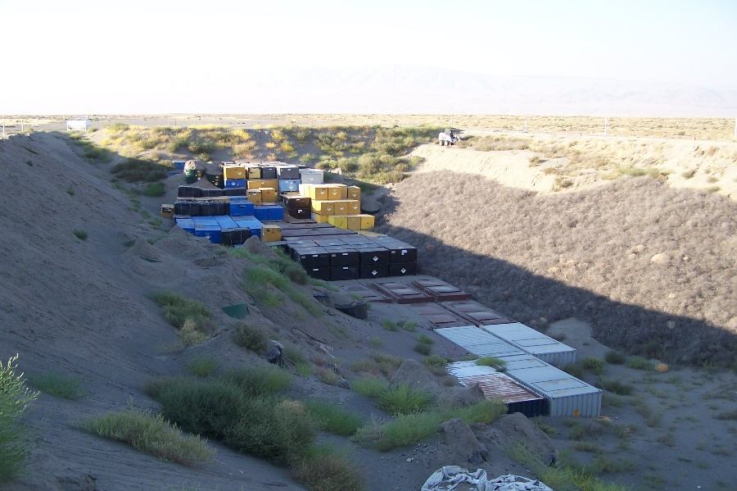
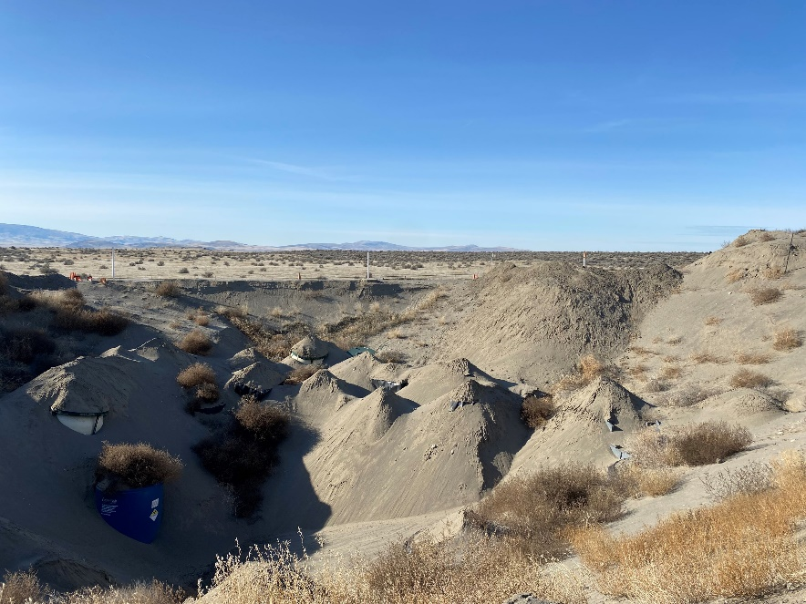
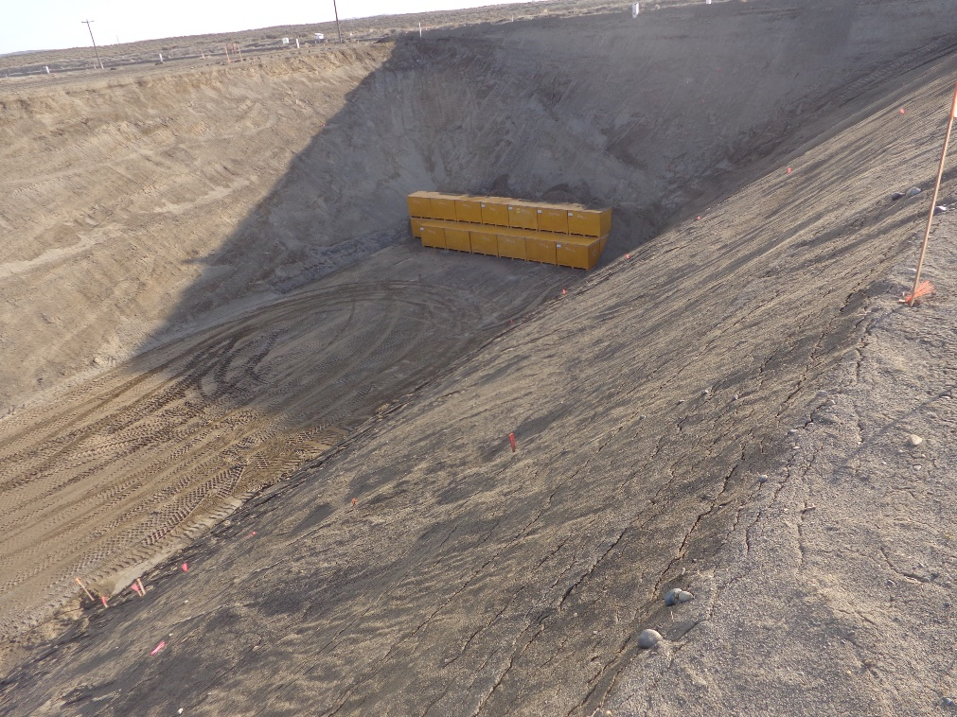
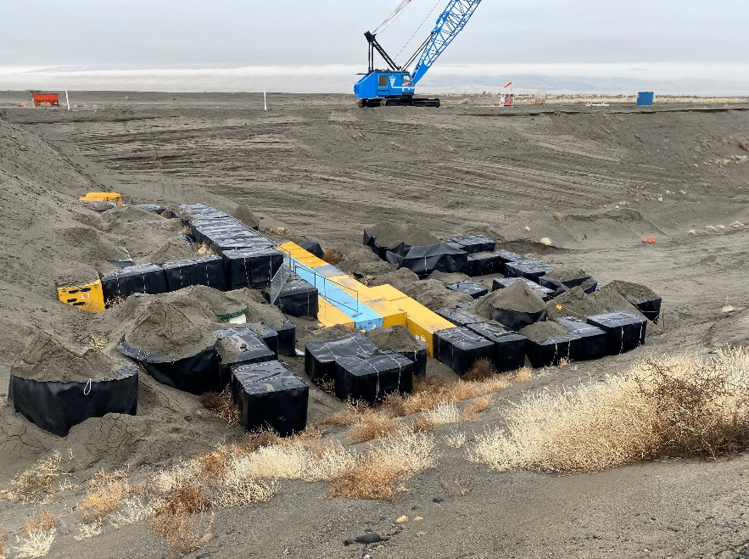
Class A Unstable Waste Trenches
2012
2023
Trench 18
2018
2023
Trench 12
Notes:
Class A Unstable Trenches 18 & 12
Trench 18 was constructed in 1995. Anticipate it will be full by and of 2024/ early 2025. Place interim cap on it in 2025.
Trench 12 – first phase was constructed in 2019. Build-as-you-go method, adding 150’ of trench at a time. Phase 2 was certified earlier this year.

Slide 10
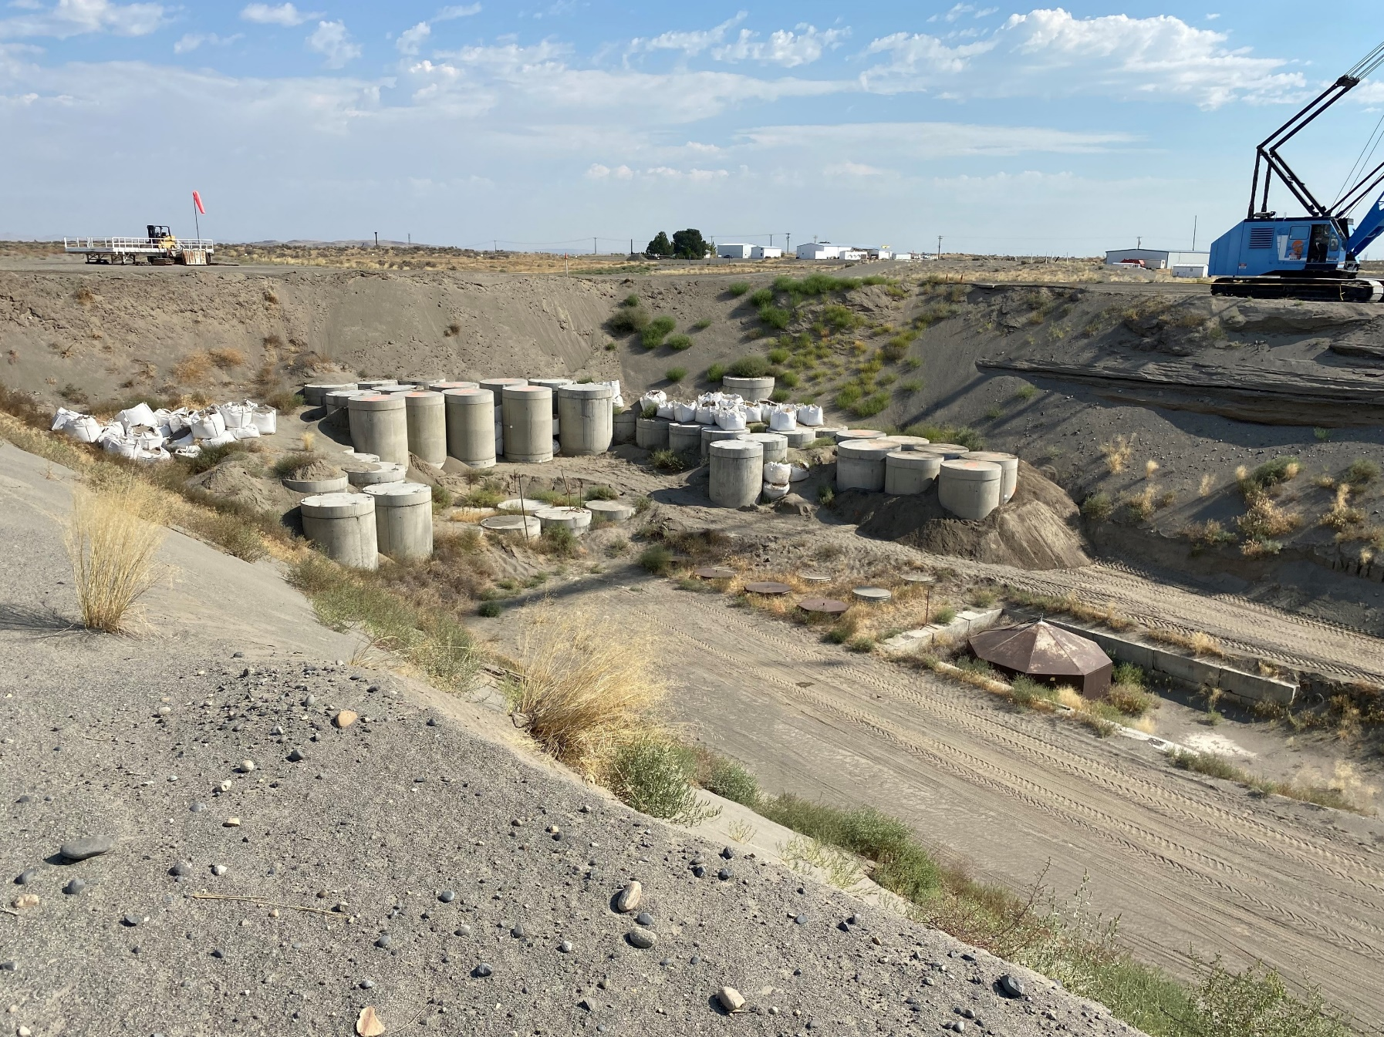
Trench 19 –Class A/B/C Stable Trench
ECBs
Below Grade Caissons
Notes:
Trench 19 was constructed 2006/2007
Trench 19 is where we dispose of our Class A, B & C Stable waste
Small subset of overall waste received; still on “first phase”
ECB - Engineered Concrete Barriers

Slide 11
Washington Historical Volumes
Washington Facility has received an annual average volume of ~20,800 ft³ (2013-2022) from generators within the Northwest and Rocky Mountain Compacts
Approximately 50% of volume is generated at Energy Northwest Columbia Generating Station
Ample capacity remains to support generator needs through 2056
All values in cubic feet (ft³)
11
Notes:
2017/2018 – primary WG was temporarily suspended from shipping to USEW
2020 - COVID

Slide 12
Richland Revenue Requirement
USEW operates under a base Revenue Requirement (RR)
Submitted for approval by WUTC every 6 years
Facility Cost of Operation @ 71% operating ratio
Annual adjustments to RR based on core inflation metrics
Uncollected amounts in a category (volume, shipments, containers, etc.) may be rolled over into next year’s RR
Overcollection results in refunds to all generators that shipped waste that calendar year
Notes:
Revenue Requirement “Set by WUTC every 6 years”- we are actually operating under the $5.2 million revenue requirement that was set for the six year period Jan. 1, 2008 through Dec. 31, 2013. We petitioned to extend the Settlement Agreement continuing with the same revenue requirement as adjusted by annual inflationary adjustments each year for an additional six year period 2014-2019 and then again for 2020-2025. The 71% Operating Ratio as agreed to in the Settlement Agreement was used to determine the original revenue requirement and was submitted to the WUTC and generators for approval so to be precise, it’s also not really “set by” the WUTC. Maybe to make it simple you could just say “submitted for approval by WUTC every 6 years” as your second bullet point.

Slide 13
Richland Revenue Requirement
Rates are set using generator supplied volume estimates
Total Rate = RR / Volume Estimates*
Base Rates set in January and adjusted in May of each year
Revenue Requirement is split into 5 categories
Site Availability (22%)
Volume (31.6%)
Shipments (10.7%)
Containers (21.5%)
Dose Rate (14.2%)

Slide 14
Richland Revenue Requirement
Year | Base RR Adjusted by Inflation | Total Prior Year Carryover | Final RR
2018 | $5,976,482 | $1,895,058 | $7,871,540
2019 | $6,151,681 | $1,727,783 | $7,879,464
2020 | $6,255,450 | $166,477 | $6,421,927
2021 | $6,329,230 | $182,964 | $6,512,194
2022 | $6,584,107 | $92,239 | $6,676,346
2023 | $7,031,600 | $110,404 | $7,142,004
Notes:
2018 and 2019 carryovers were driven by lack of ENW Columbia NPP waste shipments

Slide 15
Richland Revenue Requirement
Year | Revenue Requirement Components | RR Rate Components
 |  | Site Availability Charge (SAC) | Volume | Shipments | Containers | Dose Rate | TOTAL
 |  | 22.0% | 31.6% | 10.7% | 21.5% | 14.2% | 100%
2023 | Base Revenue Requirement | $1,546,952 | $2,221,986 | $752,381 | $1,511,794 | $998,487 | $7,031,600
2022 | Carryover/$-0- if Refund | $110,404 | $-0- | $-0- | $-0- | $-0- | $110,404
2023 | SAC Under-recovery Allocated to Other Rate Components | $(824,168) | $333,894 | $113,059 | $227,174 | $150,041 | -
2023 | Final Rev Requirement | $833,188 | $2,555,880 | $865,440 | $1,738,968 | $1,148,528 | $7,142,004
Notes:
Showing how RR components were adjusted from the previous year
$110k carried over
SAC maxed out (limited by Settlement Agreement), applied by percentage to each of the other components

Slide 16
2023 Revenue Requirement (through August)
Component | Revenue Requirement | Collected | Remaining
Site Availability | $833,188 | $842,591 | ($9,403)
Volume | $2,555,879 | $1,114,864 | $1,441,015
Shipment | $865,440 | $452,020 | $413,420
Container | $1,738,968 | $660,100 | $1,078,868
Exposure | $1,148,528 | $328,734 | $819,794
Total | $7,142,003 | $3,398,309 | $3,743,694
Notes:
Expect a busier 4th quarter
2/3 through the year, ½ of revenue collected

Slide 17
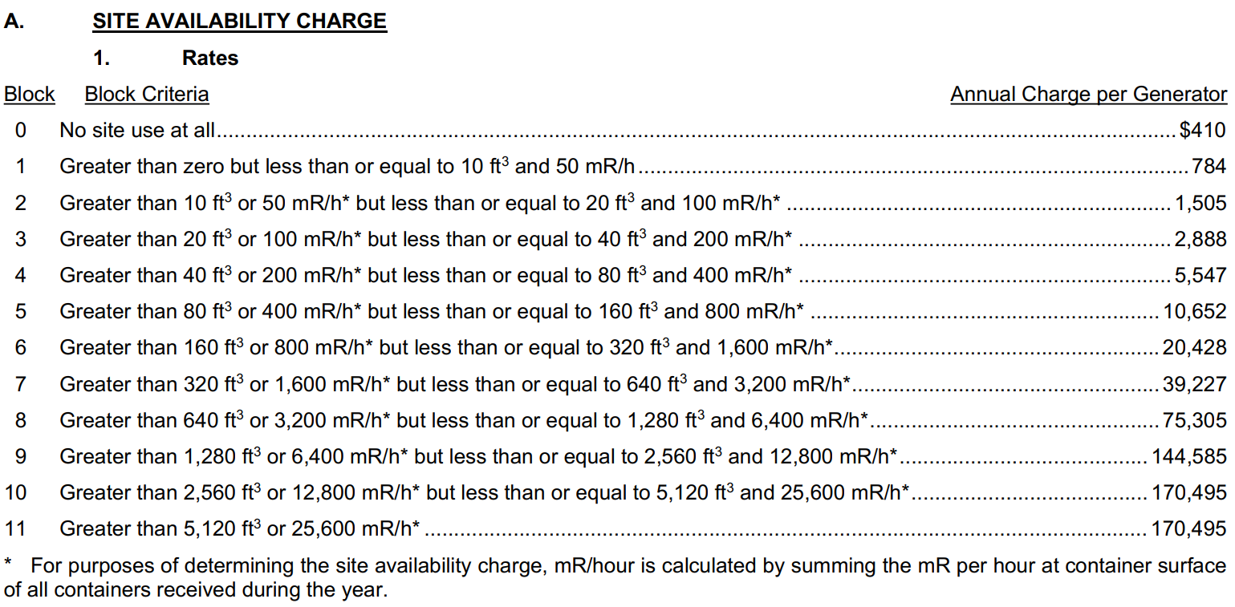
Richland May 2023 Rates

Slide 18
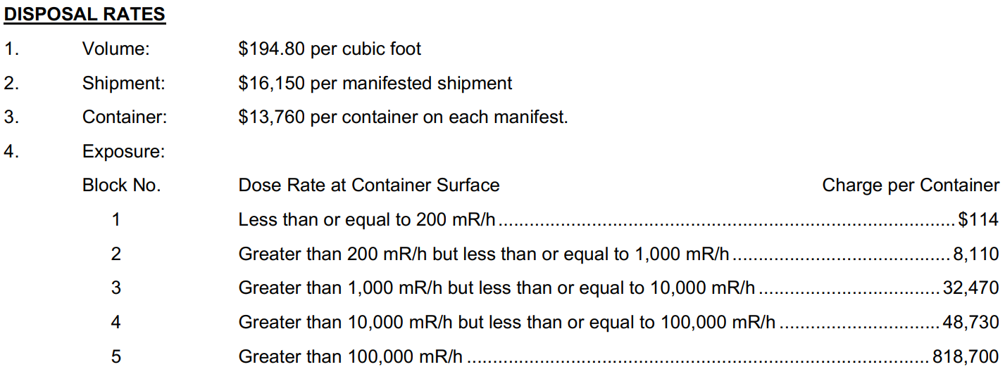
Richland May 2023 Rates
Notes:
The perpetual surveillance and maintenance fee collected from the facility’s customers, currently set at $1.75 per cubic foot of waste disposed, is remitted to the Department of Ecology on a quarterly basis. Collection of this fee is ongoing.
The closure fund was established in 1982 (per Agreed Order) and set at $0.25 per cubic foot of waste disposed. In 1992, the State ceased requiring contributions to Fund 125.

Slide 19
Organization – Changing Workforce
Over the last few years, we have said farewell to many of the tenured employees here. Changing the “Old Guard.”
In April, our Assistant Radiation Protection Manager, Steve Gowen retired (37+ years)
In August, our former Facility Manager, Mike Ault retired (33+ years)

Slide 20
Contact Us!
Doug Frenette General Manager Richland Facility (509) 377-2411 (o) Douglas.Frenette@usecology.com DFrenette@republicservices.com | Sherry Frenette Sr. Mgr, Rad Programs (702) 912-7925 (m) Sherry.Frenette@usecology.com SFrenette@republicservices.com
Tim Jenkins Corporate Health Physicist (208) 741-1089 (m) Timothy.Jenkins@usecology.com TJenkins@republicservices.com | Hans Honerlah Manager Strategic Services (512) 202-4928 (m) Hans.Honerlah@usecology.com HHonerlah@republicservices.com

Slide 21
Do you
have any
questions?

