Slide 1
Engaging Local Governments on Nuclear Development and Waste Management
Low Level Radioactive Waste Forum
October 4, 2023
Kara Colton
Director of Nuclear Policy
Energy Communities Alliance

Slide 2
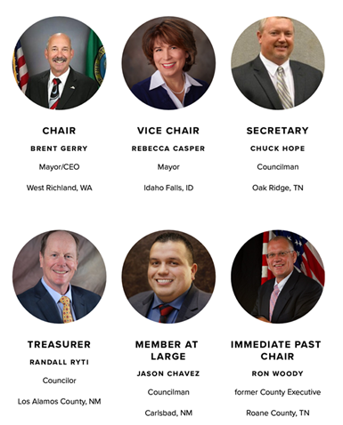
Who is ECA?
Formed over 30 years ago by local governments responsible for protecting the human health and environment in their communities in a way that offers community-driven and risk-based economic opportunity.
Communities currently hosting DOE’s national laboratories, EM cleanup sites, nuclear weapons facilities, nuclear component manufacturing, nuclear energy sites, de facto interim storage sites, and potential hosts for nuclear waste storage and disposal facilities.
NEW: Communities hosting or interested in hosting future public or private advanced nuclear facilities.

Slide 3
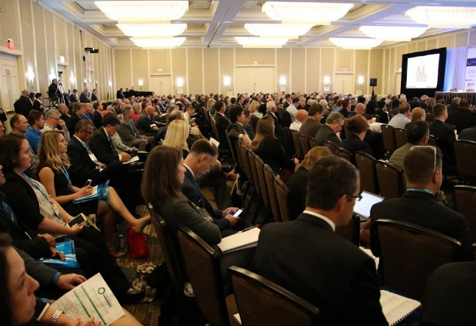
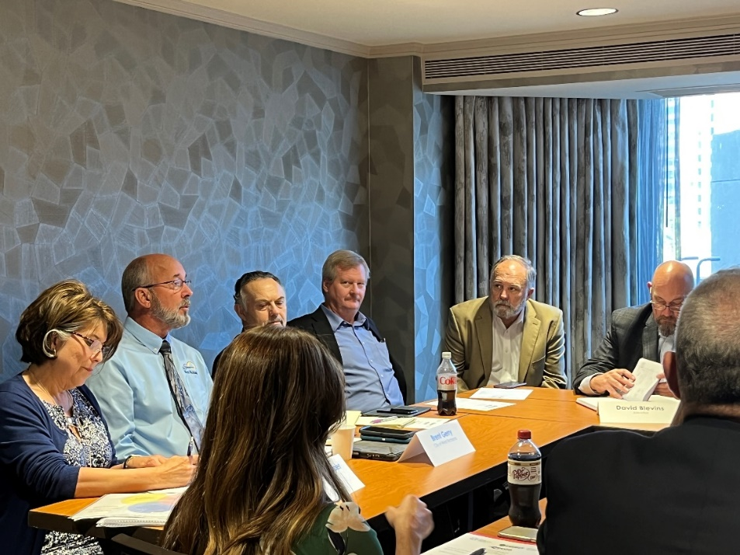
ECA Members
Mayors
Councilors
Commissioners
Chief Executives
City/County Managers
Port Authorities
Economic development entities
Community Reuse Organization
Chambers of Commerce
Universities
School districts

Slide 4
ECA Mission
To share information, establish policy positions, and ensure that local governments are meaningfully engaged, and their environmental, safety, health, and economic priorities are considered in decision-making that directly impacts nuclear host communities.

Slide 5
Impacts of Engaging Local Leaders
Trust
Capacity – Necessary to build enduring, informed decisions
Partnership around/support for a project
How decisions are perceived – “Risk” (real or perceived) must be addressed, seen as based on sound science, and there must be transparency at each step.
How to address environmental justice and equity – There should be no “one- size-fits-all approach. Stakeholders around potential new nuclear development must be engaged in defining, evaluating and determining how to mitigate environmental justice and equity issues.

Slide 6
How to Approach Communication and Engagement
Company/Federal Government/Regulator must engage the community (and vice a versa). Announcements are not engagement
Build a working relationship and provide outreach opportunities through various channels
Definitions matter – everyone needs to be on the same page
Know and understand all goals (developer, regulator, regional/state/local government, stakeholders)
Communities need resources and experts to engage
Define opportunities, risks, timelines – be truthful and realistic
Failure to make decisions leads to failures
Be Organized
Repeat, Repeat, Repeat

Slide 7
ECA’s Cooperative Agreement with EM
Working for decades with local governments and leaders in communities around federally-owned nuclear weapons, energy and research facilities
Long-term experience working with DOE, Congress, states and industry to support the environmental cleanup mission
ECA goal is for DOE to be successful by ensuring local engagement on:
Cleanup strategy/priorities
Safety
Facility resilience
Workforce Development
Transportation
History – Manhattan Project National Historical Park
Agreement on end states
Future economic development opportunities

Slide 8
ECA’s New Nuclear Initiative
To define the role of local governments in supporting the development of the new nuclear technologies.
Chaired by Rebecca Casper, Mayor of the City of Idaho Falls, ID
Focused around three core questions:
What do communities need to know to attract and support new nuclear development/missions?
What and how should communities communicate to industry, national laboratories, state and federal governments about local resources and development opportunities?
What hurdles and challenges will communities face and who can we work with to overcome them?

Slide 9
ECA on Consent-Based Siting
Terms of CBS agreement – There is no “one-size-fits-all” agreement: The conditions under which a specific community will take on a nuclear mission needs to reflect the priorities and vision of that community.
Informed consent yields enduring “consent”: Local governments and states must be given resources to provide education and outreach on potential benefits and risks of a project.
Stakeholder vs. interested party
Opportunities for Federal/State/Local/Regional Wins with Advanced Nuclear
Coal-to-Nuclear
DOE’s Cleanup to Clean Energy Initiative
Carbon Reduction Goals
Clean Energy Jobs

Slide 10
Lessons Learned: Successful Siting
WIPP
Extended timeline for engagement (10+ years)
Recognition of national need
Existence of a “clear” benefit for citizens of the state and local jurisdiction in which the facility was sited
Solid local support
Competent technical oversight by the State of New Mexico
Intense, iterative and early outreach
Rigorous quality assurance from the earliest stages of the project
Credibility

Slide 11
Lessons Learned Failed Siting
YUCCA MOUNTAIN/PFS
Local government, Tribal and community support alone will not lead to successful siting and deployment of new nuclear projects – support from the state government is necessary
Local governments and state governments need to work together
Need federal alignment

Slide 12
New Global Partnership of Municipalities with Nuclear Facilities

Slide 13
Joint Recommendations
Engage early and often with host municipalities on all aspects of the nuclear project, ensuring safety and protection of human health and the environment.
Provide resources to the host municipalities to create technical expertise in the community to be able to work cooperatively with the government/project owner.
Create, expand, and cooperate with the host municipalities on socio-economic opportunities for the long-term sustainability of the region.
Commit to short and long-term investment in the education, infrastructure and workforce of the host community (i.e., local purchasing from local businesses) as part of any new nuclear project.

Slide 14
Thank you! Kara Colton Director of Nuclear Policy Energy Communities Alliance (703) 864-3520 kara.colton@energyca.org
www.energyca.org
@EnergyCAorg

