Slide 1

EPA Update
LLW Forum Fall Meeting
Salt Lake City, Utah
Jonathan Major, EPA Office of Radiation and Indoor Air
October 4, 2023

Slide 2
Overview of Presentation
Waste Isolation Pilot Plant (WIPP) Activities
  Compliance Recertification Application (CRA) Schedule
  Review of Sandia National Laboratories
NORM/TENORM
  Phosphogypsum
  Critical Minerals
Ukraine
Multi-Agency Radiation Site Survey and Investigation Manual (MARSSIM)
Federal Guidance
American Nuclear Society Recommendations for EPA Repository Standards

Slide 3
WIPP Compliance Recertification Application
Modification to the CRA Submittal Schedule
The WIPP Land Withdrawal Act specifies that
  “Not later than 5 years after the initial receipt of transuranic waste for disposal at WIPP, and every 5 years thereafter…the Secretary shall submit…documentation of continued compliance…” – Section 8(f)(1) (emphasis added)
  Initial emplacement in March 1999, CRAs subsequently in 2004, 2009, 2014, 2019
DOE requested that submittals be allowed five years after EPA determines DOE has submitted a complete application
  Provides additional time to address outstanding issues before next submittal
    CRA-2019 completeness determined in November 2021 after multiple rounds of questions, many addressing outstanding issues from CRA-2014
    Recertification decision in May 2022, data cut-off for March 2024 submittal in late 2022
EPA agreed – next CRA due no later than November 2026

Slide 4
Review of Sandia National Laboratories (SNL)
Primary DOE Contractor for WIPP Performance Assessment
EPA has had concerns about how newer data and literature are vetted and incorporated into the WIPP performance assessment
EPA conducted an onsite technical review in December 2022
  Goal was to understand how SNL applied its internal review processes to PA-related work
EPA’s July 2023 report found areas of problematic documentation, nonconformance with procedures, and degraded data quality that complicated CRA review
  Also identified areas of good documentation and review practices
EPA concludes that “SNL Carlsbad needs to reassess and strengthen its review process, as well as its current methodologies, to ensure data quality and the integrity of the WIPP PA”
  DOE “should also increase its oversight of SNL work to confirm it follows its procedures and produces data of acceptable quality”

Slide 5
Phosphogypsum
Example of the Circular Economy
Phosphogypsum is generated by the production of fertilizer from phosphate ore
Phosphogypsum is regulated under the Clean Air Act to control radon emissions
By rule (40 CFR part 61, subpart R) phosphogypsum must be managed in an engineered stack
  Exceptions for certain agricultural or indoor research uses
  EPA may approve other uses if they are at least as protective as management in a stack
EPA is evaluating a request from The Mosaic Company for a test road on its property
  Segments constructed using different mixtures of phosphogypsum and other materials
  Florida DOT has requested some modifications to the original project design
    Implementing new direction from legislature to evaluate suitability of phosphogypsum in road base
    Determination of suitability would eliminate further state review (including environmental)

Slide 6
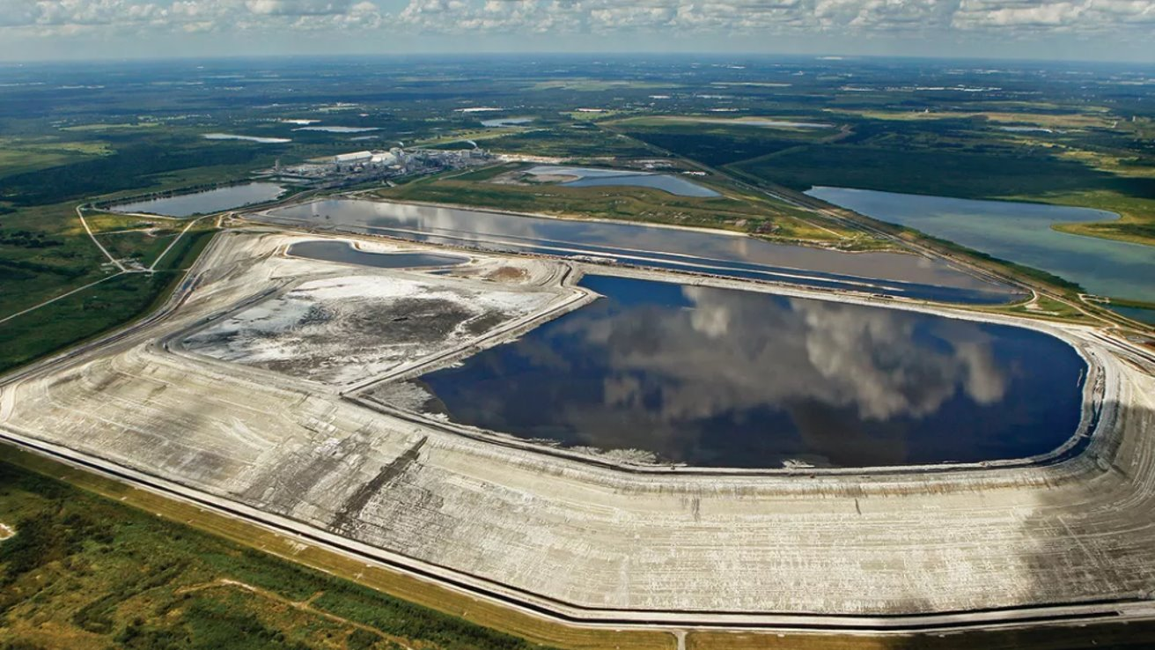
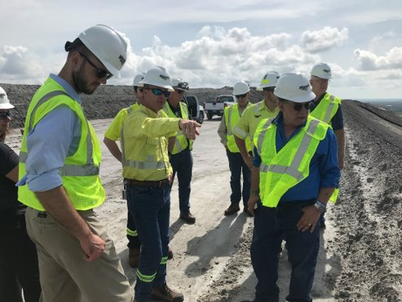
Phosphogypsum
~ 1 billion tons of phosphogypsum stacked in Florida,
  > 30 million tons produced annually​
1,800 miles of four-lane highway would be required to divert Florida’s annual PG production

Slide 7
Phosphogypsum
Mosaic pilot road study
 | Specification
Road width | 24 feet
Road length | 1200 feet in 200’ test sections
Total amount of PG used | 337 tons
Road base thickness | 10 inches
Mix 1 | PG + limerock (LR)
Mix 2 | PG + recycled concrete aggregate (RCA)
Mix 3 | PG (<50%) + sand + Type 1 portland cement
PG content | 30-50%
Ra-226 | ~15 pCi/g (555 Bq/kg)

Slide 8
Critical Minerals
Example of the Circular Economy
Big push at the federal level to increase domestic and allies’ mineral production and reduce reliance on foreign, potentially adversarial suppliers
  Rare earths, lithium, cobalt, many others
  USGS Critical Minerals List (2022) & DOE Critical Materials Assessment (2023)
Interagency Working Group on mining reform
  President Biden Issued Executive Order 14017 – Securing America's Supply Chains
  Involved Interior, USDA, DOE, EPA, State, others
  Final Report “Recommendations to Improve Mining on Public Lands” Published Sept. 2023
Mining and processing of many critical minerals are associated with NORM/TENORM
  Raise awareness of potential, evaluate early in permitting
  Ex: Energy Fuels’ new REE circuit

Slide 9
Critical Minerals
Recent federal documents

Slide 10
Ukraine
Situation at Zaporizhzhia Nuclear Power Plant relatively stable
  Drilling new wells to ensure supply of cooling water after destruction of Kakhovka dam in early June threatened existing reservoir
  All six reactors shut down, transitioning between “hot” and “cold” shutdown to help keep power and steam at the facility
  External electricity lines still operating
Westinghouse fuel supplied to Rivne and Khmelnytskyi NPPs for testing
  First use of western-supplied fuel in Ukrainian NPPs

Slide 11
Multi-Agency Radiation Site Survey and Investigations Manual (MARSSIM)
Version 2 of MARSSIM anticipated early 2024
  Undergoing final review by authoring agencies
  Follows EPA Science Advisory Board report in 2022 and public comment
  Abstract submitted for Waste Management 2024 Symposium
  Workshops and longer-form training on Version 2 under development
Key issues addressed in Version 2
  Use of Scenario B (assumed to meet criteria until proven otherwise)
  Site-specific scanning surveys
  Measurement Quality Objectives and measurement uncertainty
  Continuously collected data
  Improved discussion on setting the Lower Bound of the Gray Region
  Multiple areas of elevated activity
  Updated instrumentation information and aerial surveys

Slide 12
Federal Guidance Report No. 16
Update to FGR 13
FGR 16 provides cancer risk coefficients for estimating population radiogenic cancer risks (morbidity and mortality) for environmental exposures to radionuclides.
  Updates FGR-13 (1999)
Risk coefficients are provided for:
  1,252 radionuclides for external exposure from air and soil.
  888 radionuclides for internal exposure from ingestion (water and diet) and inhalation.
Compared to FGR 13, FGR 16 includes:
  Increased number of radionuclides considered and updated nuclear decay data
  Updated biokinetic models
  Updated dosimetric models (including phantoms and SAFs)
  Updated U.S. population demographic data
  Updated cancer risk models based upon ~20 more years of data
Preparing for interagency and SAB review
  Goal for final publication in 2024

Slide 13
Updated Data in FGR 16
Biokinetic Data
ICRP Pub. 66
ICRP Pub. 100
ICRP Pub. 130
ICRP Pub. 134
ICRP Pub. 137
ICRP Pub. 141
Nuclear Decay Data
ICRP Pub. 107
Usage Data
EPA Exposure Factors Handbook
ICRP Pub. 66
ICRP Pub. 89
SAF Data
ICRP Pub. 133
German and UF Phantoms
Stylized models
External Dose Coefficients
EPA Federal Guidance Report No. 15 (uses ICRP Pub. 103 and 107)
Cancer Risk Coefficients

Slide 14
Future EPA Repository Standards
Recommendations of the American Nuclear Society
ANS formed an internal working group to consider new repository standards
  Echoes recommendations of the 2012 Blue Ribbon Commission on America’s Nuclear Future
  Hopes that report spurs Congressional action to advance the repository program
Final report issued August 2023 (https://www.ans.org/policy/repositorystandard/)
  Considered aspects of
    40 CFR part 191 (EPA’s current generic standards, applied at WIPP)
    40 CFR part 197 (EPA’s site-specific standards for Yucca Mountain)
    International approaches
  Key recommendations include:
    Use 40 CFR part 197 as the starting point for new standards
    Specify dose to a Reasonably Maximally Exposed Individual as the primary metric of performance
    Limit quantitative standards to 10,000 years, with qualitative evaluations up to 1 million years
    Retain concepts of “reasonable expectation” and “controlled area”

Slide 15
Questions?
https://www.epa.gov/radiation

