Slide 1

NRC UPDATE
FALL LLW FORUM MEETING
OCTOBER 3,4, 2023
Stephen Koenick, Chief
Low-Level Waste and Projects Branch
Division of Decommissioning, Uranium
Recovery, and Waste Programs (DUWP)
Office of Nuclear Material Safety and Safeguards (NMSS)
Protecting today, tomorrow, and
cleaning up the past

Slide 2
Agenda
Low-Level Waste​ (LLW)
Decommissioning​
2

Slide 3

LLW Program
https://www.nrc.gov/waste.html
https://scp.nrc.gov/llrw.html

Slide 4

  Effectively Managing the LLW Program
Completing identified tasks from programmatic assessments
  Integrated Part 61 Rulemaking
Providing technical support related to disposal activities
  Alternative Disposal Requests (ADRs)
  Uniform Waste Manifest
Leading other efforts of our baseline LLW regulatory program
  Participating in integrated materials performance evaluation program (IMPEP) review of Agreement States’ LLW programs
  Providing guidance on domestic and international activities on LLW management
  Outreaching and assessing feedback
    Different types of forums such as Agreement State workshops (second in-person workshop scheduled for November 2023)

Slide 5

Updated Prioritized Tasks from the LLRW Programmatic Assessment
  Strategically Assessing the LLW Program to
  Accommodate Changes
Task | Priority | Status
1. Complete and Implement Site-Specific Analysis Rulemaking | High | Active Integrated LLW Rulemaking – SRM SECY-20-0098
2. Address update to the 10 CFR Part 61 Waste Classification Tables | High | No action-(Awaiting task 1 completion)
3. Implement the Updated Concentration Averaging and Encapsulation Branch Technical Position | High | Completed Training in March 2016 (https://www.nrc.gov/waste/llw-disposal/llw-pa/llw-btp.html)
4. Prepare a regulatory basis and conduct potential rulemaking for Greater-Than-Class C (GTCC) and transuranic waste (TRU) disposal | High | Active Technical requirements for near surface disposal of GTCC and TRU have been integrated into the Part 61 Rulemaking – SRM SECY-20-0098
5. Finalize internal procedure/Standard Review Plan for 10 CFR § 20.2002 requests to improve alternate disposal process | High | Completed ADR guidance (https://www.nrc.gov/waste/llw-disposal/very-llw.html) (April 9, 2020)
6. Update NUREG/BR-0204, Rev. 2 (July 1998), “Instructions for Completing NRC’s Uniform Low-Level Radioactive Waste Manifest” | High | Completed/Published NUREG/BR-0204, Rev 3, (June 25, 2021) https://www.nrc.gov/waste/llw-disposal/llw-pa/llw-uwm.html
7. Perform VLLW Scoping Study | Medium | Completed/Issued SECY-21-0057 (June 1, 2021)
8. Update and consolidate LLRW guidance into one NUREG | Medium | No Action
9. Examine the need for guidance on defining when radioactive material becomes LLW | Low | No Action
10. Develop and implement the national waste tracking system | Low | No Action

Slide 6
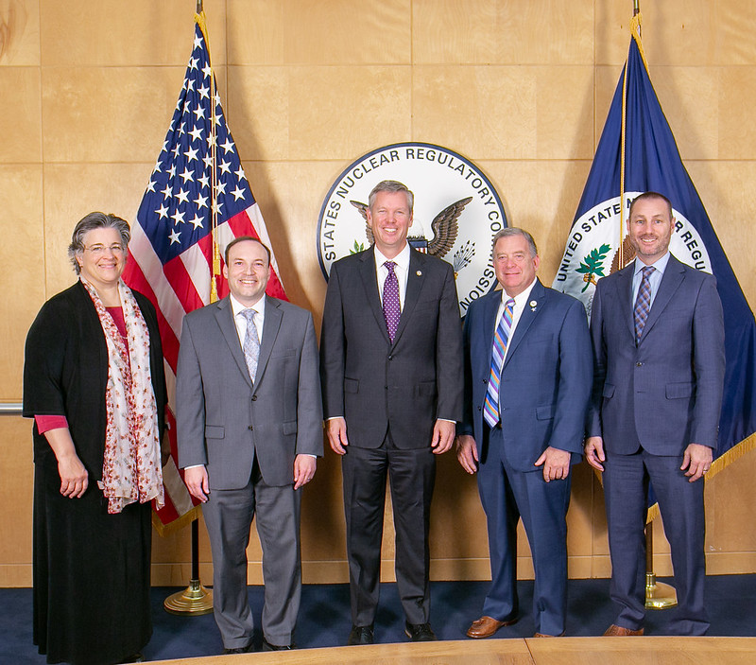
Integrating the LLW Rulemakings to Gain Efficiencies
Part 61 and GTCC/TRU Rulemakings
Staff proposed combining these efforts to address overlapping technical requirements, streamline stakeholder outreach, and gain efficiency in proceeding as one rulemaking activity (SECY-20-0098)
Commission approved staff’s recommendation (Staff Requirements Memorandum (SRM-SECY-20-0098)) on
April 5, 2022

Slide 7
Developing Proposed Rule Language Based on
Commission Directed Changes
Directed Changes
Allow case-by-case application of new requirements
Include safety case and defense-in-depth considerations
Allow single regulator for GTCC waste streams containing strategic special nuclear material
Consider site-specific, graded compliance period
Flexibility for facilities to develop Site-Specific Waste Acceptance Criteria
Allow Agreement State licensing of certain GTCC waste streams

Slide 8
Timing of Activities
Rulemaking
Develop Proposed Rule that Integrates GTCC and 10 CFR Part 61 Rulemaking
Publish Final Rule
Submit to Commission for Approval
Publish Proposed Rule
Hold Public Meetings and Comment Period
Develop Final Rule
Submit to Commission for Final Approval
Virtual Public meeting
May 2024
2026
Guidance
Revise NUREG-2175 and Develop GTCC Guidance
Issue Final Guidance
Hold for Commission Approval of Proposed Rule
Publish Draft Guidance
Hold Public Meetings and Comment Period
Develop Final Guidance
Hold for Commission Approval of Final Rule

Slide 9

Topics of interest to the LLWF
    GTCC
      as GTCC will “now” be part of 10 CFR Part 61, does that mean that GTCC also falls under the Low-Level Radioactive Waste Policy Act?
      Will the compacts have authority over the transportation of GTCC between compacts and or states?
      Will Agreement States immediately have regulatory authority over commercial GTCC within their borders – if so, will states have authority to license GTCC within their borders regardless if it is for disposal?
    Compliance period
      Staff has presented a few slides showing a variety of compliance periods – are these appropriate for comparison purpose, including DOE facilities. What would different compliance periods between the DOE / NRC mean.

Slide 10
Topics of interest to the LLWF, continued
    Grandfather clause – now titled an exception.
      Will disposal facilities that fall under the exception be considered 10 CFR Part 61 disposal facility or will they operate under a lesser license or a license that doesn’t meet the requirements of Part 61
    Regulatory Analysis
      SRM SECY-16-106 directed staff: “Be informed by broader and more fully integrated, but reasonably foreseeable, costs and benefits to the U.S. waste disposal system resulting from the proposed rule changes, including pass-through costs to waste generators and processors.”
    Opportunity for public input prior to the rule going back up to the commission.

Slide 11

George Tartal
  Rulemaking PM
  Email: george.tartal@nrc.gov
  Phone: (301) 415-0016
Cardelia Maupin
  GTCC Technical PM
  Email:
  cardelia.maupin@nrc.gov
  Phone: (301) 415-4127
Priya Yadav
  Part 61 Technical PM
  Email:
  priya.yadav@nrc.gov
  Phone: (301) 415-6667

Slide 12
Decommissioning Program
https://www.nrc.gov/waste/decommissioning/oversight.html

Slide 13
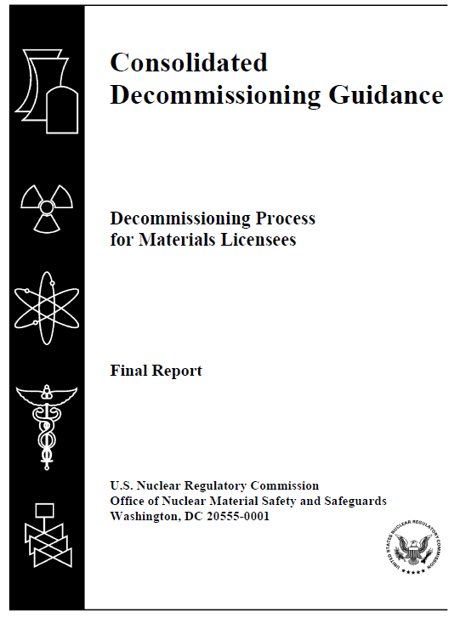
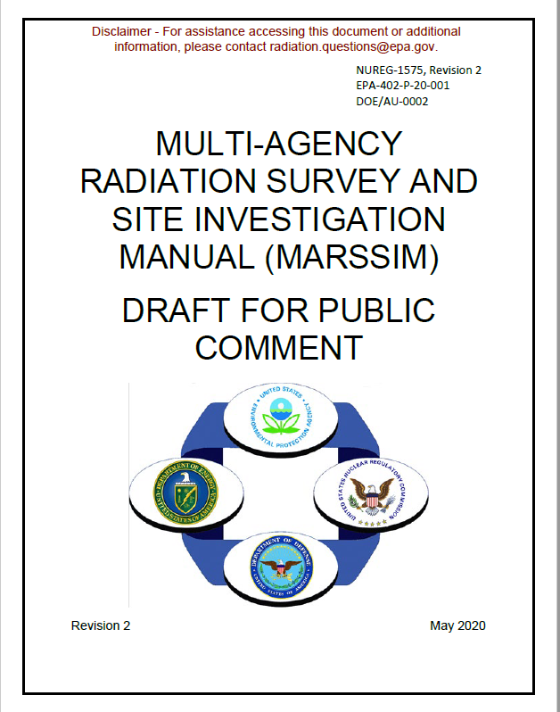
Improving Decommissioning Process – Guidance
NUREG-1757, “Consolidated Decommissioning Guidance,” Volume 2, Rev. 2, “Characterization, Survey, and Determination of Radiological Criteria”
NUREG-1575, Rev. 2, “Multi-Agency Radiation Survey and Site Investigation Manual (MARSSIM)”
  Final published on July 19, 2022 (ML22194A859)
  FRN was published on July 22, 2022 (87 FR 43906)
  Comment resolution document (ML21299A032)
  Interim Staff Guidance is being issued to address surveys and dose modeling for residual radioactivity associated with open excavations, substructures, and backfill materials (fall 2023)
    Issued for public comment in July 2021
    Over 60 comments in 17 comment letters
    Science Advisory Board peer reviewed
    MARSSIM Working Group is currently addressing comments
Estimated to be finalized in 2024

Slide 14
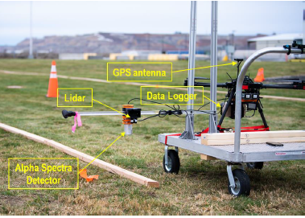
Continuously Collected Data
NRC licensees are increasingly using more modern data logging systems with integrated survey and location data.
NUREG-1507 provides a methodology for calculation of scan MDCs for surveys with a surveyor listening to audible counts.
A priori methods for calculation of scan MDCs for continuously collected data surveys conducted without the surveyor listening to the audible counts are being developed.
A posteriori methods for post processing of data and identification of areas for follow-up investigation are also being developed and implemented in the Visual Sample Plan computer code.
A FRN was issued May 4, 2023, to get stakeholder input related to CCD and associated regulatory gaps. NRC received 11 responses to the FRN.
MARSSIM, Rev. 2 will include guidance on CCD collection and data analysis. Calculation of a priori scan MDC is an area of ongoing research. See NRC's What's New in Decommissioning Web Site for additional information.

Slide 15
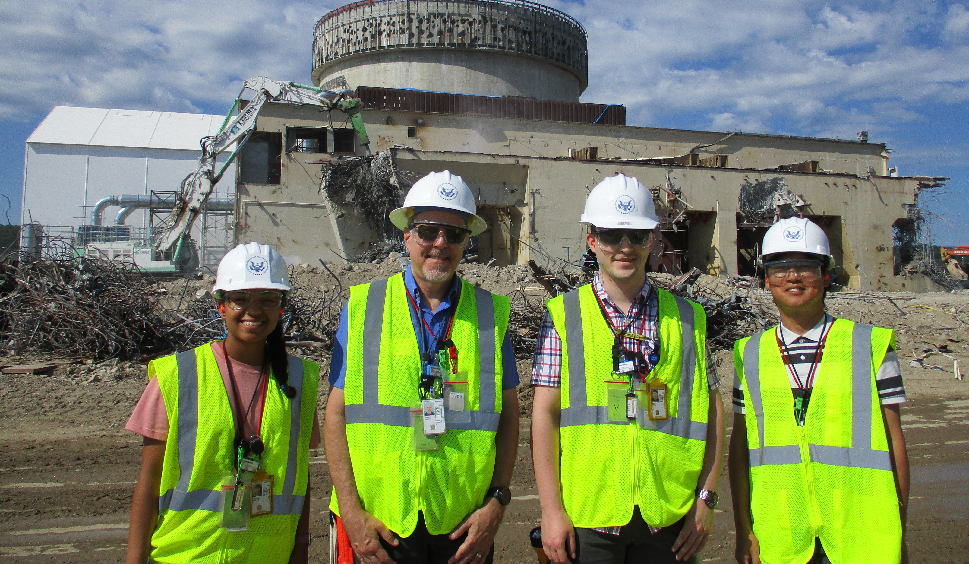
Risk-Informed, Performance Based
Decommissioning Inspection Oversight Guidance
IMC 2561
“Decommissioning Power Reactor Inspection Program”
IMC 2602
“Decommissioning Oversight and Inspection Program for Fuel Cycle Facilities and Materials Licensees”
IMC 1248, Appendix F
“Training Requirements and Qualification Journal for Decommissioning Inspectors"
ISG on very low safety significance issue resolution process

Slide 16
Decommissioning Rulemaking Update
Would implement specific regulatory requirements for different phases of the decommissioning process consistent with the reduced radiological risk. Topics include:
  Emergency Preparedness
  Decommissioning Funding Assurance
  Environmental Considerations
  Spent Fuel Management Planning
  Record Retention Requirements
Target date for submitting the draft final rule to the Commission is January 2024
Proposed rule published on March 3, 2022 (87 FR 12254)
Comment period closed on August 30, 2022

Slide 17
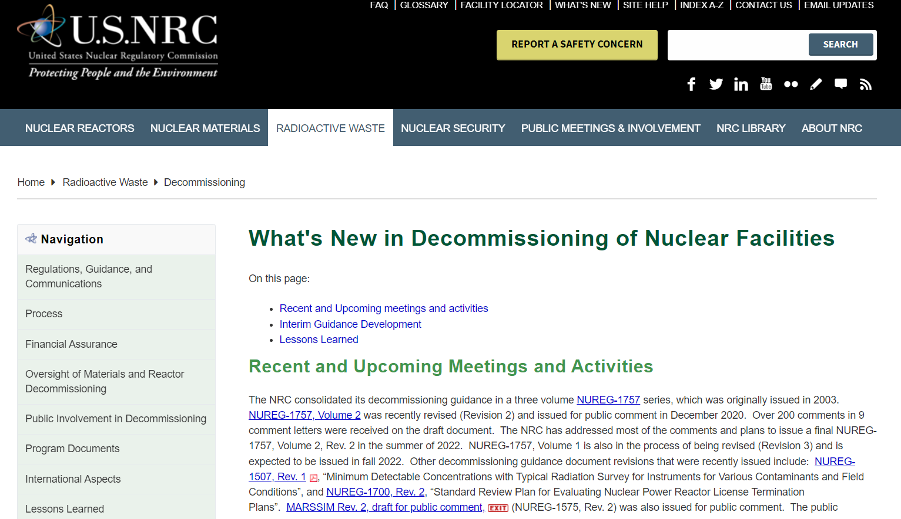

Enhancing Decommissioning Outreach
New Webpage on NRC.GOV
Keep Up-to-Date on Upcoming Workshops and Guidance Releases
https://www.nrc.gov/waste/decommissioning/whats-new.html

Slide 18






Questions/Comments
Follow @NRCgov
To subscribe to e-mail updates: https://www.nrc.gov/public-involve/listserver.html#lyris

