Slide 1
US Ecology Update
LLW Forum Meeting - Fall 2022
Baltimore, MD
Joseph J. Weismann, CHP
October 12, 2022

Slide 2

Agenda
Acquisition by Republic Services
New Products and Services
USE Site Updates
Q&A

Slide 3
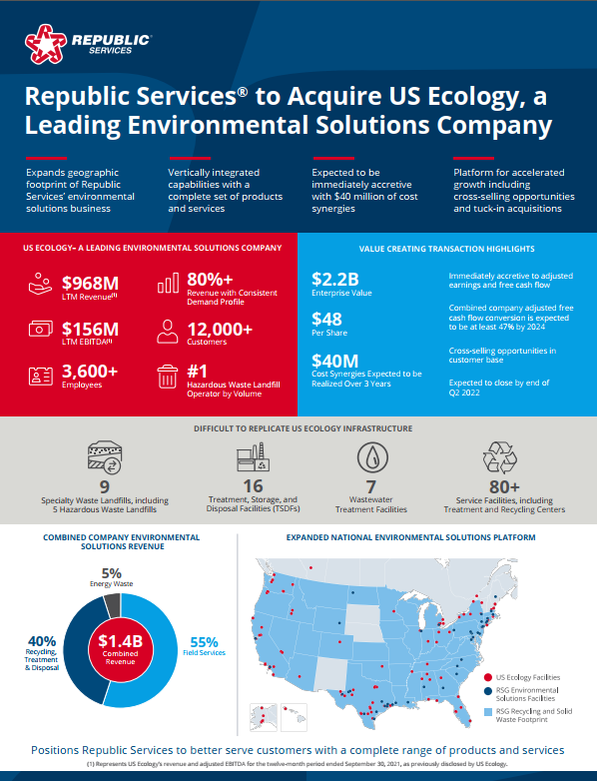
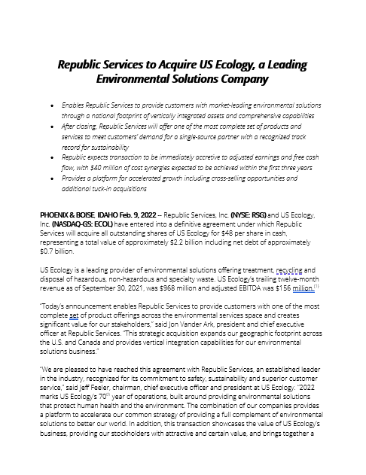
Feb 9th Announcement
US Ecology Joins Republic Services
Notes:
Introduction
We announced some exciting news, and I wanted to gather the team to talk about how we got here, what it means, and what comes next.
Before I do that, I want to start by saying thank you for all you do. Our team members have always been the foundation of our success.
Your passion and creativity, willingness to face challenges head on, and relentless optimism have helped build US Ecology into the Company we are today.
I am really looking forward to seeing what we achieve next, as we reach this new milestone and begin a new chapter together.
What We Announced / Why Republic Services
So - let’s get into it. As you have seen by now, we announced that we have entered into a definitive agreement to become part of the Republic Services family as part of its environmental solutions business.
We are very pleased to be joining with Republic as we believe this is a natural next step for US Ecology.
If you are not already familiar with Republic Services, it is one of the country’s largest providers of environmental services, including recycling, solid waste collection and waste disposal services.
This transaction enables Republic to become a single source partner for customers’ traditional and specialty waste and recycling needs, increases its national footprint and adds critical infrastructure to its growing business. It will help Republic advance its key initiatives of customer zeal, sustainability and digital transformation.
The combination will provide customers with a comprehensive suite of multi-disciplinary services. It will also accelerate our growth – resulting in improved and expanded services for customers over time – create new opportunities for our team, and deliver a significant, immediate cash premium to our shareholders.
We strongly believe that this combination is in the best interests of all of our stakeholders and the clearest path forward to advance our mission to provide safe and compliant solutions to protect human health and the environment.

Slide 4

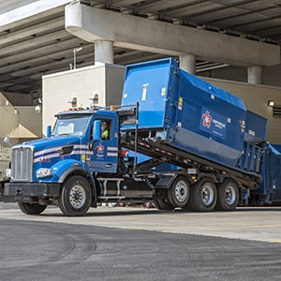

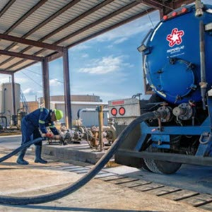
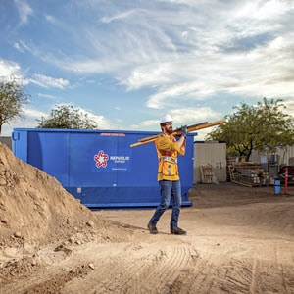
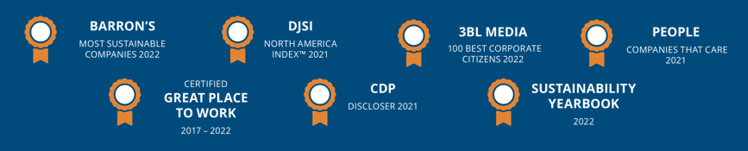

Republic Services
About
Republic Services, Inc. is now the nation’s leading environmental services provider. Through our subsidiaries (US Ecology, ACV Enviro, Ecoflo), we provide superior service offerings to ensure compliance while partnering with customers to create a more sustainable world.
Company Overview
39K employees
14M customers
1,000+ worldwide locations
$11B in revenue in 2021
95% customer retention
16K Trucks | 5th largest vocational fleet in the nation
View 2021 Sustainability Report
Business Solutions
Solid waste collection and disposal
Recycling
Dumpster rental
Construction and demo
Compactor solutions
Environmental solutions

Slide 5
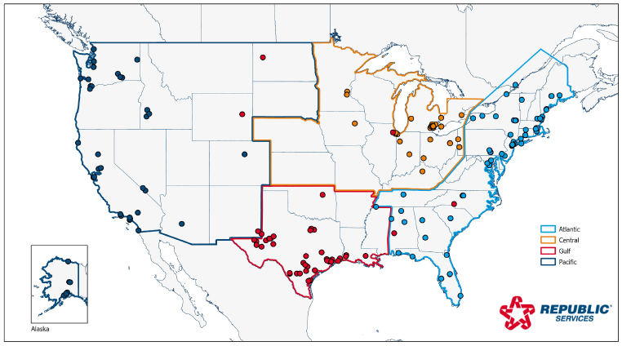
So, What’s Changing?
No changes to radioactive waste programs or services
US Ecology will be part of larger “Environmental Solutions” Group within Republic
ES Group divided into (4) Areas – Atlantic, Central, Gulf and Pacific
Corporate HQ will be in Phoenix, AZ with Boise, ID office serving as Pacific Area base
US Ecology will be rebranded to Republic Services starting this year (& throughout 2023)

Slide 6
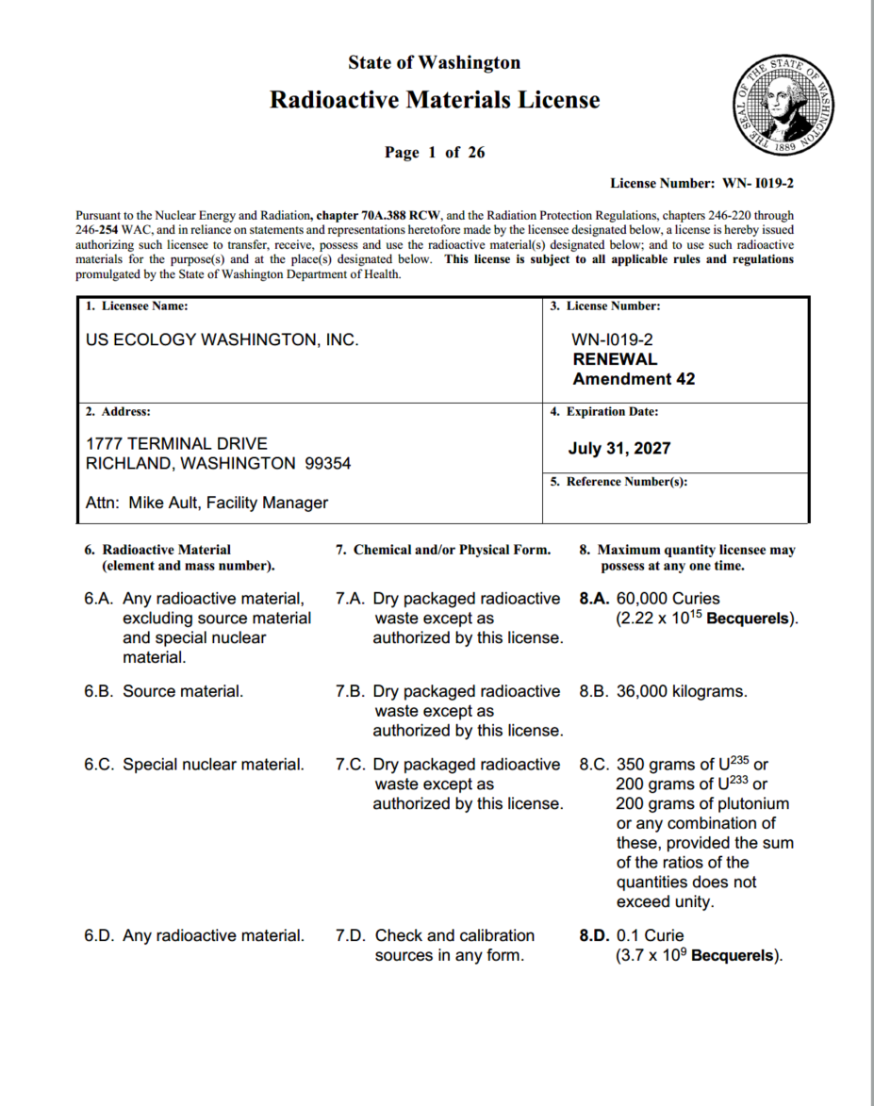
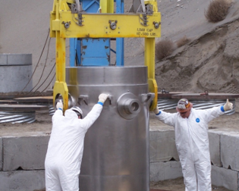
USEW License & Accepted Waste
Disposal License
Accepted Waste
Class A, B and C LLRW in the Northwest and Rocky Mountain Compacts
NORM/TENORM/NARM acceptable from generators nationwide
High-activity sealed source capabilities
WDOH License # WN-I019-2, Amendment 42 (recently renewed)
Expires July 31, 2027

Slide 7
Historical Volumes
USE Washington has received an annual average volume of ~19,000 ft³ (2016-2022) from generators within the Northwest and Rocky Mountain Compacts
Approximately 50% of volume is generated at Energy Northwest Columbia Generating Station
Ample capacity remains to support generator needs through lease expiration in 2056
All values in cubic feet (ft³)

Slide 8
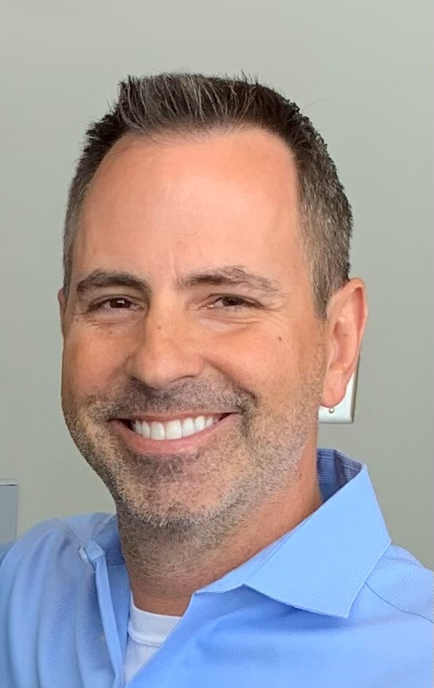
New Richland GM
Doug Frenette
Joined USE in May 2022
LLRW management and operations experience at both NNSS (Area 5) as well as WCS (Federal and Compact facilities)
20+ years experience in rad waste operations, operational health physics, and environmental remediation
Graduate of Navy Nuclear Power Program

Slide 9
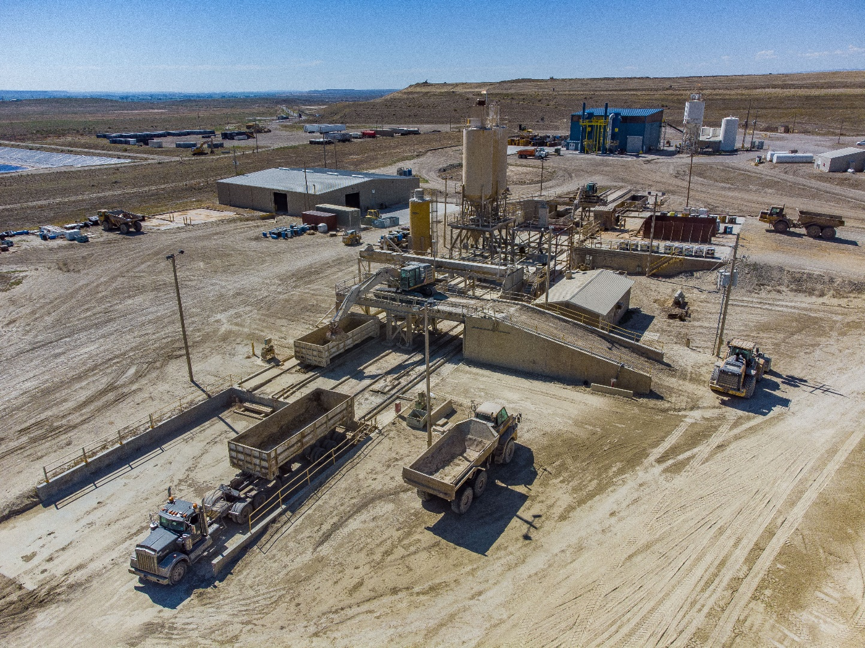
US Ecology Idaho – Grand View, ID
RCRA Sub-C TSDF
Capacity: 10M+ yd³ permitted, 18M+ yd³ additionally sited
NORM, TENORM
Exempt VLLW (byproduct, Source, and SNM)
High-capacity RTF with 15k feet of rail track
New Treatment Building completed in 2021

Slide 10
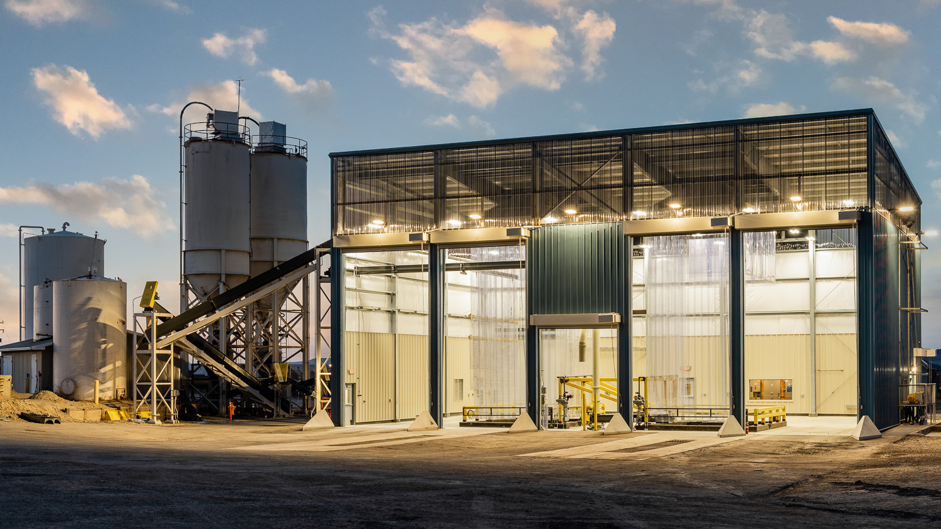

Slide 11
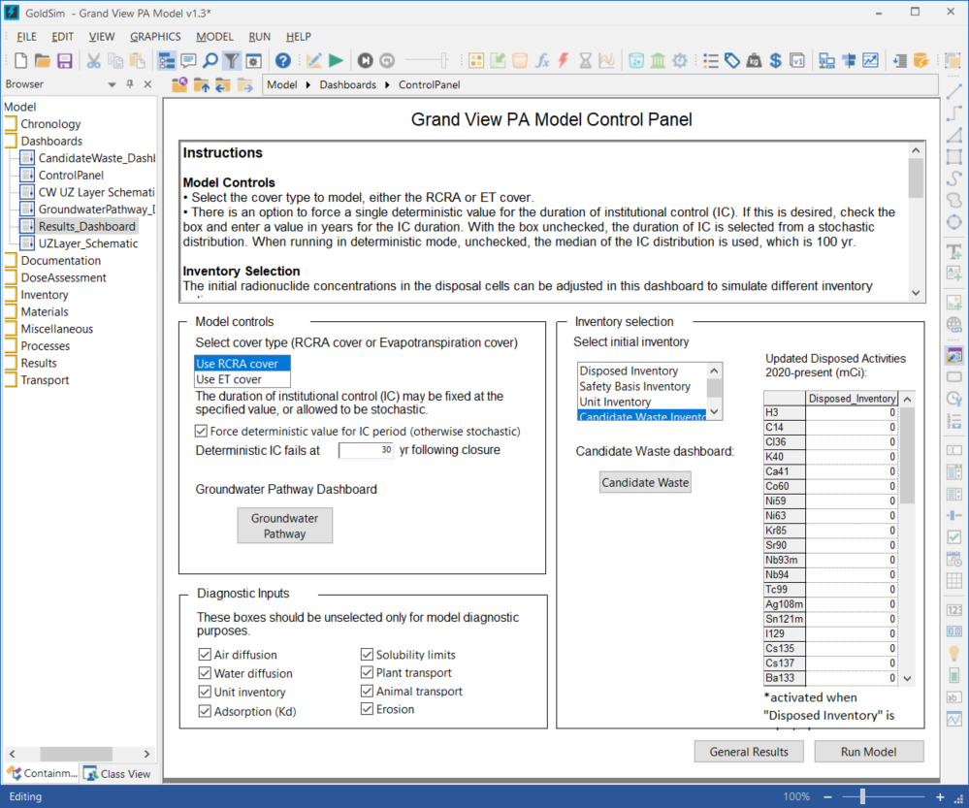

New Grand View Performance Assessment
Replacing RESRAD with GoldSim Model at US Ecology Idaho
Why We Did it
  Eliminate unjustified conservatism in RESRAD model
  Model USEI more accurately and appropriately, i.e., what is actually happening at the site
  Implement probabilistic model parameters
Benefits and Outcomes
  Multiple pre-programmed and user-defined inventories can be run
  Benchmarking vs prior RESRAD model
  Inadvertent Intruder scenarios & multiple closure cover designs incorporated
  Properly represents groundwater pathway in semi-arid environment
  Supports WAC increases

Slide 12
NRC Part 61 Rulemaking
Generally agree with direction in “Option1“ in SECY-20-0098
Concerned about impact to timing on Part 61 portion due to inclusion of GTCC
More concerning is direction from Commission in SRM:
“The staff should take another look at the technical basis for the performance objectives in Part 61 and ensure that the compliance period is based on scientific data. Rather than using the same compliance period for disposal sites containing significant amounts of depleted uranium, GTCC, or transuranic waste, the staff should consider a site-specific, graded approach based on when the peak dose is projected to occur or establish a longer compliance period for disposal sites containing significant quantities of mobile, long-lived radionuclides.”

Slide 13

Do you
have any
questions?

Slide 14
Contacts
Joe Weismann, CHP
Director, Radiological Programs
(208) 319-1634
Joe. Weismann@USEcology.com
Sherry Frenette
Sr Mgr, Radiological Programs
(702) 912-7925
Sherry.Frenette@USEcology.com
Tim Jenkins
Corporate Health Physicist
(208) 741-1089
Timothy.Jenkins@USEcology.com
Doug Frenette
General Manager, Richland
(509) 377-2411
Douglas.Frenette@USEcology.com

