Slide 1

Using TableCalculator to Evaluate Parametric and Model Uncertainty in the Development of the NRC LLRW Classification Tables
September 12-13, 2022
Low-Level Radioactive Waste Forum
Fall 2022 Meeting
Christianne Ridge, David Esh, Louis Caponi, Patrick LaPlante*, and Christepher McKenney
U.S. Nuclear Regulatory Commission
*Center for Nuclear Waste Regulatory Analyses

Slide 2
Background
NRC developed waste classification limits in the early 1980s by considering the potential dose to an inadvertent intruder in agricultural, construction, and discovery scenarios
  NRC evaluated other scenarios (e.g., accident, groundwater contamination) that did not directly affect the limits
In 2013, the Commission directed the NRC staff to consider whether to revise the low-level waste classification tables after completing the ongoing revision to 10 CFR Part 61
TableCalculator replicates the calculations in the original Fortran codes the NRC used to develop the tables and allows sensitivity analyses
Like the IMPACTS code it is based on, TableCalculator is intended for use in generic regulatory calculations, not site-specific analyses

Slide 3


Intruder Agriculture
Direct radiation from dust cloud
Plant-to-animal product-to-human
Class A: 102 years
Class C: 502 years
Intruder-Agriculture limiting for most non-TRU nuclides
Deposition of dust
Inhalation of dust
Plant-to-animal-to-human
Cap
Direct radiation from waste volume
Soil to root transfer
Waste
3

Slide 4
Intruder Construction
Includes modified food pathways to account for non-equilibrium deposition and subsequent root uptake: (i) plant-human; (ii) plant-animal-human; and (iii) plant-animal product-human
Class A: 102 years
Class B: 102 years short “discovery” exposure
Class C: 502 years
Intruder-Construction limiting for most TRU nuclides
Direct radiation from waste volume
Cap
Inhalation of dust
Waste
Direct radiation from dust cloud
4

Slide 5
Purpose
Why am I here today? To discuss processes the NRC staff could use to develop risk insights to evaluate whether to revise the LLW classification table
Why did NRC develop TableCalculator?
  Enhance transparency and knowledge management for the technical bases for the existing limits
  Prepare to respond to stakeholder comments by creating a tool to easily evaluate “what-if” scenarios
  Evaluate model uncertainty by identifying differences between the original calculations and a more modern probabilistic intrusion analysis

Slide 6
Original Calculations & Adjustments
Calculations were based on a critical organ approach (ICRP 2) with the following dose limits:
  5 mSv (500 mrem) to the total body or bone
  15 mSv (1.5 rem) to the liver, kidney, lung, or gastrointestinal tract/lower large intestine
  30 mSv (3 rem) to the thyroid
NRC then adjusted certain limits based on other factors (e.g., assumptions about waste accessibility or dilution)
Nonetheless… NRC staff and stakeholders often refer to the limits representing a 5 mSv (500 mrem) total effective dose equivalent (TEDE), although that is an inaccurate simplification

Slide 7
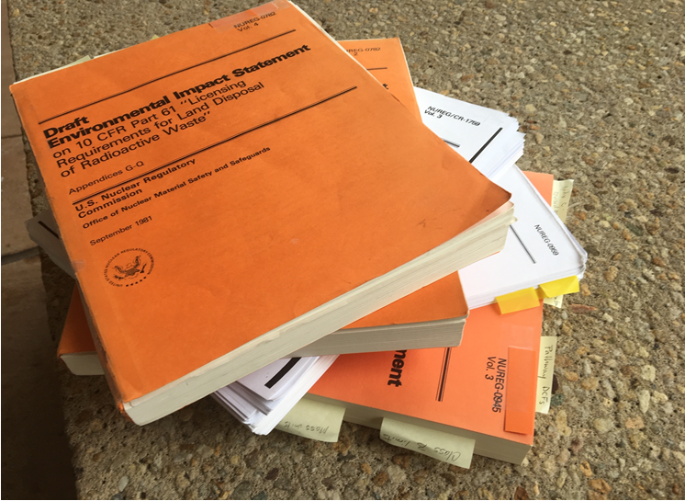
Documentation of LLRW Classification Calculations
Fortran codes and data files for the original calculations are available in public documents
Detailed explanations are provided in the Draft EIS and supporting documents
Scenarios, assumptions, equations, and parameter values underlying the intruder dose calculations and subsequent adjustments are publicly available….
Some are not trivial to trace

Slide 8

Tool Availability
Publicly available without fee: https://ramp.nrc-gateway.gov/

Slide 9
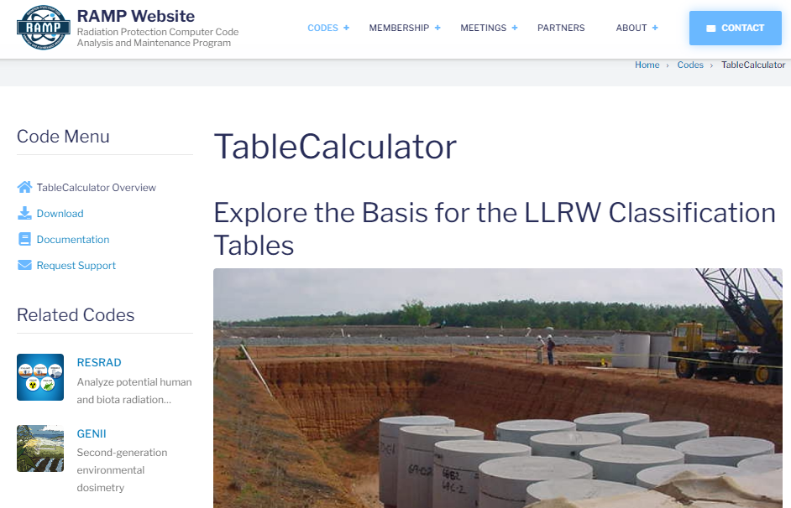

Slide 10

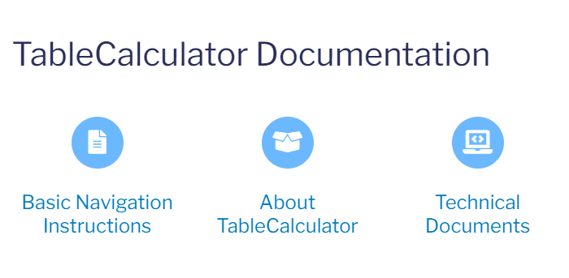
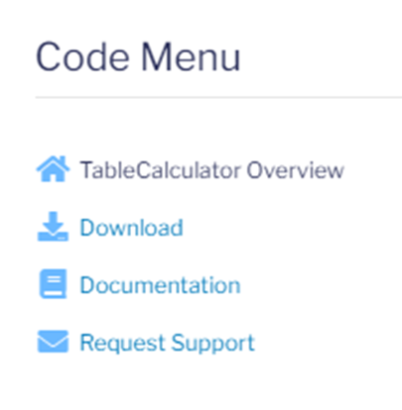

Slide 11

Request support with website button for installation issues or problems running code
Contact authors for questions or comments about the calculations or mathematical implementation
  Christianne.Ridge@nrc.gov
  David.Esh@nrc.gov

Slide 12
Installation
Step 1: Download the GoldSim Player from the GoldSim Technology Group (no cost)
https://www.goldsim.com/Web/Customers/Downloads/Player/
Step 2: Apply for a RAMP membership (no cost) and fill out a nondisclosure agreement: https://ramp.nrc-gateway.gov/
Step 3: Download TableCalculator from the NRC RAMP website
Step 4: Open the TableCalculator file with the GoldSim Player program. To enable reference links in TableCalculator, place technical references from RAMP webpage in the same folder as the TableCalculator file

Slide 13
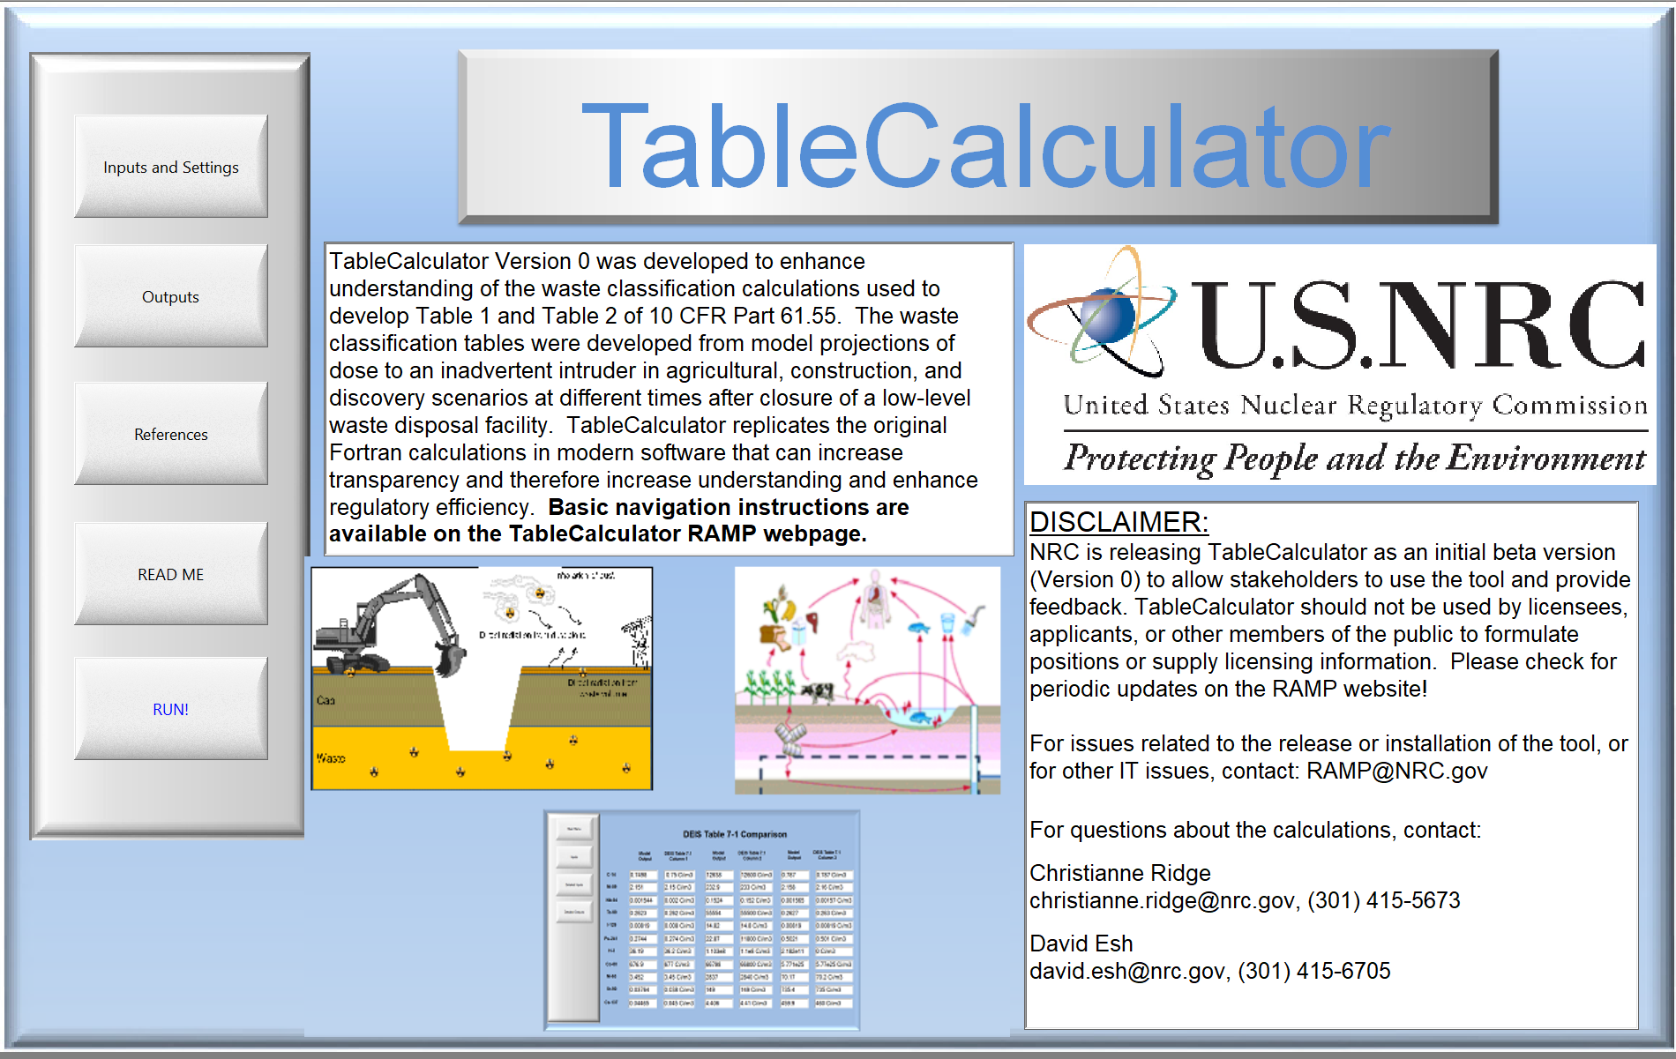

Slide 14
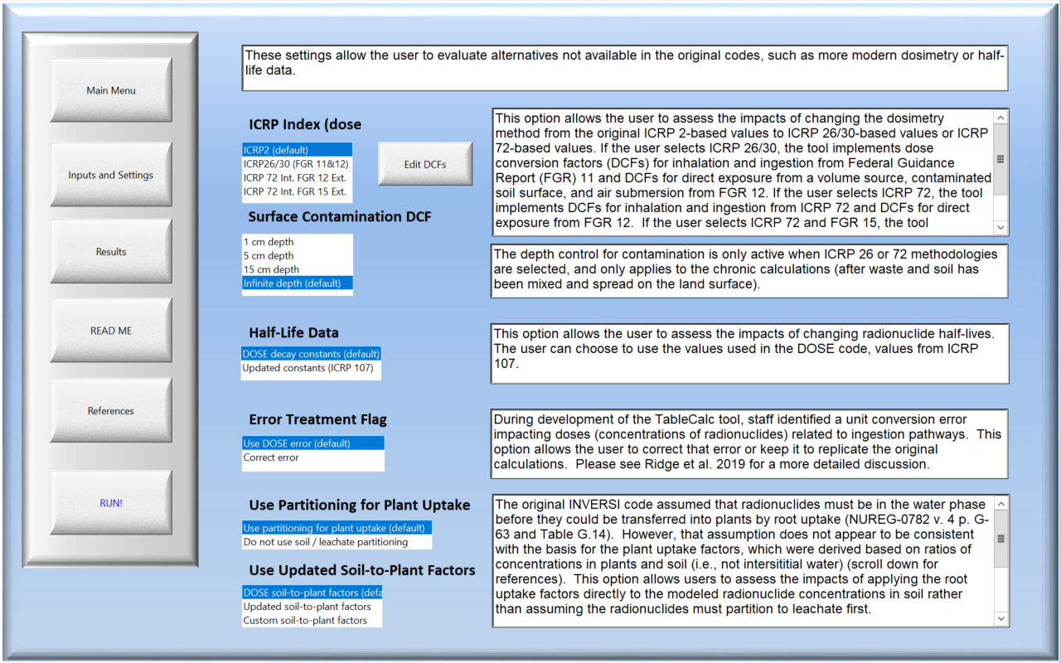
Main Settings

Slide 15
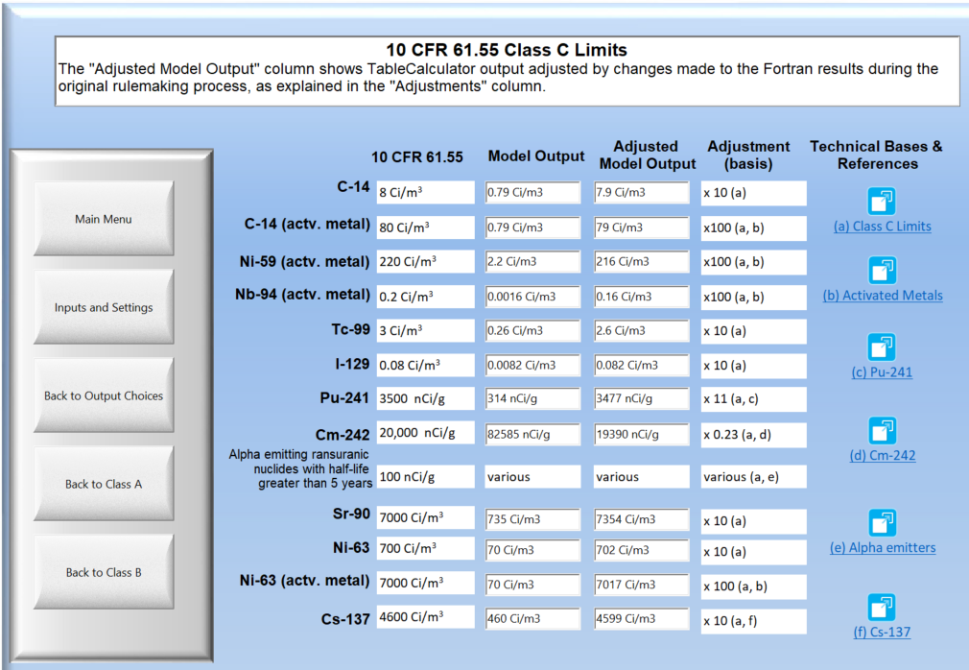
Key Outputs
Default inputs yield results used in the 1980s development of the waste classification limits

Slide 16
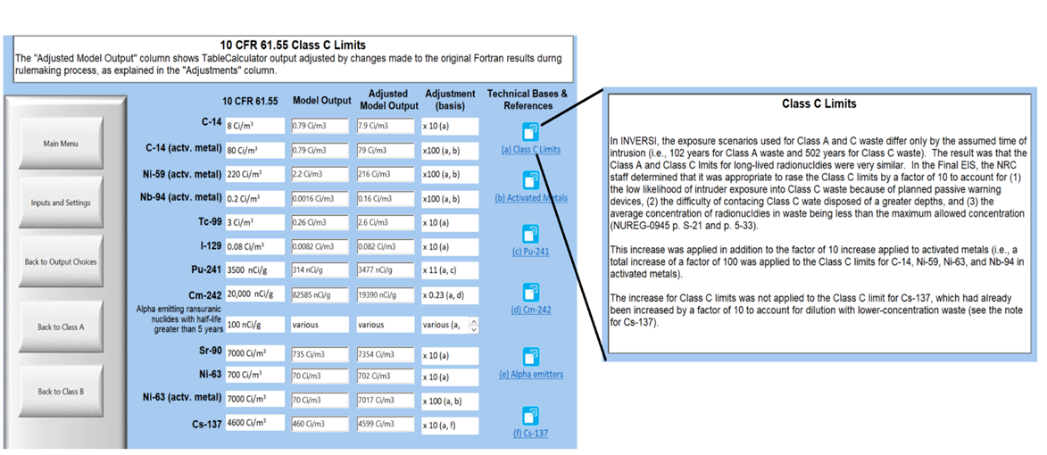
Key Outputs (continued)
Links provide explanations and references for adjustments made during rulemaking in the 1980s

Slide 17
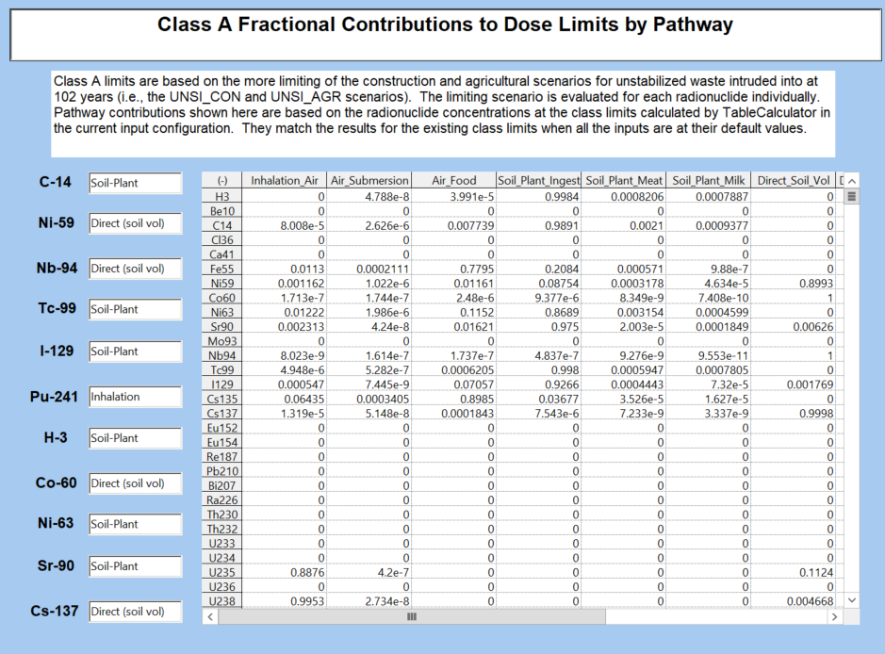
Additional Outputs
Pathway results were previously calculated but not output by the code
Information about dominant exposure pathways provides insights

Slide 18
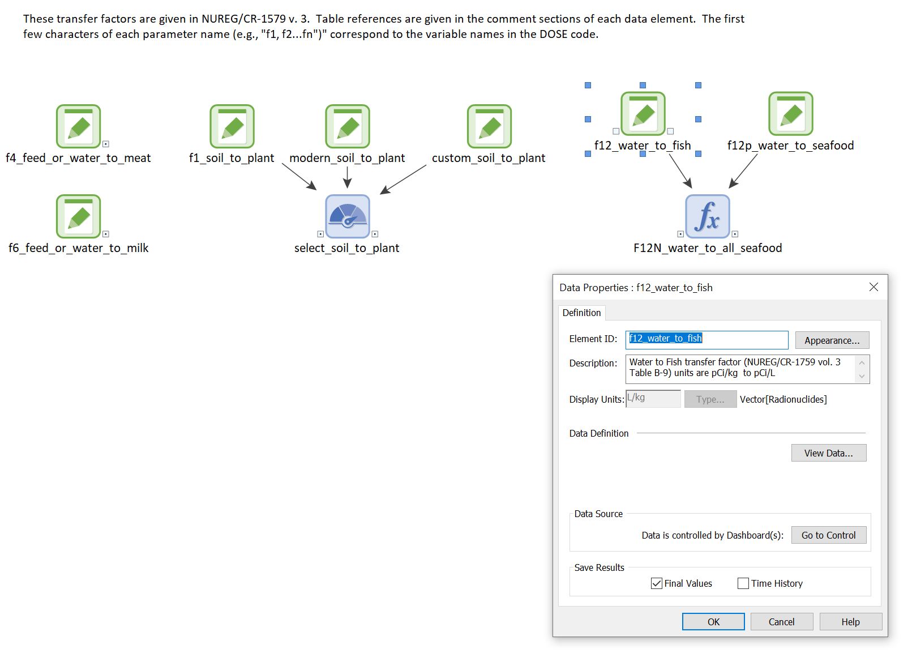
Tool offers “Behind the Scenes” look at the model
Visible relationships and in-line documentation
Model View

Slide 19
Comparison with a Modern Analysis
Staff from the Southwest Research Institute, Center for Nuclear Waste Regulatory Analyses (CNWRA) developed a modern probabilistic intruder assessment based on BDOSE
  BDOSE is a Biosphere Dose Model previously developed by CNWRA staff
  BDOSE is implemented in GoldSim, a commercial software package developed by GoldSim Technology Group of Issaquah, WA
Comparing results from TableCalculator and the modern analysis helps staff understand the impacts of different modeling approaches
The ability to change input parameters and evaluate intermediate model results provided insights into the reasons underlying the differences between the results of the two approaches

Slide 20
Comparison with a Modern Analysis (continued)
In some cases, large differences between the result of a modern analysis and the original results could be explained by changes to bone dosimetry between ICRP 2 and ICRP 26/30
Some differences could be explained by differences in the conceptual model for root uptake of radionuclides by plants
For other radionuclides, the difference was dominated by regulatory adjustments the NRC made to the table values during the 1980s rulemaking process

Slide 21
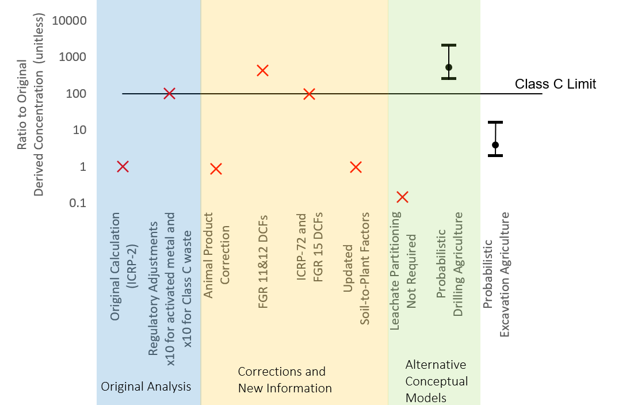
Class C Ni-59
Adjustments for Class C waste and metal wasteform increased limit by x 100
Using ICRP-72 DCFs increased the derived concentration
Revising conceptual model for plant uptake of radionuclides decreased derived concentration
Significant difference between drilling and excavation scenario (scenario uncertainty larger than parametric uncertainty)

Slide 22
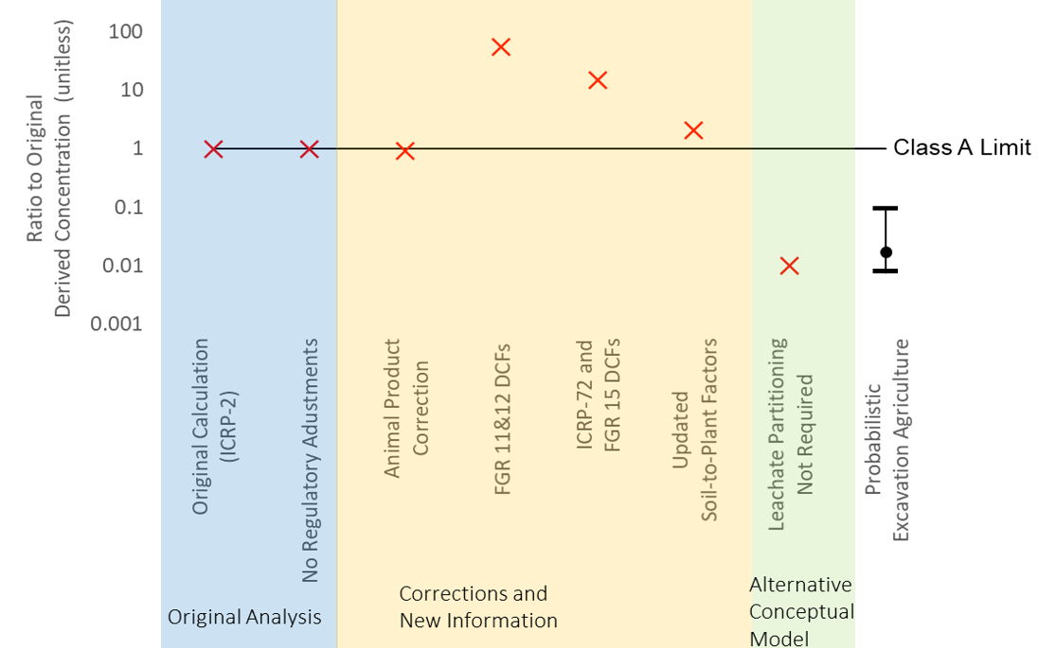
Class A Sr-90
No regulatory adjustments applied
Using ICRP-72 DCFs increased derived concentration
Revising conceptual model for plant uptake of radionuclides decreases derived concentration

Slide 23
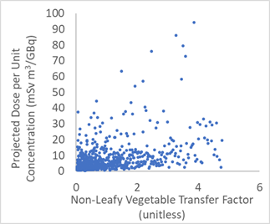
Class A Sr-90 Probabilistic Sensitivity Analysis
Scatter plots show projected dose at time of intrusion vs. key parameter values for 750 realizations of modern analysis
Parameters with the greatest correlation to the projected dose for Class A Sr-90 were
  Non-leafy vegetable transfer factor
  Non-leafy vegetable consumption
  Leafy vegetable consumption

Slide 24
Conclusions
Future NRC review of waste classification tables directed by the Commission will include the staff’s technical analyses, programmatic considerations, and stakeholder input
Sensitivity analyses with the TableCalculator tool help the staff assess the significance of assumptions in the original analysis and will help staff respond to stakeholder comments
Comparison of deterministic sensitivity analyses results with the results of a modern probabilistic intrusion analysis provides risk insights into key parameters and areas of conceptual model uncertainty
TableCalculator is publicly available without cost on the Radiation Protection Computer Code Analysis and Maintenance Program website: https://ramp.nrc-gateway.gov
Like the original codes it is based on, TableCalculator is only intended for regulatory, generic calculations, not site-specific analyses

