Slide 1
Environmental Justice
and MDE
LLW Forum
October 12, 2022

Slide 2
EPA Definition of EJ
The fair treatment and meaningful involvement of all people regardless of race, color, national origin, or income with respect to the development, implementation, and enforcement of environmental laws, regulations, and policies.
Fair treatment means that no group of people, including a racial, ethnic, or socio-economic group, should bear a disproportionate share of the negative environmental consequences resulting from industrial, municipal, and commercial operations of the execution of federal, state, local, and tribal programs and policies.

Slide 3
Maryland Definition of EJ
MD builds on the EPA definition to add
that citizens should expect to be protected from public health hazards and to have access to socio-economic resources necessary to address concerns about their livelihood and health.

Slide 4
MDE’s Internal EJ Policy
Released late 2020
Living document – currently being updated
Creates the role of an EJ Officer to be responsible for coordinating MDE EJ practices and to serve as a liaison between communities and the Department
Enhanced inspections, compliance, enforcement and infrastructure investments in communities with EJ concerns
Developed an Internal MDE EJ Workgroup
Development of the MDE EJScreen Tool

Slide 5
Commission on Environmental Justice & Sustainable Communities
Focus on examining EJ issues and ensuring sustainable communities
Review and analyze the impact of current State law and policy to address issues of EJ
Address the adequacy of State and local government laws to address issues of EJ and sustainable communities, as well as Title VI of the Civil Rights Act
Recommend options to address EJ issues to the Governor and the General Assembly

Slide 6
Commission on Environmental Justice & Sustainable Communities
Works closely with the Children’s Environmental Health Protection Advisory Council (CEHPAC), the Maryland Climate Change Commission (MCCC), and the Office of Minority Health & Health Disparities
Total of 23+ members including representatives of the business community, health experts, environmental advocates, local government, and affected communities.
Required to have 6 meetings/year and 4 listening sessions with communities

Slide 7
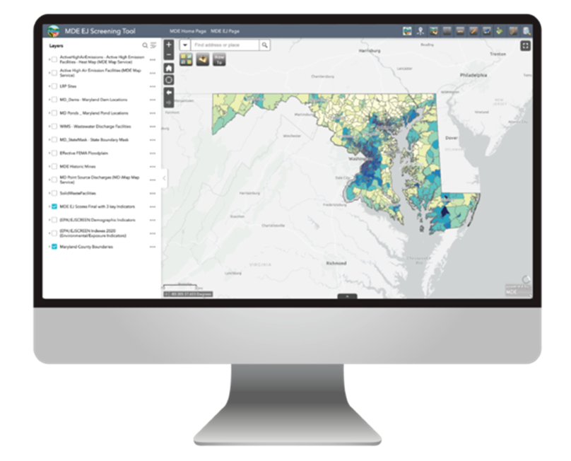
MDE EJScreen
Launched beta version in early June
for a public comment period
For external and internal use
Incorporates demographic and socioeconomic data with MDE elements like industrial facilities, wastewater treatment plants and proximity to dams
Users can identify potential overburdened communities
Allows for enhanced agency compliance, oversight, and monitoring, as well as enhanced communication and outreach in areas with permitting activities in overburdened or underserved communities.
https://mdewin64.mde.state.md.us/EJ/

Slide 8
SB 0528- Climate Solutions Now Act of 2022
MDE is required to consult with the CEJSC on various issues including adopting a methodology for identifying communities disproportionately affected by climate impacts
Defined Underserved Community
“Means any census tract in which, according to the most recent U.S. census bureau survey:
(I) at least 25% of the residents qualify as low-income;
(II) at least 50% of the residents identify as nonwhite; or
(III) at least 15% of the residents have limited English proficiency.”

Slide 9
SB 0528- Climate Solutions Now Act of 2022
Defined Overburdened Community
“Means any census tract in which three or more of the following environmental health indicators are above the 75th percentile statewide:
(I) particulate matter (PM) 2.5;
(II) ozone;
(III) National Air Toxic Assessment (NATA) diesel PM;
(IV) NATA cancer risk;
(V) NATA respiratory hazard index;
(VI) traffic proximity;
(VII) lead paint indicator;
(VIII) national priorities list superfund site proximity;
(IX) risk management plan facility proximity;
(X) hazardous waste proximity;
(XI) wastewater discharge indicator;
(XII) proximity to a concentrated animal feeding operation (CAFO);
(XIII) percent of the population lacking broadband coverage;
(XIV) asthma emergency room discharges;
(XV) myocardial infarction discharges;
(XVI) low-birth-weight infants;
(XVII) proximity to emitting power plants;
(XVIII) proximity to a toxic release inventory (TRI) facility;
(XIX) proximity to a brownfields site;
(XX) proximity to mining operations; and
(XXI) proximity to a hazardous waste landfill”.

Slide 10
HB 1200 - Environment Permit Applications Environmental Justice Screening
Requires applicants for MDE public notice and participation permits to use a Maryland EJ tool to develop a score in which their permit will be located and report the score in the application.
Applicant provides score along with project application
MDE will review the score and post in the public notice.
Defined EJ Score
“Means an overall evaluation of an area's environment and existing environmental justice indicators, as defined by the department in regulation, including:
(1) pollution burden exposure;
(2) pollution burden environmental effects;
(3) sensitive populations; and
(4) socioeconomic factors.”
Effective on October 1, 2022

Slide 11
Other Relevant 2022 Legislation
SB 90 - Department of the Environment - Supplemental Environmental Projects Database
MDE is required to maintain a database of SEPs to be considered as part of a settlement of an enforcement action
MDE will prioritize SEPs located in the same geographic area as the alleged violation
HB 53- Conservation Finance Act
Requires the CEJSC to make recommendations to MDE to ensure that the Department is advancing the human right to safe, clean, affordable, and accessible water for consumption, cooking, sanitation, health, and recreation.

Slide 12
Contact Information
Devon Dodson, Assistant Secretary
devon.dodson1@maryland.gov
Lisa Nissley, ARA
lisa.nissley@maryland.gov

