Slide 1
DoD
Low Level Radioactive Waste
Lead Agent
Mike Kurth and Breezy Coleman
HQ Joint Munitions Command
Rock Island Arsenal
Rock Island, IL

Slide 2
Mission
Safe, compliant, and cost-effective disposition of LLRW and mixed waste for DOD and other Federal agencies
Vision
The provider for DOD LLRW disposition, providing users with a seamless end of life cycle (treatment and disposal) for excessed low-level radioactive materials
Governing Instruction
DoD Instruction 4715.27 – DoD Low Level Radioactive Waste (LLRW) Program - DOD Lead Agent (DODLA) for LLRW (Deputy Assistant Secretary of the Army for Environment, Safety and Occupational Health)

Slide 3
LLRW Scope
DoD LLRW Lead Agent program services all military property or assets containing source, special nuclear, or byproduct material that is acceptable for disposal in a land disposal facility, in accordance with the U.S. Nuclear Regulatory Commission (NRC) Regulations.
The program also includes:
- Mixed waste (hazardous and radioactive)
- Naturally occurring radioactive material waste (NORM)
- Naturally occurring and accelerator-produced radioactive material waste (NARM)

Slide 4
Turn-In of Military Radioactive Items
Found in the Public Domain
DoD occasionally is contacted by State officials and public citizens requesting support for a radioactive item that has military markings found in the public domain
  Our DoD LLRW program supports the effort
  Safety First - ensure the radioactive source is secured and minimize exposure to others
    Immediate response if exposure/contamination concerns
  Review circumstances to understand condition/situation
    Evaluate regulatory reporting criteria (i.e. exposure, theft, material loss of control, etc.)
  Consult with DoD legal office prior to retrieval

Slide 5
Military Item
Found in the Public Domain
State of New Jersey – Municipal Waste Transfer Station
  Contacted by the New Jersey Bureau of Environmental Radiation
    Radioactive monitor alarmed as a waste truck rolled through the gate
    Waste truck was secured onsite and surveys conducted using handheld instruments
    Trash sorting and surveys helped to isolate the source
    Cylindrical device with glass top – military markings identified
    Handheld spectrometer – Ra-226 Source
    Further investigation identified the source as a Metascope (early night vision device) from the 1940’s

Slide 7
Military Item
Found in the Public Domain
State of California – Member of Public
  Contacted by a California National Guard Unit
    Public citizen purchased a gently used toolbox from a charitable foundation store
    Later discovered there was an item with military and radioactive markings in the toolbox
    Citizen contacted the local National Guard
    National Guard contacted our office
    Item examined and was fully intact, no leakage/contamination concerns
    Item stored with National Guard and our office retrieved the item

Slide 8
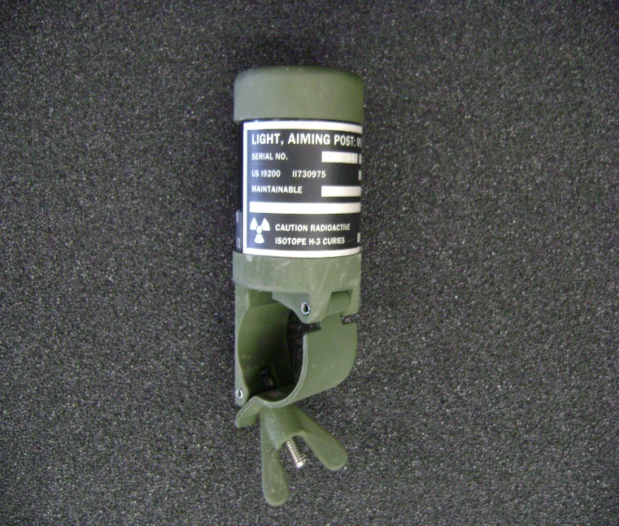
Aiming Post – Tritium 5 curies

Slide 9
Military Item
Found in the Public Domain
State of Indiana – Metal Scrap Recycling Facility
  Contacted by a Metal Recycling Company
    Radioactive monitor alarmed as truck hauling metal scrap rolled through the gate
    Truck was secured onsite
    Surveys conducted
    Old military jeep with Radium-226 gauges identified
    Gauges examined and were fully intact, no leakage/contamination concerns
    Gauge panel removed, stored at recycling center and our office retrieved the item

Slide 10
Old Jeep – Radium Gauges

Slide 11
Military Item
Found in the Public Domain
State of Indiana - Metal Scrap Recycling Facility
  Contacted by a Metal Recycling Company
    Items found to have “Caution Radioactive Materials” markings on devices
    Our office was contacted
    Pictures shared – devices attached to old military helicopter blades
    IBIS sources – In-Blade Inspection System (IBIS) Strontium-90 sources
    Devices In-Tact – no concern about leakage/contamination concerns
    Stored at recycling center and our office retrieved the item

Slide 12
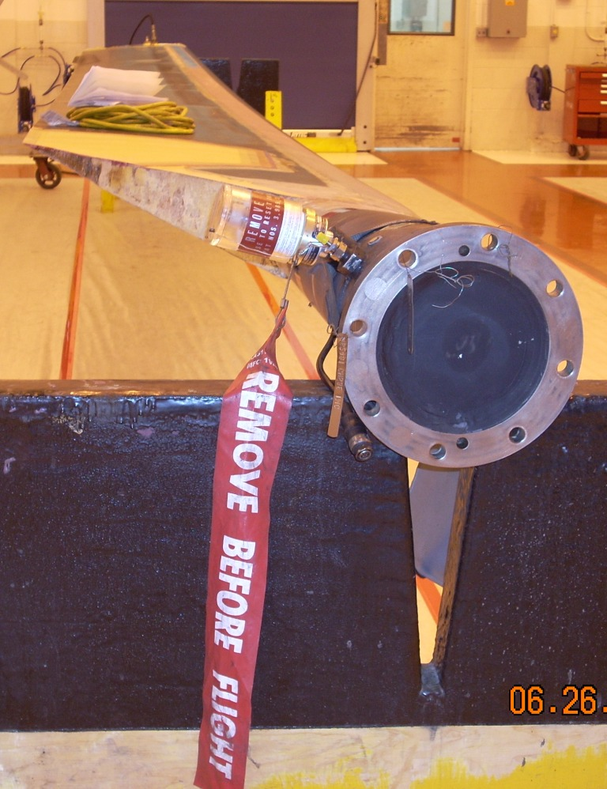
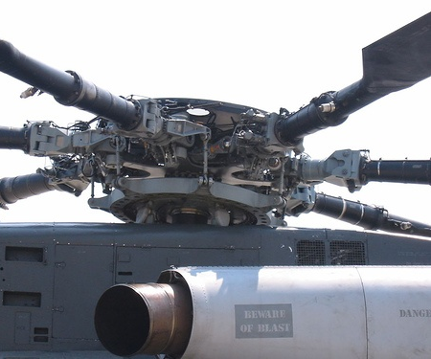
Retired Helicopter Blades with IBIS Sr-90 Sources

Slide 13
Please contact us if military items containing radioactive materials are found in the public domain
Questions?
Breezy Coleman
US Army, HQ JMC
Rock Island Arsenal
Rock Island, IL
Breezy.n.coleman.civ@army.mil
Mike Kurth
US Army, HQ JMC
Rock Island Arsenal
Rock Island, IL
Michael.f.kurth.civ@army.mil
Cyrus Turner
US Army, HQ JMC
Rock Island Arsenal
Rock Island, IL
Cyrus.e.turner.civ@army.mil

